Slide 1
History of the Inner Core Recorded by Seismology: Freezing, Melting, Differential Rotation
V.F. Cormier, J. Attanayake, K. He,
A. Stroujkova, and L. Xu
Notes:
The way in which the inner core solidifies is important not only for understanding its elastic anisotropy but also for understanding effects on seismic waveforms that are either transmitted through it or are reflected by its boundary. These effects are the effects of scattering that exist for wavelengths that are on the order of heterogeneity scale lengths in the inner core.

Slide 2
Inner Core Structure from Seismology
Radially symmetric structure and F layer
Inner core boundary topography
Large scale/hemispherical heterogeneity (> 1000 km)
Small scale heterogeneity (0.01 to 100 km)/constraints from attenuation and anisotropy
Implications for freezing, melting, and differential rotation or oscillation

Slide 3
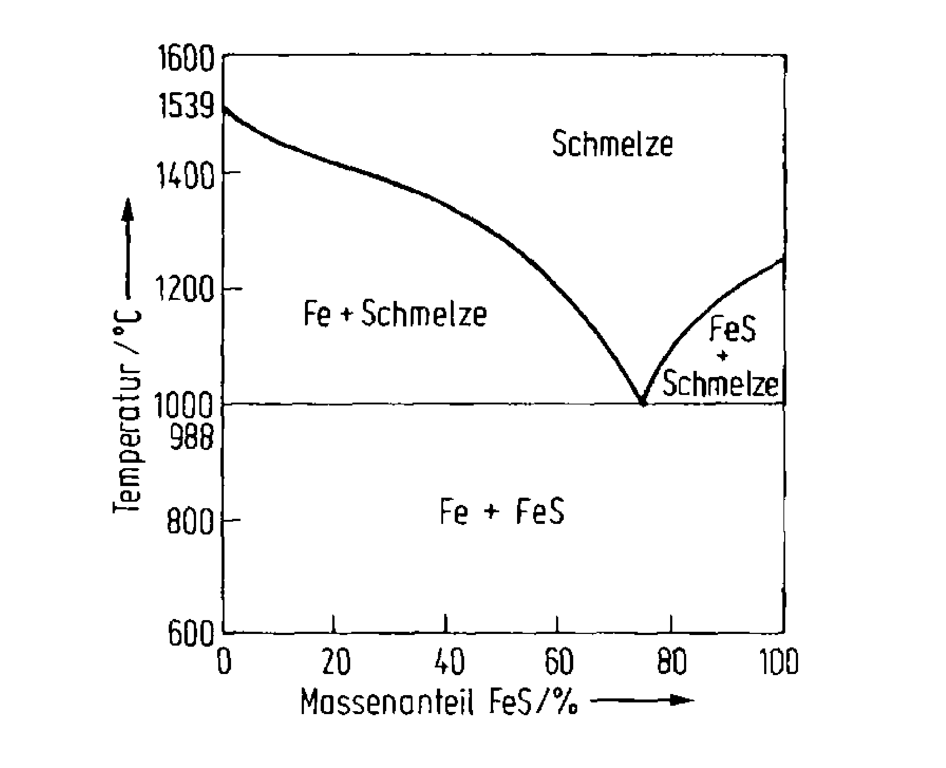
Compositional Dynamo
Existence of light alloying elements in the core like S, O, Si
Core temperature between solidus and liquidus

Slide 4
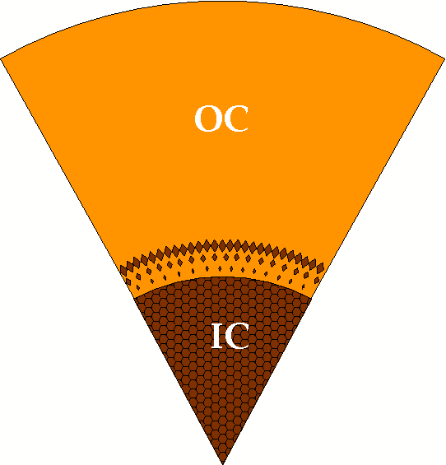
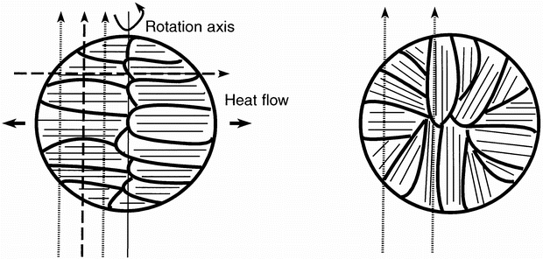
Snowing from Above or Growing from Below?
Snow model: Texturing acquired from subsequent inner core convection
Growing from below: texturing acquired from heat flow

Slide 5
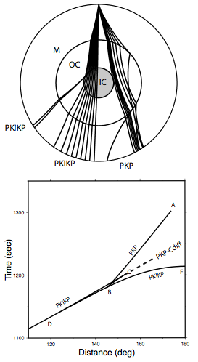
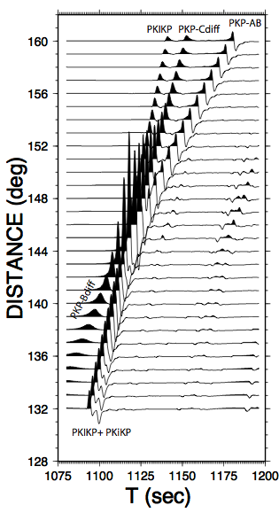
Seismic Body Waves Sensitive to ICB Structure

Slide 6
P Velocity Models of F Region
solid
liquid
F Region
ICB
(Zou et al., J. Geophys. Res,doi: 10.129/2007JB005316, 2008)

Slide 7
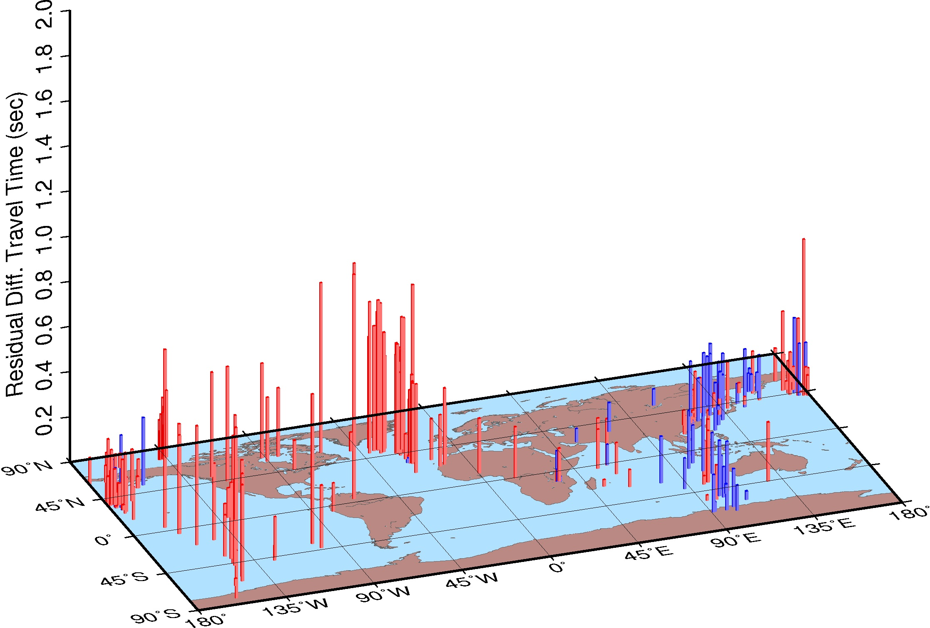
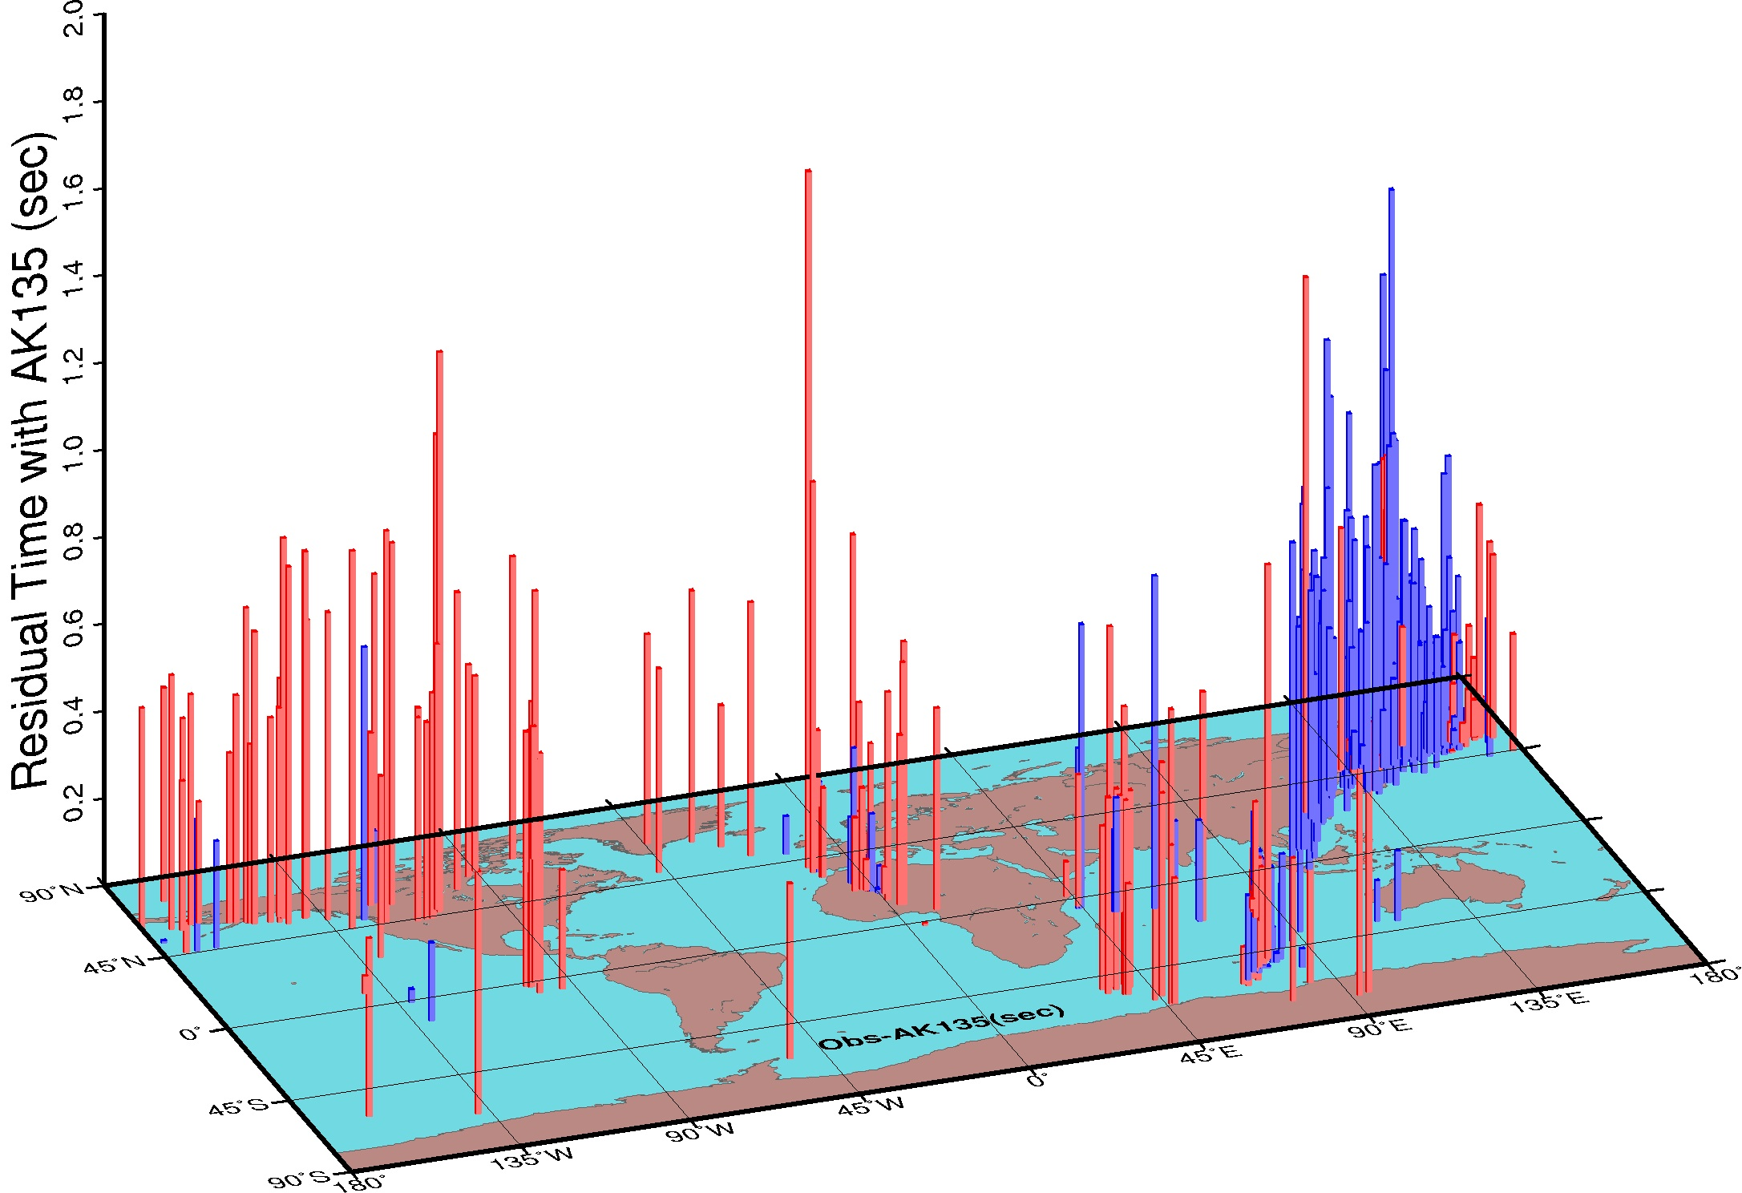
Hemispherical Structure
0-75 below ICB
Differential travel time residual
Note: Hemispherical differences persist up to 250 km below ICB
75-250 km below ICB
J. Attanayake, PhD. Thesis,UConn., 2012

Slide 8
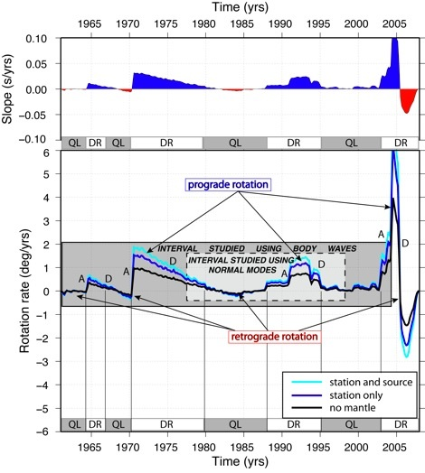
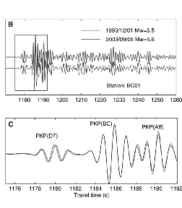
Inner Core Differential Rotation: A Complex Signal ?
H. Tkalcic and M. Sambridge, Fall 2011 AGU.

Slide 9
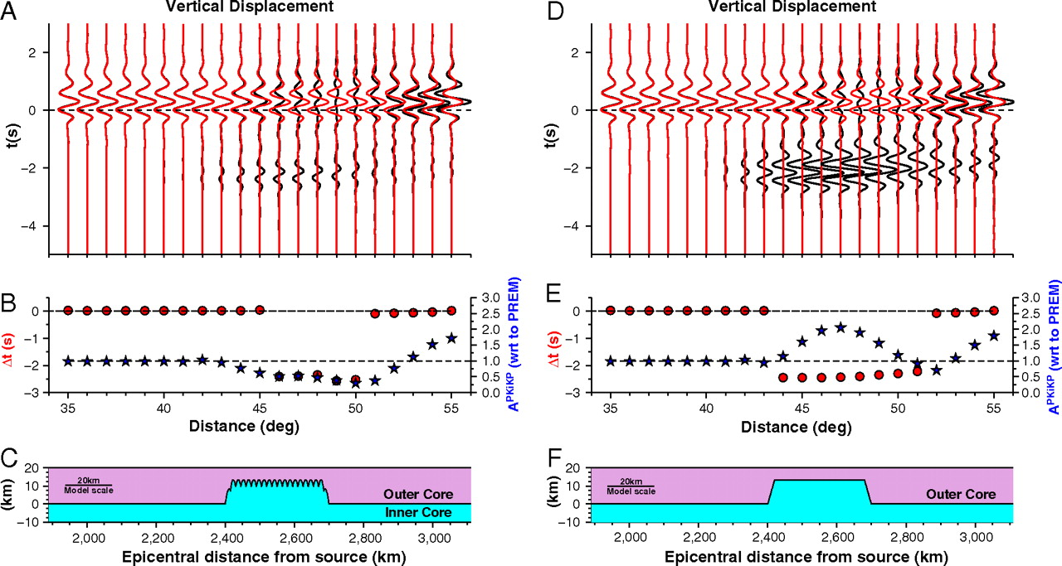
(A) Synthetic vertical component of PKiKP seismograms at the distance range from 35° to 55° for PREM (red traces) and a model with ICB topography shown in C (black traces).
Dai Z et al. PNAS 2012;109:7654-7658
©2012 by National Academy of Sciences
Notes:
(A) Synthetic vertical component of PKiKP seismograms at the distance range from 35° to 55° for PREM (red traces) and a model with ICB topography shown in C (black traces). The black traces are normalized with respect to (wrt) the amplitudes of PKiKP synthetics based on PREM. Traces are band-passed filtered with the same filtering procedures applied to the data and aligned along the predicted PKiKP arrival times based on PREM (t = 0). (B) PKiKP travel time residuals (red dots, left scale) and amplitudes (blue stars, right scale) with respect to the PREM predictions at various epicentral distances. (C) ICB topographic model plotted as a function of distances from the seismic source, which also correspond to the PKiKP reflected points for the distances of the synthetics at A and B. (D–F) Same as A–C, except that the ICB topographic model has a superimposed small-scale topography with a height variation of 4 km repeated with a horizontal length scale of 3 km. Note the amplitude differences in the distance range of 43° to 52° between the synthetics in A and D.

Slide 10
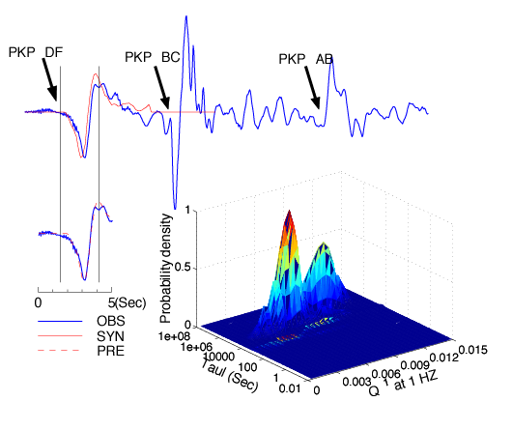
Inverting for Inner Core Attenuation Parameters
Li and Cormier, JGR,107, 10.1029/2002JB001795, 2002.

Slide 11
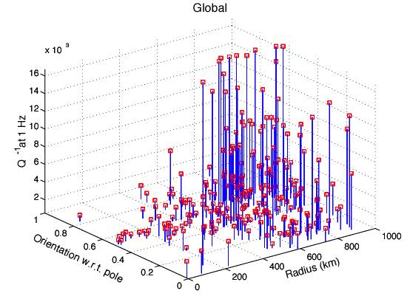
Q inversion with a scattering model: Note signature of inner inner core at radius 500-600 km

Slide 12
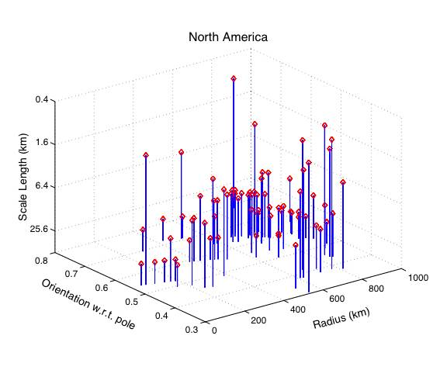
SCALE LENGTHS FROM SCATTERING MODEL

Slide 13
PKiKP Coda
Cormier et al., Phys. Earth Planet. Int., 178, 163-172, 2011.

Slide 14
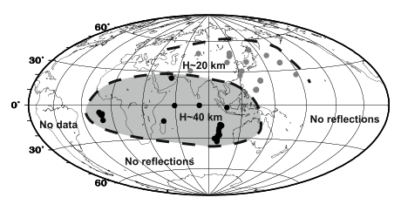
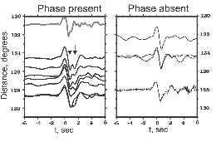
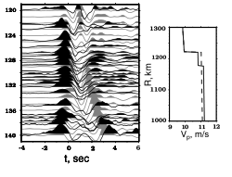
Anomaly in the Uppermost Inner Core
Stroujkova and Cormier, J. Geophys. Res., 109, 2004

Slide 15
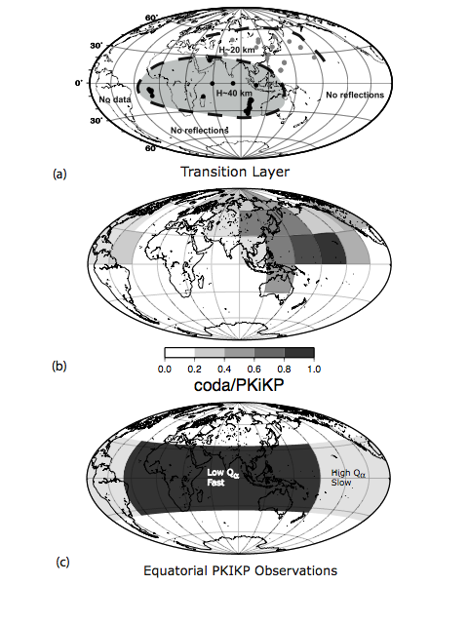
Structural Connections
(a) Contours thickness of anomalous lower velocity layer in the uppermost inner core determined in the study by Stroujkova and Cormier (2004)
(b) excitation of backscattered PKiKP coda from heterogeneity in the uppermost inner core determined in the study by Leyton and Koper(2007)
(c) lateral variations in attenuation and P velocity in the equatorial region of the inner core determined in the study by Yu and Wen (2005).
(d) uppermost inner core P velocity perturbations (solid contours) and predicted inner core growth rate variations (colors) (Aubert et al. 2009)

Slide 16
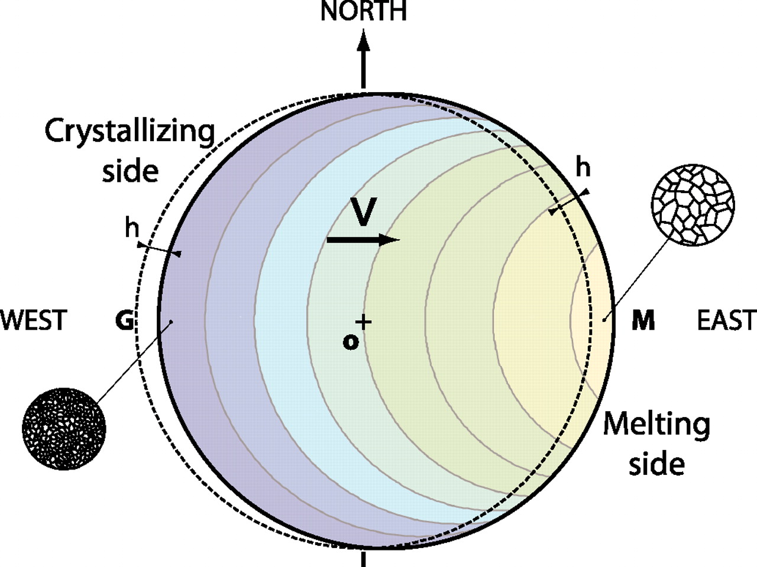

Slide 17
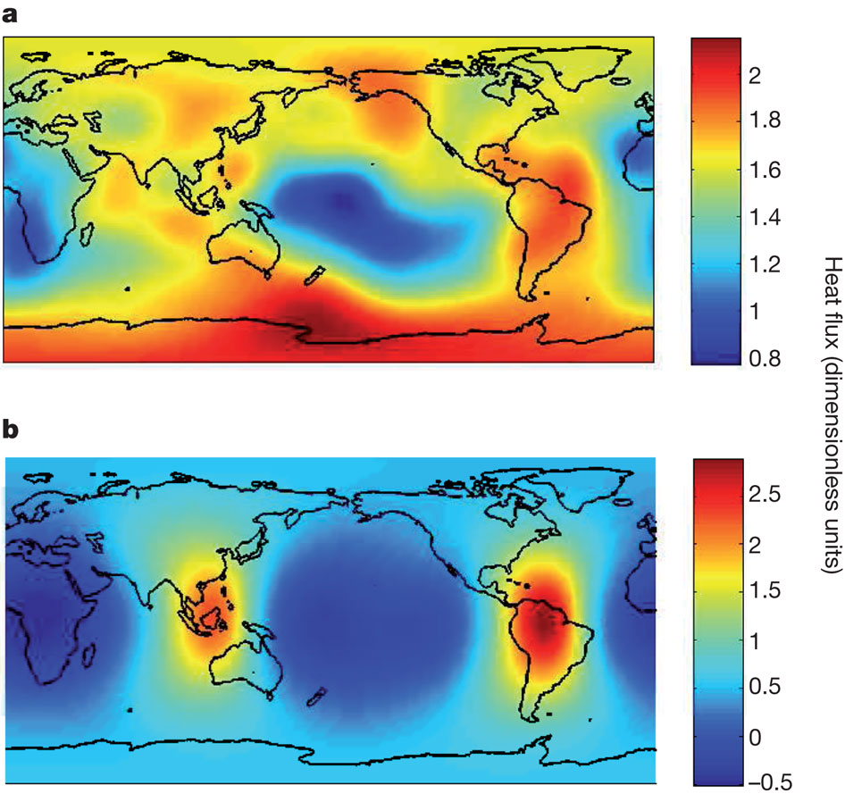
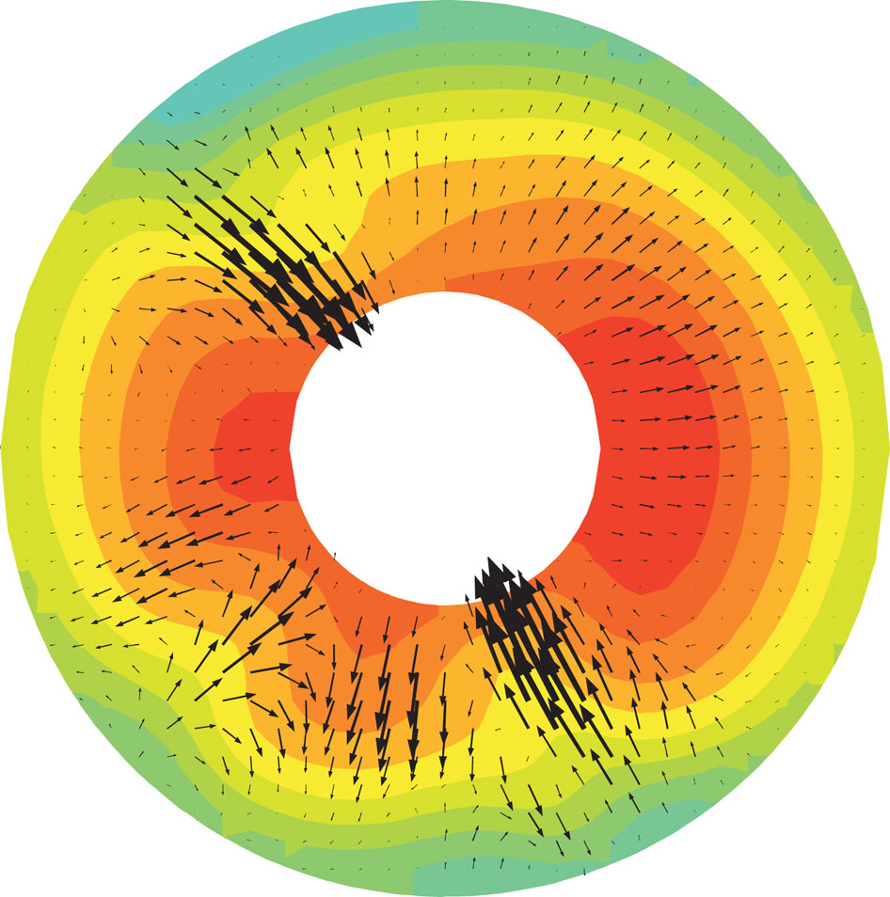
Heat flux at CMB from lower mantle heterogeneity
Heat flux at ICB predicted from above using a numerical dynamo simulation
Outer core flow predicted from numerical dynamo simulation
D Gubbins et al. Nature 473, 61-363 (2011) doi:10.1038/nature10068

Slide 18
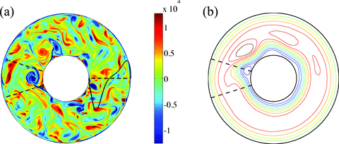
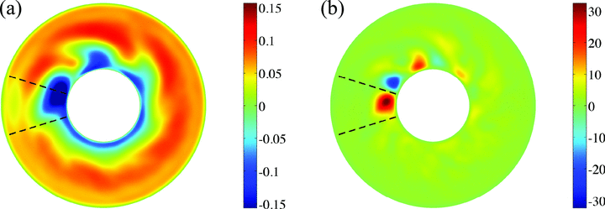
Effect of CMB Topography on OC Flow and ICB Heat Flux
Vorticity
Stream function
T perturbation
Convective heat flux
M.A. Calkins et al., Geophys. J. Int., vol. 189, 799-814, 2012.

Slide 19
Conclusions
Two transitions in inner core texture: deep (500-600 km) and shallow (0-100 km ) with lateral variations concentrated in equatorial regions.
Lateral variations in large-scale (>1000 km) and small-scale structure (0.01 to 10 km) (texture):
Quasi-hemispherical (degree 1) variations in velocity, attenuation, anisotropy, and back-scattering of small scale heterogeneity.
2. Two scenarios to explain lateral variations, which both require lateral variations in ICB heat flux, but with predicted locations of freezing and melting reversed.
Notes:
In the meantime, a firm conclusion is that several types of lateral heterogeneity in the uppermost inner core can be observed in its equatorial region. In some models of the geodynamo, this is the region of often the strongest outer core flow in a cylinder tangent to the inner core. An interesting hypothesis to test is that whether waveform anomalies in PKIKP and high attenuation in the equatorial eastern hemisphere can be explained by a vertically oriented fabric in a region of strong upwelling in the liquid outer core, associated with an actively growing inner core in this region, and whether strong backscattering of in the coda of PKiKP in the equatorial Pacific region can be explained by a horizontally oriented fabric in the uppermost inner core associated with a zone of strong downwelling in the outer core. Finally, the correlation of core flow features predicted from tomographic images of the lowermost mantle with structural features of the uppermost inner core may suggest that any differential rotation of the inner core with respect to the mantle may be in the form of an oscillation or wobble rather than a constant differential rotation.

Slide 20
Freezing and Melting
Freezing in east/ Melting in the west consistent with dominant viscoelastic attenuation in the east/dominant scattering attenuation in the east.
Melting in the east/Freezing in the west consistent with some textural models predicting anisotropy and scattering attenuation.
ICB Topography
7 km heights; wavelengths on the order of 50 -- 100 km. Possibly linked to quasi-stationary cyclones in the outer core due to CMB topography and enhanced heat flow.
Alternative to a mosaic of impedance contrasts to explain PKiKP amplitudes

