Slide 1
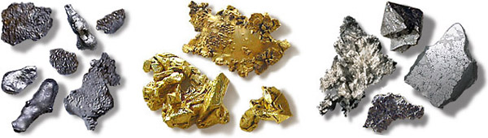


The Late Veneer: constraints on composition, mass, and mixing timescales
Divya Allupeddinti
Beth-Ann Bell
Lea Bello
Ana Cernok
Nilotpal Ghosh
Peter Olds
Clemens Prescher
Jonathan Tucker
Matt Wielicki

Slide 2
Late veneer is mixed by 2.9 Ga
Maier et al., 2009
Notes:
Recent measurements of HSE in archaean and proterozoic komatiites suggest that the late veneer became mixed in the mantle by 2.9 Ga. Is this a realistic timescale? Our proposal is to test the

Slide 3
Questions and Hypotheses
Is the late veneer well-mixed by 2.9 Ga?
What kind of impactors were they?
  Constraints from geochemistry, size-frequency distributions
  Determines number, size, density of impactors
How efficiently does the mantle homogenize?
  Determines the mixing timescale of the mantle

Slide 4
Constraints from Geochemistry
We take a new look at PGE abundances and tungsten isotope systematics to constrain the mass of the late veneer.
We use radiogenic osmium isotope systematics to put constraints on the compositions of the impactor(s).
  ¹⁹⁰Pt-¹⁸⁶Os system
  ¹⁸⁷Re-¹⁸⁷Os system
We tried to use other, stable isotope systems to put constraints on the composition of the impactors.
  But nothing works as well as the PGE, W, and Os isotopes.

Slide 5
PGE Abundances
Assumes zero PGE in the earth’s mantle after core formation.
~0.6% addition required (if chondritic).
Tungsten isotopes provide an independent constraint.
  Returns the same mass for the late veneer.
 | % of BSE mass |  |  |  |  |  | %
Impactor Population | Re | Os | Ir | Ru | Pt | Pd | Average for population | stdev for population
c. chondrites | 0.65 | 0.58 | 0.55 | 0.78 | 0.65 | 1.09 | 0.72 | 0.20
e. chondrites | 0.60 | 0.58 | 0.57 | 0.76 | 0.61 | 0.79 | 0.65 | 0.10
ordinary chondrites | 0.53 | 0.51 | 0.51 | 0.68 | 0.55 | 0.94 | 0.62 | 0.17
Average for element | 0.59 | 0.56 | 0.55 | 0.74 | 0.60 | 0.94
stdev for element | 0.06 | 0.04 | 0.03 | 0.05 | 0.05 | 0.15

Slide 6
Osmium Isotopes
This shows the present-day mixing line. But we also need to account for radiogenic ingrowth over time.
¹⁸⁷Re → ¹⁸⁷Os, t_{1/2} ~ 42 Ga
¹⁹⁰Pt → ¹⁸⁶Os, t_{1/2} ~ 650 Ga

Slide 7
Assumes closed-system, radiogenic ingrowth only
Goal: composition/timing solutions that reasonably re-create Earth’s osmium
3000 Ma
3500 Ma
3500 Ma
4000 Ma
4000 Ma
4500 Ma
4500 Ma
Some Uncertainties:
a) the initial ¹⁸⁶Os/¹⁸⁸Os and ¹⁸⁷Os/¹⁸⁸Os values.
b) effects of Re mobility on the Re/Os ratios.

Slide 8
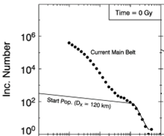
Constraints of Impact Flux (ancient-SFD)
Collisional evolution model provides constraints on the size-frequency distribution of the asteroid belt
We take 200km impactors as the largest due to SPA crater
99% of the mass is delivered by >50km impactors
(Bottke et al., 2005)
Diameter (km)
Bottke 2010 ancient
Number | Diameter (m) | Radius (m) | Density (Kg.m^3) | Mass (Kg) | %mass delivered
1 | 200000 | 100000 | 2700 | 1.13E+19 | 87.3
1 | 100000 | 50000 | 2700 | 1.41E+18 | 10.9
1.333333 | 50000 | 25000 | 2700 | 2.36E+17 | 1.8
1.5 | 10000 | 5000 | 2700 | 2.12E+15 | 0.0
2 | 1000 | 500 | 2700 | 2.83E+12 | 0.0
 |  |  | Total Mass (Kg) | 1.30E+19 | 100.0
Notes:
When developing mantle mixing models of HSE’s it is essential to understand how the material was delivered through time. We present three end-member impact flux scenarios as our starting points to test the differences to mantle mixing. First we will use a scaling of the SFD of the asteroid belt, we will also test one large impactor, as well as many small impactors. The ancient SFD of the asteroid belt can be estimated from the collisional erosion model of Bottke et al. 2005 and suggests that the impactors of 100 km or more do not change much through time as they are large enough to not be disrupted and eroded. Calculations of such a SFD scaled for the largest crater on the lunar surface, and thus effecting the Earth-Moon system, is SPA with an estimated impactor diameter of 200km. Considering ancient scaling 99% of the mass is delivered through impactors of >50km and should be delivered directly to the mantle assuming normal impact velocity and angle (20 km/s & 45°) as well as a transient crater depth of at least on diameter.

Slide 9
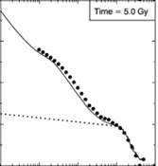

Constraints of Impact Flux (present-SFD)
Size-frequency distribution of present-day main asteroid belt
We take 200km impactors as the largest due to SPA crater
>90% of the mass is delivered by >50km impactors
(Bottke et al., 2005)
Diameter (km)
Bottke 2010 Today
Number | Diameter (m) | Radius (m) | Density (Kg.m^3) | Mass (Kg) | %mass delivered
1 | 200000 | 100000 | 2700 | 1.13E+19 | 37
10 | 100000 | 50000 | 2700 | 1.41E+19 | 46
30 | 50000 | 25000 | 2700 | 5.30E+18 | 17
60000 | 1000 | 500 | 2700 | 8.48E+16 | 0
 |  |  | Total Mass (Kg) | 3.08E+19 | 100
Notes:
Present day SFD has many more small impactors however the little change on the large end. When applying the present day SFD we also deliver >90% of the mass with >50 km impactors also presumably penetrating directly to the mantle.

Slide 10
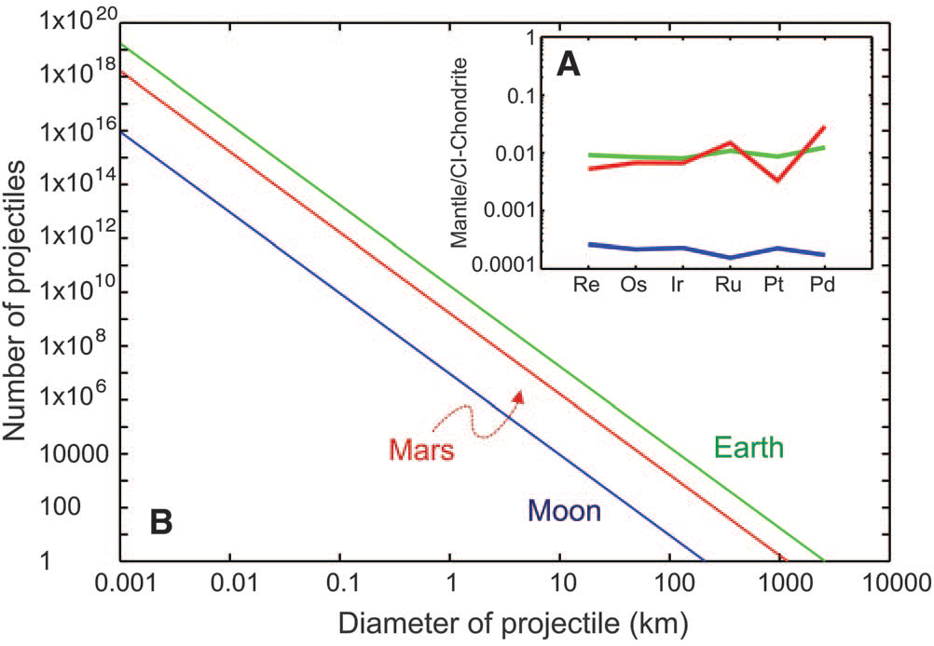
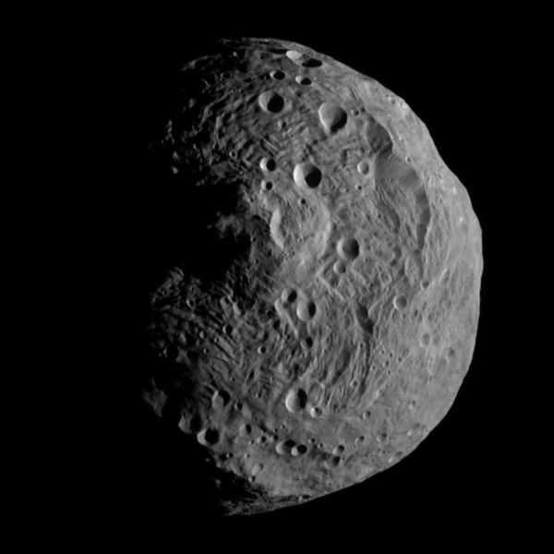
Constraints of Impact Flux (single impactor)
Lunar HSE abundances are >20 times lower than Earth and Mars (could mean that relying on the lunar record is not sufficient)
Depending on density our calculations suggest that you would need an impactor of ~2500km to provide the mass necessary for the late-veneer
(Bottke et al., 2010)
Number | Diameter (m) | Radius (m) | Density (Kg.m^3) | Mass (Kg)
1 | 2050000 | 1025000 | 5400 | 2.44E+22
1 | 2410000 | 1205000 | 3300 | 2.42E+22
1 | 2500000 | 1250000 | 3000 | 2.45E+22
1 | 2600000 | 1300000 | 2700 | 2.48E+22
94 | 525000 | 262500 | 3420 | 2.44E+22
(4 Vesta, Dawn Mission Image)
Notes:
Bottke 2010 has proposed to have the late-veneer delivered in one single impactor of ~2500 km diamter

Slide 11
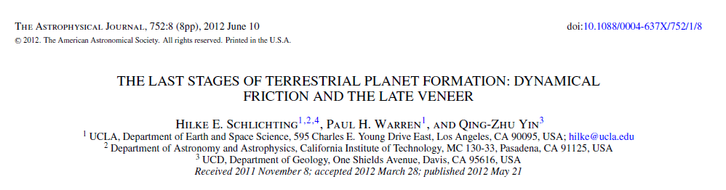
Constraints of Impact Flux (many small impactors)
“(1) a residual population of small planetesimals containing 0.01 M⊕ is able to damp the high eccentricities and inclinations of the terrestrial planets after giant impacts to their observed values.
(2) At the same time, this planetesimal population can account for the observed relative amounts of late veneer added to the Earth, Moon and Mars provided that the majority of the accreted late veneer was delivered by small planetesimals with radii <10 m.”

Slide 12
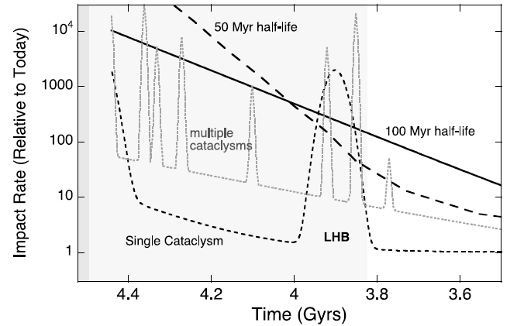
Constraints of Impact Flux during LHB
Mass delivered to Moon during LHB (including SPA) is 2.22 x 10¹⁹ kg
Scaled to the Earth’s ~20-30x gravitational cross-section, total mass delivery to the Earth of 4-6 x 10²⁰ kg of material or 1.9-2.8% of the total estimated for the late-veneer
If we account for the Moons deficiency of HSE we account for 35-55% of the abundance of HSE delivered to the Earth during the LHB suggesting at least one and maybe two LHB-style events prior to ~3.8 Ga
(Zahnle et al., 2007)
LHB
Crater | Number | Crater diameter (m) | Impactor diameter (m) | Radius (m) | Density (Kg.m^3) | Mass (Kg) | %mass delivered
SPA | 1 | 2240000 | 224000 | 112000 | 2700 | 1.59E+19 | 71.4
Nectaris | 1 | 860000 | 86000 | 43000 | 2700 | 8.99E+17 | 4.0
Imbrium | 1 | 1160000 | 116000 | 58000 | 2700 | 2.21E+18 | 9.9
Orientale | 1 | 930000 | 93000 | 46500 | 2700 | 1.14E+18 | 5.1
Crisium | 1 | 1060000 | 106000 | 53000 | 2700 | 1.68E+18 | 7.6
Serenitatis | 1 | 674000 | 67400 | 33700 | 2700 | 4.33E+17 | 1.9
 |  |  |  |  | Total Mass (Kg) | 2.22E+19 | 100.0

Slide 13
Dynamic Approach
3-D spherical convection models
Crater anomalies introduced into a convecting mantle
Three possible scenarios to account for isotopic compositions
  A distribution of small sized impactors
  A size-frequency distribution estimated from lunar cratering record
  A single large impactor

Slide 14

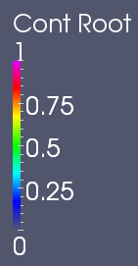
Preliminary Models: Whole Earth Distribution

Slide 15
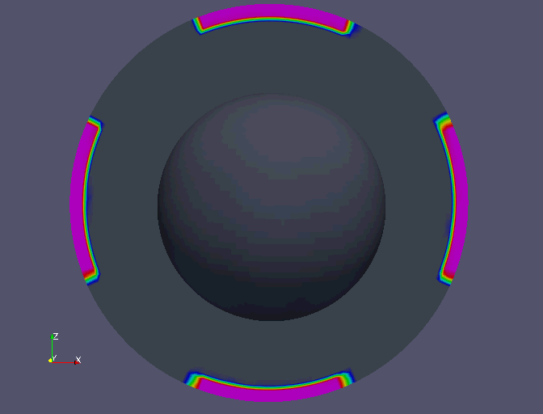
Preliminary Models: Six Large Impacts

Slide 16
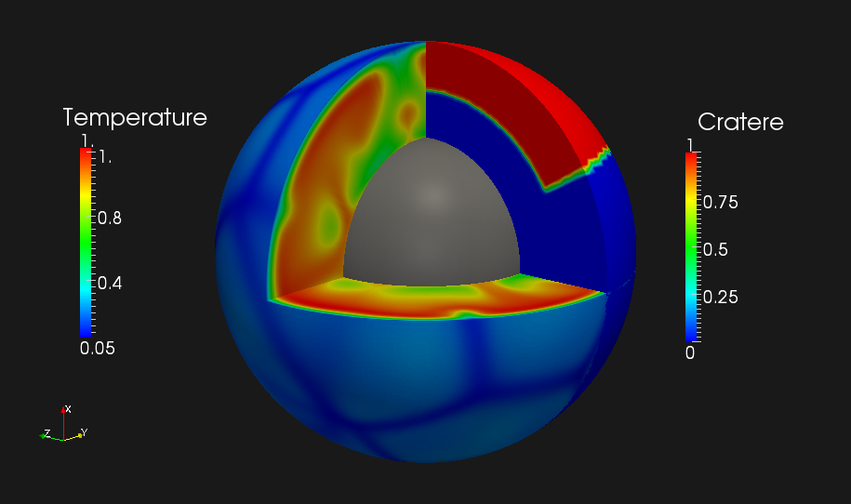
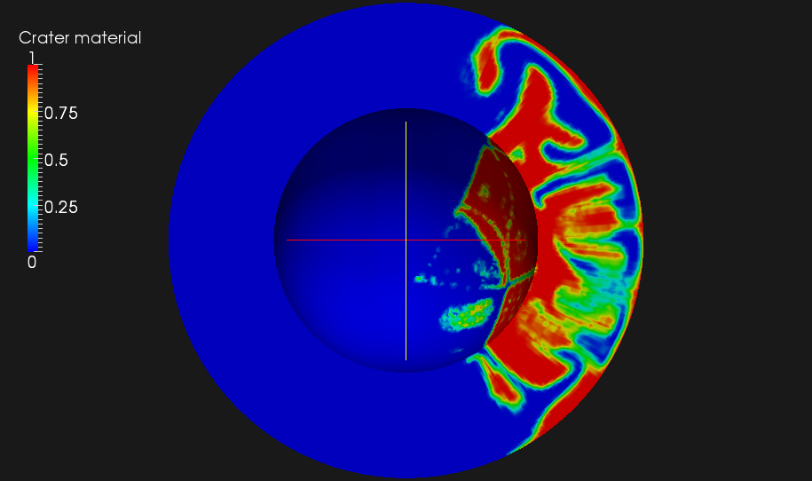
Preliminary Models: One Large Impact

Slide 17
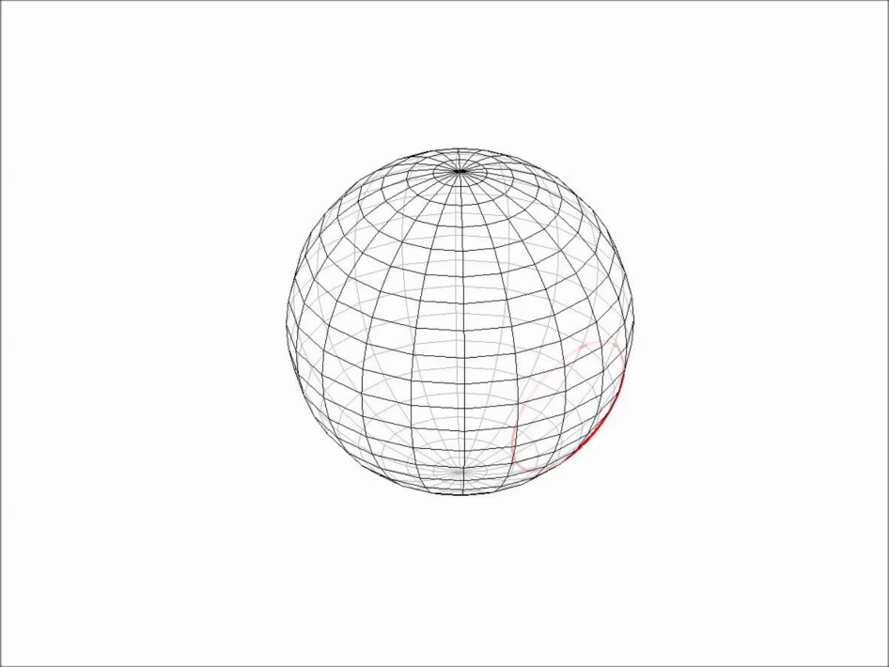
Preliminary Conclusions, Future Work
We are able to reproduce mass estimates for the late veneer and have begun to use osmium isotopes to put constraints on the composition and timing of the late veneer.
Majority of the mass is delivered with large (>50 km) projectiles assuming no size-dependent mechanism for disturbing the asteroid belt
Only ~2-3% or up to 35-55% of the late-veneer mass was added during the LHB suggesting at least one if not two LHB events prior ~3.8 Ga
Convection models that test the mixing efficiency of impact material using appropriate scaling laws
Collins et al. 2005
Notes:
2nd pt: No matter the SFD chosen (present day or ancient) the vast majority of the mass appears to be within >50km impactors which should penetrate directly to the mantle.
3rd pt: Assuming the lunar record of the LHB can be directly scaled to the Earth the LHB would account for merely 2-3% of the mass necessary for the late veneer. However, if we assume the 20x less abundance of HSE is the Moon to be reflective of impact flux the LHB could account for 35-55% of the mass of the late-veneer. Either case argues strongly against a single cataclysm.

