Slide 1
Continental lithosphere investigations using seismological tools
Seismology- lecture 5
Barbara Romanowicz, UC Berkeley
CIDER2012, KITP

Slide 2
Seismological tools
Seismic tomography: surface waves, overtones
  Volumetric distribution of heterogeneity
  “smooth” structure – depth resolution ~50 km
  Overtones important for the study of continental lithosphere
  Additional constraints from anisotropy
“Receiver functions”
  Detection of sharp boundaries (i.e. Moho, LAB?, MLD?)
“Long range seismic profiles” –
  Several 1000 km long
  Map sharp boundaries/regions of strong scattering
“Shear wave splitting” analysis
Teleseismic P and S wave travel times: constraints on average velocities across the upper mantle

Slide 3
Archean Cratons
Stable regions of continents, relatively undeformed since Precambrian
Structure and formation of the cratonic lithosphere
  How did they form?
  How did they remain stable since the archean time?
  How thick is the cratonic lithosphere?
  What is its thermal structure and composition?

Slide 4
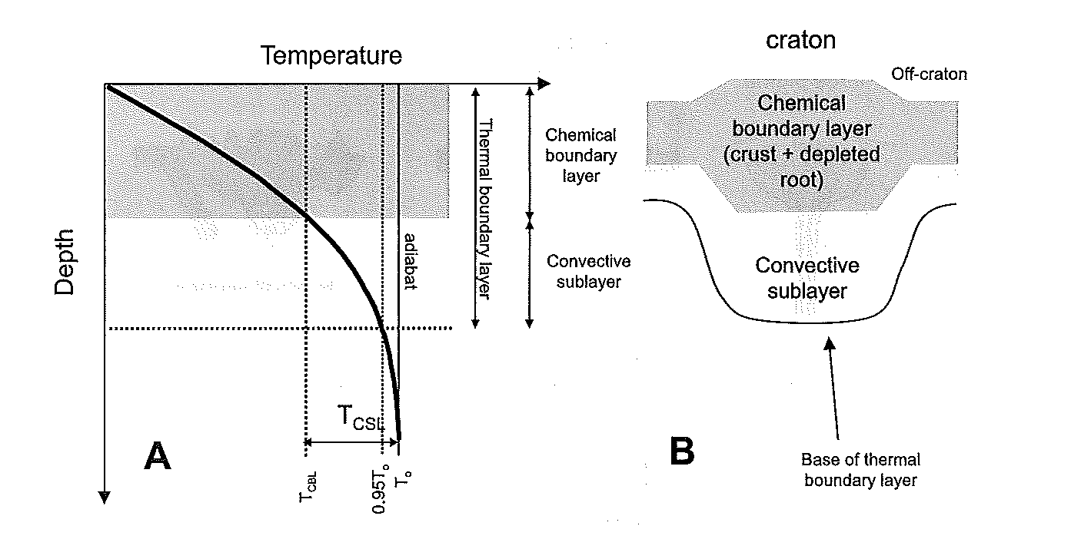
Upper mantle under cratons
Strength
Transitional
layer
Transitional
layer
From heat flow
Data ~200 km
Cooper et al., 2004;
Lee, 2006;
Cooper and Conrad, 2009

Slide 5
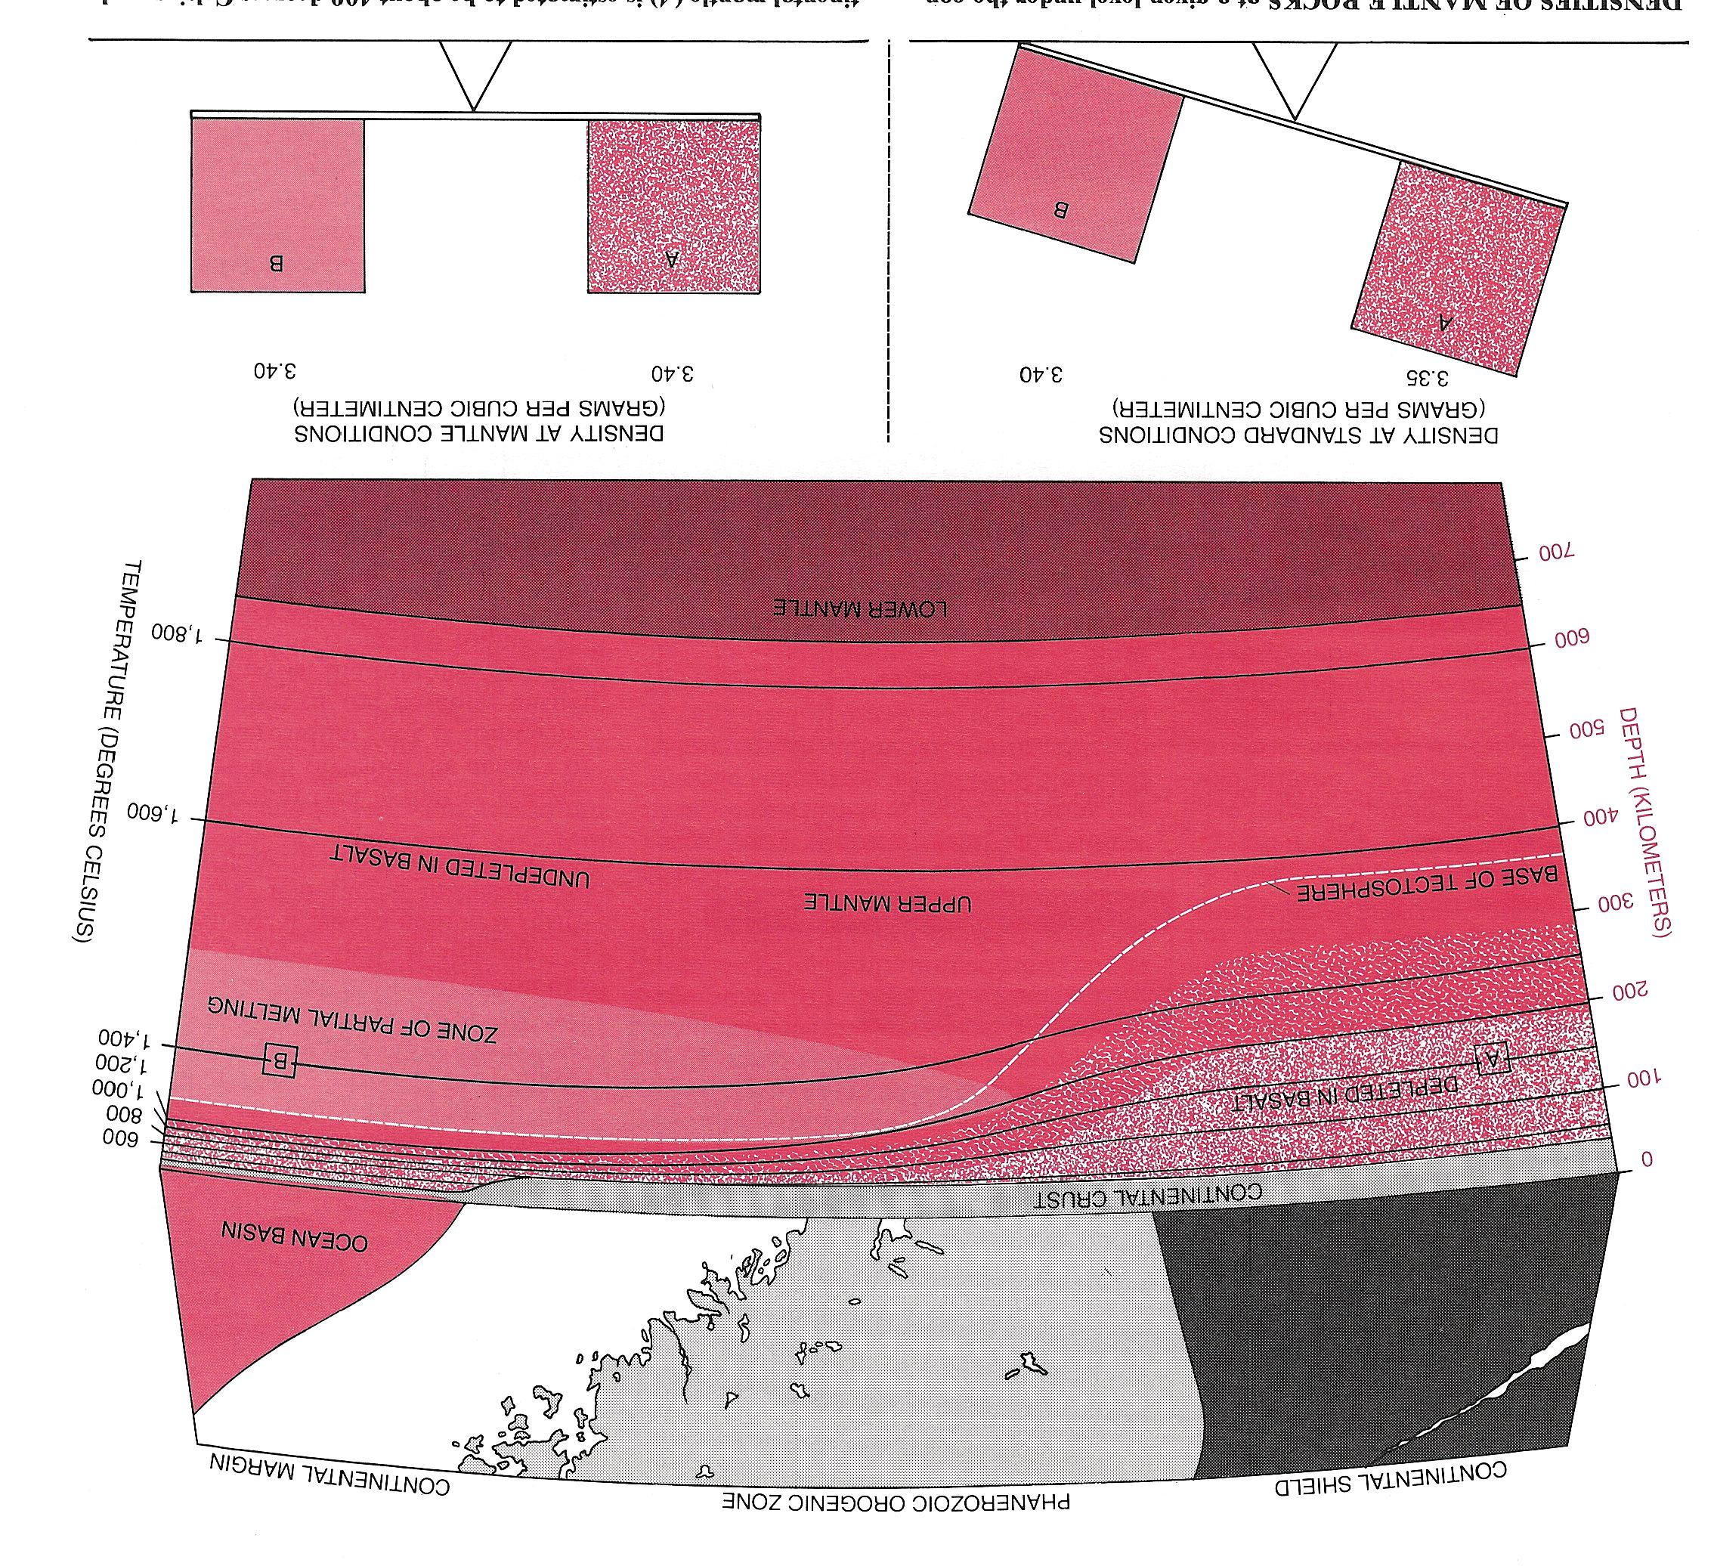
Isopycnic (Equal-Density) Hypothesis
A
B
Density Structure
normative densities
In situ densities
The temperature difference between the cratonic tectosphere and the convecting mantle is density-compensated by the depletion of the tectosphere in Fe and Al relative to Mg by the extraction of mafic fluids.
Courtesy of Tom Jordan
3.35 Mg/m³
A
3.40 Mg/m³
3.40 Mg/m³
3.40 Mg/m³
A
B
B

Slide 6
How thick is the cratonic lithosphere?
Jordan (1975,1978) “tectosphere” ~400 km
Heat flow data, magnetotelluric, xenoliths ~200 km (e.g. Mareschal and Jaupart, 2004; Carlson et al., 2005; Jones et al., 2003)
Receiver functions (Rychert and Shearer, 2009): ~ 100 km?

Slide 7
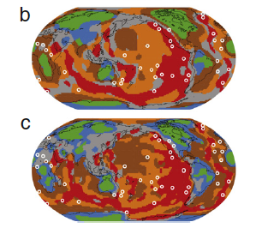
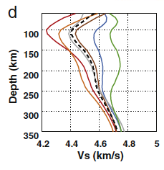
Cluster analysis of upper mantle structure
from seismic tomography
Isotropic Vs
S362ANI
SEMum
Lekic and Romanowicz, EPSL, 2011

Slide 8
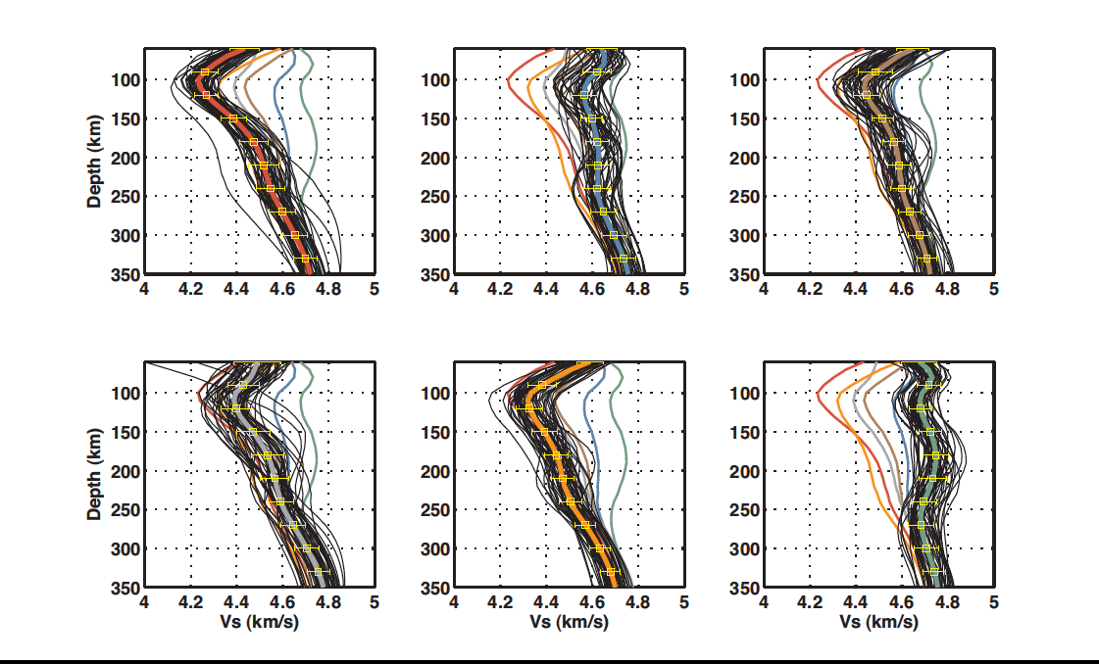
Cratons

Slide 9
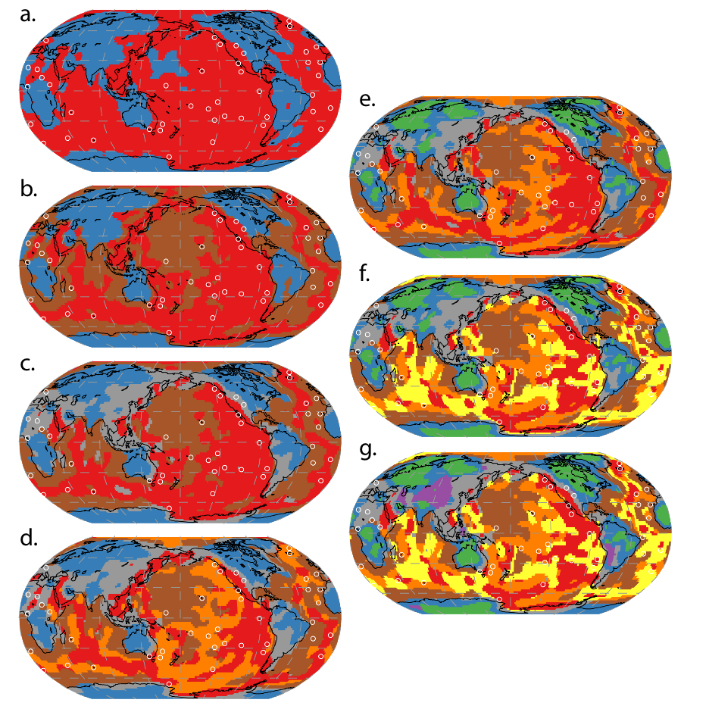
N=2
Clustering analysis of SEMum model
N=3
N=6
N=4
N=5
Lekic and
Romanowicz
2011,EPSL

Slide 10
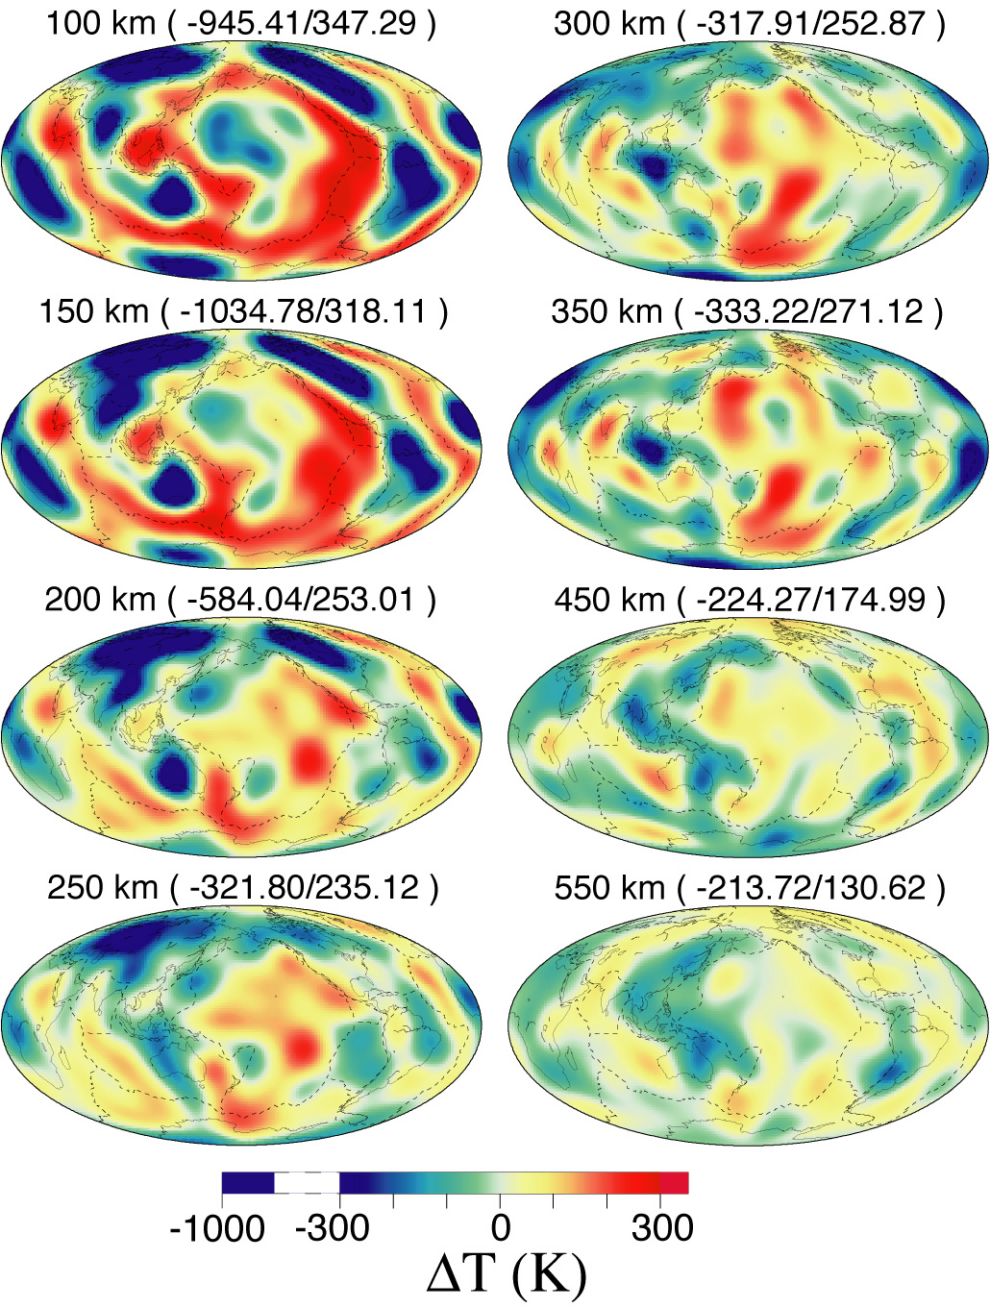
3D temperature variations based on inversion of long period
seismic waveforms (purely thermal interpretation)
Cammarano and Romanowicz, PNAS, 2007
Notes:
Inversion of long period seismic waveforms, assuming shear velocities depend only on temperature and accounting for dispersion effects due to attenuation and an arrhenius temperature dependence for attenuation (which introduces non-linearity)

Slide 11
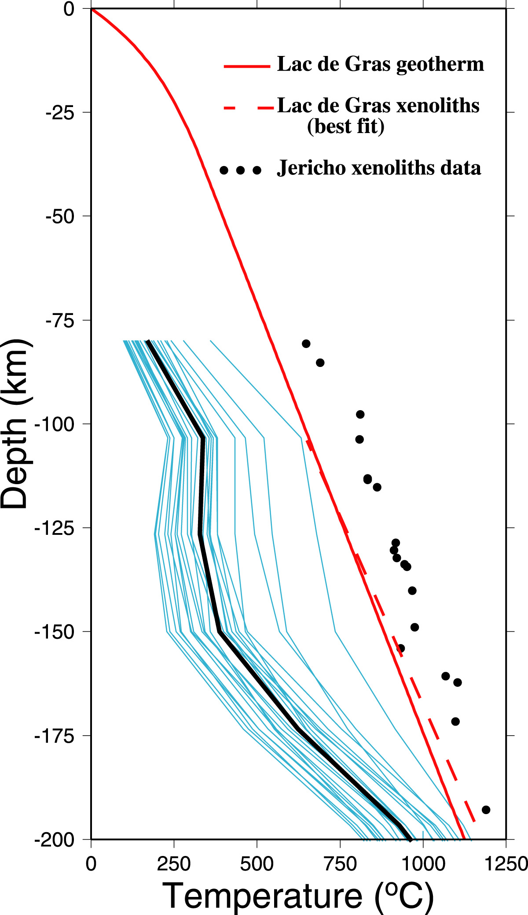
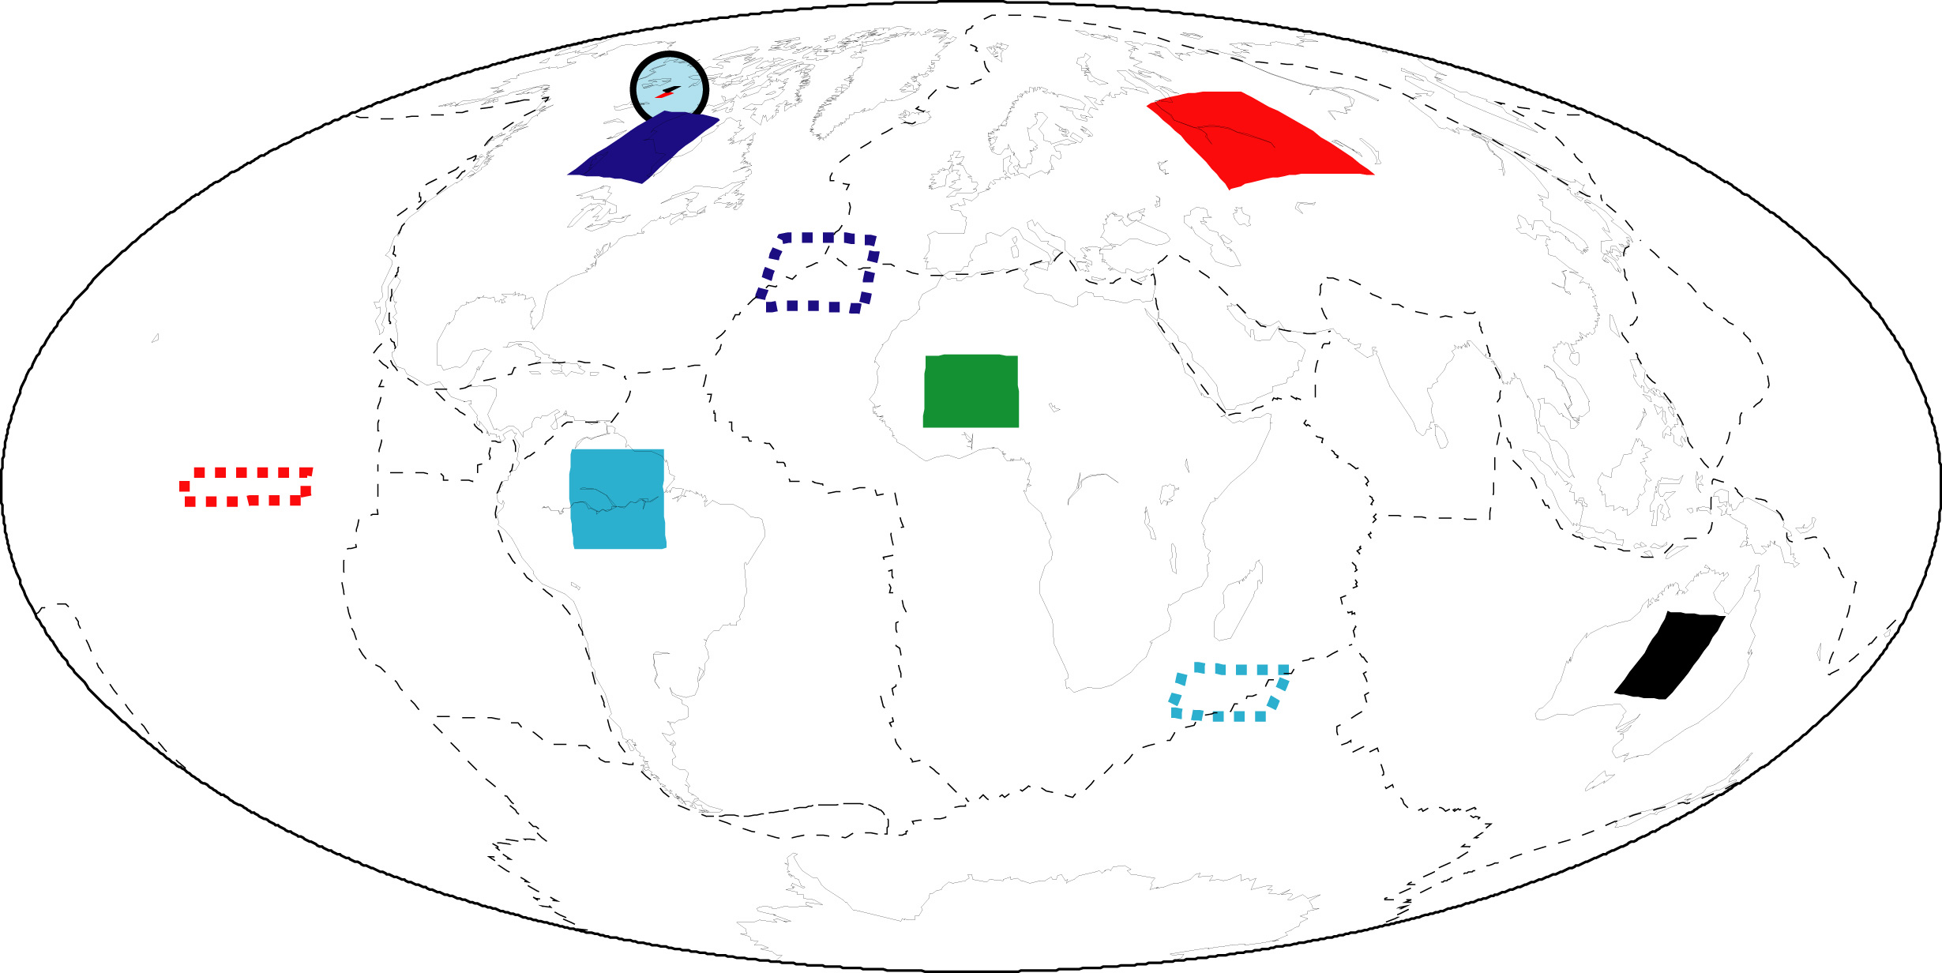
Continental geotherms obtained with a purely thermal interpretation are too cold => compositional signature
modified from Mareschal et al., 2004
Courtesy of F. Cammarano, 2008

Slide 12
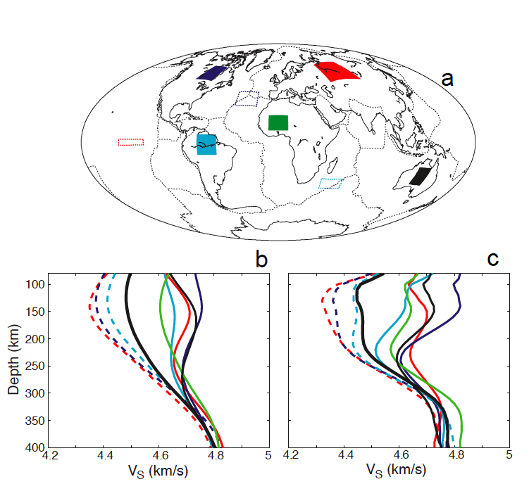
From global S wave tomography: cratonic lithosphere is thick and fast
Kustowski et al., 2008
Cammarano and Romanowicz, 2007

Slide 13
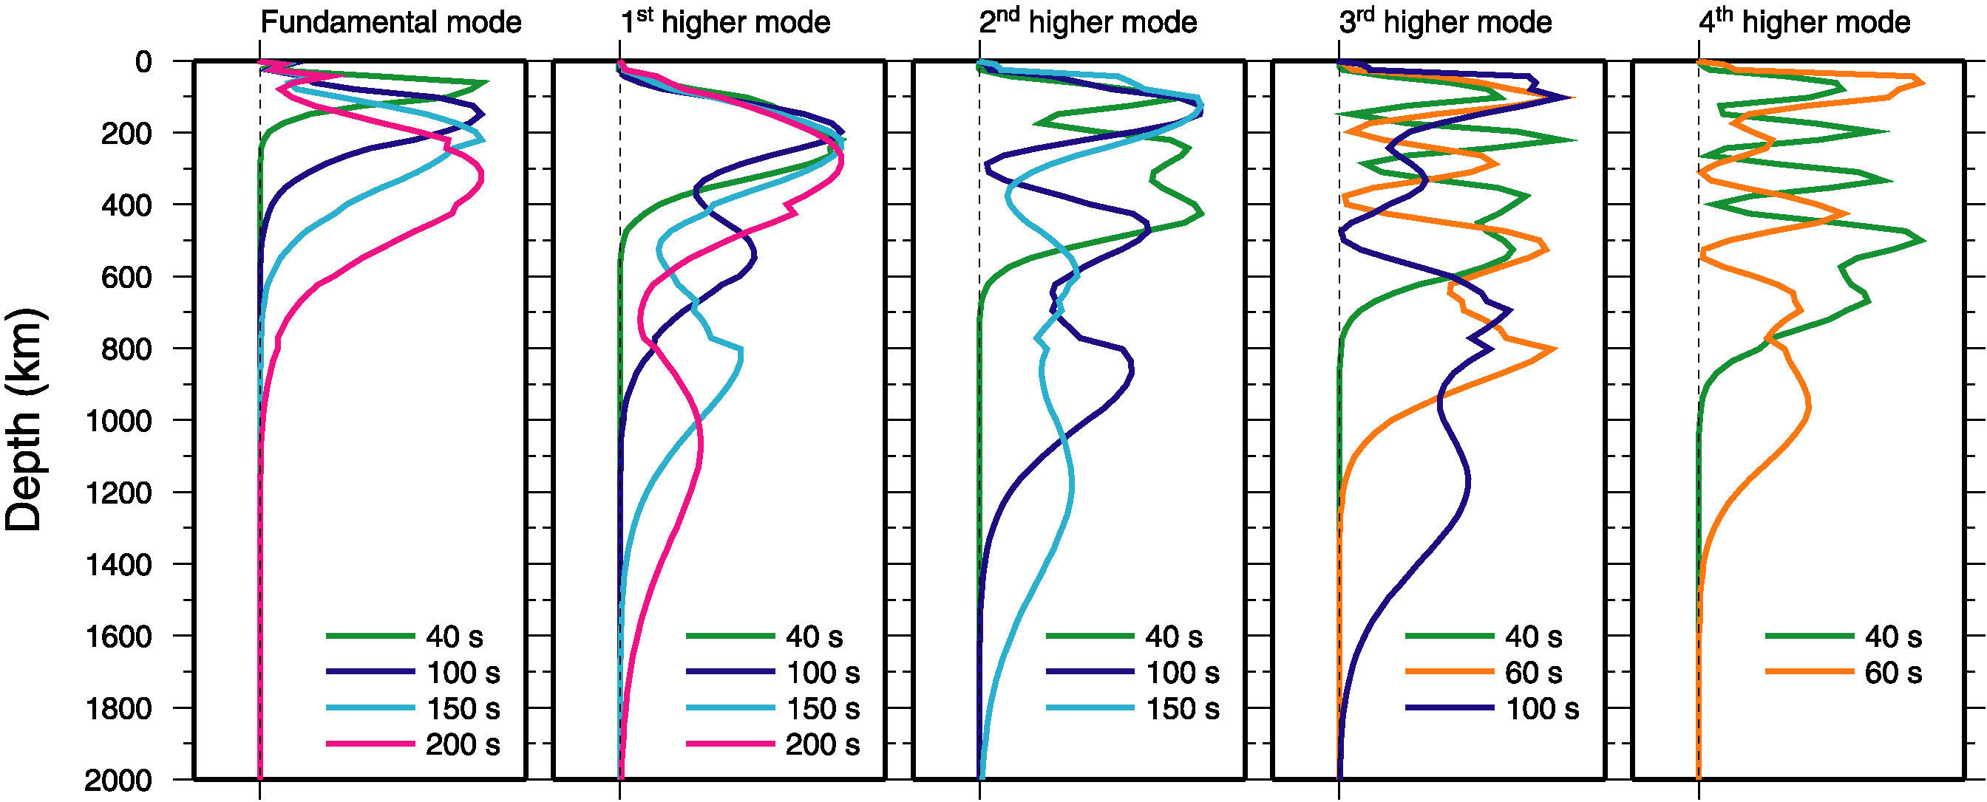
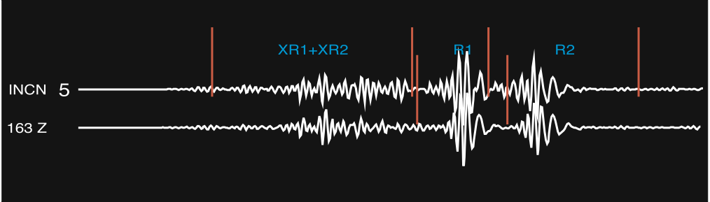
Rayleigh wave overtones
By including overtones, we can see into the transition zone and the top of the lower mantle.
after Ritsema et al, 2004

Slide 14
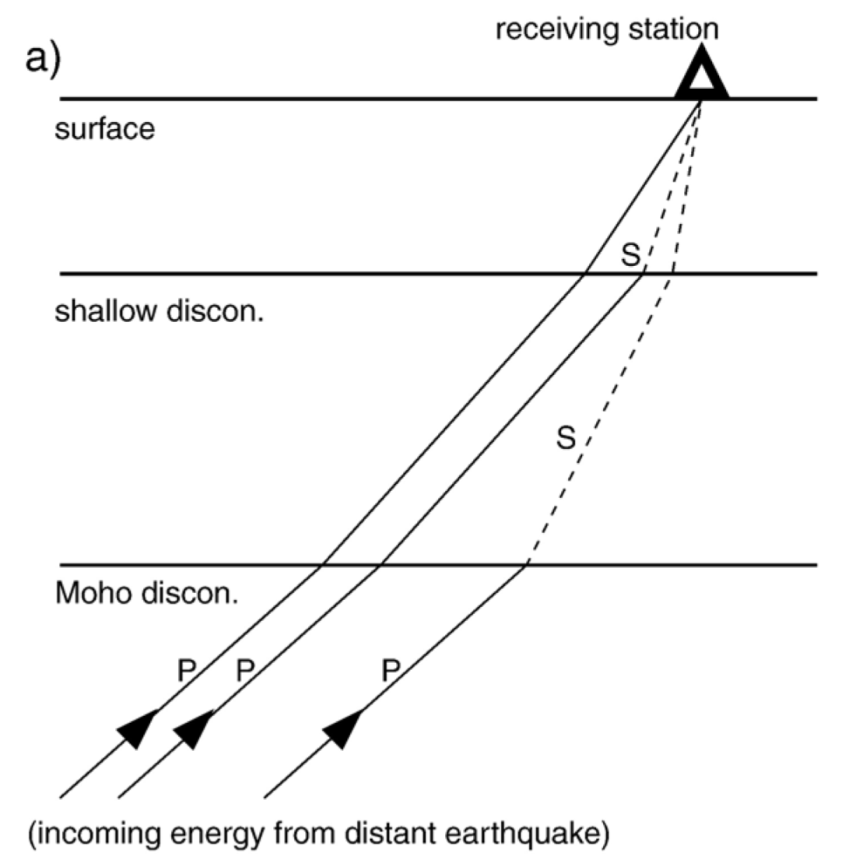
P-RF Ray Paths
P Receiver functions: P-RF
Converted phase:
PdS
Reading EPSL 2006
Notes:
Simple P-RF ray paths in the crust. Solid lines: P waves, broken lines: S waves

Slide 15
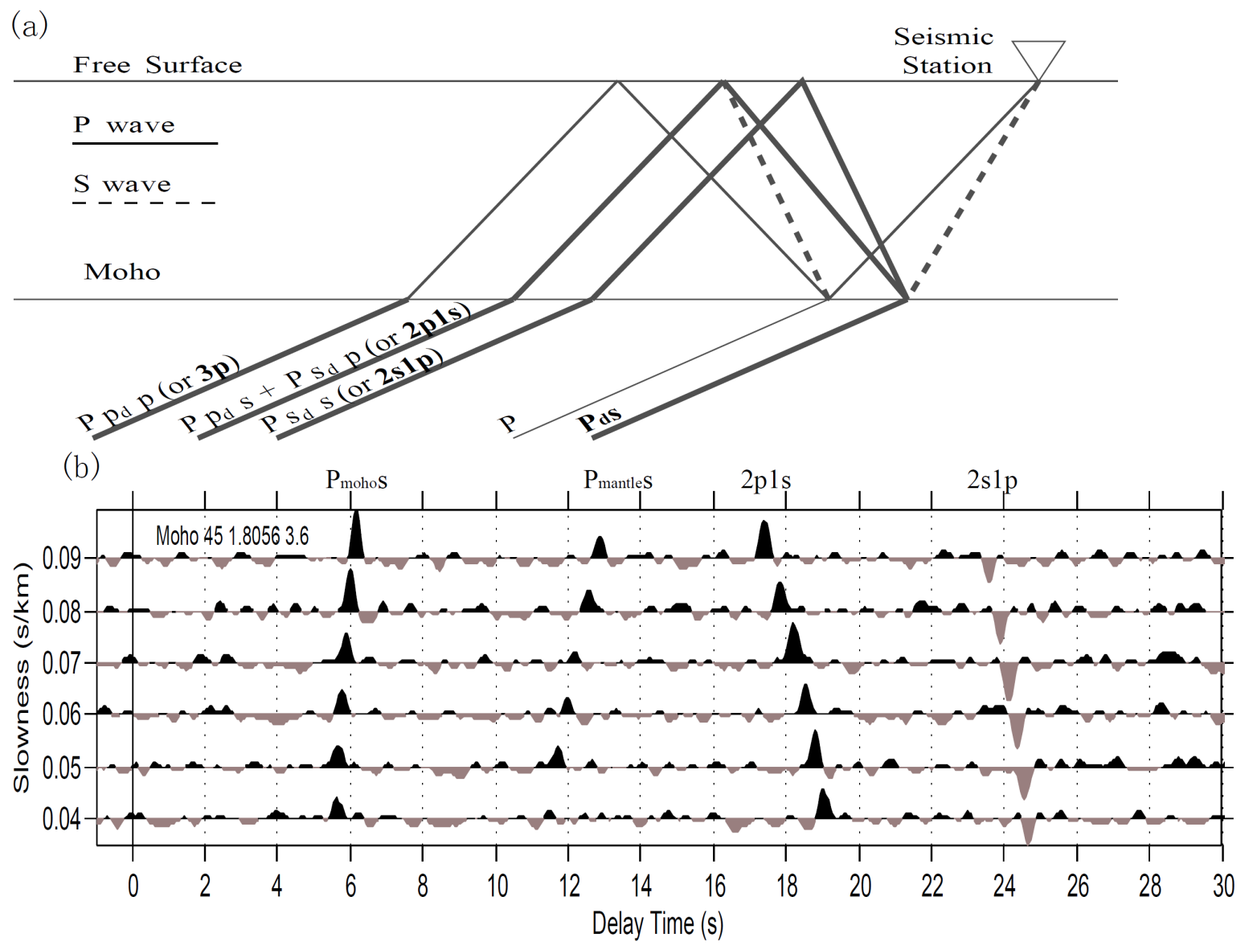
Crustal P-RF and Multiples
Notes:
Top:
P: direct P wave
Pds: P-to-s Moho converted waves
2p1s: Moho multiple, 2 legs of P wave + 1 leg of S wave
2s1p: Moho multiple, 2 legs of S wave + 1 leg of P wave
3p: Moho multiple, 3 legs of P wave; not shown in the RFs due to the deconvolution by direct P
Bottom:
Synthetics P-RFs sorted by slowness; with noise added.

Slide 16
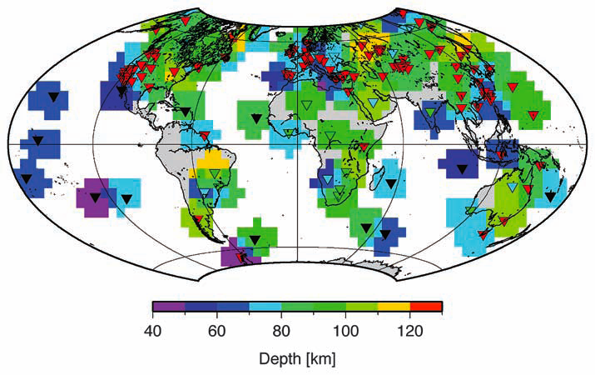
Depth of “LAB” from receiver function analysis
Rychert and Shearer, Science, 2009

Slide 17
Seismic anisotropy
In an anisotropic structure, seismic waves propagate with different velocities in different directions.
The main causes of anisotropy are:
  SPO (shape-Preferred Orientation)
  LPO (lattice-preferred orientation)

Slide 18
Seismic anisotropy
In the presence of flow, anisotropic crystals will tend to align in a particular direction, causing seismic anisotropy at a macroscopic level.
In the earth, anisotropy is found primarily:
  in the upper mantle (olivine+ deformation)
  in the lowermost mantle (D” region)
  in the inner core (iron crystals)

Slide 19
Wave propagation in an elastic medium
--------------------
Linear relationship between strain and stress:
i,j,k ->1,2,3
Stress tensor
Strain tensor
u_{i}: displacement
Elastic tensor :
4-th order tensor which characterizes the medium
In the most general case the elastic tensor has 21 independent elements

Slide 20
Special case 1: Isotropic medium :
μ = shear modulus
Compressional modulus
λ,μ: Lamé parameters
Notes:
Pour completement specifier le modele: ajouter la densite

Slide 21
Types of anisotropy
General anisotropic model: 21 independent elements of the elastic tensor C_{ijkl}
Surface waves (and overtones) are sensitive to a subset, (13 to 1st order), of which only a small number can be resolved:
  Radial anisotropy (5 parameters)- VTI
  Azimuthal anisotropy (8 parameters)

Slide 22
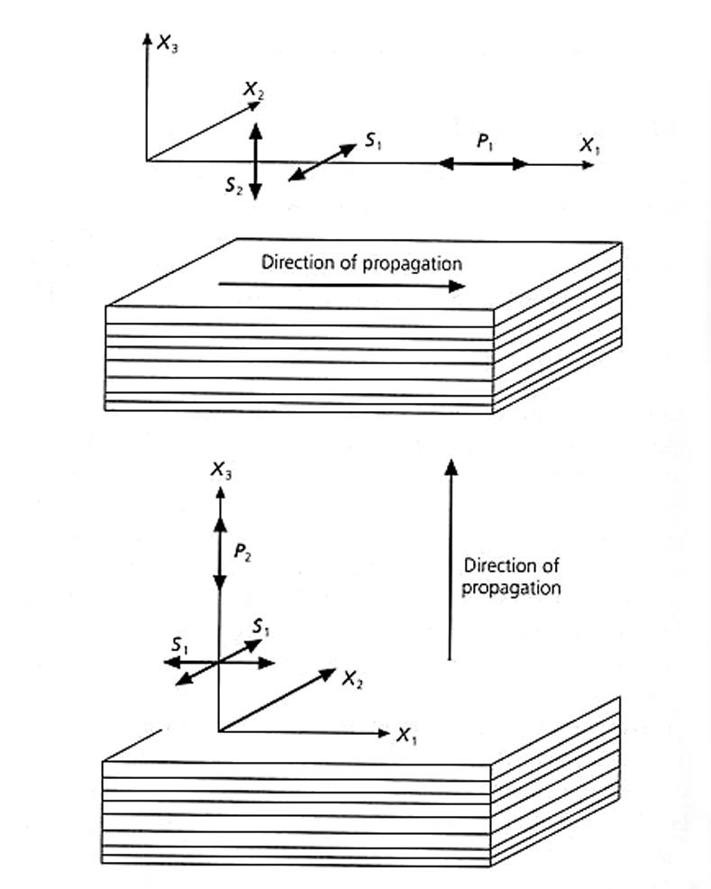
Radial Anisotropy (or transverse isotropy)
e.g. SPO:
Anisotropy due to layering
Radial anisotropy
5 independent elements
of the elastic tensor:
A,C,F,L,N (Love, 1911)
  L = ρ V_{sv}²
  N = ρ V_{sh}²
  C = ρ V_{pv}²
  A = ρ V_{ph}²
  η = F/(A-2L)

Slide 23
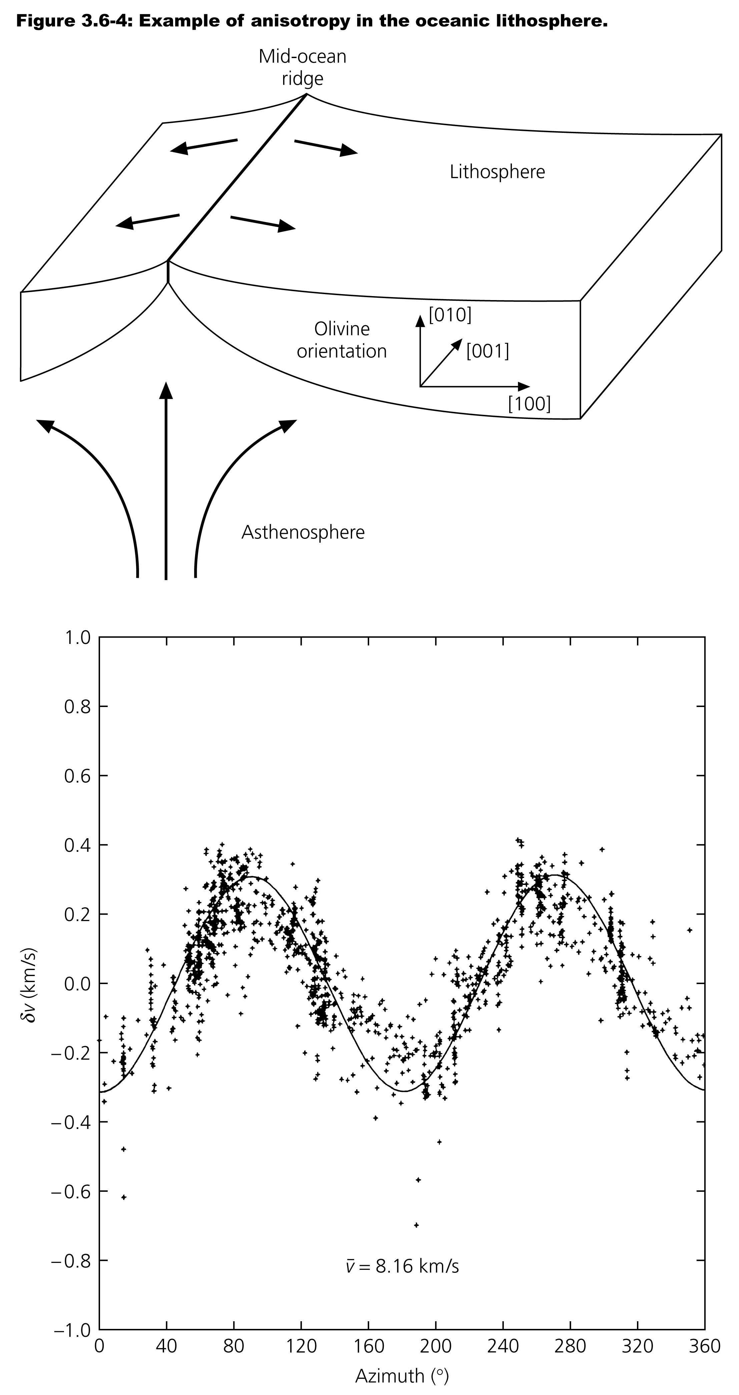
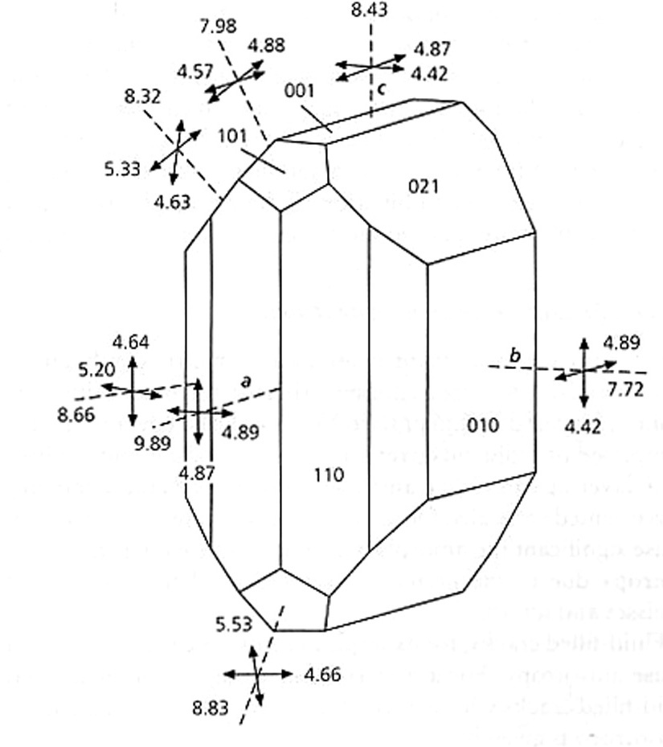
Anisotropy in the upper mantle
Azimuthal dependence of
seismic wave velocities supports
the idea that there is lattice
preferred orientation in the
Pacific lithosphere associated
with the shear caused by plate
motion.
(Hess, 1964)
Spreading direction
Fast direction of olivine: [100]
aligns with spreading direction
P_{n} wave velocities in Hawaii, where azimuth
zero is 90º from the spreading direction
P_{n} is a P wave which propagates right below
the Moho.

Slide 24
Azimuthal anisotropy:
  Velocity depends on the direction of propagation in the horizontal plane
Where ψ is the azimuth counted counterclockwise from North
a,b,c,d,e are combinations of 13 elements of elastic tensor C_{ijkl}
(A, C, F, L, N, B^{1,2}, G^{1,2}, H^{1,2}, E^{1,2})

Slide 25
Vectorial tomography
_{(Montagner and Nataf, 1988)}
Orthotropic medium: hexagonal symmetry with inclined symmetry axis
(A, C, F, L, N, B^{1,2}, G^{1,2}, H^{1,2}, E^{1,2})
(A₀, C₀, F₀, L₀, N₀, Ψ, Θ)
x
Ψ
Θ
(L₀, N₀, Ψ, Θ)
y
Axis of symmetry
z
Use lab. measurements of mantle rocks to establish proportionalities between
P and S anisotropies (A,C / L, N), and ignore some azimuthal terms

Slide 26
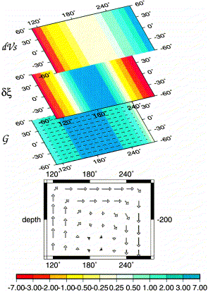
Isotropic
velocity
Radial
Anisotropy
ξ = (Vsh/Vsv)²
Azimuthal
anisotropy
Hypothetical
convection
cell
Montagner, 2002

Slide 27
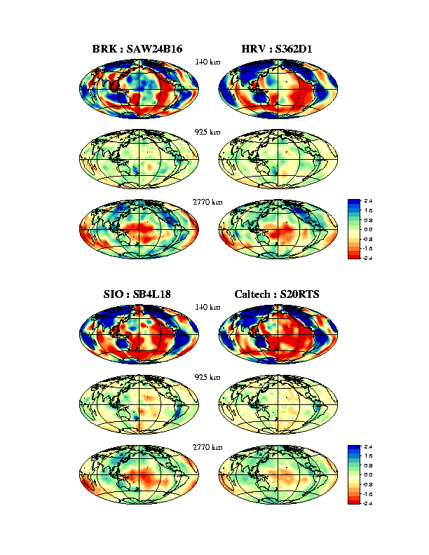
Depth = 140 km
“SH”: horizontally polarized S waves
“SV”: vertically polarized S waves
“hybrid”: both

Slide 28
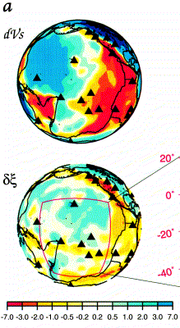
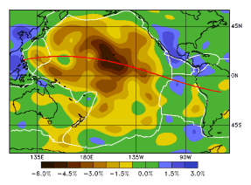
Depth= 100 km
Pacific ocean radial anisotropy: Vsh > Vsv
Ekstrom and Dziewonski, 1997
Montagner, 2002

Slide 29
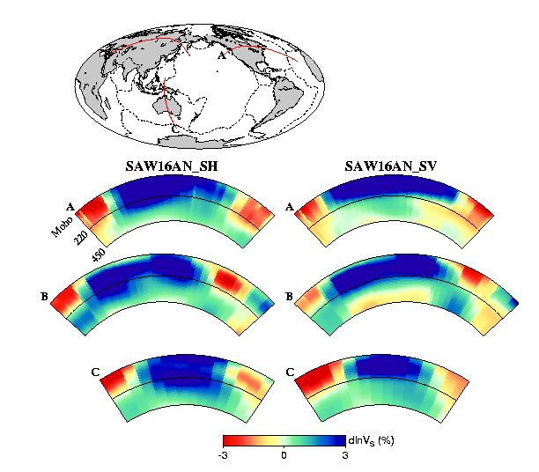
Gung et al., Nature 2003

Slide 30
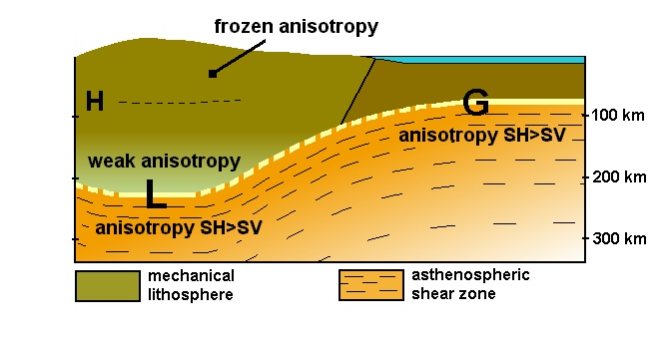
Gung et al., Nature, 2003

Slide 31
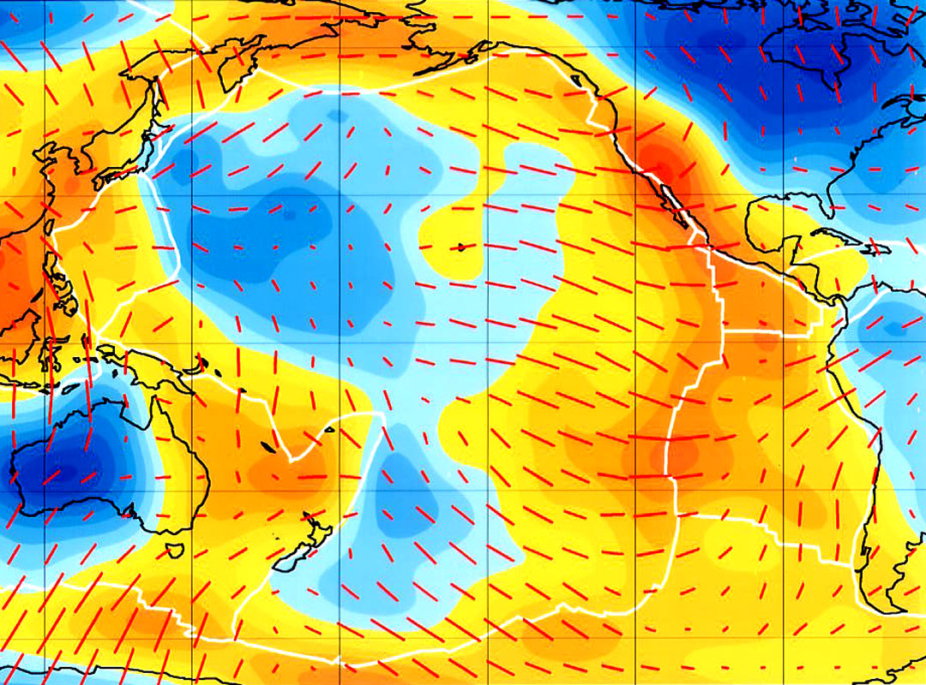
Surface wave anisotropy
Ekström
et al., 1997
Dispersion of Rayleigh waves with 60 second period (most sensitive to depths
of about 80-100 km.
Orange is slow, blue is fast. Red lines show the fast axis of anisotropy.
Notes:
Replace by Ekstrom (2011) map

Slide 32
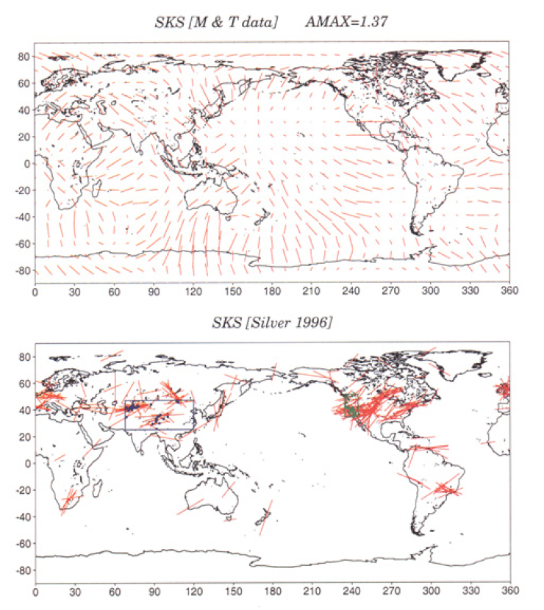
Predictions
from surface
wave
inversion
SKS splitting
measurements
Montagner
et al.
2000

Slide 33
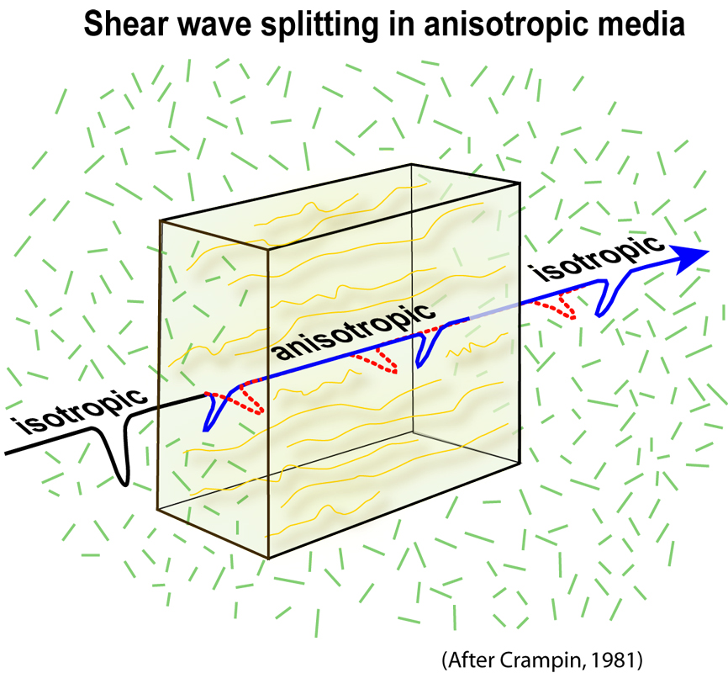
Body wave anisotropy
s

Slide 34
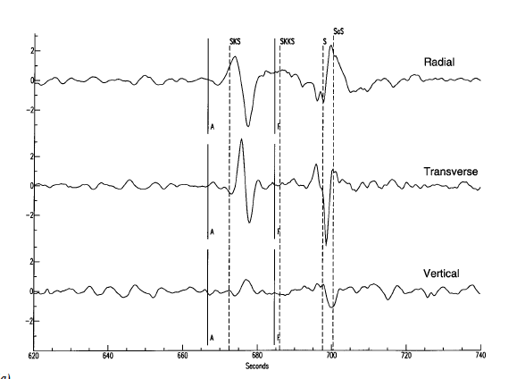
SKS splitting observations
In an isotropic medium, SKS should be
polarized as “SV” and observed
on the radial component, but NOT
on the transverse component

Slide 35
SKS Splitting Observations
Interpreted in terms of a model of
a layer of anisotropy with a horizontal
symmetry axis
Δt = time shift between fast
and slow waves
Ψ_{o} = Direction of fast velocity
axis
Montagner et al. (2000) show how to
relate surface wave anisotropy and shear
wave splitting
Huang et al., 2000

Slide 36
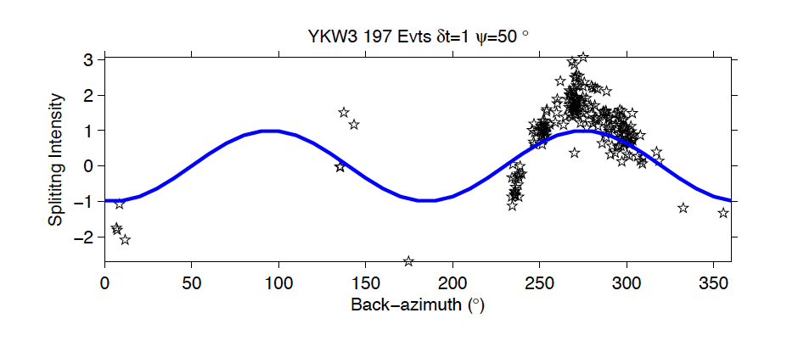
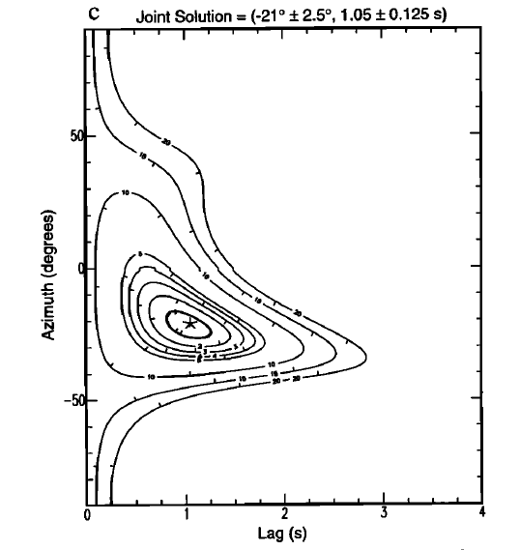
Station averaged SKS splitting is robust
And expresses the integrated effect of anisotropy over the depth of the upper mantle
Wolfe and Silver, 1998

Slide 37
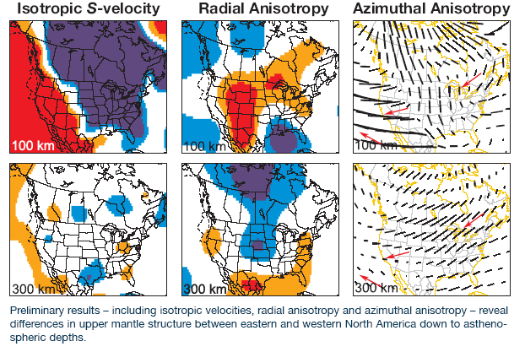
Surface waves + overtones + SKS splitting
Absolute Plate Motion
Marone and Romanowicz, 2007

Slide 38
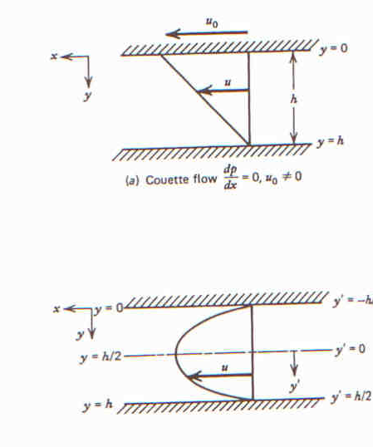
Couette Flow
Channel Flow
Absolute Plate Motion
From Turcotte and Schubert, 1982

Slide 39
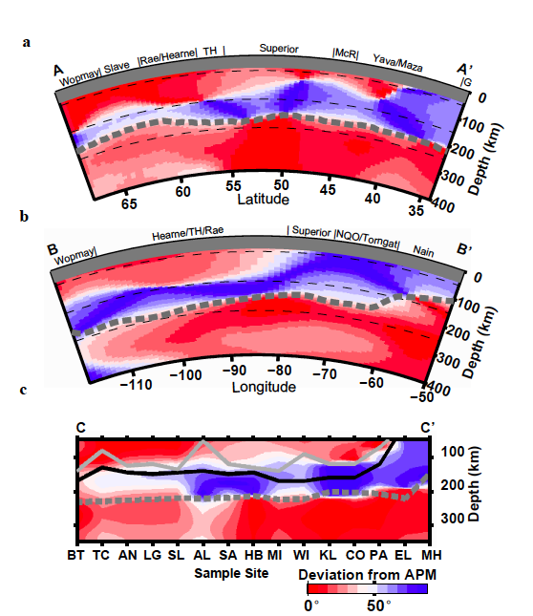
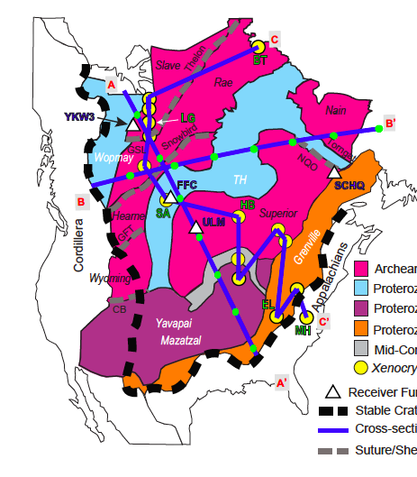
Continuous lines: % Fo (Mg) from
Griffin et al. 2004
Grey: Fo%93
black: Fo%92
Yuan and Romanowicz, Nature, 2010

Slide 40
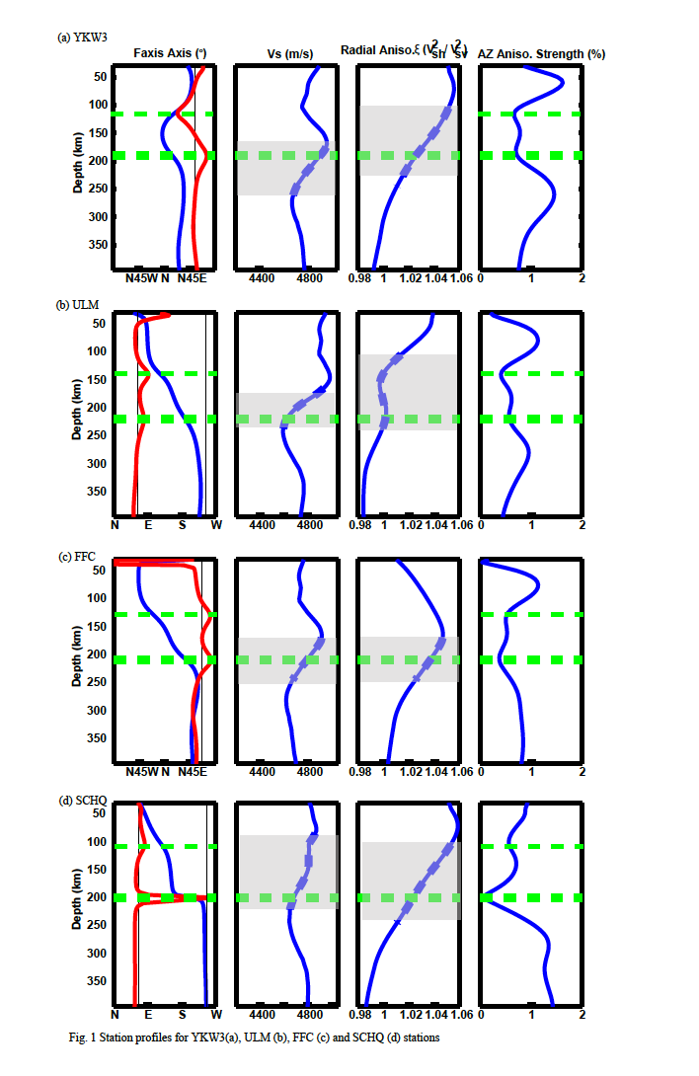
YKW3
ULM
Change
In direction
with depth
Fast axis
direction
Isotropic
Vs
Azimuthal anisotropy
strength

Slide 41
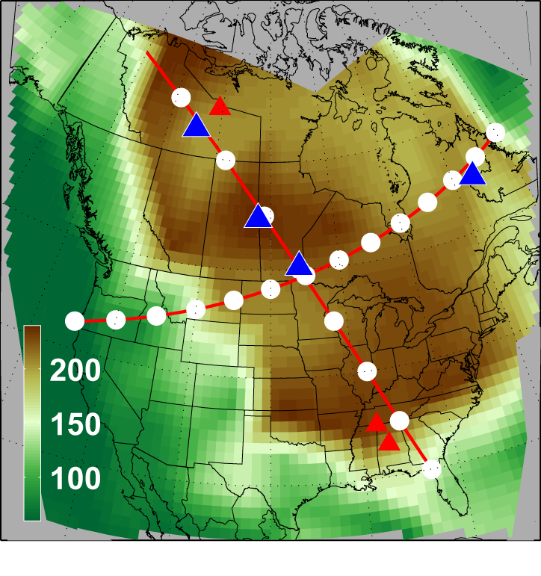
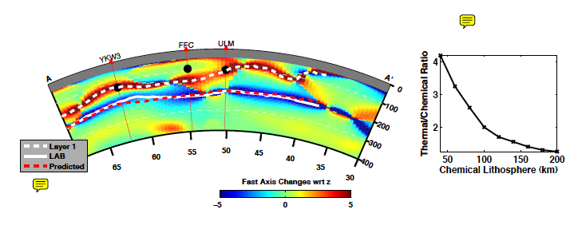
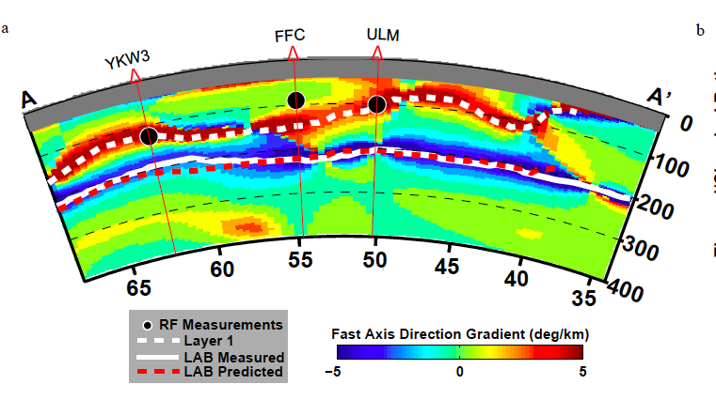
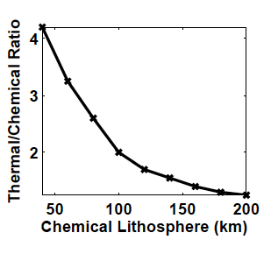
A
Geodynamical modeling:
Estimation of thermal layer thickness
from chemical thickness
From :
Cooper et al.
2004
A’
Yuan and Romanowicz, Nature, 2010

Slide 42
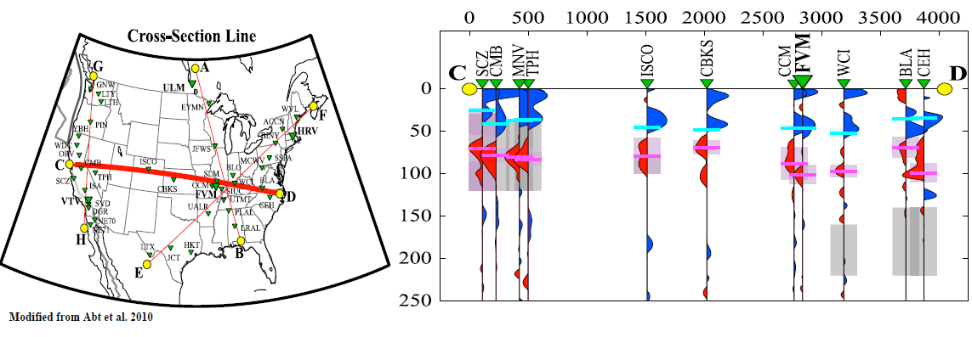
LAB in the western US and MLD in the craton occur at nearly same depth
LAB
MLD
Receiver functions
Notes:
People feel confused when

Slide 43
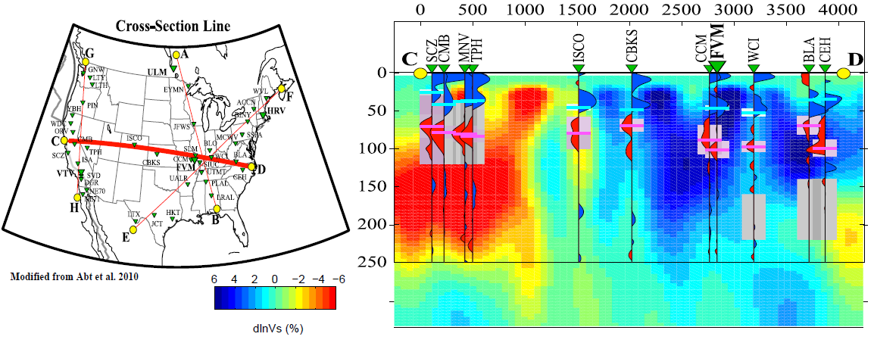
LAB: top of asthenosphere
MLD: in the middle of high Vs lid, also detected with azimuthal anistropy
LAB
MLD
Notes:
People feel confused when

Slide 44
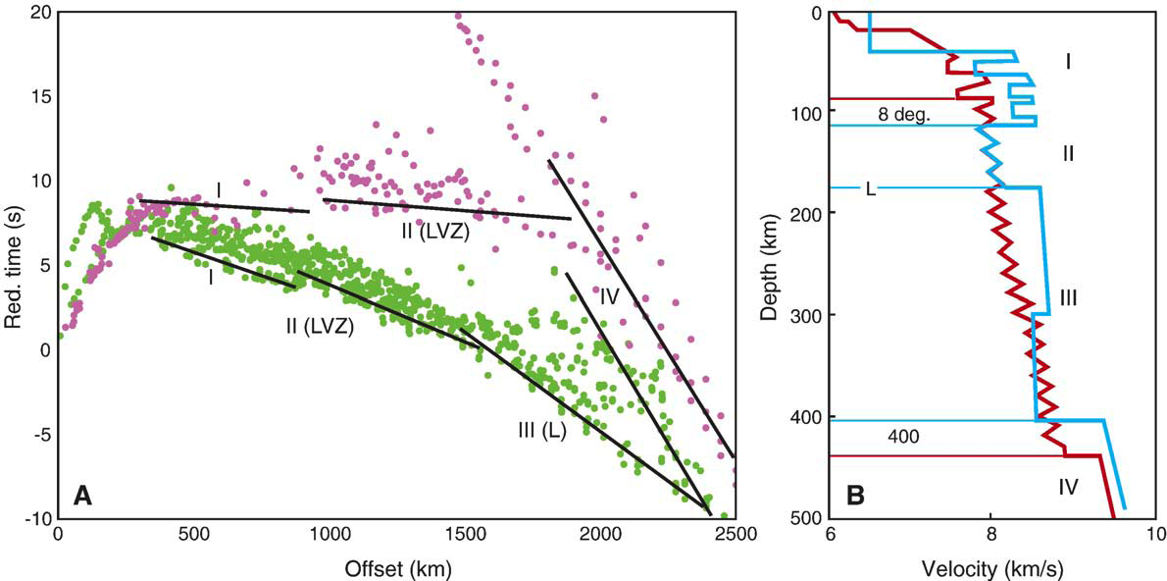
Long range seismic profiles
8º discontinuity
Thybo and Perchuc, 1997

Slide 45
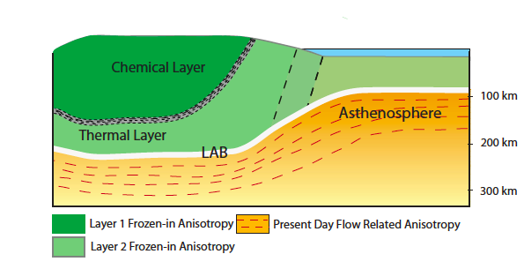
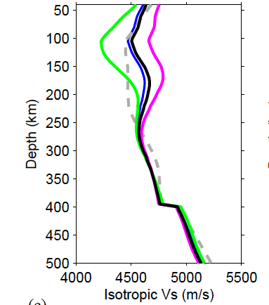
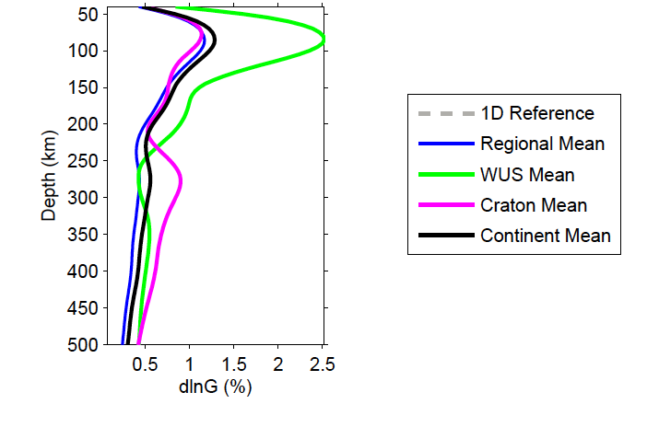
Isotropic velocity
North America
Azimuthal anisotropy
North American continent
Yuan et al., 2011

Slide 46
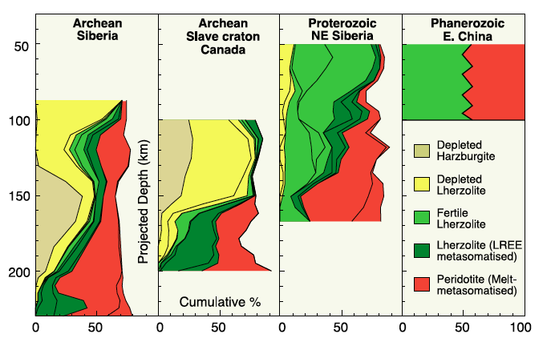
O’Reilly, 2001

Slide 47
100 to 140 km
Less depleted
Root
x
200 to 250 km: LAB

Slide 48
Does this hold on other cratons?
At least in some…

Slide 49
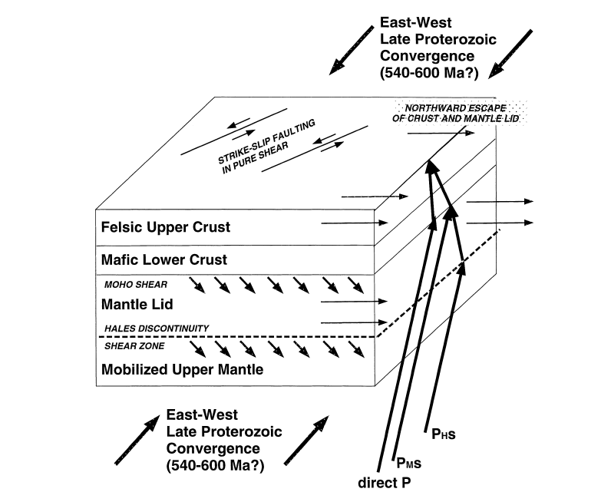
Arabian Shield
Anisotropic
MLD from
Receiver
functions
Levin and Park,
2000,

Slide 50
Need to combine information:
  Long period seismic waves (isotropic and anisotropic)
  Receiver functions
  SKS splitting

Slide 52
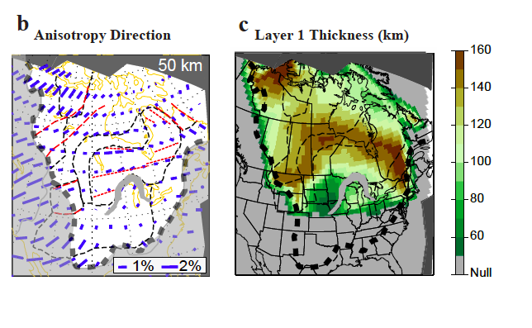
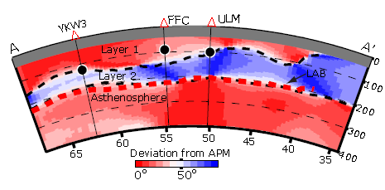
Anisotropy direction in shallow upper mantle
Our results also reconcile contrasting
interpretations of SKS splitting
measurements (in north America):
SKS expresses frozen anisotropy
(Silver, 1996)
SKS expresses flow in the asthenosphere
(Vinnik et al. 1994)
Major suture zones
Notes:
Figures are from Yuan and Romanowicz , Nature 2010
They show that the fast axis direction in the shallow part o the craton is aligned along the major suture zones. The purple ticks indicate the direction and strength of the fast axis of anisotropy.

Slide 53
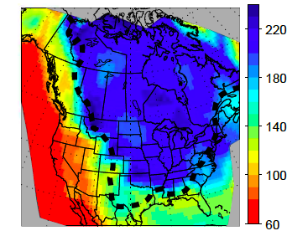
Layer 1 thickness
LAB thickness
Trans Hudson
Orogen
Mid-continental rift zone
Yuan and Romanowicz, 2010

