Slide 1
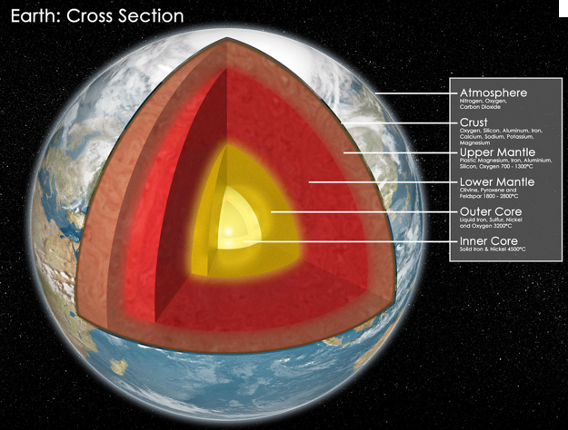
How Did Early Earth Become Our Modern World?
Richard W. Carlson, Department of Terrestrial Magnetism
Carnegie Institution of Washington
Notes:
The most significant chemical discontinuities in Earth: Atmosphere-Crust-Mantle-Core. Crust formed over Earth history, but both atmosphere and core predominantly formed within 100-200 million years of Earth formation. Are similarly old differentiation events also recorded in the silicate portion of Earth? How might these have affected the later geodynamic evolution of the planet?

Slide 2
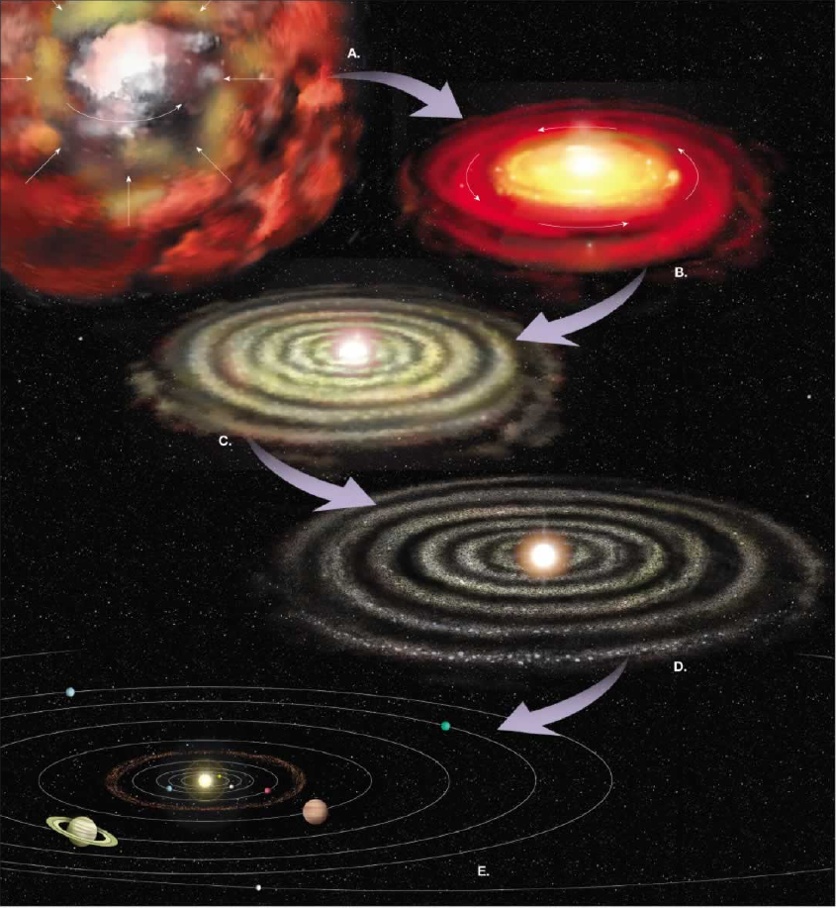
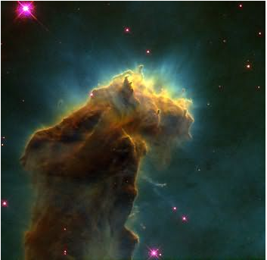
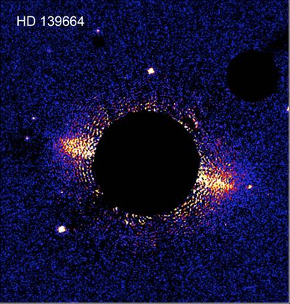
Molecular Cloud, M16
NASA/ESA
Protoplanetary Disk,
Hubble Telescope
When did planetary chemical differentiation begin?
Before there were planets!
Notes:
We will push this back one step farther and consider the chemical fractionation processes that could occur before planet formation. Collapse of the Solar molecular cloud leads to a central mass concentration which results in high temperatures, at least within the inner Solar system. The survival of presolar grains show that temperatures did not get sufficiently hot throughout the nebula to volatilize everything, but a hot gaseous, well-mixed, inner solar system is at least a good place to start this story.

Slide 3
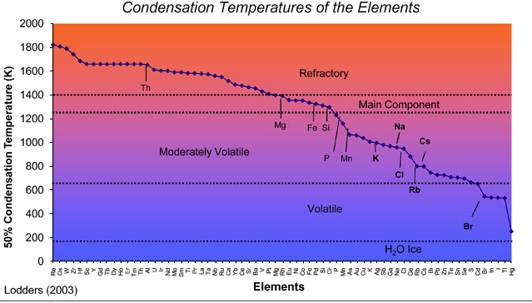
Cooling of a Hot, Gaseous, Solar Nebula Can Cause Element Fractionation According to Condensation Temperature
Notes:
As the Solar nebula cools, different elements condense out of the gas at different temperatures. One means of chemical fractionation thus is any physical mechanism that can mechanically separate dust from gas during this cooling phase.

Slide 4
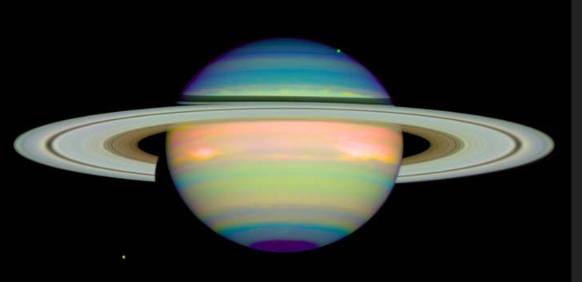
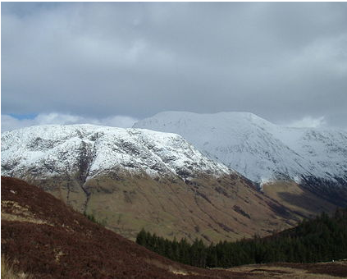
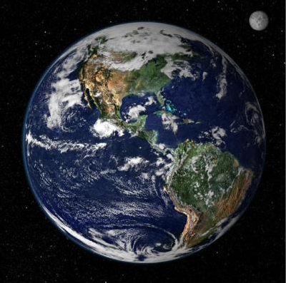
The “Snow Line” and Separation of Volatile from Refractory Elements
Notes:
The most obvious volatility-related separation is the frost line interior to which ices remained as gases and only silicate and metal-rich planets formed whereas beyond the snow line, ices condensed and accumulated into the giant gas planets. Examination of extra solar planetary systems shows that the story is not this simple as gas giants have a habit of migrating inwards, and outwards, but in our solar system, the concept of a frost line provides a convenient explanation for the inner terrestrial planets and the outer gas planets.

Slide 5
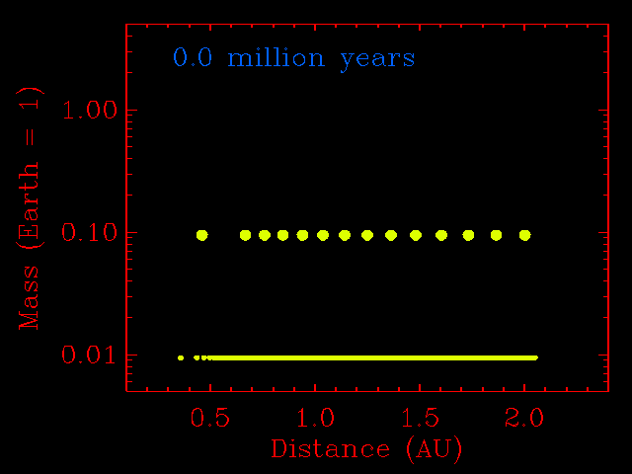
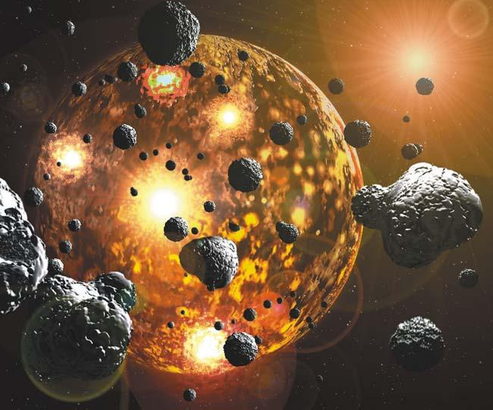
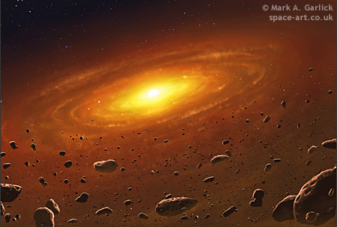
Planet accumulation animation
by John Chambers, DTM
The Latter Stages of Planetary Accumulation Involve Considerable Heliocentric Migration and REALLY BIG Impacts

Slide 6
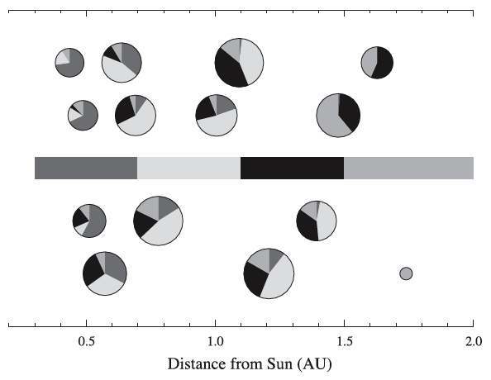
Did the Planets Inherit Compositional Variations
Present in the Nebula?
Results of 4 planetary accumulation models that track the original heliocentric distance of the material that ends up being accreted into the planet (Chambers, EPSL 2004)
Run 1
Run 2
Run 3
Run 4
Notes:
The planetary migration seen in extra solar planetary systems brings up the issue of how much initial chemical heterogeneity that might have been present in the nebula that would be preserved during the planetary accumulation process. Although lots of mixing occurs due to orbital perturbations during planetary accretion, the theoretical evidence suggests that heliocentric compositional gradients can survive the planetary accumulation process.

Slide 7
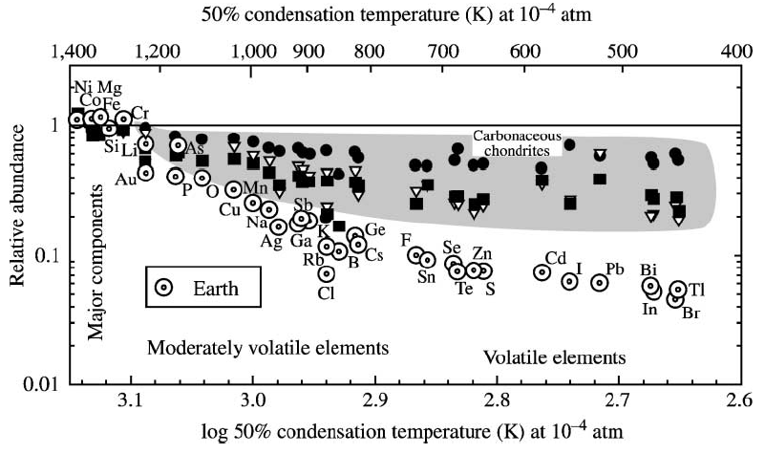
Volatile Depletion is a Characteristic of Many Solar System Objects, Including Earth
From McDonough
TOG, 2003
CI-normalized terrestrial volatile element abundances decrease with decreasing condensation temperature. Same pattern, though less extreme, is seen in “primitive” meteorites. Volatile depletion of Earth may be a “pre-accretion” phenomena
Notes:
Earth is depleted not only in gases, but in moderately volatile elements. This separation of volatile-refractory elements is one of two major chemical separation processes that occurs before planets form.

Slide 8
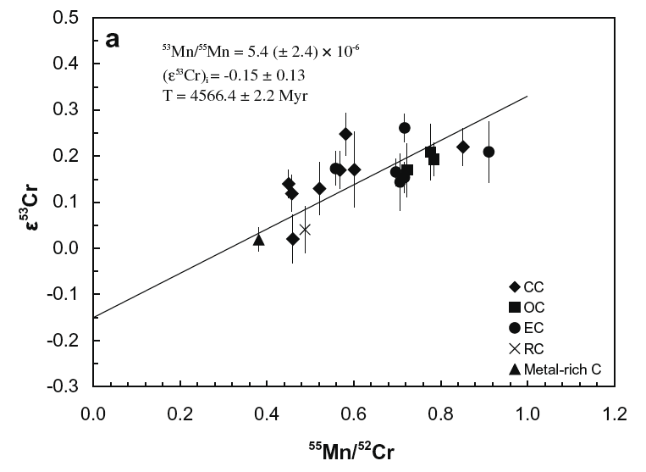
Earth Formed Volatile Depleted
Chondrite Mn/Cr variation correlates with ⁵³Cr/⁵²Cr.
Earth has a lower ⁵³Cr/⁵²Cr than almost all chondrites. Mn more volatile than Cr.
Earth’s volatile depletion occurred while ⁵³Mn was alive (t_{1/2} = 3.7 Myr)
Earth
From Qin et al., GCA 2010
Notes:
Evidence from the short-lived 53Mn to 53Cr decay (3.7 million year half life) provides support for the idea that Earth formed volatile depleted – it did not gain volatile depletion through some later differentiation process.

Slide 9
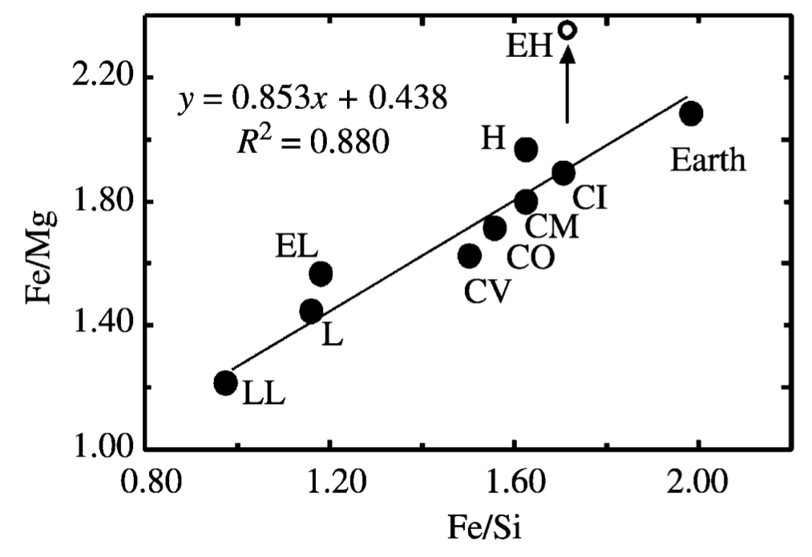
Iron – Silicate Separation
McDonough, TOG, 2004
Iron to (everything else) ratio variable among meteorites
and different from Earth.
Notes:
The other obvious nebular fractionation process is between iron metal and silicate. In a gas of solar composition, most of the iron condenses as iron metal. Given the very different densities of iron and silicate grains, mechanical sorting in the nebula can fractionate metal from silicate. Supporting this, meteorites show a wide range in the ratio of iron to silicates. Estimates of Earth composition suggest that it has even higher bulk Fe content than any group of meteorites.

Slide 10
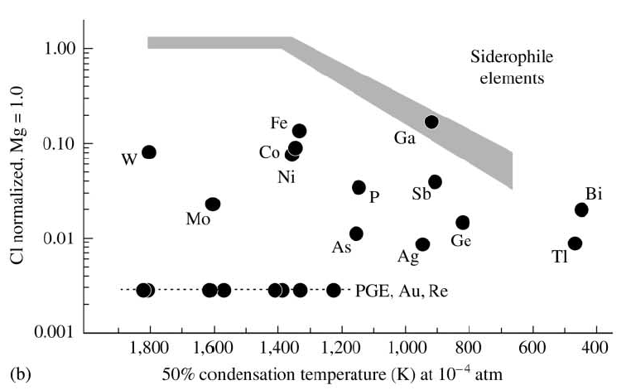
Core Formation Depleted Earth’s Mantle
in Siderophile (Iron Metal Soluble) Elements
Hf
Palme and O’Neil
TOG, 2003
When did core formation occur?
Notes:
Although we don’t know the exact composition of the core, we can see the consequences of its formation as a chemical imprint in the mantle – the depletion of those elements that prefer to be in metal rather than silicate.

Slide 11
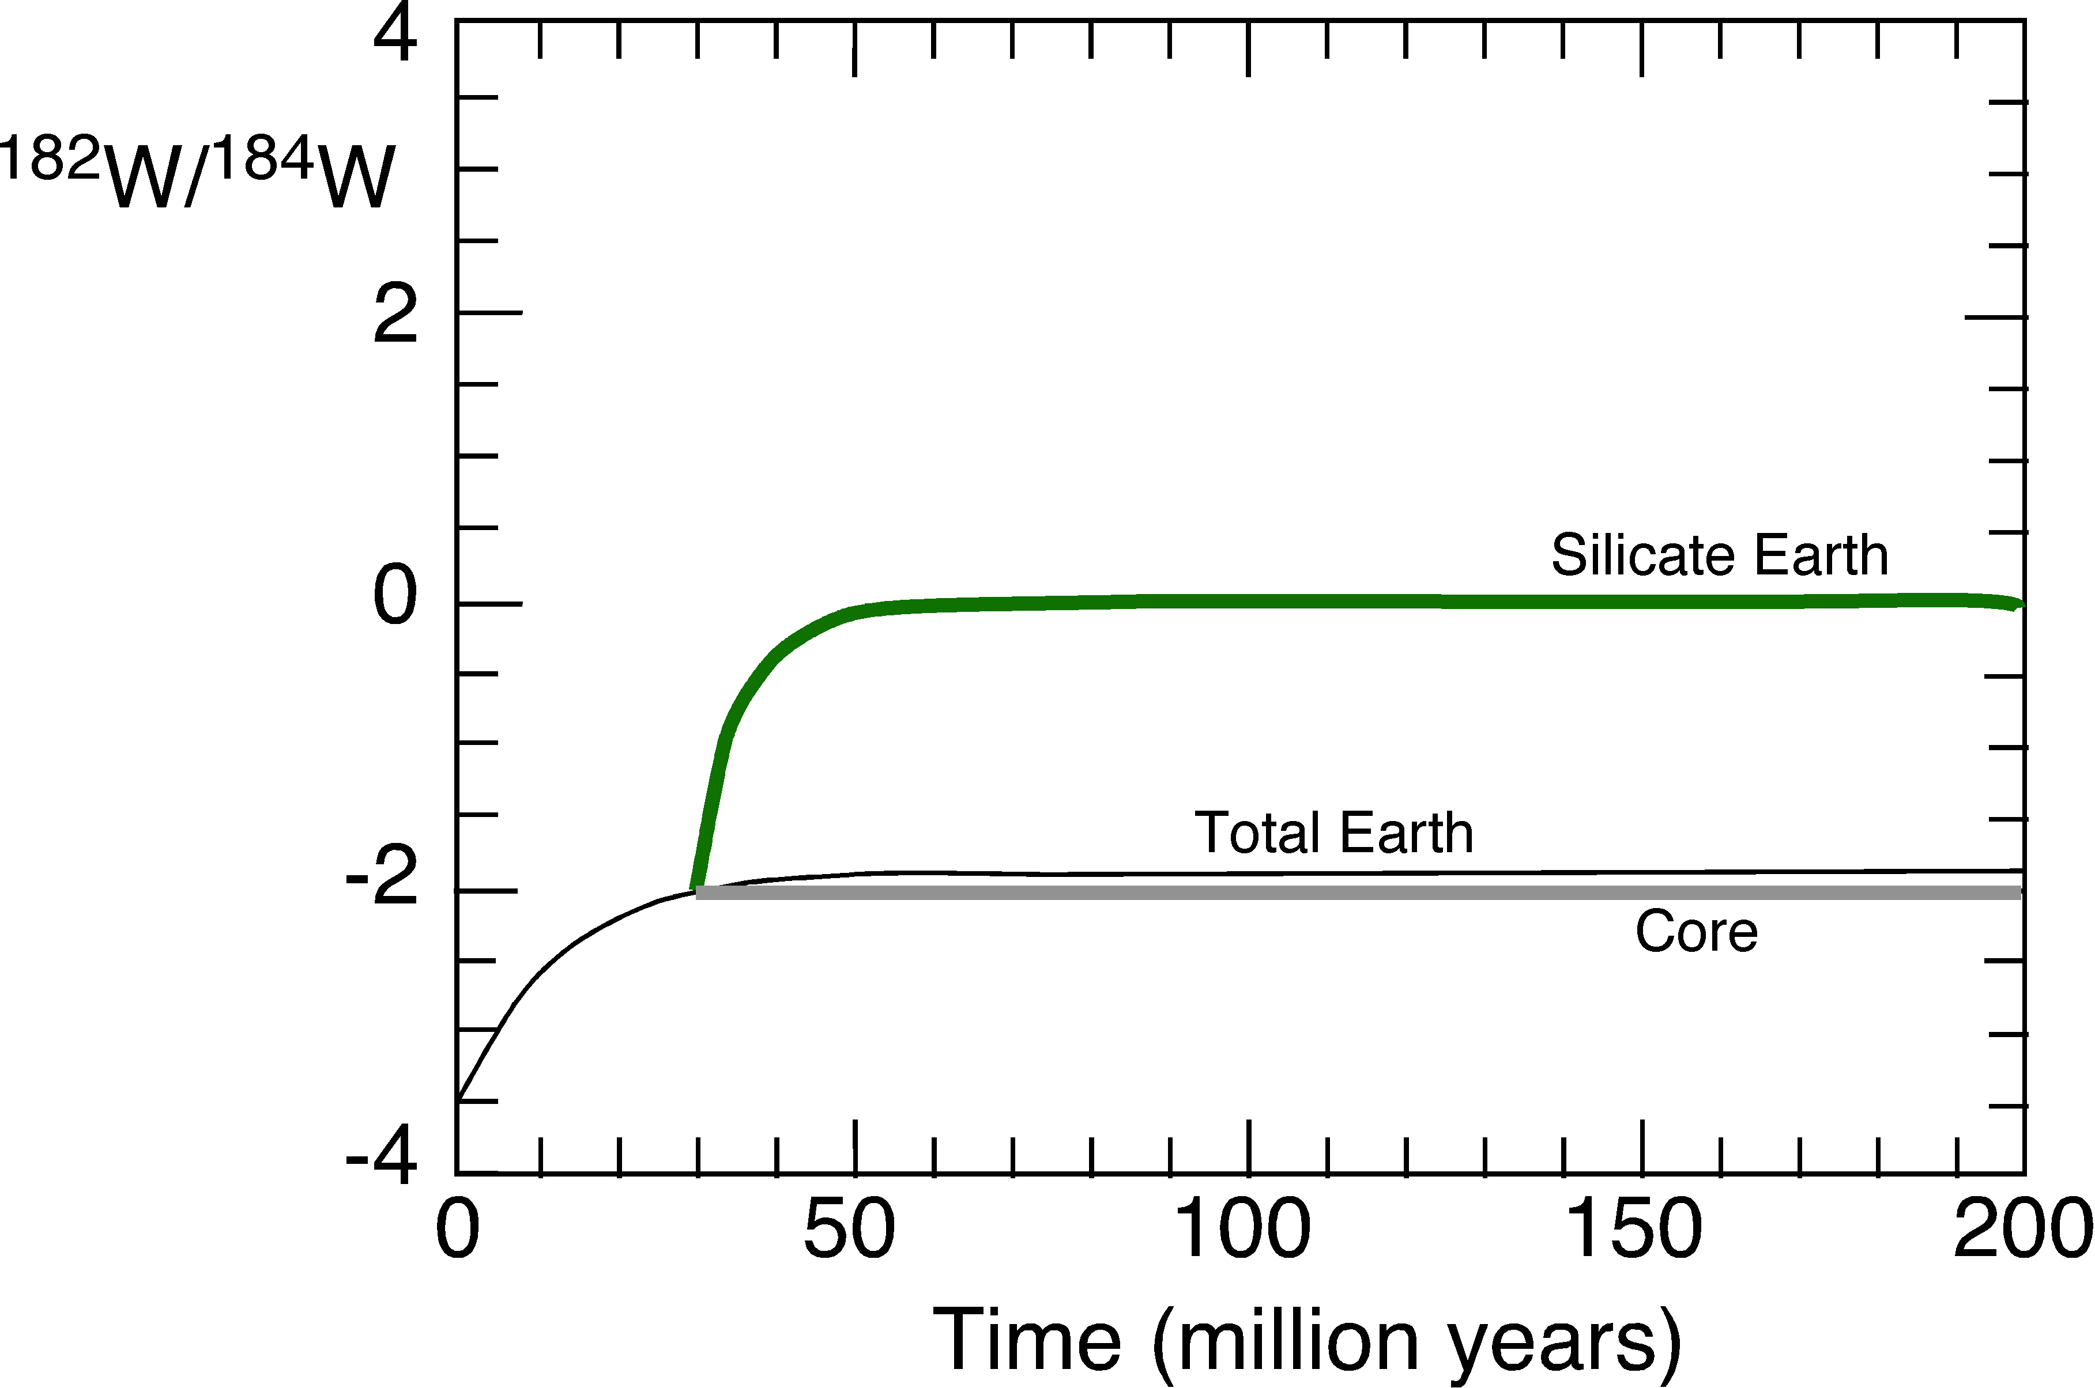
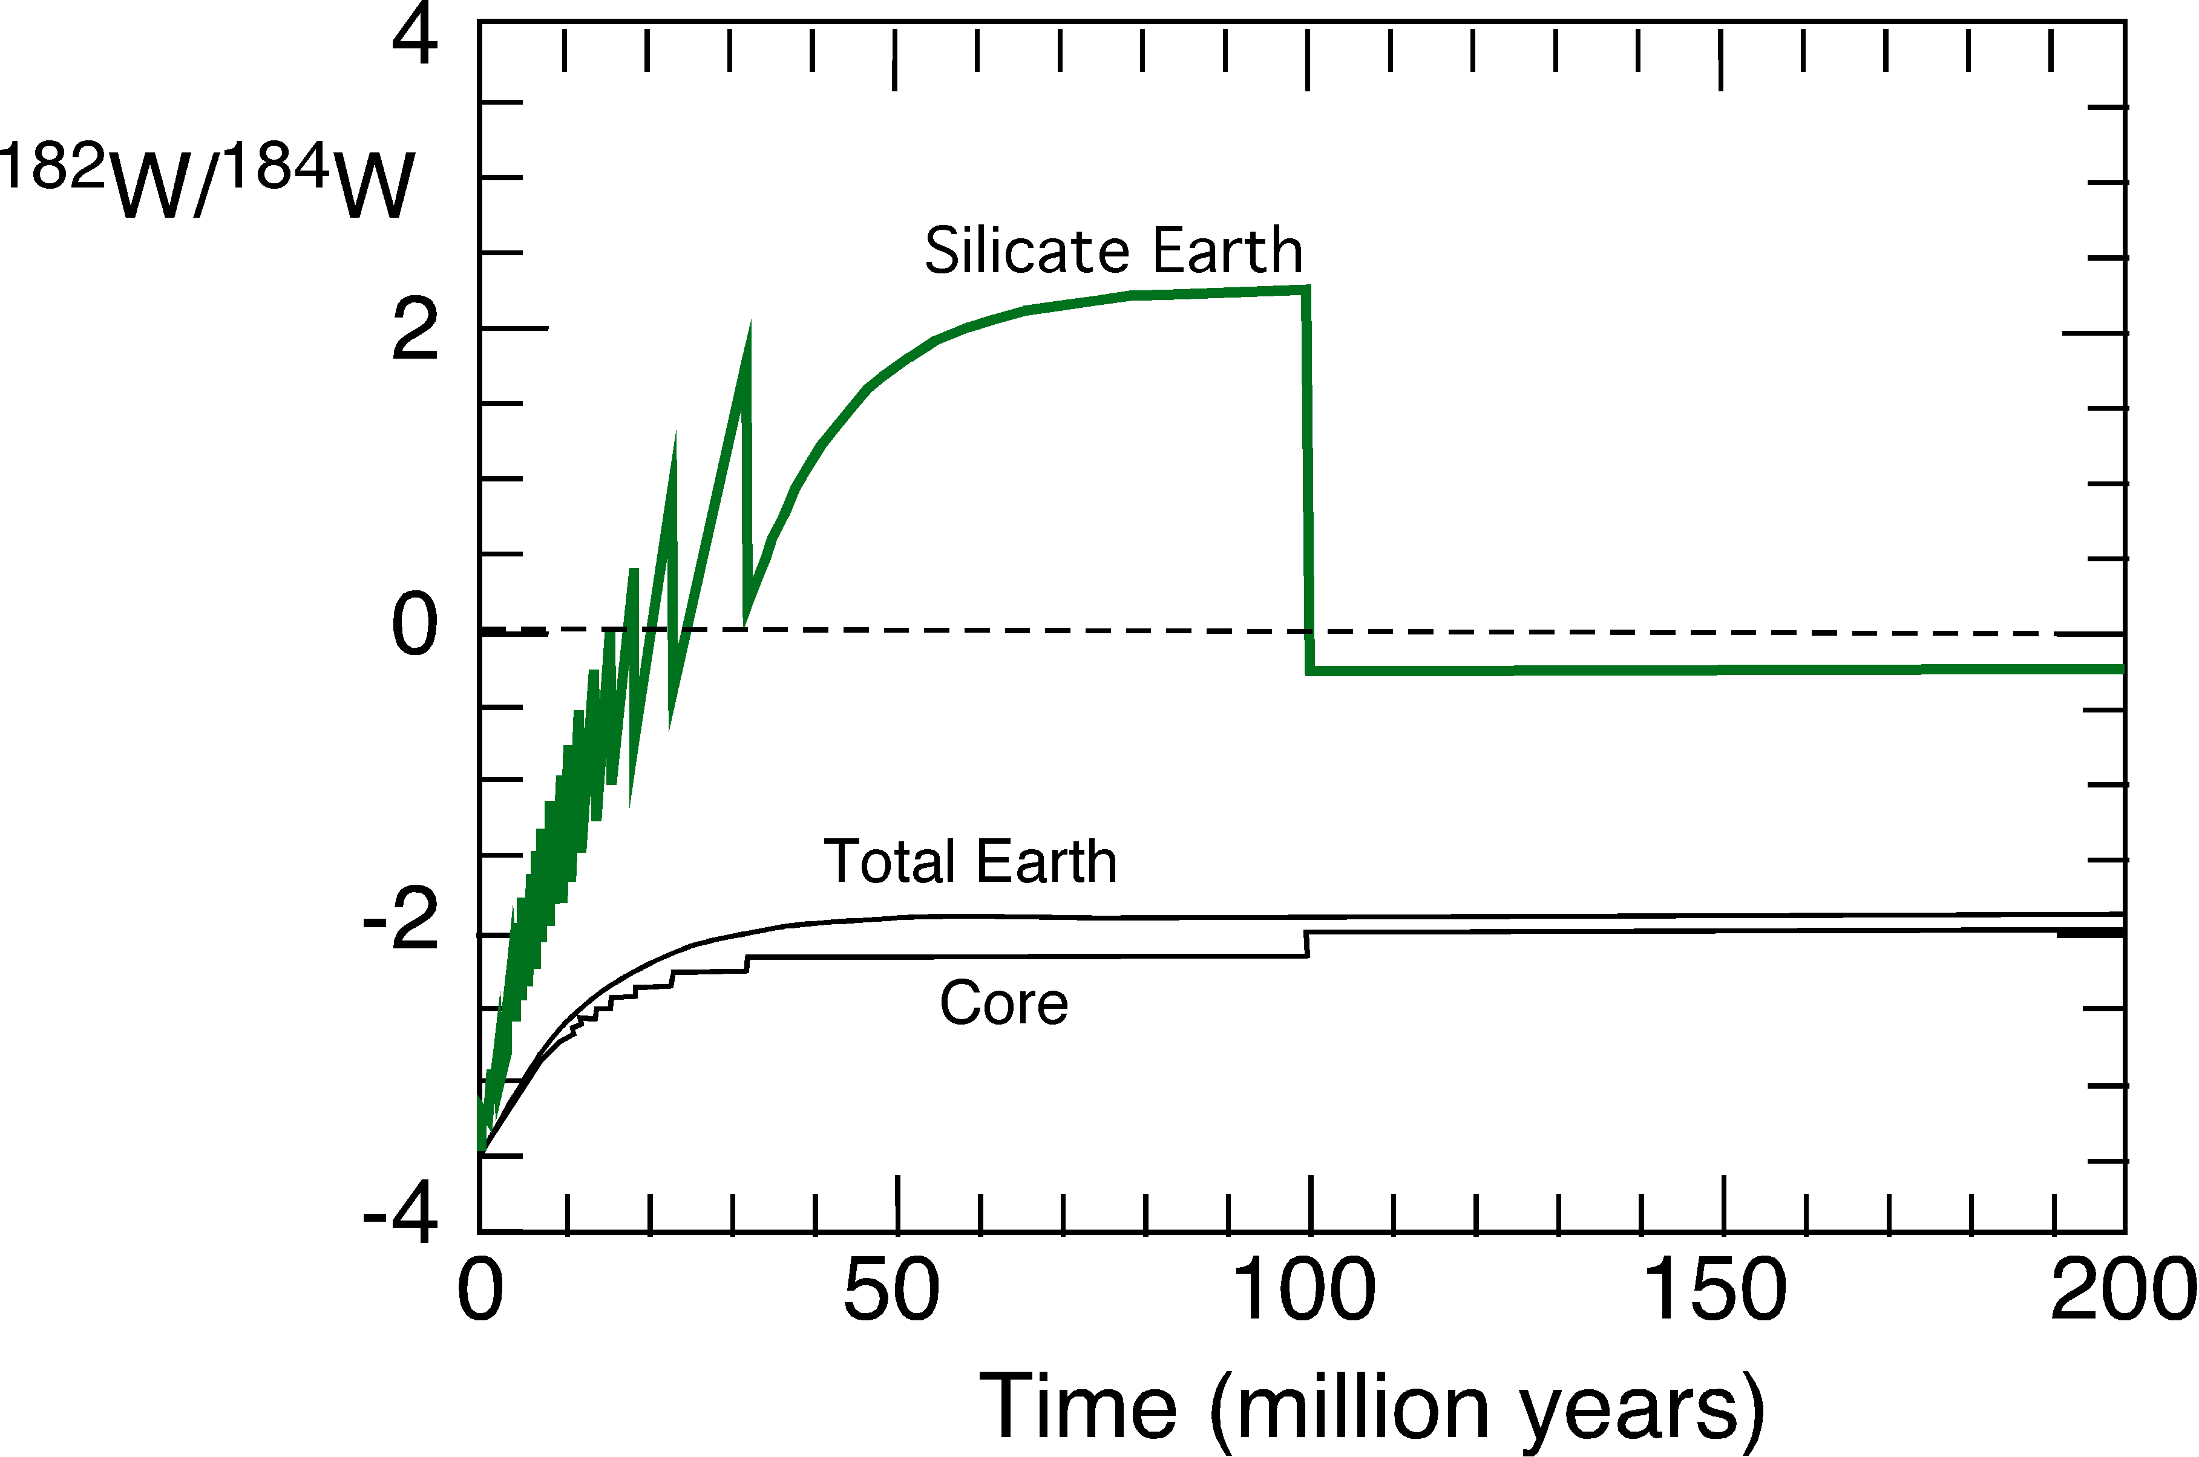
When Did Earth’s Core Form?
If core formation were simple 33 ± 2 Myr after Solar System formation or 4.535 Gyr
If Earth grew slowly and involved many “accumulation events”, then the answer depends on the details of Earth accumulation
Parts in 10,000
Parts in 10,000
¹⁸²Hf → ¹⁸²W (t_{1/2} = 9 Myr)
Chondrite Hf/W = 1
Metal Hf/W = 0
Mantle Hf/W = 10
Notes:
Core formation clearly occurred very early – depending on how you approach the Hf-W systematics, somewhere between 30 and 100 million years after Solar system formation.

Slide 12
Accretion Post Core Formation
Earth = 6 x 10²⁴ Kg
Ocean = 1.4 x 10²¹ Kg
CI Chondrite = 18 wt% H₂O
1% Earth Mass of CI Chondrite contains 10²¹ Kg water
Notes:
The so-called highly siderophile elements – called that because they have metal-silicate distribution coefficients of 10^4 or above, and hence should be depleted in the mantle by a similar amount, are instead found in the mantle at nearly chondritic relative abundances at a bit less than 1% of chondritic abundances. One way to do this is to add about 1% of the mass of the Earth after core-mantle exchange stopped – a so-called “late veneer”. If the later veneer were made of volatile-rich chondrites, then this material would have brought in an amount of water similar to that currently present in the ocean. The siderophile element abundances in the mantle don’t require a volatile-rich late veneer, however.

Slide 13
What About Early Silicate Differentiation?
Refractory Lithophile Elements, like the Rare Earth Elements
~ 3% variation in the ¹⁴⁷Sm/¹⁴⁴Nd ratio
All chondrite groups the same
± 3%
¹⁴³Nd / ¹⁴⁴Nd
4.567 Ga
Average
Chondrite = BSE?
¹⁴⁷Sm / ¹⁴⁴Nd
Jacobsen and Wasserburg, 1980, 1984; Prinzhofer et al., 1992; Patchett et al., 2004; Boyet and Carlson, 2005; Bouvier et al, 2008
Notes:
To investigate silicate differentiation processes, primarily done through partial melting, refractory lithophile elements, like the rare earth elements are useful because they are not fractionated by core forming processes nor by volatile loss. Chondrites, for example, show only a very small variation in REE patterns and of ratios of two neighboring REE like Sm and Nd.

Slide 14
Continental Crust and (at least) the Upper Mantle are Chemically Complimentary
Mass Fraction
0.45%
Sample/Bulk-Silicate-Earth
30-70%
70-30%
WHEN DID THIS SEPARATION OCCUR?
Sm-Nd model ages for MORB = 200 - 2000 Ma
Pb-Pb model age for oceanic basalts ~1800 Ma
“Average” continental crust Sm-Nd model age ~2000 Ma
Notes:
The chemical composition of the continental and oceanic crust are relatively well known. The mantle source of oceanic crust is the chemical compliment to the continents. Various methods to estimate the age of the crust indicate that crust formation has occurred throughout Earth history, though the rate of crust production and recycling is highly uncertain. The chemical complementarity between continent and depleted mantle is not the result of early Earth differentiation. Continental crust can be added back to an appropriate mass of depleted mantle to produce a mixture similar to that expected for the undifferentiated silicate Earth, but did this process start from “primitive” mantle or one already affected by early Earth differentiation processes?

Slide 15
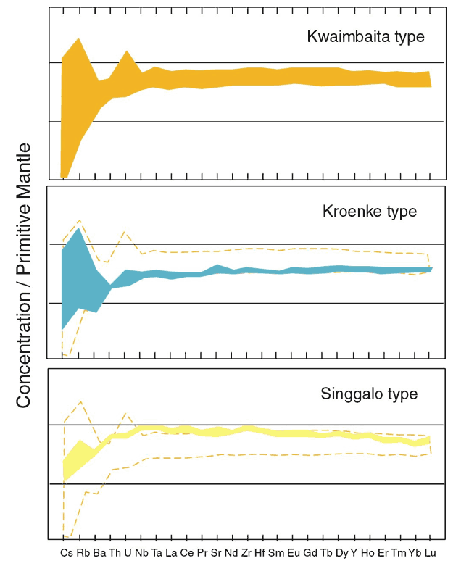
Some Large-Volume Flood Basalts have Nearly Flat Normalized Incompatible Element Abundance Patterns with Just a Slight Depletion in the Most Highly Incompatible Elements
Ontong-Java Flood Basalts
“The flat primitive-mantle-normalized patterns defined by alteration-resistant incompatible elements in the Kwaimbaita- and Kroenke-type basalts (see Fitton & Godard, 2004) point to a mantle source not too different from estimated primitive mantle in most of its inter-element ratios. However, the observed isotopic values (e.g., εNd(t) ~ +6) are clearly far-removed from those estimated for primitive mantle (εNd = 0).”
(Tejada and Mahoney, MantlePlumes.org)
10
1
10
All these samples have ε¹⁴³Nd between +4 and +7
1
Notes:
The chemical complementarity of continental crust and the mantle source of oceanic crust testifies to the effectiveness of partial melting in separating the lithophile elements. Some important basalt provinces, for example the largest of the flood basalt provinces – the Ontong-Java Plateau – show lithophile element patterns closer to those expected for undifferentiated mantle than to MORB mantle. Are these melts from Earth’s primitive mantle? Maybe, but if so, the primitive mantle is not chondritic according to their Nd isotope compositions.

Slide 16
Evidence for Early Silicate Differentiation from the ¹⁴⁶Sm-¹⁴²Nd System
¹⁴²Nd is produced by the decay of ¹⁴⁶Sm (68 Ma half life)
¹⁴²Nd/¹⁴⁴Nd ratios measured in carbonaceous, ordinary and some enstatite chondrites, and eucrites, are lower than laboratory standard and terrestrial samples
The offset in ¹⁴²Nd/¹⁴⁴Nd can be explained if the modern terrestrial mantle has a Sm/Nd ratio 6% higher than chondritic since > 4.5 Ga.
Data from Nyquist et al., 1995; Boyet and Carlson 2005; Andreasen and Sharma, 2006; Rankenburg et al., 2006; Carlson et al., 2007; Gannoun et al., 2011
Notes:
Although the long-lived 147Sm-143Nd data can be explained by much younger differentiation ages, the offset of 142Nd/144Nd of the modern mantle from that measured in most chondrites suggests that the accessible Earth has had a higher than chondritic Sm/Nd ratio since the time that 146Sm (half life = 68 Ma) was alive – in other words, since a few tens of million years after Earth formation.

Slide 17
Predicted Parental Mantle Reservoir from ¹⁴²Nd Overlaps with high ³He/⁴He Reservoir
(Ra)
Reservoir parental to terrestrial mantle
“primordial” chondrite reservoir
Notes:
A mantle reservoir with a Sm/Nd ratio 6% higher than chondritic would today have a 143Nd/144Nd ratio (0.5130) about 6 parts in 10,000 higher than chondritic (0.51263). The predicted 143Nd/144Nd of the reservoir parental to modern terrestrial lavas overlaps with the 143Nd/144Nd of the highest 3He/4He lavas, another tracer of “primitive” mantle.

Slide 18
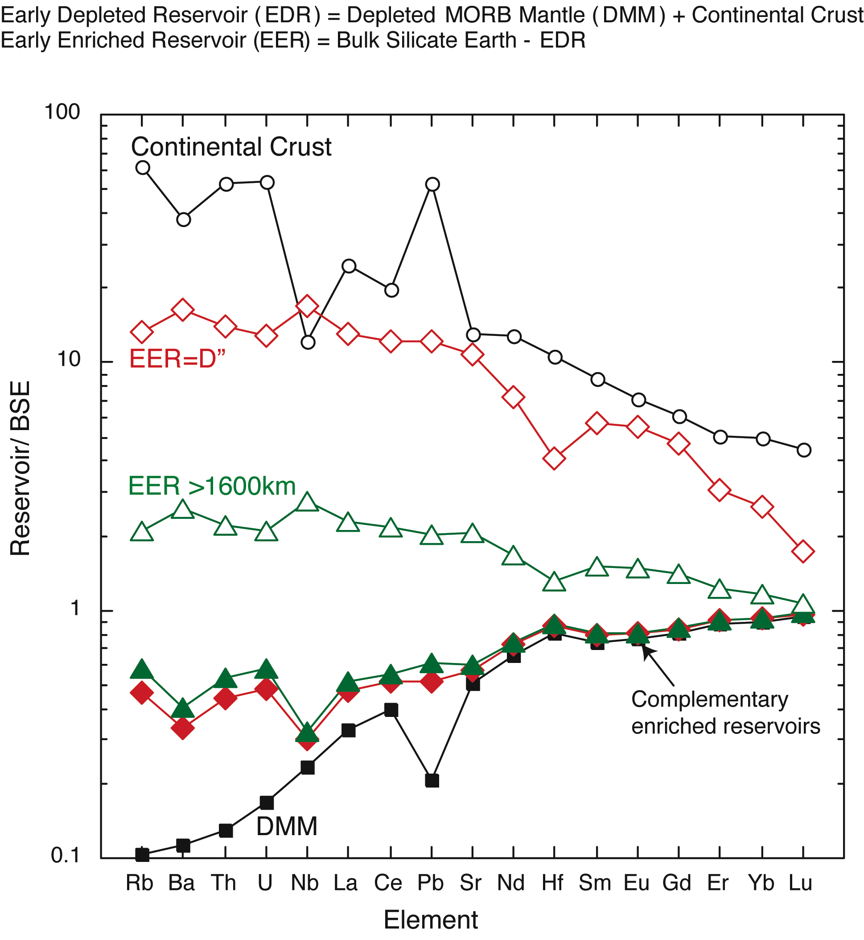
Small, Barely Detectable, Concentration Variations in some Obscure Rare Elements. So What?
Reservoir Mass(10²⁵g) Th(ppb)U(ppb) K(ppm) TW
Cont. Crust 2.26 5600 1300 15000 7.3
Enriched=D” 17 920 230 2650 9.3
Enriched>1600km 111 150 40 440 10.4
Primitive (60%) 242 79 20 240 11.7
Early Depleted 290-390 43-53 11-13 ~150 9.5-10.3
MORB Mantle 161 7.9 3.2 50 1.1
Notes:
These small – percent level – differences in relative REE abundances have critical implications for the abundances of the heat producing elements U, Th and K, and hence for the geodynamic evolution of Earth’s interior. If the silicate Earth has chondritic abundances of U, Th, and K, Earth is presently generating just over 20 TW of energy from radioactive decay (7 TW from the continental crust, 1 TW from the depleted upper mantle, and 12 TW from a “primitive” lower mantle). If the Earth has the lithophile element abundances suggested by the 146Sm-142Nd results, than Earth may be presently generating only 10 TW of energy from radioactive decay.

Slide 19
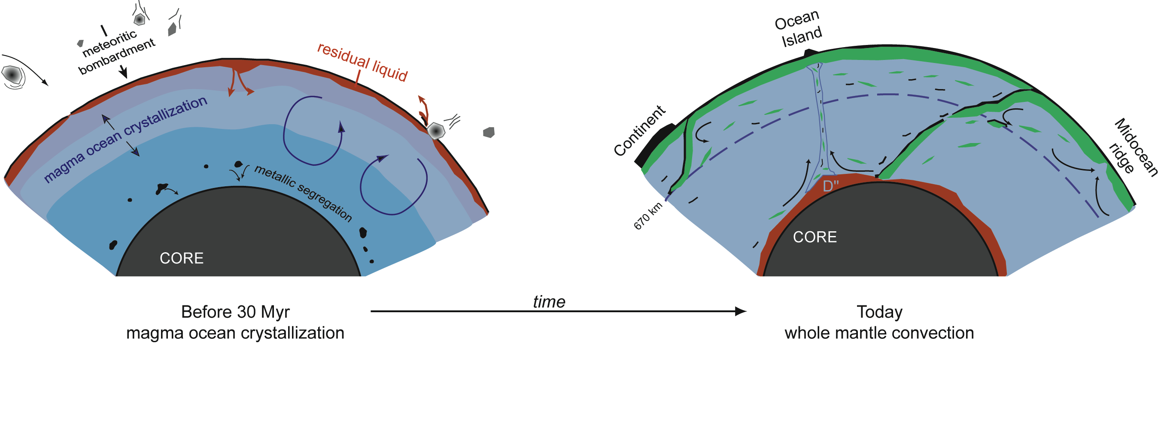
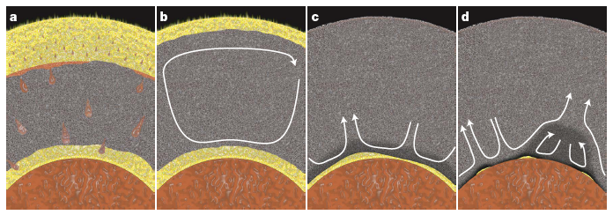
Two Ways to Create an EDR – EER Pair
Magma Ocean Overturn
Basal Magma Ocean (Labrosse et al., Nature 2007)
Notes:
If the bulk silicate Earth has chondritic relative abundances of the refractory lithophile elements, then the 142Nd imply an early differentiation event and complementary incompatible element enriched and depleted mantle reservoirs. Only the depleted reservoir has been sampled by surface igneous rocks. Two ways to do this are illustrated above, one a lunar-analog magma ocean that evolves to an iron-rich, and hence dense, silicate liquid at the top that eventually sinks to the base of the mantle and stays there. The other considers the possibility that at high pressure, silicate liquids are more dense than solids and hence would sink to the bottom of the mantle to form a basal magma ocean.

Slide 20
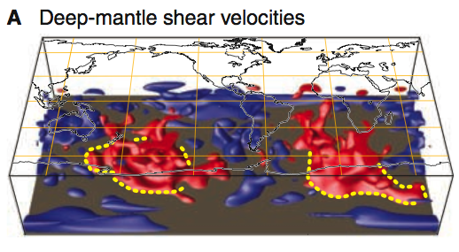
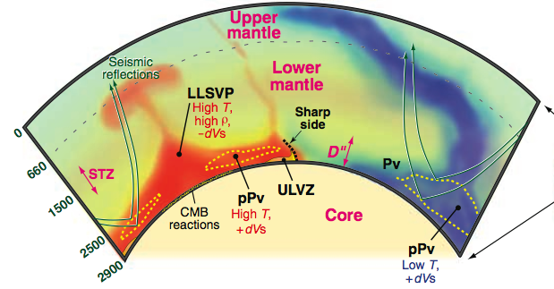
LLSVPs:
A Remnant of Early Differentiation or Modern Subduction?
Garnero and McNamara, 2008
Notes:
Is the complementary, but hidden incompatible element enriched reservoir seen in the complex structure of the lower mantle?

Slide 21
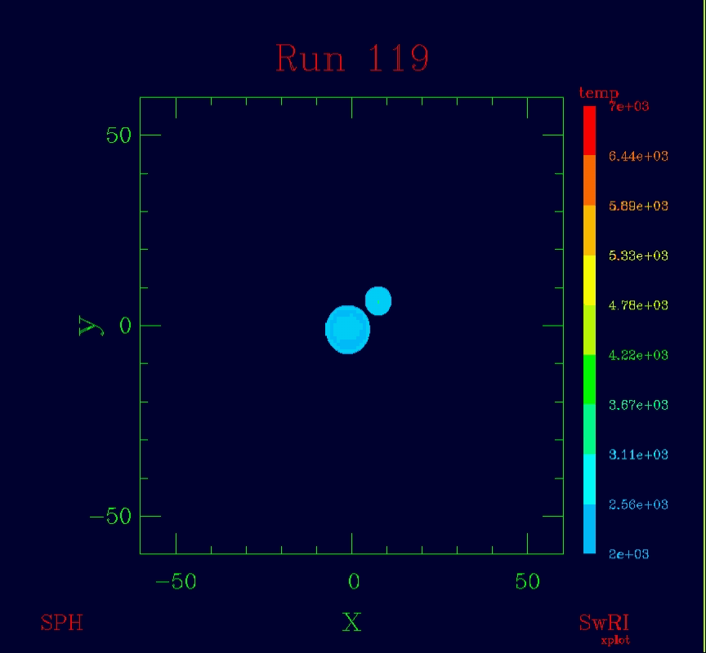
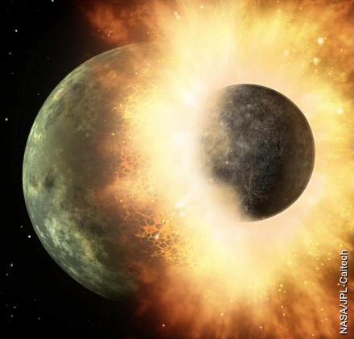
Another Place to put a Hidden Reservoir - Space!
Animation by
Robin Canup
SWRI
Notes:
If the incompatible element enriched compliment to the early incompatible element depleted mantle is not in the Earth, then how can one explain a non-chondritic abundance of refractory lithophile elements in Earth? One possibility is the collisional erosion of the incompatible element enriched crusts on planetesimals.

Slide 22
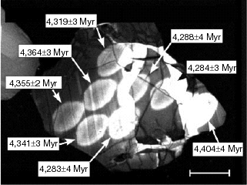
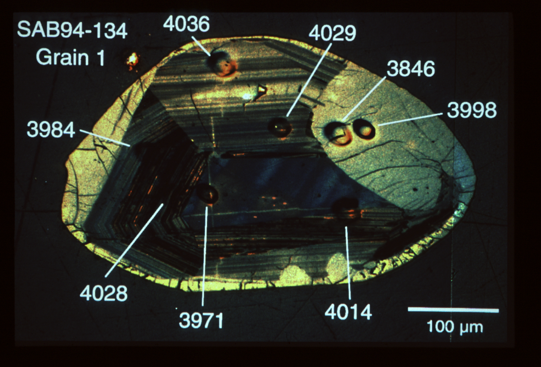
The Beginning of Crust Formation on Earth
Jack Hills, Australia
Age ~ 4.40 billion years
(Wilde et al., 2002)
Acasta Gneiss
Slave Craton, Canada
Age = 4.036 billion years
(Bowring et al., 1990)
Notes:
Crustal remnants dating back to 4.4 Ga suggest that crust formation on Earth began rapidly after the giant impact and that some small remnants of this early crust remain on Earth’s surface today.

Slide 23
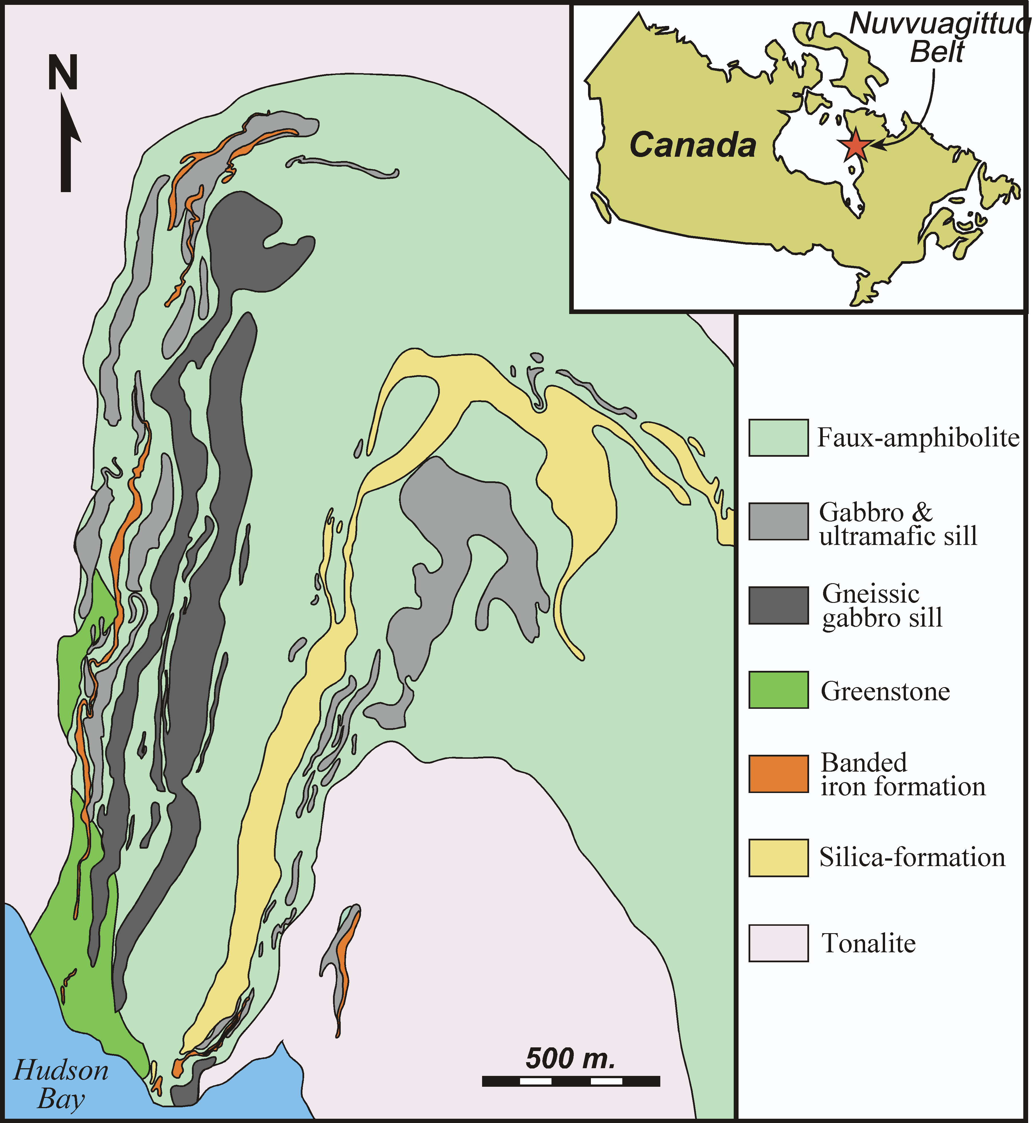
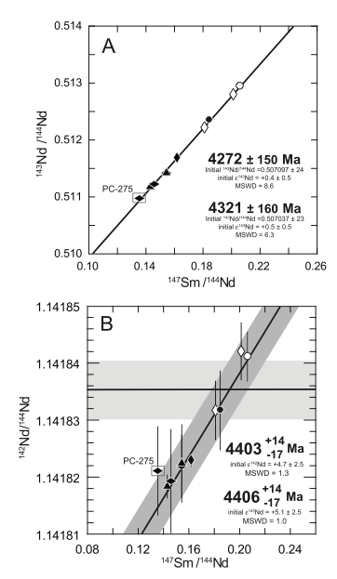
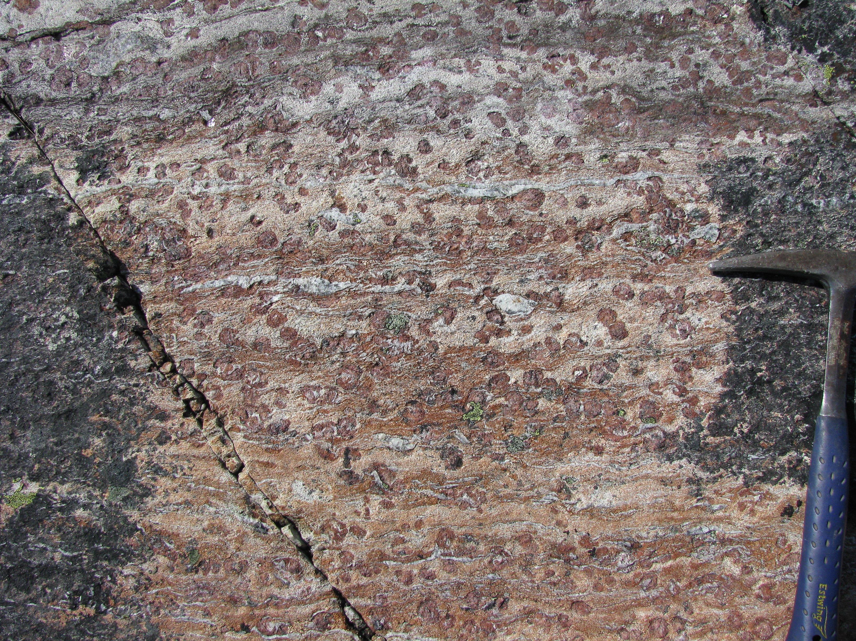
The Nature of the Early Crust?
Magma Ocean Product, Melting Above Plumes, or Formed in a Subduction Zone like Modern Crust?
O’Neil et al., PCRes, in press
Notes:
How and when did Earth’s first crust form? Was the process similar or different to today?

Slide 24
The Chemical Characteristics of Earth that were Determined Within ~200 Ma of Earth Formation
Earth formed depleted in volatile elements
Earth may have formed with an excess of iron metal
Core formation(s) occurred within ~200 Ma of Earth formation, likely much quicker
Material accreted after core formation was completed added back some highly siderophile elements to the mantle and perhaps brought in a significant fraction of Earth’s water
Evidence for a major differentiation of the silicate Earth is muted
Accessible Earth appears to be slightly depleted in highly incompatible elements compared to chondritic estimates. Is this a remnant of an early magma ocean or a non-chondritic Earth?

Slide 25
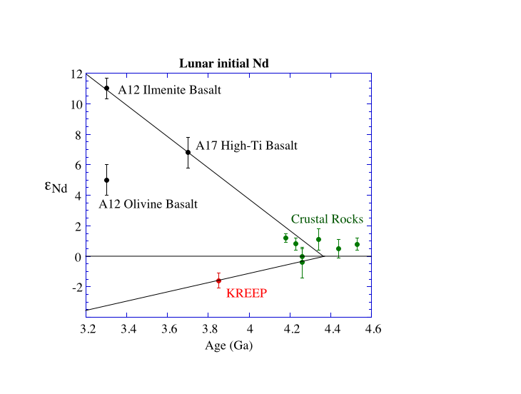
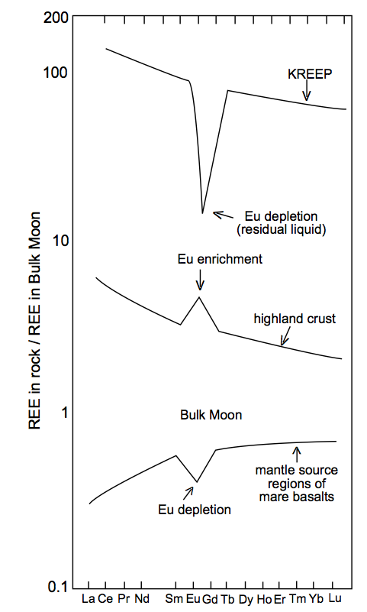
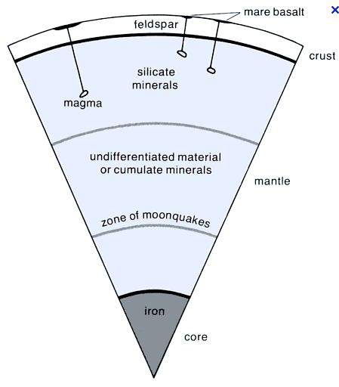
Lunar crust and mantle show a similar chemical complementarity, but one established near, or at, the time of Moon formation
Notes:
The Moon shows a similar chemical complementarity between crust and mantle as does the Earth, but on the Moon the complementarity was established by 4.4 Ga, likely as a result of an early global melting event. Similarly old global differentiation events on Mars leaves the expectation that early planetary silicate differentiation is the norm in terrestrial planet history, rather than the exception.

