Slide 1
Are KT boundary chromites terrestrial or extra-terrestrial?
Terrestrial isotopic signatures for Raton Basin KT boundary chrome spinels would also corroborate evidence for mantle or ultramafic material in KT boundary ejecta as proposed by:
DePaolo, Kyte, Marshall, O’Neil & Smit; EPSL Vol. 64, Sept. 1983. Rb-Sr, Sm-Nd, K-Ca, O, and H isotopic study of Cretaceous-Tertiary boundary sediments, Caravaca, Spain: evidence for an oceanic impact site,
Montanari, Hays, Alvarez, Asaro, Michel, Alvarez & Smit ; Geology, Nov. 1983. Spheroids at the Cretaceous-Tertiary boundary are altered impact droplets of basaltic composition,
Bohor, B., W. Betterton, and E. Foord, Meteoritics, 25 1990. Shocked zircon and chromite in K/T boundary claystones.
Hildebrand & Boynton, LPSC, 18 1987. The K/T Impact excavated Oceanic Mantle: Evidence from REE Abundances.
Hildebrand, Meteoritics, 23 1988. Impact Wave Deposits at the Cretaceous/Tertiary Boundary Imply an Oceanic Impact Site Near North America.
Hildebrand & Boynton, Science Vol 248, May 1990. Proximal Cretaceous-Tertiary Boundary Impact Deposits in the Caribbean.
KT boundary layer, Madrid roadcut near Trinidad, CO.

Slide 2
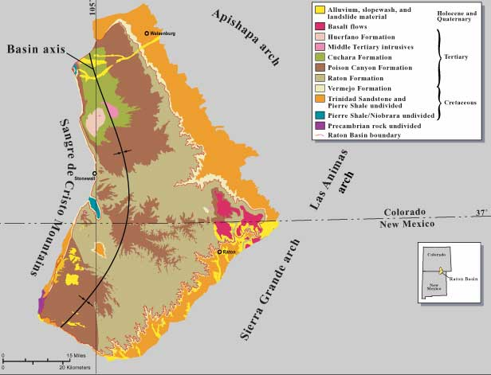
Raton Basin, Colorado ( Wikipedia geologic map)
Notes:
KT boundary claystones were collected from various sites in the vicinity of Trinidad, Colorado (blue oval).

Slide 3
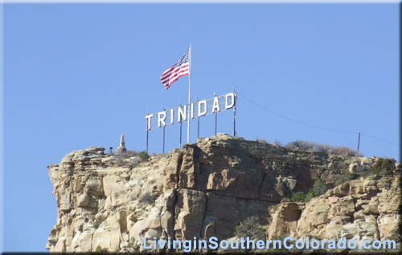

Slide 4
Bruce Bohor collecting Raton Basin KT boundary ejecta at an outcrop in
June 2010. Location: Clear Creek North roadcut on Hwy 25.

Slide 5
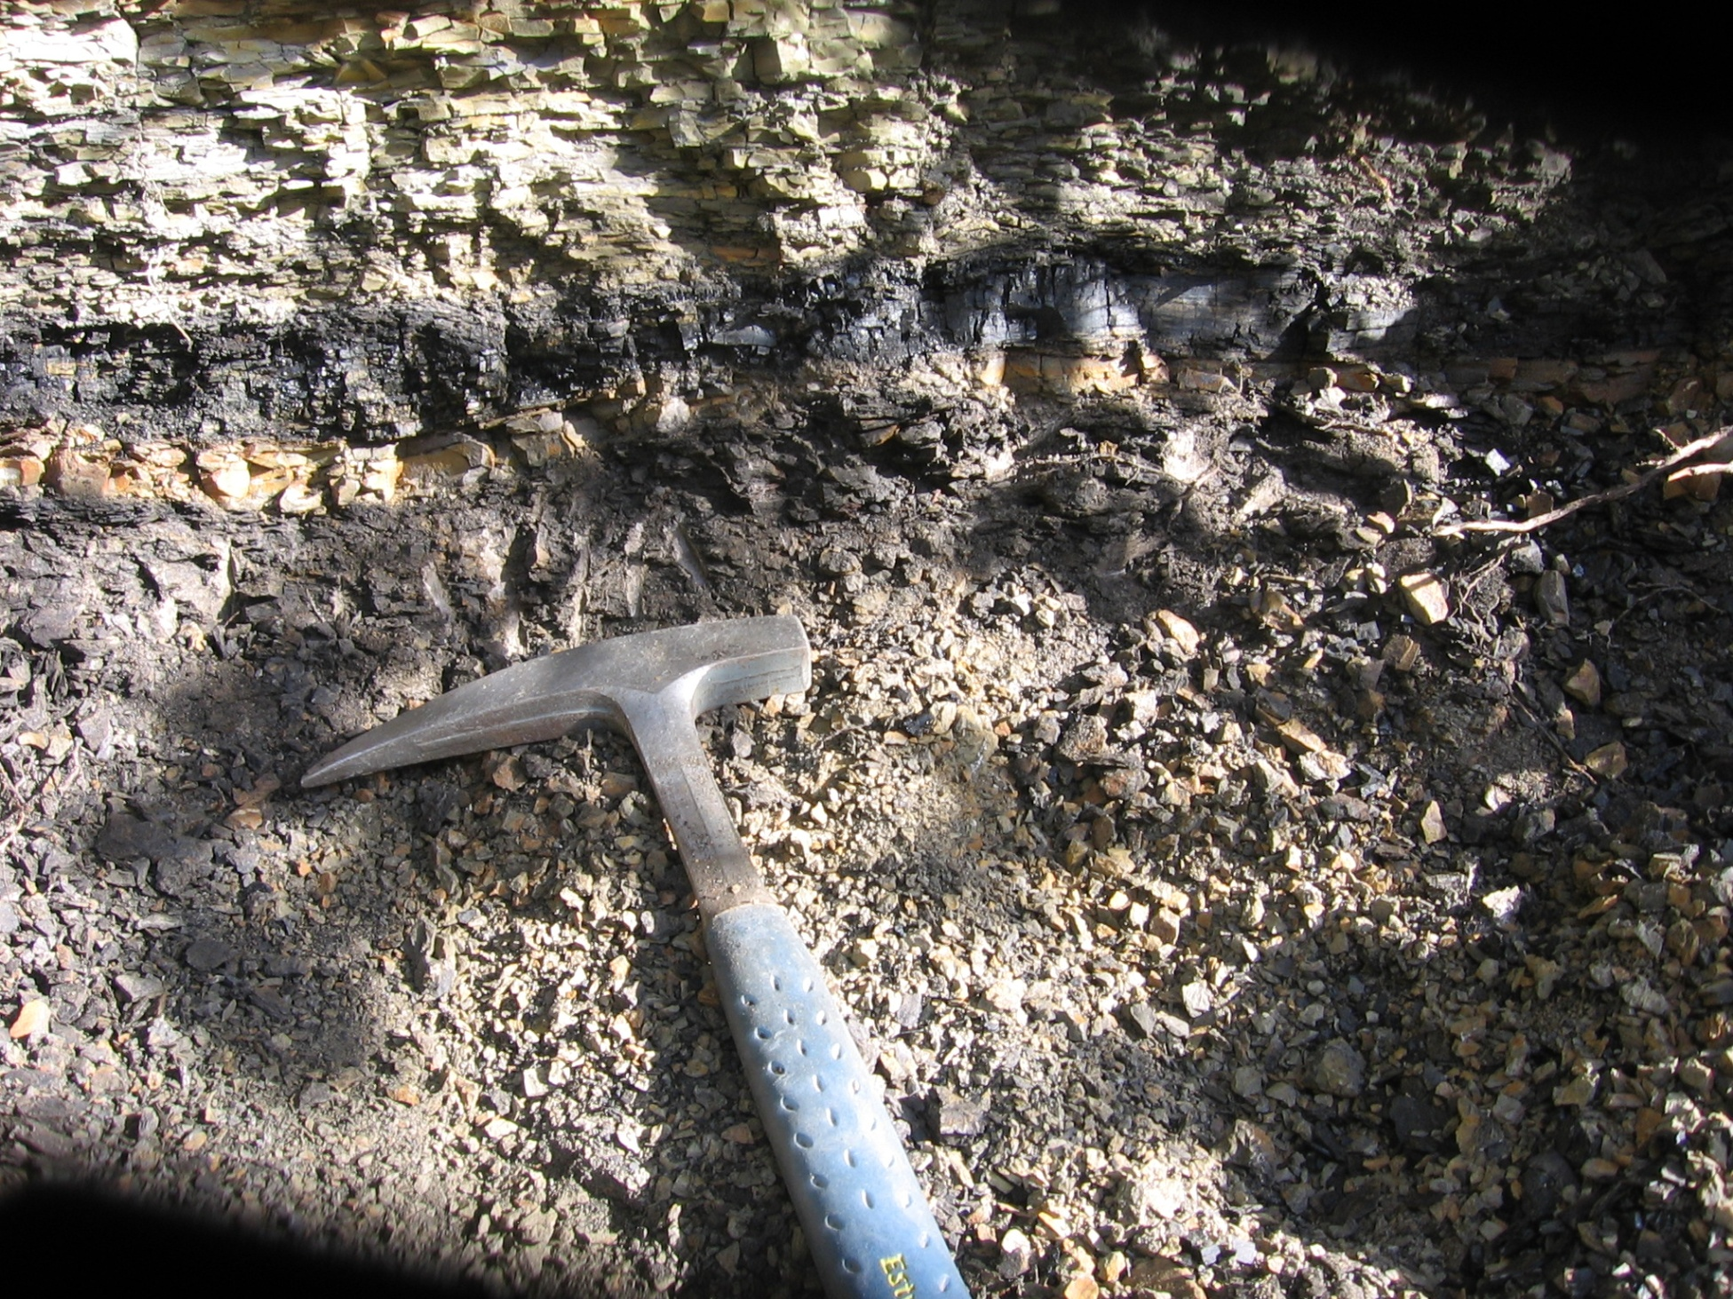
Raton Basin KT boundary claystone “melt ejecta” layer visible below a coal seam.
Notes:
Kaolinitic melt ejecta layer ~ 1cm thick below a smectitic fireball layer ~ 1mm thick.

Slide 6
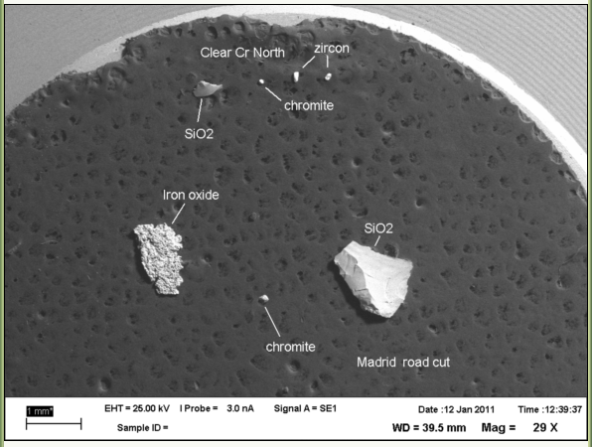
Acid resistant mineral grains from Raton Basin KT boundary claystones mounted on
SEM stub.

Slide 7
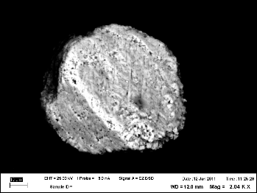
Chromite from Raton Basin KT boundary claystones, Clear Creek North outcrop
showing possible shock induced planar deformation features (pdf). Thanks Tim Teague!
Notes:
Chromite grains are imaged with SEM and positively identified with EDAX. Shock planar deformation features are visible in this grain. Scale bar is 10 microns.

Slide 8
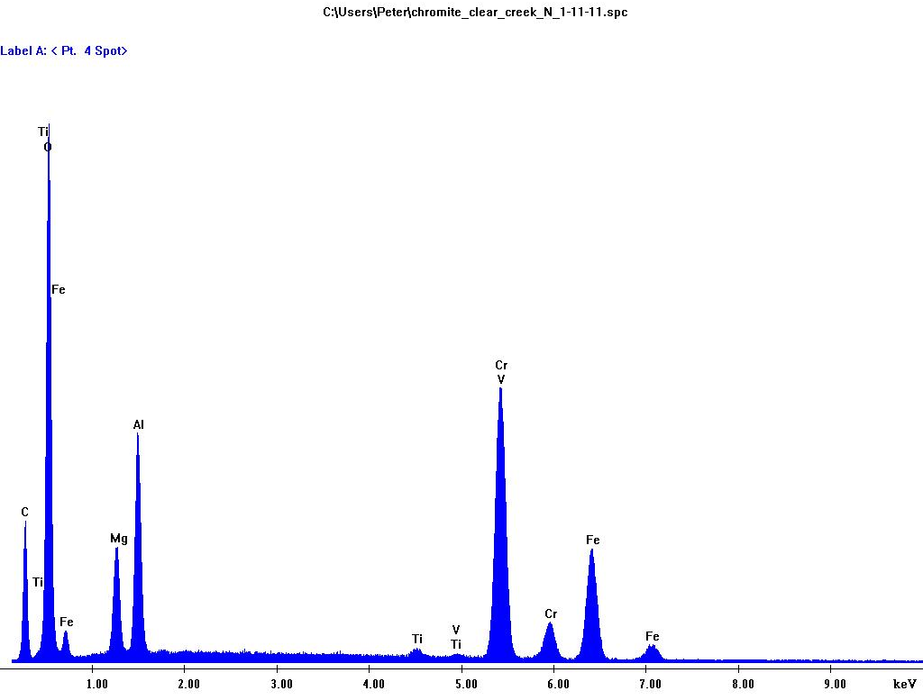
EDAX analysis of Clear Creek North KT boundary shocked chromite.

Slide 9
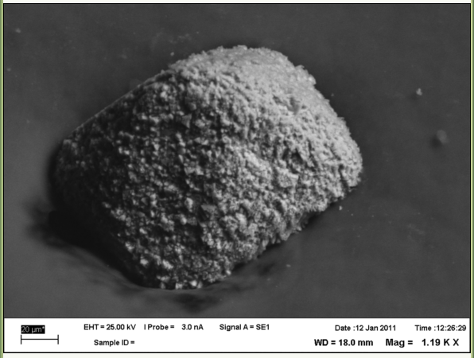
Chromite from Raton Basin KT boundary claystones, Madrid outcrop.
140 microns wide, 160 microns corner to corner diagonal. Probably acid etched
crystal faces.
Notes:
Large octahedral chromite grain showing acid etching from separation procedure. Scale bar is 20 microns.

Slide 10
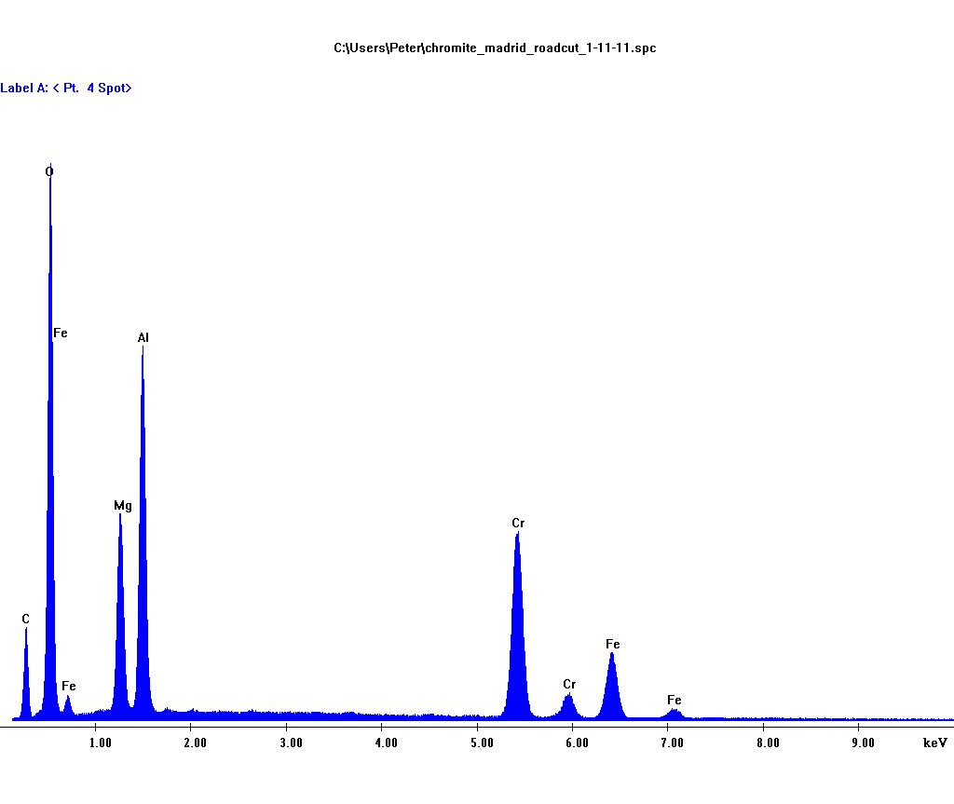
EDAX analysis of Madrid road cut chromite. (more Mg and Al rich than Clear
Creek North chromite).

Slide 11
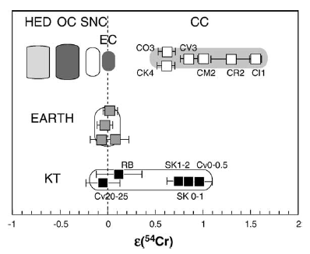
Figure 2 from Trinquier et al. 2006 The nature of the KT impactor. A 54Cr reappraisal Earth and Planetary Science Letters 241 (2006) 780–788
Whole rock 54Cr/52Cr
isotope analysis on
Raton Basin KT
boundary claystones
is within uncertainty
of terrestrial.
Fig. 2. 54Cr/ 52Cr values for KT rocks compared to common classes of meteorites and terrestrial rocks. HED represent the eucrites, and diogenites. The mesosiderite and main group pallasite silicates plot at the same position as the HED group. OC are ordinary chondrites (H, L, LL) from various petrological types (4 to 6). CC are carbonaceous chondrites from distinct metamorphism grade (1 to 4), some samples of which are quoted in Table 2. All values are given after exponential correction [20] as relative deviations in 104 from the laboratory standards (e-unit). Cr data are normalized to NBS 52Cr/ 50Cr=19.28323 [54]. All uncertainties are 2r. Data after [18].
Notes:
Terrestrial chromium can be clearly distinguished from various meteorite classes using the 54Cr/52Cr ratio with a part in 10⁵ (i.e. 1/10 epsilon) precision. Enstatite chondrites have the same isotopic composition as Earth but do not contain chromites. The KT impactor is currently thought to be a CM type carbonaceous chondrite in part based on Ann Trinquier’s work shown here.

Slide 12
Exercise in simple logic: The Raton Basin KT boundary chromites are either terrestrial or extra-terrestrial.
Chromite is a minor mantle mineral, typically present in depleted oceanic harzburgites at the 2-3% level.
If Colorado KT boundary chromites turn out to be terrestrial it is strongly implied that the Chicxulub crater is not the only large KT boundary crater. Chicxulub crater is on continental crust away from any plate boundaries, and based on scaling considerations, the impact was not large (energetic) enough to have excavated mantle material from beneath the MOHO at ~35 km depth on the Yucatan platform. (See Melosh, 2001.)
If the chromites turn out to be extra-terrestrial, we will learn something about the KT impactor. Various meteorite types have unique chromium isotopic compositions different than the earth's mantle, which is essentially homogeneous with respect to Cr isotope composition. (Trinquier et. al. 2006, Qin et al. 2010.)
We are currently carrying out TIMS Cr isotope analysis in Justin Simon’s lab at Johnson Space Center, Houston.
Notes:
Kevin Burke’s proposed hypothesis that Chicxulub crater might intersect a rotated segment of the Suwanee-Wiggins suture seems very unlikely since:
No ophiolitic or ultramafic material has been found on or in exploration wells drilled on the Yucatan Peninsula.
Sea-floor spreading in the Gulf of Mexico was not sufficient to achieve 90 degrees of rotation needed to place a N-S suture segment matching the linear magnetic anomaly feature on the Yucatan Peninsula.
There is no missing segment of the Suwanee Wiggins suture in the southern US.
KT boundary zircons sampling Chicxulub basement are all Pan-African in age.

Slide 13
What is the point?
If the Colorado KT boundary chrome spinels are terrestrial, then either
An additional piece of bolide hit on or near a plate boundary where ultramafics were already exposed at or near the surface; or
An additional much larger (than Chicxulub) fragment penetrated to and excavated mantle material from beneath the crust; or
Possibly both of the above.
If the lithosphere was breached then there may be implications for the origin and evolution of the Caribbean North-American plate boundary.

Slide 14
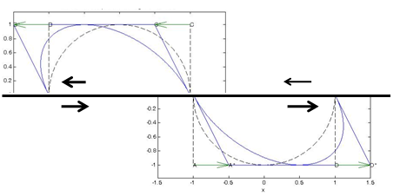
Combined effect of both homogeneously distributed and discontinuous left-lateral shear on a circle.
S shape of Greater Antilles ultramafic belt can be modeled as a combination of continuous and discontinuous left lateral simple shear on a hypothetical ~600 km diameter circular impact crater.
Notes:
Craters are circular. Large craters are naturally occurring strain gauges and can be used to infer lithospheric deformation over plate tectonic timescales. An original 600 km diameter impact crater on (or resulting in?) the North-American Caribbean plate boundary resulted in a strain ellipse recording integrated plate boundary deformation since the impact and includes components of both continuous and dis-continous of left-lateral simple shear. Present day left-lateral simple shear rate on the North-American Caribbean plate boundary is ~2 cm per year. Left-lateral shear has been going on for ~50 ma (Rosencrantz et. al. 1988, Leroy et. al. 2000).

Slide 15
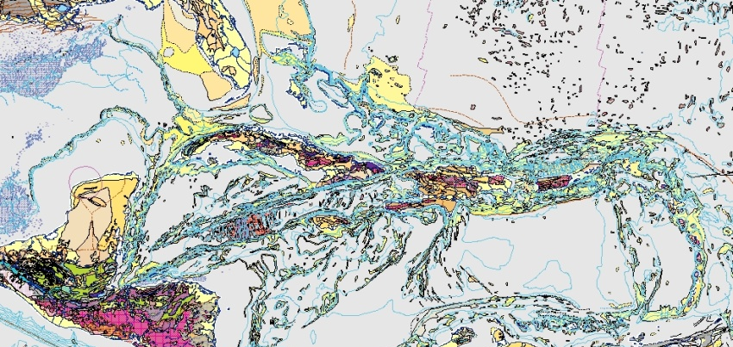
To first order, the Greater Antilles island chain and ultramafic belt appear to define a left-lateral shear strain ellipse. So is this the remnant of a lithosphere penetrating impact crater after 45-50 ma of left lateral shear across the North American – Caribbean plate boundary?
North American Plate
Cayman Trough
Caribbean Plate
Notes:
Simplified diagram of the North American – Caribbean plate boundary and hypothesized Greater Antilles left-lateral shear strain ellipse.

Slide 16
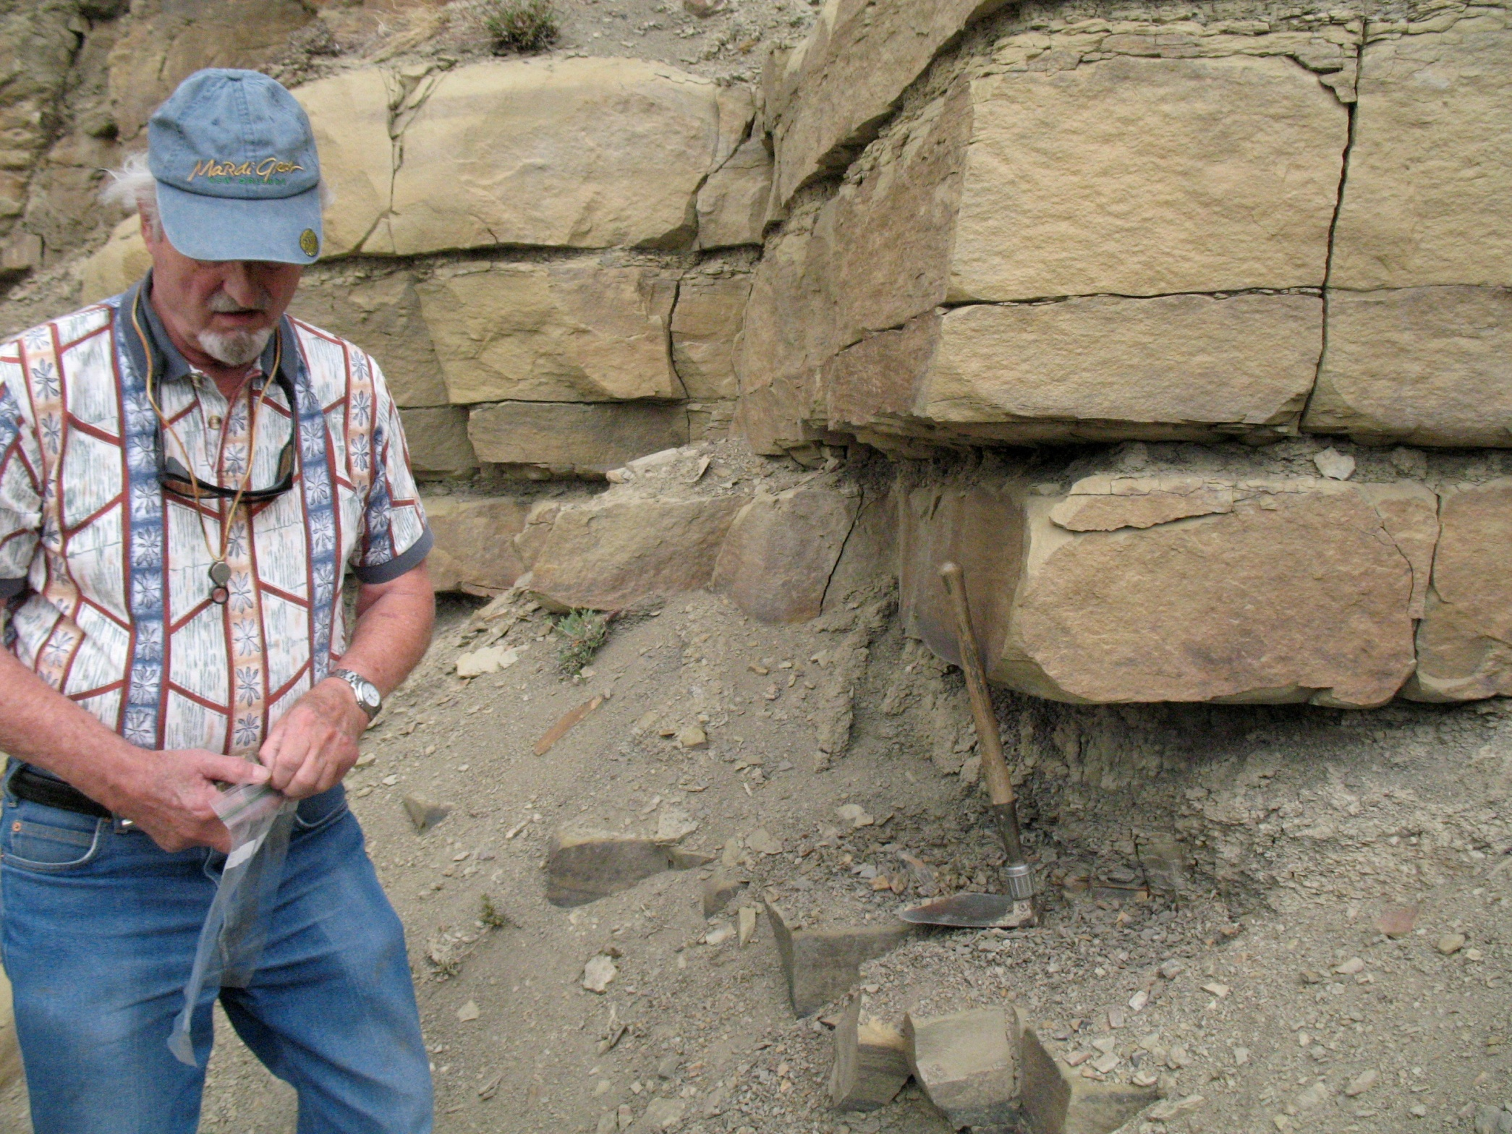
Notes:
Bruce Bohor collecting KT boundary claystones. Clear Creek North outcrop.

Slide 17
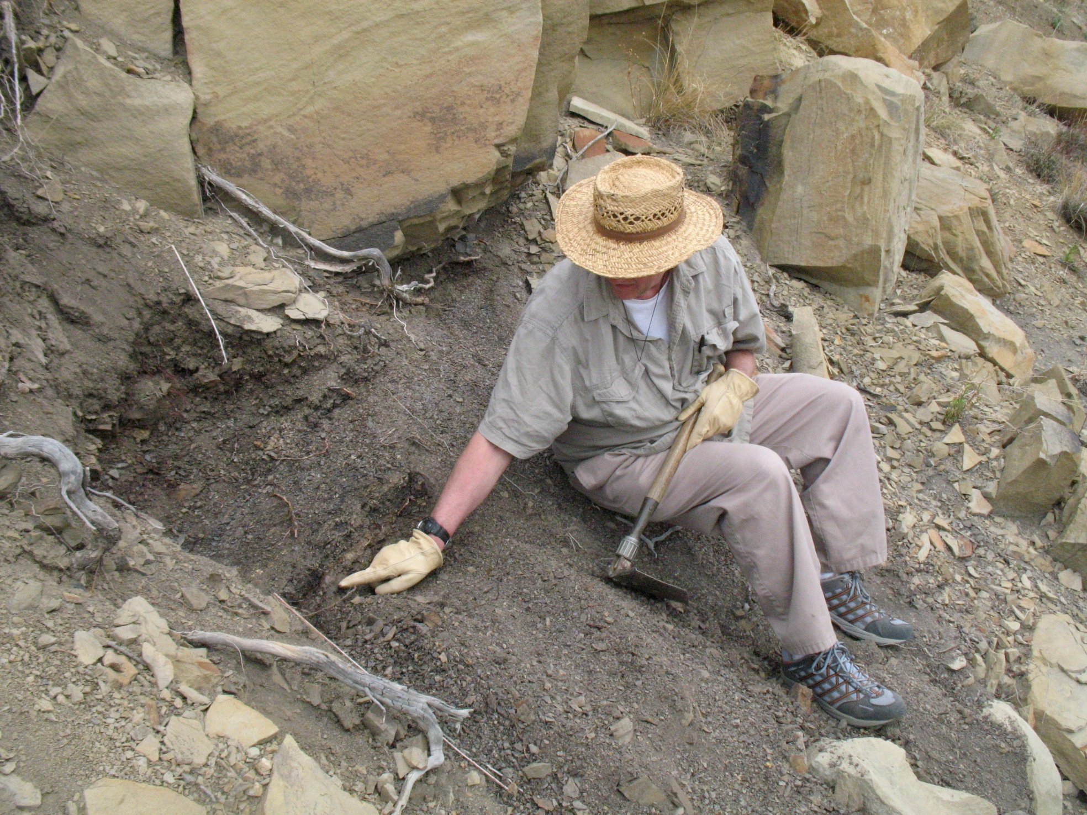
Notes:
Weathered KT boundary claystone layer. Clear Creek North outcrop near Trinidad, CO.

Slide 18
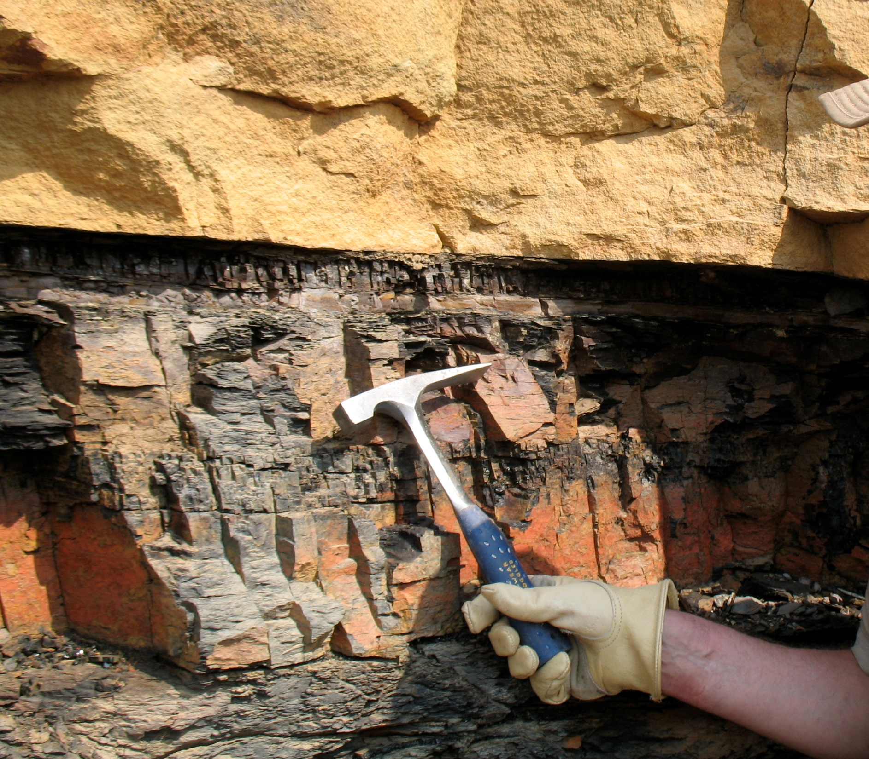
Notes:
KT boundary claystone layer. Madrid roadcut near Trinidad, CO.

Slide 19
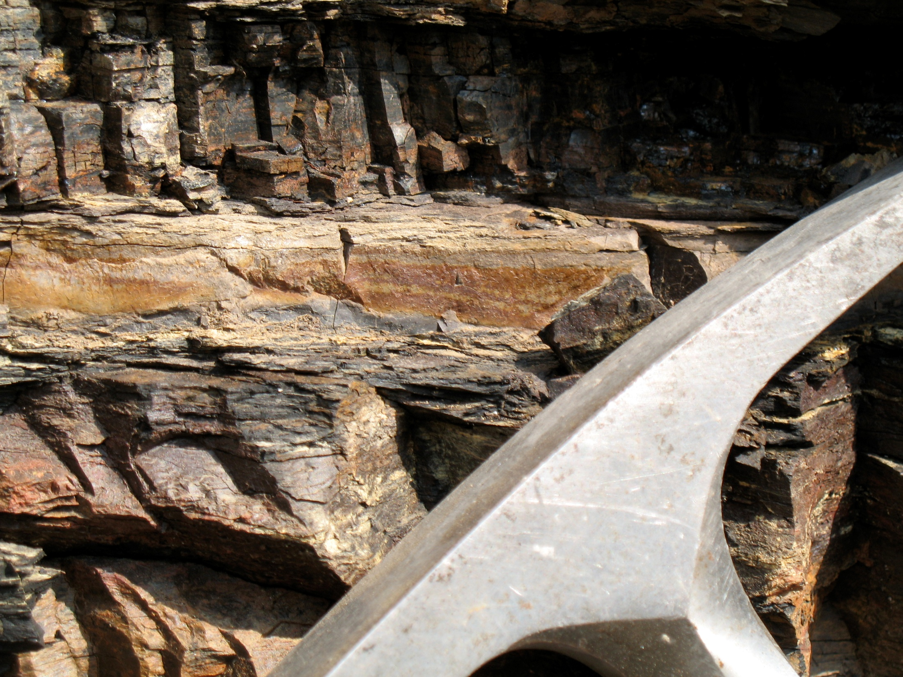
Notes:
KT boundary layer, Madrid roadcut near Trinidad, CO.

Slide 20
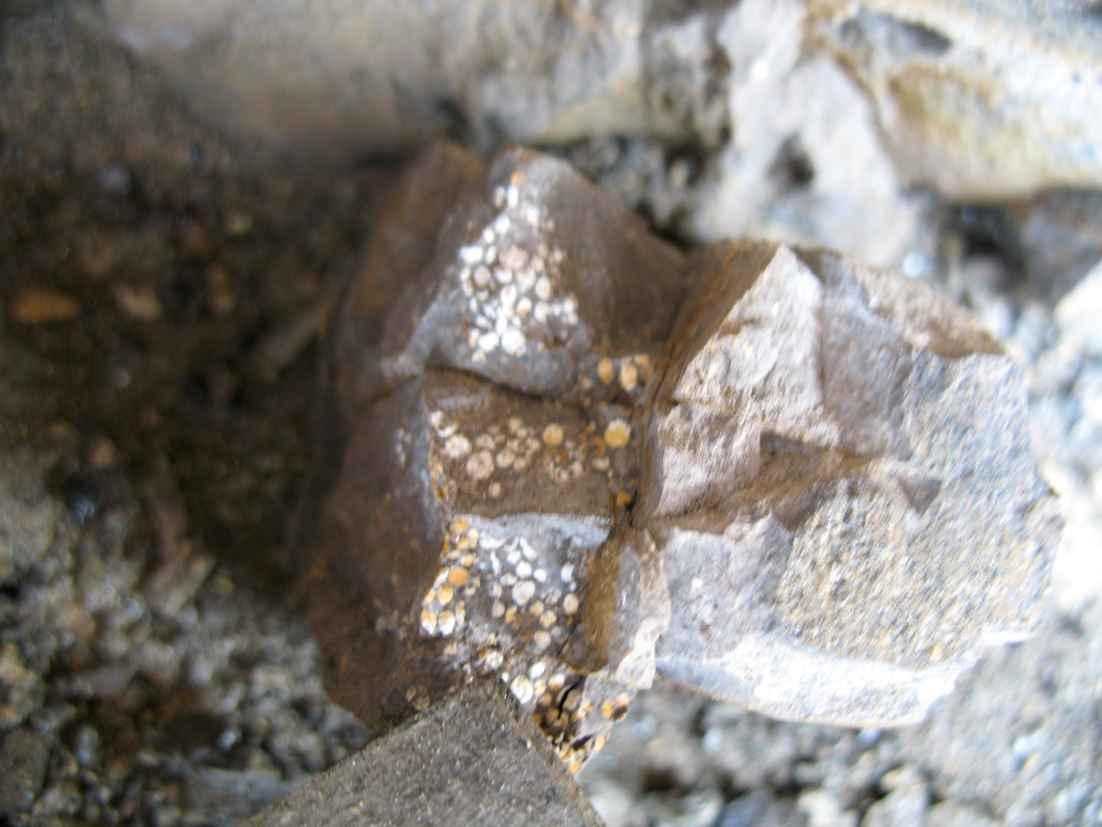
Notes:
Impact spherules in KT boundary claystone melt ejecta layer. Madrid roadcut locality.

Slide 21
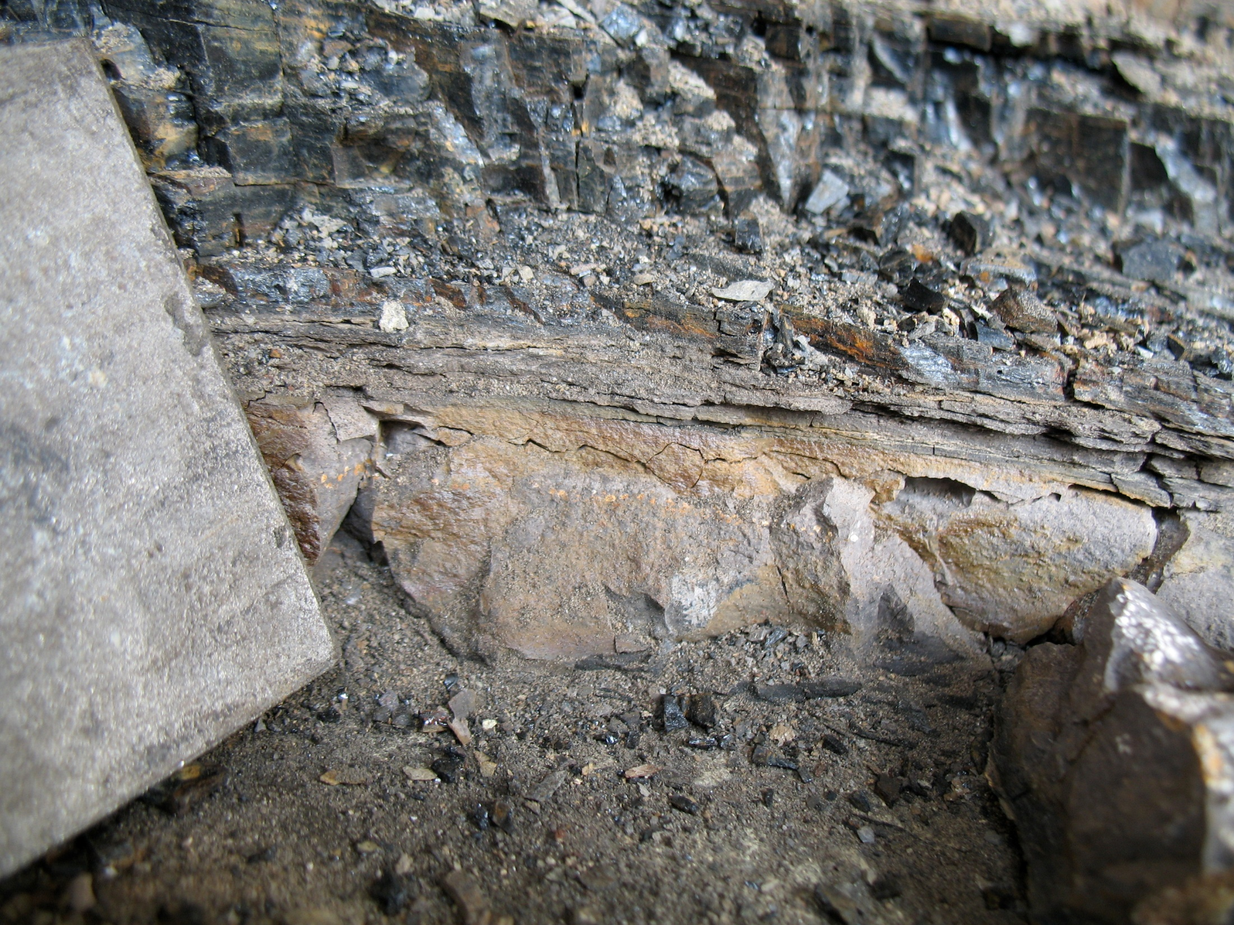
Notes:
KT boundary claystone melt ejecta layer with spherules. Madrid roadcut locality.

Slide 22
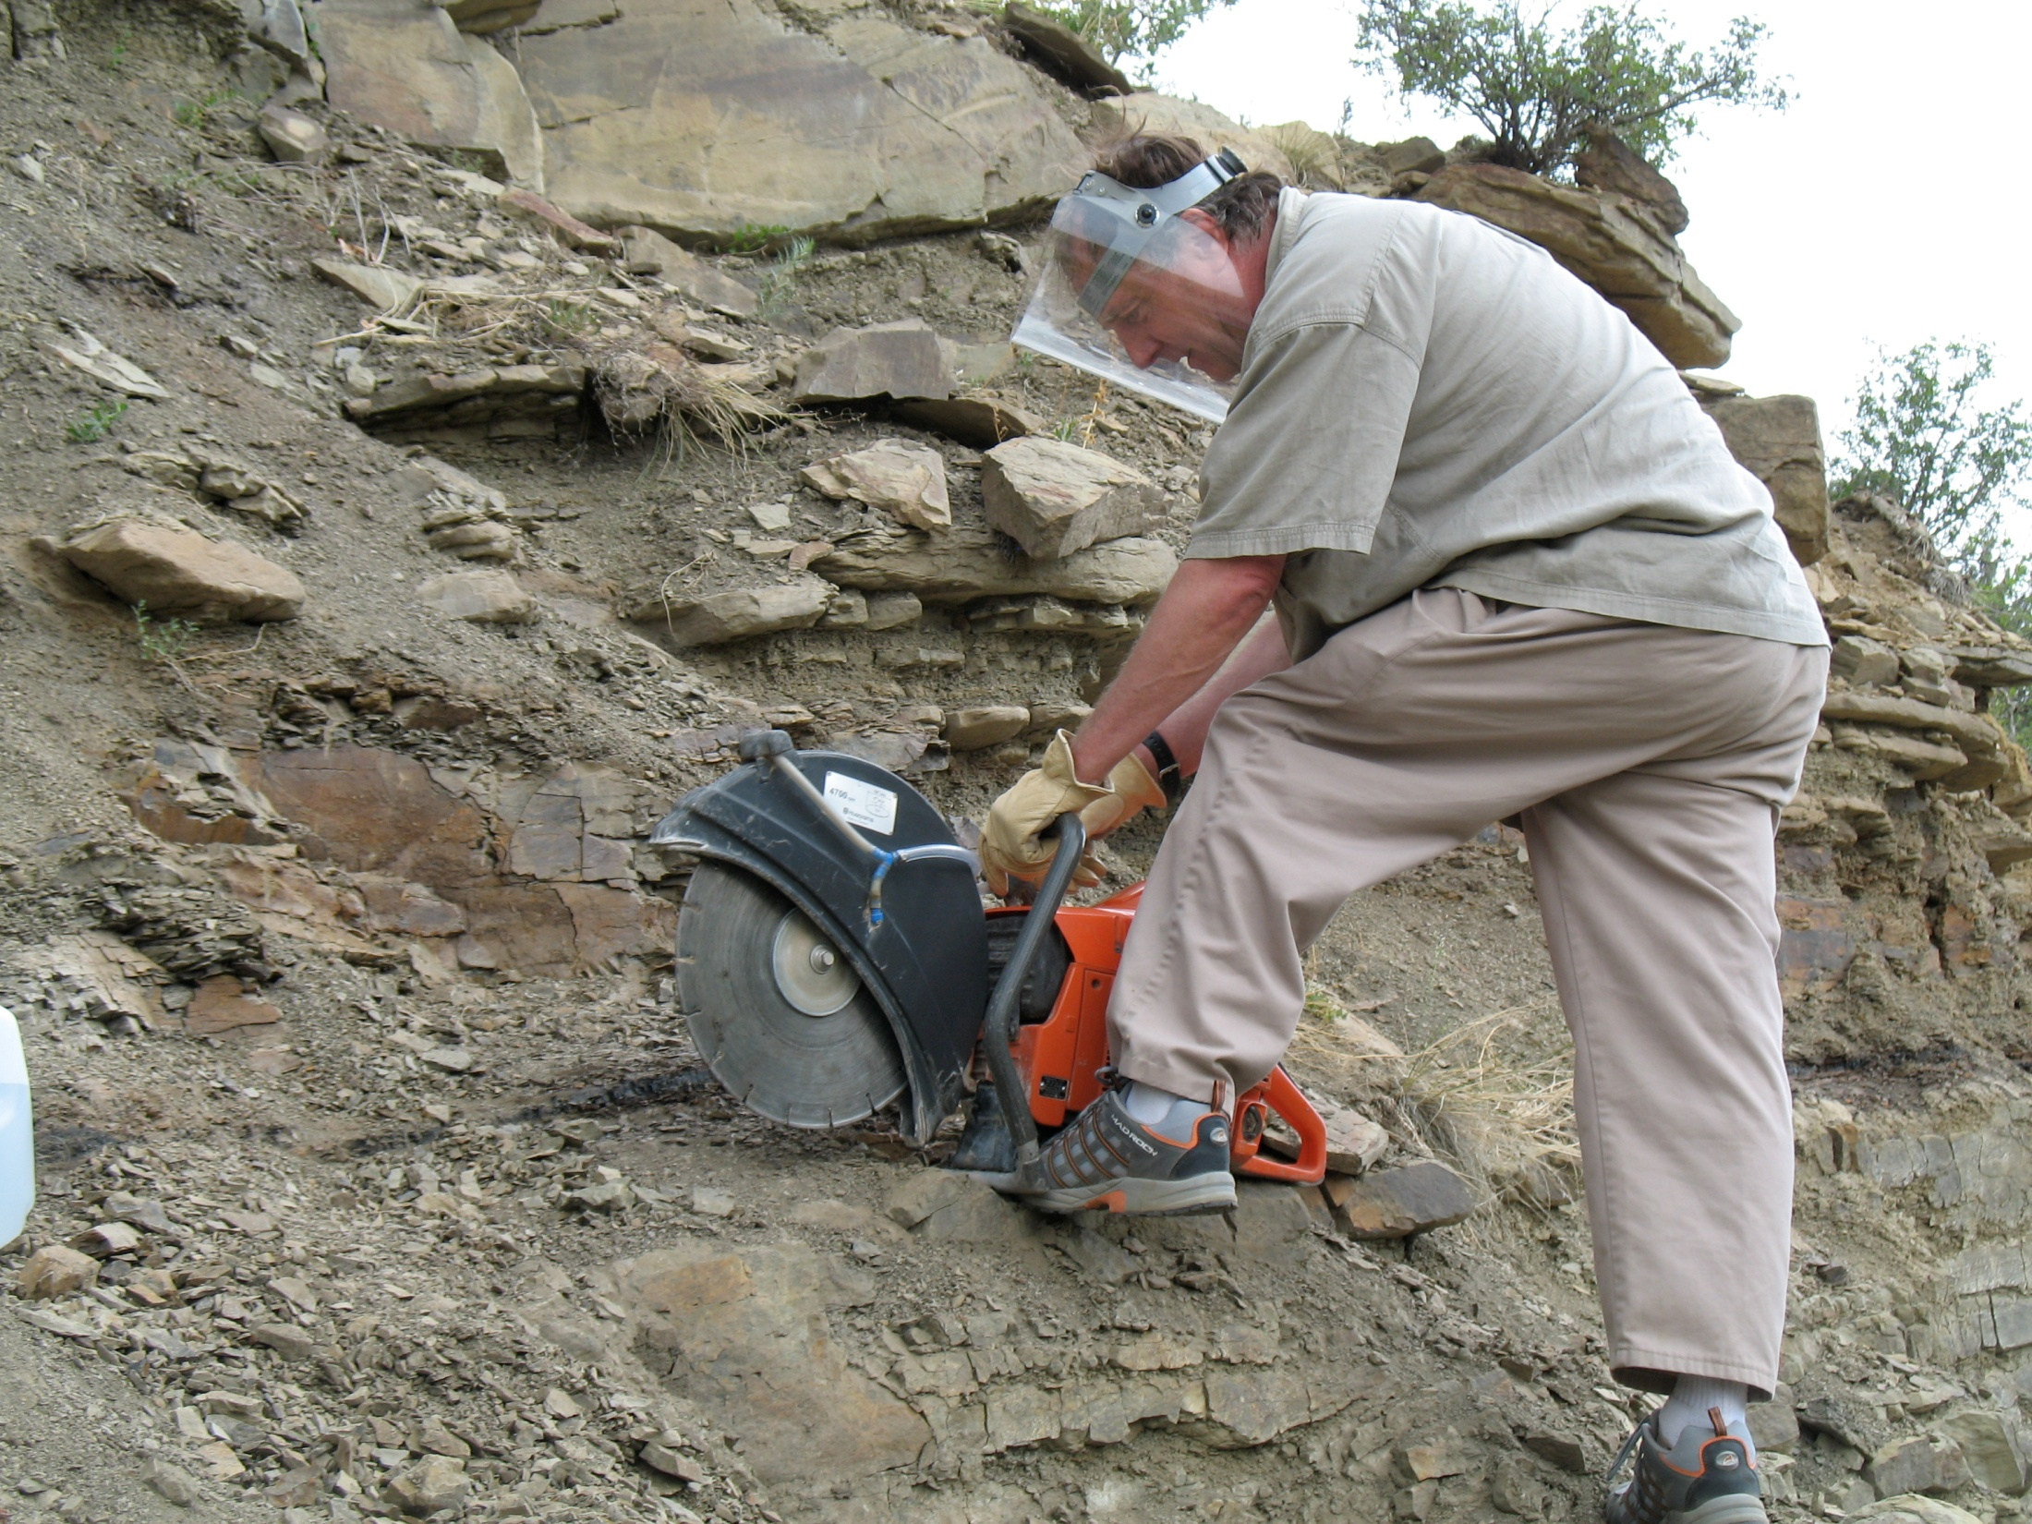
Notes:
Obtaining KT boundary section for X-ray tomography. Berwind Canyon outcrop.

Slide 23
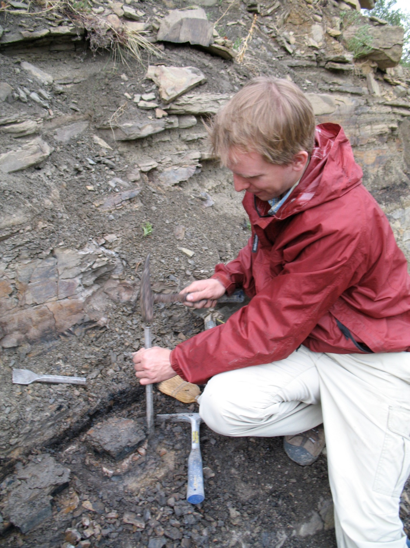
Notes:
Max Rudolph preparing KT boundary sample for plaster casting for subsequent X-ray tomography at the Advanced Light Source at LBL. Berwind Canyon outcrop.

