Slide 1
CIDER 2016 Summer Program “Flow in the deep Earth” Overview of questions and challenges
Matt Jackson
UC Santa Barbara

Slide 2
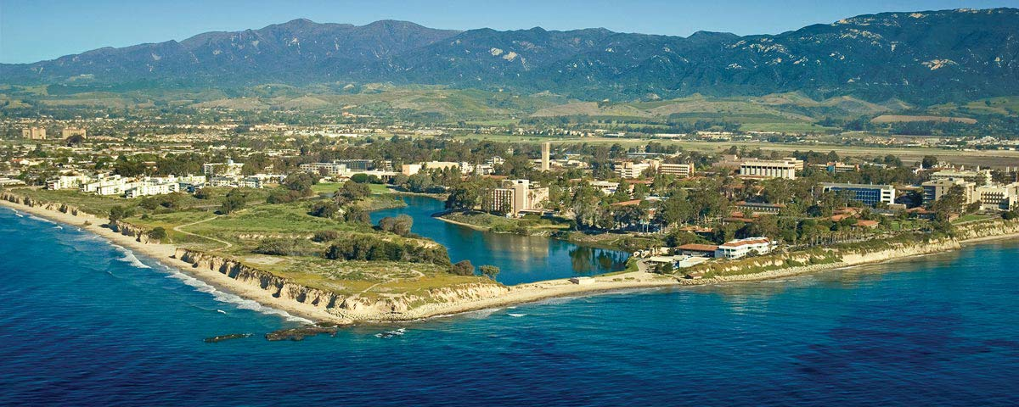
First, welcome to paradise….
A great place to ponder the Earth’s deep interior

Slide 3
Building community
Use the next two weeks to identify important issues.
Discuss, question, engage.
Weeks 3 and 4 are reserved for something unique to CIDER.
Students…. 10 years ago…
Quiz…

Slide 4
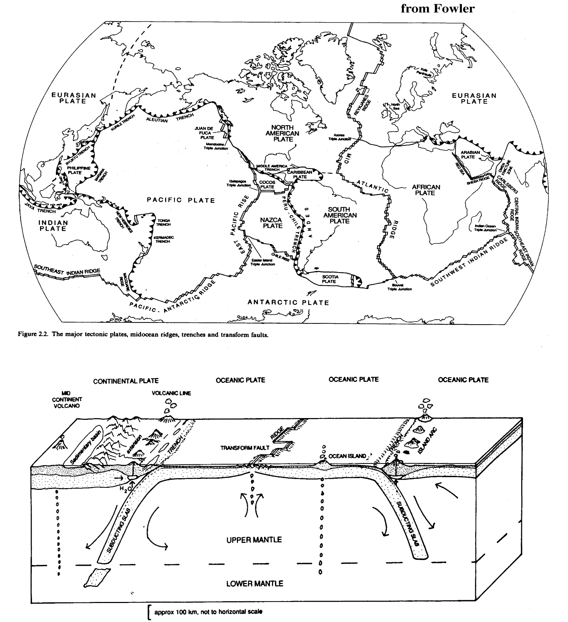
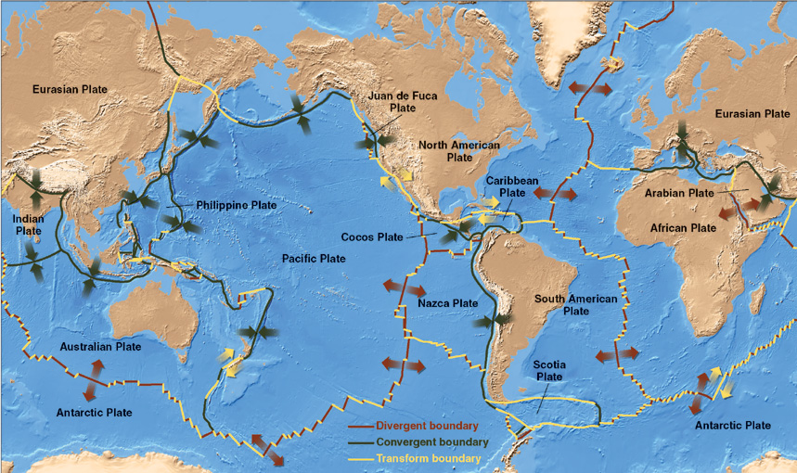
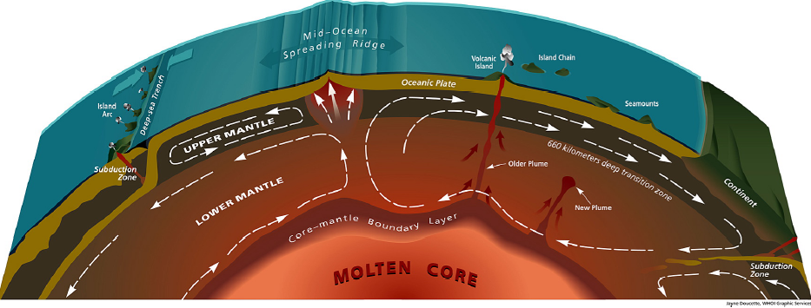
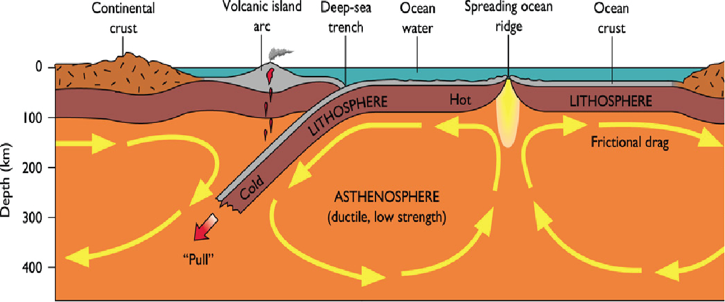
A Dynamic Earth
Notes:
Intro. “First, a little backgroung”. The earth is divided into a number of rigid plates that are moving around at about the rate your fingernails grow.

Slide 5
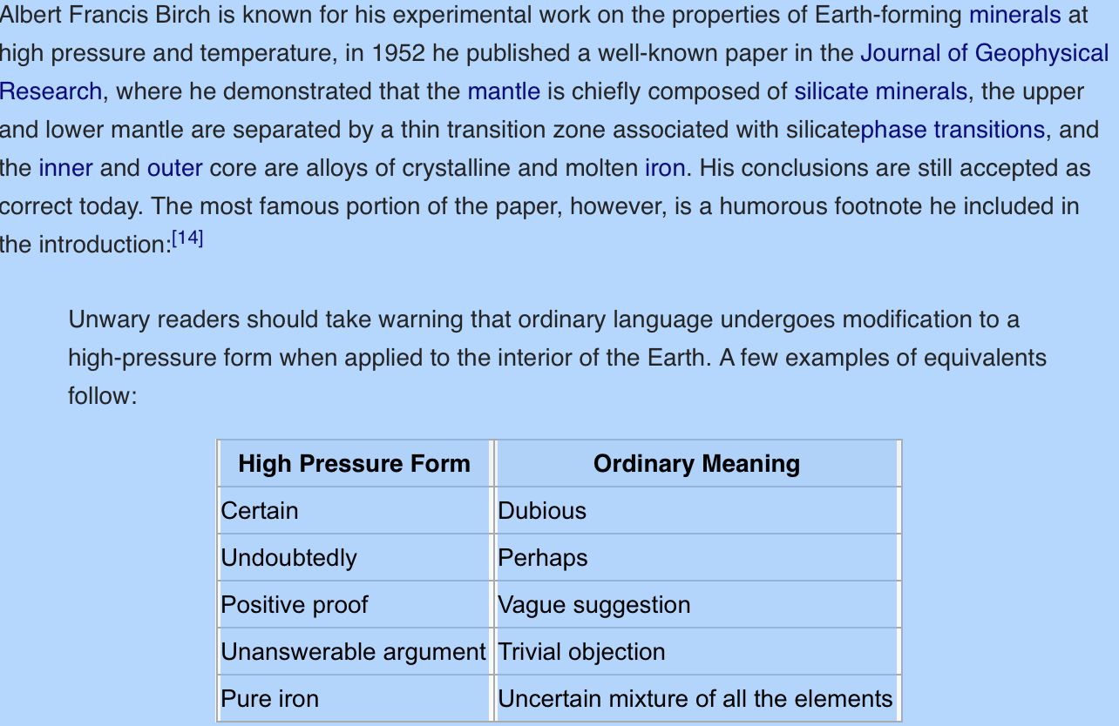
Francis Birch’s translation

Slide 6
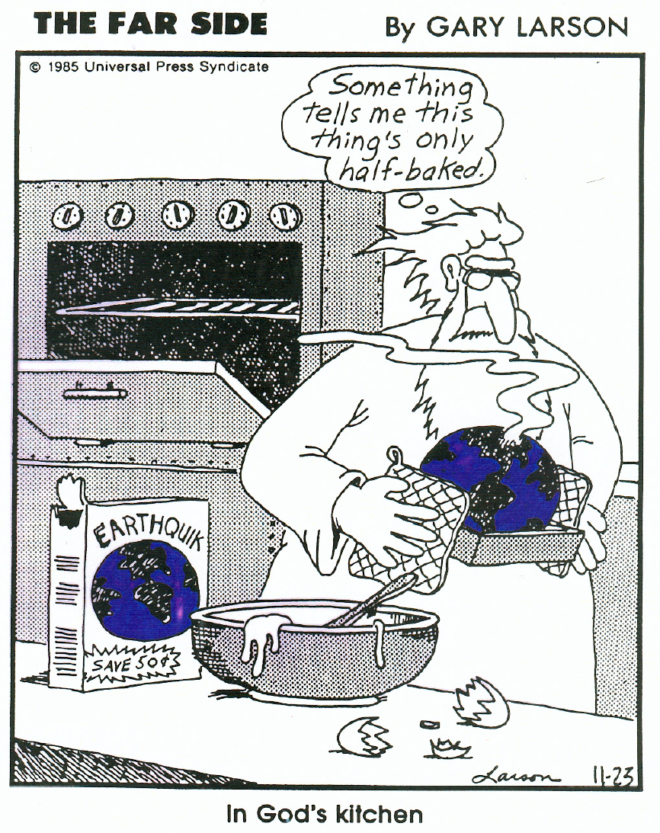
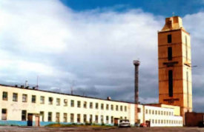
A virtually inaccessible interior
On the outside, looking in.
A challenging inverse problem with constraints from:
-Seismology
-Geochemistry
-Mineral Physics/Petrology
-Geodynamics
The Soviet “Kola” drill hole (1970-1992), 12.3km
Soviet “Kola” drill hole, 12.3 km (1970-1992)

Slide 7
A previous approach…..
Outstanding issues
the composition of the lower mantle (major elements)
proportion of ferro-periclase (0% to 20%)
role played by H phase in lower mantle?
Mass transfer between upper and lower mantle
Need for uncertainty analyses in our science
Advances in PREM and its uncertainties
Full uncertainty treatments in mineral physics
Are the geochemical/cosmochemical models
comprehensive
radiogenic power in the Earth
radioactive elements in the Earth’s core
¹⁴²Nd signature of the Earth – what are the
building blocks?
timing of inner core crystallization
measuring the Earth’s geoneutrino flux ☺
age and formation of the Moon
post-core formation, before oldest lunar rocks
during a super-rotational stage of the early Earth?
compositional difference with the Earth
the light element in the core (H, C, O, Si, S, …)
f_{O2} dependence
volatility depletion trend for the Earth
integrated T & P of metal-silicate equilibrium
density deficit - wt% element – Temperature at
CMB-&-ICB
age of core formation
Hf-W isotopes
U-Pb isotopes
Moon forming event
age and introduction of the “late veneer”
HSE abundances, absolute and relative
W isotopic composition
Nature of the added component
Secular evolution of the mantle
Crystallization of a magma ocean
Extraction of the continental crust
Implications for mantle Urey number
Inventory and distribution of elements
role of the top & bottom conductive layers
in the mantle
Slabs penetrating the 660 km discontinuity
Nature of LLSVP, ULVZ

Slide 8
The deep Earth: What do we really know?
Earth’s bulk composition:
--Radiogenic heat production: via U, Th, K
--Viscosity: water content, melt, etc.
--Distribution of compositional heterogeneities: geochemistry and seismology tell us that the Earth’s interior is highly heterogeneous. What length scales?
Variation in key parameters with depth:
--Compositional: upper versus lower mantle composition
--Thermal: CMB gradient, lower mantle temperature profile
--Rheological: viscosity of lower mantle?
--Melts at the top and bottom of the mantle?
Age and Evolution of mantle domains:
--Some mantle domains have fingerprints of the early Hadean. Where are these domains preserved? How?
Description of mantle (core) convection.

Slide 9
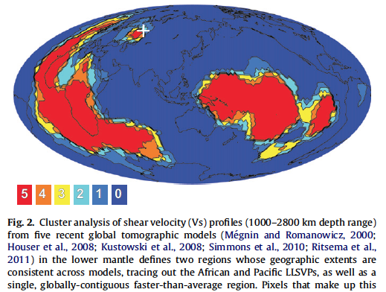
Peering into the Earth. Most salient feature of the deep mantle: Large Low Shear Wave Velocity Provinces (LLSVP’s)
Lekic et al., 2012
Seismic tomography reveals two large, low velocity regions in the lowermost mantle, centered on the Pacific and Africa
LLSVPs for 32 years, since Dziewonski (1984, JGR)

Slide 10
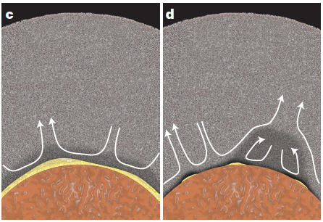
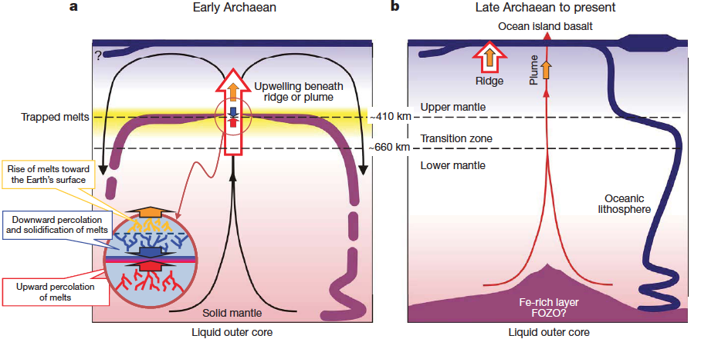
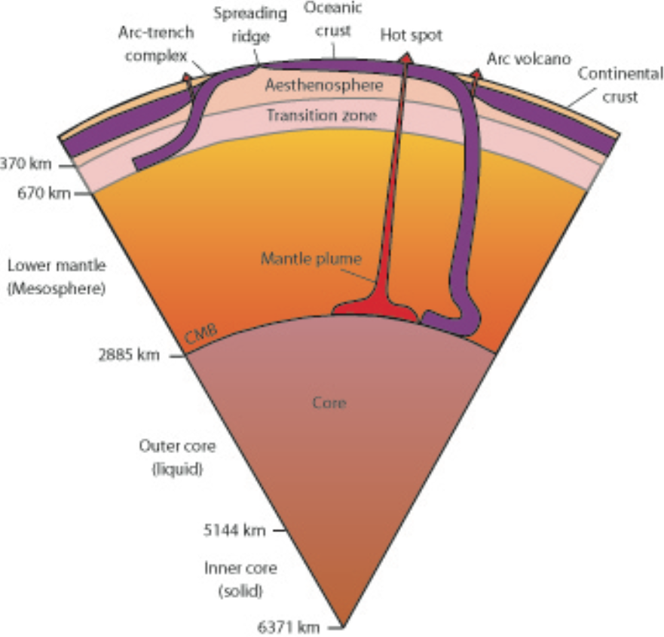
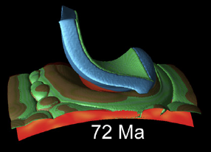
LLSVP’s: “Primitive reservoirs” or “slab graveyards”?
Primitive Reservoirs?
Labrosse et al., 2007
Lee et al., 2010
Slab Graveyards?
Tackley

Slide 11
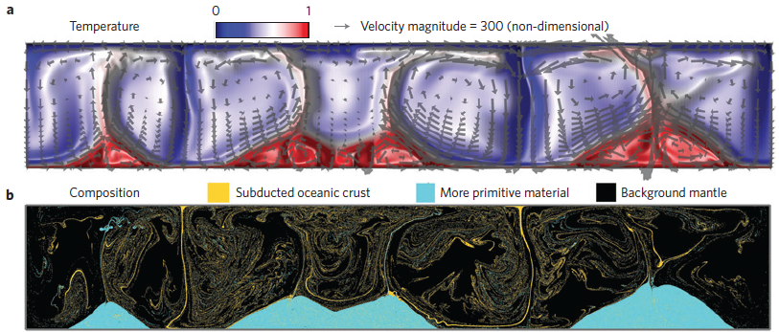
Or both primitive and recycled?

Slide 12
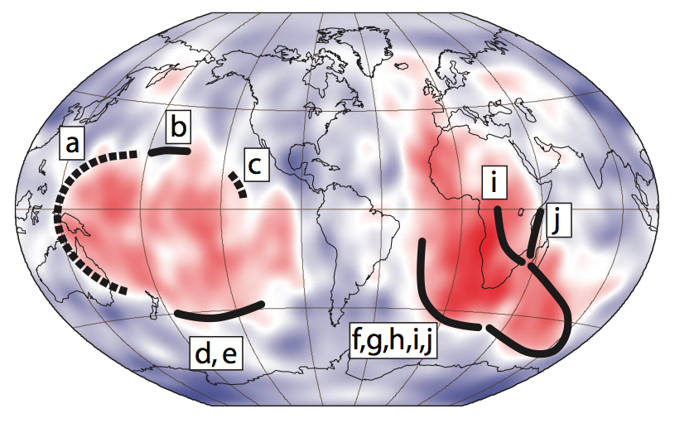
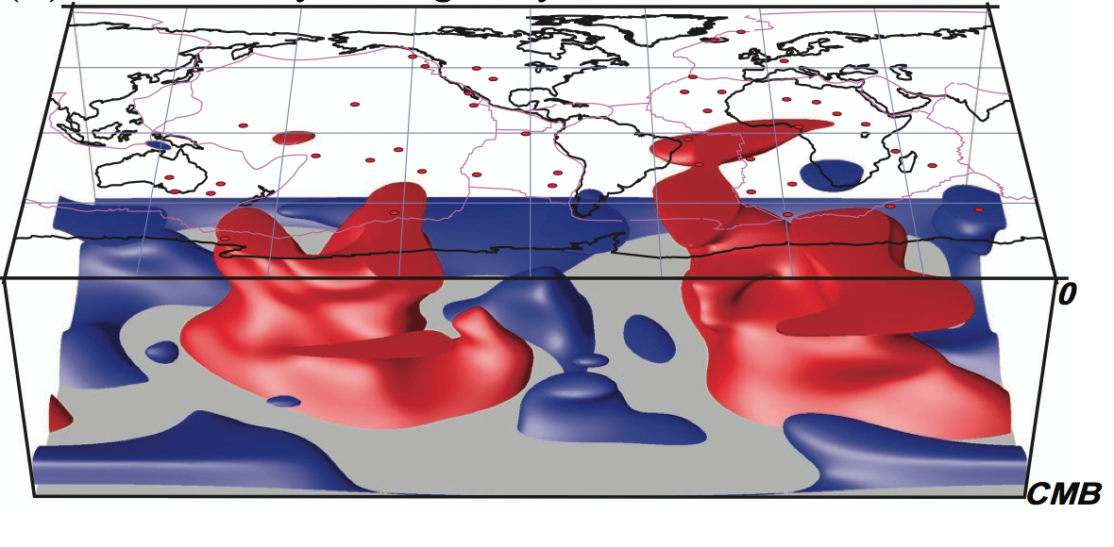
LLSVPs: the continuing saga.
More questions than answers:
Are they hotter? Or chemically anomalous? Or both?
Are they stationary? Or mobile?
Are they primordial? Or are they slab graveyards?
Are they growing?
Do they host pockets of melt (ULVZs)?
Garnero et al. (2007)

Slide 13
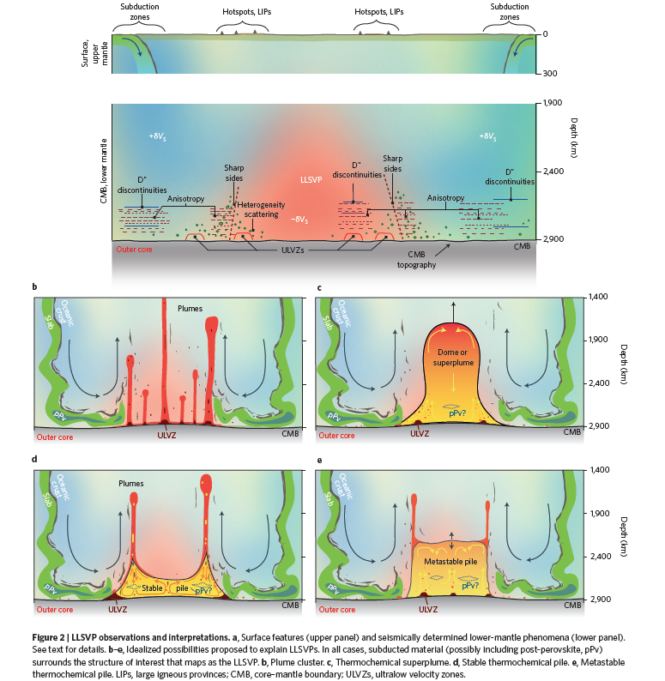
Garnero et al. (2016, Nat. Geosci.)

Slide 14
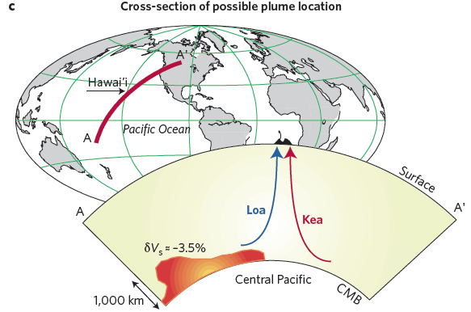
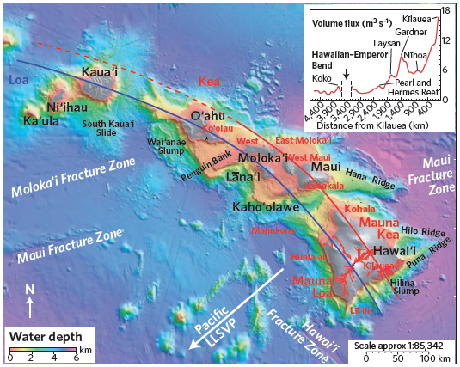
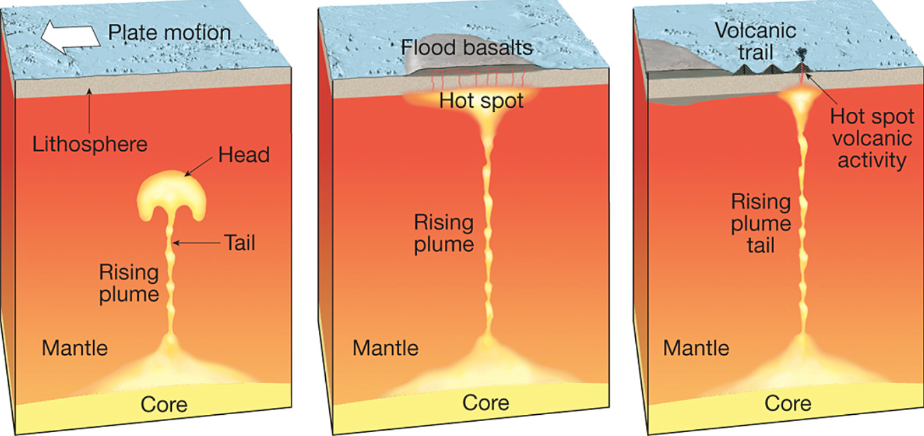
Do LLSVPs cause bilateral geochemical asymmetry in mantle plumes?
Kerr and Mériaux (G-cubed, 2004)
Weis et al., 2013
Hawaii

Slide 15
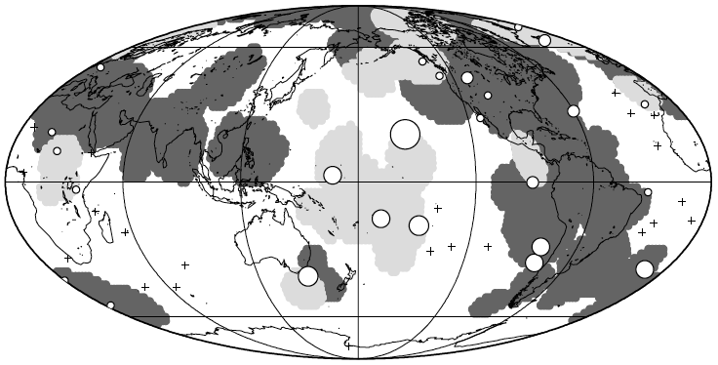
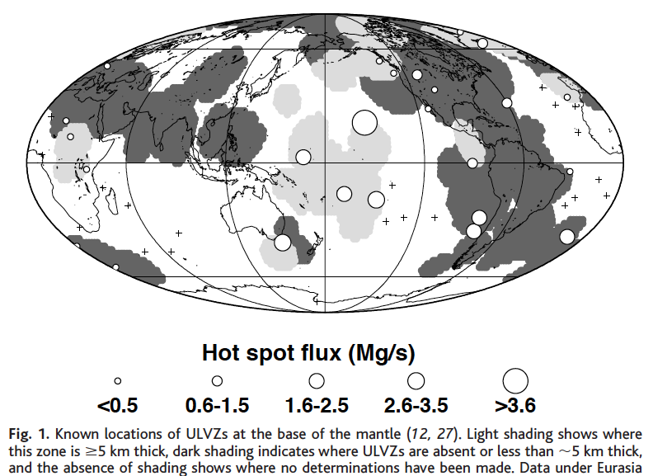
Volcanic hotspots tend to overlie LLSVPs? Can we use plume-fed hotspots to probe compositions of LLSVPs?

Slide 16
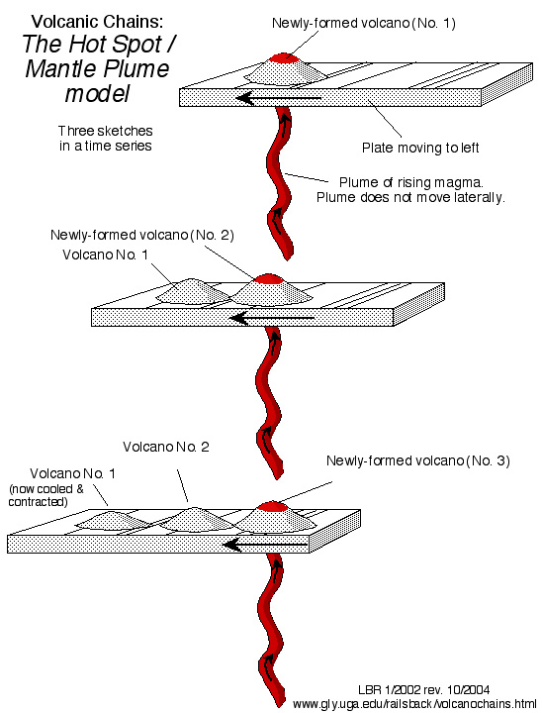
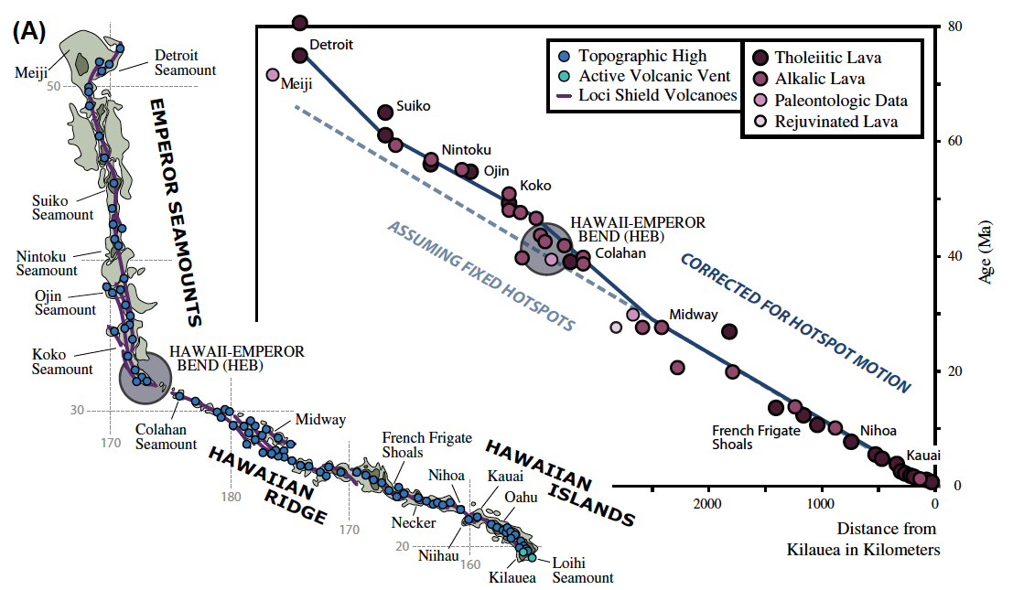
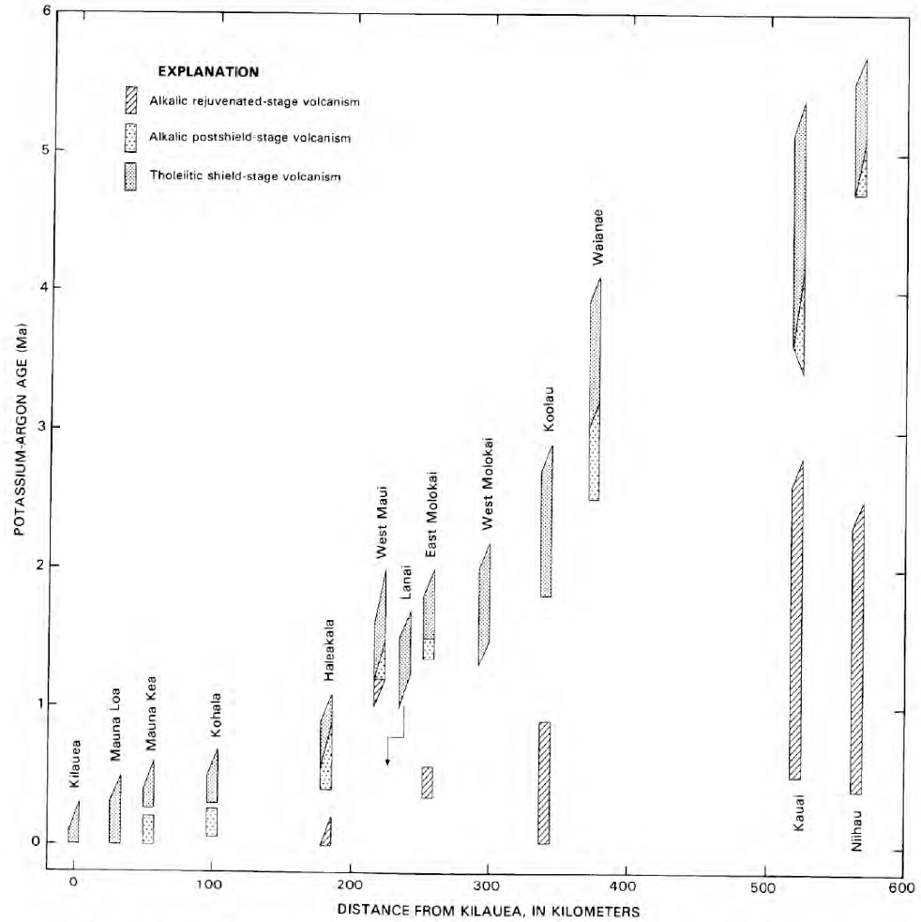
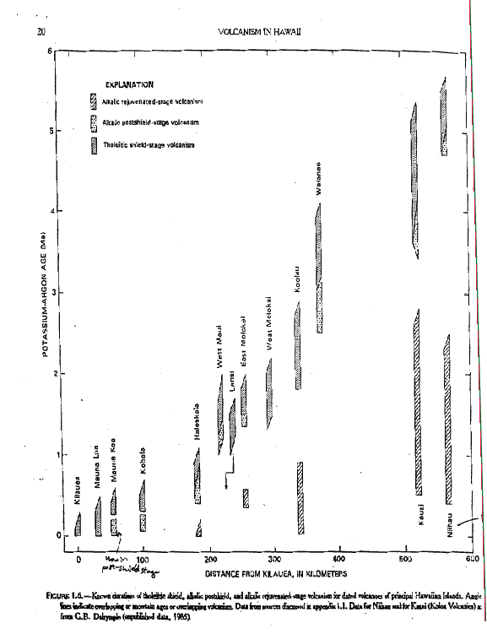
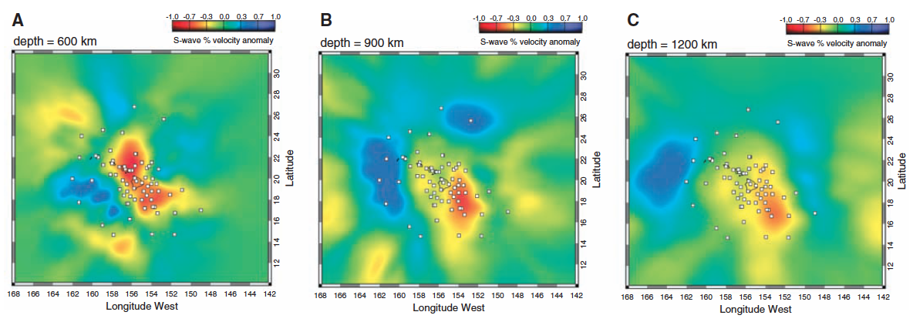
How do volcanic hotspots sample the mantle?
45th anniversary of an important hypothesis: Hotspots are formed by upwelling mantle plumes (Morgan, 1971).
Staudigel and Koppers, 2015
Age (million years)
Shield
Clague and Dalrymple
Rejuvenated
Distance (km)

Slide 17
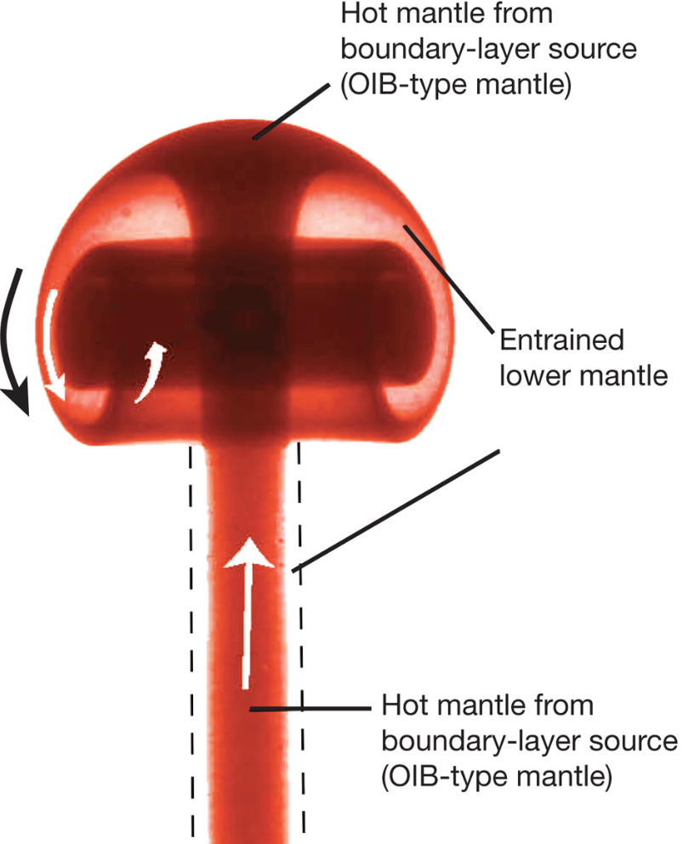
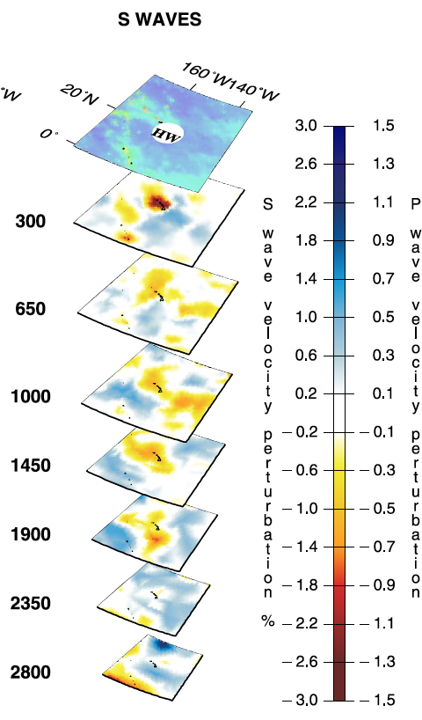
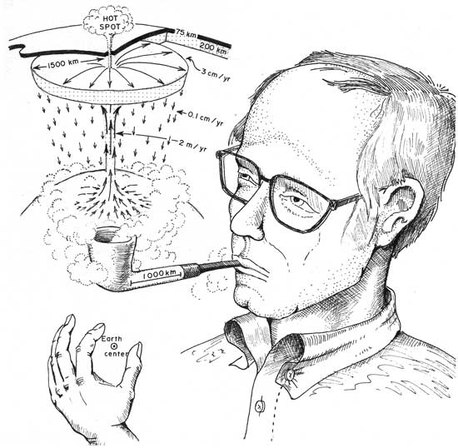
Vertical flow in the deep Earth
(Hawaii)
Campbell & O’Neill (2003)
Holden & Vogt, EOS, 1977
Montelli et al., 2006
Plumes predicted, but hard to image seismically.

Slide 18
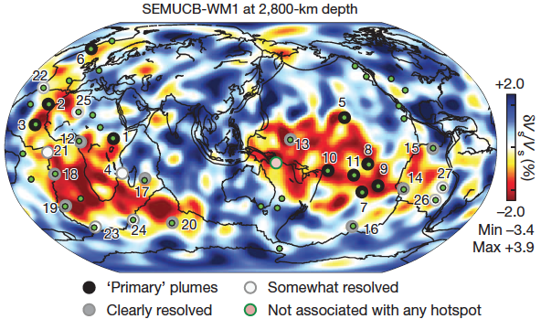
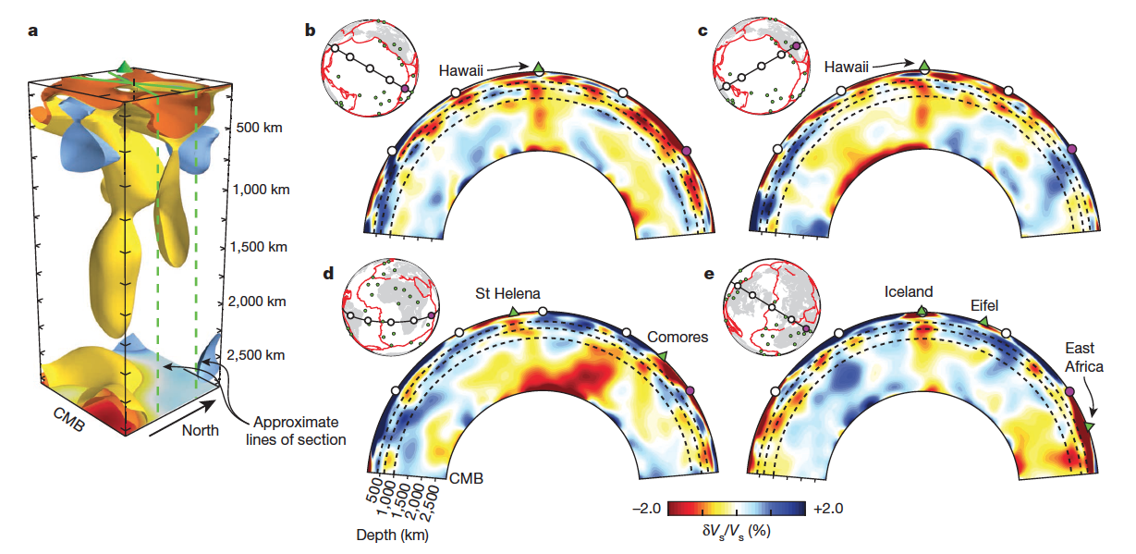
Mantle plumes beneath 28 volcanic hotspots! (French & Romanowicz, 2015)
Plumes anchored to LLSVP’s?
Thermochemical (lot of recycled crust?)? And purely thermal plumes?
Are plume-fed hotspots chemically different than non-plume hotspots?

Slide 19
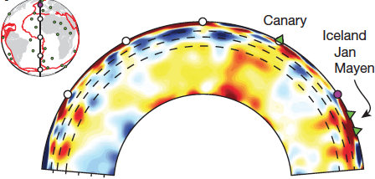
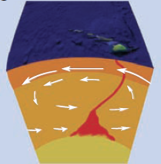
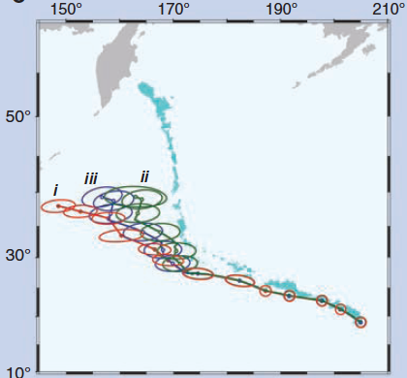
Lateral flow of plumes in the “mantle wind”?
Not all plumes rise vertically. Some “tilt” in the upper 1000 km of the mantle as they rise.
(French & Romanowicz,
2015)
Some plumes seem to drift over time.

Slide 20
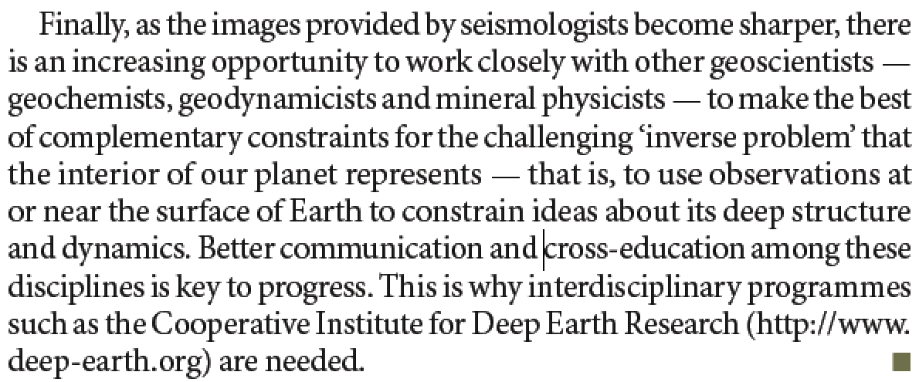
CIDER’s task
Romanowicz (Nature, 2008)

Slide 21
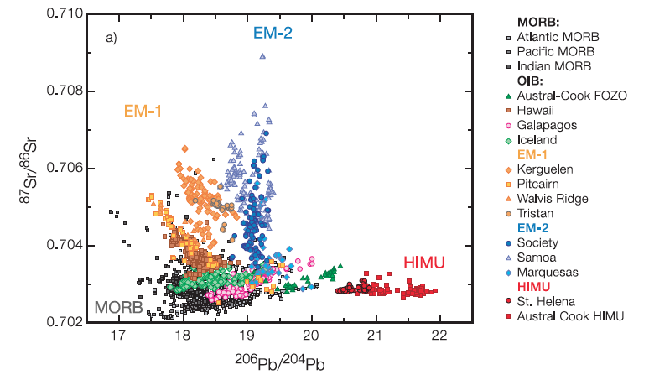
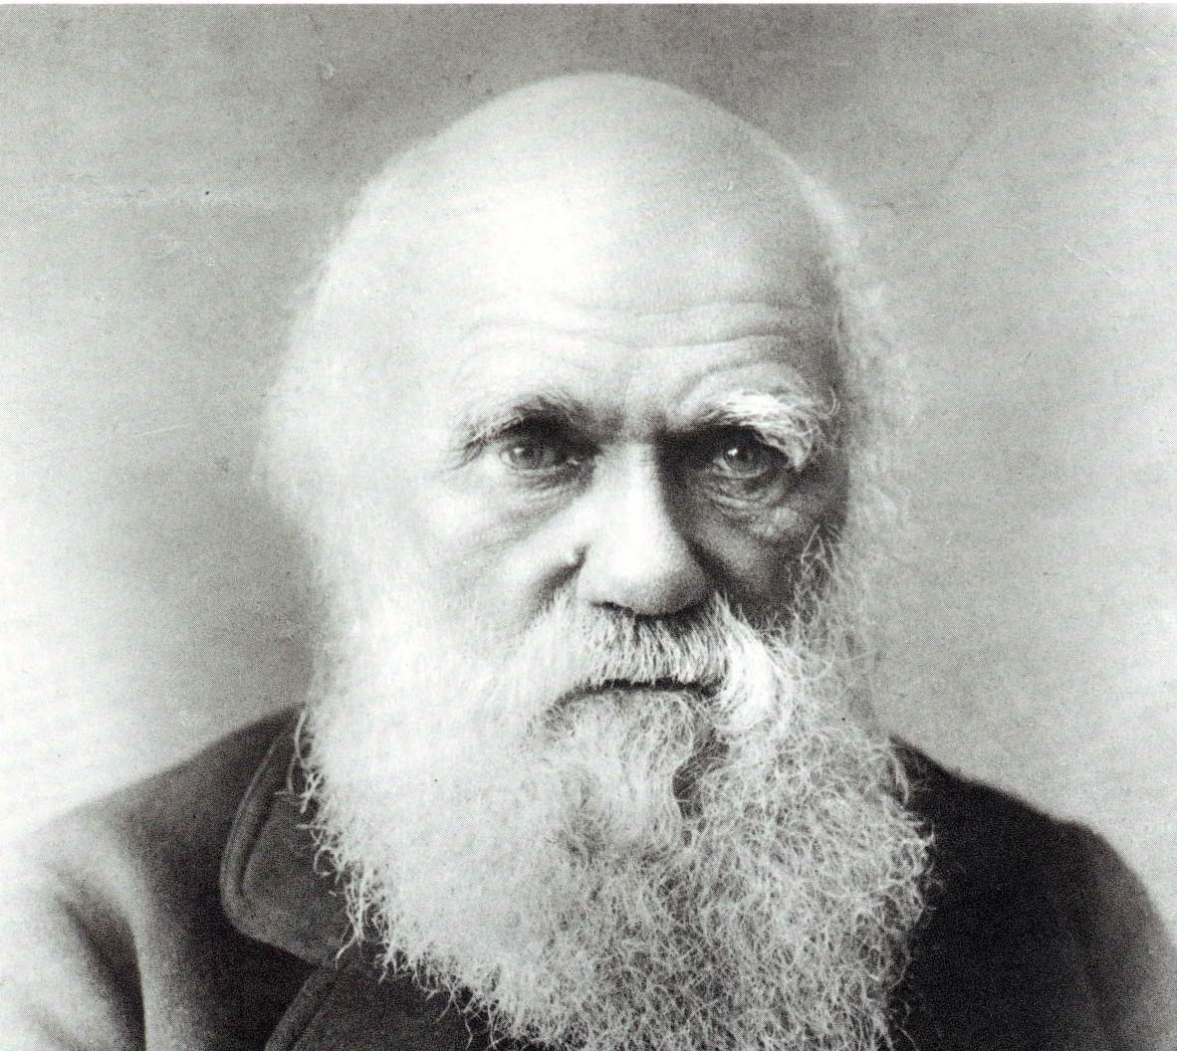
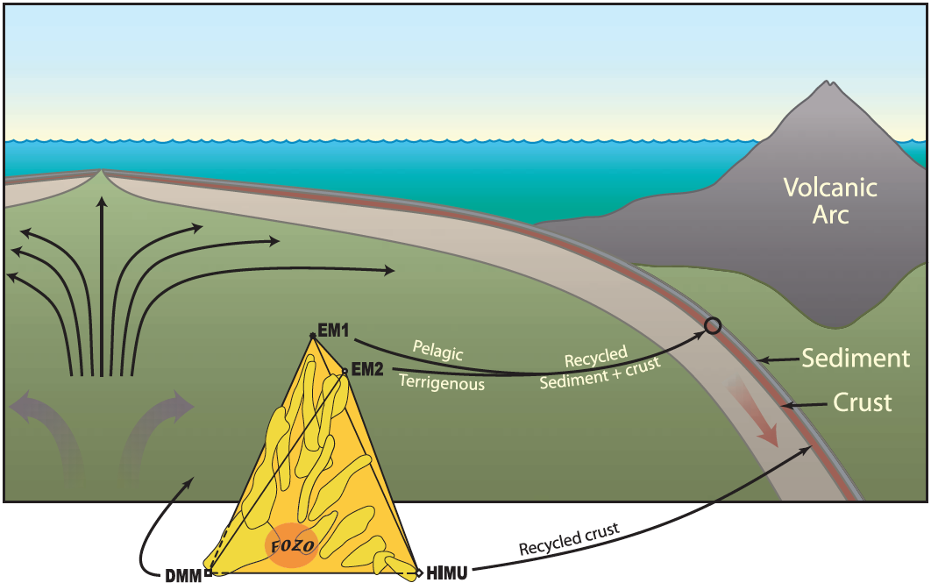
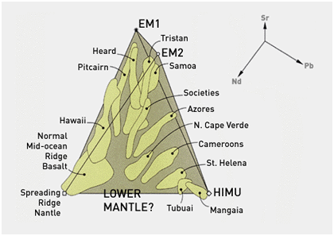
The mantle “zoo”:
Origin of the species?
Willbold and Stracke, 2002
Workman et al., 2004
Where are the various “species” located in the mantle?
Long-standing problem:
1. Geochemists know which animals are in the zoo, but don’t know where the “cages” are.
2. Seismologists know where the “cages” are.

Slide 22
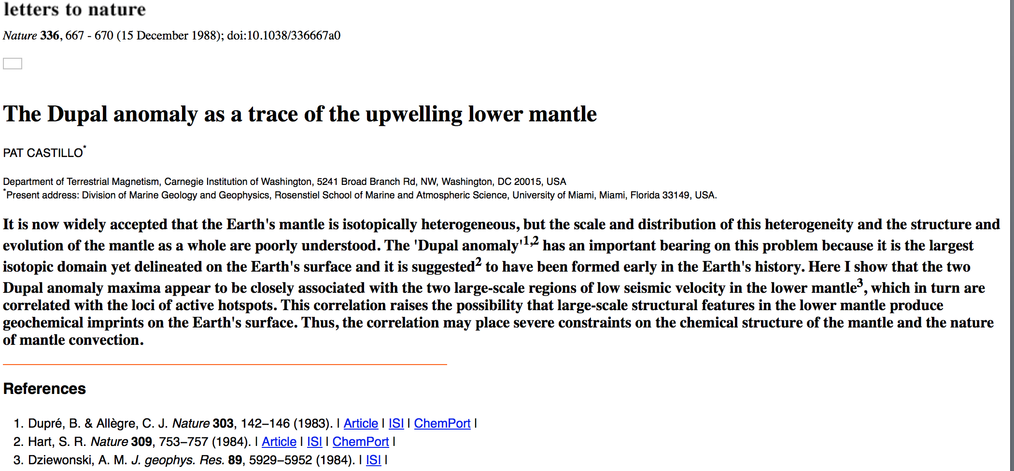
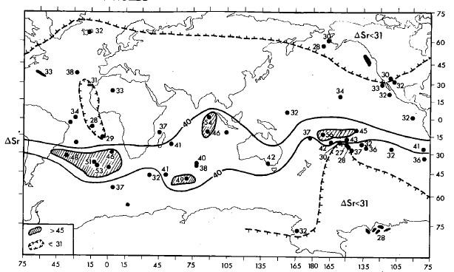
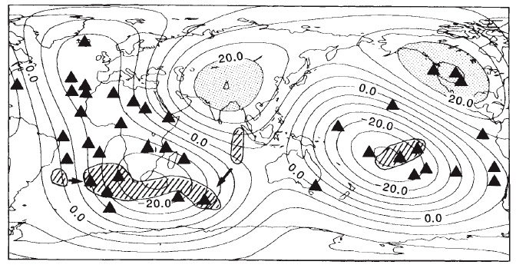
Distribution of mantle heterogeneities: Connecting surface volcanism with the deep mantle
DUPAL
anomaly
DUPAL vs. seismic
low velocity anomaly
Hart, Nature, 1984
Low ⁸⁷Sr/⁸⁶Sr
DEPLETED
High ⁸⁷Sr/⁸⁶Sr
ENRICHED
LOW seismic V
LOW seismic V
High ⁸⁷Sr/⁸⁶Sr
DEPLETED
Low ⁸⁷Sr/⁸⁶Sr
Castillo, Nature, 1988
--The DUPAL anomaly… globe encircling feature of isotopic enrichment OIBs.
--Key observation: Geochemistry of hotspot lavas at surface associated with seismic low velocity anomalies (LLSVP’s) at depth.
DUPAL = Dupré+Allègre LLSVP = Large Low Shear-wave Velocity Province

Slide 23
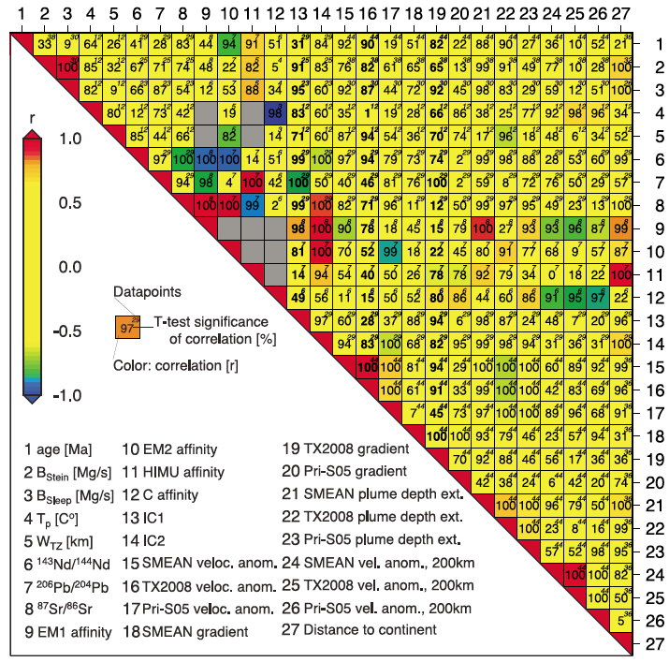
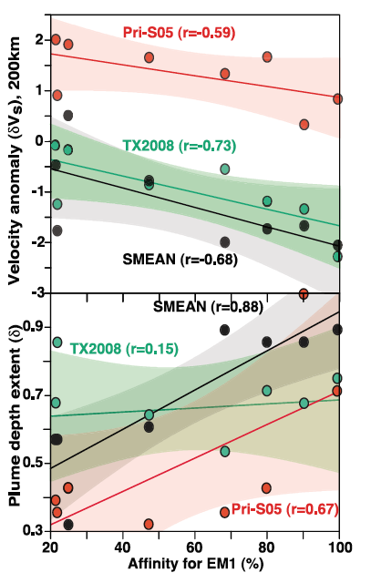
A classic example of the power of CIDER collaboration: Linking geochemistry and geophysics
Thinking ahead about CIDER projects in weeks 3 and 4.

Slide 24
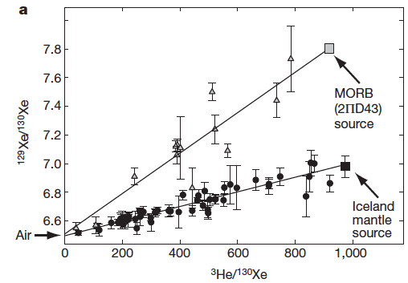
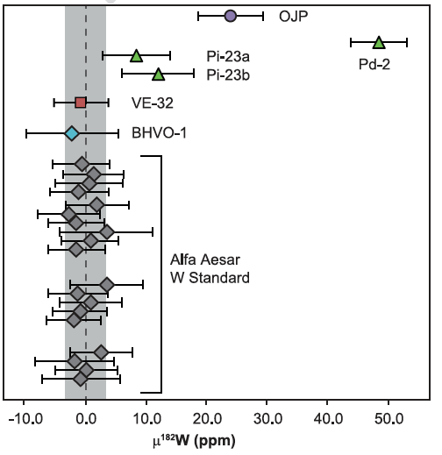
But there are heterogeneous, Hadean ¹²⁹Xe and ¹⁸²W signatures in the modern mantle!
¹²⁹I →¹²⁹Xe (t_{1/2}=15.7 Ma)
¹⁸²Hf →¹⁸²W (t_{1/2}=8.9 Ma)
Ontong Java Plateau
Baffin Is.
Mukhopadhyay, 2012
MORB
Hawaii (Kilauea)
Rizo et al., 2016
¹²⁹Xe variability generated in first ~90 Ma of Earth’s history.
¹⁸²W variability generated in first ~50 Ma.
Thus, both the ¹²⁹Xe and ¹⁸²W signatures preserved in the convecting mantle since the Hadean.

Slide 25
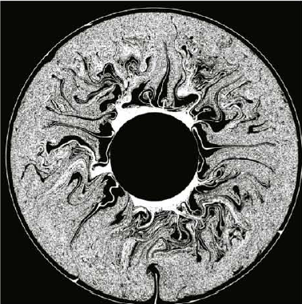
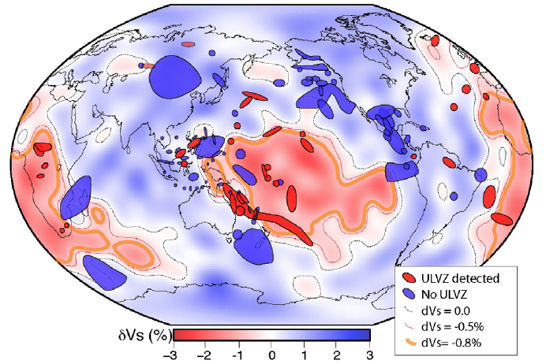
Big Problem: Survival of early-Earth reservoirs in a chaotic mantle?
Preserved throughout mantle?
Preserved in LLSVP’s/ULVZ’s?
Brandenburg et al. (EPSL 2008)
McNamara et al. (EPSL 2010)
Where? How?

Slide 26
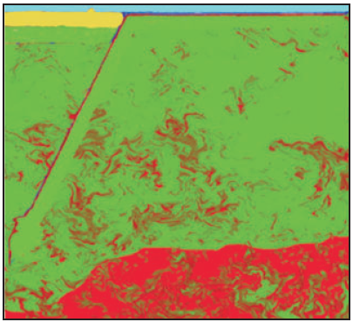
Mantle mixing (mantle convection)
Stretching and thinning
Diffusion
Stixrude & Lithgow-Bertollini (2012)
van Keken et al. (2004)

Slide 27
There is an ongoing debate about the bulk composition of the silicate Earth
Debate triggered by observation that ¹⁴²Nd/¹⁴⁴Nd of Earth’s mantle and chondrites are different. Breaks the long-held assumption that refractory-lithophile element ratios in bulk silicate Earth are chondritic.
But the ¹⁴²Nd/¹⁴⁴Nd difference may be nucleosynthetic, not radiogenic. Initial rationale for exploring non-chondritic Earth may have been wrong. But a non-chondritic BSE works better in many ways….
Why is this important? Well, geochemical mass balance models:
Bulk silicate Earth – (upper mantle + continental crust) = lower mantle
Battle of the Bills

Slide 28
The Geodynamo (See review by Peter Olson, G-cubed, 2016)

Slide 29
A final “quiz” (suggested by Quentin)
Which of these is not a Mantle Geochemical end member?
HIMU
EMO
C. EMI
D. EMII
E. FOZO

