Slide 1
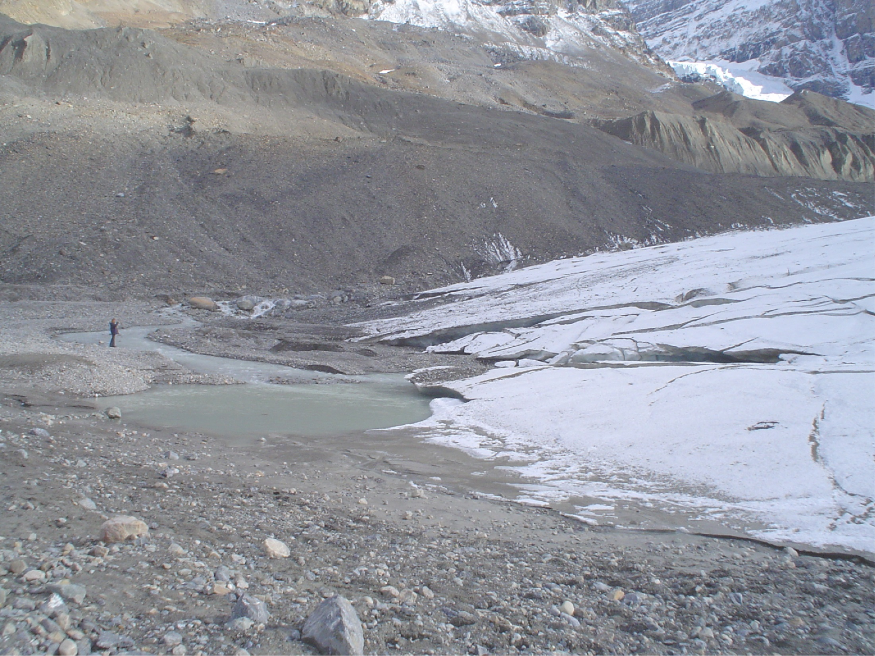

Postglacial rebound model, viscosity, gravity
Wouter van der Wal
CIDER, 13 July 2015

Slide 2
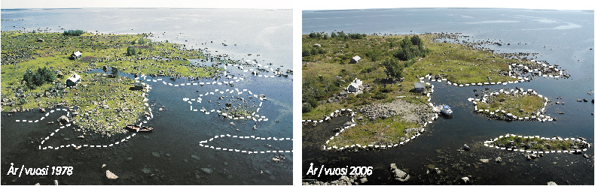
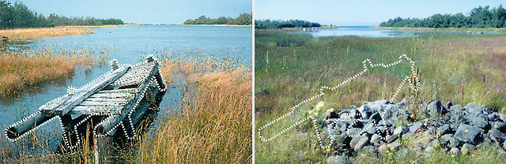
between Sweden and Finland www.kvarken.fi

Slide 3
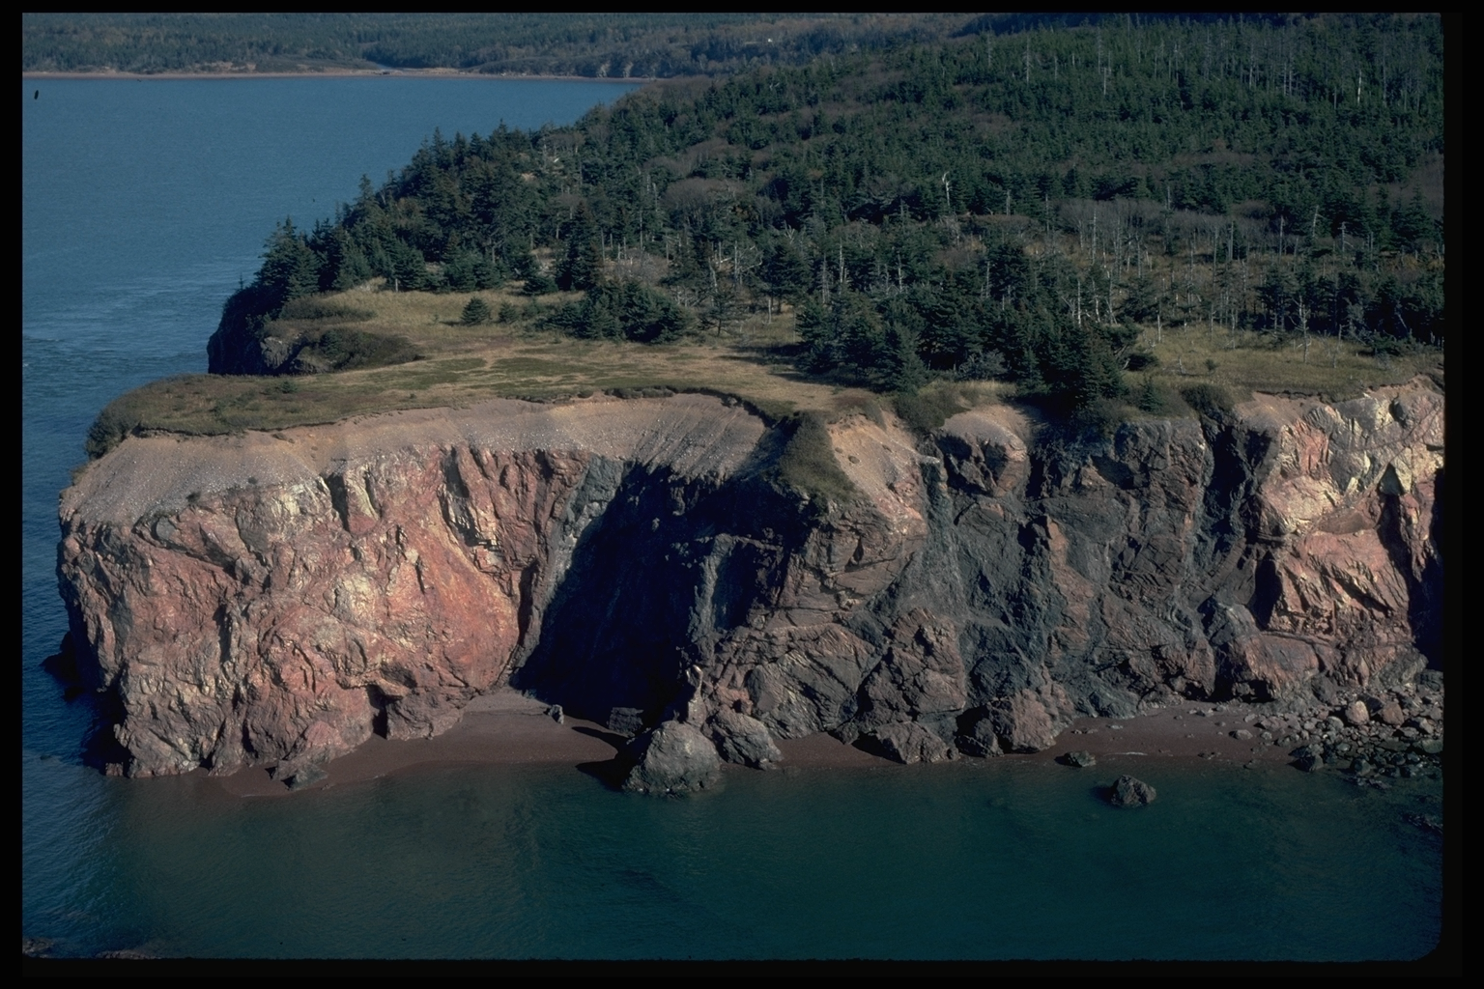
Bay of Fundy, Source: NRCan

Slide 4
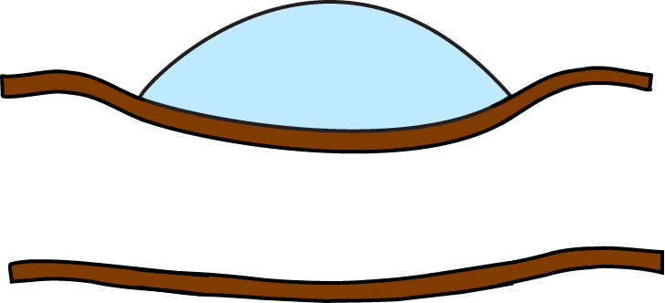
Glacial Isostatic Adjustment (GIA)
~1,000 years
Flow in the mantle determined by viscosity

Slide 5
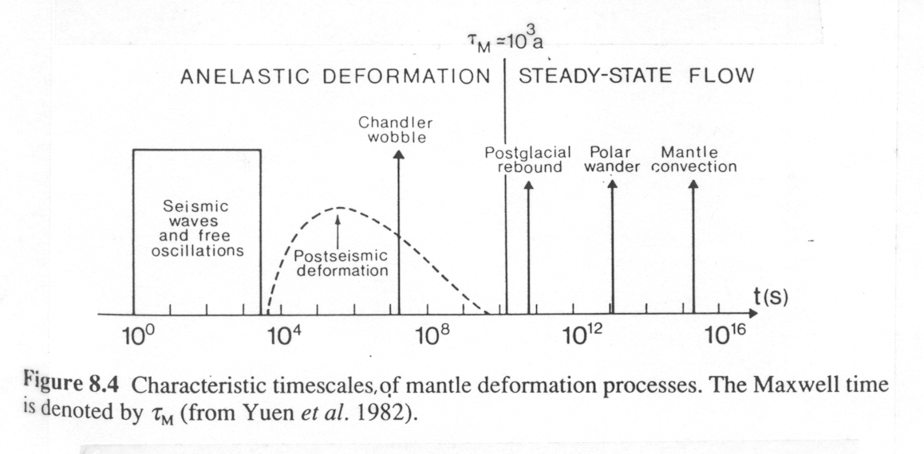
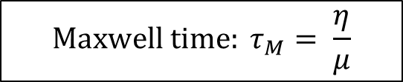
Mantle Rheology and Stress Field Duration
Ranalli (1995)
$${Maxwell time: τ}_{M}= \frac{η}{μ}$$

Slide 6
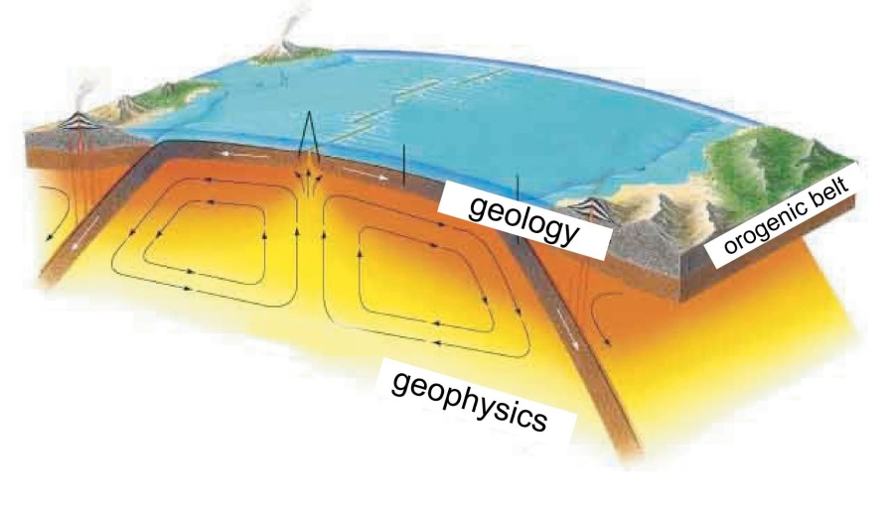
Why model GIA?
(or what does this presentation have to do with the rest of the workshop)
Laboratory experiments
Seismic velocity anomalies
Geophysical model
Sea-level, stress?
Geodetic observations

Slide 7
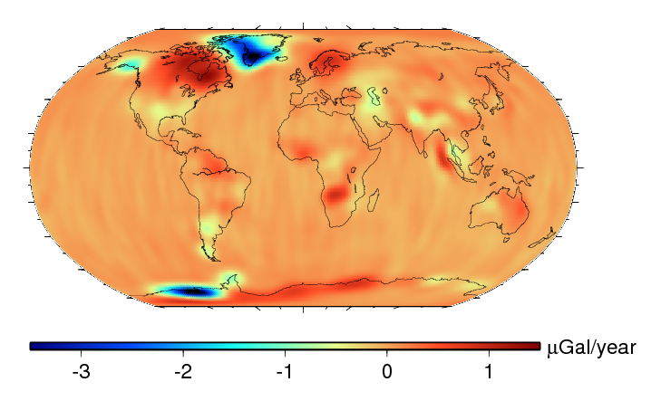
GRACE satellite measurement of mass change

Slide 8
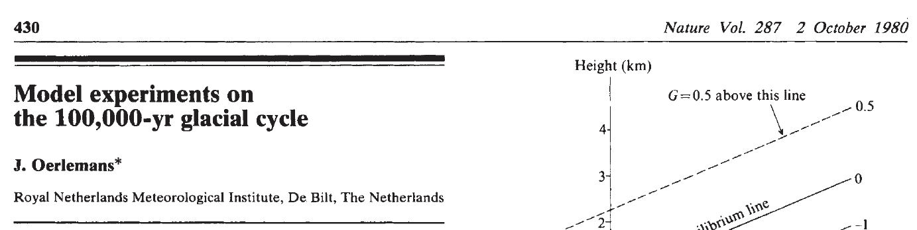
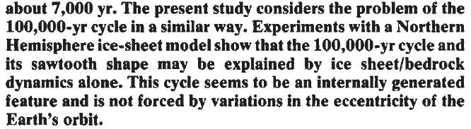

Slide 9
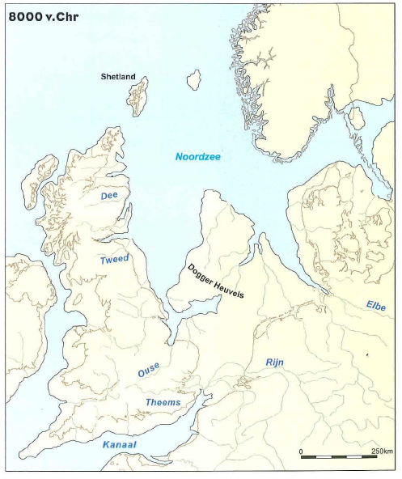
From: Nederland in het Holoceen

Slide 10
Load on an elastic plate
3000 m
80 km
1100 km
Young’s modulus = 70 x 10¹⁰ Pa; Poisson’s ratio = 0.25;
(Turcotte and Schubert 2002)

Slide 11
3000 m
80 km
1100 km
Maximum deflection ~ 500 m
Young’s = 70 x 10⁹ Pa; Poisson’s = 0.25;
Mantle density = 3300 kg/m³
Turcotte and Schubert (2002)

Slide 12
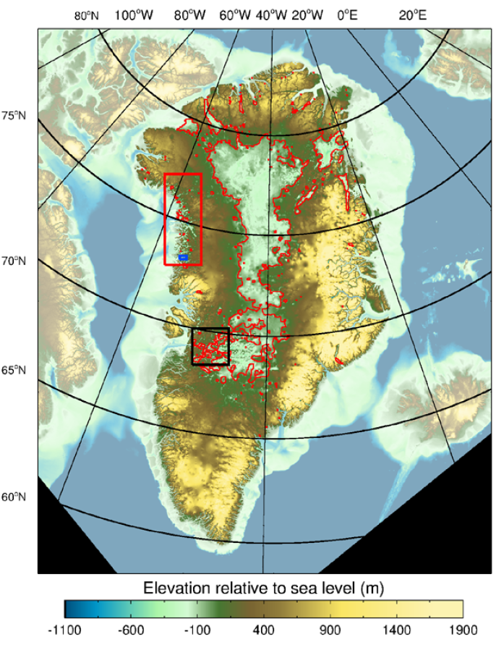
Bamber et al. (2013)

Slide 13
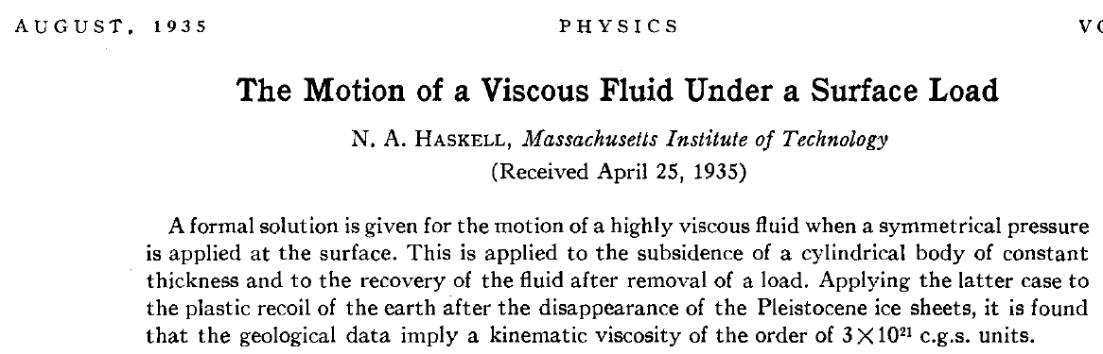
Kinematic viscosity of the order of 3 x 10²¹ c.g.s units
~ 10²¹ Pascal-second dynamic viscosity (multiplied with density)
→ characteristic relaxation time of several thousand years

Slide 14
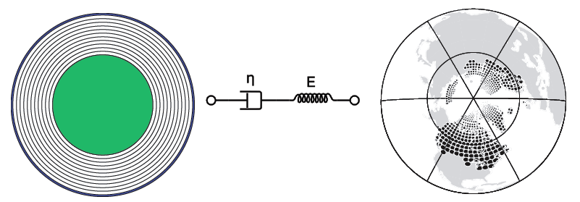
GIA model
Free parameter
Paolo Stocchi, NIOZ

Slide 15
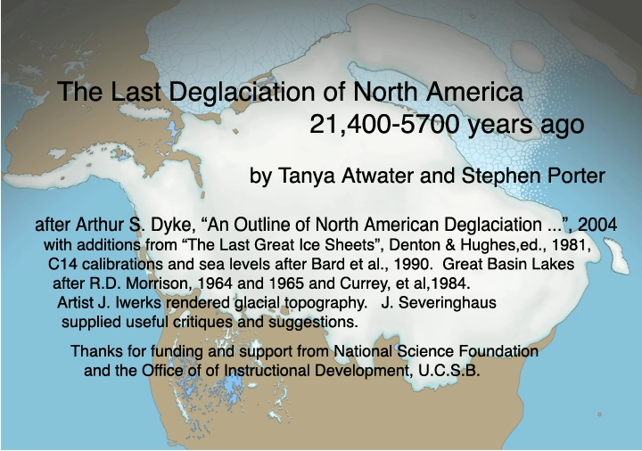

Slide 16
Surface loading
…
Farrell (1972)
Peltier (1974)
Wu and Peltier (1982)
…
Sea-level equation
Farrell and Clark (1976)
Mitrovica and Peltier (1991, 1993)

Slide 17
eigenfunctions
“It is found that a jump in density will introduce a buoyancy mode, whereas a discontinuity in the value of Maxwell time will introduce two viscoelastic (or ‘transition’) modes simultaneously”
(Wu & Ni 1996)
ρ₁, τ₁
ρ_{2,} τ₂

Slide 18
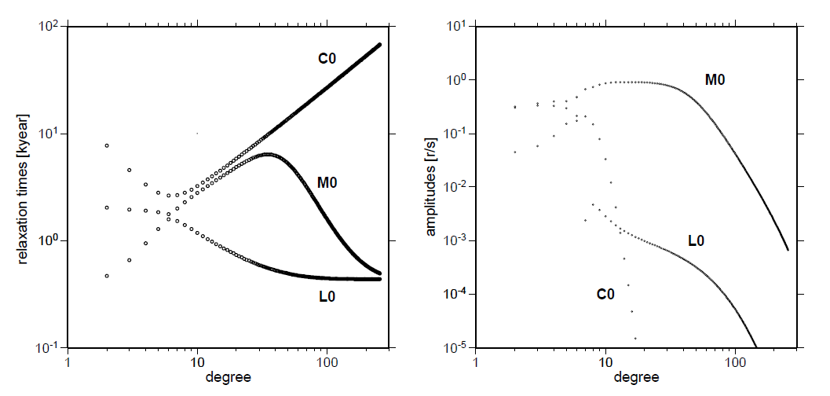
Normal modes

Slide 19
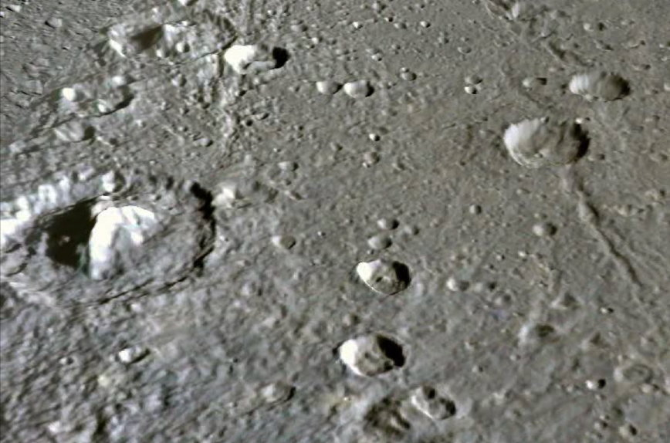
“The largest crater is 105 km across. Its large central peak towers 3 km above the plains”
Larger loads are sensitive to deeper structure
From: http://stereomoons.blogspot.nl/2010/04/return-to-dione.html

Slide 20
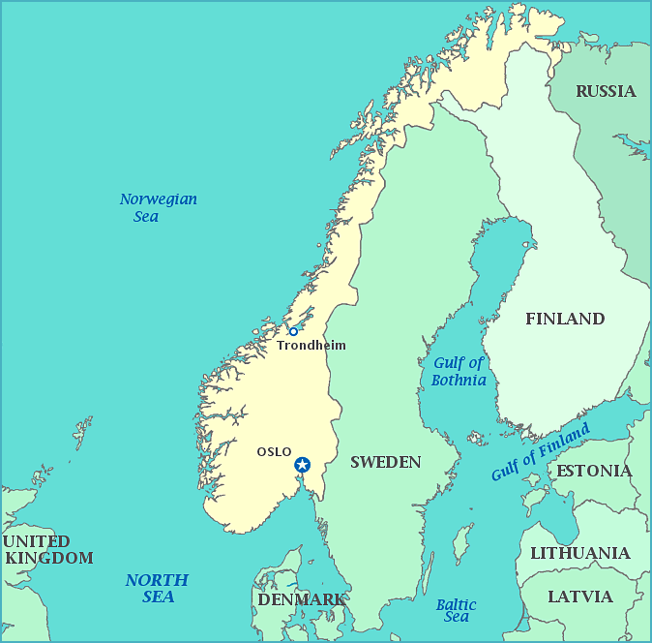
Sensitivity kernels
Assume you have a model that is ‘close’ to reality
Perturb one of the input parameters by a small amount, and calculate the change in observable.
Gravity rate
[μGal/year]
Depth [km]

Slide 21
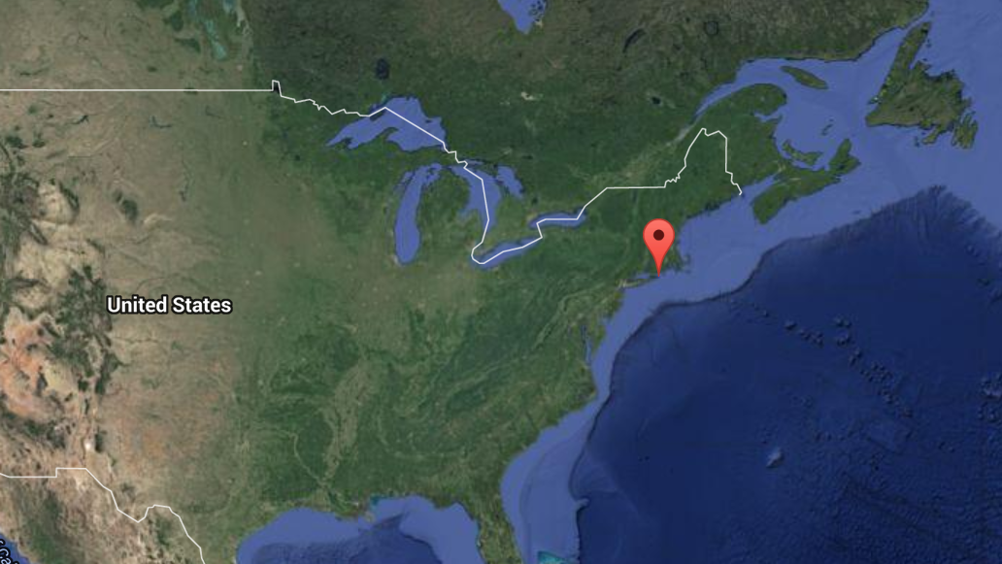
Sensitivity kernels
Assume you have a model that is ‘close’ to reality
Perturb one of the input parameters by a small amount, and calculate the change in observable.
Gravity rate
[μGal/year]
Depth [km]

Slide 22
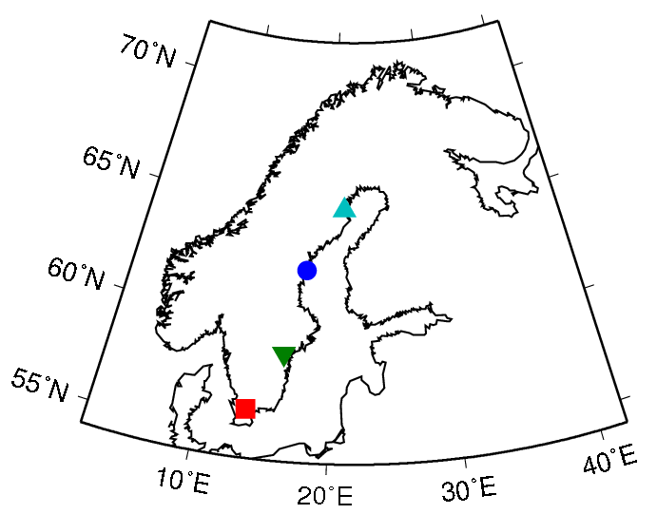
van der Wal et al. (2011)

Slide 23
van der Wal et al. (2011)

Slide 24
ICE-6G/VM5a model
Ice sheet in Scotland
Ice sheet in Scandinavia
Ice sheet in North America
(2004)
(1996)
Change in length of day and polar wander
Argus et al. (2014)

Slide 25
Increase in viscosity from upper to lower mantle:
3x (Peltier 2004)
> 10x (Lambeck et al. 1998)

Slide 26
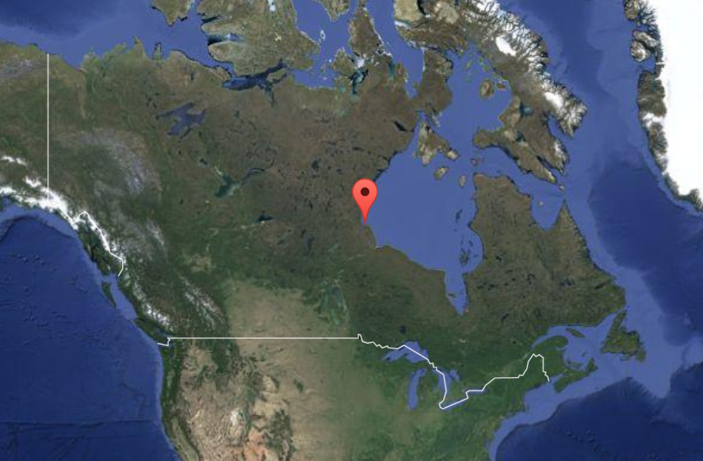
Relaxation time

Slide 27
Relaxation time

Slide 28
Relaxation time

Slide 29
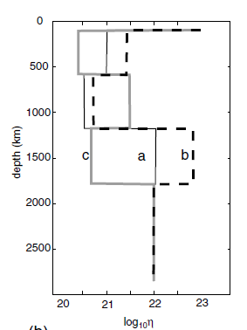
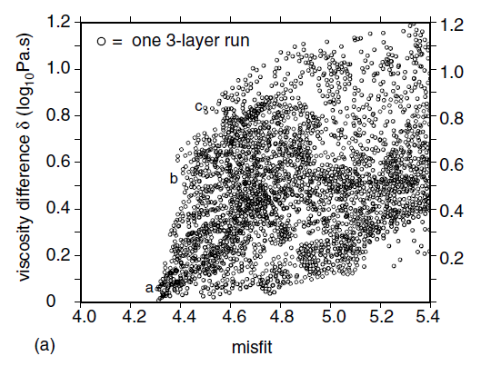
(Paulson et al. 2007)
GRACE, sea level curves
→ Can not invert for more than two layers

Slide 30
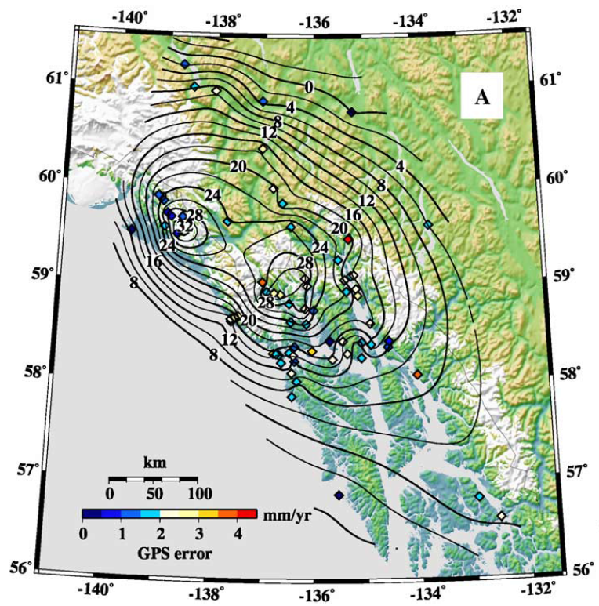
Alaska
Post-LIA deglaciation
Low-viscosity asthenosphere
4 x 10¹⁸ Pas
Larsen et al
(EPSL 2005)

Slide 31
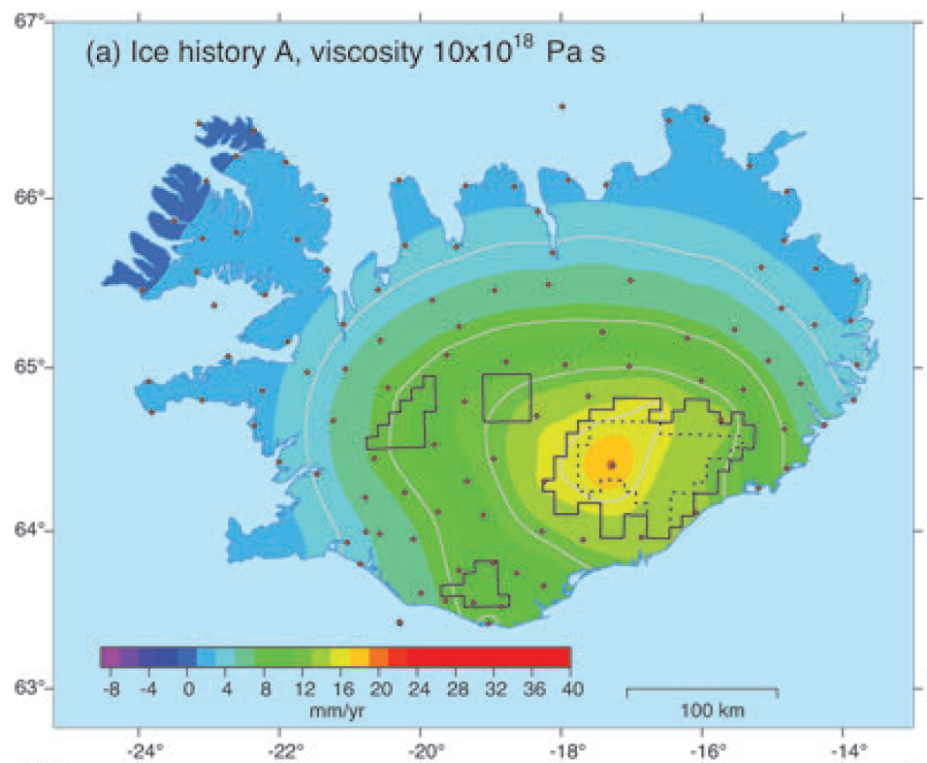
Iceland
Uplift rate due to ice melting (1890-2004 AD), viscosity 10¹⁸ Pas
Arnadottir et al. (GJI 2007)

Slide 32
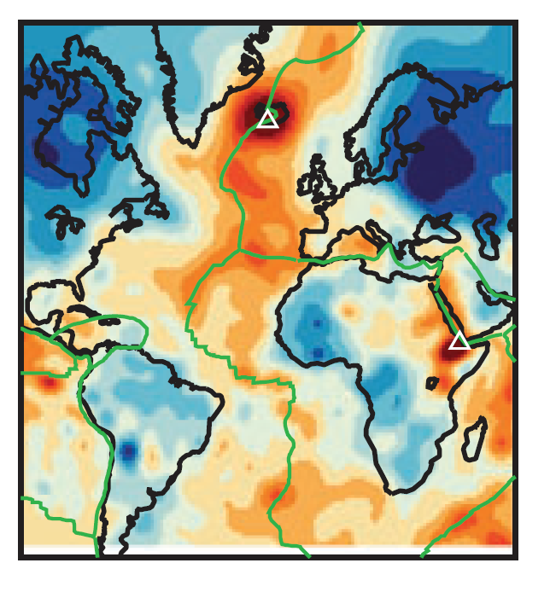
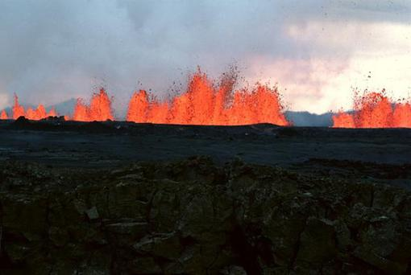

@ 200 km depth
Iceland
http://www.geographic.org/photos/volcanoes/volcano_photos_34.html
Ritsema et al (GJI 2011)

Slide 33
Depth sensitivity
Scandinavia - VM2 viscosity model
??
Where is the viscosity that GIA sees?

Slide 34
GIA models with 3D viscosity
Finite-element (University of Colorado, Zhong et al. 2003)
Finite-element (University of Calgary, Wu and van der Wal 2003)
Finite-volume (University of Toronto, Latychev et al. 2005)
Spectral/finite-element (GeoForschungsZentrum Potsdam, Martinec 2000)

Slide 35
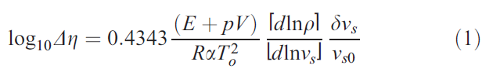
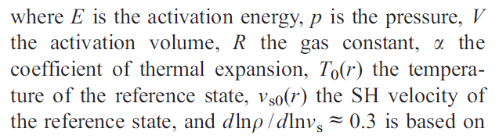
How to compute 3D viscosity?
Ivins and Sammis (1995)

Slide 36
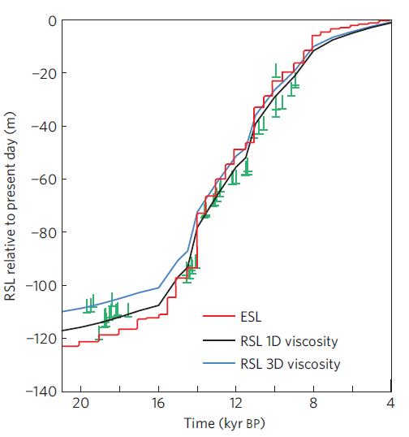
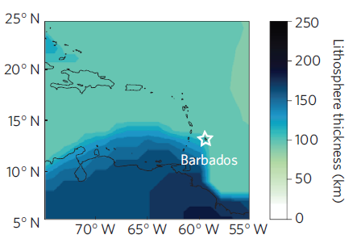
Austermann et al. (2013)

Slide 37
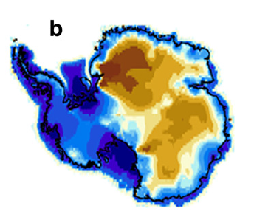
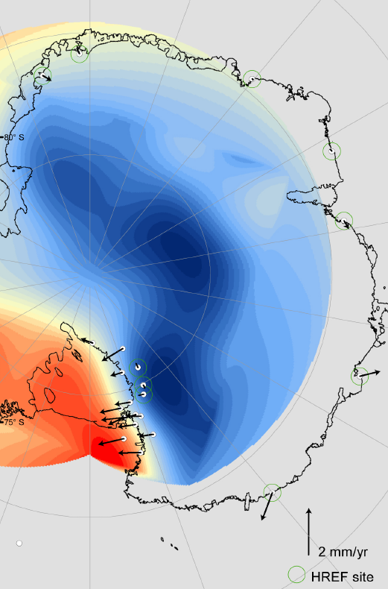
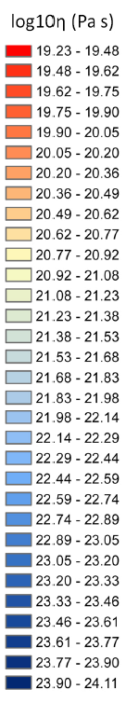

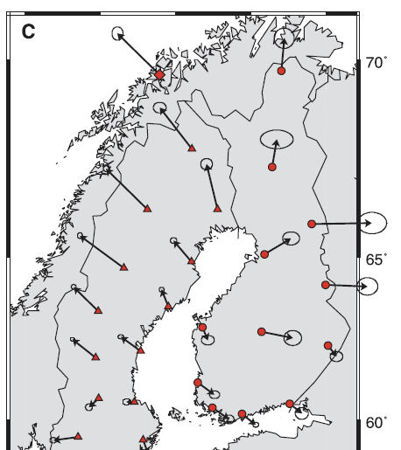
Whitehouse et al. (QSR, 2012)
Konfal, Ohio State Univ.
Milne et al. (2001)

Slide 38
10¹⁸ Pas

Slide 39
Can we compare viscosity to other processes?
Mantle Rheology and Stress Field Duration
Ranalli (1995)
$${Maxwell time: τ}_{M}= \frac{η}{μ}$$

Slide 40
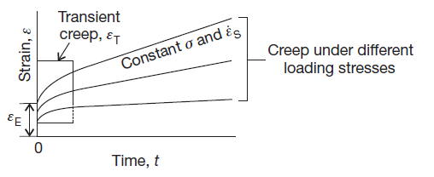



Can we compare viscosity to other processes?
What viscosity is used in other fields?
Post-seismic (Wang et al., Nature 2012)
Faul et al., JGR 2011
Convection (Becker, GJI 2006)

Slide 41
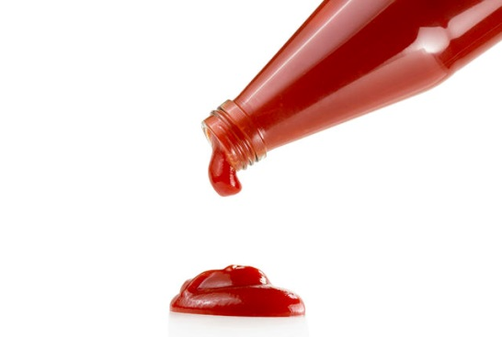
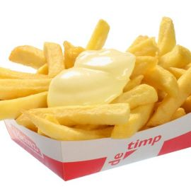
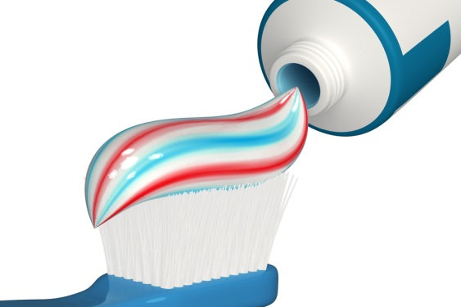
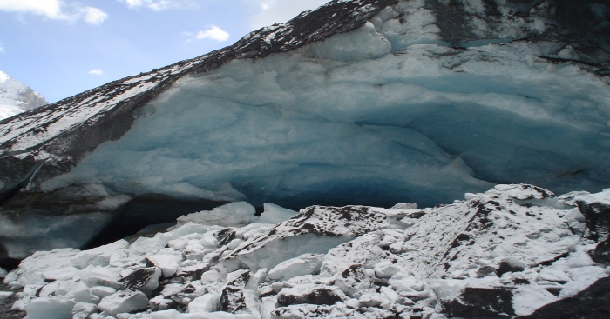
Model: flow laws for olivine
Dislocation creep
Diffusion creep
+
Total strain rate
Hirth and Kohlstedt (2003)

Slide 42
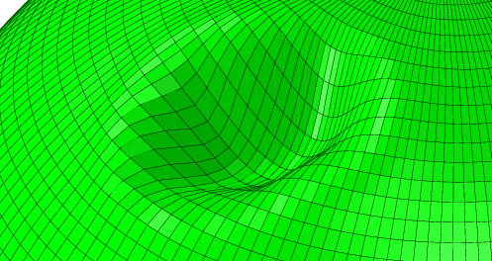
Model
depth
CR
UM
TZ
LM
Crust
(fully elastic)
35
70
120
170
230
400
670
1170
2890
Diffusion creep
Dislocation creep
Gravity
Apply buoyancy as load on the layer boundaries
Compute gravitational potential from displacement

Slide 43
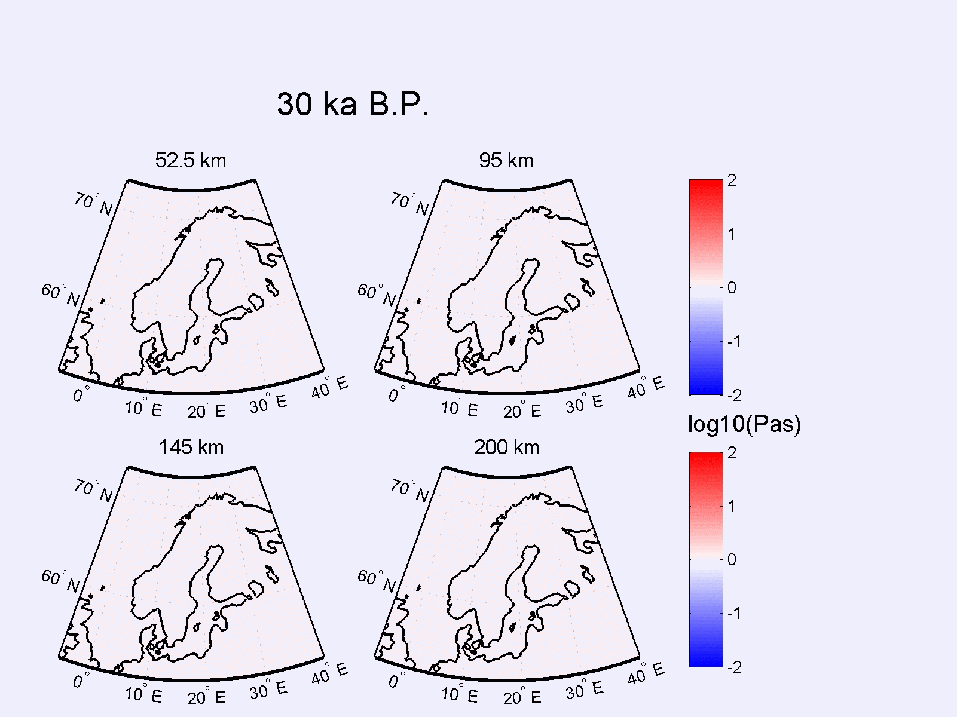
Time-dependent viscosity
Effective viscosity change wrt 30,000 yrs before present (wet/10 mm)
Barnhoorn et al. (2011)

Slide 44
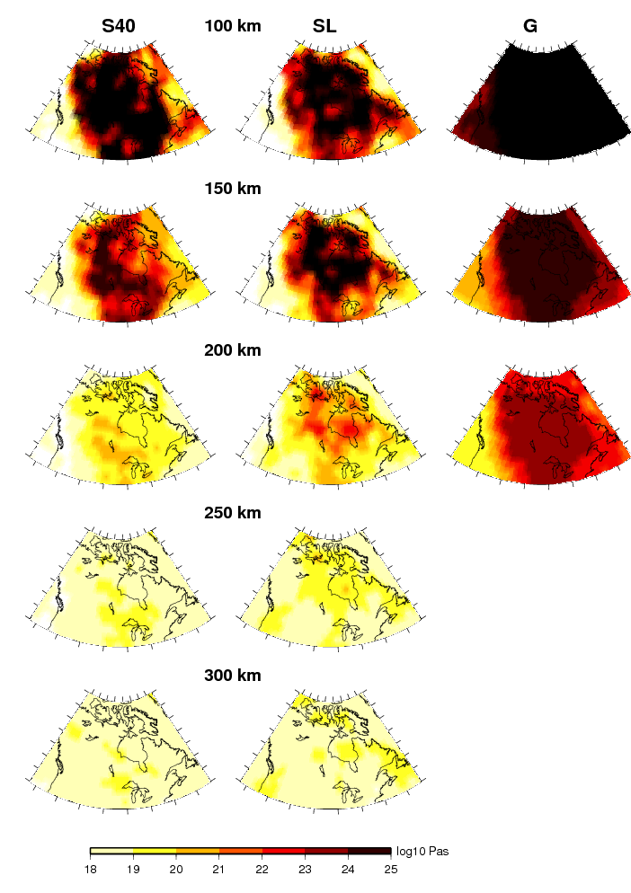
Conversion of seismic velocity to temperature by iteratively adjusting composition and temperature to fit seismic and gravity data
(Ward Stolk, PhD thesis 2013)

Slide 45
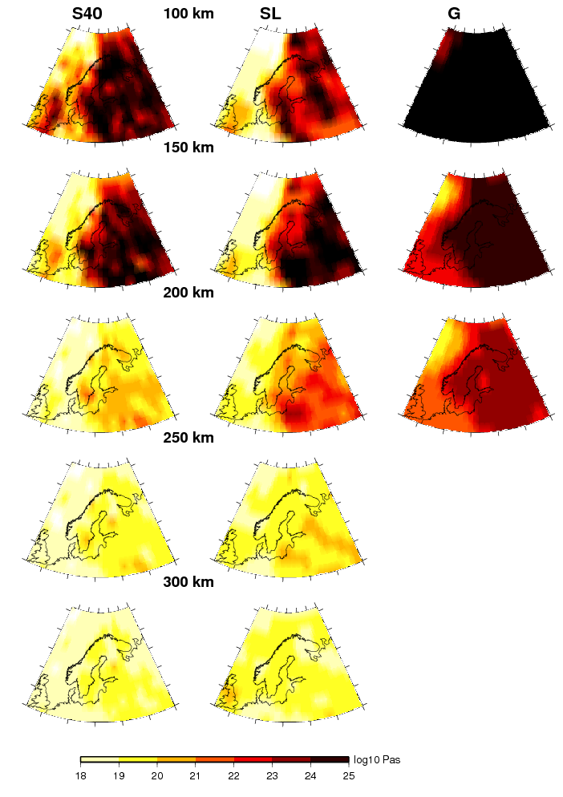

Slide 46
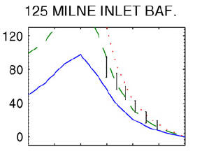
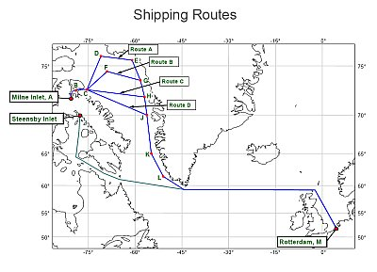
Composite rheology can accommodate more ice

Slide 47
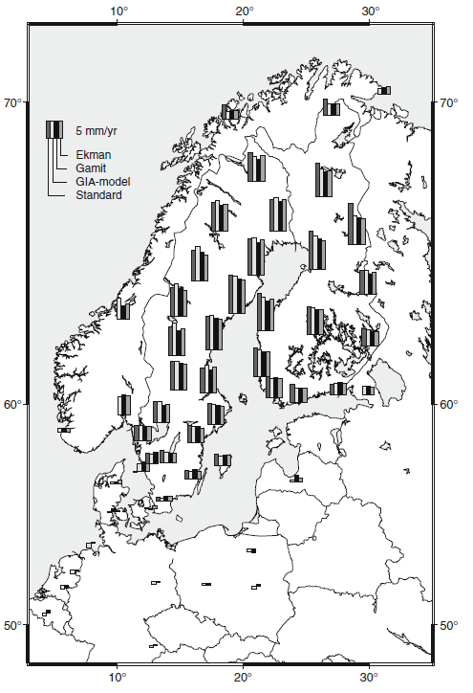
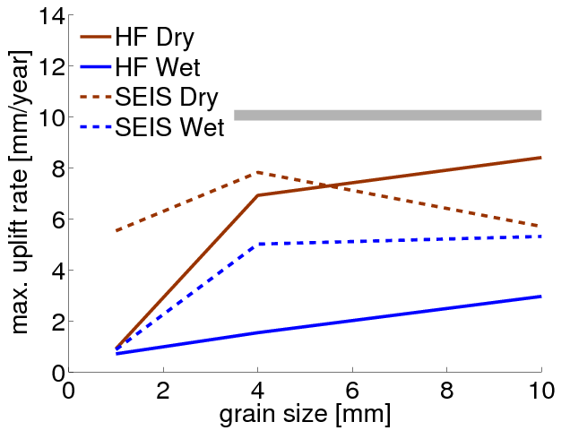
Lidberg et al. (2007)
van der Wal et al. (2013)

Slide 48
Relaxation time
Relaxation time = viscosity/rigidity
0.7 mm/year
0.1
mm/year

Slide 49
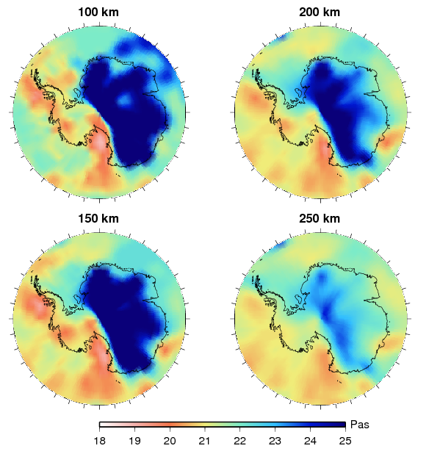

Effective viscosity Antarctica
Seismic model:
Schaeffer & Lebedev (2013)
+ Heeszel et al. (in preparation)
Rheology:
dry, 10 mm grain size
Photo Credit: Andrew Collins, 2012

Slide 50

Relaxation Times
Whitehouse et al. (2012)

Slide 51

Relaxation Times

Slide 52
Changing the viscosity
year

Slide 53

Antarctic mass loss
Viscosity model | Mass loss [Gt/year]
3D | -55
1D (Whitehouse et al. 2012b) | -98
3D
1D
van der Wal et al. (EPSL 2015)

Slide 54

van der Wal et al. (EPSL 2015)

Slide 55
Can we observe the incomplete rebound?
9,8066538223

Slide 56


Slide 57


http://expeditiewikipedia.nl/#vening-meinesz

Slide 58

http://expeditiewikipedia.nl/#vening-meinesz

Slide 59

GOCE satellite
Measures gravity gradients
Panet et al. (2014)

Slide 60


Slide 61

Problems with gravity measurements
deeper
Larger sphere

Slide 62
Degree amplitude V_{zz} at 250 km

Slide 63


Slide 64
Time-variable gravity
2003-2013, 400 km gaussian filter

Slide 65


Biomass
50 million water buffaloes (1000 kg each)
On 0.33 million km²
(150 water buffaloes per km²)
Moving a 1000 km north

Slide 66
Water buffalo movement

Slide 67
GRACE trends

Slide 68

Barents Sea Region – RSL data
Svendsen (QSR 2004)

Slide 69


Microgal/year
Root et al. (GRL 2015)

Slide 70

Current models place too much ice over the Barents Sea
GRACE sees 5-6 m sea-level equivalent instead of 8.5 m
ICE-6G (2015)
ICE-5G (2004)
Tarasov
Root et al. (GRL, in press)

Slide 71
Conclusions
Surface loading (GIA) feels viscosity at a certain depth and location
GIA viscosity/lithosphere is not necessarily the same as lithosphere/viscosity in another geophysical model
Relaxation times are well below 1000 years in several locations (West Antarctica, Iceland, Alaska, Patagonia, western Norway, Eastern US)
Dislocation creep means small relaxation times
What is the effect on inferred ice thickness? On corrections for sea-level and ice melt measurements? On feedback between ice growth and elevation?

Slide 72
Conclusions
Gravity is accurate but ambiguous
Uncompensated crust and topography

