Slide 1
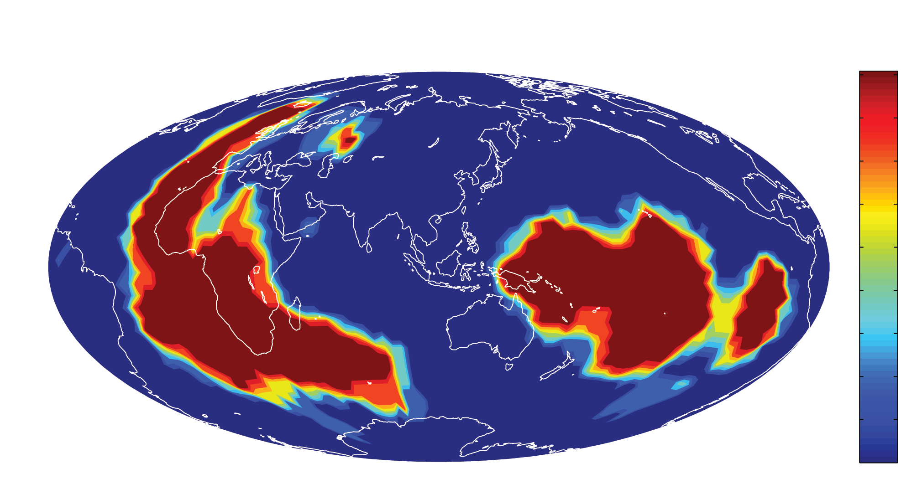
Terra Incognita Again;
Five zones in the mantle
Adam M. Dziewonski
in cooperation
with Ved Lekic and Barbara Romanowicz
KITP July 19, 2012

Slide 2
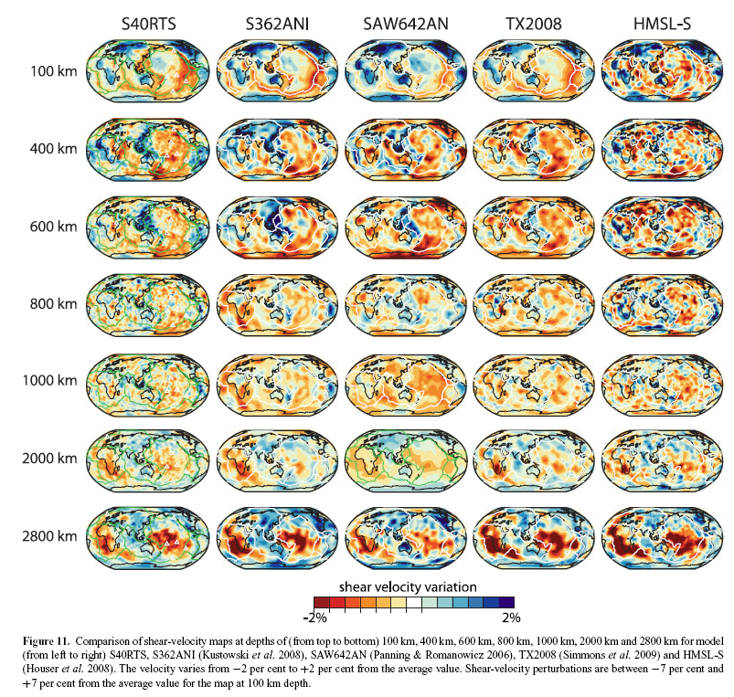
Convergence of 3-D models
Ritsema et al., 2011

Slide 3
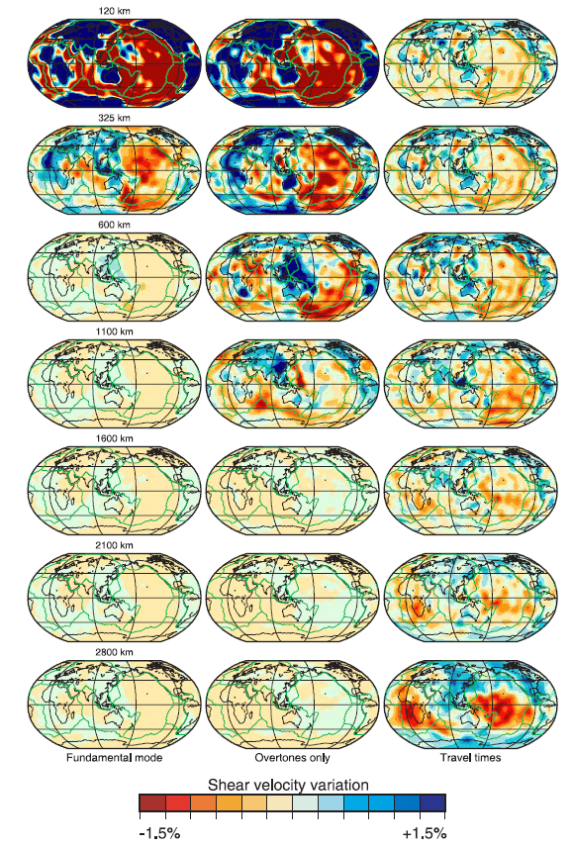
Different subsets of data have to be used to recover the whole mantle structure.
Models obtained using only one subset of data are shown:
Left: fundamental mode
Center: overtones
Right: teleseismic travel times
Ritsema et al., 2004

Slide 4
Spectral characteristics of three recent models obtained using all three subsets of data

Slide 5
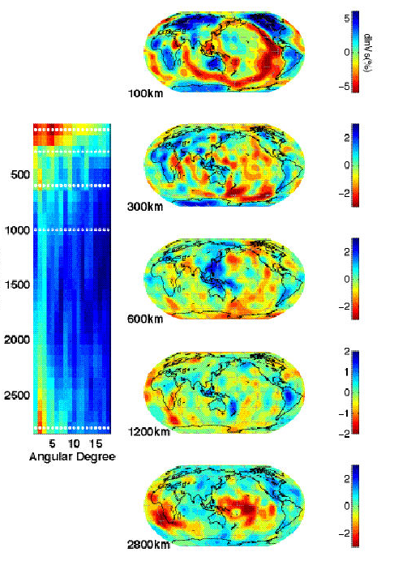
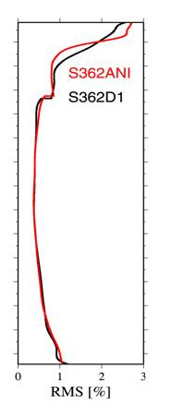
Five zones in the mantle
heterosphere
Moho – 225 km
upper mantle
buffer zone
225-500 km
transition zone
500-650 km
lower mantle
buffer zone
650-2400 km
abyssal zone
2400 km - CMB
(Dziewonski et al., 2010)

Slide 6
Three upper mantle zones

Slide 7
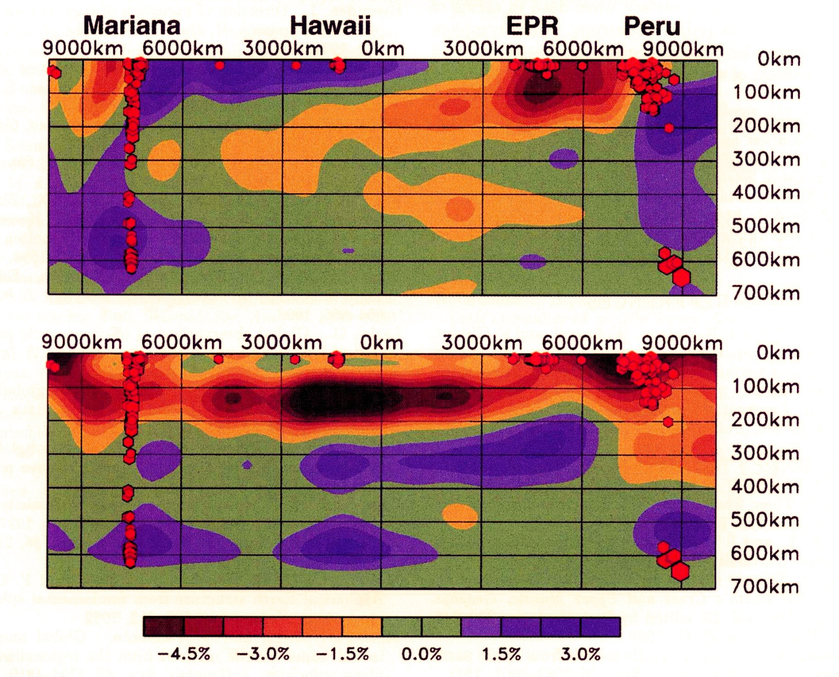
Heterosphere
isotropic
anisotropic

Slide 8
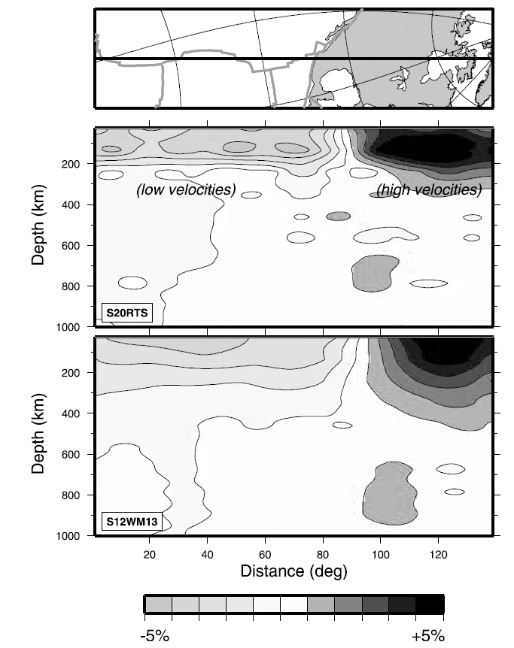
Velocity anomalies change abruptly between 200 and 300 km depth
From Ritsema et al., 2004

Slide 9
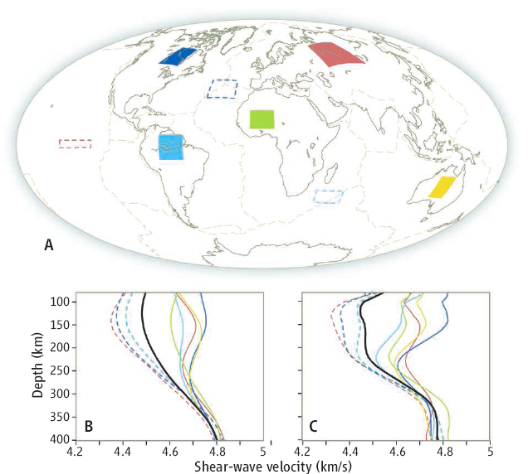
Rapid change in the level of heterogeneity at 200 – 250 km depth: heterosphere
Romanowicz (2009)

Slide 10
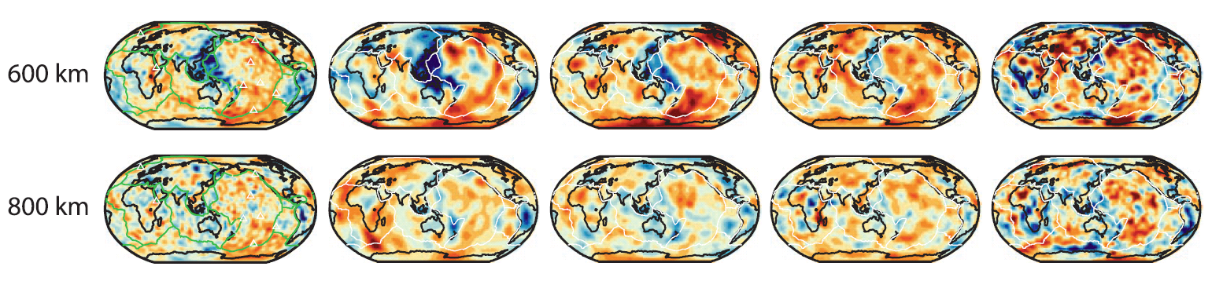
Crossing the 650 km discontinuity
Model TX2008 has weak constrains in transition zone
Model HMSL-S has no constraints in transition zone
After Ritsema et al., 2011

Slide 11
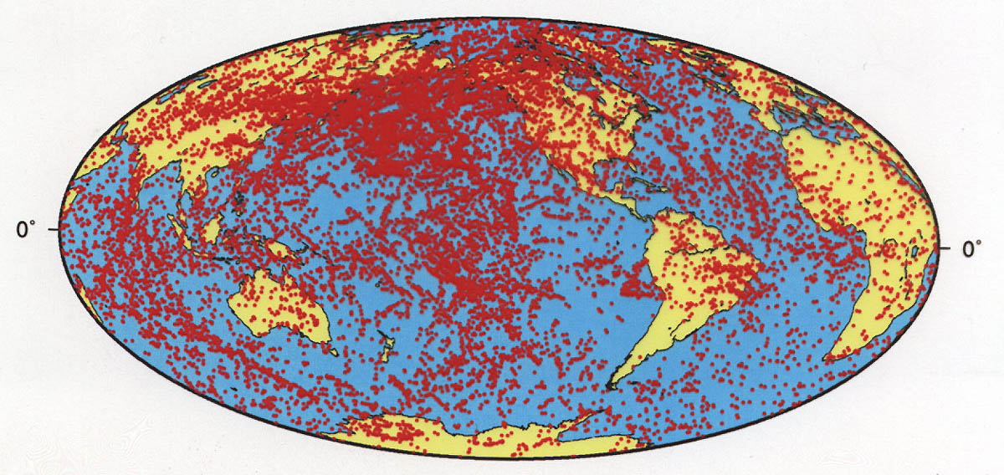
Travel times of SS – SdS from 21,000 seismograms constrain topography of the 650 and 410 km discontinuities

Slide 12
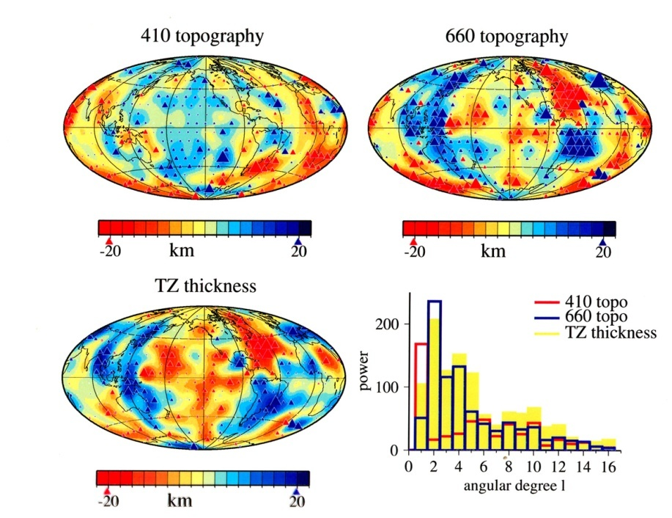
Topography of upper mantle discontinuities
Gu and Dziewonski, 2001

Slide 13
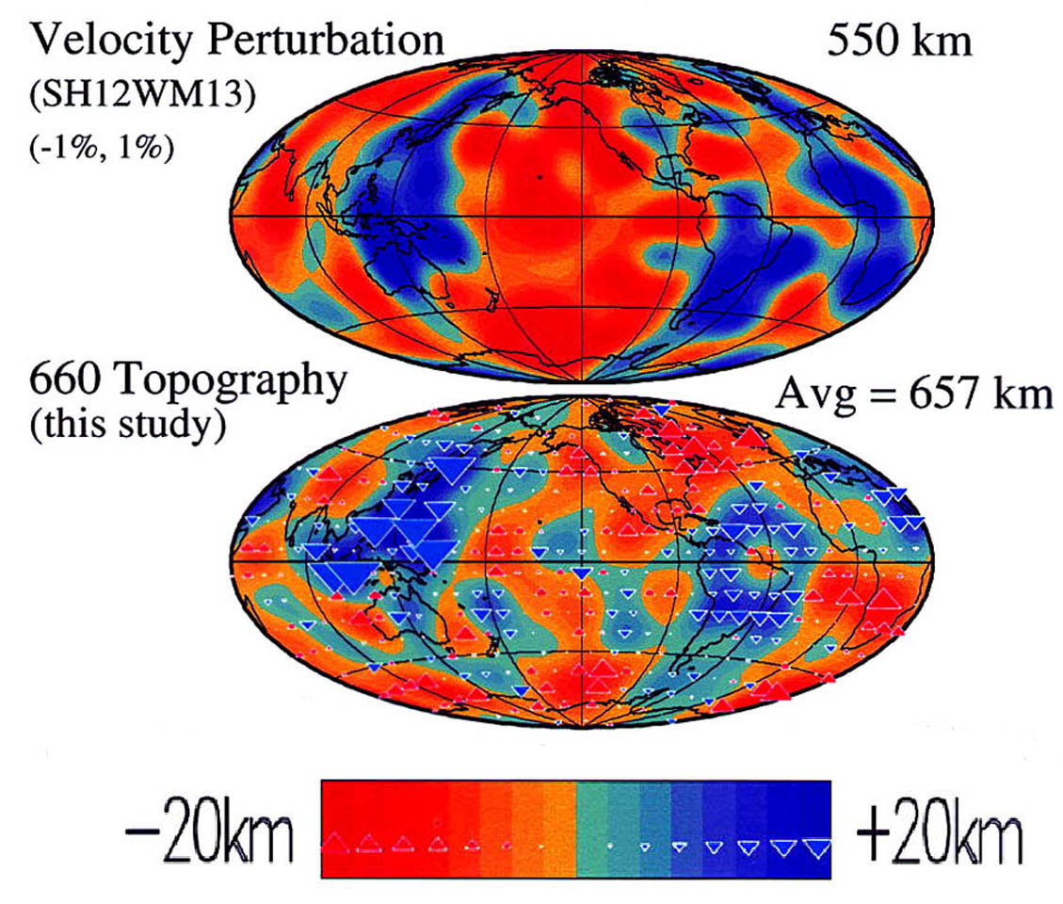
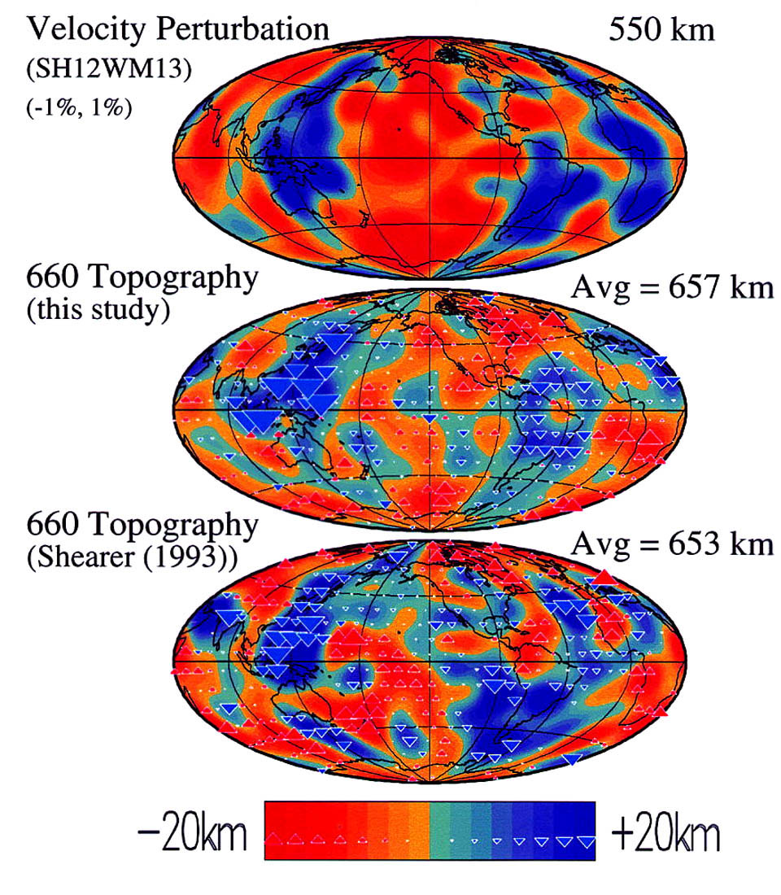
Correlation of TZ velocity anomalies and 660 topography
High correlation of the 660km discontinuity topography with velocity perturbations in the transition zone indicates ponding of heavier (cooler) material. There is no correlation with the anomalies below 660km.

Slide 14
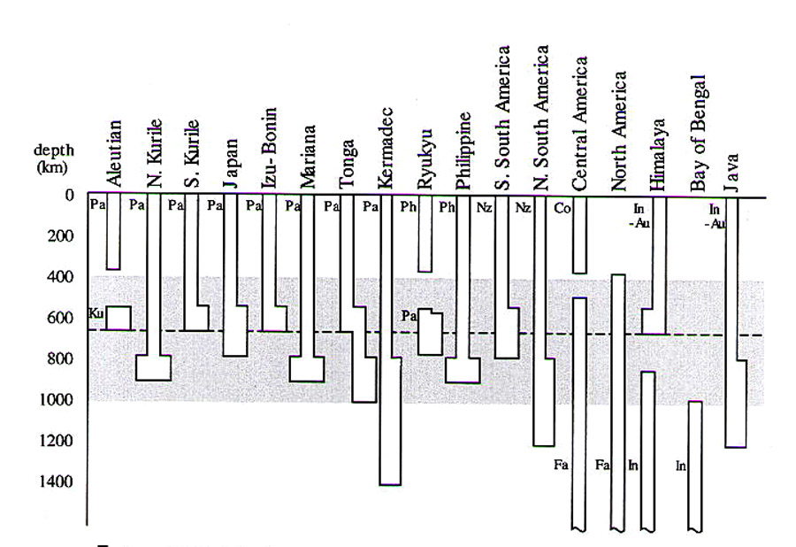
Stagnant slabs are common
from Fukao et al. (2001)

Slide 15
Lower Mantle
Ritsema et al., 2011

Slide 16
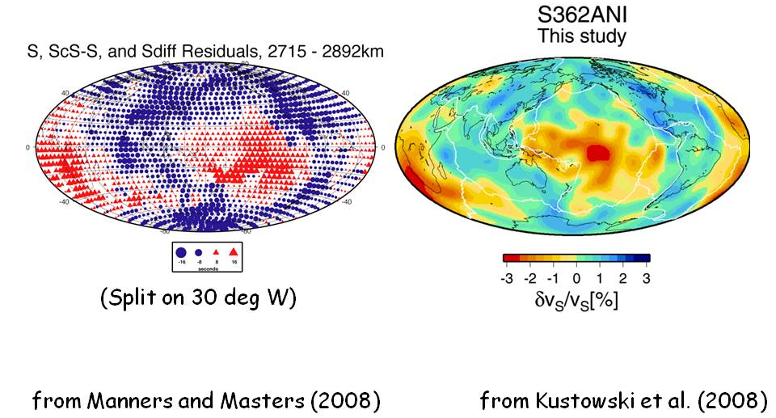
Data and Model
The dominant degree-2 signal is clearly visible in the data; the model at 2800 km depth looks very much like travel time anomalies of S-waves that bottom in the lowermost mantle.

Slide 17
Lower mantle “slow – fast” regionalization
5
4
3
2
1
0
How similar are regionalizations based on cluster
analysis of different tomographic models?
Lekic et al. (2012)
Notes:
Even though we have less data that constrains lower mantle structure ( no surface waves, etc. ) the structure is simple, so we will start there

Slide 18
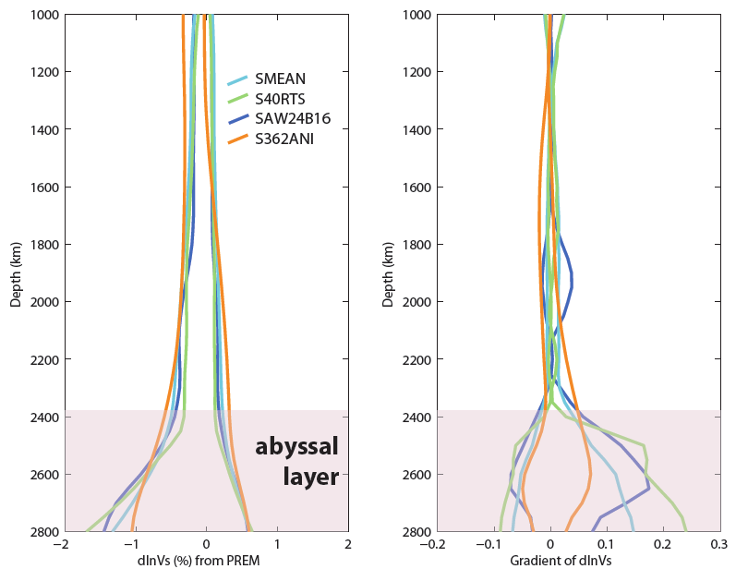
The Abyssal Layer
Velocities
Velocity gradient

Slide 19
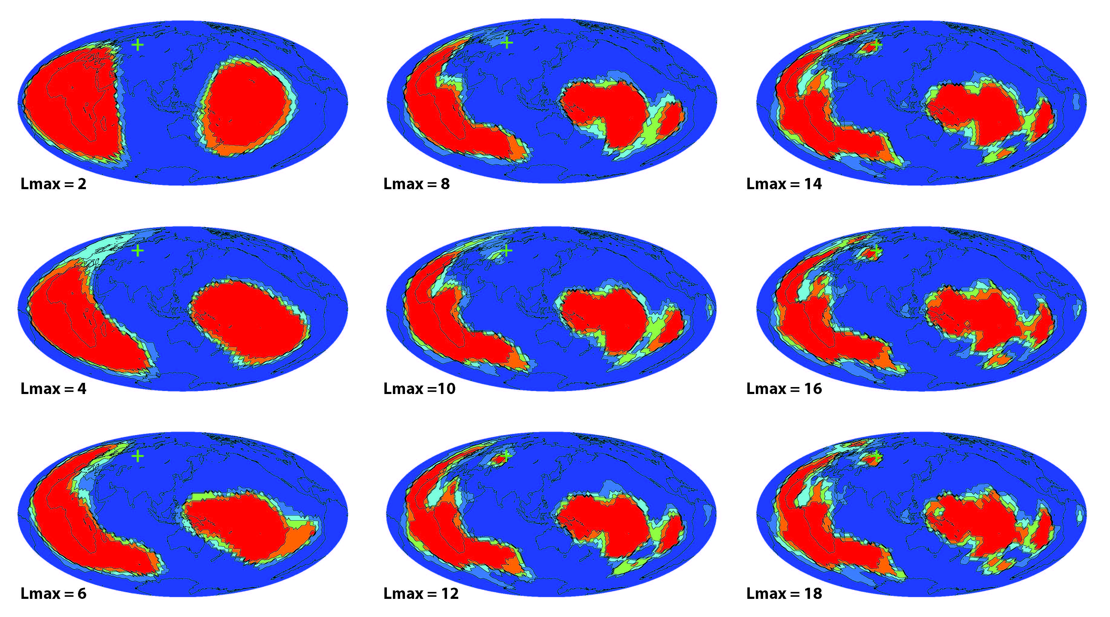
Voting vs. harmonic order

Slide 20
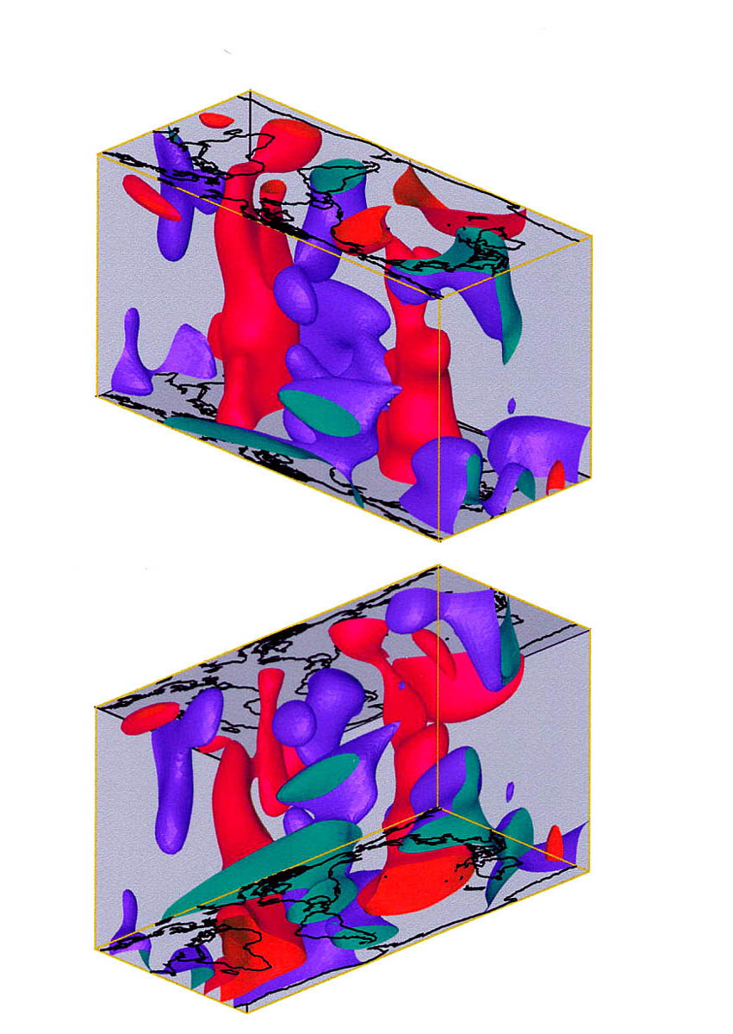
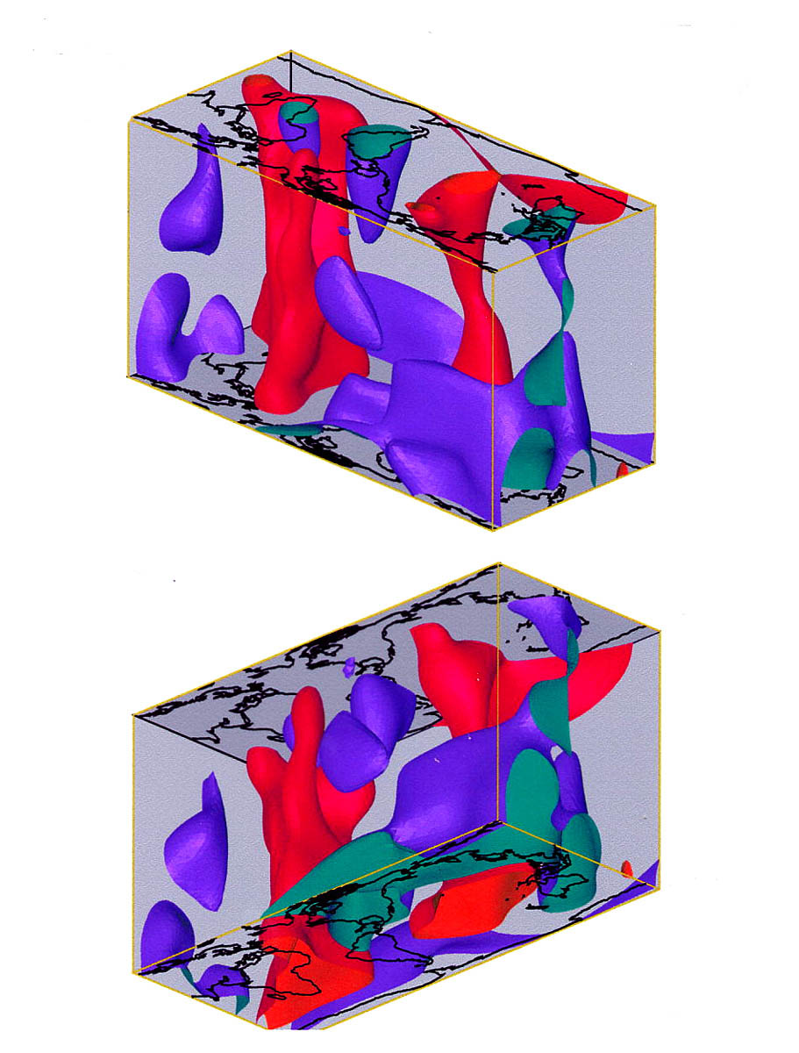
Large scale features in different models are similar
Caltech/Oxford
Scripps

Slide 21
A puzzle:
Geodynamic functions; degrees 2 & 3 only
Geoid
Hot spots
Seismic structure
Subduction 0 – 120 Ma
Richards & Engerbretsen, 1992

Slide 22
Slabs at depth
72 km
362 km
652 km
942 km
1377 km
After Lithgow-Bertelloni
and Richards, 1998
2102 km
j
2827 km

Slide 23
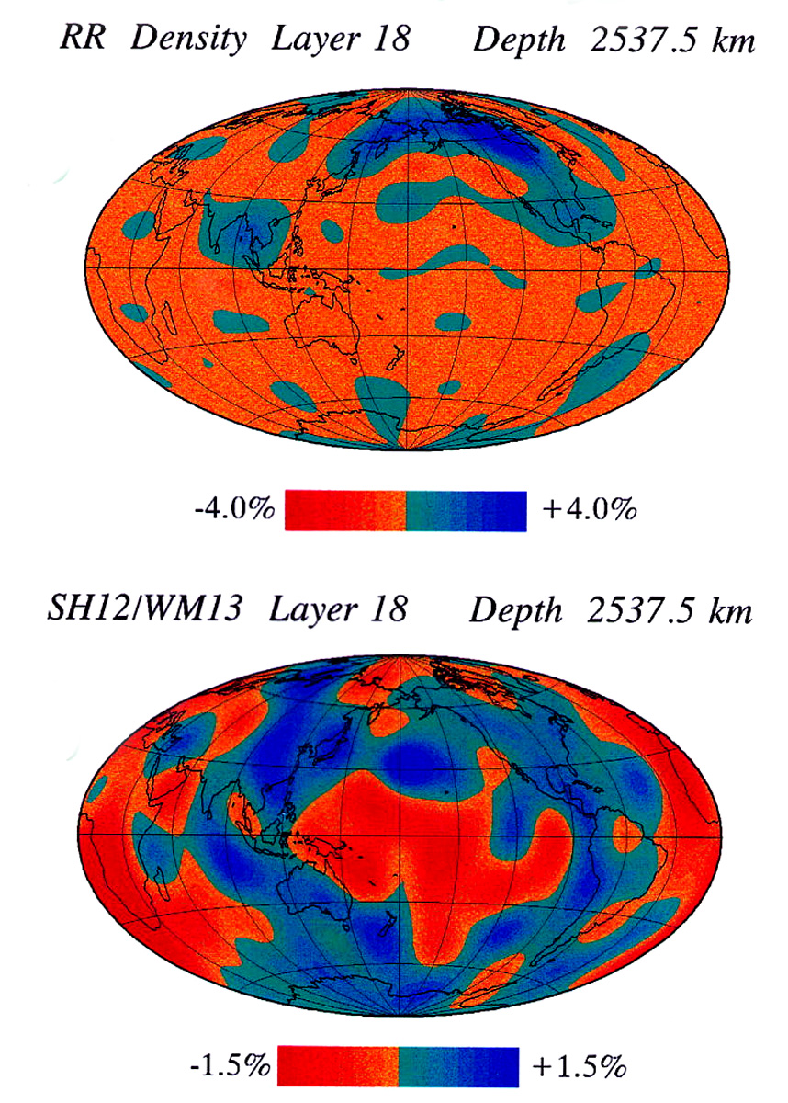
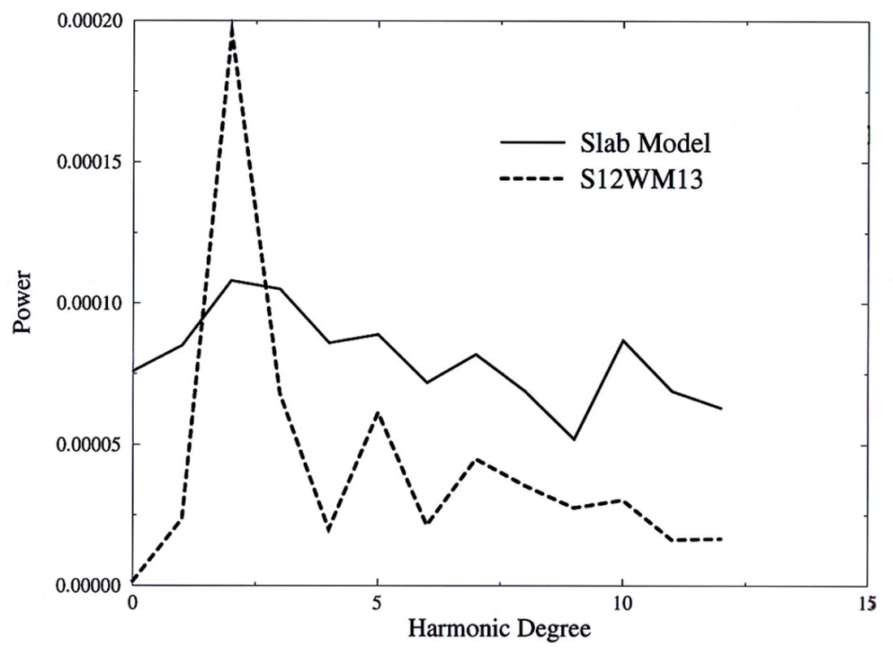
It does not work!
Slabs and seismic velocities;
Degrees 1-12
Power spectra

Slide 24
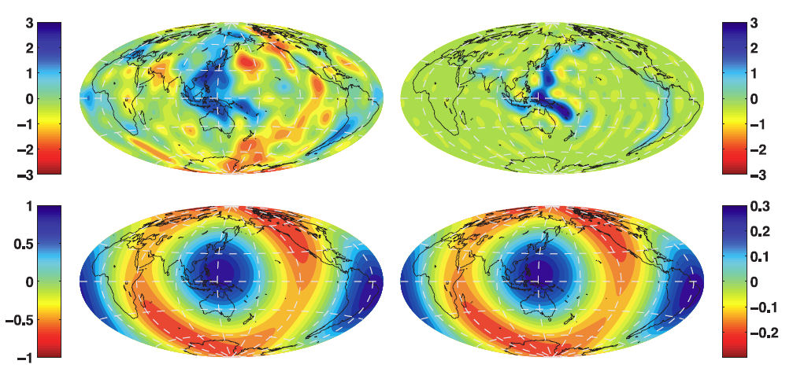
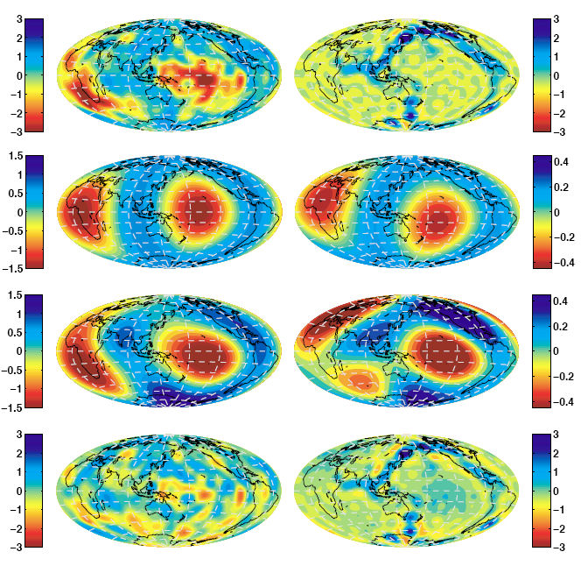
Slabs at depth
72 km
Sum: upper mantle
362 km
652 km
942 km
1377 km
After Lithgow-Bertelloni
and Richards, 1998
Sum: whole mantle
2102 km
j
2827 km

Slide 25
It works for the Upper Mantle!
Comparison of seismic model S362ANI (left column) at 600 km and integrated mass anomaly for slab model L-B&R (right column). The top maps show the velocity model at 600 km and the whole-mantle integrated slab model for degrees 1-18. The bottom row shows degree-2 pattern only (note the changed color scale).

Slide 26
It works for the whole mantle; degrees 2 &3 only!
2800 km
All degrees
Degree 2
Degrees 2 & 3
Comparison of seismic model S362ANI (left column) at 2800 km and integrated mass anomaly for slab model L-B&R (right column). The top maps show the velocity model at 2800 km and the whole-mantle integrated slab model for degrees 1-18. The middle row shows degree-2 pattern only (note the changed color scale), while the third row shows the combined degree 2 and 3 pattern.

Slide 27
What does it mean?
This means that velocity anomalies in the lowermost mantle represent a long time average of the subduction process.

Slide 28
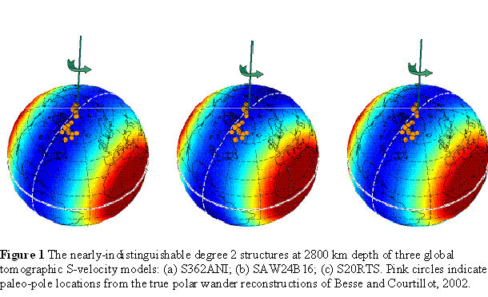
Degree 2 velocity anomalies at 2800 km, the Earth’s rotation axis and TPW paths of Besse and Courtillot (2002)
S362ANI
SAW24B
S20RTS
There is less than 1 in 1,000 probability that such a configuration of
degree 2 is random. If low velocities are associated with a positive
gravitational effect, then the axis of the minimum moment of inertia
is in the equatorial plane.

Slide 29
Two main points:
The characteristics of the spectrum of heterogeneity as a function of depth indicates the presence of five different regions: three in in the upper mantle and two in the lower mantle.
A very large structure at the bottom of the mantle imposes a permanent imprint on the tectonics at the surface. It determines a broad ring in which subduction can occur and regions of high hot-spot activity.

Slide 30
What should CIDER do?
The paradigm of whole mantle convection should be modified to account of zonation of mantle heterogeneity. This will require close and constructive cooperation of geodynamicists, seismologists, mineral physicists and geochemists.
CIDER has now the means to support an effort to identify the issues that need to be addressed in order to achieve substantial progress.

Slide 31
The next 10 slides were not shown

Slide 32
Principal Component Analysis (PCA)
A multi-dimensional function – a 3-D velocity model, for example – may be represented by a sum of multi-dimensional functions that are orthogonal:
Δv(r,θ,φ) = ∑ λi • fi (r, θ, φ)
Where λi are eigenvalues and
∫ fi • fj dV = δij
The advantage of PCA is to determine the importance of different elements of the model.

Slide 33
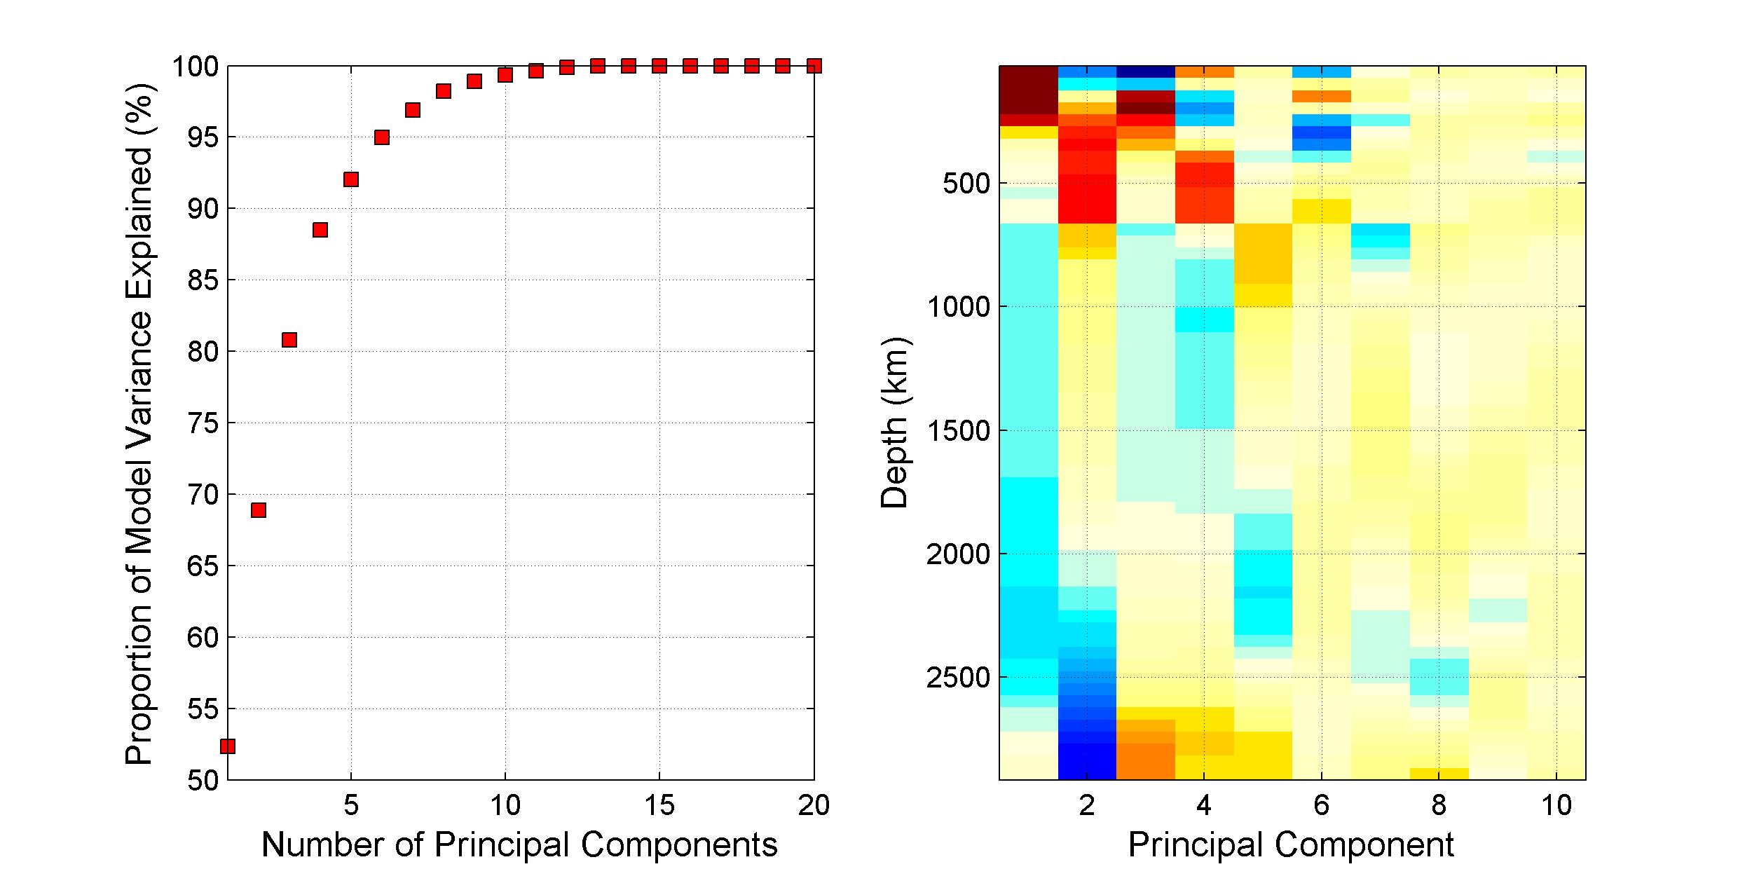
Variance reduction and the radial components of the largest PC’s of model S362ANI

Slide 34
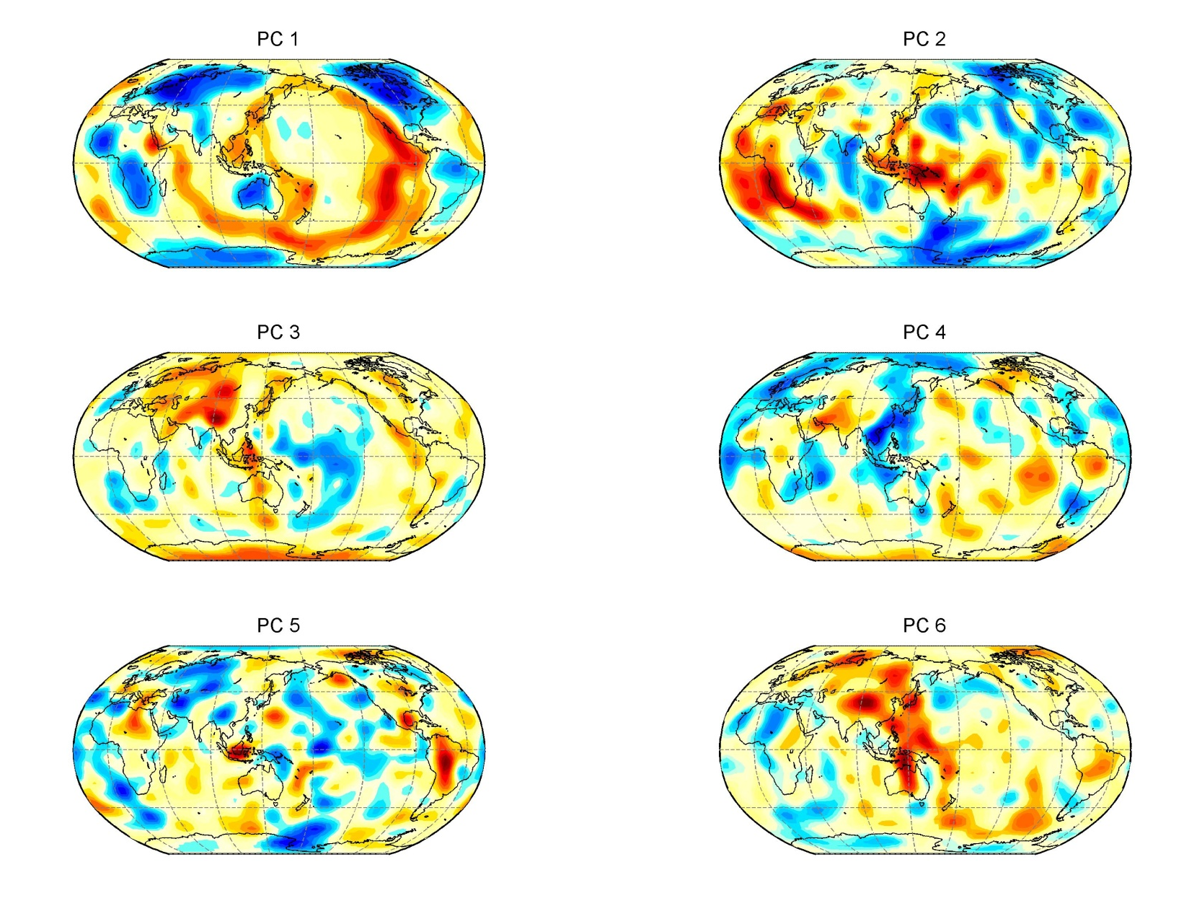
The first six PC’s: horizontal component

Slide 35
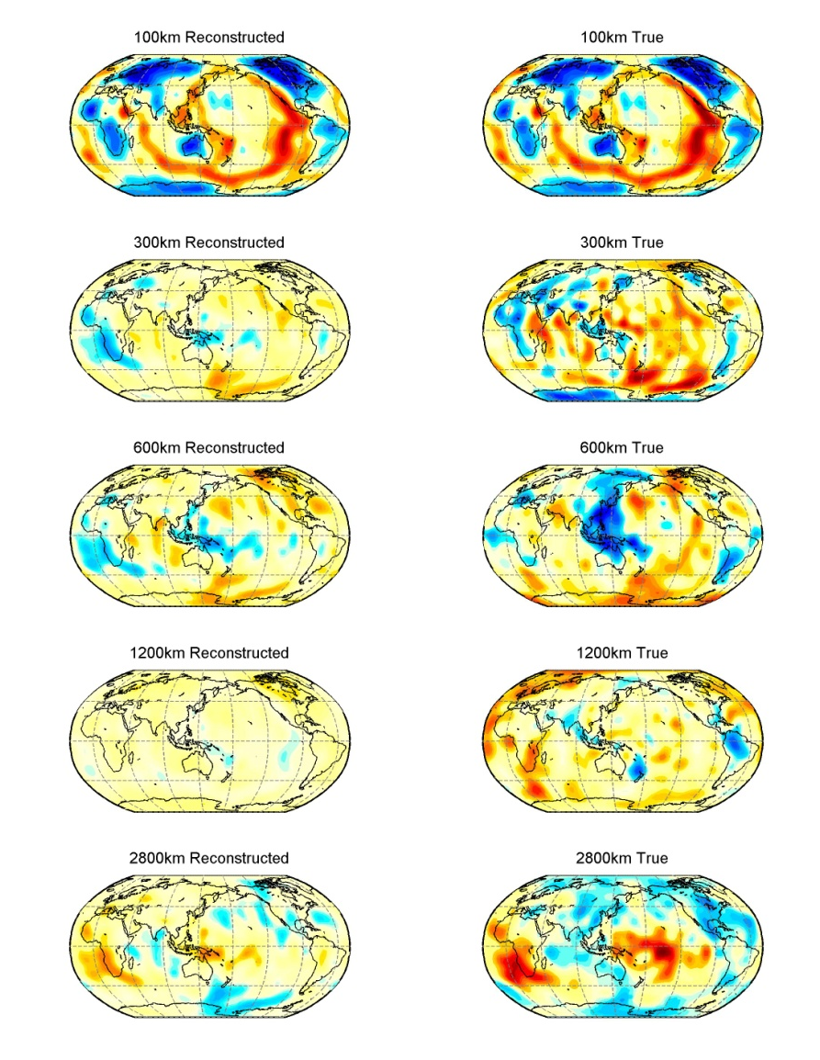
Model obtained by using two largest PC’s compared to S362ANI (right)
69% variance reduction

Slide 36
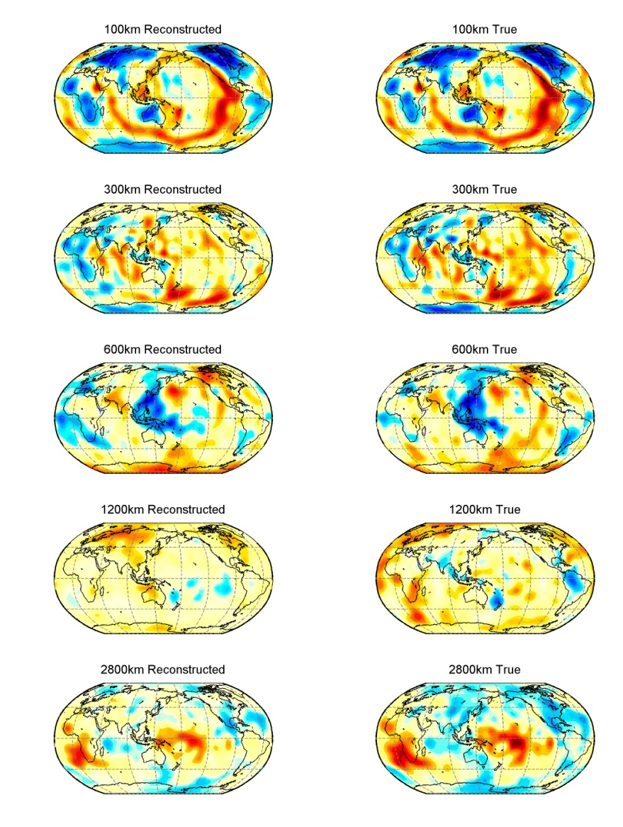
Model obtained by using six largest PC’s compared to S362ANI (right)
95% variance reduction

Slide 37
Comparison of five models at a depth of 2800 km

Slide 38
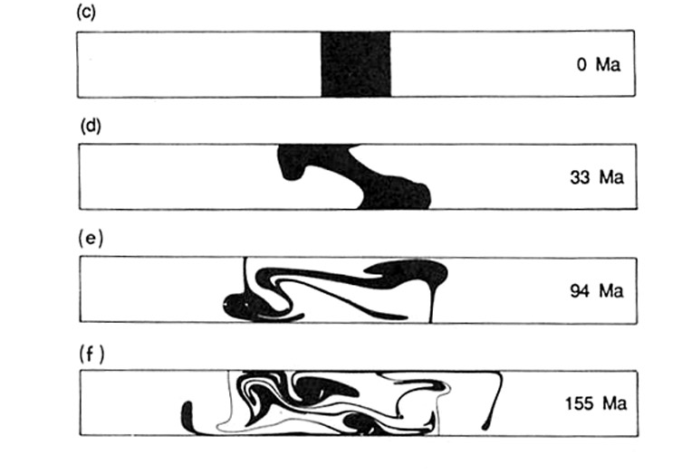
You cannot unmix convection
After 4.5 billion years after
the Earth accreted, the dominant
component of lateral
heterogeneity in the lowermost
mantle still looks like the initial
model of the convection experiment

Slide 39
Degrees 2 & 3 tell most of the story
S362ANI
Degrees 2 & 3
Five model voting
All degrees

