Slide 1
Transport Properties (A Mostly Mineral Physics-ish Perspective)
Differing Flavors of Transport Properties: Thermal, Chemical, Electrical
A Brief Guide to Formalisms
Briefly, How They are Determined…
An Example or Two of Each of Interest for the Deep Earth

Slide 2
T-conductivity--Geophysical Issues at Stake Include
Heat Transport/Gradient Through Conductive Zones (Lithosphere, D”)
Rate of Equilibration of Thermal Anomalies (Like Slabs…)
Input to Fluid Dynamic Models (Rayleigh #, etc.)

Slide 3
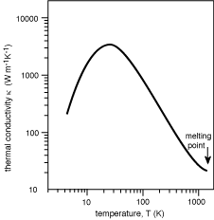
Thermal Conductivity: A Tale of Three (Main) Transporters
In insulators/semiconductors, generation and transport of thermal waves (phonons, lattice-mediated)---conductivity controlled by anharmonic- (scattering) and defect-driven effects.
α T³
α T⁻¹

Slide 4
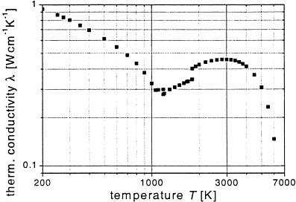
Thermal Conductivity: A Tale of 3 Mechanisms
2) In metals, can have lattice and electron-mediated thermal transport—T dependence modulated by electron-electron and electron-phonon scattering.
Liquid
Body-centered
cubic
F.c.c.
Fe
From Schaaf, Prog.
Mater. Sci., 2002;
after Toulokian.

Slide 5
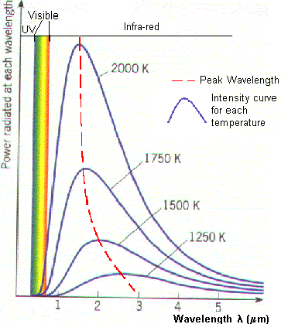
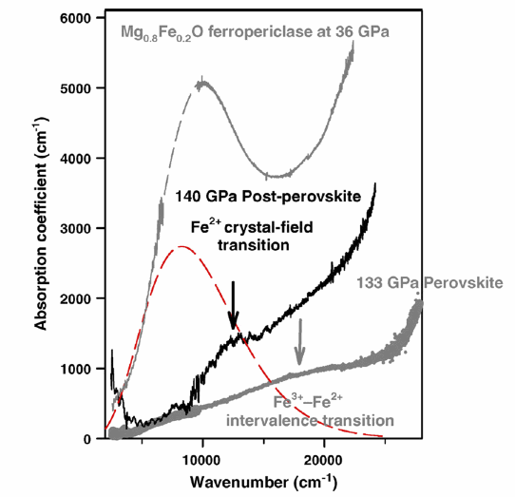
Thermal Conductivity: A Tale of 3 Mechanisms
3) Radiative conductivity (photon-mediated)— Limited by material opacity. Transparency is fragile…
2 μm
1 μm
0.5 μm
Goncharov et al., PEPI, 2010

Slide 6
Just to Remind you (and the Math for Chemical Diffusion is essentially identical---right down to the anisotropy….)
q (heat flow/unit area/time) = -k dT/dz
where k is thermal conductivity (W/m-K)
Or, if you like vectors, q = -k grad T ,
Or, q_{i} = - Σ k_{ij} δT/δx_{j} (yes, thermal conductivity is
a lovely (and symmetric) tensor, and hence anisotropic…)
With respect to time, Energy Balance requires
ρc dT/dt = k d²T/dz²; with k/ρc = κ (the thermal diffusivity: l²/sec), with c = heat capacity.

Slide 7
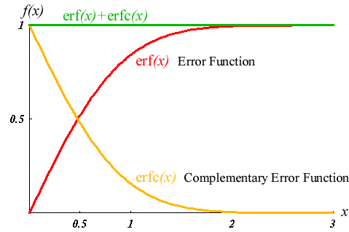
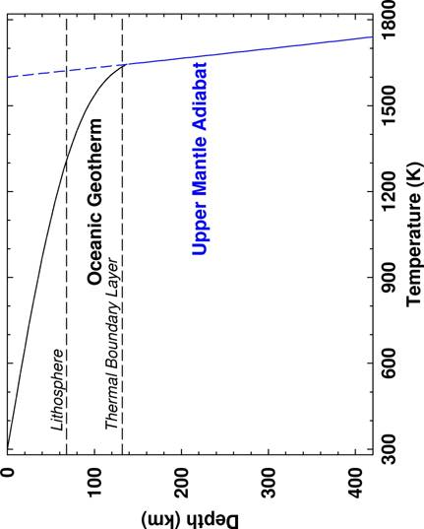
The non-dimensional net solution is:
(T-T₀)/(T_{s}-T₀) = 1 – erf z/(2√κT), and that describes the T distribution in thermal boundary layers (w/o internal heating).

Slide 8
Thermal Conductivity--Lots of Ways to make Measurements, Including
Modulated Thermal Input and Response Measurement (Phase Lag) (Mostly LVP, so ca. 2000 K and 25 GPa)
Input Thermal Pulse (Laser Flash or other) at one interface, measure response at opposite interface (Mostly low P and high T; preliminary measurements at high P (ca. 100 GPa, 2000 K))
Measuring and Modeling Thermal Gradients within Spot-Heated Samples (DAC-Very High P/T)
Optical Techniques--Effectively, measure phonon decay, via impulsive stimulated scattering. Prospects, but limited ES applications to date.
Theory (often in defect-free solids)…

Slide 9
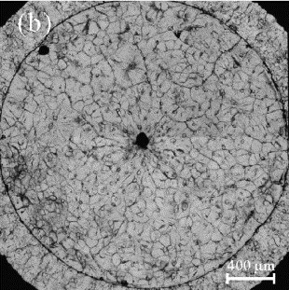
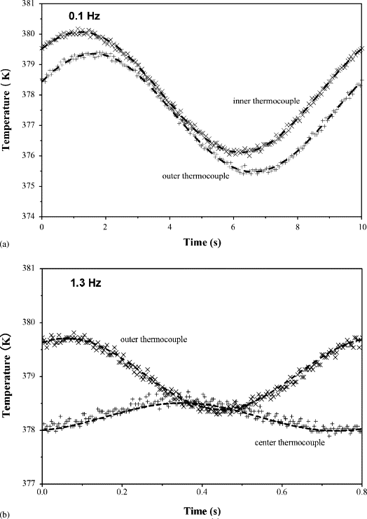
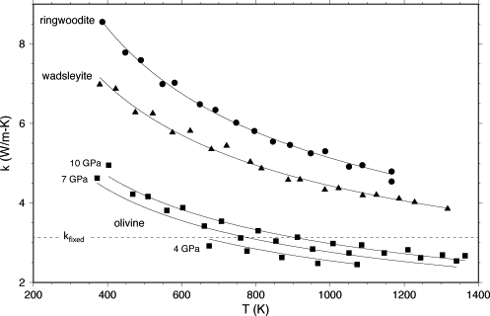
TC
An Example of the Phase Lag Technique for Thermal Conductivity Measurements at High-Pressures and Temperatures
TC
From: Xu et al., PEPI, 2004; Marton et al., PEPI, 2005)

Slide 10
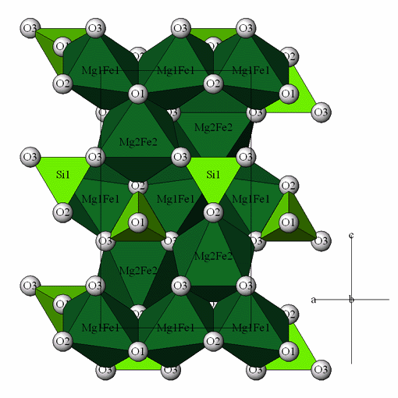
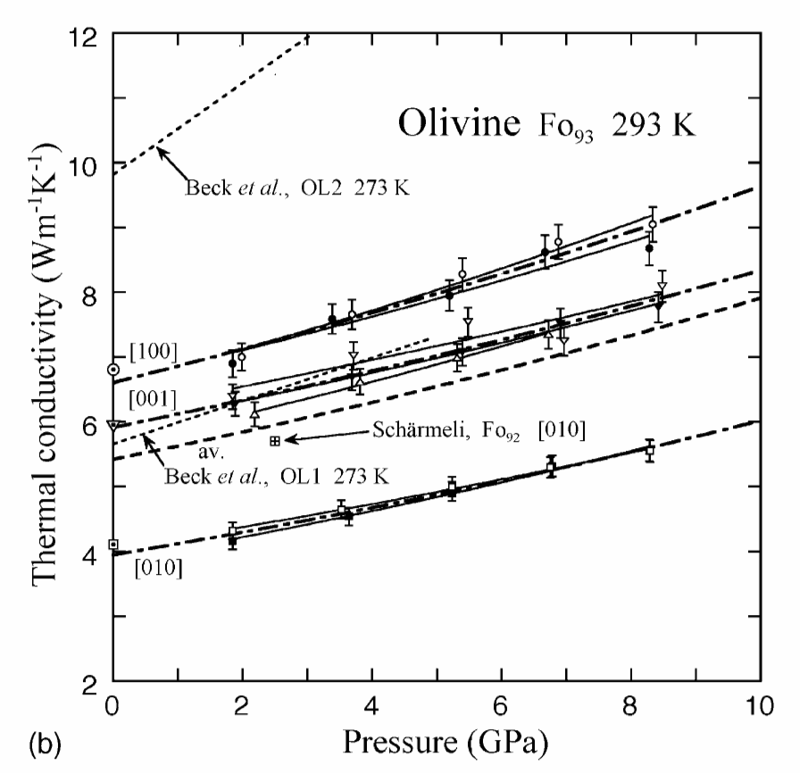
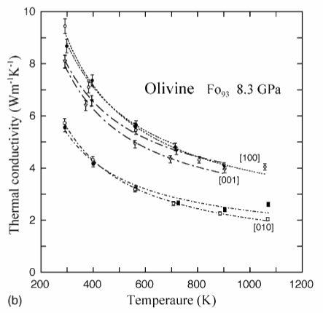
Now about Thermal Conductivity Being a Tensor…
T-cond along [100] ~70% larger than in the slowest direction [010]. Limited Data on T-cond Anisotropy for High-P Phases
Osako et al., PEPI, 2004

Slide 11
Thermal Conductivity: Rough Means of Getting it at High T and P
Details: the temperature and pressure dependence of T.C. of a pure phase depends on: 1) V^{-1/3}; 2) the shift of a weighting of the phonon spectrum with P/T (hence Gruneisen parameter); and 3) the shift in phonon scattering with P/T (not at all well-constrained).
Hofmeister (Science, 1999) gives the long formulas…
Gross (but not too bad) approximations are:
λ_{L} = λ (298/T)^{n}(ρ/ρ_{ref})^{(γ + 2q + K’ -4/3)}
Here, λ_{L} is the Thermal Conductivity, λ is its ambient value,
n = ~1, K_{T} is the bulk modulus, K_{T}’ is its pressure derivative, γ is the
Gruneisen parameter, and q its logarithmic derivate w.r.t. volume:
Hasterok and Chapman, EPSL, 2011; Manthilake et al., PNAS, 2011.

Slide 12
Chemical Transport--Geophysical Issues at Stake Include
Homogenization of Heterogeneities
A Control on Viscous Flow (especially Diffusion Creep)
Feedthrough to Electrical Conductivity, via Ionic Transport…

Slide 13
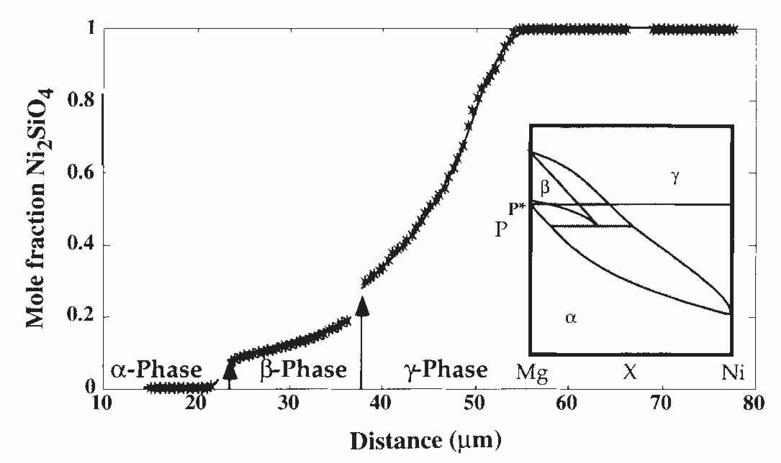
Chemical Diffusion: Conceptually Straightforward Measurements
Juxtapose Chemically or Isotopically Different Materials (Bulk, Thin Film, Surface Layer), Cook at P/T, Look and Invert…
Farber et al., JGR, 2000
C(x,t) = 0.5(C_{+∞} - C_{-∞} )(1-erf[(x-x*)/(2√Dt)]) + C_{+∞}
Can Include Concentration-Dependence, and Has Unusual Richness for Multiphase Assemblages: Phase Diagram, K_{d}’s, etc. as well…

Slide 14
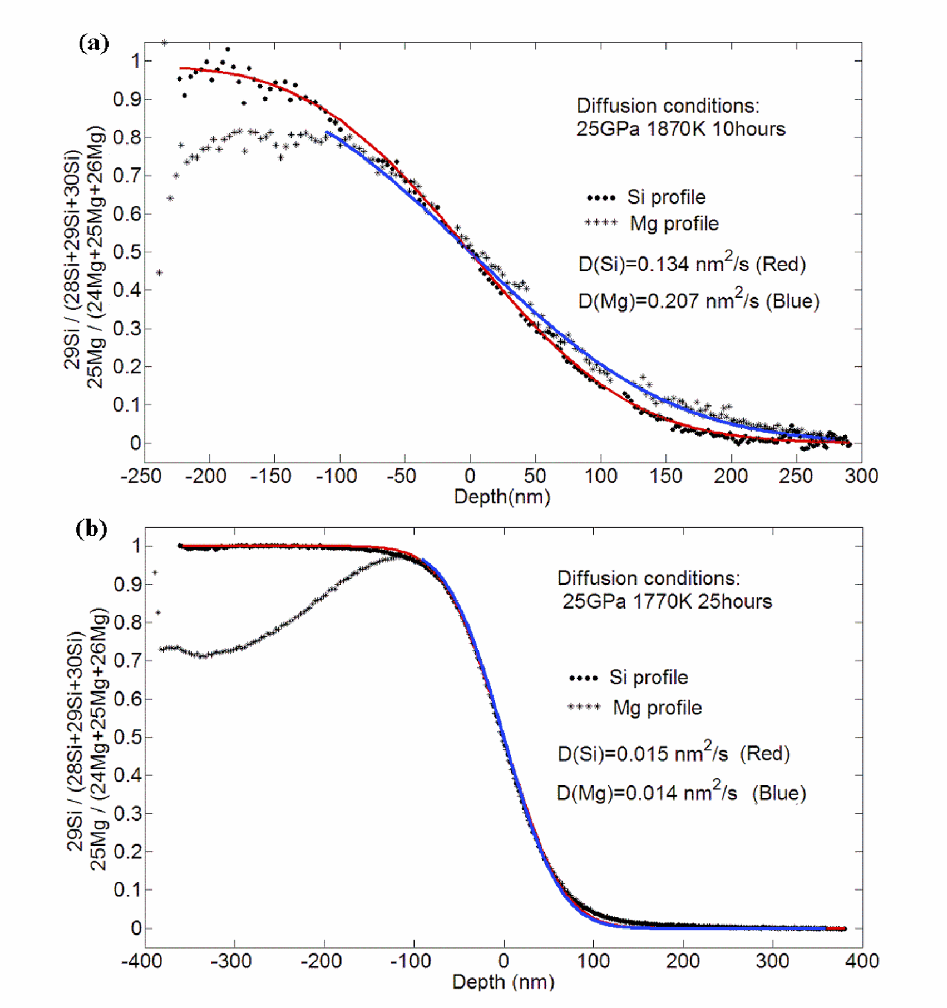
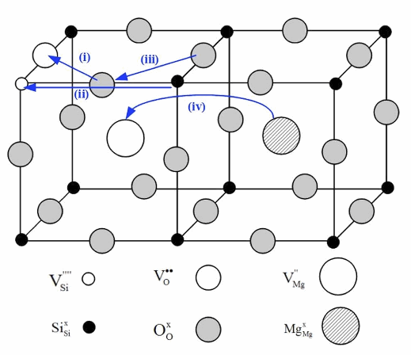
Perovskite Diffusion: Perhaps Less Straightforward in Practice
Huh? Si and Mg move at the same rates?!?
Xu et al., JGR, 2011

Slide 15
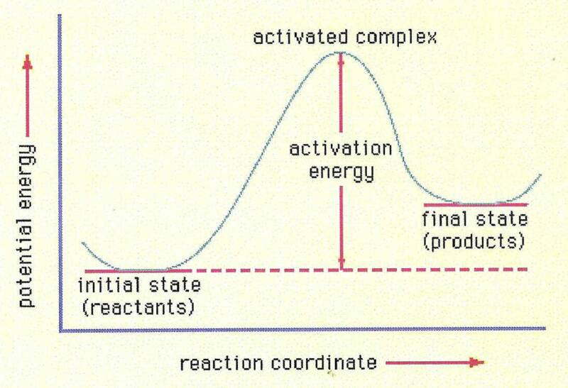
As an Activated Process, Simple Chemical Diffusion is Straightforward to Extrapolate in P/T…
D = D₀ exp[(-E_{a} + PΔV*)/kT]
Here, D is the chemical diffusivity, D₀ is a pre-exponential factor,
E_{a} is the activation energy, and ΔV* is the activation volume.
N.B. This doesn’t include potentially important effects such as
pressure, temperature or fO₂-driven variations in defect
chemistry that can shift diffusion rates.

Slide 16
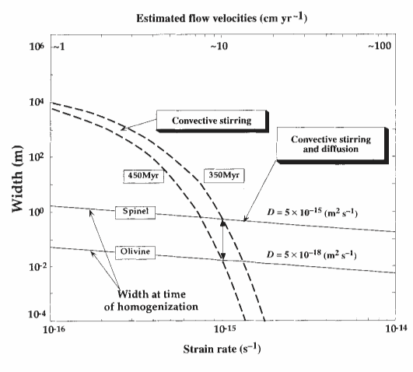
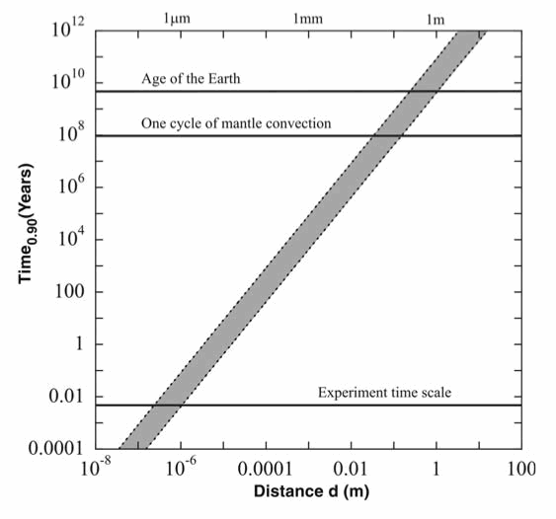
That said, Diffusion is a Pretty Terrible Way to Get Rid of Heterogeneities
Farber et al., Nature, 1994
Holzapfel et al., Science, 2005
Heterogeneities bigger than about a meter take forever to get rid of diffusively…

Slide 17
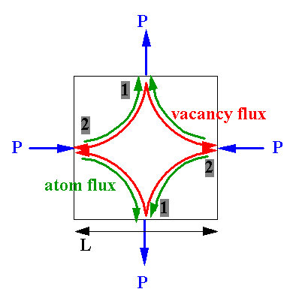
The Right Chemical Diffusion Rate can Yield Viscosity in the Diffusional Creep Regime (Nabarro-Herring Creep)…
ν = σ/ε. = d²kT/αD_{sd}V
Here, σ is stress, ε. is strain rate, d is grain size, k is Boltzmann’s constant, α is a geometric constant (usually ~5-ish), D_{sd} is the self-diffusivity, and V is the atomic volume.
As you might expect, strongly grain size dependent…

Slide 18
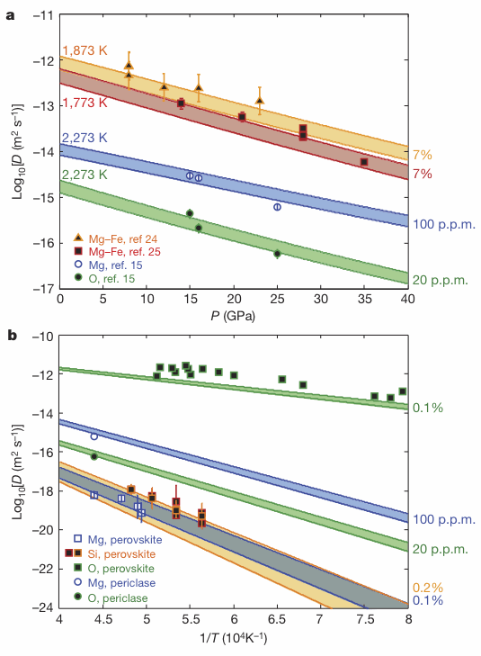
How about those Defects?
(Mg,Fe)O on top, (Mg,Fe)O and Pv on the bottom; estimated vacancy contents are numbers on the side. Theory is bands, Data are points.
Now: How many defects are there in the deep Earth?
Ammann et al., Nature, 2010

Slide 19
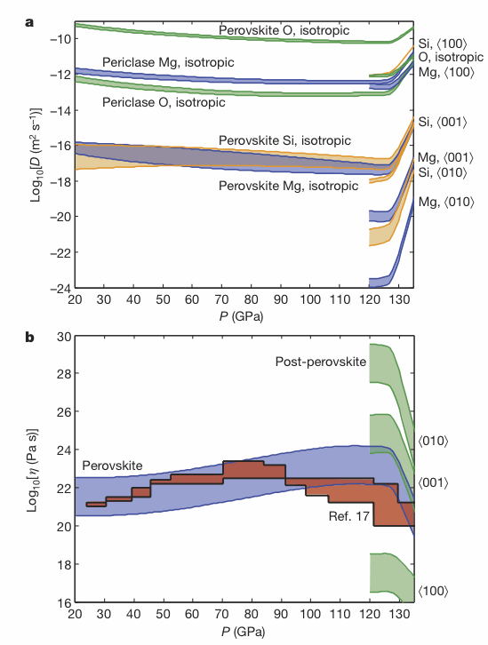
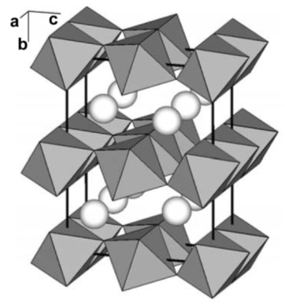
Now: Recall Diffusion is Anisotropic, as Well (as is post-perovskite)….
Hmmm…ca. 10 orders of magnitude in diffusivity anisotropy translates into ca. 10 orders of magnitude of viscosity anisotropy.
Ammann et al.,
Nature, 2010

Slide 20
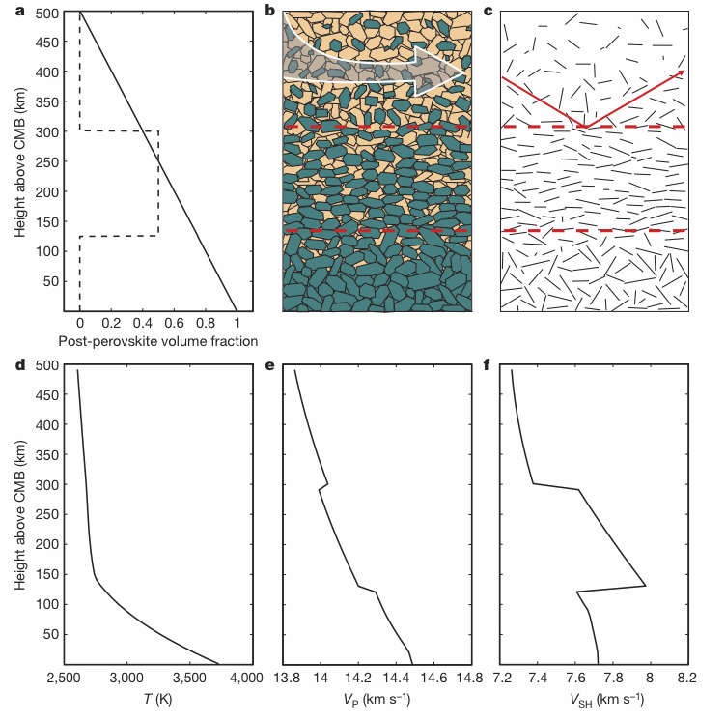
Now: Put in some Variable Preferred Orientation and Elastic Anisotropy.
And, seismic profiles emerge that look like some that have been attributed to folded slabs…
Ammann et al., Nature, 2010

Slide 21
E-conductivity--Geophysical Issues at Stake Include
Through Thermal Conductivity, Heat Flow out of Core (!), Age of Inner Core, Geodynamo Operational Conditions (metallic conductivity: negative dσ/dT)
Identification of Hydrous/Melt-Bearing Regions via Magnetotellurics (mostly ionic conductivity: positive dσ/dT)
Magnetic Field Filtering by Mantle; Variations in Length of Day (EM coupling in mantle)

Slide 22
Within an Ionic Regime, Conductivity and Diffusivity are Linked
σ(P,T) = D(P,T)q²n/kT]:
Nernst-Einstein Equation
Here, σ is the electrical conductivity, D is the diffusion rate,
q is the charge on the species, k is Boltzmann’s constant,
and n is the concentration.
Great Stuff. However, one does have to know all the possible charge carriers, and their mobilities/vacancy concentrations (as a function of P/T), to get the right answer for rocks/minerals.

Slide 23
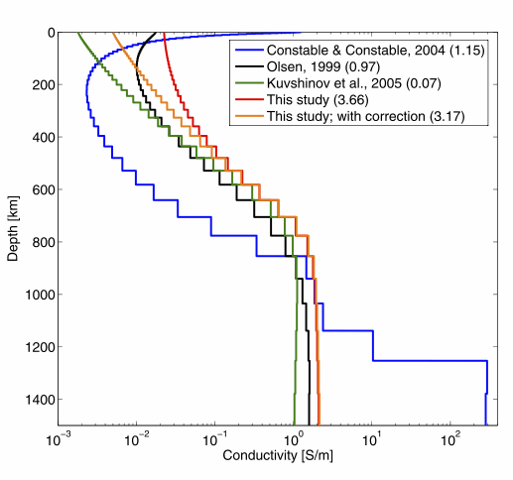
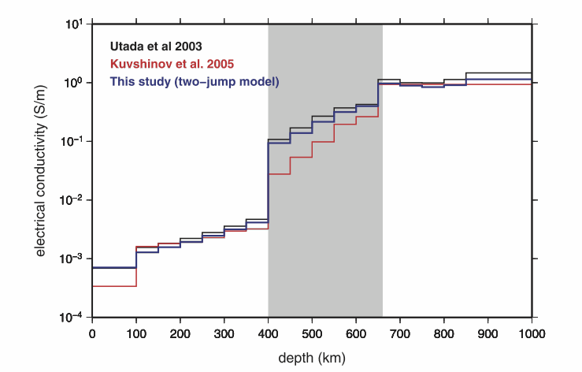
E-conductivity—Observationally, A Coarse Probe
Global 1-D Models
Regional N-Pacific Models
Kuvshinov and Olsen, GRL, 2006
Shimizu et al., Geophys. J., 2010

Slide 24
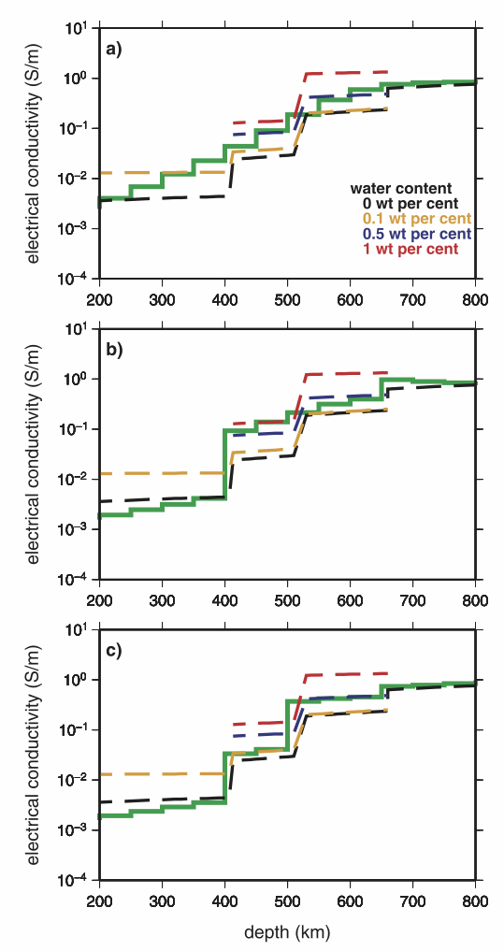
But, Attempts Are Made—with Some Prospects
Comparison with Yosino et al., Nature, 2008 lab data. Assumes that all of the conductivity mismatch is produced by H₂O—no T anomalies, no melt, no high conductivity GB phases, etc.
Shimizu et al., Geophys. J., 2010

Slide 25
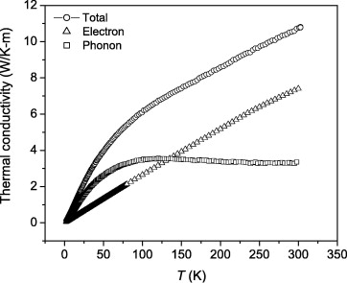
Metallic Conductivity—A Venerable Relationship
The Wiedemann-Franz Law:
L = k/σT,
Where L is the Lorenz #, and is quite close to 2.5 x 10⁻⁸ W-Ω/K² for lots and lots of metals, k is thermal conductivity and σ is electrical conductivity. Hence, measure e-conductivity, get thermal conductivity for cheap….
Austenitic Steel (mostly Fe)
Lu et al., Cryogenics, 2009

Slide 26
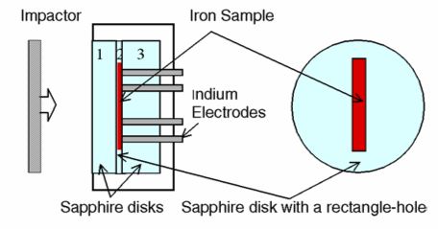
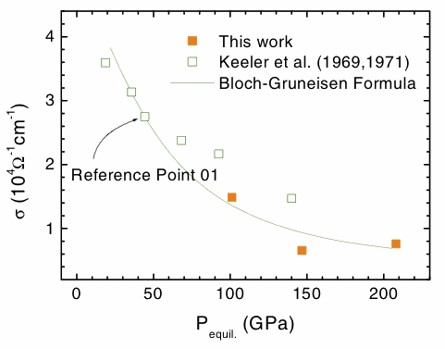
E-conductivity—Measurements at Core Conditions are Challenging
As it turns out, the ~factor of two difference in shock measurements of iron e-conductivity REALLY matters (especially if one cares about its thermal conductivity)…
Bi et al., J. Phys. Cond. Matter, 2002

Slide 27
Theoretical Electronic Thermal and Electrical Conductivity of Fe
Thermal Conductivity is higher than expected, hence heat transport in/out of the core is larger, power available for the dynamo is less, forming an inner core early is *much* harder, and stable stratification might be necessitated at the top of the outer core---Momentous Conclusions!
Issues include: Effect of lighter alloying components (still unclear, but will lower the values); Accuracy of theory for transport properties at these extreme conditions hasn’t really been demonstrated…
Pozzo et al., Nature, 2012

Slide 28
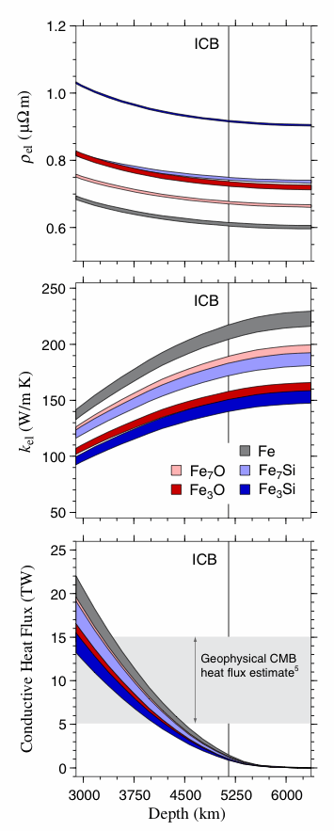
Role of Impurities on Thermal/Electrical Conductivity of Fe: More Theory
Issues include: Other Impurities? (C, H)…and accuracy of theory for transport properties...
deKoker et al., PNAS, 2012

Slide 29
Take-Home Messages
As with most characteristics, transport properties become less well-constrained as one goes to higher pressures and temperatures; nevertheless, simple formalisms for extrapolation exist, BUT
One might need to know a lot of information (defect concentration, vacancy abundance, H/minor element concentrations to extrapolate accurately (especially for chemical diffusion and e-conductivity)
It is well worth keeping in mind that these properties are tensors---hence, they can be highly anisotropic, and this anisotropy could be of key importance.

