Slide 1
Terra Incognita (Again? Again! Again.)
The zonal nature of the spectrum of lateral heterogeneity in the mantle as function of depth: five zones
Adam Dziewonski
A very informal presentation; KITP July 9, 2012

Slide 2
Geodynamic functions; degrees 2 & 3 only
Geoid
Hot spots
Seismic structure
Subduction 0 – 120 Ma
Richards & Engerbretsen, 1992

Slide 3
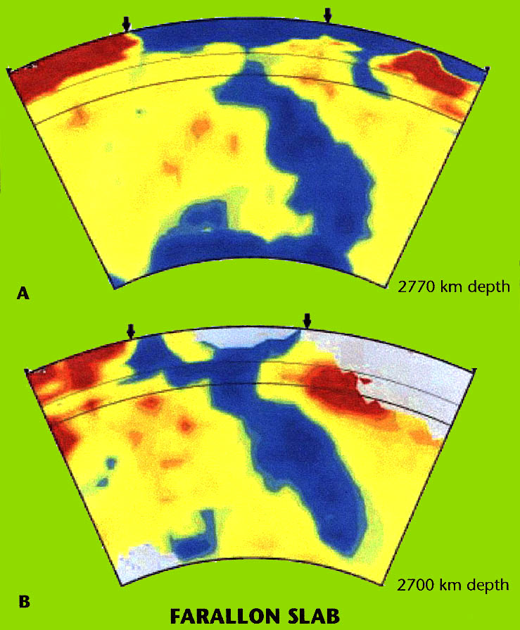
Slabs go to the bottom of the mantle !!!
1997
Grand et al., 1997

Slide 5
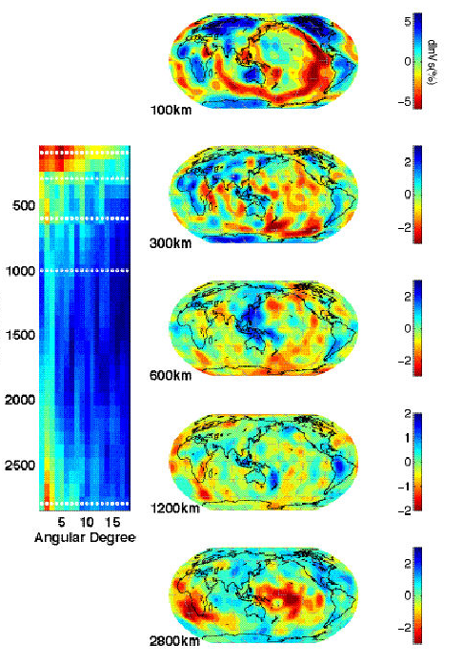
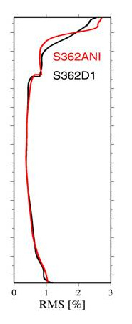
Five zones in the mantle
heterosphere
Moho – 225 km
upper mantle
buffer zone
225-500 km
transition zone
500-650 km
lower mantle
buffer zone
650-2400 km
abyssal zone
2400 km - CMB
(Dziewonski et al., 2010)

Slide 6
Spectral characteristics of three models
All models show five zones

Slide 7
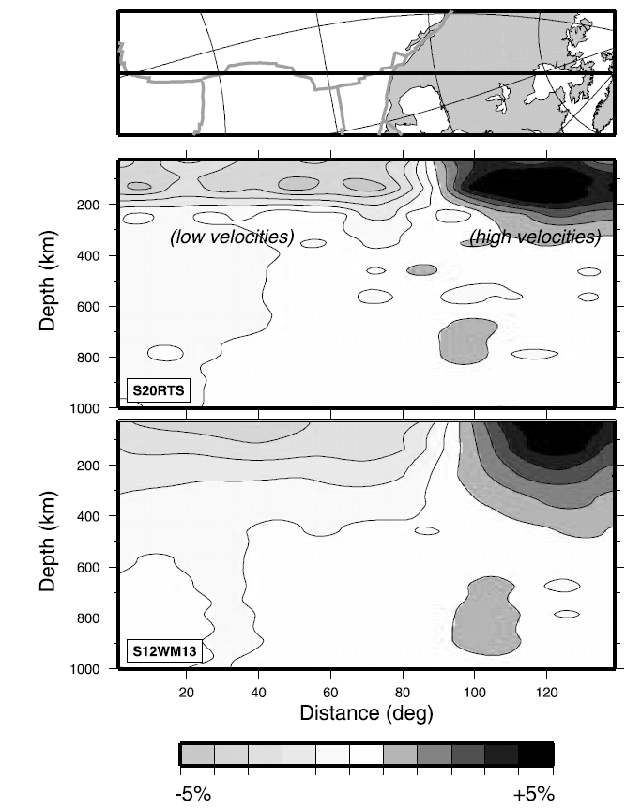
Velocity anomalies change abruptly between 200 and 300 km depth
From Ritsema et al., 2004

Slide 8
Five zones in the mantle
heterosphere
Moho – 225 km
upper mantle
buffer zone
225-500 km
transition zone
500-650 km
lower mantle
buffer zone
650-2400 km
abyssal zone
2400 km - CMB
(Dziewonski et al., 2010)

Slide 9
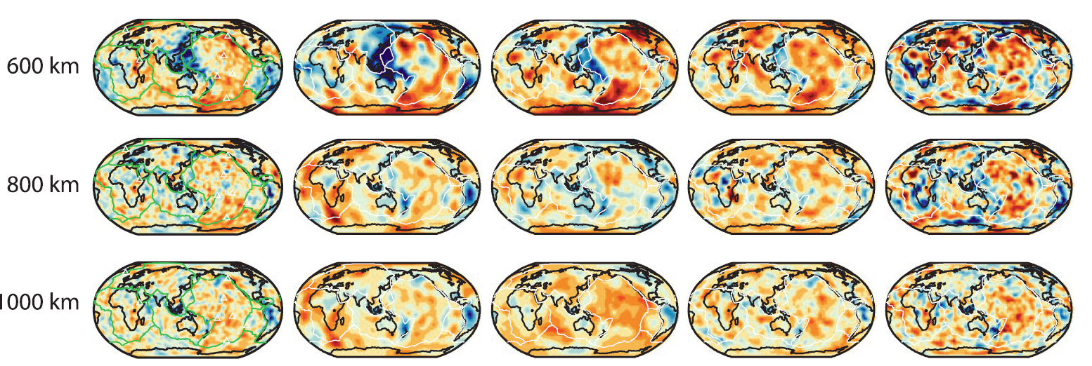
Comparison of five models
After Ritsema et al., 2011

Slide 10
Principal Component Analysis (PCA)
A multi-dimensional function – a 3-D velocity model, for example – may be represented by a sum of multi-dimensional functions that are orthogonal:
Δv(r,θ,φ) = ∑ λi • fi (r, θ, φ)
Where λi are eigenvalues and
∫ fi • fj dV = δij
The advantage of PCA is to determine the importance of different elements of the model.

Slide 11
Variance reduction and the radial components of the largest PC’s of model S362ANI

Slide 12
The first six PC’s: horizontal component

Slide 13
Model obtained by using two largest PC’s compared to S362ANI (right)
69% variance reduction

Slide 14
Model obtained by using four largest PC’s compared to S362ANI (right)
88% variance reduction

Slide 15
Model obtained by using six largest PC’s compared to S362ANI (right)
95% variance reduction

Slide 16
Comparison of five models at a depth of 2800 km

Slide 17
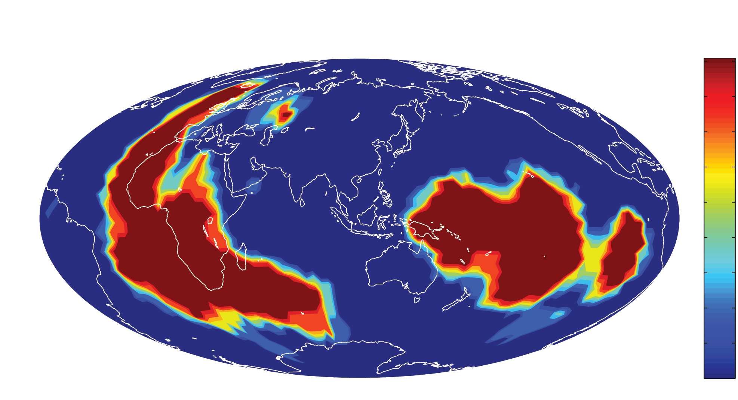
Lower mantle “slow – fast” regionalization
5
4
3
2
1
0
How similar are regionalizations based on cluster
analysis of different tomographic models?
Lekic et al. (2012)
Notes:
Even though we have less data that constrains lower mantle structure ( no surface waves, etc. ) the structure is simple, so we will start there

Slide 18
Vs Profiles of 2 Clusters

Slide 19
Voting vs. harmonic order

Slide 20
All degrees
2800 km
Degree 2
Degrees 2 & 3
Comparison of seismic model S362ANI (left column) at 2800 km and integrated mass anomaly for slab model L-B&R (right column). The top maps show the velocity model at 2800 km and the whole-mantle integrated slab model for degrees 1-18. The middle row shows degree-2 pattern only (note the changed color scale), while the third row shows the combined degree 2 and 3 pattern.

Slide 21
Degree 2 velocity anomalies at 2800 km, the Earth’s rotation axis and TPW paths of Besse and Courtillot (2002)
S362ANI
SAW24B
S20RTS

Slide 22
You cannot unmix convection
After 4.5 billion years after
the Earth accreted, the dominant
component of lateral
heterogeneity in the lowermost
mantle still looks like the initial
model of the convection experiment

Slide 23
Degrees 2 & 3 tell most of the story
S362ANI
Degrees 2 & 3
Five model voting
All degrees

Slide 24
Two main points:
The characteristics of the spectrum of heterogeneity as a function of depth indicates the presence of five different regions: three in in the upper mantle and two in the lower mantle.
A very large structure at the bottom of the mantle imposes a permanent imprint on the tectonics at the surface. It determines a broad ring in which subduction can occur and regions of high hot-spot activity.

Slide 25
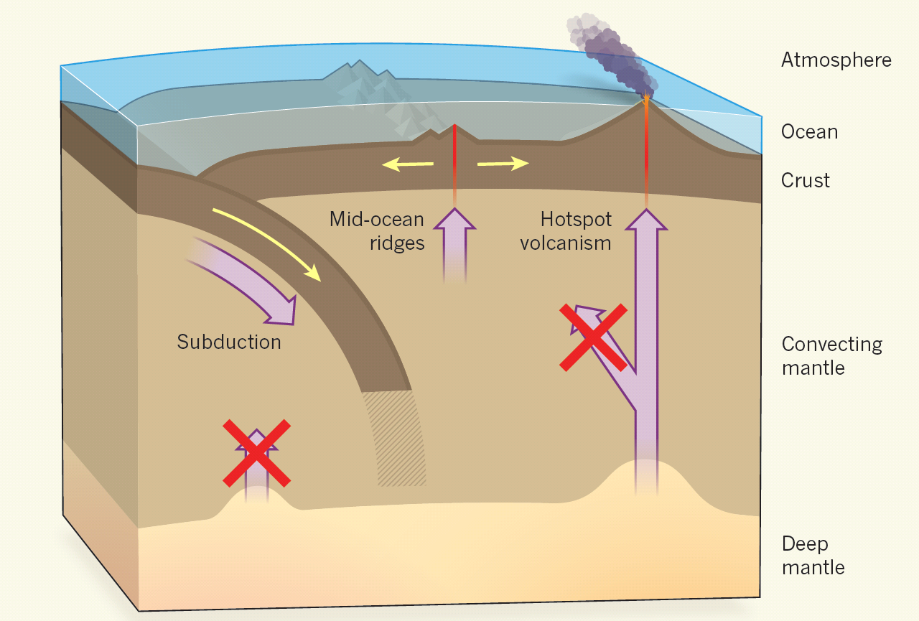
Deep mantle and convecting mantle do not mix
Mukhopadhyay (2012) ; figure from Ballentine (2012)

