Slide 1
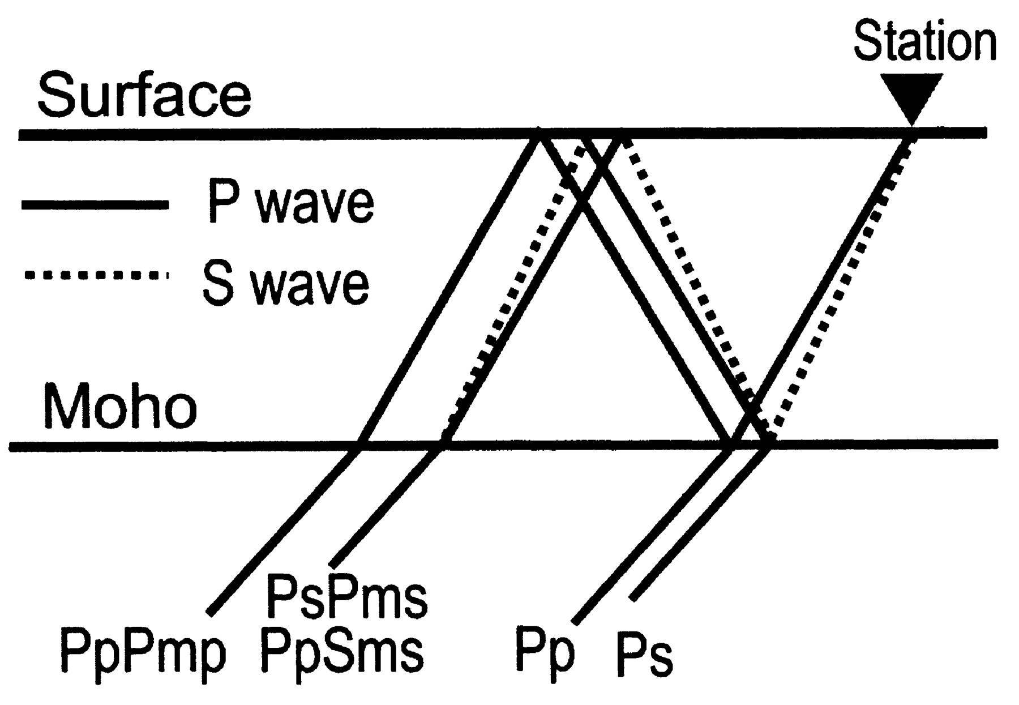
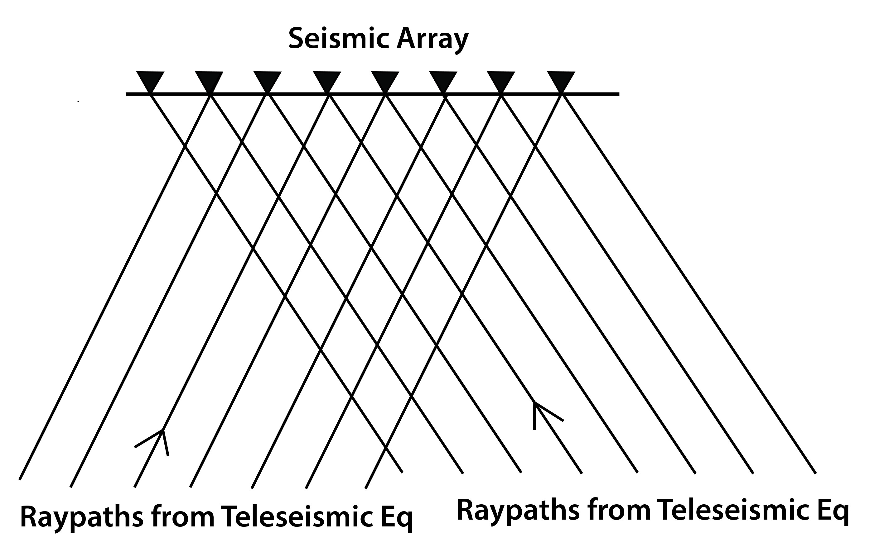
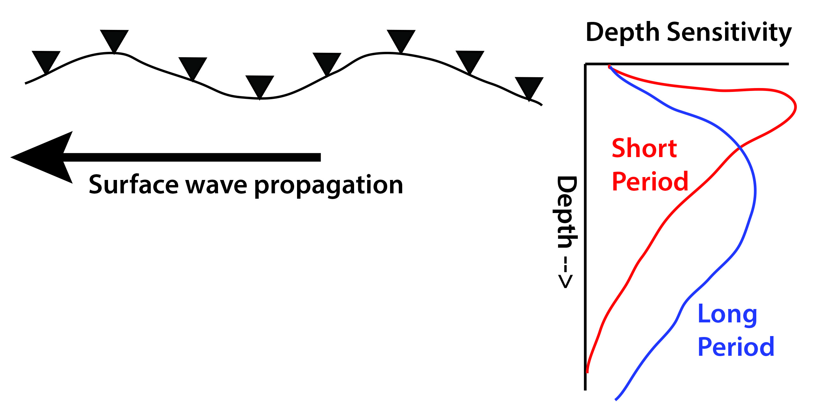
Seismological Analysis Methods
Receiver Functions
Body Wave Tomography
Good for: Imaging discontinuities
(Moho, sed/rock interface, 410)
Weakness: can’t see gradients
can’t constrain velocities well
results limited to immediately below station
Good for: lateral variations
Structure in 100-600 km depth range
Weakness: need close station spacing,
often poor depth resolution
velocities are relative, not absolute
Surface (Rayleigh) wave tomography
Good for: depth variations
gives absolute velocities
Weaknesses: often poor lateral resolution
limited to upper 300 km

Slide 2
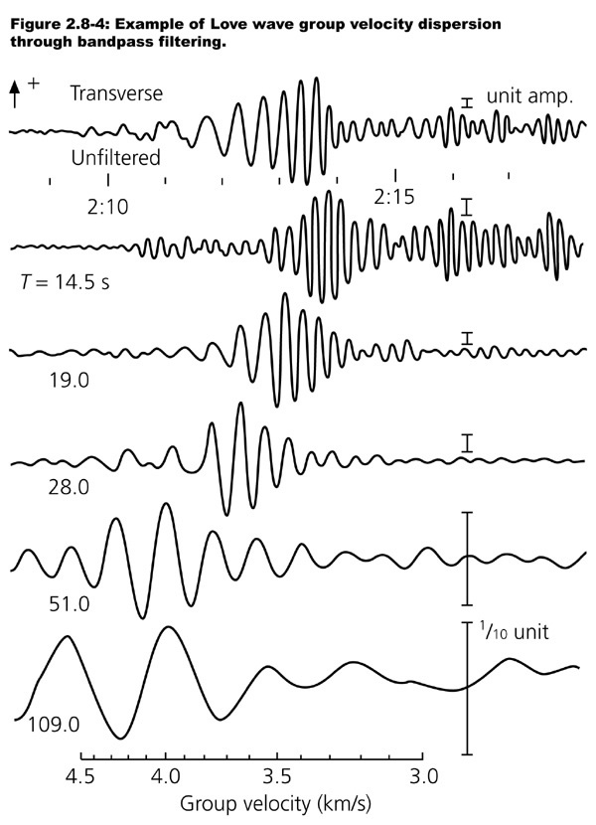
Surface Wave
Dispersion

Slide 3
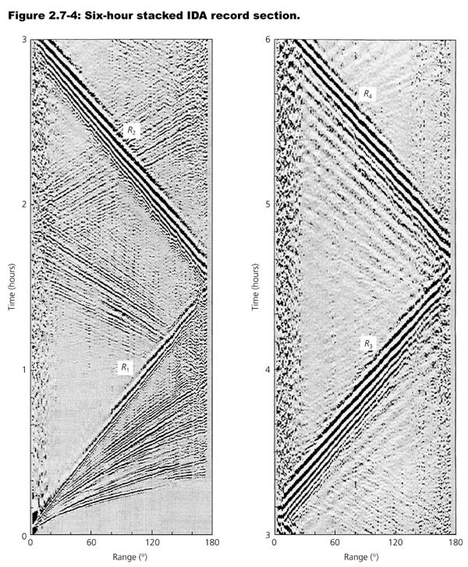
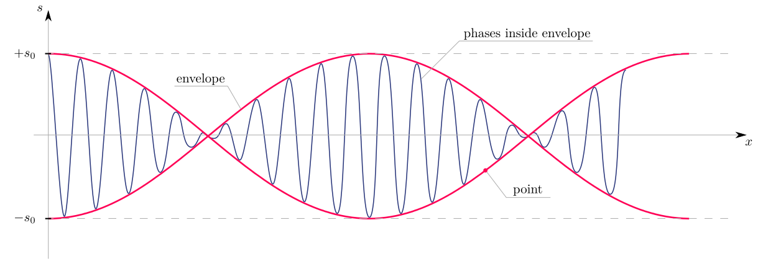
Surface waves: group vs phase velocity

Slide 4
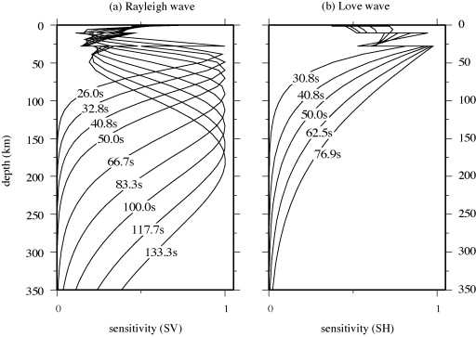
Surface wave sensitivity kernels

Slide 5
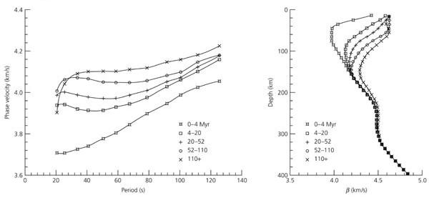
Rayleigh wave dispersion curves and
S velocity as a function of oceanic plate age
Phase velocity as a function of period
S velocity

Slide 6
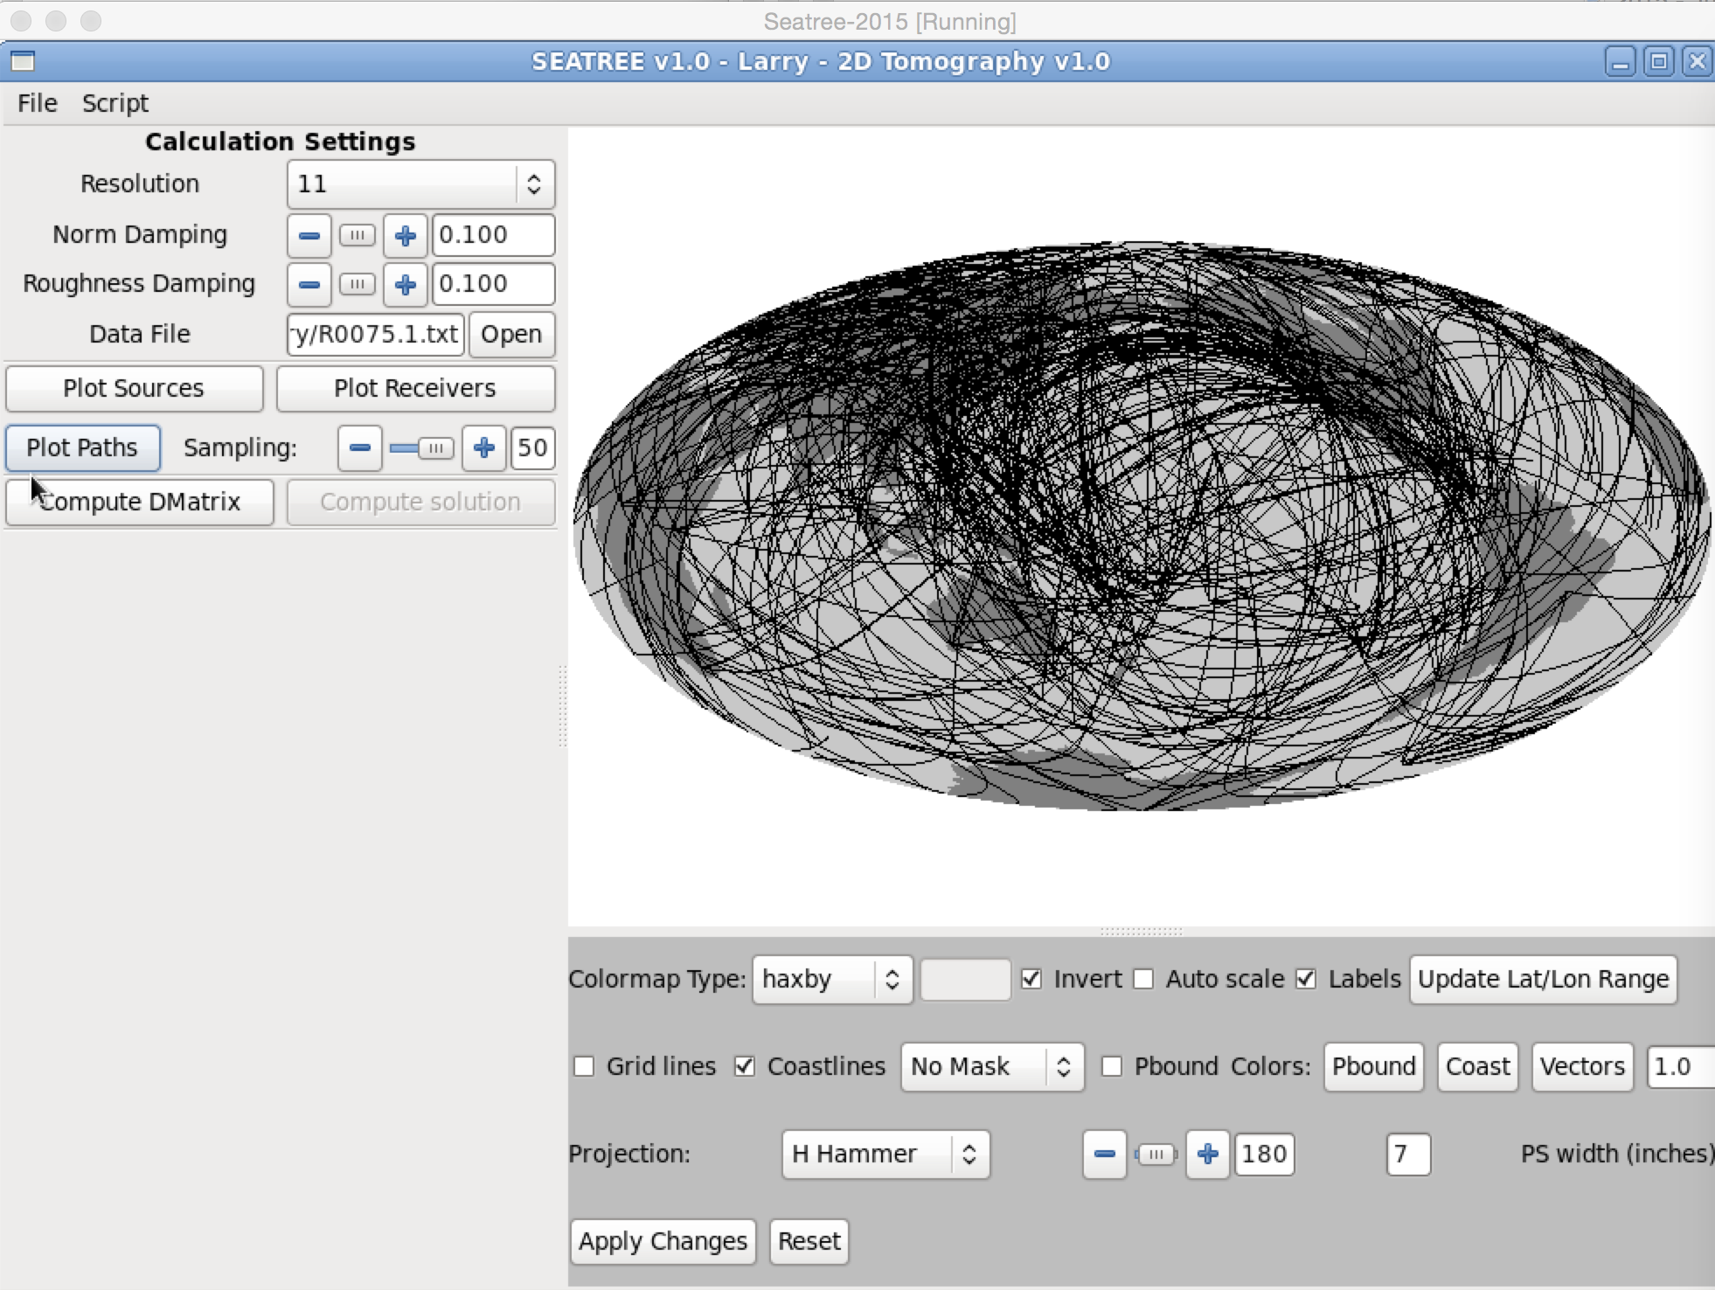
Your dataset: Rayleigh wave phase velocities measured
along various paths

Slide 7
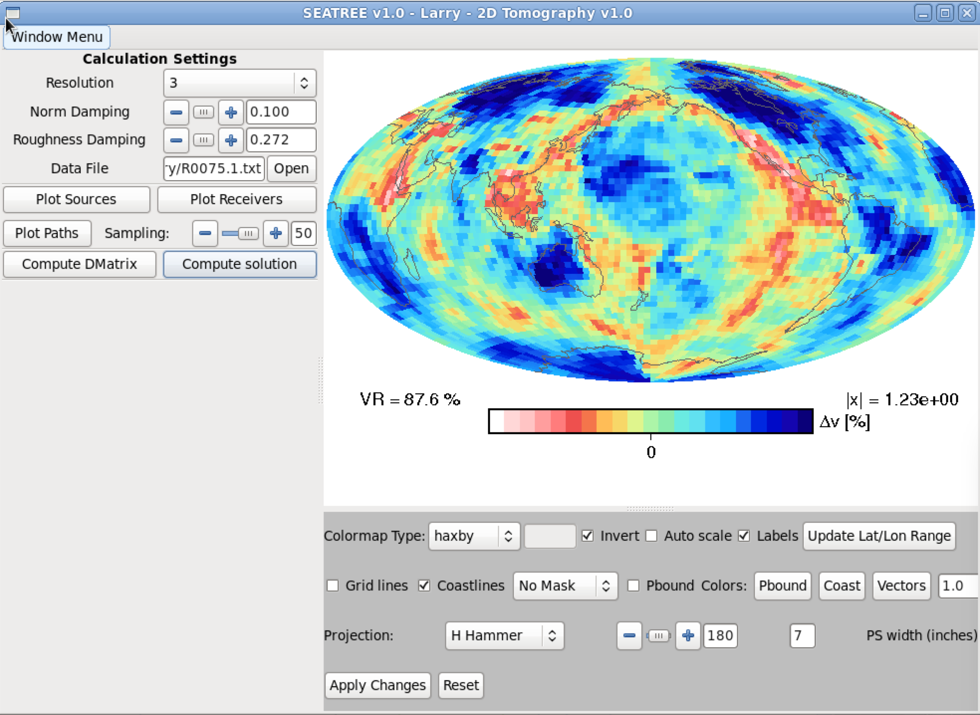
The Goal: Make a map of phase velocity over the whole globe.
“Look under the hood” – see what parameters control the final image
Phase velocity corresponds approximately to depth at 4/3 T (in km)
The final dispersion curves at each point would need to be inverted for S velocity

Slide 8
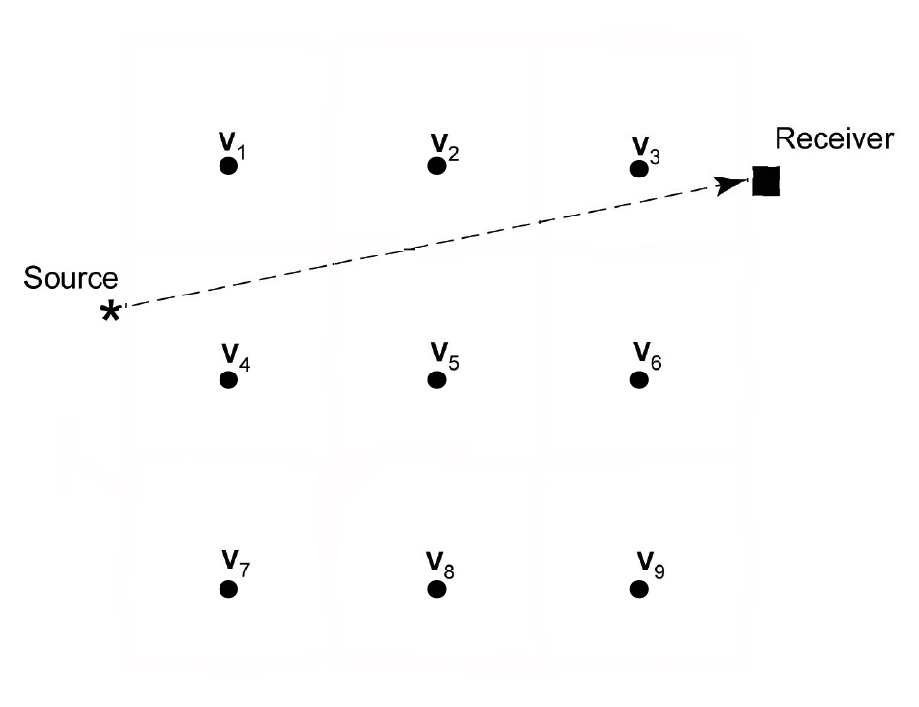
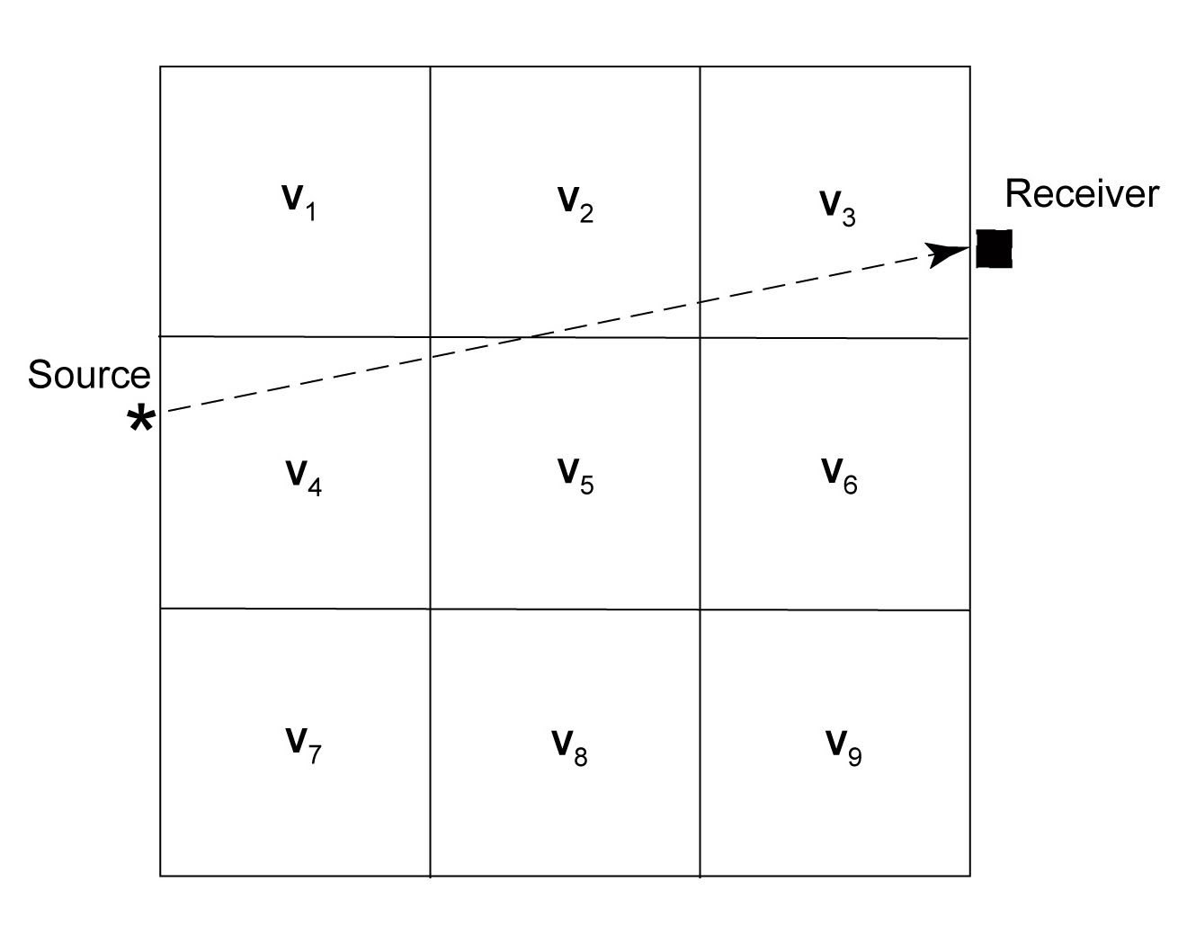
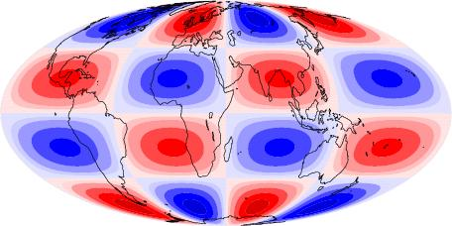
Seismic Tomography – Parameterization
Blocks or tiles
Nodes
Spherical Harmonics

Slide 9
Travel-time tomography
-- Uses observed travel time for many source-receiver
combinations to reconstruct seismic velocity image
-- Solves for the slowness s_{j} = 1/v_{j} of each block (node)
-- Travel time for each observation is the sum of travel times
in each block t = Σ L_{j} s_{j}
-- The matrix equation for all the travel times is: t_{i} = L_{ij} s_{j}
-- Has form of L s = t ( or G x = d, note that G is not square)
-- Least Squares Solution: s = [L^{T}L]⁻¹ L^{T}t

Slide 10
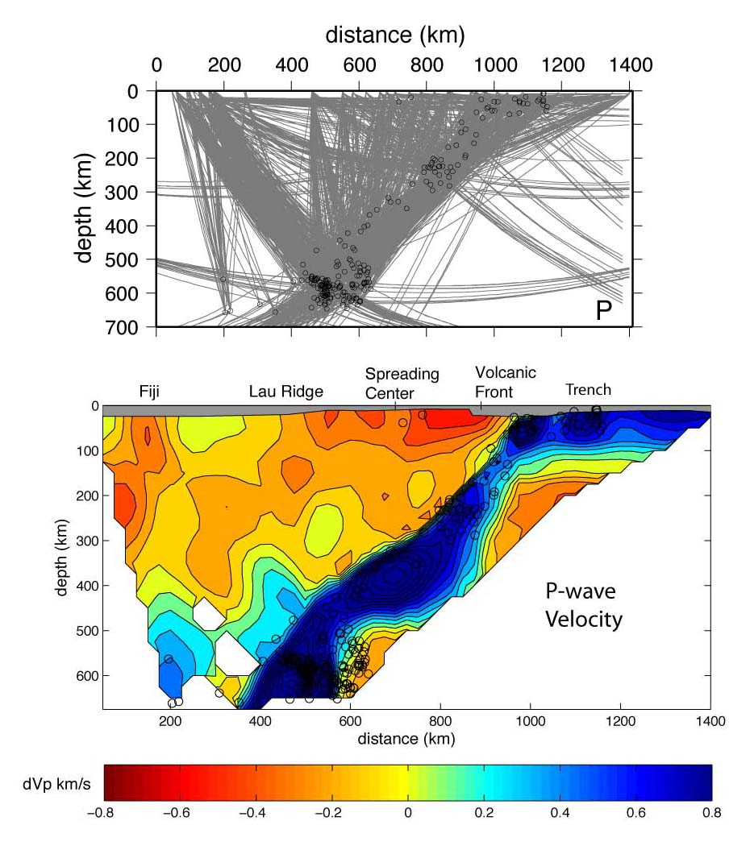
But – Tomography is messy! – usually some part of the model is poorly constrained
Raypaths
Velocity
Conder & Wiens [2006]

Slide 11
If parts of the model are poorly constrained, least squares solution blows up
So for equation S = [ L^{T}L]⁻¹ L^{T} t, the matrix [ L^{T}L] is singular, no solution possible
If it is not quite singular it will be “ill-conditioned”, so that the solution is unstable
What to do? Need to apply a priori information.
One type of information we know is the average seismic velocities as a function of
depth in the earth - a reference model
Now we seek a solution that is as close as possible to the reference model.
We call this “damping” and refer to a damping coefficent λ – the larger the damping
the smaller the deviation from the reference model, and thus the smaller lateral
variations

Slide 12
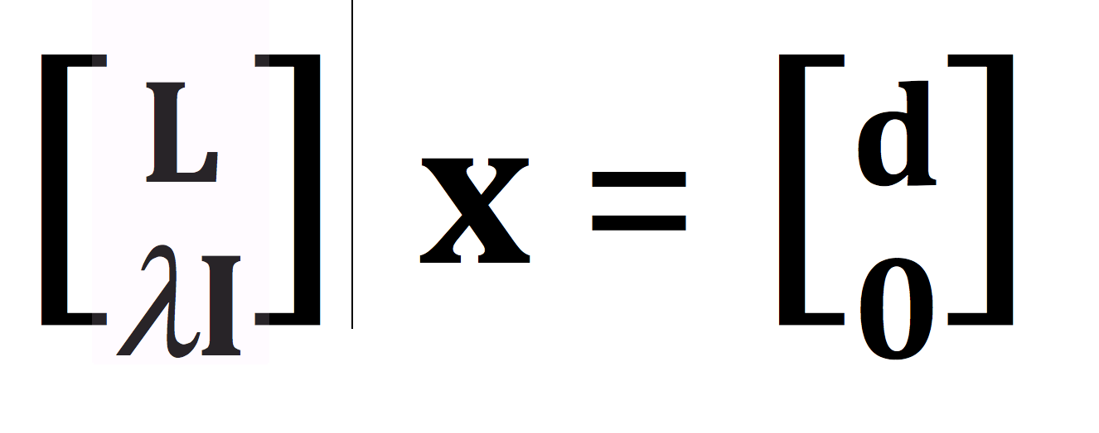
Tomography damped to a reference model
Now instead of solving for the slowness S_{i} we solve for the deviation
from the slowness of the reference model x_{i} = S_{i} – S^{r}_{i}
For data, we have the difference between the observed and predicted arrival times
d_{i} = t_{i} – t^{r}_{i}
Now we solve Lx = d under the criteria that we prefer the smallest possible x
This looks like:
The first rows of this equation are the travel time tomography equations for each d_{i}
The bottom rows specify that we want all the x_{i} to be 0 if possible
The damping parameter λ controls how strong we require the x_{i} to be near 0.
It can be shown that the addition of the damping will make the matrix L nonsingular
(for large enough λ)

Slide 13
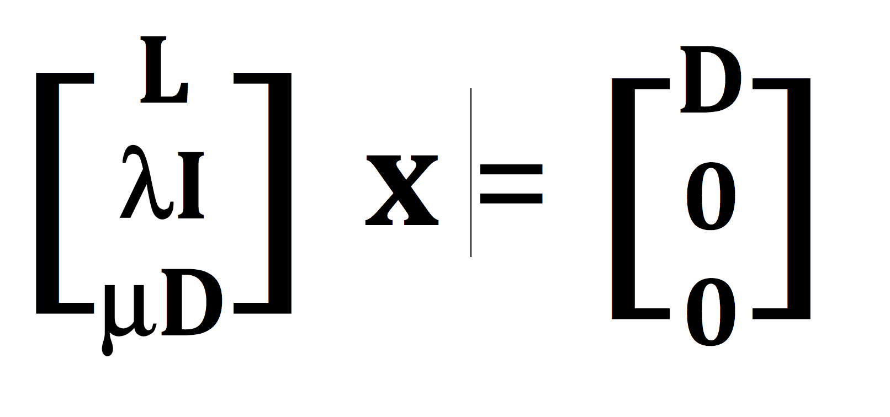
Other a-priori constraints - smoothness
We know that with limited data we cannot resolve highly detailed structure
Therefore we might want to build in a preference for a smooth model
Smoothing constraints allow poorly sampled blocks to be constrained by adjacent
well-sampled ones
Construct a “smoothing matrix” D that will either minimize the 1st derivative (slope) or
2nd derivative (curvature) of the solution. We introduce another parameter μ
that controls the strength of the smoothing constraint
Now we have

Slide 14
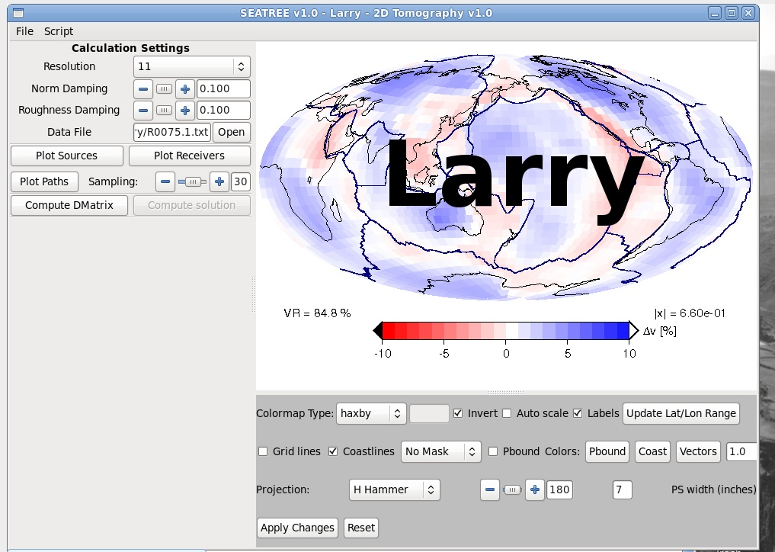
Lets try it out.

