Slide 1
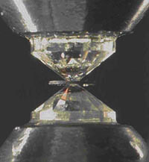
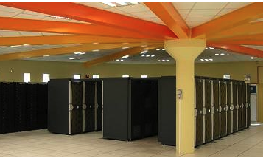
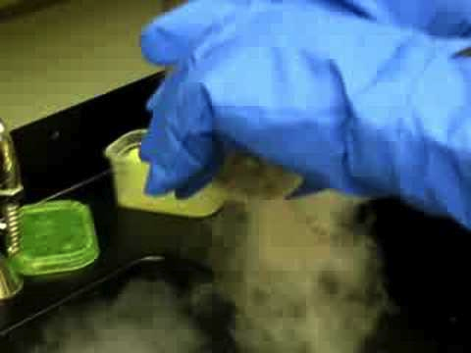
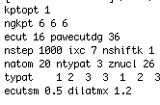
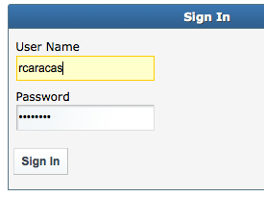
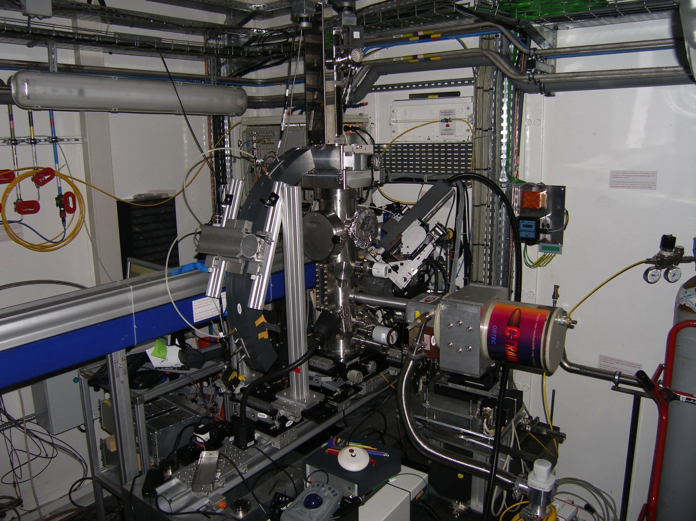
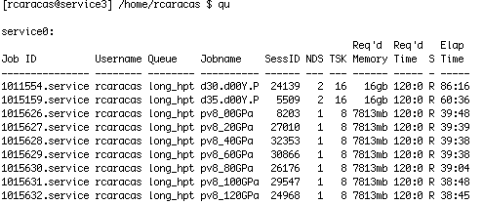
experimental methods
computational methods
Get a diamond anvil cell
Get an ab initio software package
Get beamtime on a synchrotron
Get time on a supercomputer
Load your cell.
Put medium.
Input your structure.
Choose pseudos, XCs.
Go to synchrotron
Go to supercomputer
Run your experiment
Run your experiment

Slide 2
What is it hard to calculate ?
Transport properties: thermal conductivity, electrical conductivity of insulators, rheology, diffusion
Excited electronic states: optical spectra ☹ (=constants?)
Width of IR/Raman peaks, Melting curves, Fluid properties
What we can calculate ?
Electronic properties: orbital energies, chemical bonding, electrical conductivity
Structural properties: prediction of structures (under extreme conditions),
phase diagrams, surfaces, interfaces, amorphous solids
Mechanical properties: elasticity, compressibility, thermal expansion
Dielectric properties: hybridizations, atomic dynamic charges, dielectric susceptibilities,
polarization, non-linear optical coefficients, piezoelectric tensor
Spectroscopic properties: Raman spectra with peak position and intensity, IR peaks
Dynamical properties: phonons, lattice instabilities, prediction of structures, thermodynamic properties, phase diagrams, thermal expansion

Slide 3
A set of N particles with masses m_{n} and initial positions X_{n}
t: X_{t} X_{t} (=V) X_{t}(=A) m
Compute new F
then F = ma
t+1: X_{t+1} X_{t+1} X_{t+1} m

Slide 4
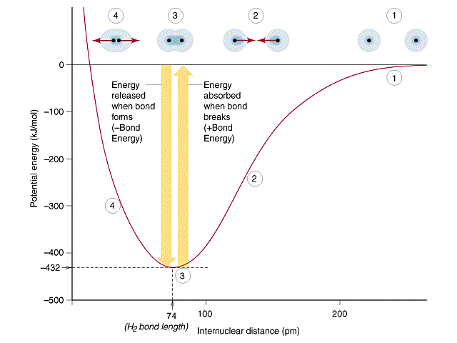
Repulsive zone
Attractive zone

Slide 5
Two-body potentials or pair potentials
Lennard-Jones
Morse
Buckingham
σ_{ij}=2
σ_{ij}=2.5

Slide 6
Multibody potentials
V_{ij}(r_{ij}) = V_{repulsive}(r_{ij}) + b_{ijk}V_{attractive}(r_{ij})
2 body
3+ body

Slide 7
Force fields – very good for molecules
Many other examples:
CHARMM, polarizable, valence-bond models,

Slide 8
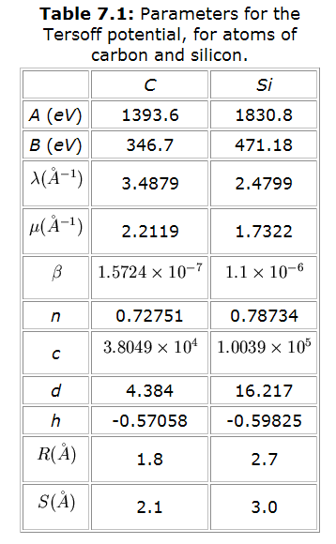
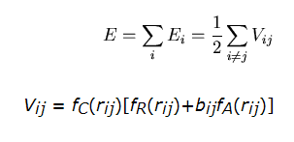
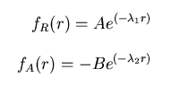
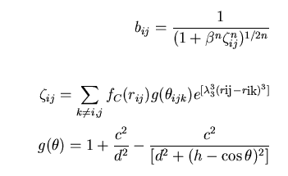
Tersoff interatomic potential
http://phycomp.technion.ac.il/~david/thesis/these2.html

Slide 9
Non-empirical = first-principles or ab initio
- the energy is exactly calculated
- no experimental input
+ transferability, accuracy, many properties
- small systems

Slide 10
Schrödinger equation
time-dependent
time-independent
Eigenvalues
Eigenstates

Slide 11
Kinetic energy of the electrons
External potential
Schrödinger equation involves many-body interactions

Slide 12
Wavefunction
contains all the measurable information
-gives a measure of probability:
~ many-particle wavefunction:
depends on the position of electrons and nuclei
scales factorial
For a system like C atom: 6 electrons : 6! evaluations = 720
For a system like O atom: 8 electrons : 8! evaluations = 40320
For a system like Ne atom: 10 electrons: 10! Evaluations = 3628800
For one SiO₂ molecule: 30electrons+3nuclei= 8.68E³⁶ evaluations
UNPRACTICAL!

Slide 13
DENSITY FUNCTIONAL THEORY
What is DFT ?
Codes
Planewaves and pseudopotentials
Types of calculation
Input key parameters
Standard output
Examples of properties:
Electronic band structure
Equation of state
Elastic constants
Atomic charges
Raman and Infrared spectra
Lattice dynamics and thermodynamics
THEORETICAL ASPECTS
PRACTICAL ASPECTS
EXAMPLES
Notes:
Exista cateva programe care circula astazi in lume si care folosesc aceasta teorie a functionalei de densitate. In cateva cuvinte, in ani 65 W. Kohn (Premiul Nobel de Chimie in 1998 pentru teoria asta) si colaboratorii au spus ca toate proprietatile unui cristal depind doar de densitatea de electroni, si ca daca cunoastem aceasta densitate, atunci vom putea determina de aici toate proprietatile fizice si chmice. Dezvoltari ulterioare au aratat ca de fapt in general este doar densitatea de electroni de valenta care conteaza, si aceasta este cea ce calculam de obicei. Eu folosesc codul ABINIT care este realizat de cam 100 de contribuitori din intreaga lume. In cele ce urmeaza am sa exemplific aceasta metoda folosind=o pentru analiza proprietatilor mineralelor in conditii extrme de presiune si temperatura, specifice interiorului Terreri.

Slide 14
What is DFT
Idea:
one determines the electron density (Kohn, Sham in the sixties: the one responsible for the chemical bonds) from which by proper integrations and derivations all the other properties are obtained.
INPUT
Structure: atomic types + atomic positions =
initial guess of the geometry
There is no experimental input !

Slide 15
What is DFT
What is DFT
Kinetic energy of non-interacting electrons
Energy term due to exterior
Coulombian energy =
E_{ee} + E_{eN}+ E_{NN}
Exchange correlation energy
Electron spin:
Decrease Increases
energy

Slide 16
E_{xc}: LDA vs. GGA
LDA = Local Density Approximation
GGA = Generalized Gradient Approximation
Non-

Slide 17
Flowchart of a standard DFT calculation
Initialize wavefunctions and electron density
Compute energy and potential
Update energy and density
In energy/potential
In forces
In stresses
Check convergence
Print required output

Slide 18
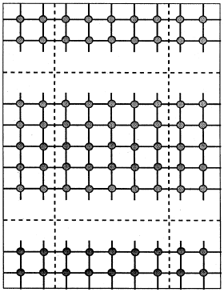
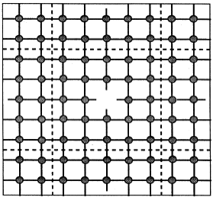
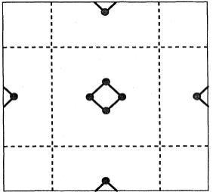
Crystal structure – non-periodic systems
Point-defect
Surface
Molecule
“big enough”

Slide 19
Input key parameters - pseudopotentials
Valence electrons computed self-consistently
Semi-core states
Core electrons ⬄ pseudopotential

Slide 20
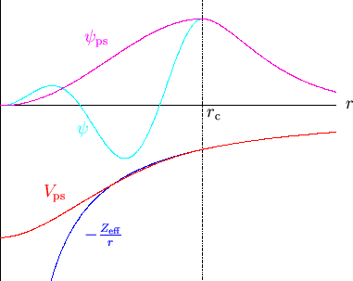
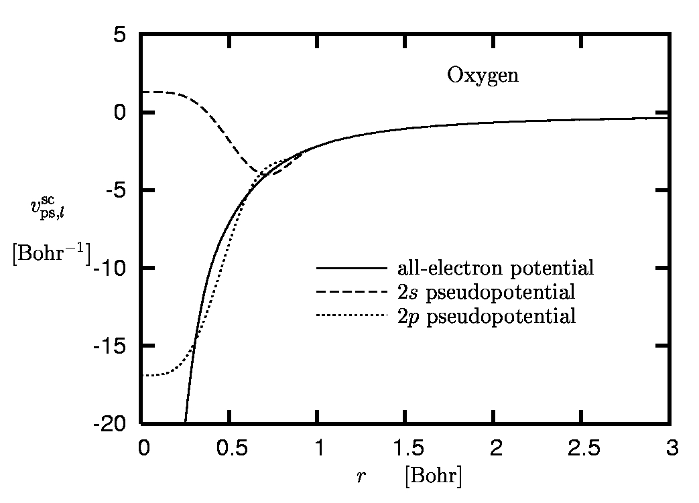
Input key parameters - pseudopotentials
Pseudo-wavefunction
All electron wavefunction

Slide 21
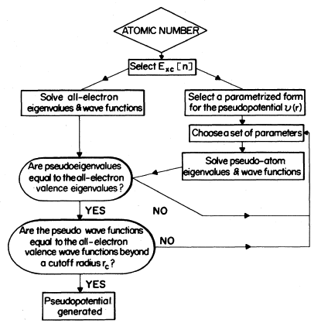
Input key parameters - pseudopotentials

Slide 22
Input key parameters - pseudopotentials

Slide 23
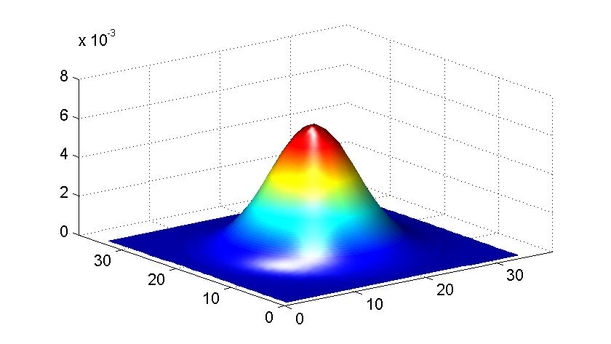
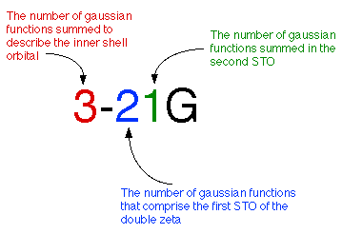
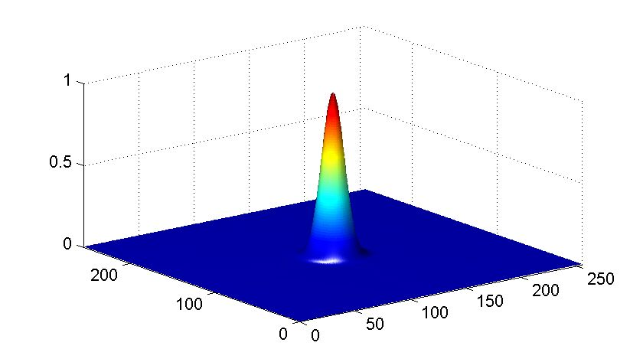
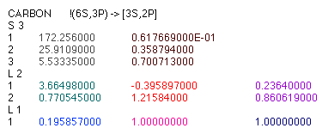
localized basis

Slide 24
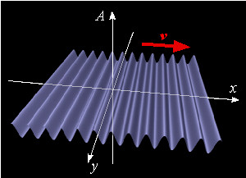
planewaves
Planewaves are characterized by their
wavevector G
angular speed ω
wavelength
= 2π/G
frequency
f = ω/2π
period
T = 1/f = 2π/ω
velocity v = λ/T = ω/k

Slide 25
planewaves
The electron density is obtained by superposition of planewaves

Slide 26
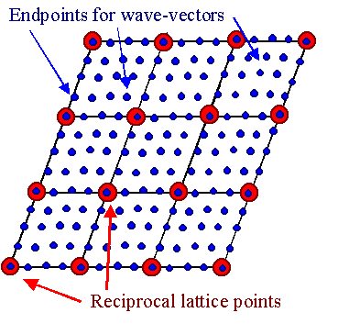
Input key parameters - K-points
Limited set of k points ~
boundary conditions

Slide 27
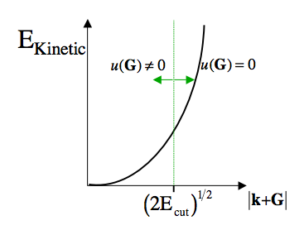
after: http://www.psi-k.org/Psik-training/Gonze-1.pdf

Slide 28
PRACTICAL ASPECTS: Properties
Electronic properties: electronic band structure, orbital energies, chemical bonding, hybridization, insulator/metallic character, Fermi surface, X-ray diffraction diagrams
Structural properties: crystal structures, prediction of structures under extreme conditions, prediction of phase transitions, analysis of hypothetical structures
Mechanical properties: elasticity, compressibility
Dielectric properties: hybridizations, atomic dynamic charges, dielectric susceptibilities, polarization, non-linear optical coefficients, piezoelectric tensor
Spectroscopic properties: Raman and Infrared active modes, silent modes, symmetry analysis of these modes
Dynamical properties: phonons, lattice instabilities, prediction of structures, study of phase transitions, thermodynamic properties, electron-phonon coupling

Slide 29
Values of the parameters
How to choose between LDA and GGA ?
- relatively homogeneous systems LDA
- highly inhomogeneous systems GGA
- elements from “p” bloc LDA
- transitional metals GGA
- LDA underestimates volume and distances
- GGA overestimates volume and distances
- best: try both: you bracket the experimental value

Slide 30
Values of the parameters
How to choose pseudopotentials ?
- the pseudopotential must be for the same XC as the calculation
- preferably start with a Troullier-Martins-type
- if it does not work try more advanced schemes
- check semi-core states
- check structural parameters for the compound not element!

Slide 31
Values of the parameters
How to choose no. of planewaves and k-points ?
- check CONVERGENCE of the physical properties

Slide 32
Values of the parameters
- check CONVERGENCE of the physical properties
ecut (Ha)
Total energy (Ha)
ecut (Ha)
-P (GPa)

Slide 33
Usual output of calculations (in ABINIT)
Log (=STDOUT) file
detailed information about the run; energies, forces, errors, warnings,etc.
Output file:
simplified “clear” output:
full list of run parameters
total energy; electronic band eigenvalues; pressure; magnetization, etc.
Charge density = DEN
Electronic density of states = DOS
Analysis of the geometry = GEO
Wavefunctions = WFK, WFQ
Dynamical matrix = DDB
etc.
Notes:
Ca o mica paranteza, Exista un numar din ce in ce mai mare de proprietatri care pot fi calculate astazi si aici avem o lista cu cateva exemple. In general valorile numerica obtinute sunt simialre cu cele experimetnale, si ca exemplu: volumul celulei este obtinut cam la 5% din cel experimental, unghiurile interatomice cam la 1-2 grade, frecventele Raman si infrarosu cam la 20 de lungimi de unda. Sut binentles si alte propretiati care inca nu stun bine descrise, dar pentru majoritatea aplicatiilor in mineralogi metoda este excelenta.

Slide 34
DFT codes
http://dft.sandia.gov/Quest/DFT_codes.html
http://www.psi-k.org/

Slide 35
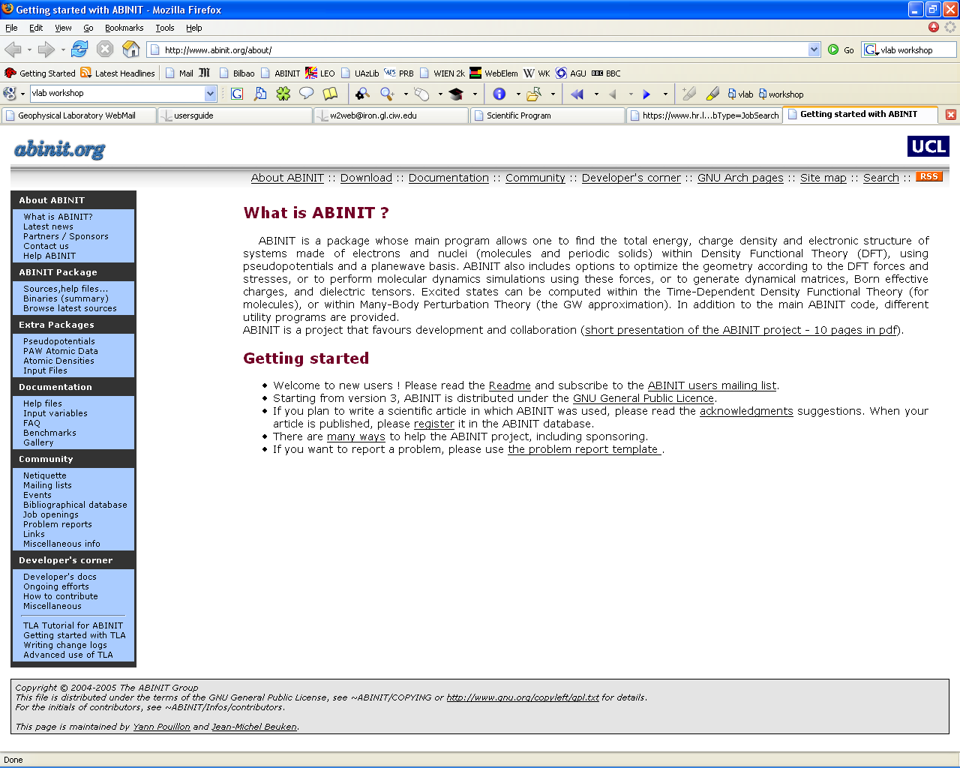
DFT codes:
A B I N I T
ABINIT is a package whose main program allows one to find the total energy, charge density and electronic structure of systems made of electrons and nuclei (molecules and periodic solids) within Density Functional Theory (DFT), using pseudopotentials and a planewave basis. ABINIT also includes options to optimize the geometry according to the DFT forces and stresses, or to perform molecular dynamics simulations using these forces, or to generate dynamical matrices, Born effective charges, and dielectric tensors. Excited states can be computed within the Time-Dependent Density Functional Theory (for molecules), or within Many-Body Perturbation Theory (the GW approximation). In addition to the main ABINIT code, different utility programs are provided.
First-principles computation of material properties : the ABINIT software project. X. Gonze, J.-M. Beuken, R. Caracas, F. Detraux, M. Fuchs, G.-M. Rignanese, L. Sindic, M. Verstraete, G. Zerah, F. Jollet, M. Torrent, A. Roy, M. Mikami, Ph. Ghosez, J.-Y. Raty, D.C. Allan Computational Materials Science, 25, 478-492 (2002)
A brief introduction to the ABINIT software package. X. Gonze, G.-M. Rignanese, M. Verstraete, J.-M. Beuken, Y. Pouillon, R. Caracas, F. Jollet, M. Torrent, G. Zerah, M. Mikami, P. Ghosez, M. Veithen, V. Olevano, L. Reining, R. Godby, G. Onida, D. Hamann and D. C. Allan Z. Kristall., 220, 558-562 (2005)

Slide 36
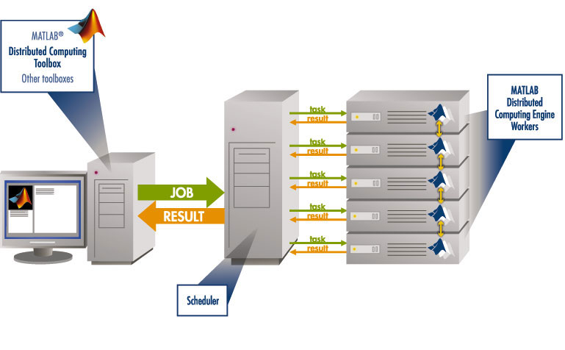
Sequential calculations ⬄ one processor at a time
Parallel calculations ⬄ several processors in the same time

Slide 37
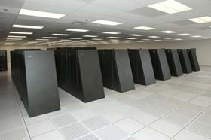
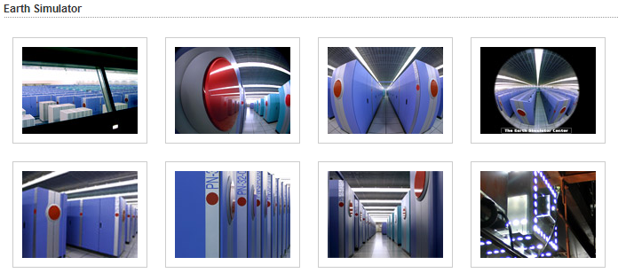
These are Gflops / second (~0.5 petaflop)
= millions of operations / second
1 flop = 1 floating point operation / cycle
Itanium 2 @ 1.5 GHz ~ 6Gflops/sec = 6*10⁹ operations/second

Slide 38
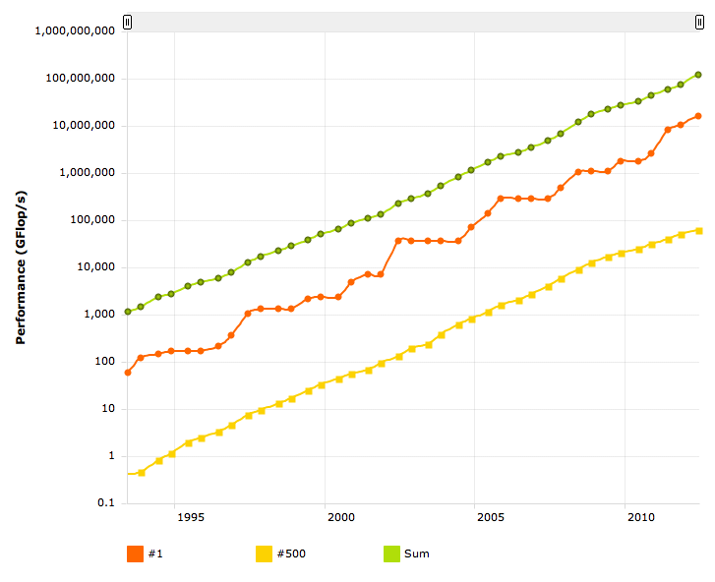

Slide 39
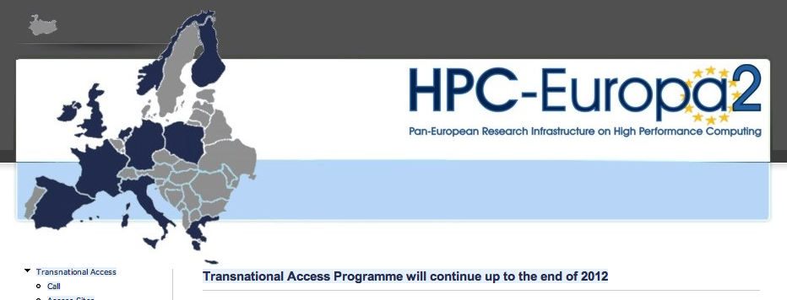
Notes:
39

Slide 40
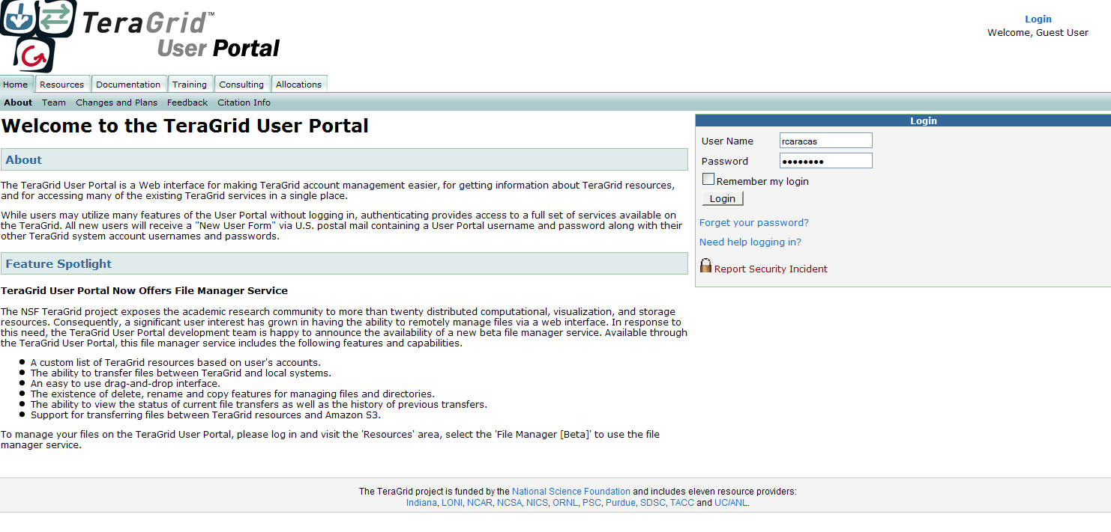
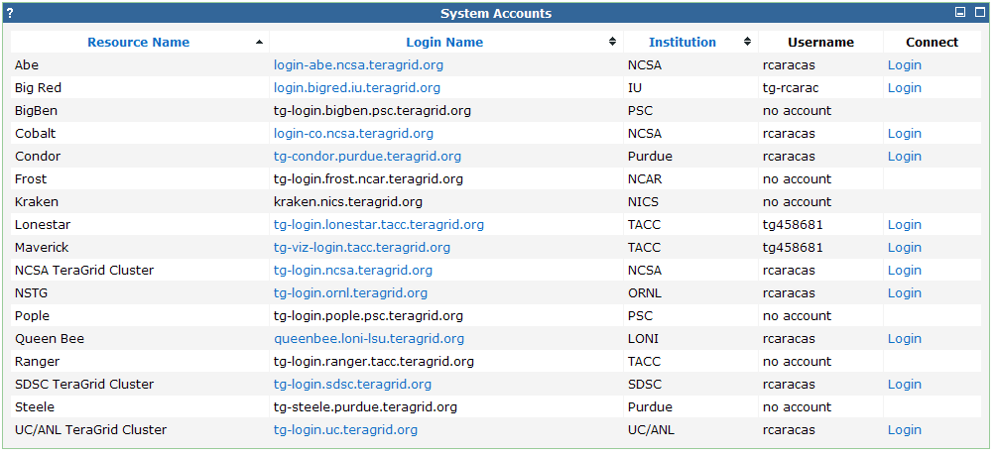
Notes:
40

Slide 41
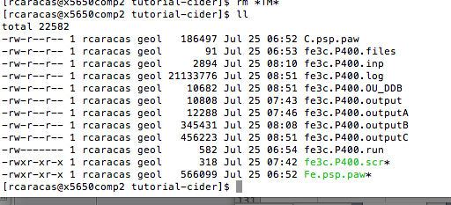
RUN MD CODE

Slide 42
Jmol exercise:
http://jmol.sourceforge.net/

Slide 43
EXTRACT RELEVANT INFORMATION:
Atomic positions
Atomic velocities
Energy
Stress tensor
VISUALIZE SIMULATION (ex: jmol, vmd)
PERFORM STATISTICS

Slide 44
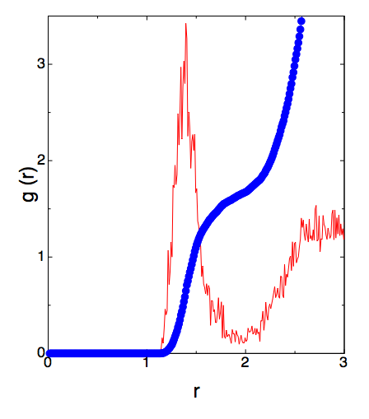
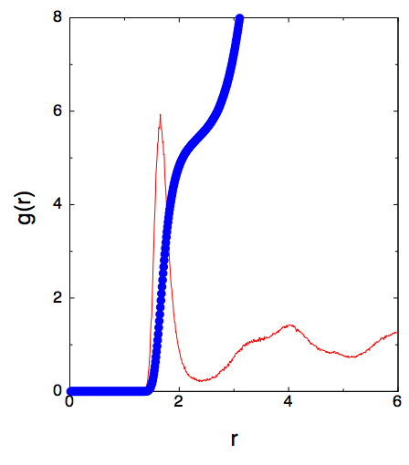
Ex: coordination in forsteritic melt at mid-mantle conditions
C-O
Si-O

