Slide 1
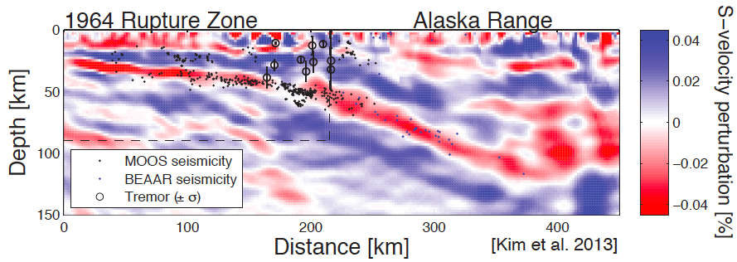
Understanding images of slabs & wedges
Geoff Abers, Cornell Univ.
Some cranky opinions on slab imaging
Using seismic properties to infer T, H₂O, 𝜙, X, … and rocks?
Notes:
- look at raw data!

Slide 2
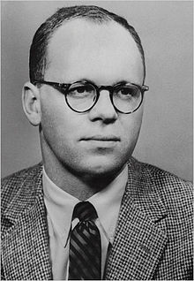
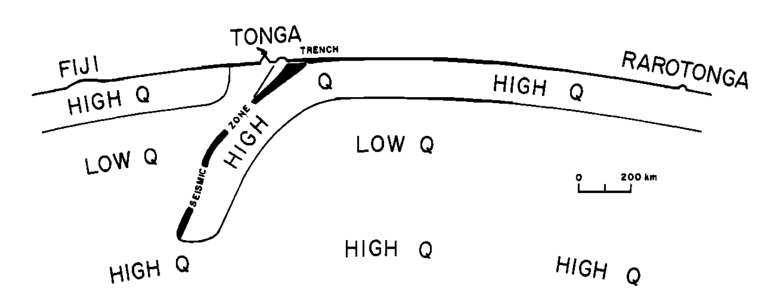
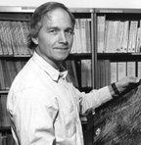
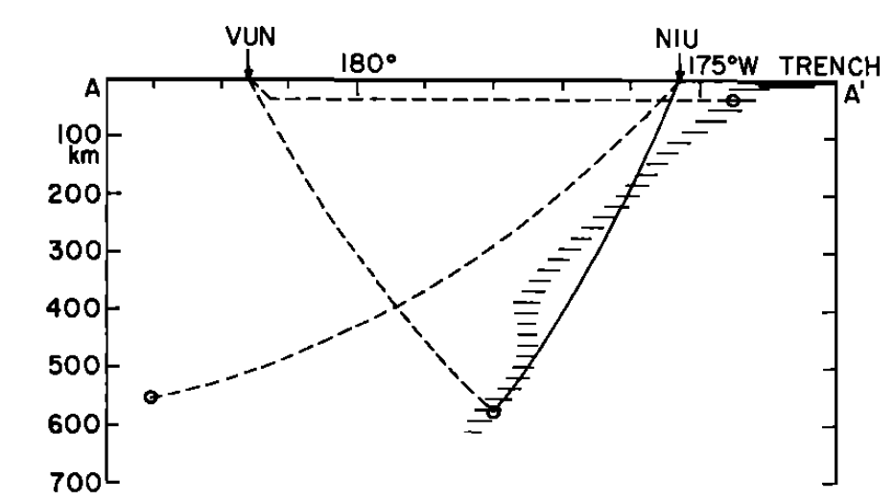
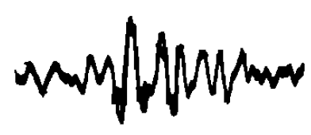
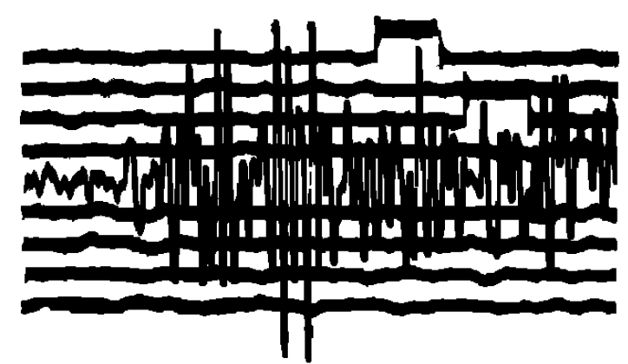
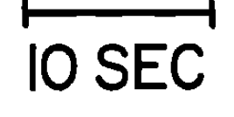
The b/w photos
(& a major result)
Oliver & Isacks,1967:
first identification of subducting lithosphere
Looking at seismograms pays off!
Notes:
- look at raw data!

Slide 3





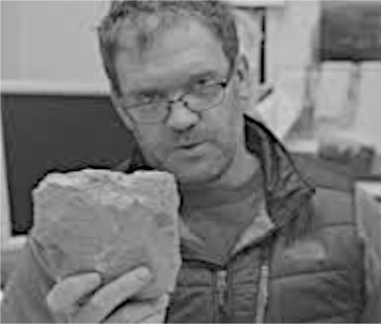

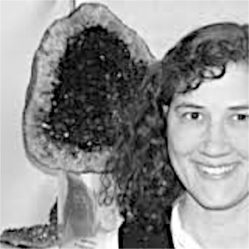
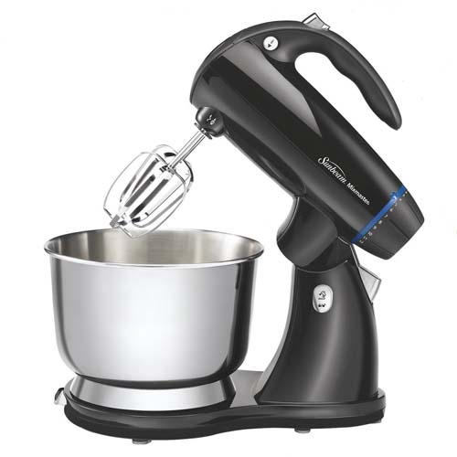

Synthesis attempt in this lecture
Seismology
Rheology
Thermal modeling
my vague understanding of rocks and chemistry
Notes:
Heads

Slide 4
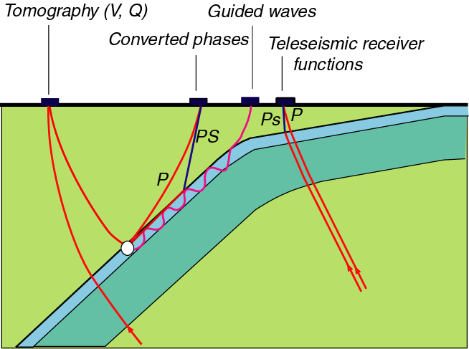
Seismological sampling
Tomography gives volume-averaged properties
Conversions & reflections resolve layering
Notes:
My approach has been to use seismic imaging as a way to get at deeper structure, also at depth.
Tomo for volume; others image layers bound by sharp interfaces
- works because distinct V

Slide 5
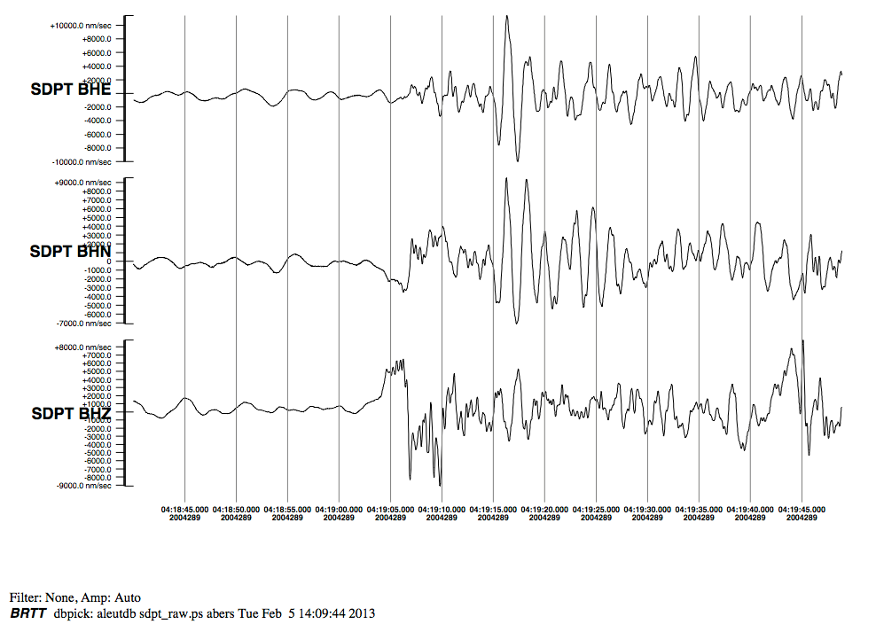
Looking at raw data: teleseismic P coda
Z
Ppms
Psms
P
Ps
radial
vertical
ORID 42890143 2004:289:04:09 24.530 122.694 mb6.4
delta 62.52 seaz 274.2 (?!) station SDPT
10 s
Back-azimuth = 274.2°. Station mis-oriented 90° so “BHN” is positive west.
Seismometer at Sand Point, AK; earthquake in Taiwan, 94 km deep

Slide 6
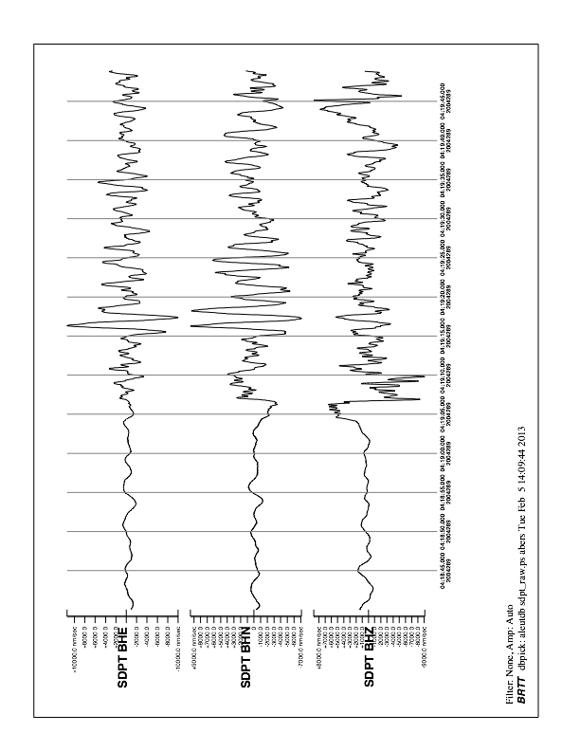
Scaled vertical on horizontals
ORID 42890143 2004:289:04:09 24.530 122.694 mb6.4
delta 62.52 seaz 274.2 (?!) station SDPT
10 s

Slide 7
Scaled vertical on horizontals
moho?
Slab P->S?
P
ORID 42890143 2004:289:04:09 24.530 122.694 mb6.4
delta 62.52 seaz 274.2 (?!) station SDPT
10 s

Slide 8
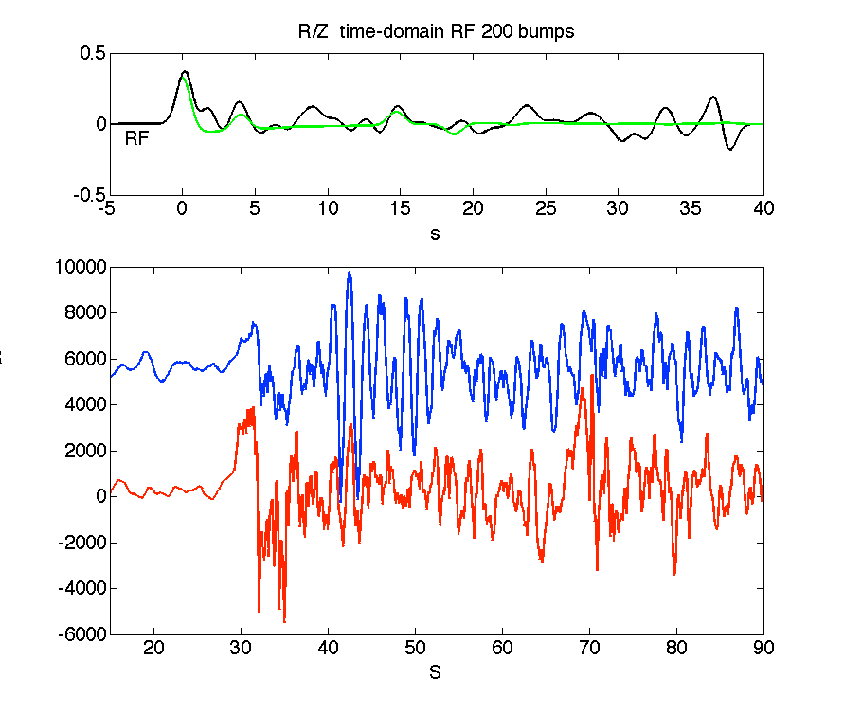
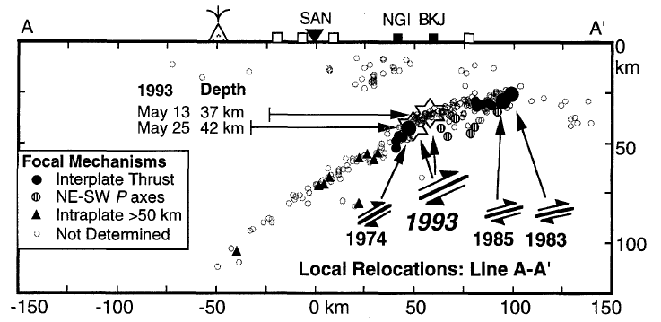
The corresponding receiver function
moho
slab
reverbs
38 km Z
1.65 vp/vs
slab at 70 km?
Abers et al., 1995 BSSA
Station SAN, Sand Point, Alaska

Slide 9
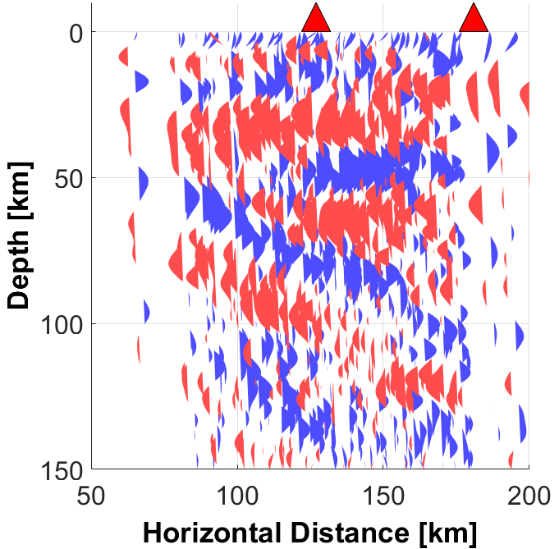
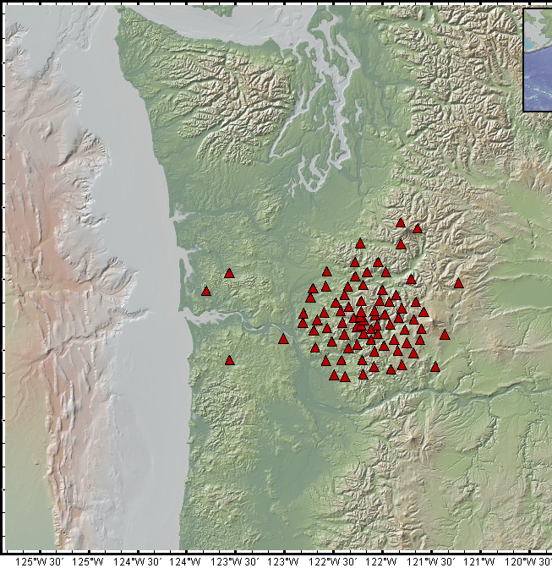
Lots of stations: Mount St Helens (iMUSH)
MSH
Adams
projected as Ppxs
Seismometers used in this study
upper plate Moho (E of MSH)
Subducting Moho: clear, strong
tiny mantle wedge beneath MSH
Ppxs

Slide 10
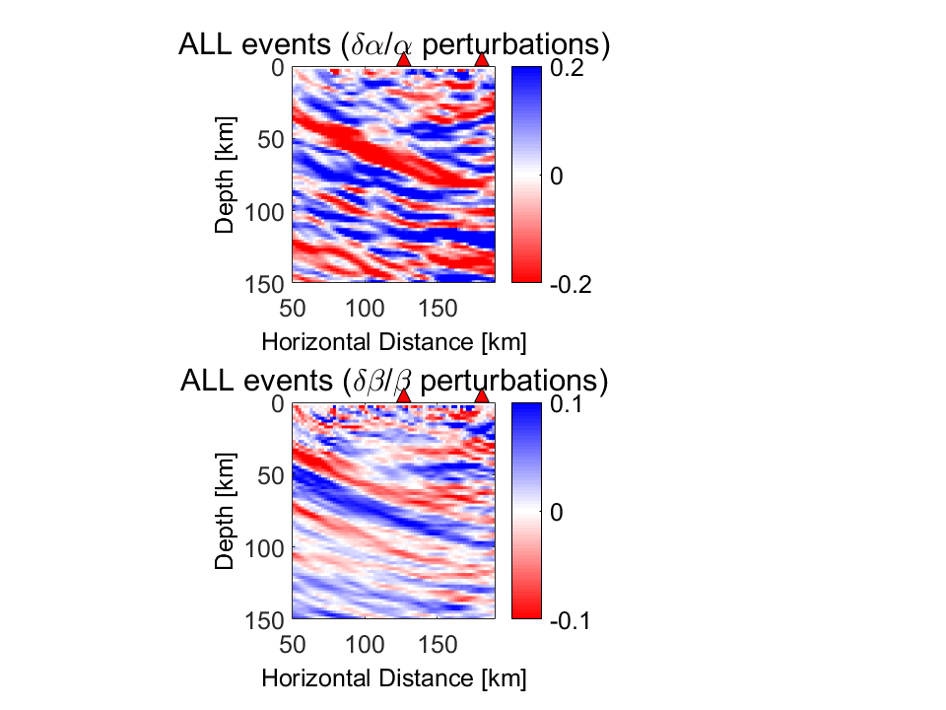
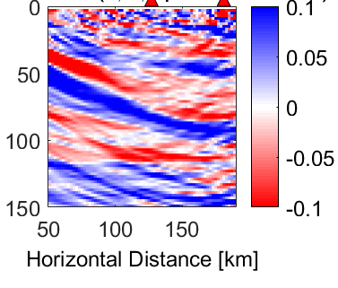
Array migration: N vs S subarrays
South
North
dVs/Vs
Mann et al., in prep.
Complex images are great tools for understanding
(but it’s great when raw-ish data show features clearly)

Slide 11
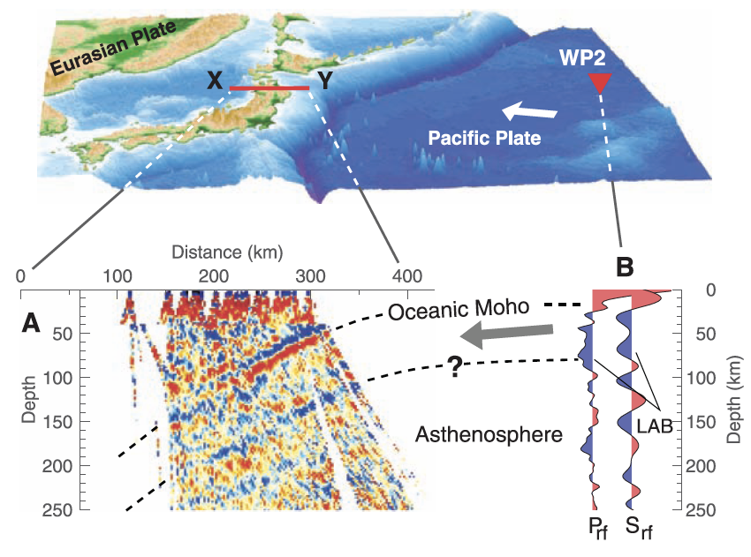
Other contributions: Japan slab + LAB
[Kawakatsu et al., 2009]

Slide 12
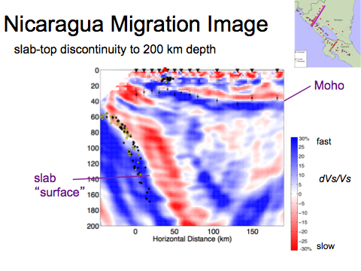
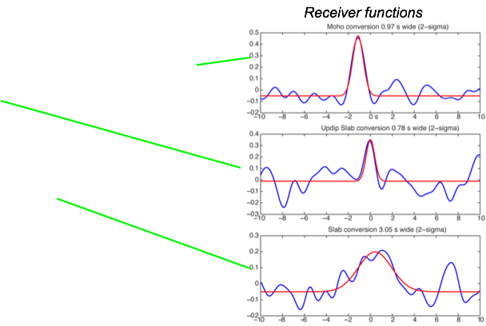
Imaging a steep slab to 200 km
[MacKenzie et al., 2010 EPSL]
note

Slide 13
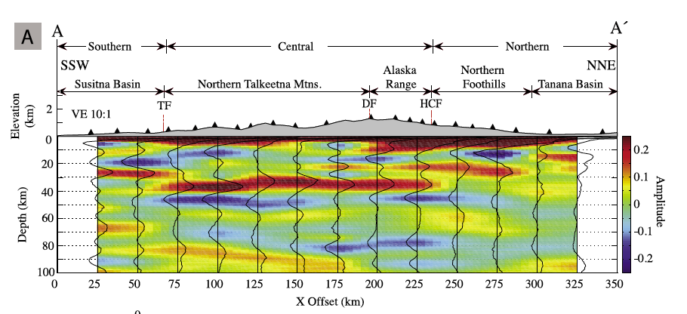
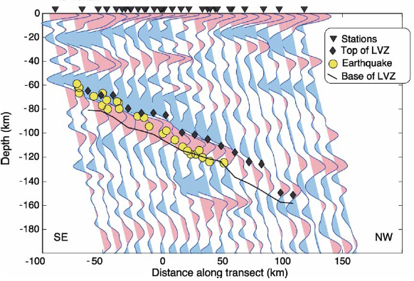
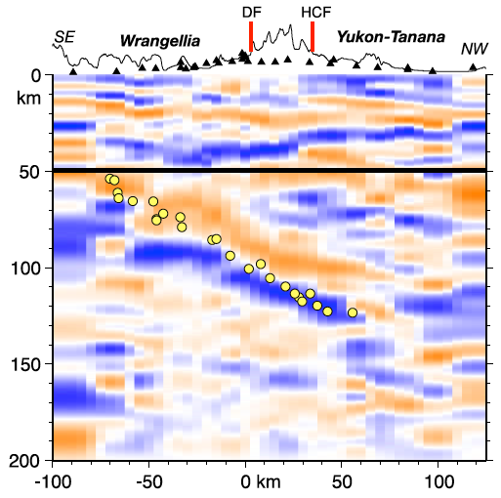
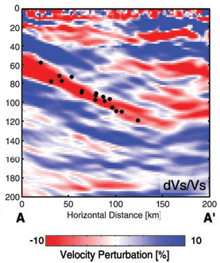
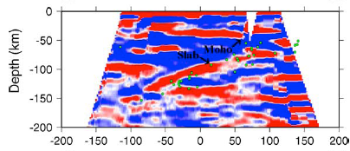
One dataset, 5 studies
CCP stack: Brennan et al. 2011 G3
4 earthquakes: Ferris et al. 2003 EPSL
CCP stack: Ai et al., 2005
Dip-tuned stack: Rossi et al. 2006
Migration:Rondenay et al. 2008,10

Slide 14
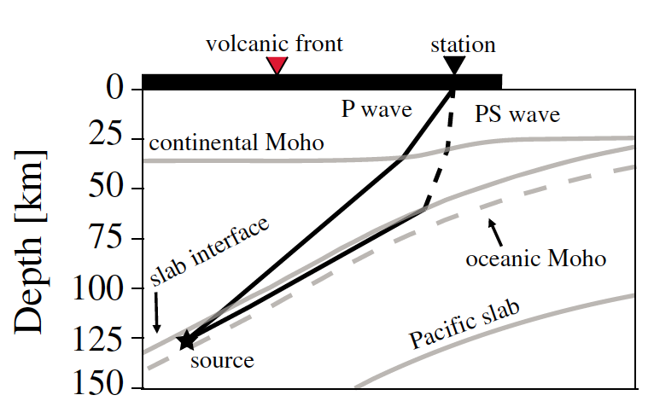
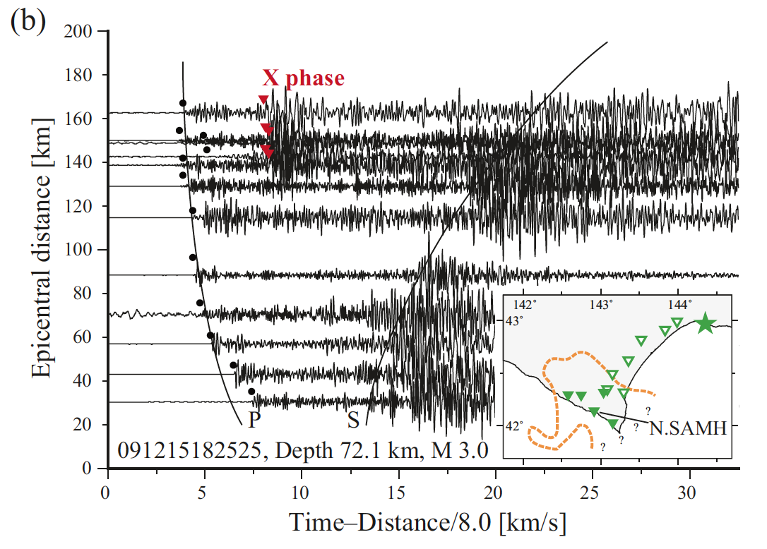
High-frequency Mode Conversions
Strong arrivals between P and S, rich in high frequencies
Observed typically for updip propagation from intermediate-depth earthquakes
Hokkaido: Shiina et al. 2014
Shiina et al. 2013
conversion
point

Slide 15
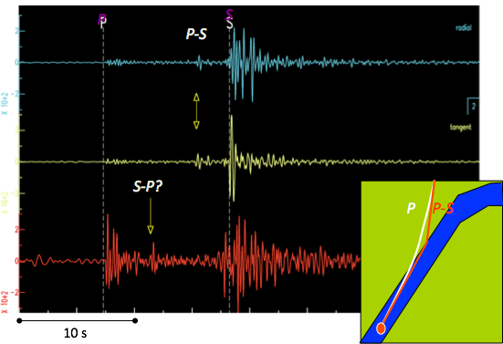
Mode-converted energy - regional
Alaska Peninsula example (Helffrich and Abers, 1997 GJI)
Seismograms from Sand Point, AK

Slide 16
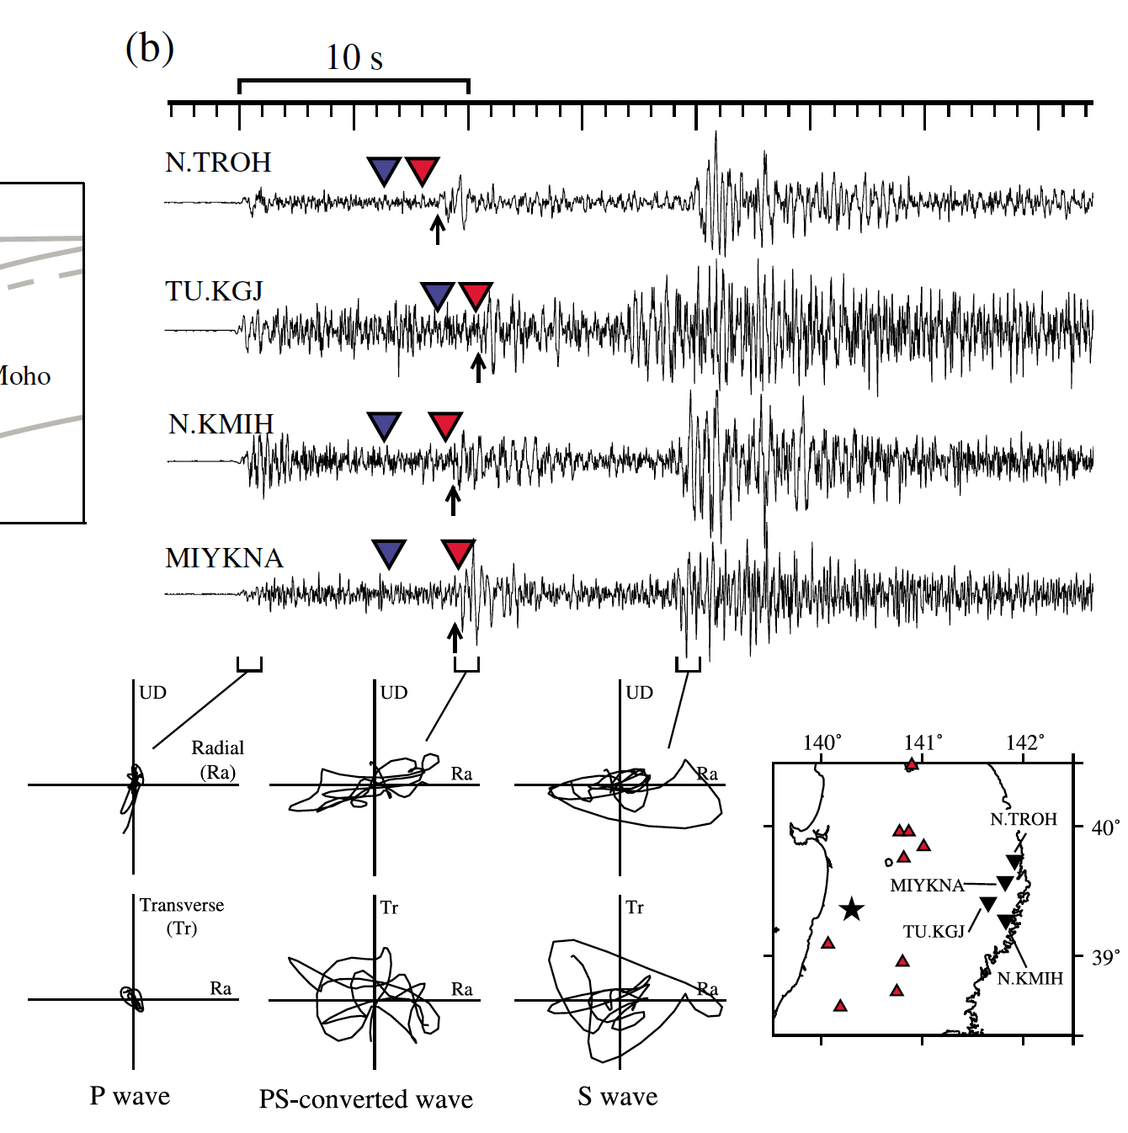
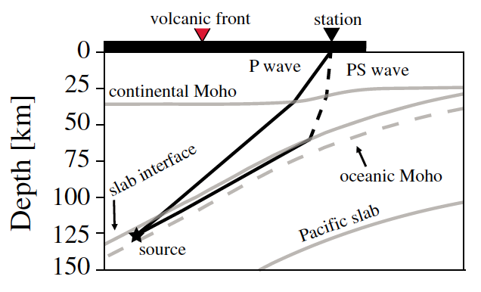
Mode conversion identification: polarization and timing
Phases are S-polarized
Travel time etween P & S
Amplitude > P
Blue: Predicted in 1D model
Red: Picked
observed P legs are slow
N. Honshu:
Shiina et al., 2013 GRL

Slide 17
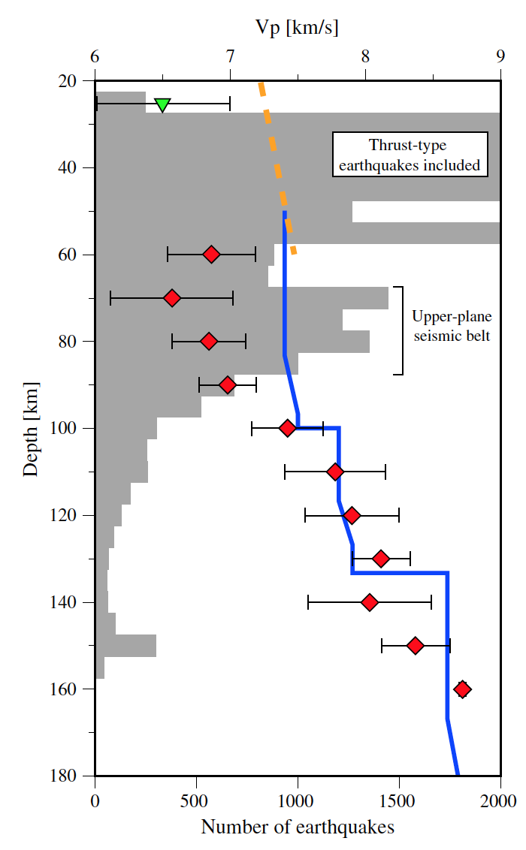
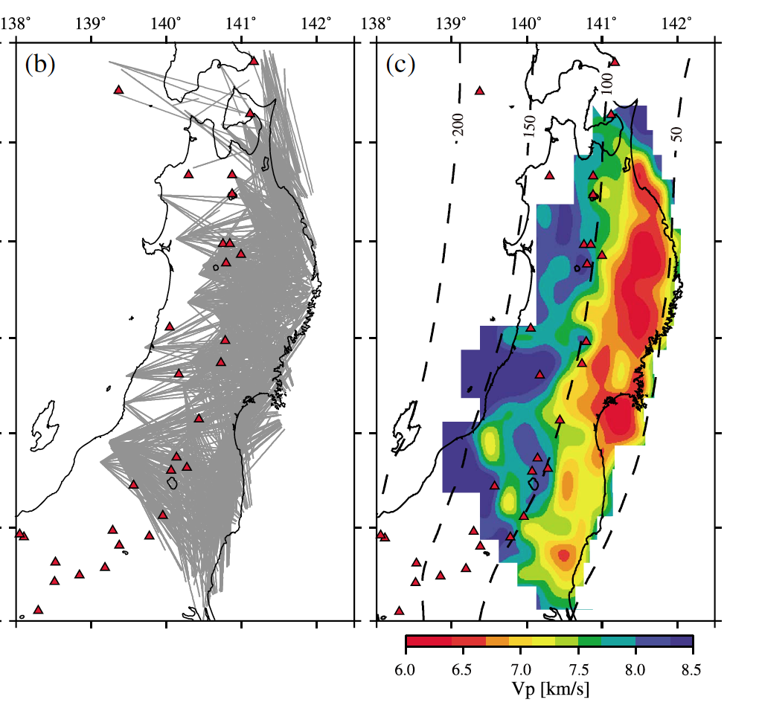
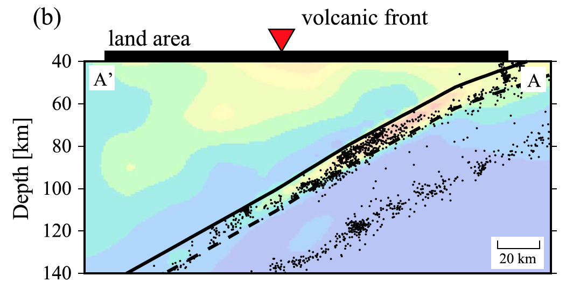
Tomography with P legs: Slow subducting crust
(Shiina et al., 2013, 2014)

Slide 18
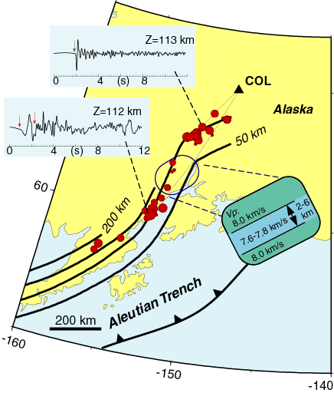
Another approach: Dispersed body waves
Early arrival is low frequency
Delays suggest high frequencies are 4-10% slow: Crustal Waveguide?
Low resolution, high sensitivity to process
(Abers and Sarker, 1996 GRL)

Slide 19
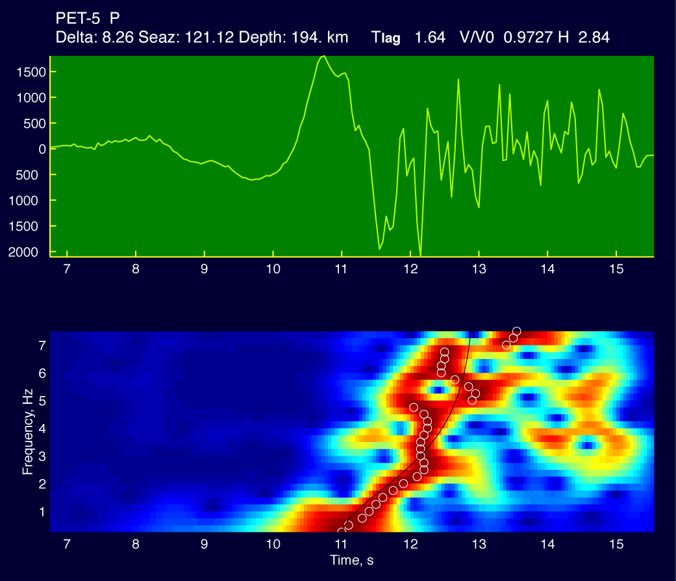
A dispersed body wave

Slide 20

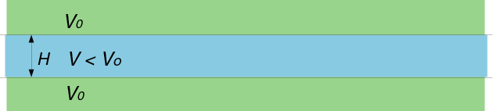
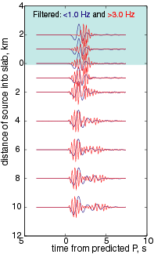
Dispersion in a Crustal Waveguide
High frequencies travel at V
Low frequencies at Vo
Frequency of transition ~ V/H
  Dispersion gives V/V₀, H

Slide 21
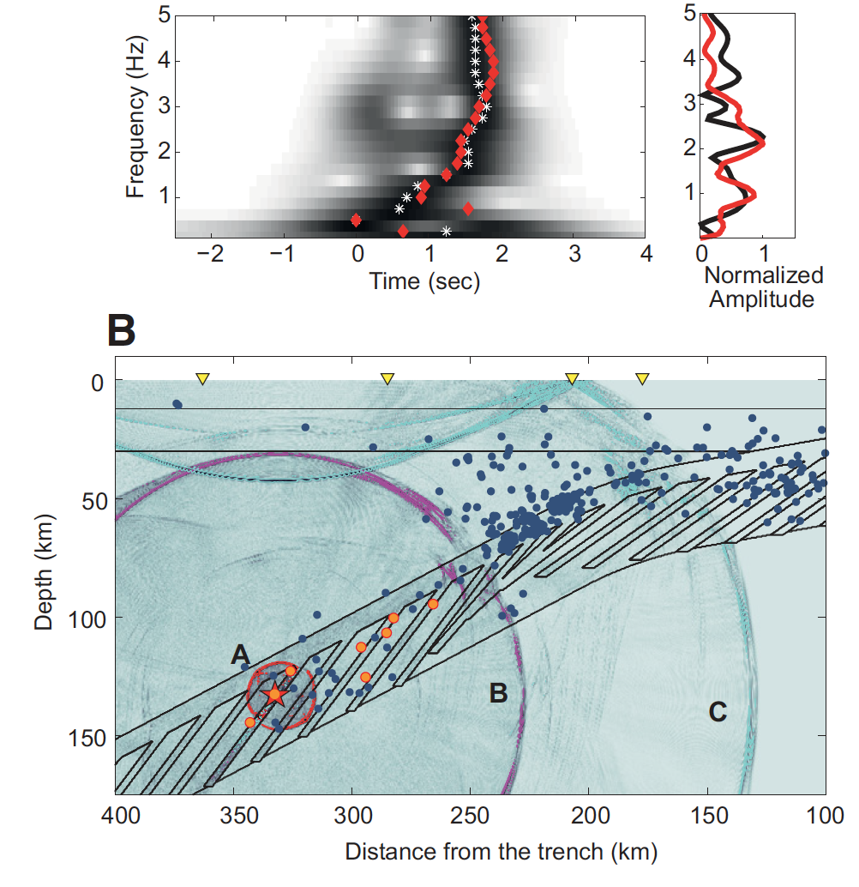
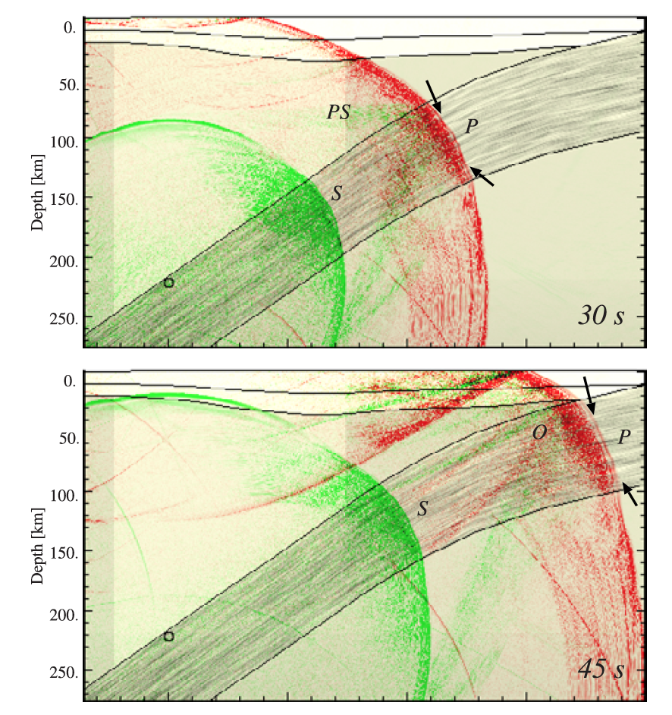
Complex propagation models
Garth and Rietbrock, 2014 Geology
Furumoto and Kennett, 2005 JGR

Slide 22
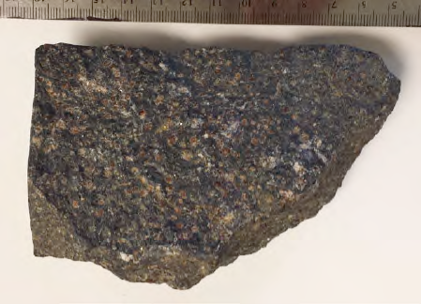
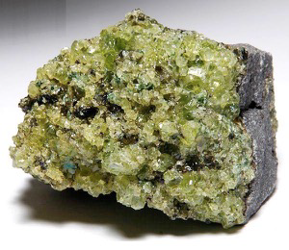
segue….If we see a xx% velocity contrast, what does that tell us?
5-8%
metagabbro vs. peridotite?

Slide 23
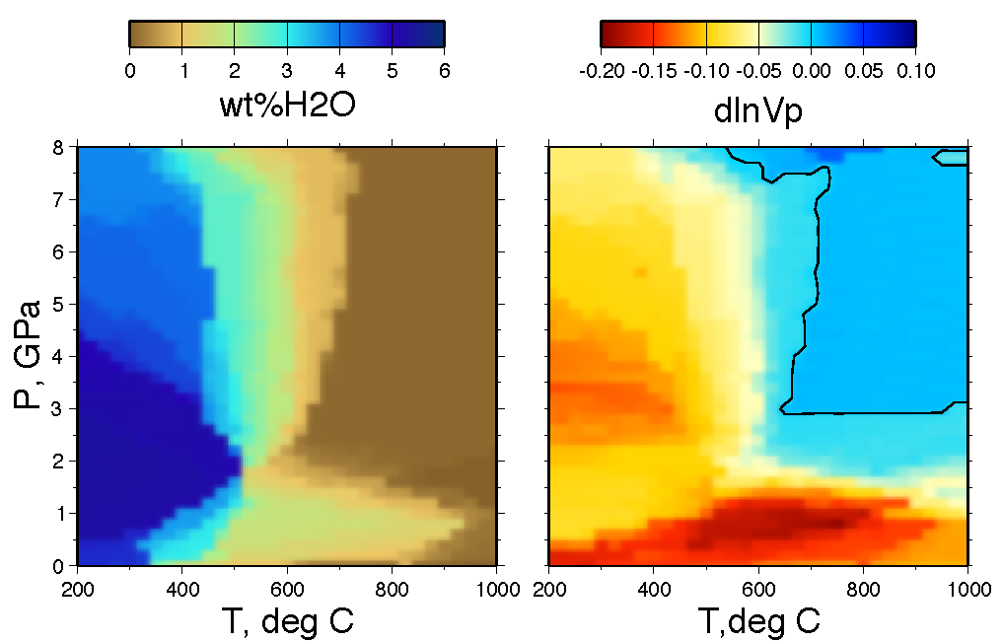
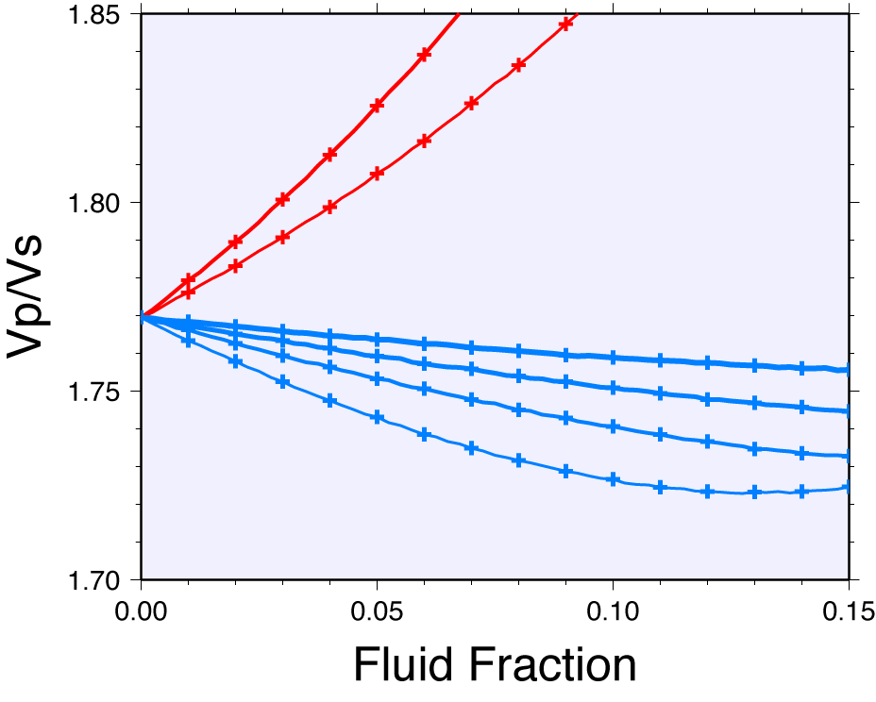
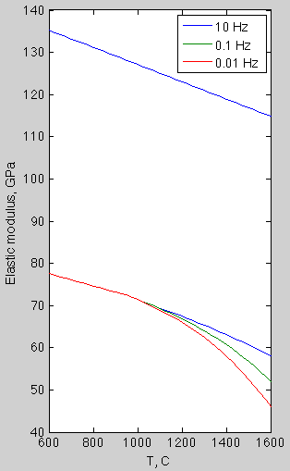
Part 2:
What affects seismic wave speeds?
(a) composition
(b) temperature
(c) pore fluids
melts
vs. peridotite
κ
vs. peridotite
200
κ = bulk modulus
Γ = shear modulus
eclogite
blueschist
H₂O
depth, km
Γ
100
Takei [2002]
poroelastic theory
amphibolite
0
(d) H₂O
Phase equilibria from Perple_x for Hydrated Metabasalt [Hacker, 2008]
Anharmonic + anelasticity
(olivine)
[Hirth & Kohlstedt]
V(X,T,P) from Hacker & Abers, 2004

Slide 24
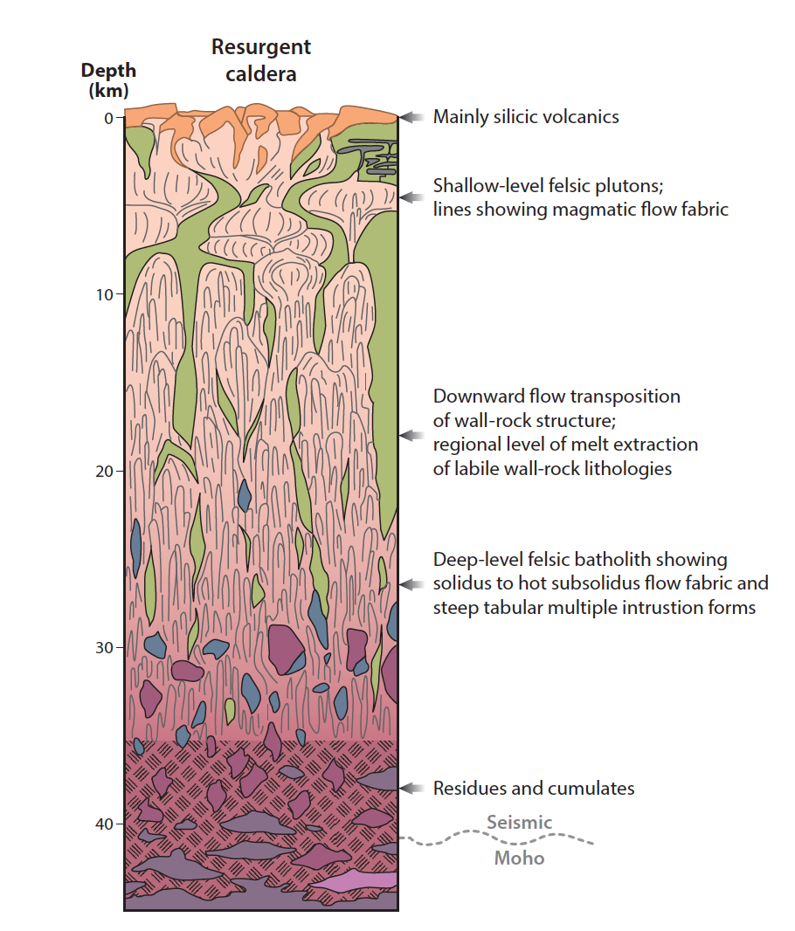
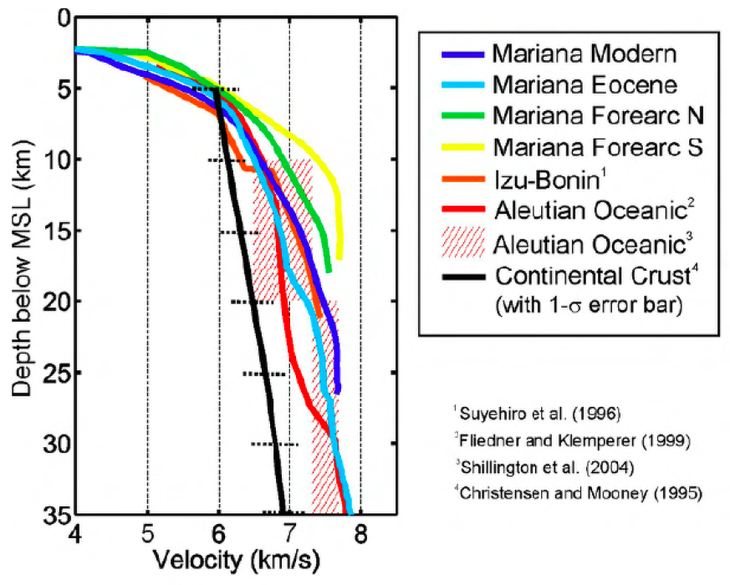
Arc crustal composition?
?
Arcs
Continents
[Ducea et al. 2015 - synthesis]
[Calvert et al., 2008 compilation]
Notes:
STEAL FIGURE FROM ADAM – Walker et al – are these same?

Slide 25
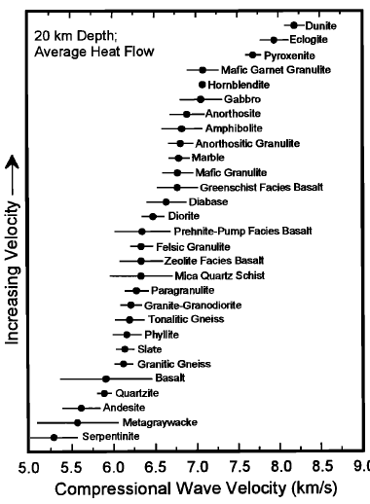


Simple approach
(1) Direct measurement of rock velocities
Problems:
All actual rocks are variably cracked and altered
Cannot access many predicted compositions
Christensen & Mooney (1995)

Slide 26



Alternate approach: Measure/calculate mineral properties, and aggregate
Disaggregate rock into mineral modal abundances
For each mineral, look up K, G, V, … & derivatives
Peridotites: Lee, 2003
Extrapolate K(P,T), G(P,T), …
Aggregate to crystal mixture
Calculate Vp, Vs
Eclogite: Abalos et al., GSABull 2011

Slide 27

Calculating “anharmonic” Velocities
Useful tool (one of several) – download the supplement to play
Notes:
Composition

Slide 28

Vp, Vp/Vs for minerals
after Rossi et al., 2006
dot ranges are 0.8-1.0 Mg/(Mg+Fe), or something analogous for garnet

Slide 29
Relevant Parameters
At reference P,T
ρ_{o} = density
K_{T0} = isothermal bulk modulus
G₀ = shear modulus
Derivatives
α₀; dα/dT = coef. Thermal expansion
K’ = dK_{T}/dP
G = dlnG/dlnρ
G’ = dG/dP
Derivatives relating elastic to thermal properties
γ_{th} = 1st (thermal) Grüneisen parameter (~dT/dV|_{S})
δ_{T} = 2nd (adiabatic) Grüneisen parameter (~∂K/∂T|_{P})

Slide 30
Aggregating & Velocities
Mixture theories, simple: Voight-Reuss-Hill
  average K, 1/K, both; same with G
Complex Hashin-Shtrikman Mixtures
  sorted/weighted averages
Finally, turn elastic parameters to seismic velocities using the usual…
NOTE this averages anisotropy

Slide 31
Examples of mixing calculation
lherzolite – serpentinite mixing
forsterite – fayalite mixing
This ignores mixing of orientations of anisotropic minerals

Slide 32
Calculating seismic velocities from mineralogy, P,T
(Abers & Hacker, 2016; Hacker & Abers 2004, Gcubed)
Parameters for ~60 end-member mineral compositions
Track Vp, Vs, rho, H₂O, major elem., T,P
2016 version: MATLAB utilities
Notes:
Aside: how do we compare seismic observations to petrology? w/ Brad, developed general strategy to calculate V at arbitrary composition, P, T. First, for 52 endmembers, calculate elastic parameters at depth. Then, using petrologic ideas of phase relations, aggregate minerals to make predicitons. track density, H2O & other elements etc. as well as V. (IGNORE Queensland)

Slide 33
hydrated meta-MORB
calculation/composition after Hacker,GCubed, 2008
Phase equilibria from Perple_x
vs. peridotite
eclogite
blueschist
amphibolite

Slide 34


V vs. composition…
Arc lower crust
(Behn & Kelemen 2006)
Bulk compositions from exposed arc sections
Mineralogy calculated at P,T from free-energy minimization (PERPLE_X*)
These figures: mostly anhydrous rx
Silicic rocks: QUARTZ abundance dominates Vp
Other minerals dominate elsewhere
*Connolly, 2005

Slide 35



MSH crustal velocities vs composition
W
E
dVs across Moho: partly crustal velocities?
[Crosbie et al., in prep.]
Behn & Jagoutz compilation

Slide 36


Mantle velocities from thermal model:
Mount St Helens predictions
900C
GRT Migration comparison
Mann et al., in prep.
Models from Syracuse et al., 2010; Abers et al. 2017
(old slab geometry)
Notes:
Hansen figure???

Slide 37


Predictions from thermal/petrologic model
H2O
Vs
2D model predictions
[van Keken et al., 2011]
Cascadia image
[Abers et al., 2009]

Slide 38

Complication: anisotropy
Known for a few minerals
olv
opx
cpx
Mainprice, 2007

Slide 39


complexities in subduction zones
90° rotation between cold forearc and hot subarc
but…
N. Honshu
(Nakajima & Hasegawa 2004)
Alaska
(Christensen and Abers, 2010)

Slide 40





many ideas to explain subduction anisotropy
In-slab fabric
Faccenda 2008]
3D wedge flow
[Bengston & vanKeken 2012]
Sub-slab fabric
[Song & Kawakatsu 2012]
B-fabric transition
[Karato et al., 2008 etc]
Global flow (Long & Wirth 2013)

Slide 41

These “anharmonic” calculations get you to about 800-1000 C.
To go hotter, we need to understand how attenuation affects observed wavespeeds.
REMINDER
Amplitude decay per cycle ~ exp(-πf T/Q)
ΔE
signal
T
noise
1/f
so higher frequencies decay quicker
S wave spectrum
low-Q wedge

Slide 42

What Causes (apparent) Attenuation?
Upper Crust: cracks, pores
Normal Mantle: thermally activated dissipation
Cold Slabs: ??
(scattering may dominate if 1/Q_{intrinsic} is low)
?

Slide 43
Attenuation vs Velocity: Physical Dispersion
Pulse smoothing + causality = dispersion
No attenuation
“Attenuation” without causality
Attenuation + Causality

Slide 44
Attenuation vs Velocity: Physical Dispersion
This means:
Band-limited measures give slower apparent velocities
As T increases, both V and Q decrease due to this effect
No attenuation
Attenuation
+ Causality

Slide 45

Shear attenuation (1/Qs) vs. T
Laboratory
Conditions
Lab-based olivine models
measure at seismic ω, mantle T
Extrapolate in grain size
Issues: H2O, melt, pyx, subgrains….
Mantle
Conditions
Abers et al., 2014 [Models from Jackson and Faul, 2010; McCarthy et al., 2011]

Slide 46









Main signal in mantle Q is T
Strong evidence for a ubiquitous cold nose
Stachnik et al., 2004 Alaska
Rychert et al., 2008 Nicaragua
Tsumura et al., 2000: N Honshu
Nicaragua
Eberhart-Phillips et al., 2008: Hikurangi
Schurr et al., 2003:
Ctrl. Andes
Pozgay et al. 2009
N Marianas
Qp

Slide 47
anelasticity + anharmonicity togther
simple model:
K
d = grain size
T = temperature
ω = frequency
α, m, E: parameters
anharmonic
G
anharmonic + anelastic
Faul & Jackson 2005 model

Slide 48


Frequency Dependence?
Q(f) = Q₀ f ^{α}
α ~ 0.1 – 0.3 (from labs)
A ~ exp[-πf T/Q(f)] implies
weak curvature: ln(A) ~ - f ^{1-α}
Izu-Bonin to Japan
[Shito et al., 2004]
Alaska
[Stachnik et al. 2004]

Slide 49

what causes high-T Q?
“elastically-accomodated grain-boundary sliding”
Grain size is important
Melt, H₂O may enhance
Looks a bit like diffusion creep
B. Holtzman, pers. comm.
Notes:
Being freplaced

Slide 50

Speculation/observation: linkage between steady-state rheology & Q
McCarthy et al., 2011
… scale to (frequency/Maxwell frequency):
allows complex effects predicted (H₂O etc), e.g.
is this true?

Slide 51



A few lab issues
McCarthy et al. (2011b): lab scaling
m ~ 1 (Jackson & Faul, 2010)
m = 3 (McCarthy et al., 2011)
grains vs. subgrains?
Grain size extrapolation: η ~ d^{m}
“peaks”
Yamauchi & Takei
2017
Sundberg & Cooper
2010
Melt? Grain boundary

Slide 52



Putting it together: finding H₂O
2. Defects in anhydrous minerals
1. In hydrous minerals
Hirth & Kohlstedt, 1996
Chloritoid schist [Angiboust et al. 2012]
3. Pore fluids
Li et al., 2017

Slide 53

Hydration via hydrous minerals
downgoing plate
forearc wedge
T < 600-700C
Notes:
.. can do same for variably hydrated serpentinites. These should be quite slow for T<600C, and can look like gabbros. Vp/Vs can be sensitive, potentially, to serpentinization. UPDATE****

Slide 54


Water as impurities in olivine
Model scaling to viscosity
(Karato 2003)
Competing effect of weakening and grain growth
(Abers et al., 2014)

Slide 55


Water in pores – pore geometry matters
Takei (2002) poroelastic theory
dVp/dVs vs. aspect ratio
Vp/Vs vs. fluid fraction
melts
H₂O
Lines indicate bulk modulus contrast
aspect ratio 0.1-0.5 (different lines)

Slide 56


Melt: big effect at small fractions?
Multiple mechanisms at work on grain boundaries
Holtzman, 2015
Some experiments and models show this

Slide 57


Melt complexities
New: pre-solidus weakening
reinterpretation of lab data
Melt segregation: not included in any models yet
Katz et al., 2006; Holtzman et al. 2003
Yamauchi & Takei 2016
upshot: quantitative treatment of melt remains enigmatic

Slide 58


Example: wedge velocities
µ varies
only
Shear modulus (µ) reduction in high Vp/Vs zone: melt signature?
T effect
δT_{f=∞}
δµ
Vp/Vs
anharmonic
Nicaragua
(Syracuse et al., 2008)
Notes:
CO only

Slide 59

Attenuation vs. petrologic temperature
Correlation exists, but way more attenuation observed than predicted, beneath arcs
Oceanic lithosphere is well predicted
Qs from local body waves; T from major-element chem of arc basalts
(or thermal model, for oceanic lithosphere)
Abers et al., 2014

Slide 60

Some possible melt models
Include ~40x small-melt effect; scale Q to viscosity
Abers et al., 2014

Slide 61



summary
At low-moderate temperatures, compositional variations can control velocities
At higher temperatures, Q is important and affects V
Dry materials relatively understood
Melt is a major unknown to seismologists
seismic
attenuation
Vp/Vs
ΔVp/Vs

Slide 63
EXTRAS

Slide 64

The cold forearc wedge: water reservoir or not?
Abers et al., 2017, Nat. Geosci.
Notes:
OPTIONAL SKIP

Slide 65

The cold wedge might be hydrated, given enough time
- hydrated peridotite
Alaska Peninsula forearc can store:
2.4 x10⁸ Tg H₂O in 510 km
Globally can store: 2.6 x 10¹⁰ Tg H₂O
= 2% global ocean
Abers et al., 2017, Nat. Geosci.
Notes:
OPTIONAL SKIP

Slide 66

But how hydrated can it be? what is input flux?
- hydrated peridotite
Flux from slab, 28 – 80 km depth:
0.17 Tg/m/Ma
- small fraction of 24 Tg/m/Ma input, mostly sediments and volcanics
Time to fully hydrate: 2.8 Ga
Globally: >500 Ma to saturate
Also see van Keken et al., 2011

Slide 67

The exception are warm slabs
Rate of H₂O loss from subducting plate: Yellow = sub- cold nose

Slide 68


Globally, expect high hydration only at hottest places
Compilation of forearc Vp: all but the hottest show Vp close to anhydrous peridotite
Global forearc can hold 2% of current ocean H2O

