Slide 1
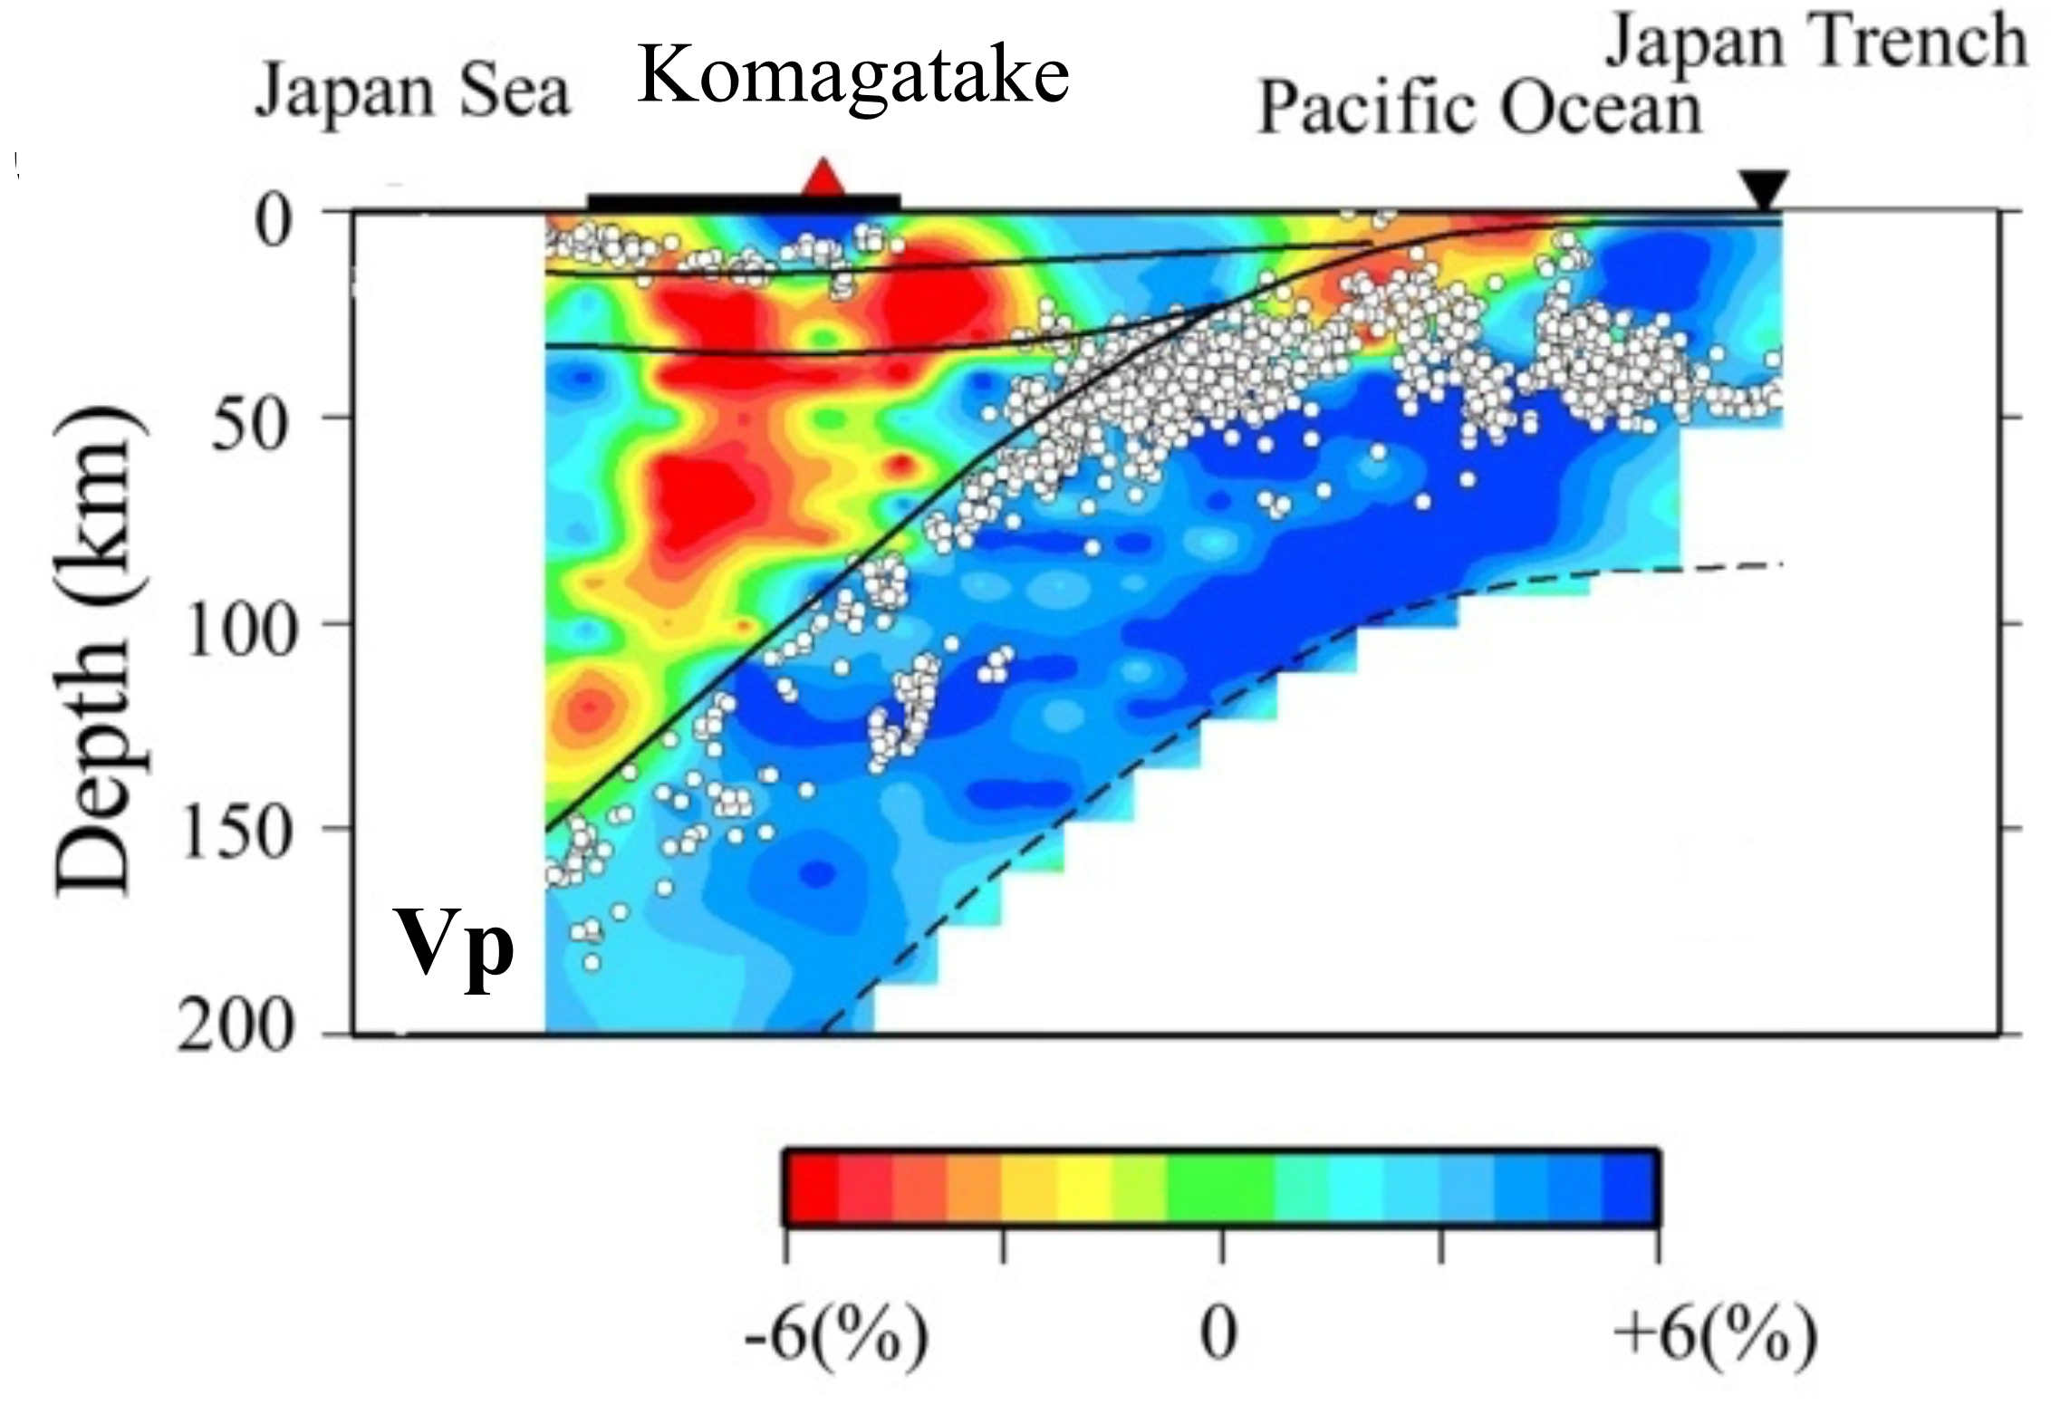
An Introduction to Subduction Zone Seismology
Highest resolution method for
imaging the earth’s interior
Primary method for detecting
and studying earthquakes
Zhao, 2012

Slide 2
Outline
Seismology basics – what can we measure?
-- P, S velocity, attenuation
-- Relationship to temperature, composition, volatiles
-- Instrumentation
Seismic constraints on the input of water at subduction zones
Evidence for dehydration from intermediate depth earthquakes
Mantle melting and the effect of water beneath arcs and backarcs

Slide 3
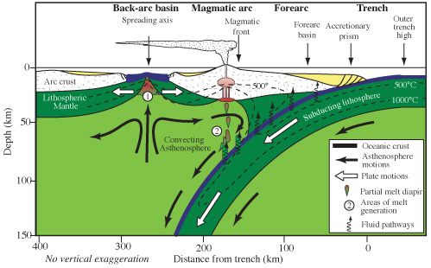
Imaging pathways of water and melt through arc/backarc systems
Figure credit:
Wikipedia
Seismology provides constraints on:
Amount of water coming into the system in the subducting plate
Depth and configuration of the melting region beneath the arc and backarc
Effect of water on the melting system when water varies along strike
Earthquake locations and source processes in the shallow thrust zone & slab

Slide 4
Measureable seismic properties
Seismic velocities – P & S
  Relationship to elastic moduli
Seismic anisotropy
-- directional variation in seismic velocity
Seismic Attenuation – 1/Q_{p} & 1/Q_{s}
-- What is seismic attenuation?
-- What causes seismic attenuation?

Slide 5
Seismic velocities
k = Bulk modulus
μ
= Shear modulus
ρ = density
λ
= Lame’s lambda constant

Slide 6
Measuring both V_{p} and V_{s} is useful
The ratio of V_{s} to V_{p} depends on Poisson’s ratio (σ):
A good approximation is often that λ = μ; then σ = 0.25 and V_{p}/V_{s} = √3
This is called a Poisson solid

Slide 7
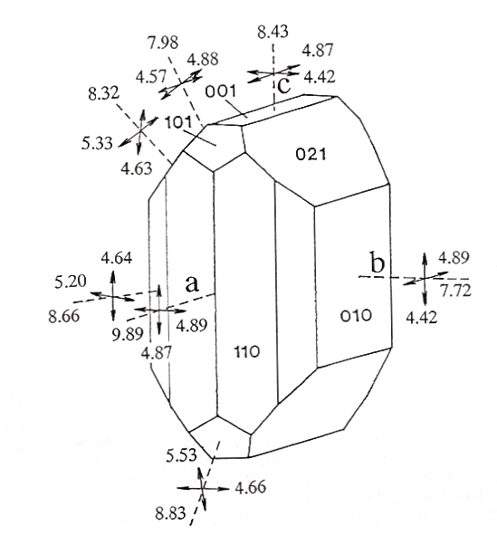
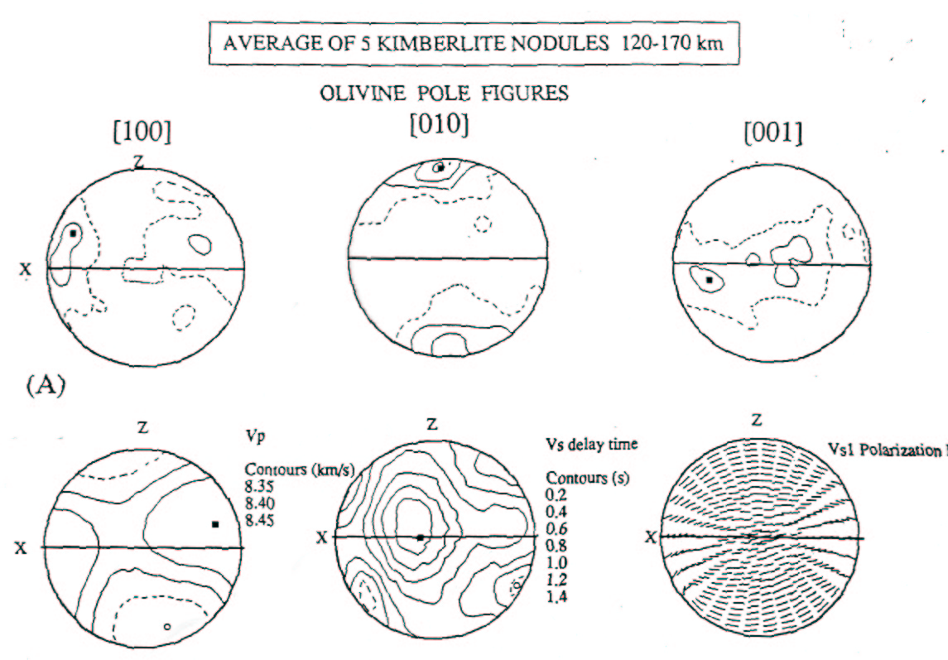
Seismic Anisotropy
Shear velocity of olivine
Relationship of anisotropy and strain - xenoliths
Mainprice & Silver [1993]
Data from Kumazawa & Anderson [1969]

Slide 8
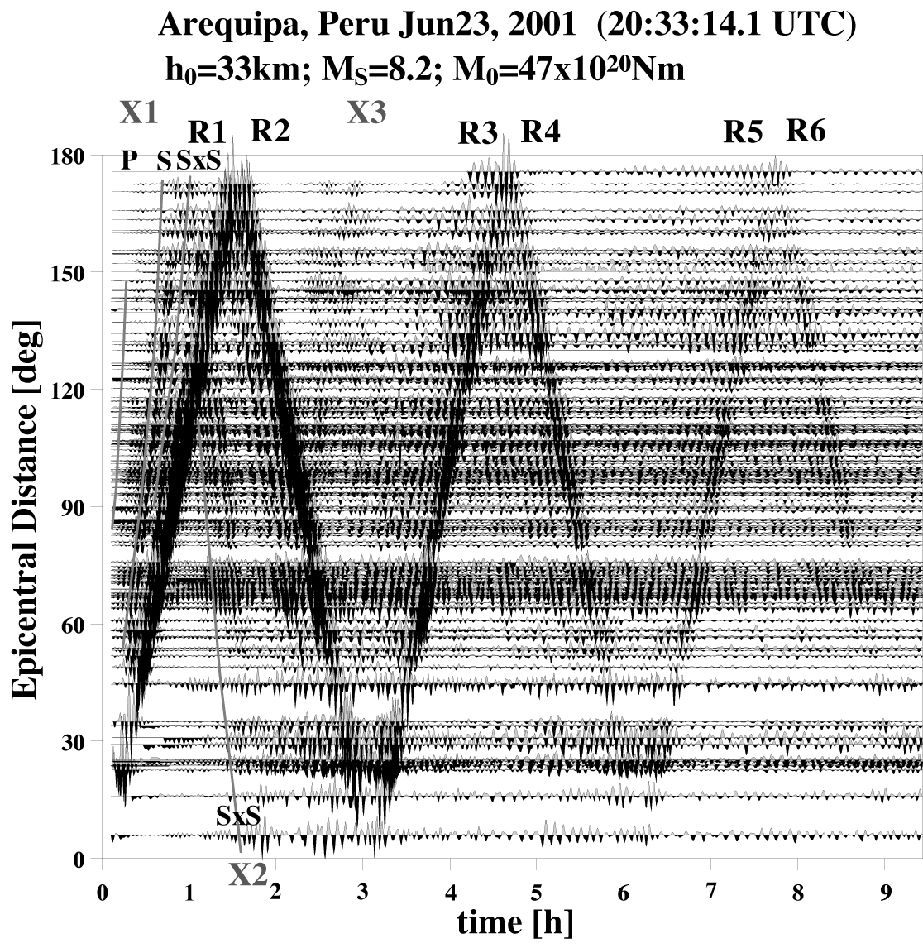
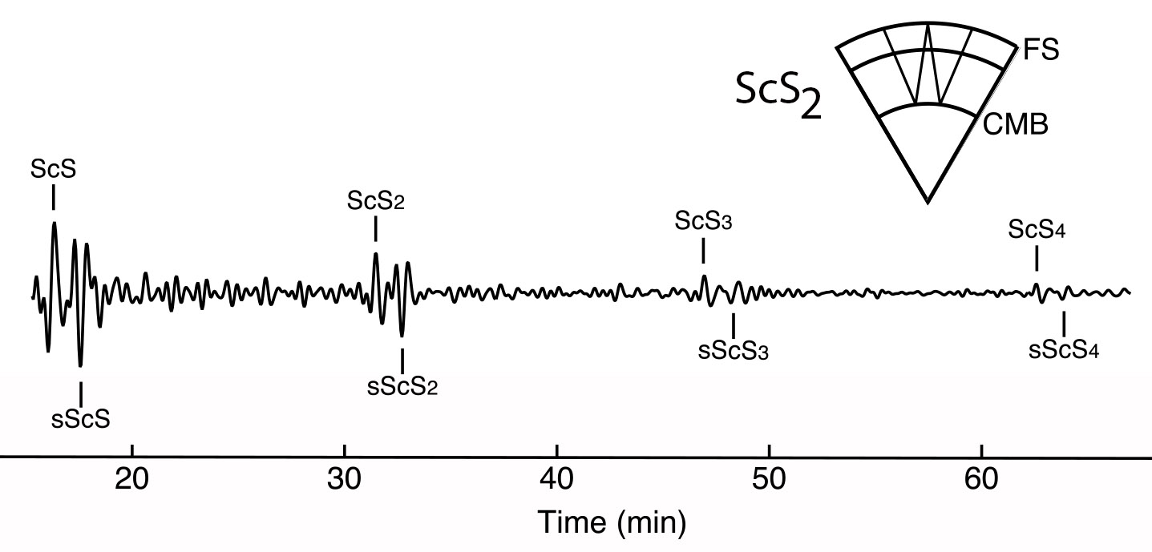
Seismic Attenuation
In a perfectly elastic medium, the total energy of the wavefield is conserved
Seismic attenuation is the absorption of seismic energy, or the deviation from perfect elasticity
Surface waves
Body waves
Coutier & Revenaugh [2006]
Widmer & Laske [2007]

Slide 9
Q – Quality Factor
Attenuation is quantified by 1/Q, in analogy to the damped harmonic oscillator (underdamped)
Smaller Q results in faster damping (greater deviation from elastic case)
Frequency-independent Q damps high frequencies more than low frequencies
Q = 2π (total energy/energy lost during one cycle)

Slide 10
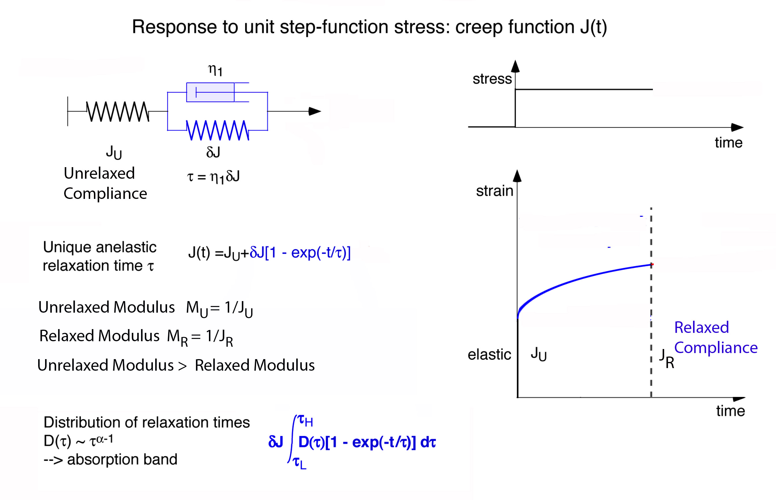
Anelasticity (Attenuation)
Makes the shear modulus frequency dependent
Figure from Uli Faul

Slide 11
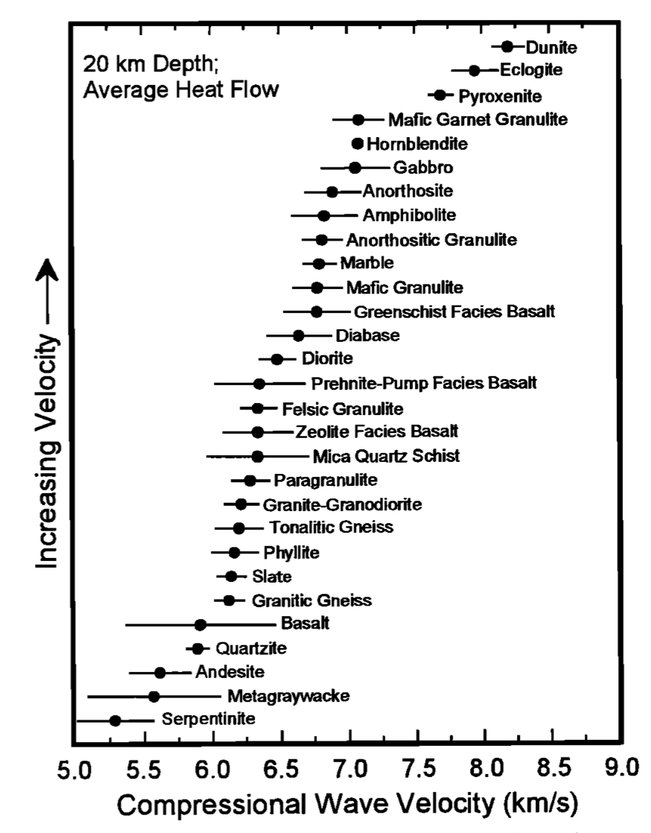
Crustal velocities: A function of composition, pressure, temperature
Christensen & Mooney [1995]

Slide 12
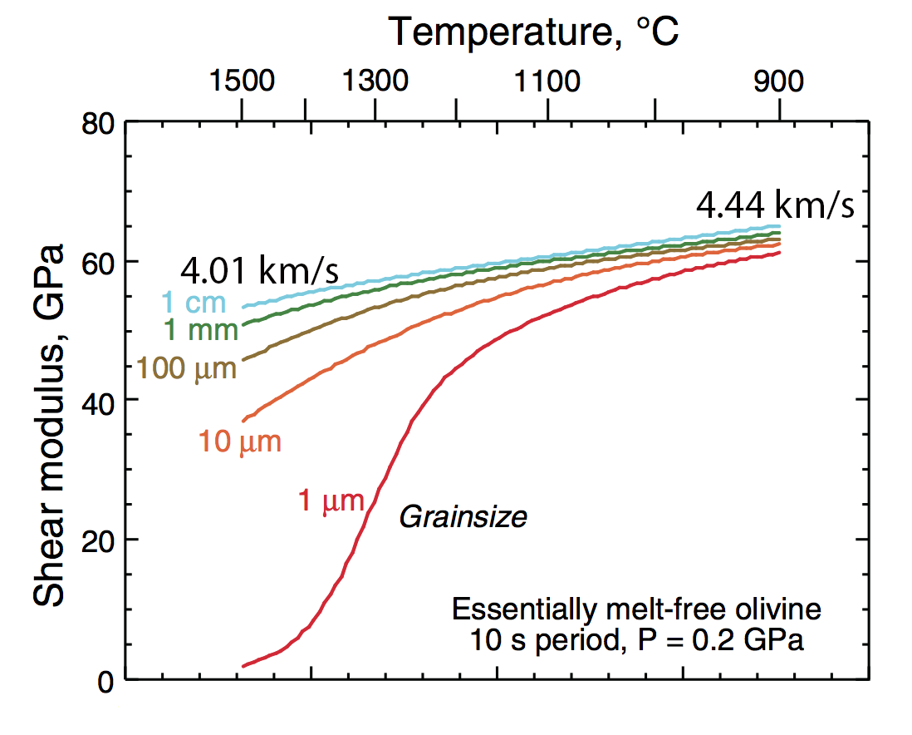
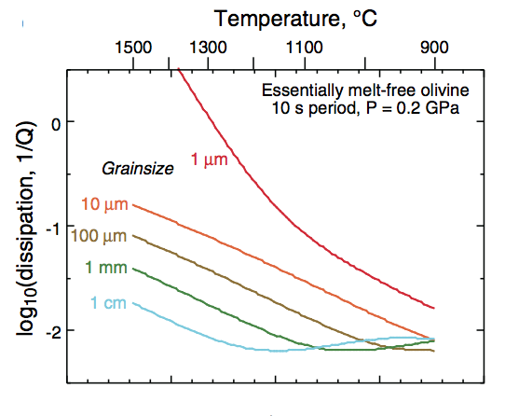
Temperature effect on upper mantle seismic velocity and attenuation
P and S velocities are controlled by anharmonic temperature derivatives at
temperatures below about 900°C --- relatively linear
Above 900°C attenuation increases rapidly and the velocity derivatives are non-linear
Both attenuation and velocity are also a function of frequency, grain size, and depth (Jackson and Faul, 2010; McCarthy & Takei, 2011)
Nonetheless, it is impossible to get extremely low shear velocities (< 3.8 km/s) and extremely low Q_{S} (~ 20) even with small grain size and high mantle temperature
Jackson & Faul [2010]

Slide 13
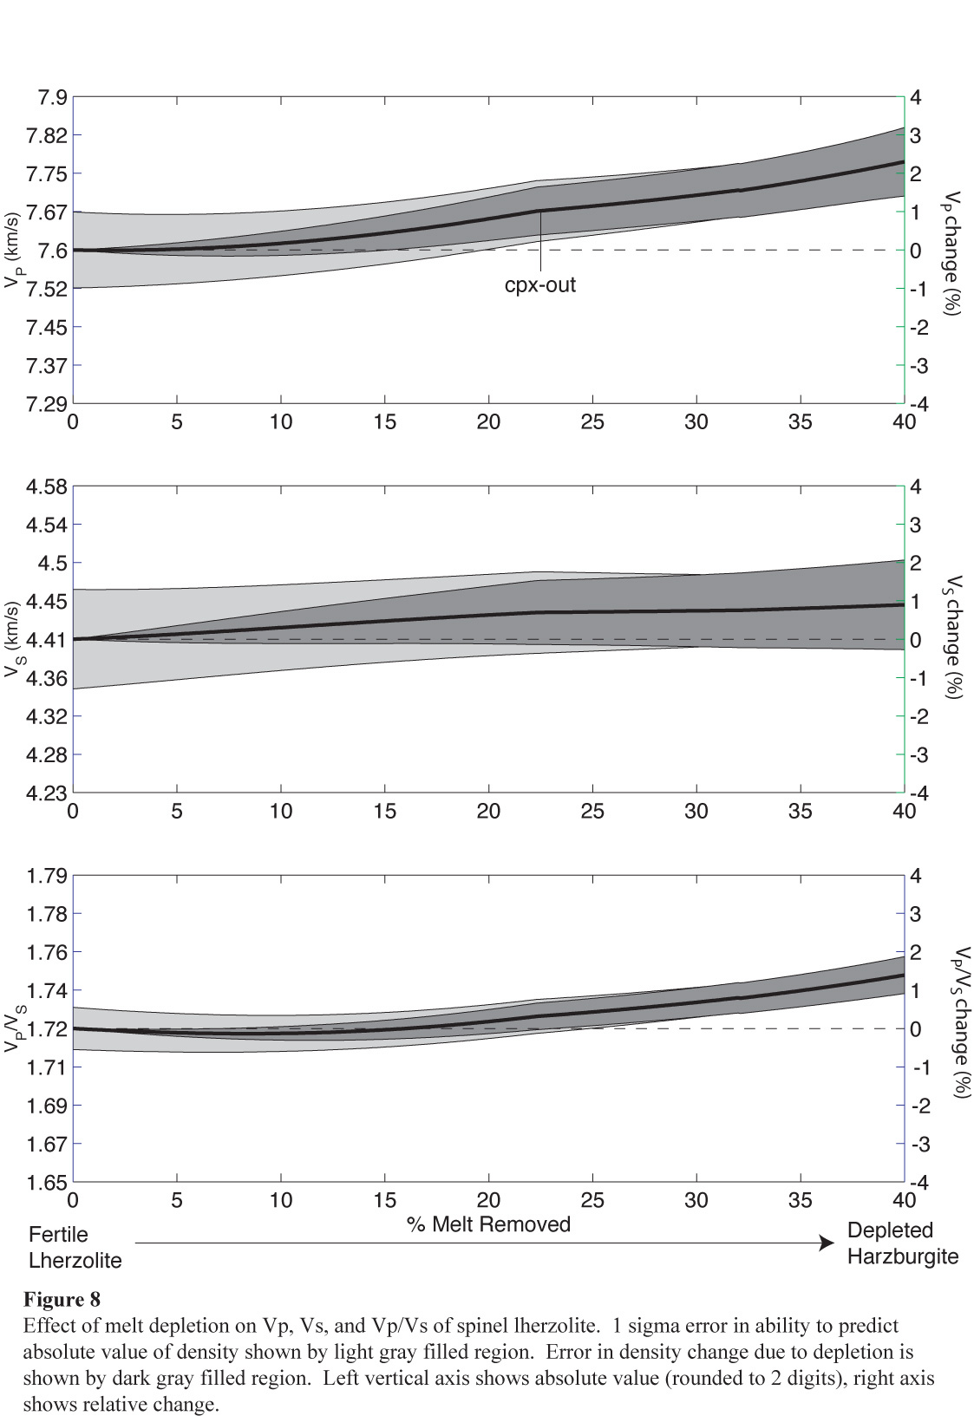
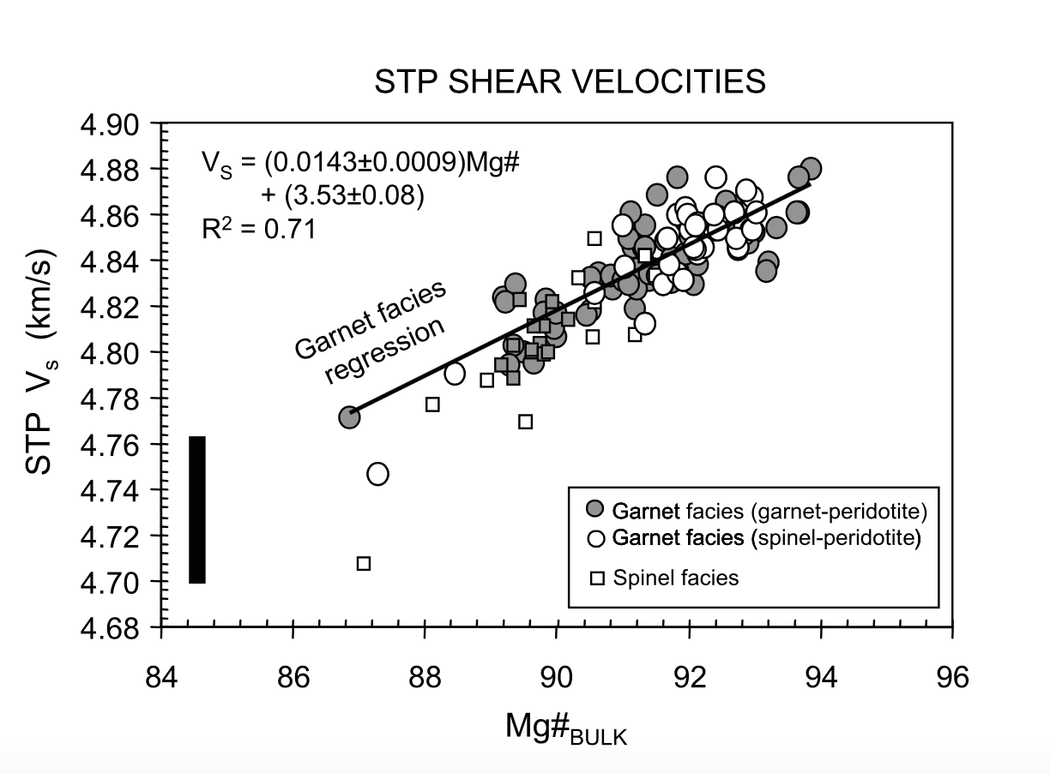
The effect of mantle composition on seismic velocity
Modeling the effect of
melt depletion on mantle
velocity (Schutt & Lesher, 2006)
Shear velocity of peridotite:
2-3% effect of Mg# (Lee, 2003)

Slide 14
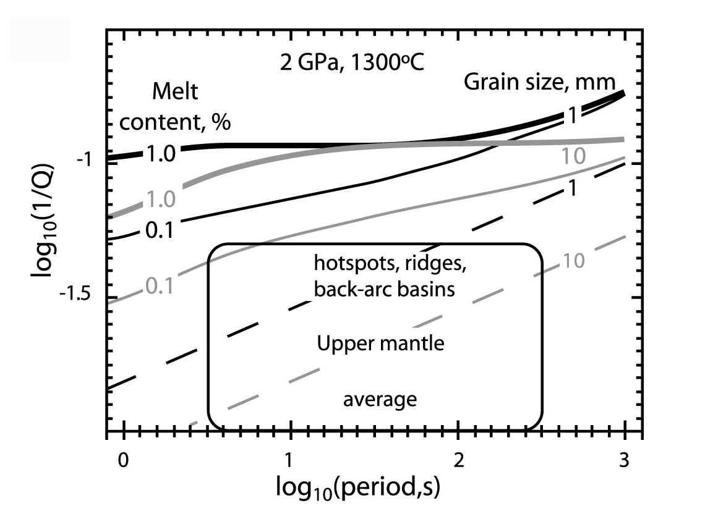
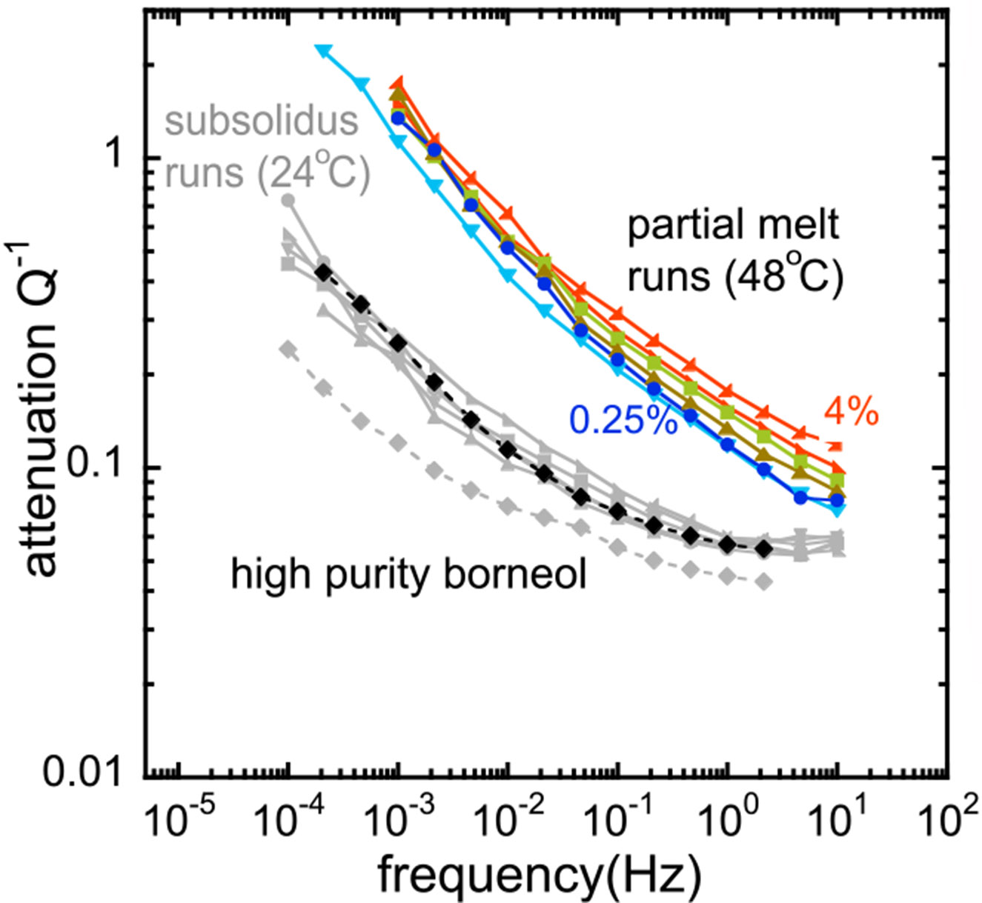
Effect of melt on seismic velocity and attenuation
Experiments on Olivine
Faul et al., 2004
Experiments with an Analog Material
McCarthy and Takei [2011]
Both experiments indicate melt produces an anelastic effect
Effect of melt is extremely strong at very small melt porosity
Strong attenuation will also produce a large velocity decrease due to dispersion
May resolve the issue of seismic data apparently indicating large (> 2 %) melt porosity

Slide 15
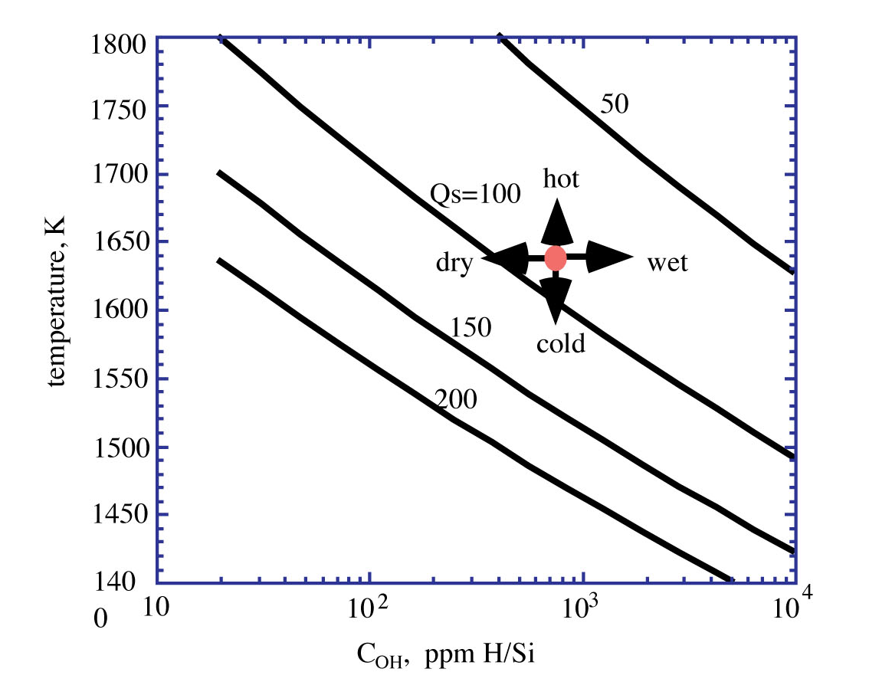
Attenuation and Velocity Reduction from Water in Olivine
Karato, 2003
Experiments: Aizawa et al [2008] shows effects but no quantitative relationship
Karato [2003] extrapolates from the rheological effect
MORB source is 0.005 wt % water (810 ppm H/Si)
At 100 km depth water < 0.02 wt % [Hirschmann, 2006]
Lowers Qs from 80 to 60; 2% decrease in seismic velocity
Water dissolved in “anhydrous” minerals has limited effect on velocity and attenuation
at depths < 100 km due to low solubility; water is mostly present as an aqueous melt

Slide 16
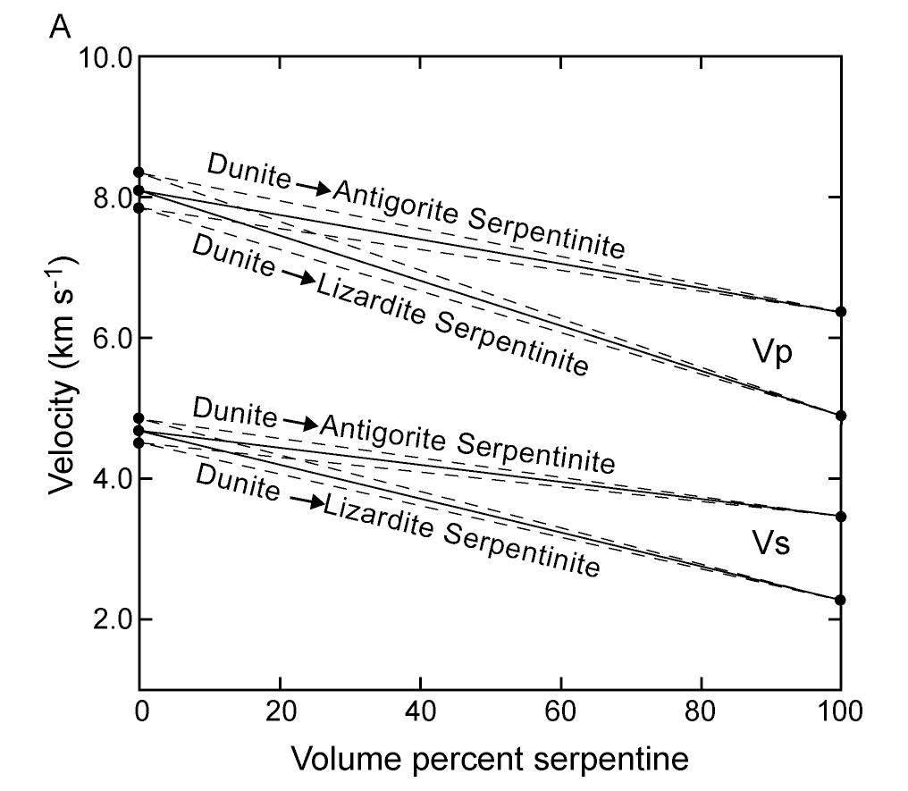
Seismic Detection of Mantle Serpentinite
P and S velocity
Christensen [2004]
Serpentinization drastically reduces seismic velocity
All three serpentine minerals contain 13 wt % water
Lizardite/Chrysotile reduces velocity much more than Antigorite
Water can be calculated from w(%) = -0.31 (ΔV_{p} %)
Best to have estimates of both P and S velocity

Slide 17
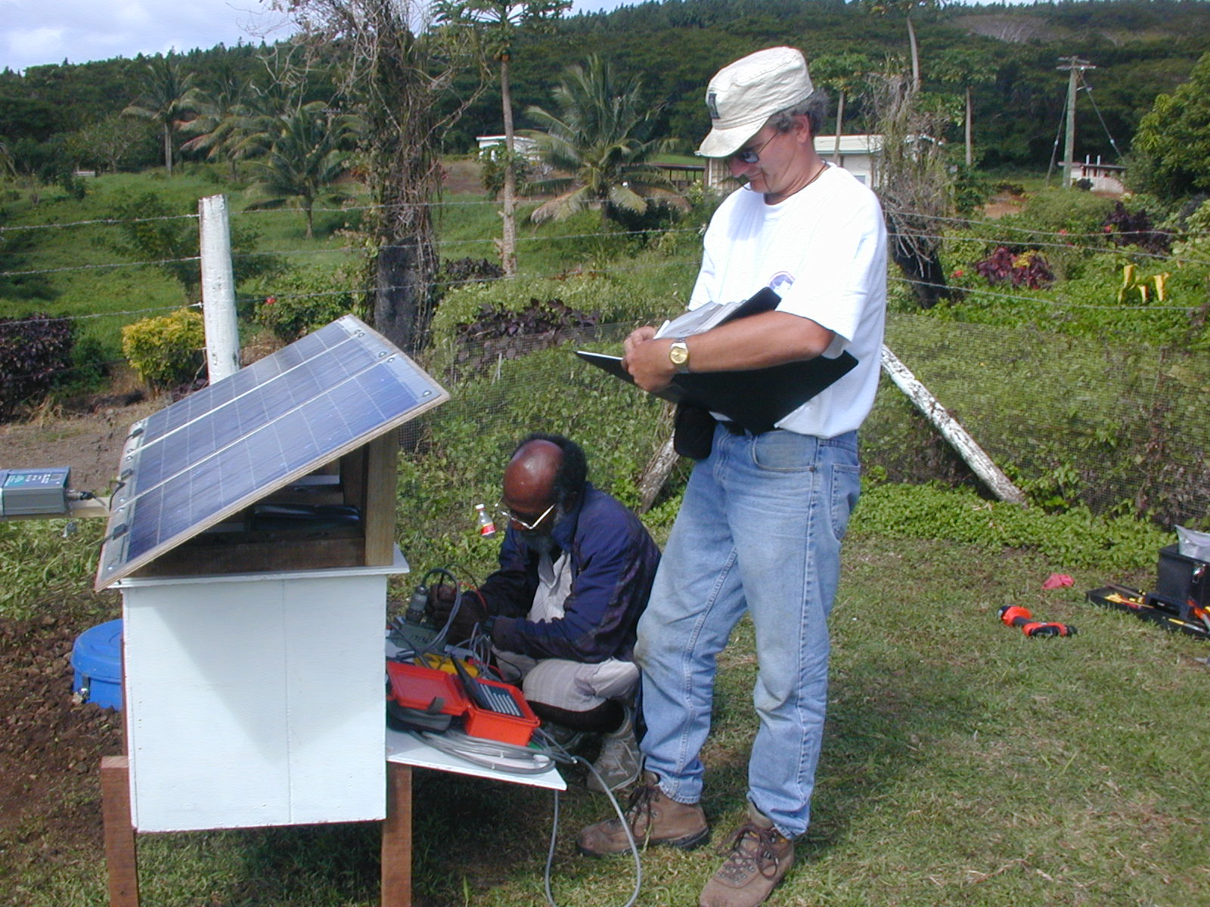
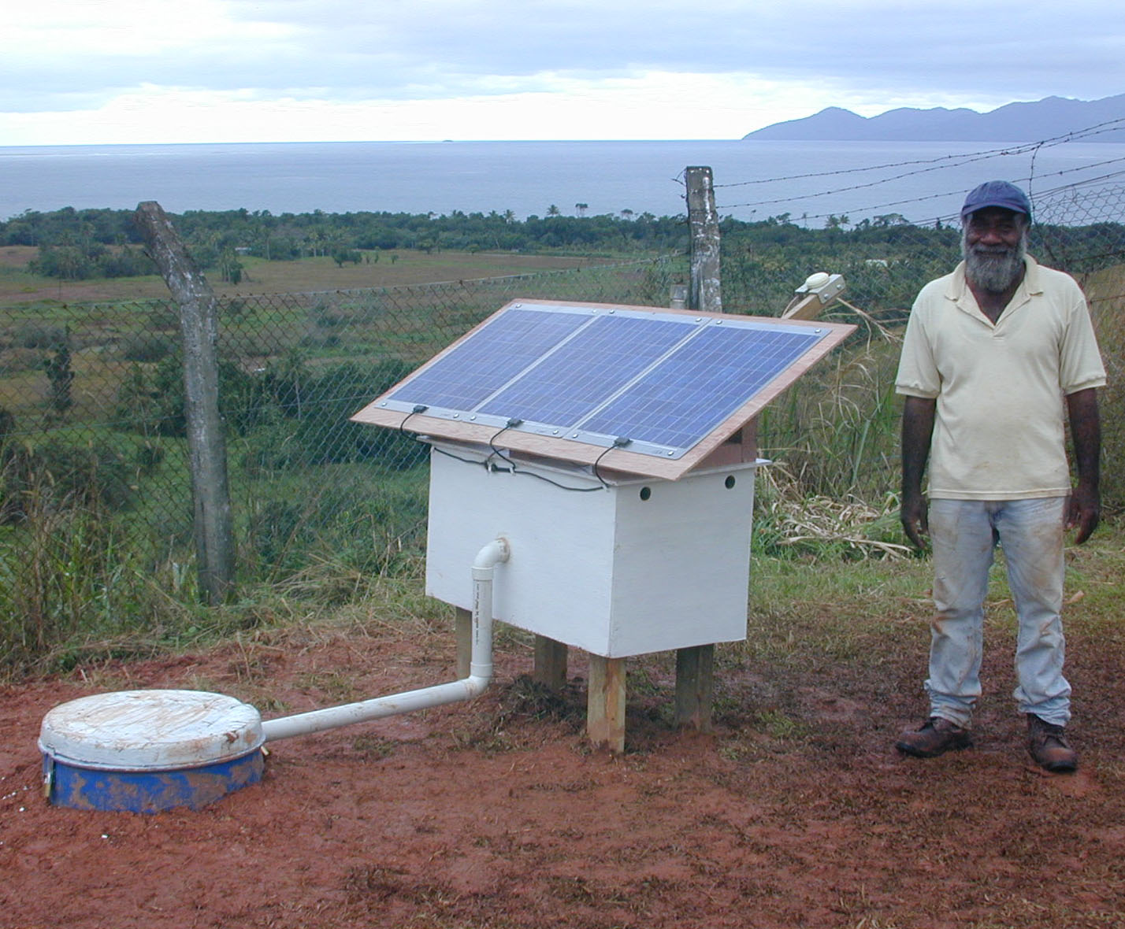
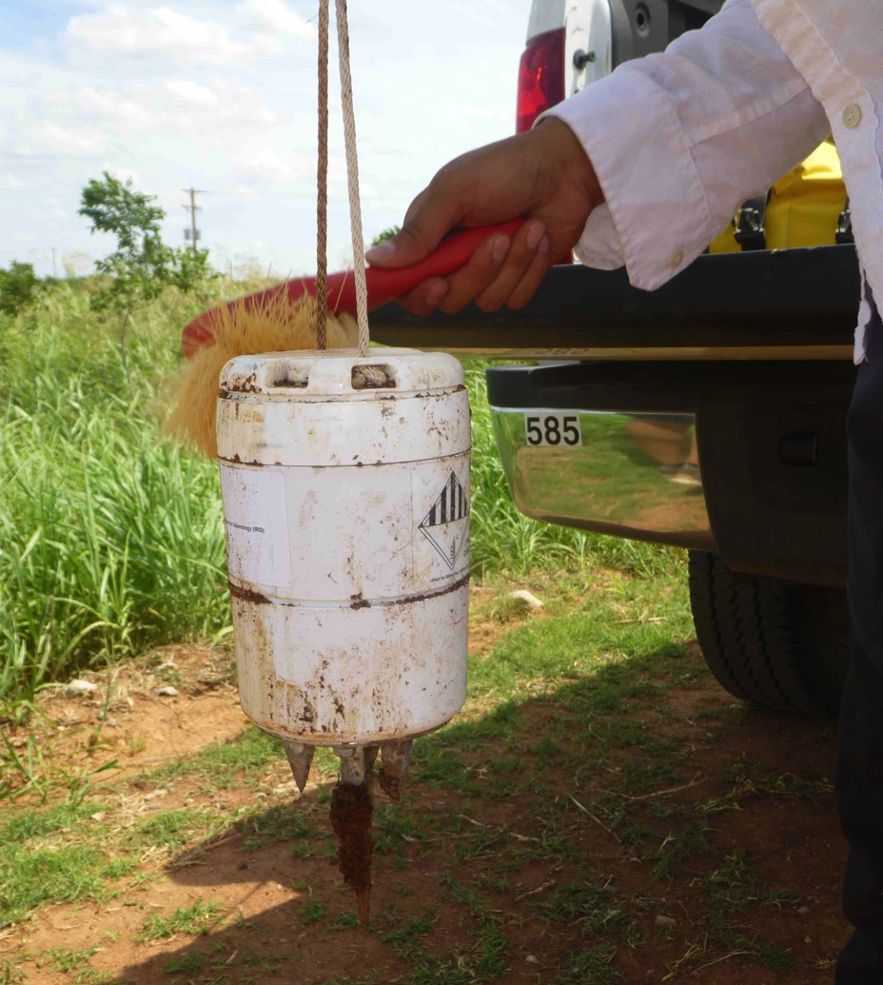
Portable Seismograph Deployments
Servicing Broadband
Seismograph in Fiji
GPS Antenna
(for timing)
Powered by
Solar Panels
High Frequency “Nodes”
Instrument box
with datalogger
and batteries
Sensor Vault
Broadband Seismic Station at Deuba, Fiji

Slide 18
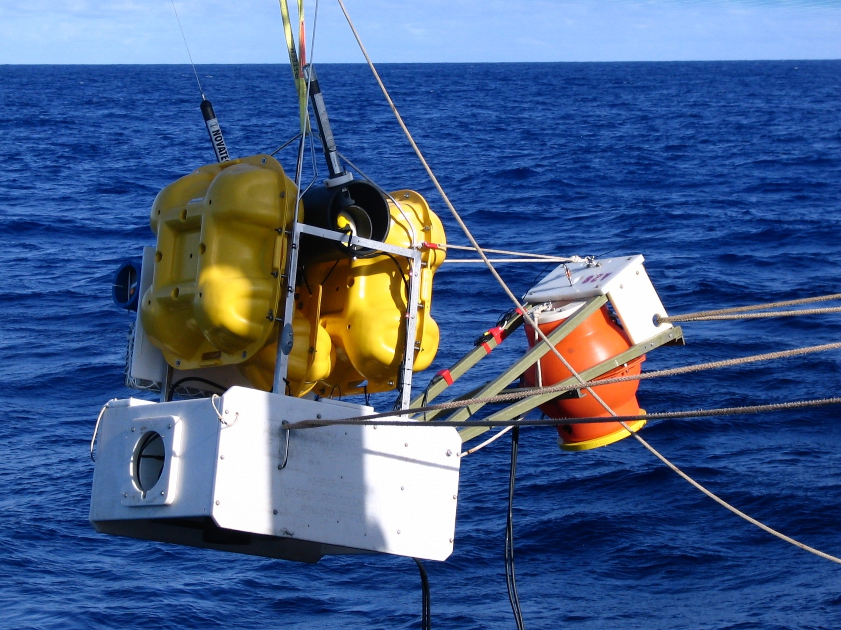
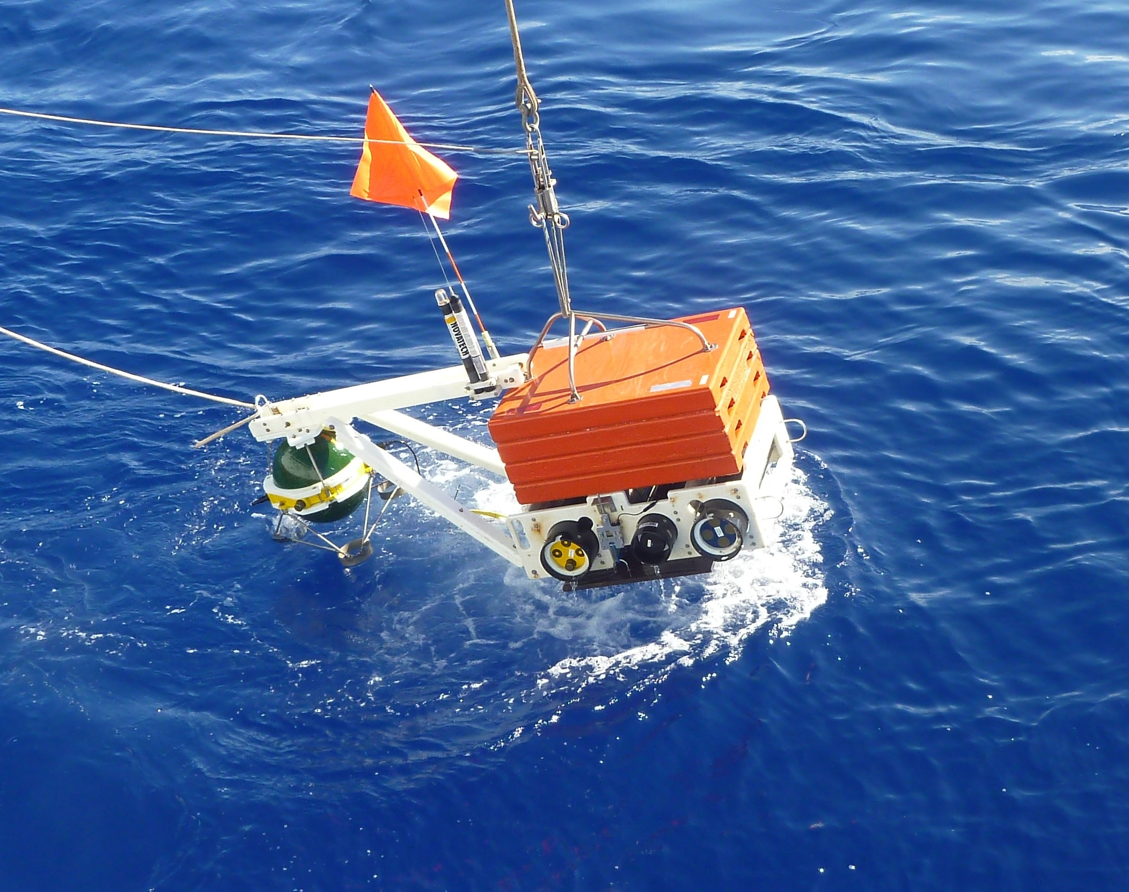
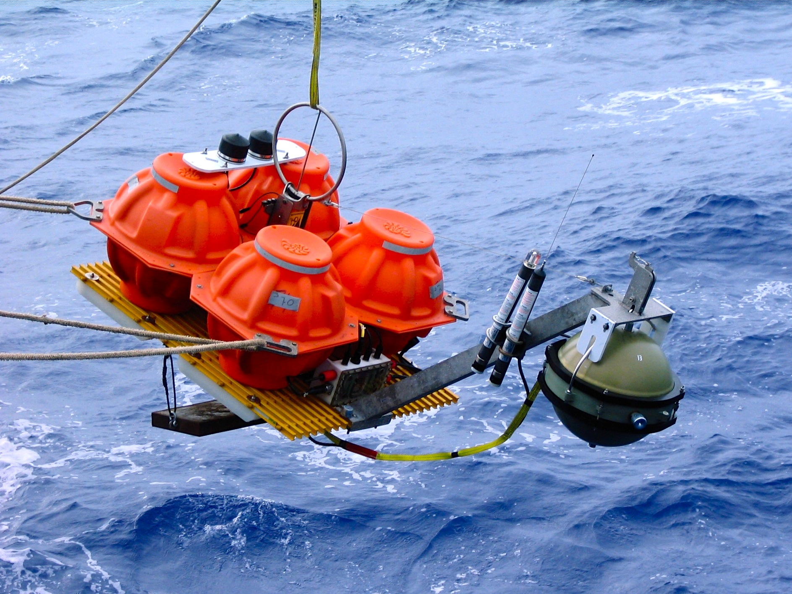
Broadband Ocean Bottom Seismographs (OBS)
Lamont-Doherty
Scripps
Woods Hole

Slide 19
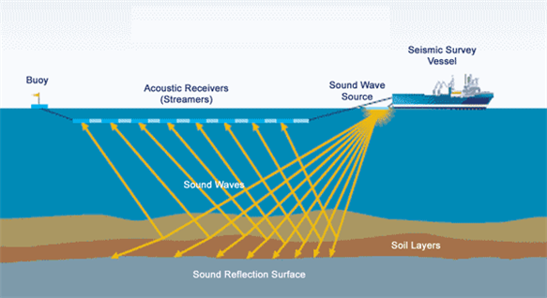
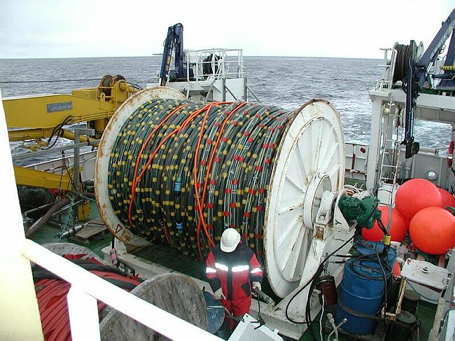
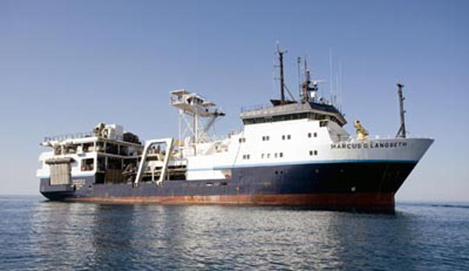
Marine “active source” imaging: airgun source recorded by hydrophones on a streamer

Slide 20
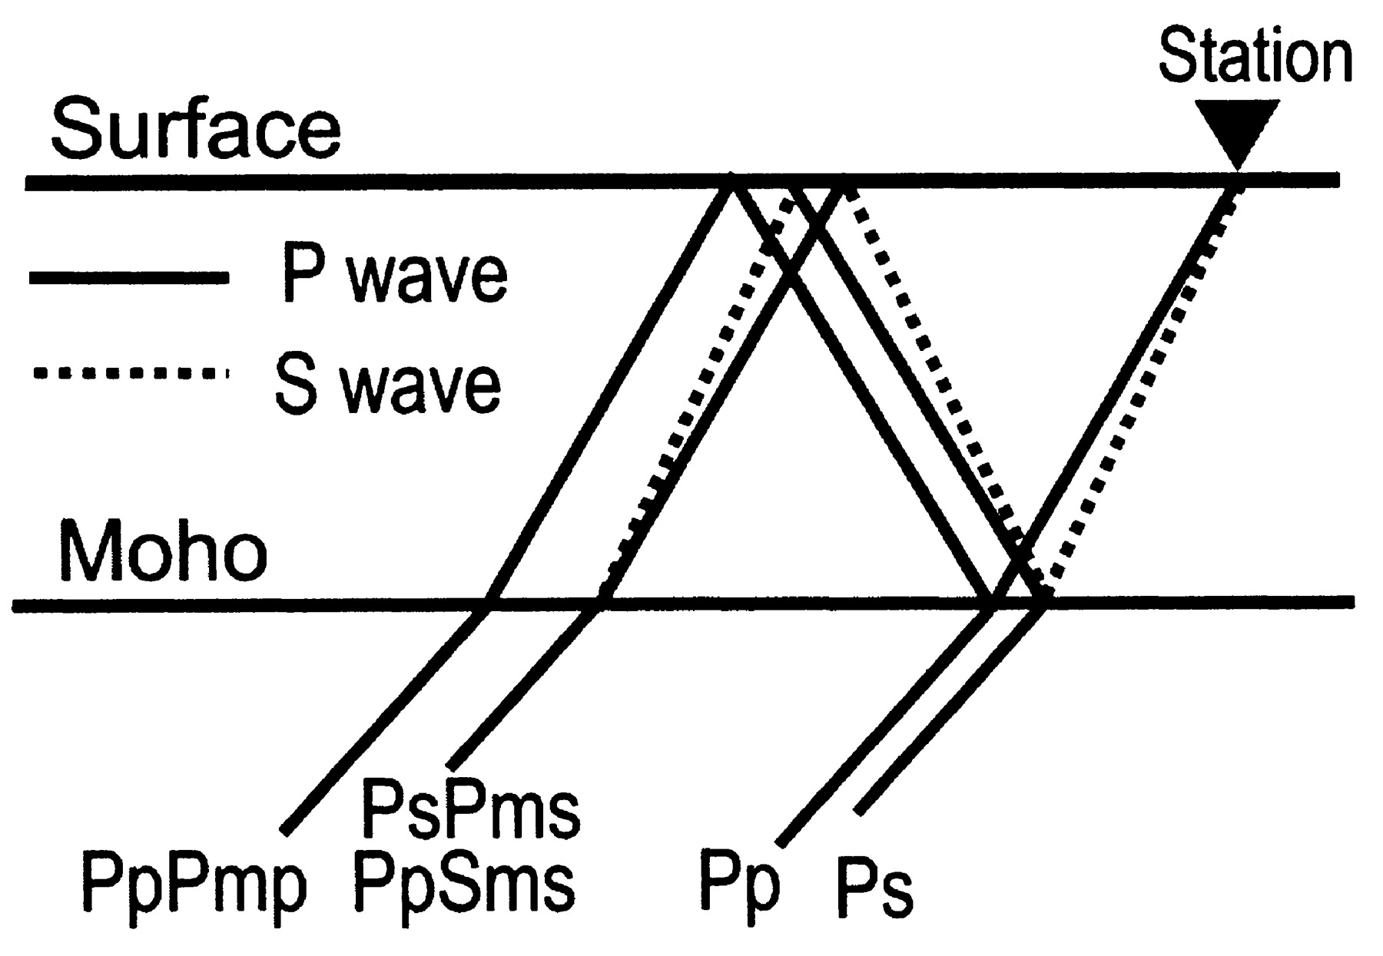
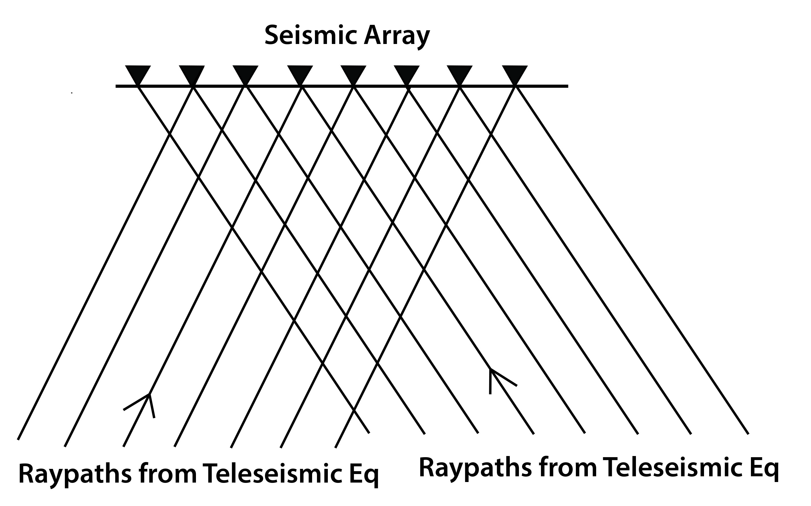
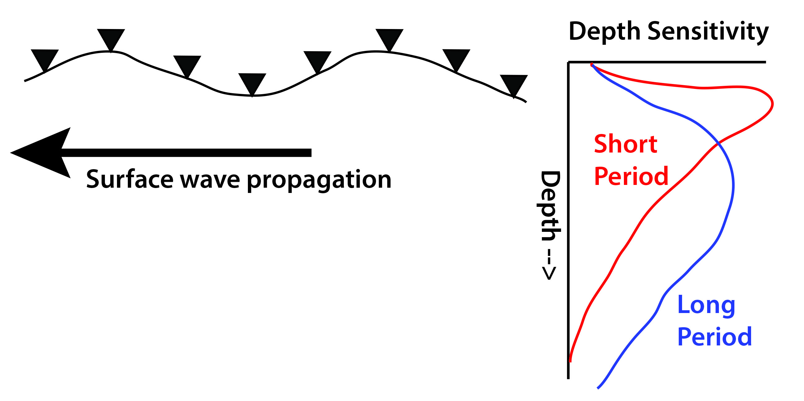
Passive Seismological Analysis Methods
Receiver Functions
Body Wave Tomography
Good for: Imaging discontinuities
(Moho, sed/rock interface, 410)
Weakness: can’t see gradients
can’t constrain velocities well
results limited to immediately below station
Good for: lateral variations
Structure in 100-600 km depth range
Weakness: need close station spacing,
often poor depth resolution
velocities may be relative, not absolute
Surface (Rayleigh) wave tomography
(often using ambient noise correlation)
Good for: depth variations
gives absolute velocities
Weaknesses: often poor lateral resolution
limited to upper 250 km

Slide 21
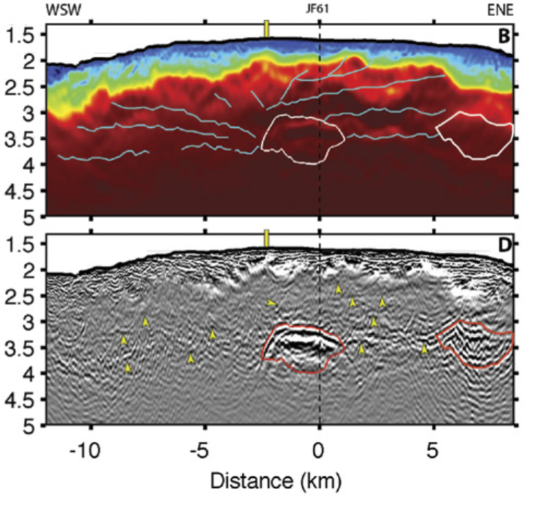
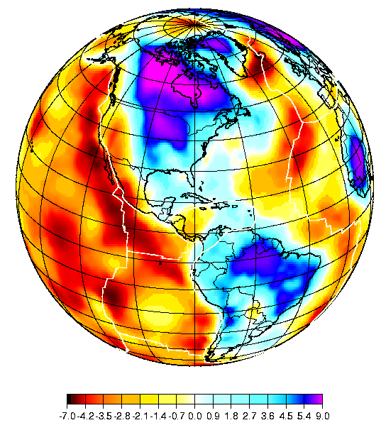
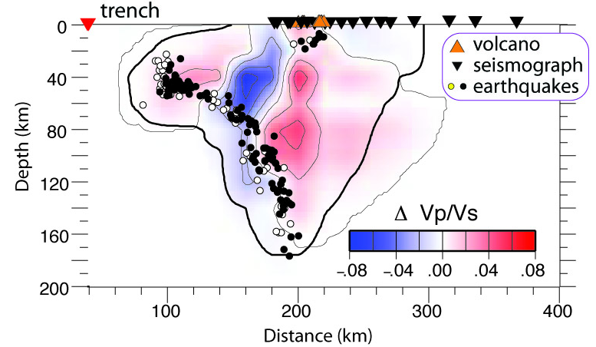
Seismic imaging: a vast range of length scales
Global Model
150 km depth
(Shapiro & Ritzwoller, 2002)
Volcano scale
Axial volcano
Arnulf et al. [2014)
Subduction zone scale
Central America
(Syracuse et al., 2008)

Slide 22
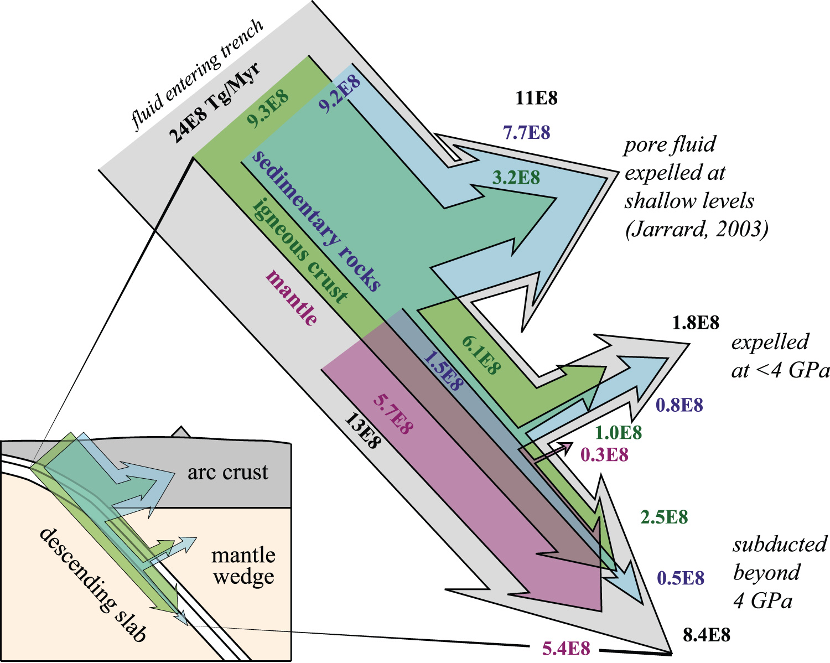
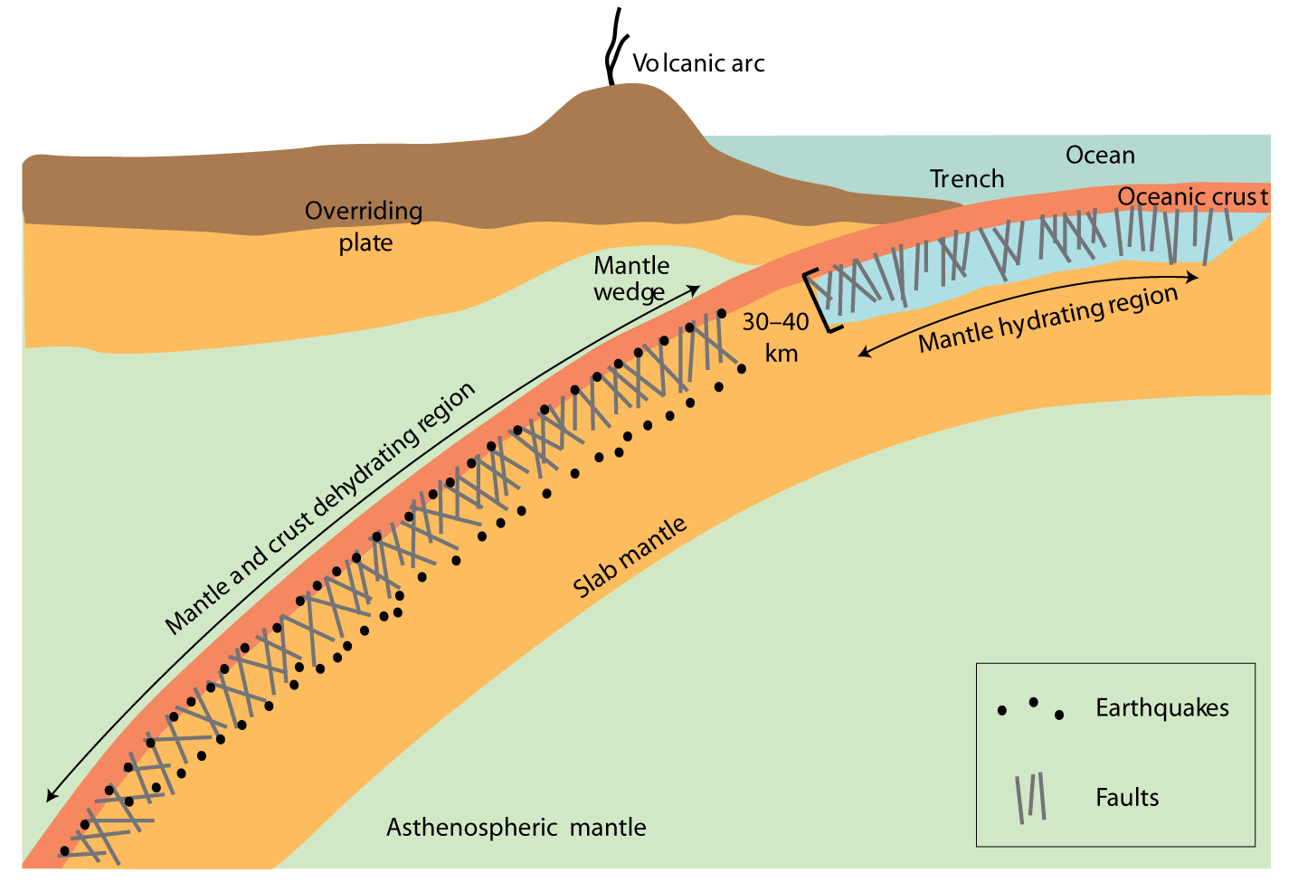
Subduction Water Budget:
Is the incoming mantle hydrated?
Mantle hydrated during bending?
Hacker [2008]
Bound water budget in 10⁸ Tg/Myr
(van Keken et al., 2011)
Input:
Sediment 0.7
Oceanic Crust 6.3
Upper mantle 3.0 ?
Output:
0-100 km depth 3.2
100-230 km 1.6 – 3.4
> 230 km 2.2 – 3.4
Figure from Billen [2009]
Normal faults penetrate the mantle when
the plate bends at trenches
Modeling suggests that pressure gradients
from the bending stresses will drive fluids
downward
Ocean water will react with fresh mantle
peridotite to produce serpentine minerals

Slide 23
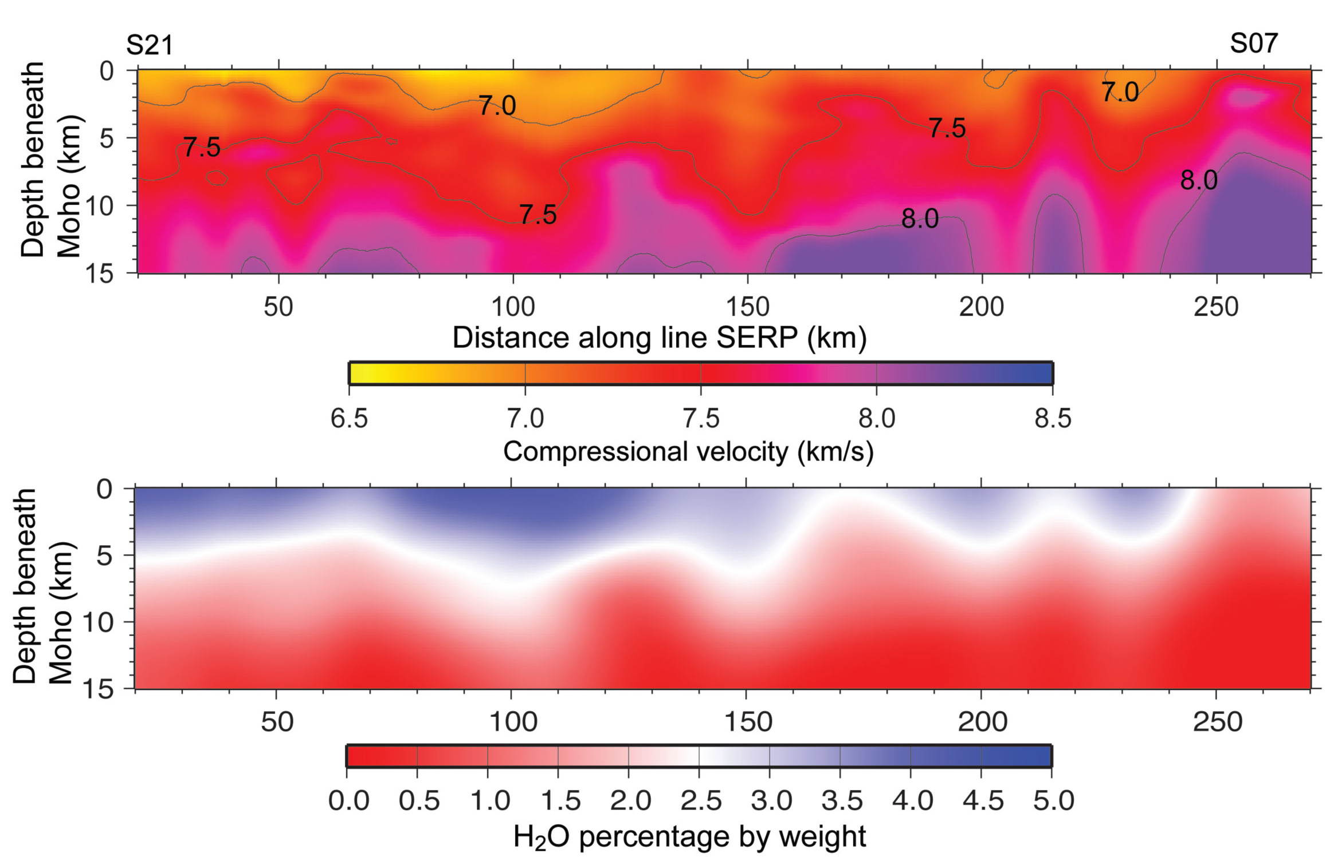
Upper Mantle Serpentinization: Central America
Nicaragua
Costa Rica
Sub-Moho seismic velocity in subducting Cocos plate
Maximum depth of extensional earthquakes
Lefeldt et al. [2009]
H2O distributed in mantle
van Avendonk et al. [2011]

Slide 24
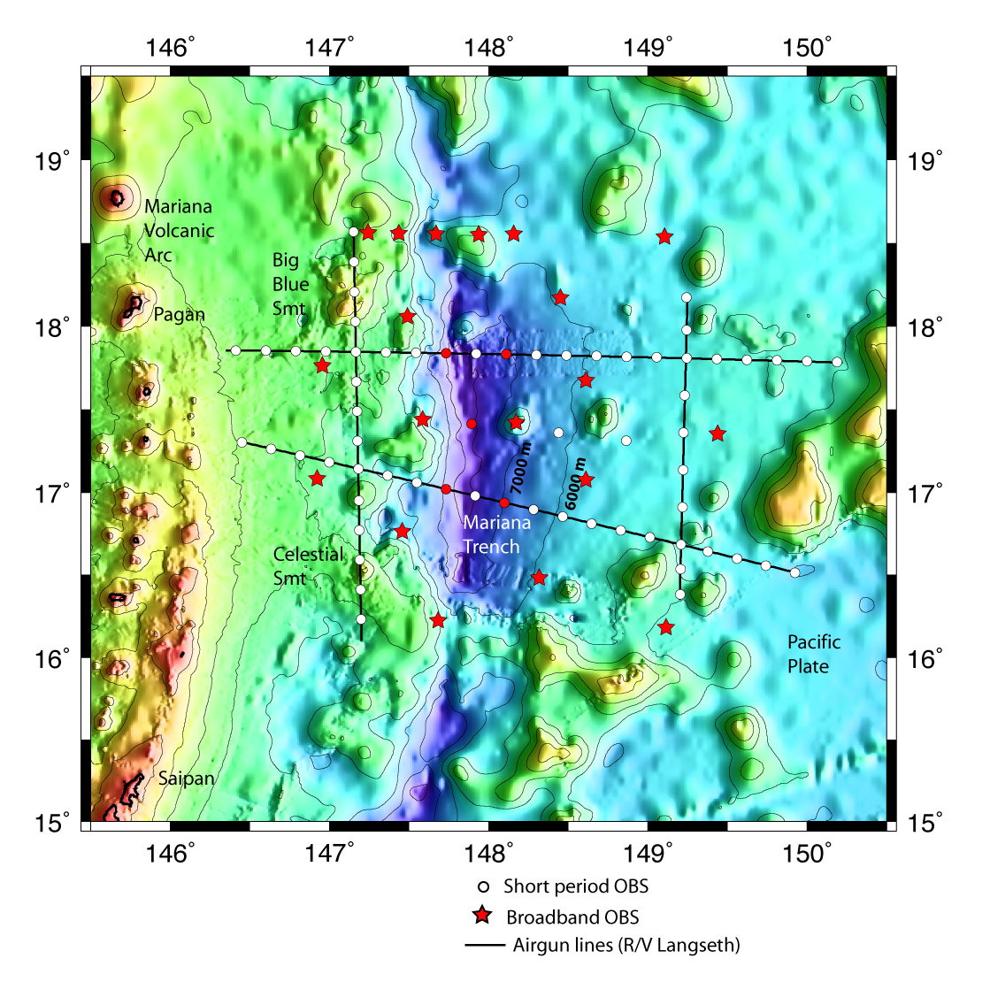
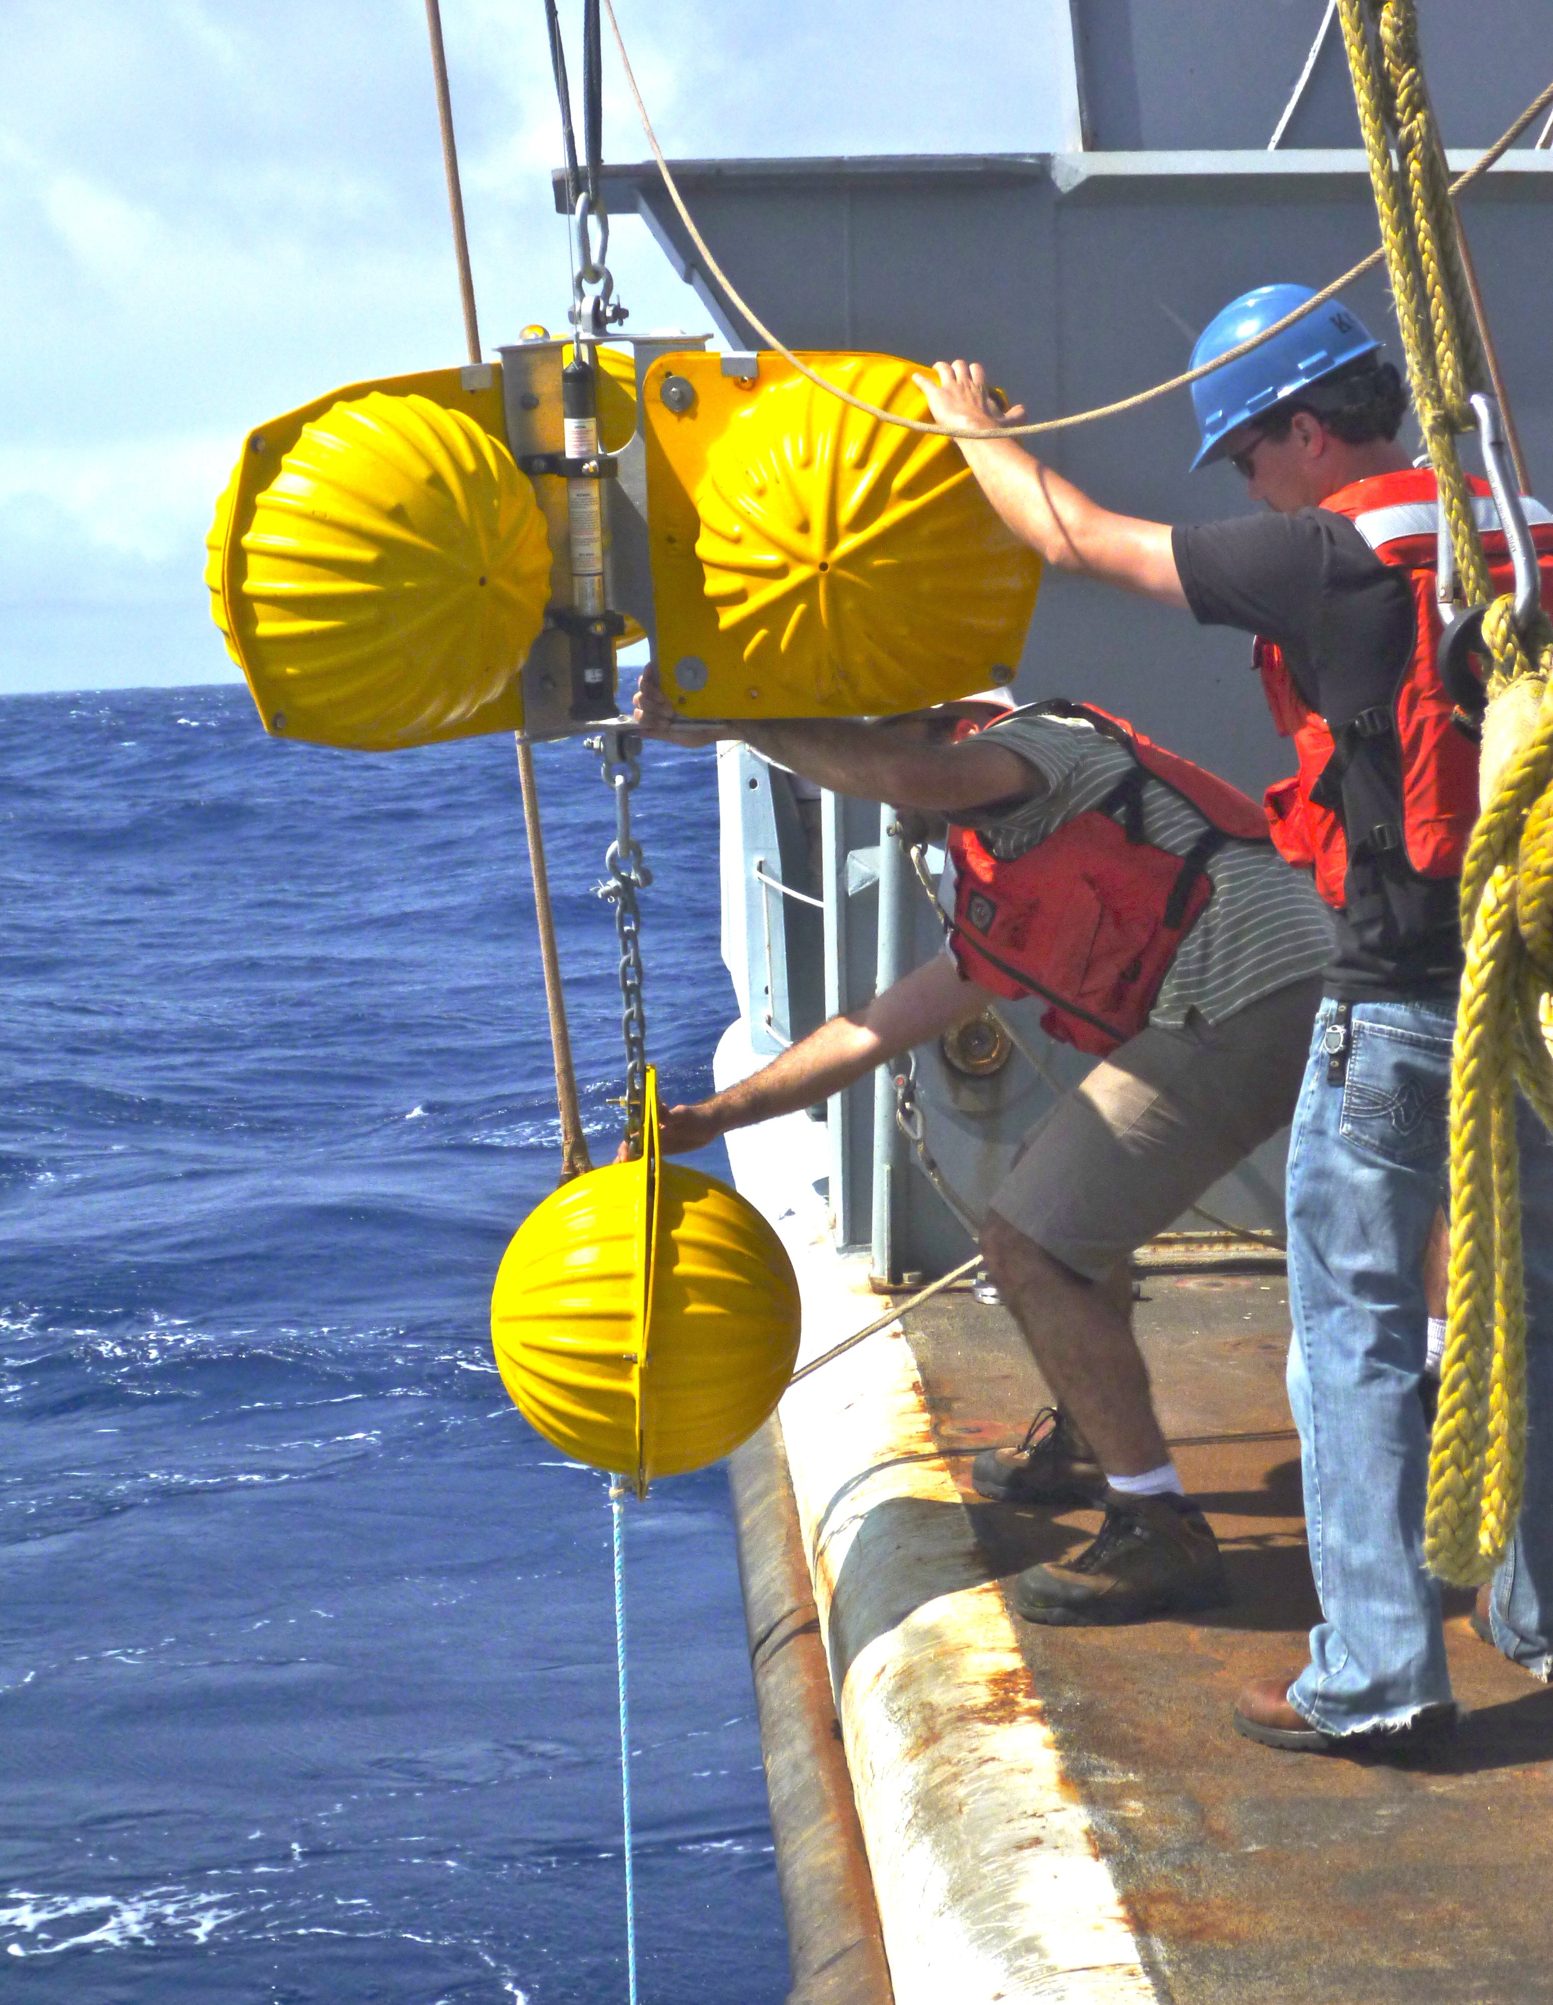
2012-2013 Mariana Trench OBS deployment
Investigating slab and forearc serpentinization
R/V Langseth
Deploying moored
hydrophones
near the Mariana
Trench axis
20 broadband OBS, 60 short period OBS,
5 tethered hydrophones

Slide 25
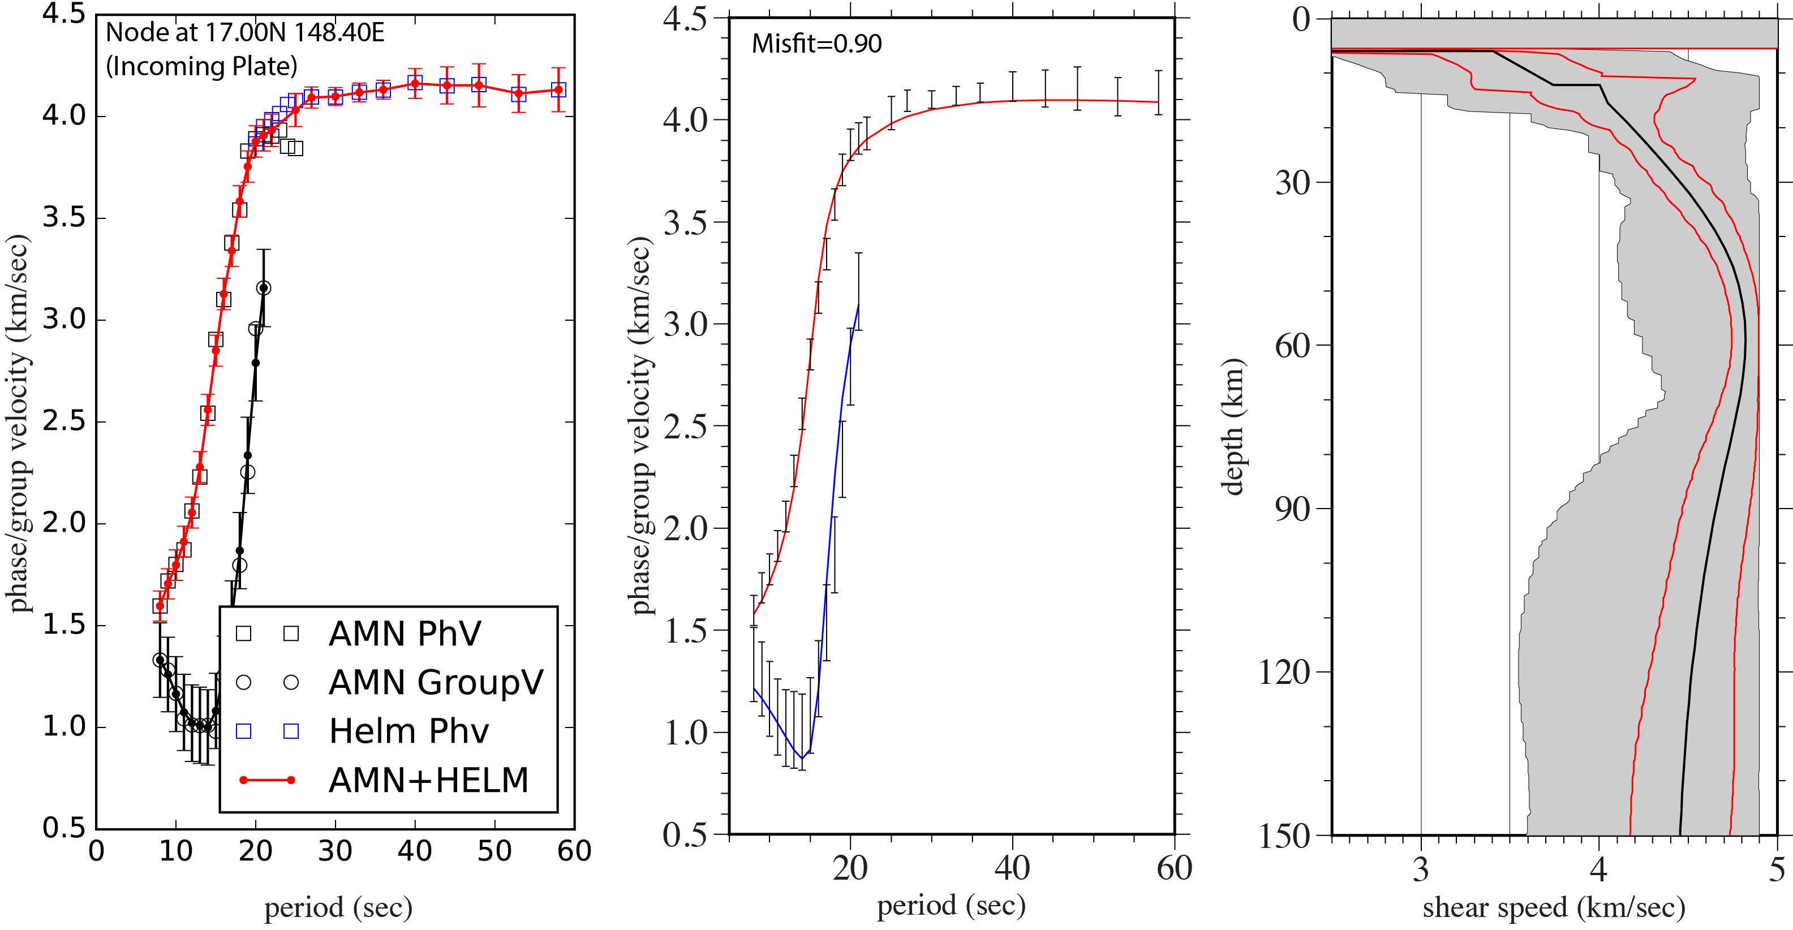
Shear wave structure analysis: Mariana incoming plate
Phase and Group Velocity
Measurements
Structure from
Monte-Carlo inversion
Fit to the Data
Cai et al., ms in prep

Slide 26
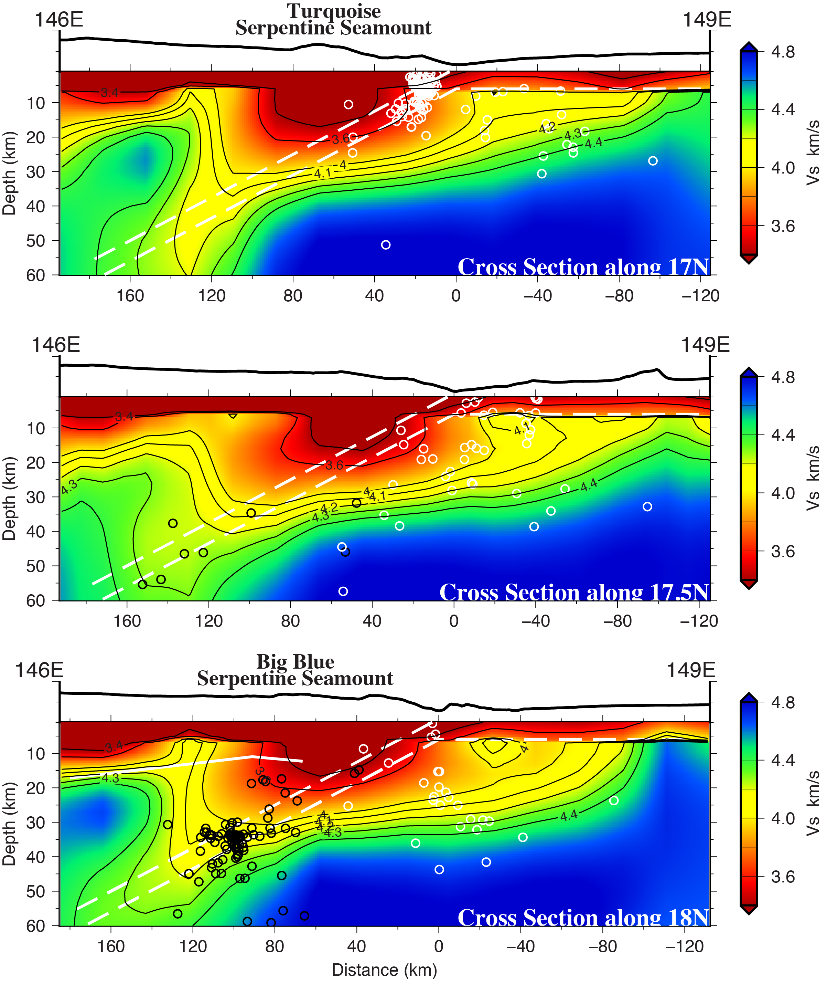
Shear velocity structure of the Mariana Trench
Incoming plate:
Slow velocities develop ~ 80 km from trench
Extend to depth of ~ 25 km below seafloor
Similar to normal fault observations
(see Melody Eimer poster)
Consistent with 20-30% serpentinization
Likely partly due to water-filled cracks
Even 15% serpentinization increases water
by 2.5X compared to van Keken (2011)
Forearc mantle:
Extremely slow velocities (3.6 km/s) beneath
serpentine seamounts
Corresponds to ~ 50% serpentinization
Sharp boundary with cold, fast forearc
Subducting slab expels significant water
at shallow depth
Cai et al., in prep

Slide 27
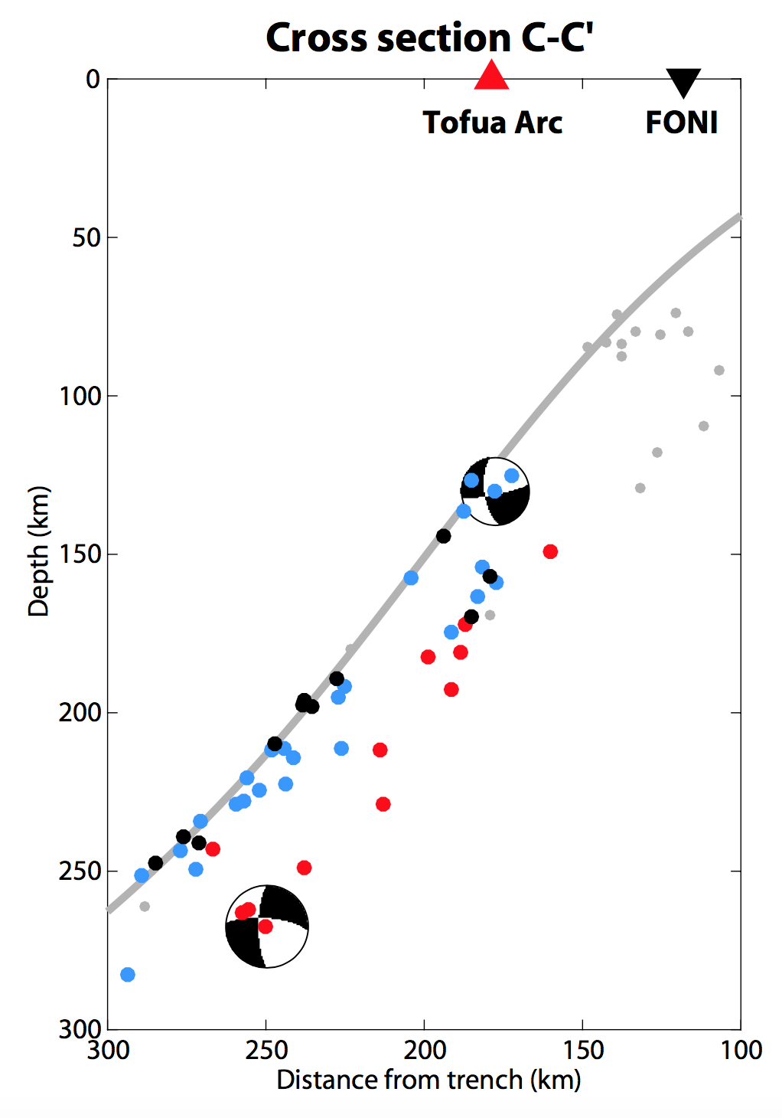
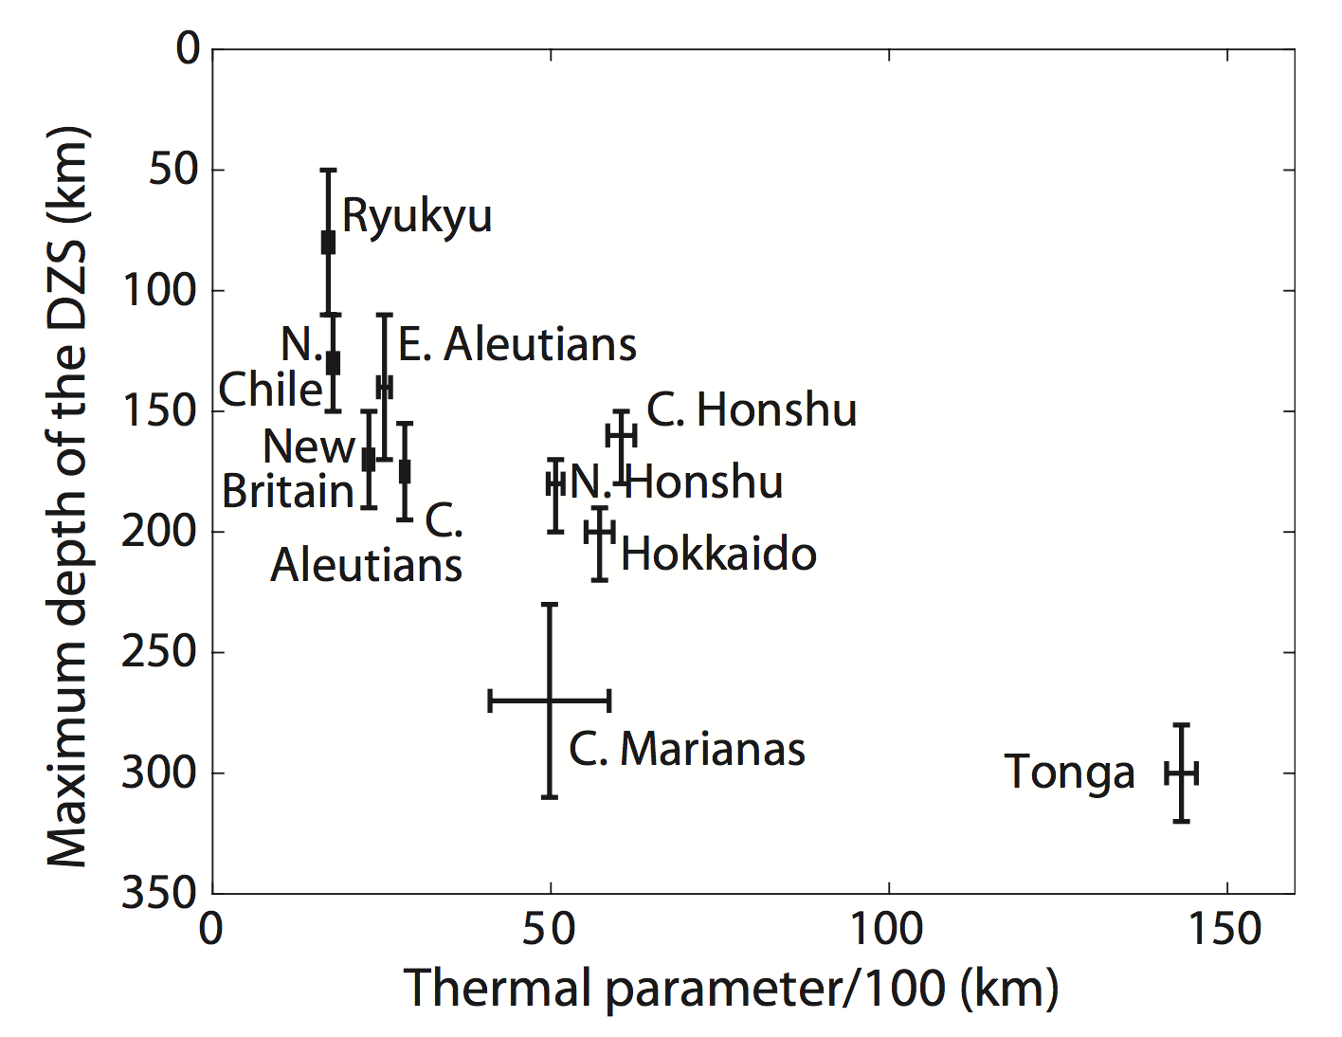
Tonga: The coldest slab
How does it affect intermediate depth seismicity?
Extremely deep double zone
Double zone depths thermally controlled
Blue = downdip compression
Red = downdip extension
Greater double zone depth for cold slabs consistent with temperature-controlled dehydration
Wei et al. [2017]

Slide 28
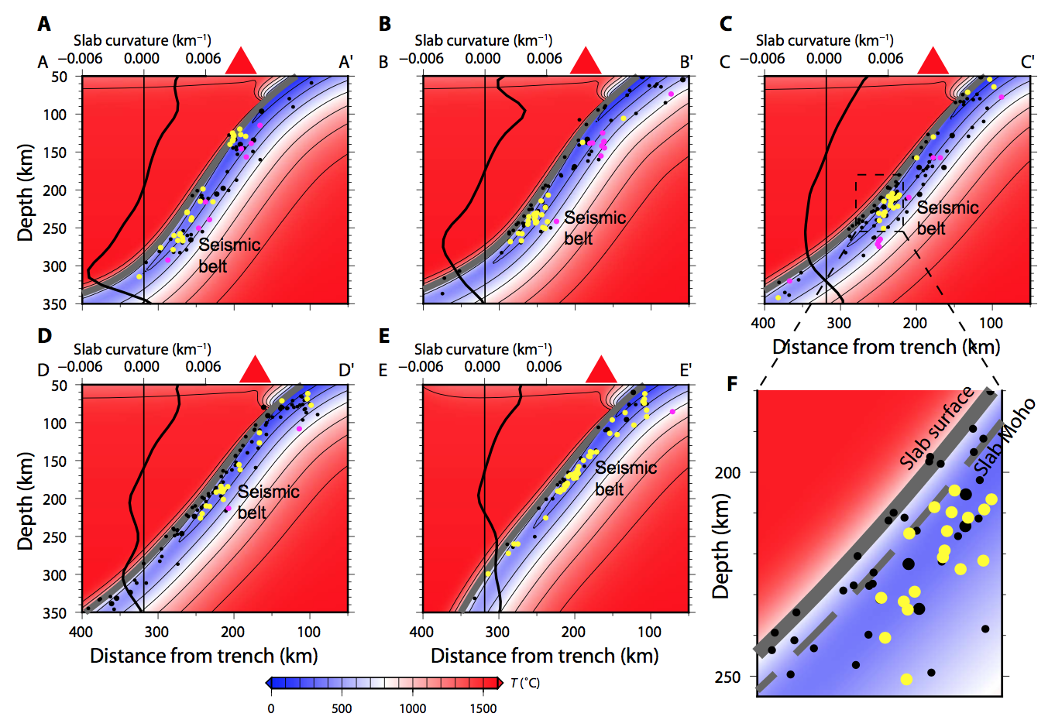
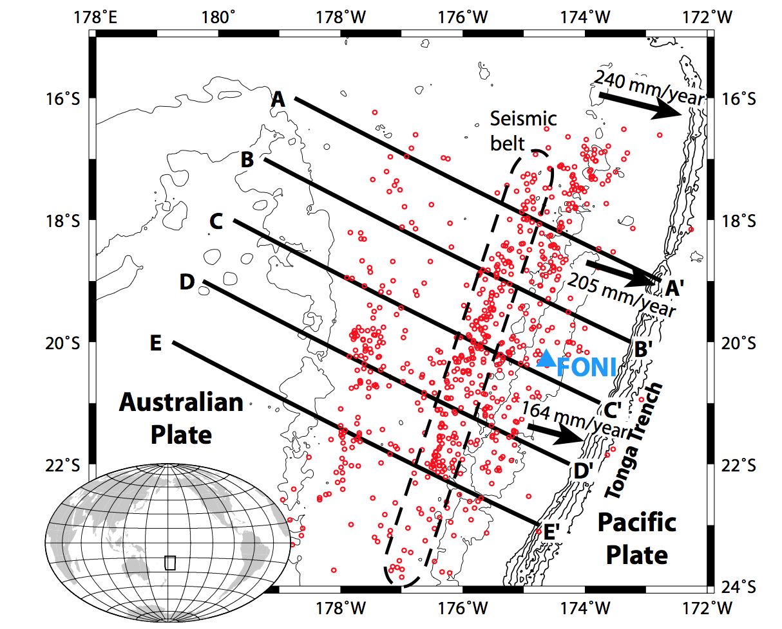
A burst of seismicity at a constant slab temperature
Yellow dots = downdip compression; Magenta – downdip extension
The seismic belt occurs when the compressional events move into the subducting mantle
This depth is greater where convergence is higher, modeling suggests a constant temperature
Wei et al. [2017]

Slide 29
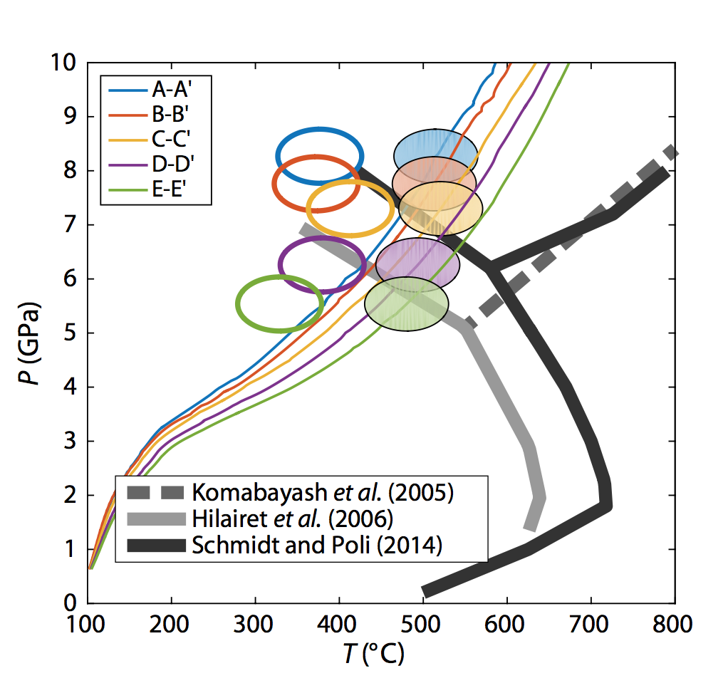
A nearly isothermal dehydration mechanism ?
Phase A
+ Enstatite
+ H2O
Forsterite
+ Enstatite
+ H₂O
Moho
P-T paths
Antigorite
The seismicity cluster plots at about 400˚C independent of pressure; adjacent Moho at 500˚C
Near the expected P&T of Antigorite → Phase A + Enstatite + H2O dehydration reaction
Does not agree with slope, but it is poorly determined by experimental data; kinetics a factor?
Wei et al. [2017]

Slide 30
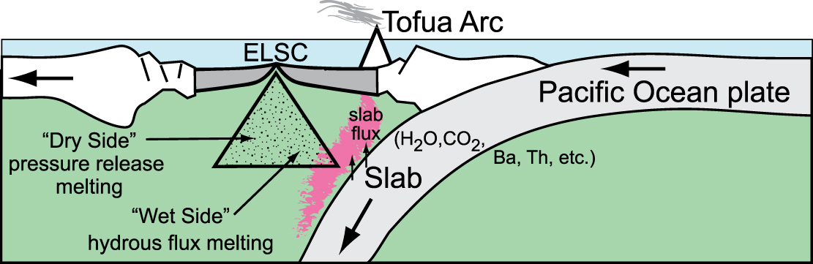
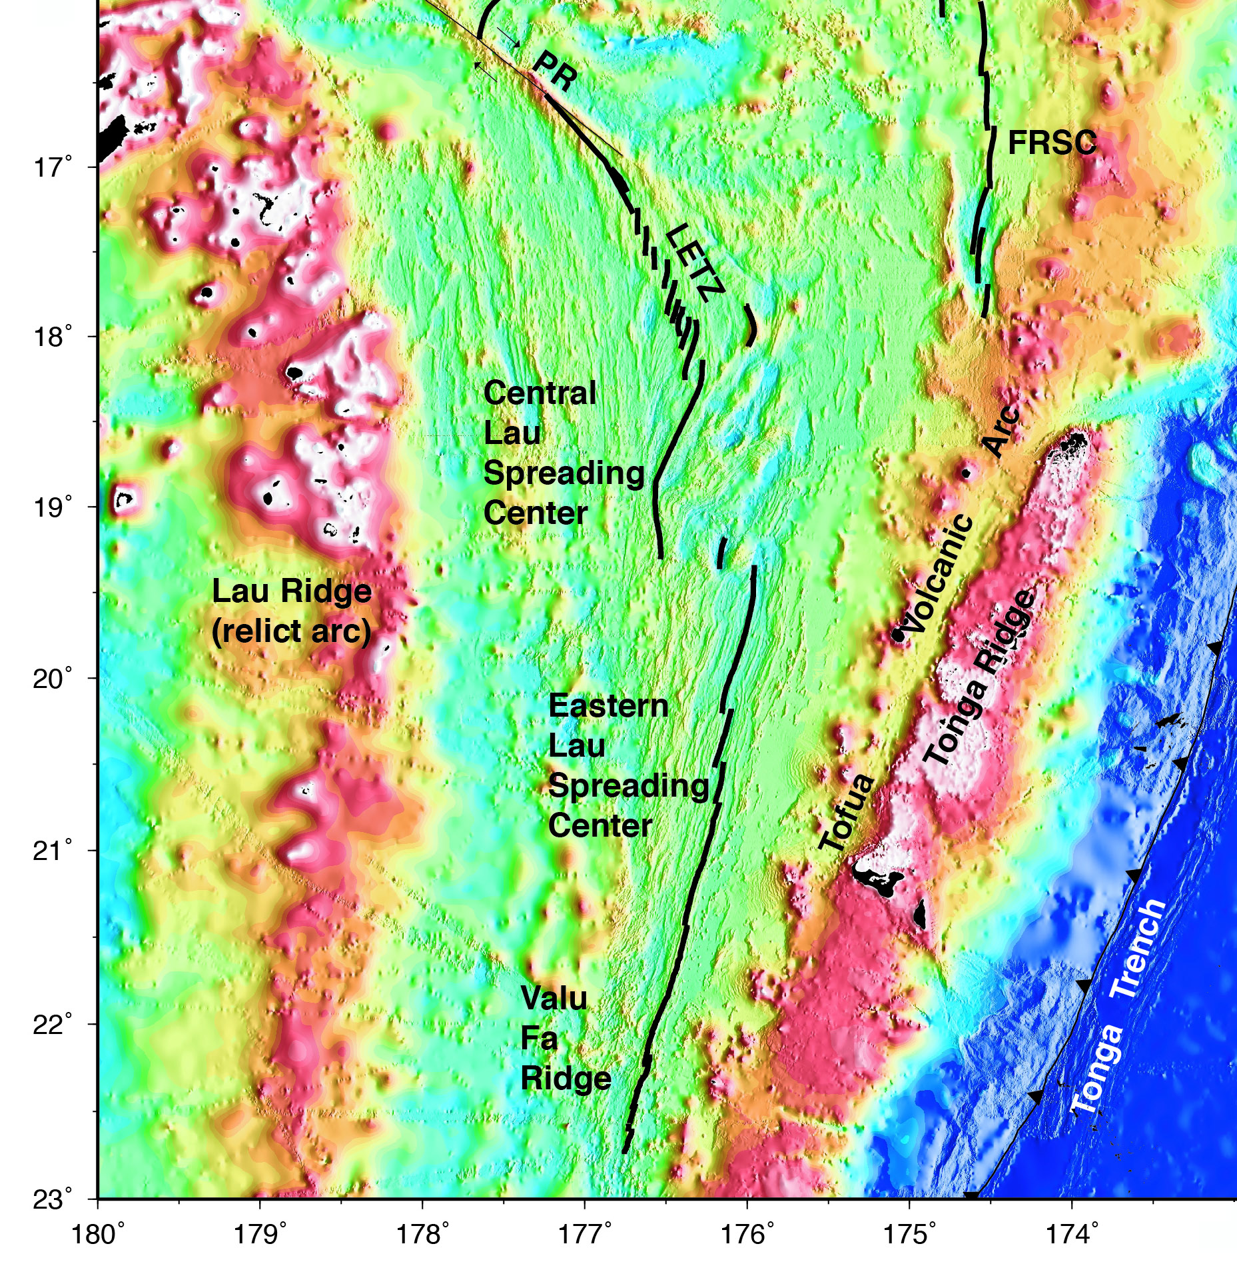
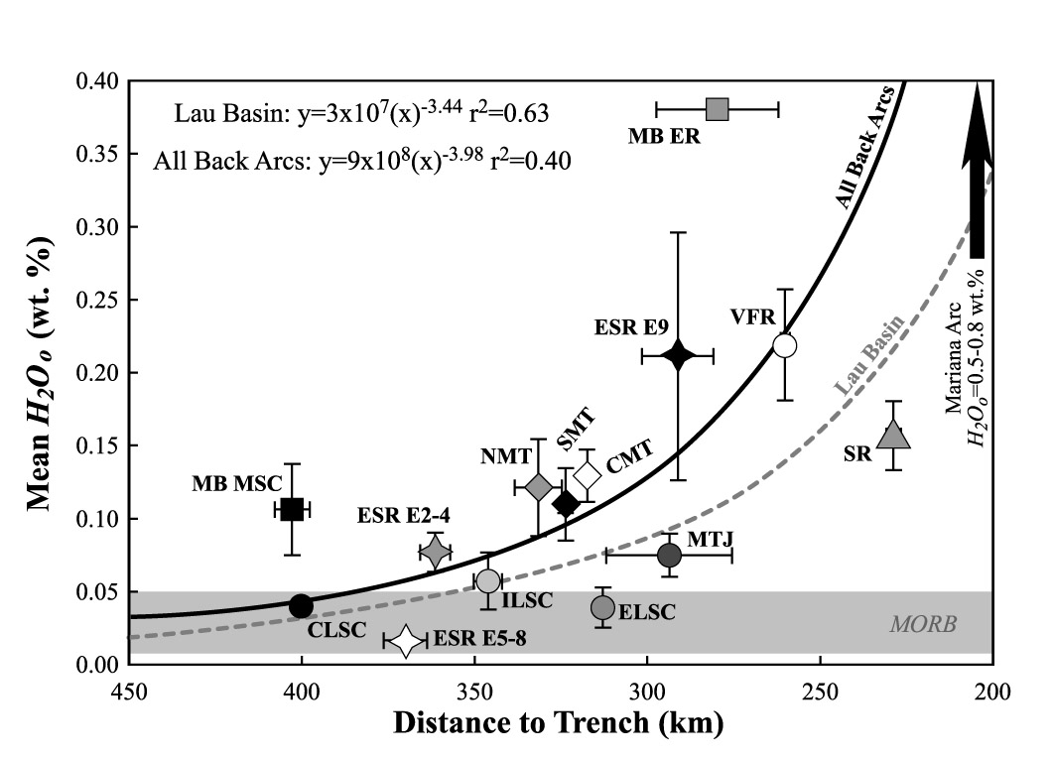
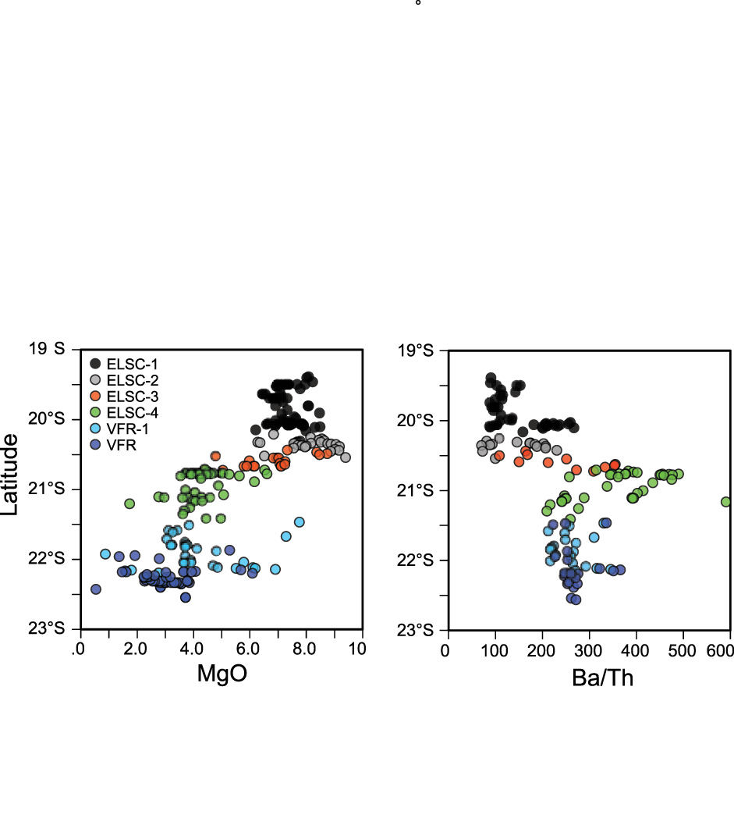
The Lau Basin: Subducted water signature in backarc spreading
Water from the slab in magma source decreases with distance from arc
Backarc spreading centers close to arc show strong slab geochemical signature
Use seismology to image the arc and backarc metling regions
Kelley et al. [2006]
Tivey et al [2012]

Slide 31
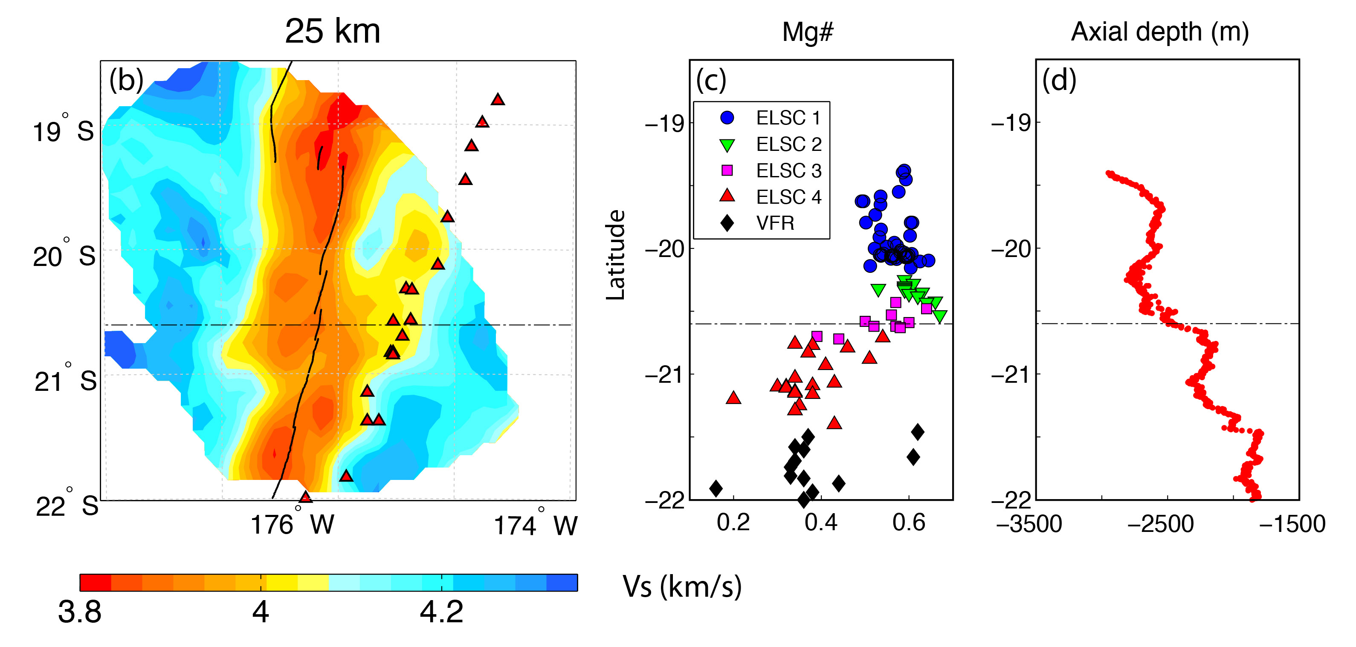
Backarc geochemical discontinuity
Tofua
Volcanic
Arc
Eastern
Lau
S C
Zha et al. [2014]
Seismic noise correlation gives higher resolution images at shallow depths
Melting region is offset to the west along northern ELSC, consistent with deeper images
Melt becomes offset to the east and extends to the volcanic arc at the chemical discontinuity
Geochemical discontinuity is where the backarc and arc melting regions begin to interact
South of the discontinuity slab water is provided to the backarc melt from the sub-arc mantle

Slide 32
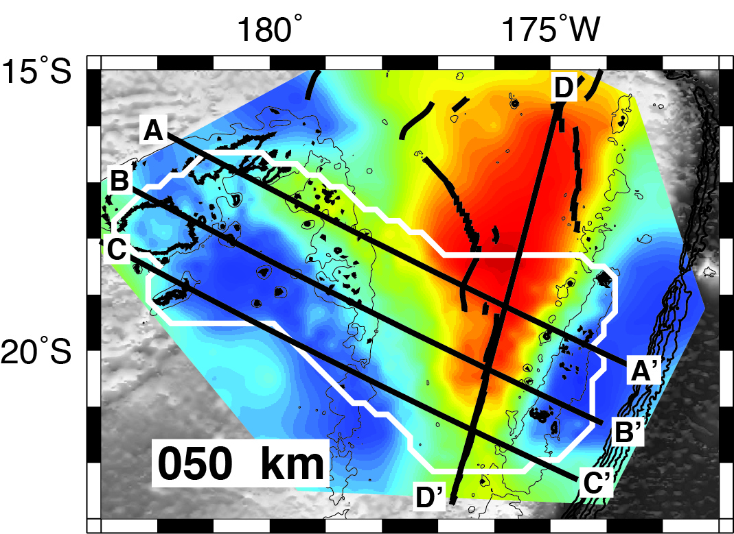
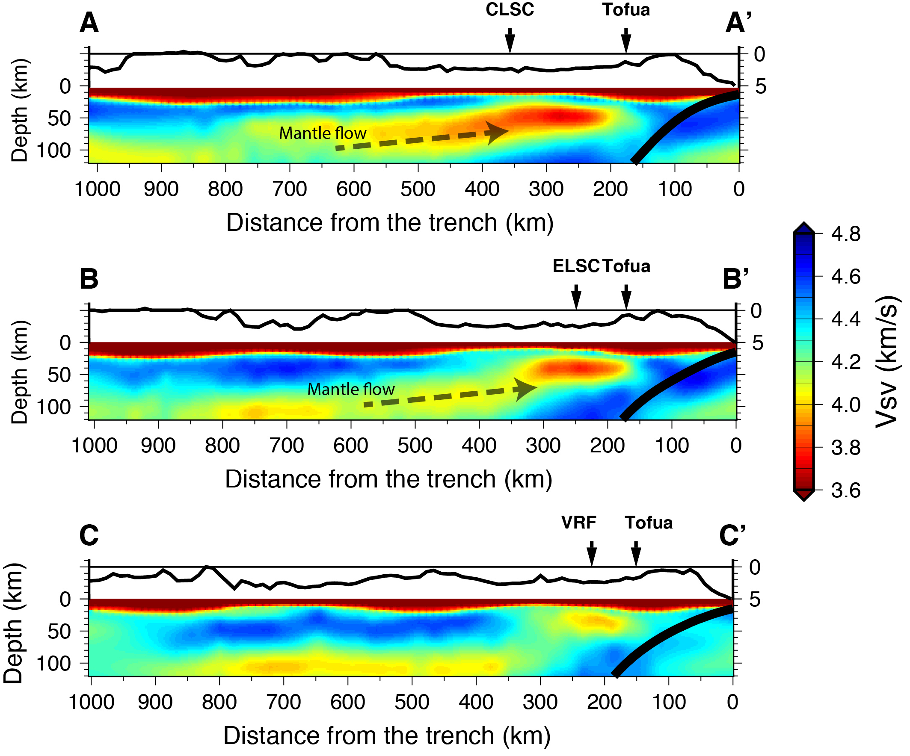
Backarc Geochemistry and Mantle Tomography
A-A’
B-B’
C-C’
Wei et al. [2015] and [2016].
Joint inversion of Rayleigh waves from earthquakes and ambient noise
CLSC and Northern ELSC show ridges are fed by decompression
melting in upwelling to the west.
Valu Fa Ridge show no connection to the upwelling to the west,
instead ridge samples only area above the slab
Explains sudden change of ridge geochemistry at 21°S

Slide 33


Backarc Geochemistry and Mantle Tomography
Wei et al., Nature, 2015
Temperatures and final equilibration
depths from Si + Mg thermobarometry
(Lee et al., 2009) provided by T. Plank
Images show great variation in the anomaly amplitude in the melting region (~50 km depth)
Largest anomaly is in the Northeast Lau Basin (with no spreading center) and CLSC
Anomaly beneath Northeast Lau basin could be a result of melt trapped beneath lithosphere?
Much smaller anomaly beneath the Valu Fa Ridge, with large water input from the slab
Seismic anomaly difference is too large to be caused by temperature differences
Anomaly amplitude is inversely correlated with water in the melt, suggesting decreased
melt porosity for aqueous melts

Slide 34

How does water affect melt porosity?
Melt Porosity
Assume the magnitude of the seismic
anomalies controlled by melt porosity
Results suggest melt porosity is reduced
in regions of high water content
If melt moves by equilibrium porous flow:
melt flux ∝ d²ϕ^{n}/μ
For similar melt flux, porosity decreases
with increasing grain size or decreasing
melt flux
Water increases grain growth rates
(Karato, 1989) and decreases melt
viscosity, both of which will decrease
melt porosity
Essentially water increases the efficiency
of melt extraction, reducing porosity
Node
Zhu et al
[2011]
Melt Flux ∝ d²ϕ^{n}/μ
Where: d = grain size
ϕ = porosity
μ = melt viscosity
n = between 2-3
Tubule

Slide 35

Questions?

