Slide 1
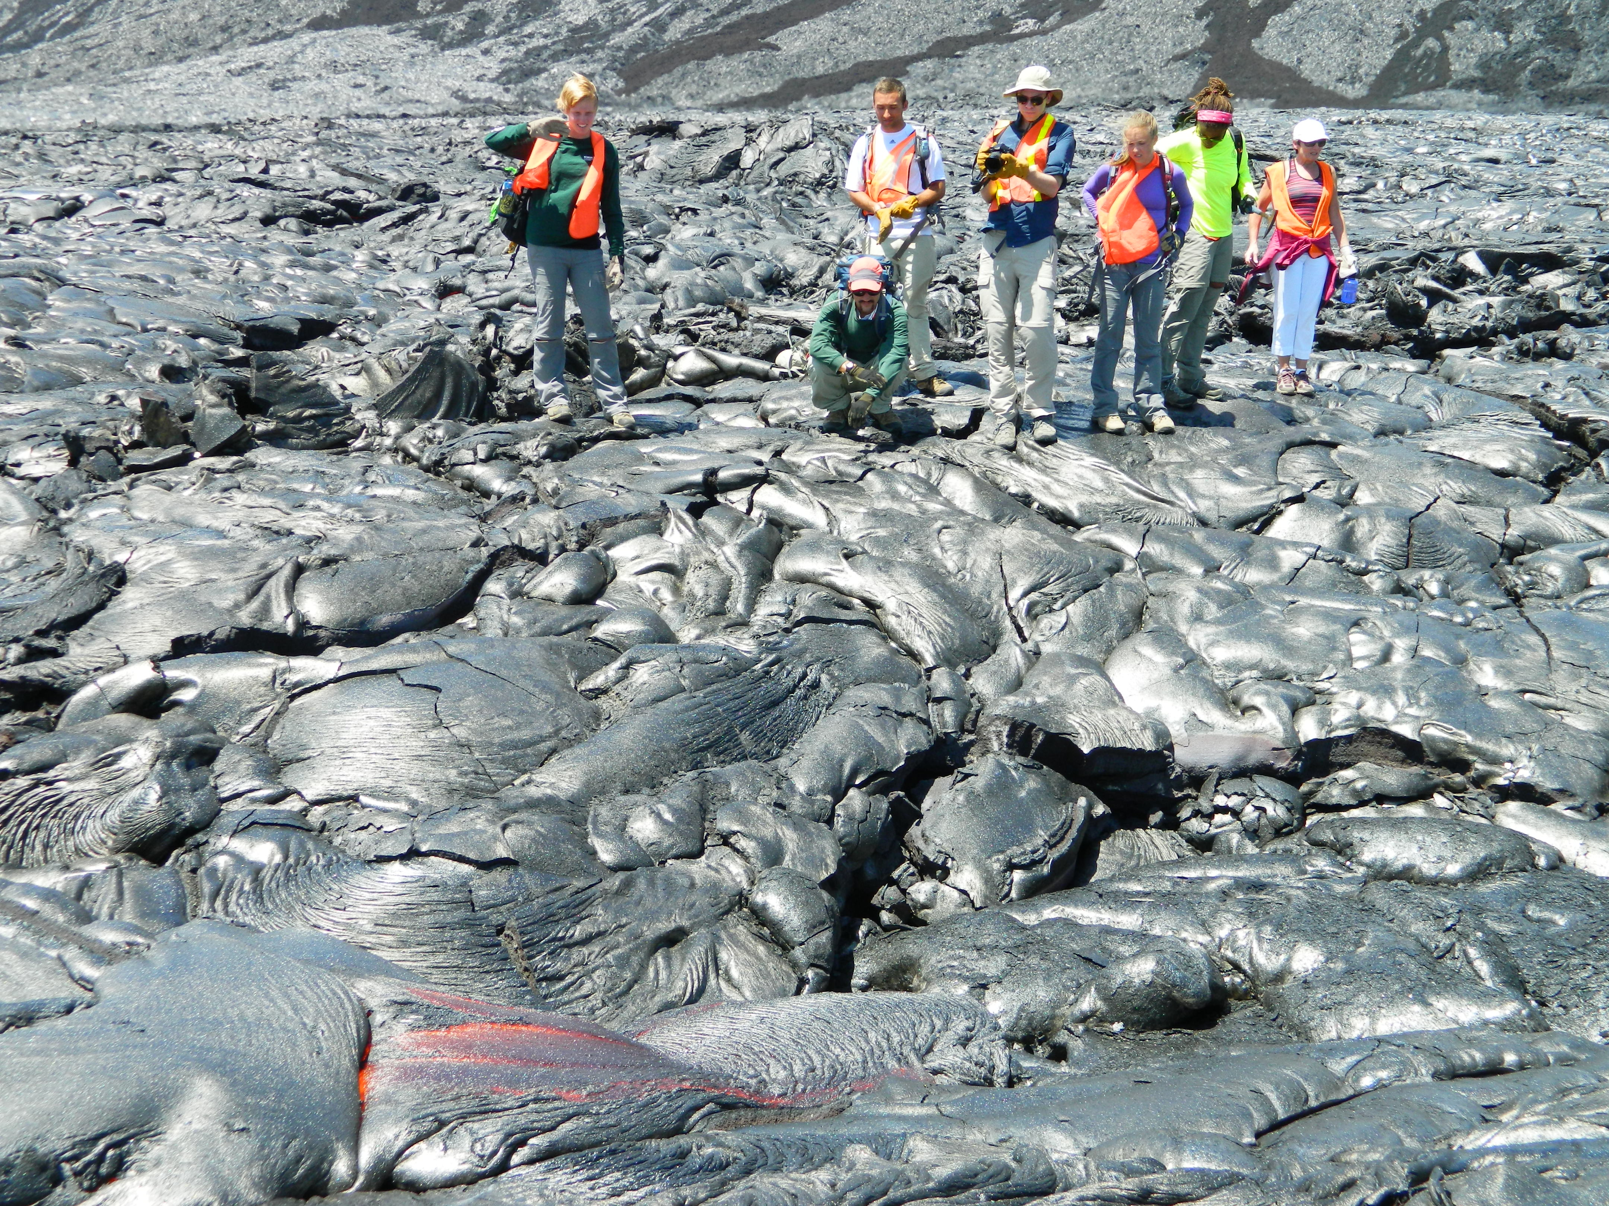
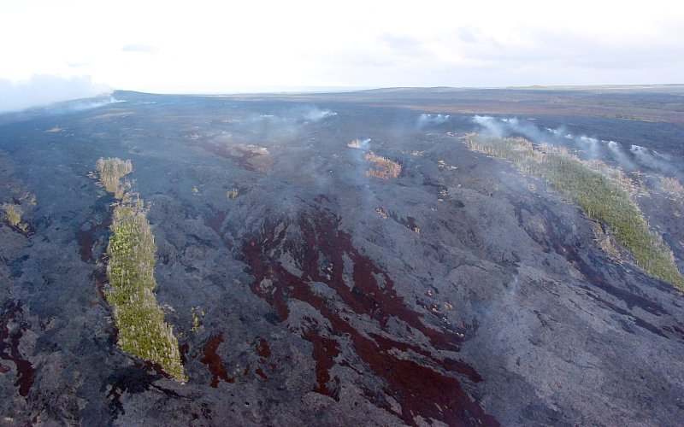
Some observations/ideas about weathering, or
How do you get from this ….
Pu’u O’o vent, Kilauea, HI
Fresh rock!
CIDER 2013 Weathering and the carbon cycle Louis Derry, Cornell U.
Notes:
Aerial view of Pu’u O’o vent and Cornell EES students on apron (Derry/Moore photos)

Slide 2
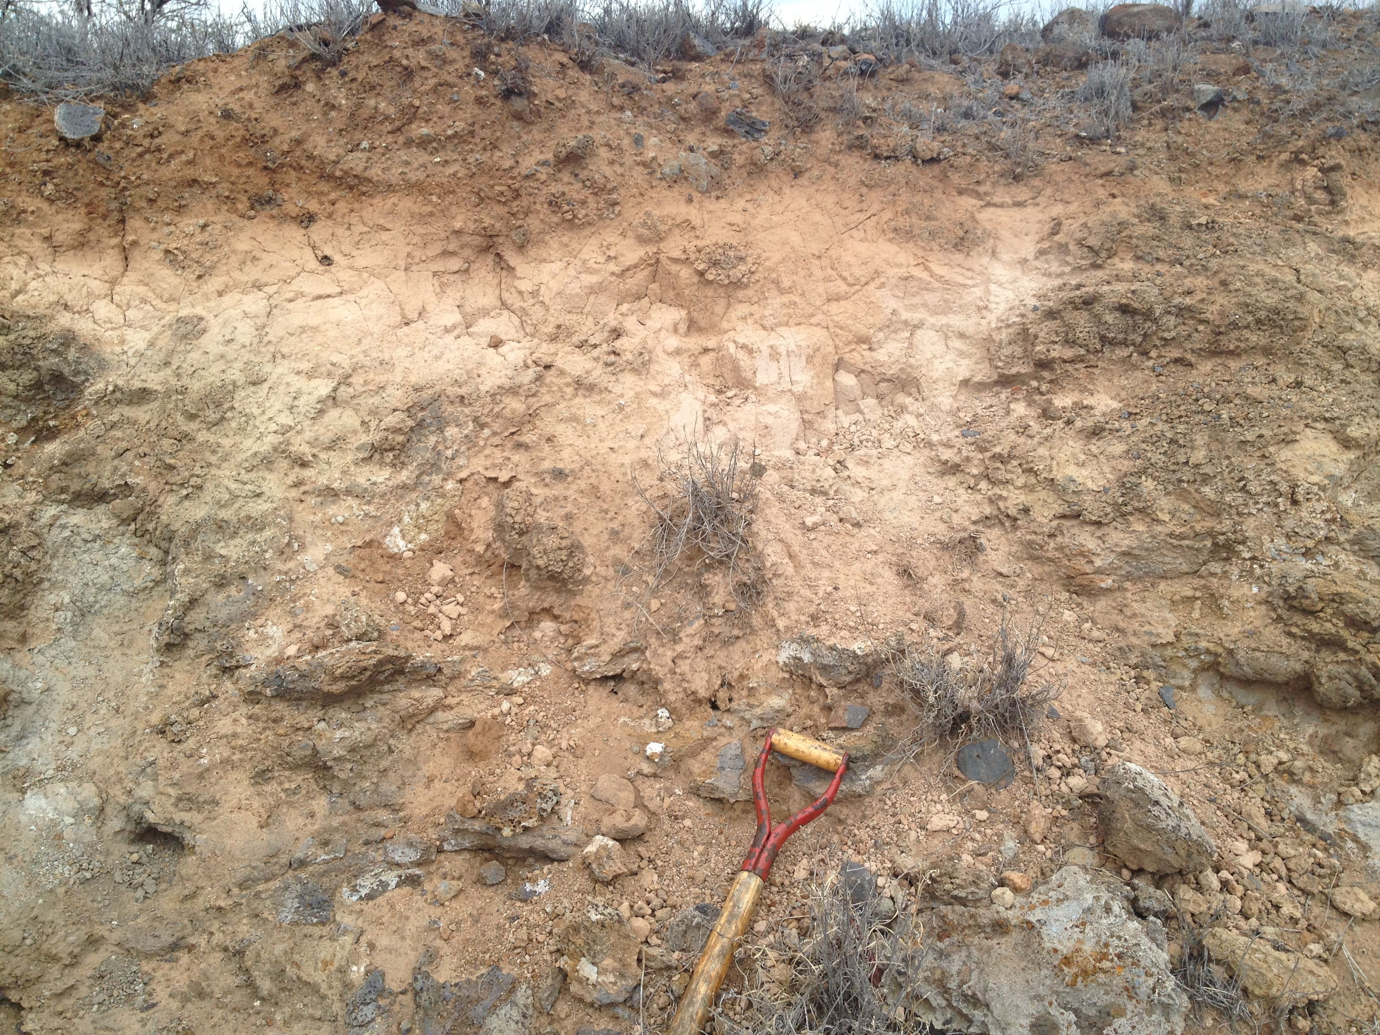
….. to this, and why do we care?
Amorphpus Fe-oxides and Si-Al mineraloids, organic matter,rock fragments
Gibbsite clay Al(OH)₃
Pedogenic carbonate
Notes:
Outcrop of weathered Pololu basalt (ca. 350 ka) near Kohala coast, Hawaii (Derry photo)

Slide 3
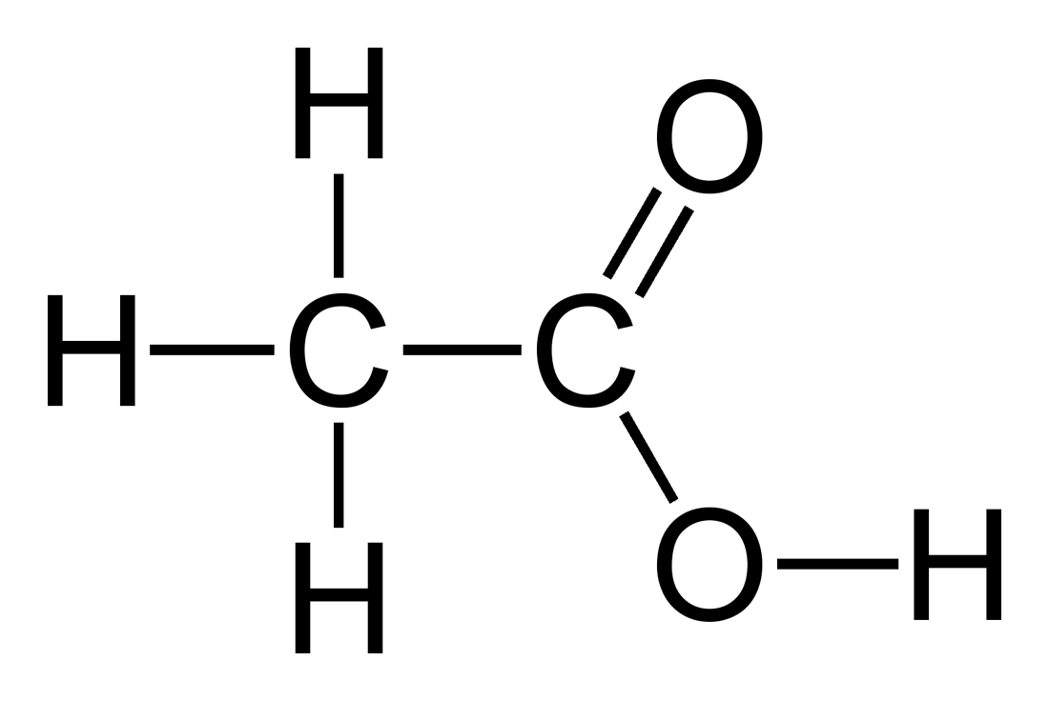
Generation of acidity – hydrolysis of CO₂
CO₂ + H₂O <-> H₂CO₃ carbonic acid
H₂CO₃ <-> H⁺ + HCO₃⁻ bicarbonate ion
HCO₃⁻ <-> H⁺ + CO₃⁼ carbonate ion
[H+] ≈ √(pCO₂) pCO₂ = 400 ppm -> pH = 5.66 atmosphere
pCO₂ = 4000 ppm -> pH = 5.16 e. g. soil gas
Organic acids from biosynthesis and decomposition
CH₃COOH <-> H⁺ + CH₃COO⁻ acetic acid as a simple
example of carboxylic acids:
citric acid, oxalic acid, etc …
Ligands also play key role in
enhancing solubility of Al, Fe, etc.

Slide 4
Weathering of carbonates:
Acid-base reaction
CaCO₃ + H₂CO₃ <-> Ca⁺⁺ + 2 HCO₃⁻
Ca⁺⁺ + 2 HCO₃⁻ <-> CaCO₃ + H₂O + CO₂
_________________________________________________________________
Carbonic acid consumed, base cation and bicarbonate produced
In oceans, reaction is reversed resulting in sedimentation and pH ≈ 8.3
Net is zero change in CO2
Carbonate weathering is an important buffer
but not a long term sink for CO₂

Slide 5
Weathering of Ca, Mg silicates consumes CO₂
CaAl₂Si₂O₈ + 2 CO₂ + 3 H₂O <-> Ca⁺⁺ + Al₂Si₂O₅(OH)₄ +2 HCO₃⁻
Ca⁺⁺ + 2 HCO₃⁻ <-> CaCO₃ + H₂O + CO₂
_________________________________________________________________
CaAl₂Si₂O₈ + CO₂ + 2 H₂O <-> CaCO₃ + Al₂Si₂O₅(OH)₄
Acid (CO₂) consumed, base cation, bicarbonate, and clay produced
net
Na, K silicates are much less efficient sinks for CO₂
(because we don’t make Na₂CO₃ in the oceans)

Slide 6
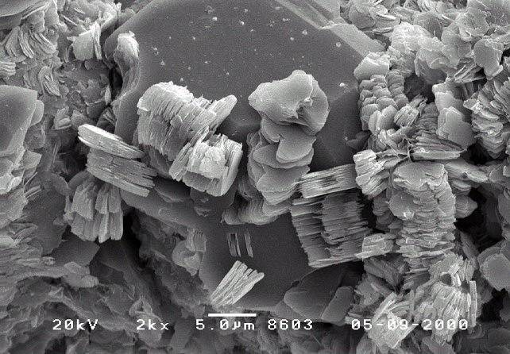
Kaolinite produced by weathering qtz diorite, Luquillo, PR (White et al., 1998)

Slide 7
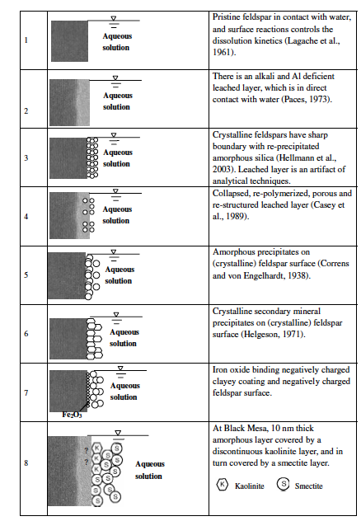
Weathering reactions are heterogeneous surface reactions,
partly controlled by crystal structure and defects in minerals.
Some hypotheses for the structure of the mineral - water interface (Zhu et al., GCA 2006)
Consequently, the controls on reaction rate are complex.

Slide 8
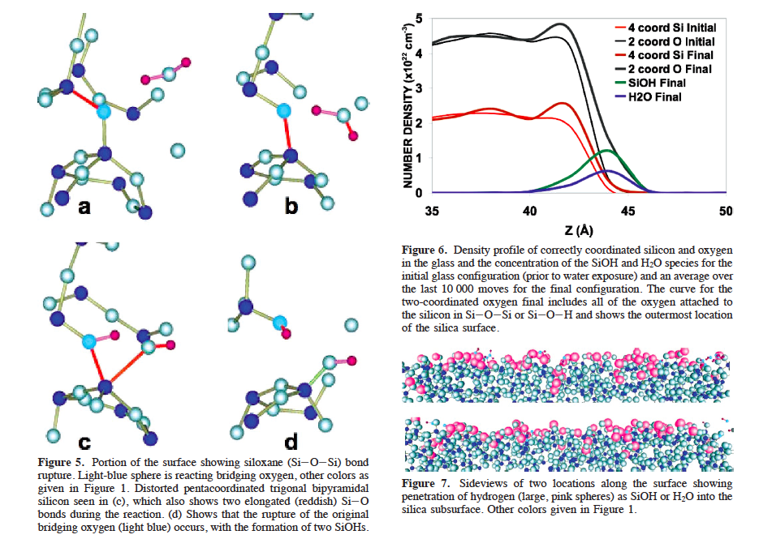
Notes:
Madadevan and Garofalini (2008) Jour. Phys. Chem. C

Slide 9
Some controls on weathering reactions rates:
Distance from equilibrium (degree of undersaturation)
Diffusive transport to/from interface
Surface site occupancy (reversible/irreversible)
Defect density in crystal structure
Mineral surface area (evolves with reaction)
Complexation, ligands (esp. organic ligands)
Temperature
Coatings of secondary minerals
pH
Strain rate from ∆V of secondary mineral formation
Permeability of weathering zone
You get the idea …
It is not easy to begin with microscopic properties/processes and predict behavior at the scale of a soil profile or watershed. Reactive transport modeling tries to do that at a continuum scale, but many kinetic parameters must be specified and are often poorly known.

Slide 10
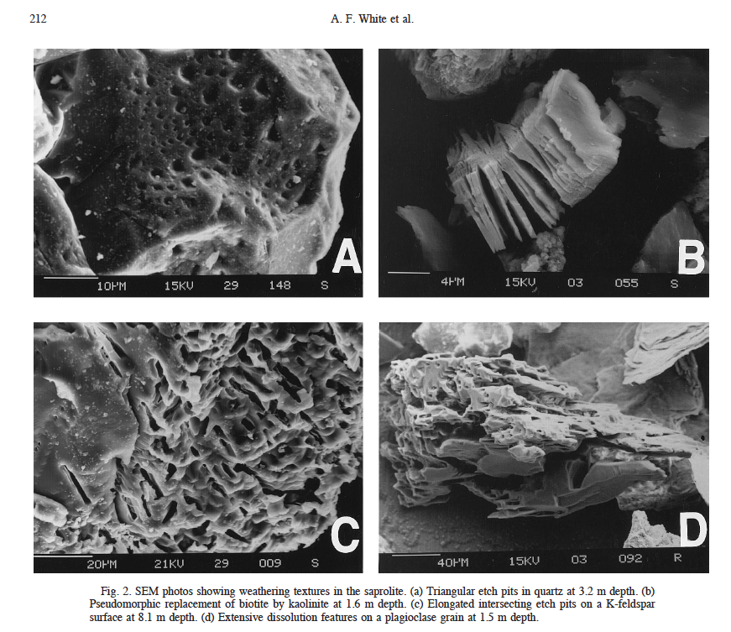
Notes:
White et al,. GCA 1998

Slide 11
Temperature dependence of weathering rate
from laboratory studies follows an Arrhenius law:
k = A exp(-E_{a}/RT)
Typical values of E_{a} for feldspars are 60 – 65 kJ mol⁻¹ K⁻¹.
Implies a temperature sensitivity equivalent to ≈ 2.3x increase in k between 20 and 30˚C.
Leads to hypothesis of
climate-weathering feedback

Slide 12
Climate – weathering feedback
Solar luminosity has increased 25 – 30% over Earth history
But liquid water continuously present since > 4 Ga
Goldilocks solution – not too hot, not too cold
Continuous CO₂ release from interior, greenhouse
Tau_{CO2} ≈ 0.5 Ma
What regulates T over time if CO₂ response time is < 0.5 Ma?
Let’s imagine that atmospheric CO₂ increases. Then :
T increases
Reaction rate increases as f(T)
Water cycle accelerates (Sat H₂O P of atm is exponential in T)
CO₂ consumption is enhanced by 2, 3
CO₂ decreases
T decreases
Voila!
But does this actually work? What exactly are mechanisms in play?

Slide 13
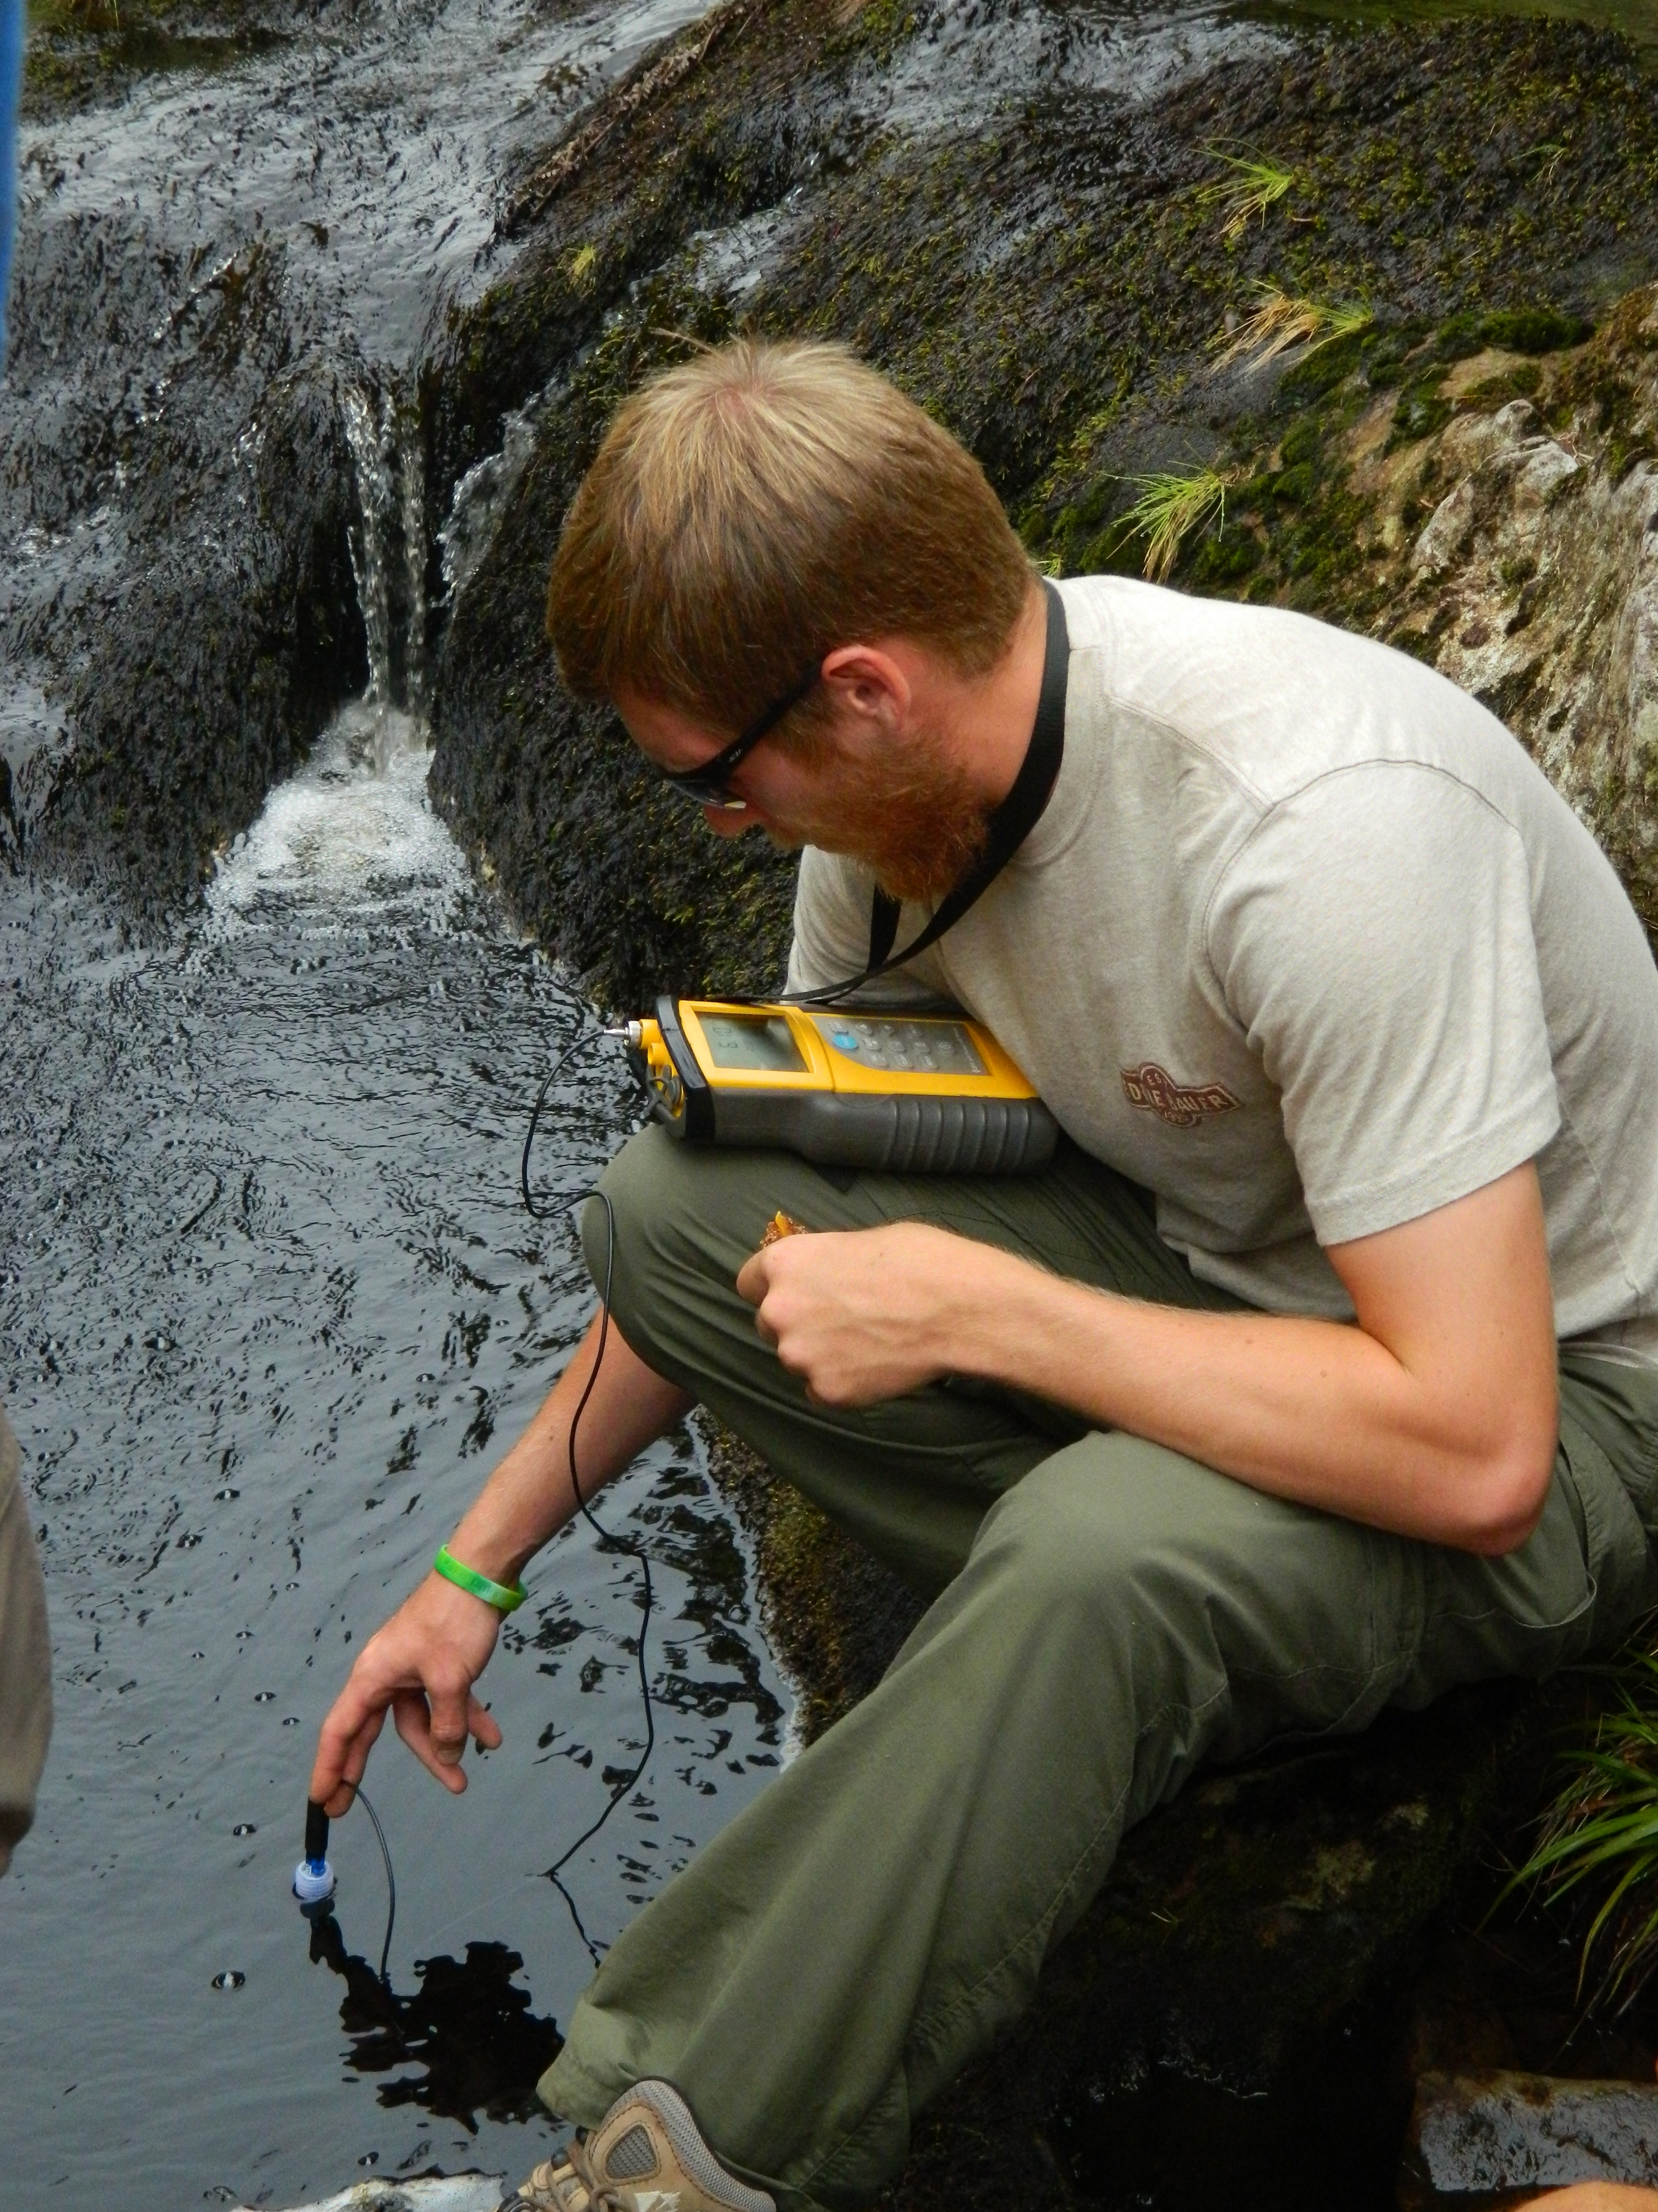
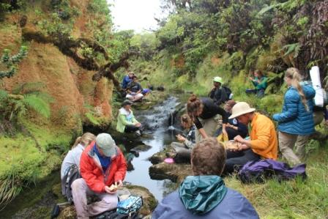
How do we study weathering rates and process at large scales?
One way is to measure the dissolved flux exported by rivers
In principle, this should integrate chemical processes over wide areas and highly heterogeneous geology. Give me one bottle of Amazon water …
Wait, isn’t that a problem if you have different kinds of processes operating whose effects you’d like to separate?

Slide 14
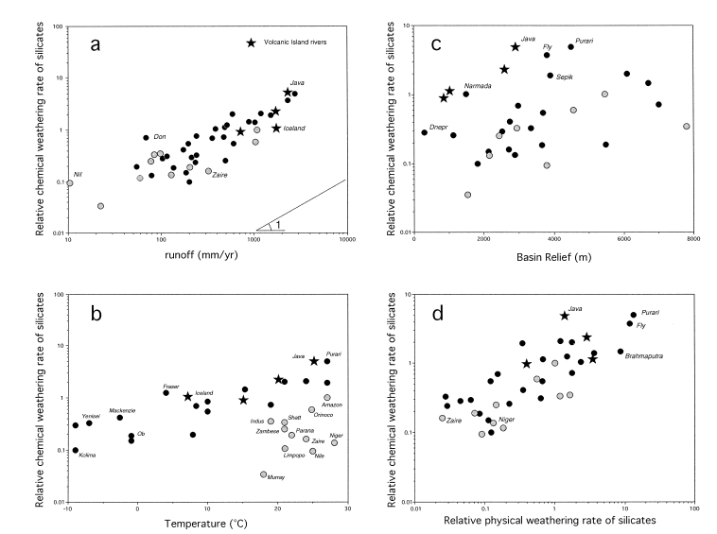
Weathering as f(Temp, runoff, erosion) in large rivers
climate sensitivity there but not as strong as expected
erosion rate plays an important role (tectonics + climate)
runoff
relief
Temperature
erosion
Gailardet et al., 1999

Slide 15
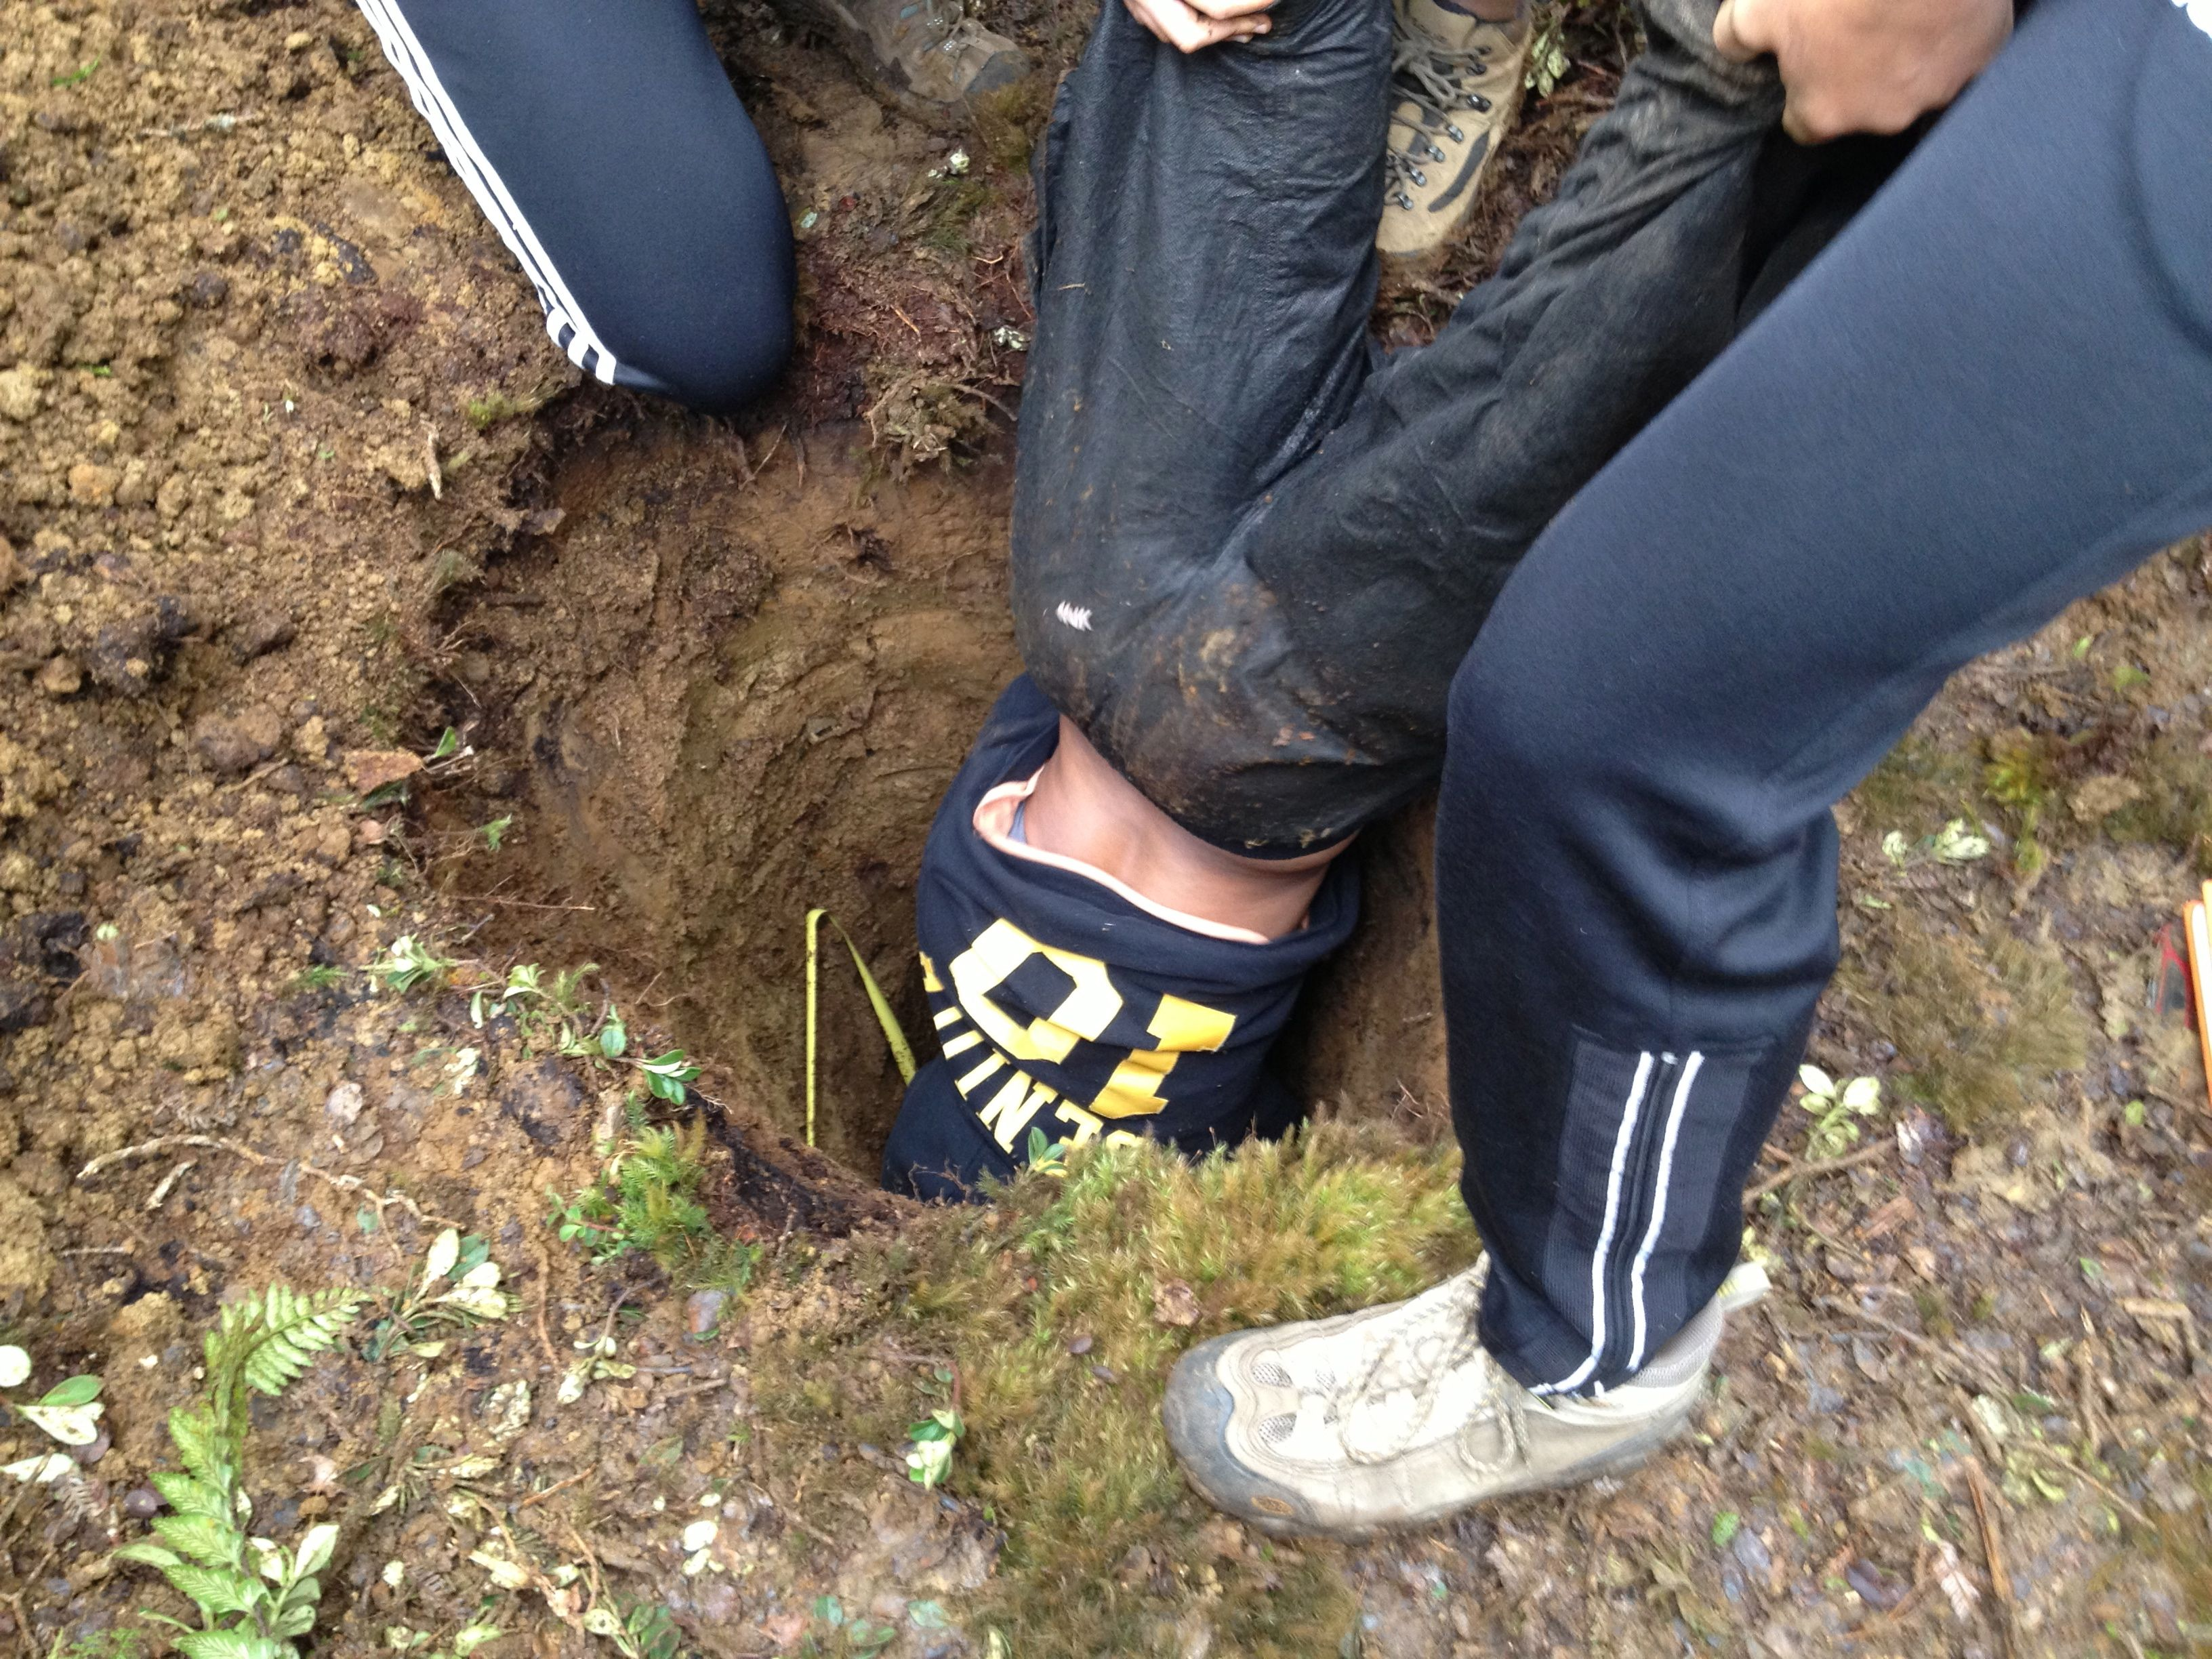
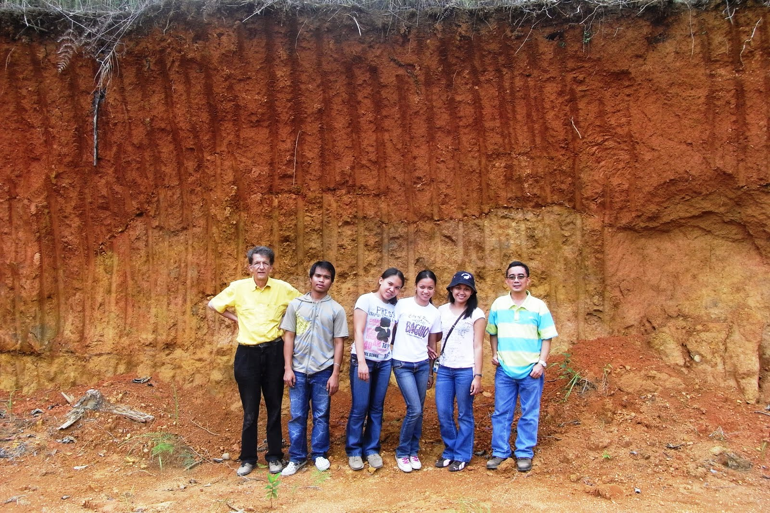
Another way is to sample the regolith (e.g. the boundary layer between the atmosphere and lithosphere, and where “everything” lives. We can look at compositional change as a function of chemistry/lithology/climate etc/

Slide 16
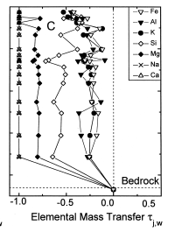
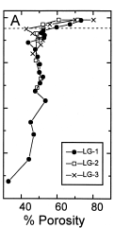
Soil profile from Luquillo, Puerto Rico, figure from White et al 1998 (GCA)
Normalized change
Integrate soil horizon density, thickness, elemental depletion to estimate
mass transfer. If we can add time we get a rate (cosmogenics).

Slide 17
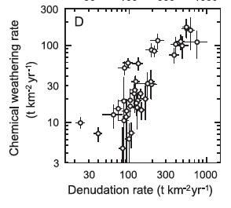
Studies based on chemical depletion indices of soil and cosmogenic nuclides
Riebe et al EPSL 2004

Slide 18
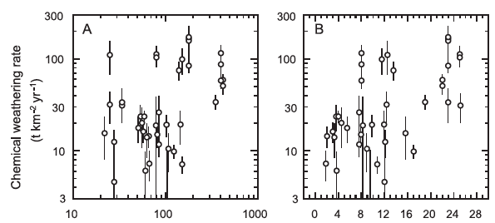
MAP, cm yr⁻¹
MAT, ˚C
E_{a} modeled 17 – 24 kJ mol⁻¹
Riebe et al EPSL 2004

Slide 19
Possible erosion control on weathering rates – is tectonics the first order control?
Paleocean tracer chemistry appears to support that, but (there’s always a but) ….
What is it, exactly, that the tracers are tracing?

Slide 20
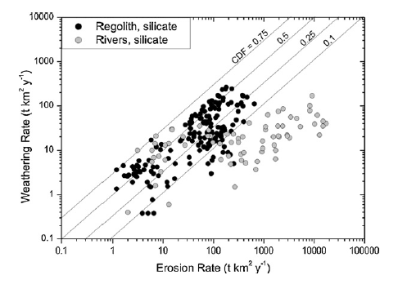
In continental settings R(wea) increases with R(erosion), to a point. At higher R(erosion) R(wea) “plateaus”, i.e. kinetics limit chemical reaction progress.
Dixon & von Blankenburg 2012 C.R. Geosci.

Slide 21
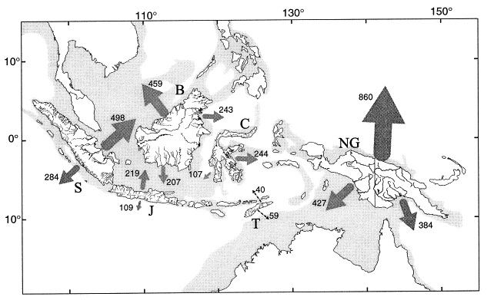
Arcs – a critical sink in the global C cycle?
Underrepresented in our data and our thinking
No big rivers
Large groundwater fluxes (unmeasured!)
Interesting features
Ca, Mg rich compositions
Fast kinetics in volcanic rocks
Tectonically active
Wet
High erosion rates
Frequent resurfacing
Climate sensitivity?
Milliman: sed yields are ≈10x global average

Slide 22
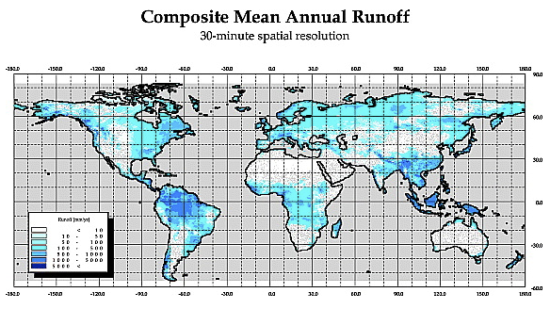

Slide 23
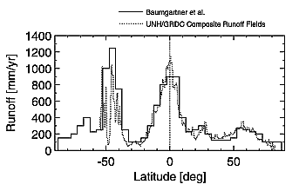
Are the fluxes from arcs and OIBs large enough to matter?
Global mean runoff ≈ 299 mm (Fekete et al., 2002)
Arcs and OIBs much wetter

Slide 24
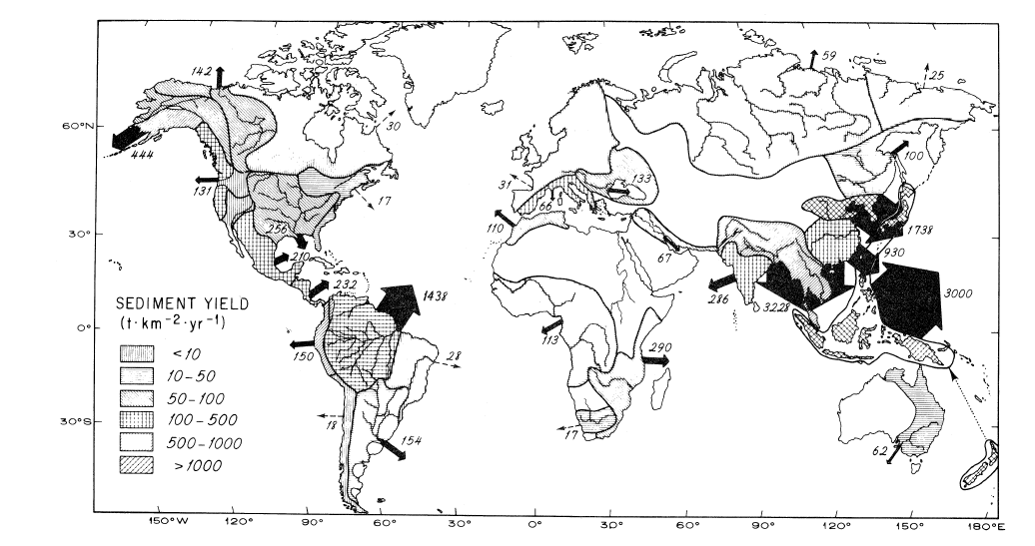
Global annual sediment delivery to oceans
Milliman 1983 J. Geol.

Slide 25
Arc and OIB rivers are different ….
Hawaii
Philippines

Slide 26
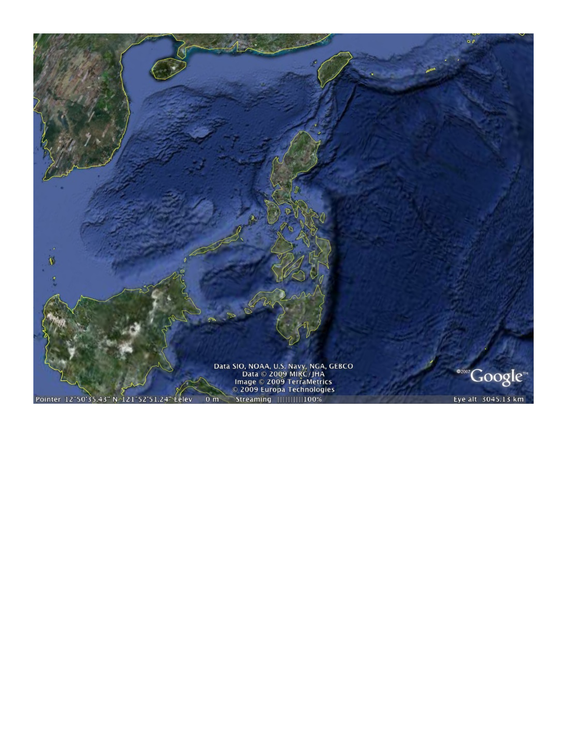
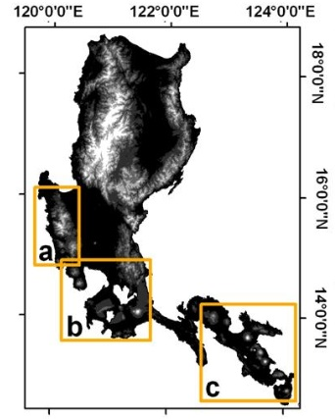
Luzon, Philippines
active arcs
ophiolites
typhoons

Slide 27
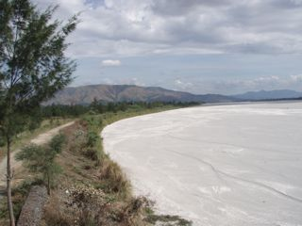
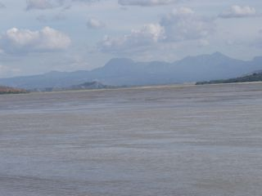
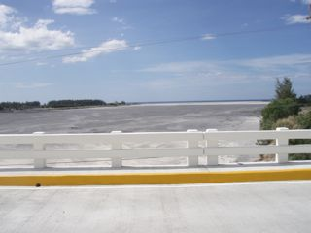
Rivers draining W side of Pinatubo
Big, full of fresh pumice, and completely uncharacterized
Large groundwater discharge directly to ocean
Pumice fills river channels
Pinatubo
S. China Sea

Slide 28
A function that estimates the impact of river input on oceanic ⁸⁷Sr/Sr:
Volcanic-hosted rivers contribute Sr with low ⁸⁷Sr/⁸⁶Sr to the oceans, typically 0.704 to 0.705 vs. seawater currently at 0.7092.

Slide 29
High CO₂ consumption associated with negative forcing on SW ⁸⁷Sr/⁸⁶Sr
increase (⁸⁷Sr/⁸⁶Sr)_{sw}
CO₂ consumption, 10³ mole km⁻² yr⁻¹
volcanics
Other major rivers
Ψ_{Sr}
Data from Gaillardet et al., 1999
Dessert et al, 2003
Schopka et al., 2010

Slide 30
Antilles
Tropical arcs have ∆CO₂
6 - 10x global mean
(Ca+Mg)_{sil}, µmol/L
SiO₂, µmol/L
Rad et al., 2007, 2008; Schopka et al., 2010

Slide 31
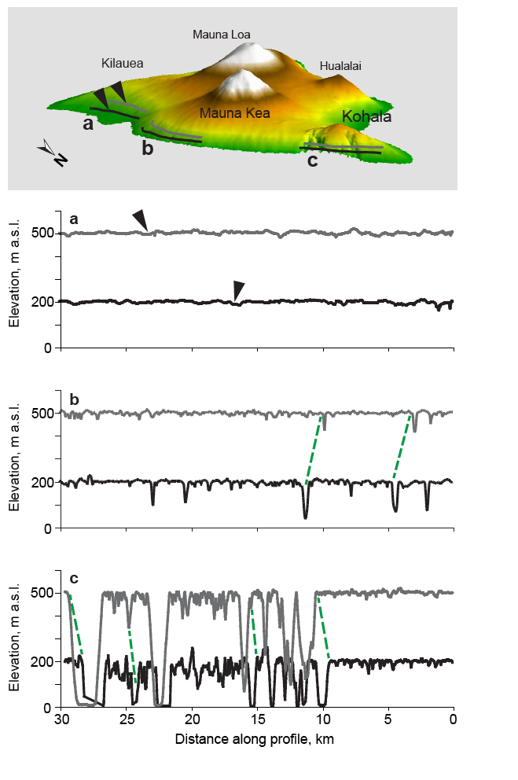
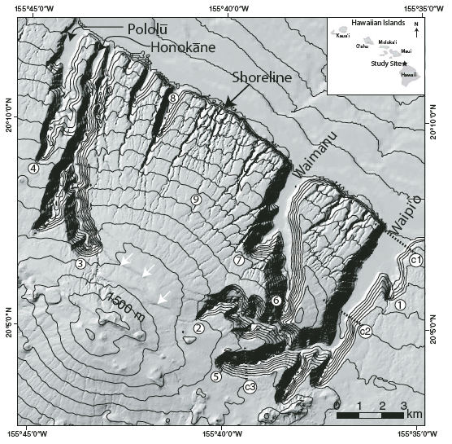
Strong coupling between weathering/pedogenesis, hydrologic pathways, and landform evolution
Kilauea/Mauna Loa (young)
Mauna Kea (intermediate)
Kohala (old, flank collapse)

Slide 32
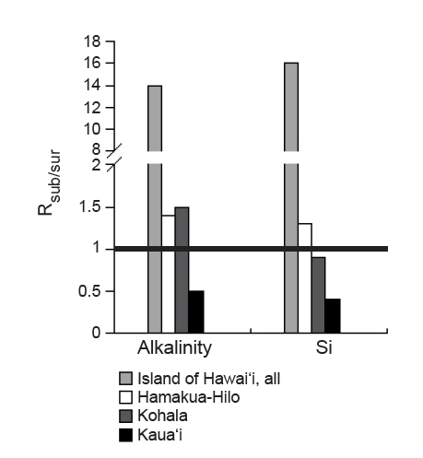
Ratio of weathering fluxes delivered via GW vs runoff

Slide 33
Weathering in basalt provinces
Basalt weathering appears to show strong climate sensitivity.
(data mostly from Dessert et al., 2003)

Slide 34
Weathering in basalt provinces
T dependence:
exponent ≈ 0.076 is equivalent to laboratory Arrhenius data, e.g. for plagioclases. Equivalent to E_{a} = 56 kJ mol⁻¹
implies ca. 2.2 x increase in weathering rate per 10˚C ∆T

Slide 35
A few important notions:
Tropical arcs ≈ 1% of terrestrial surface, with 15-20% of CO₂ consumption, with apparently strong climate sensitivity.
C fluxes in rivers – focus here, but also
geothermal fluxes
ground water fluxes (in Hawaii 15x!)
Hypothesis: Arcs (± LIPs) are the locus of the climate-weathering feedback.
Cratonic settings less sensitive to climate but also to tectonics via erosion rate effects.

Slide 36
Oh, by the way, arcs are a source of CO₂ too.
Hmm, where does that get us?
Fuego, Christmas Day 2010 (Antigua, Guatemala)
Notes:
Fuego, Christmas Day 2010, Antigua Guatemala (Derry photo)

