Slide 1

NATIONAL SCIENCE FOUNDATION
(NSF)
Lina C. Patino, Ph.D.
Division of Earth Sciences
lpatino@nsf.gov

Slide 2


Slide 3
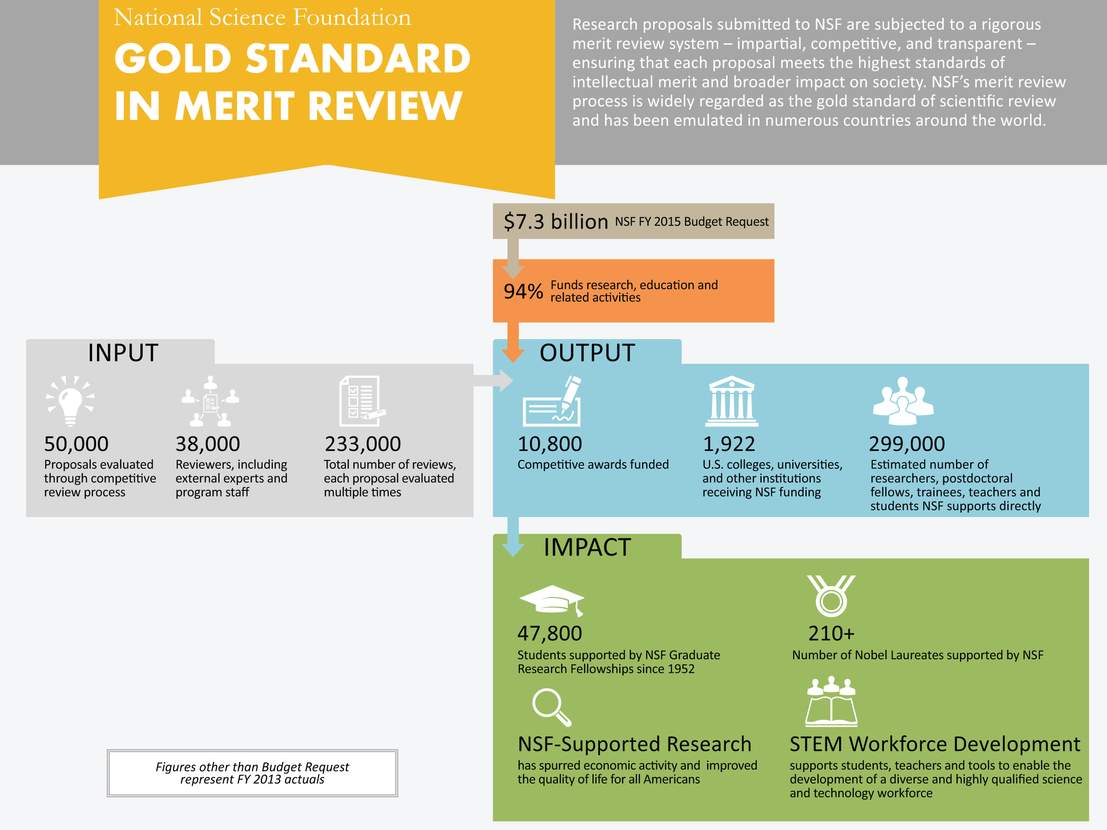

Data Current as of 2014

Slide 4
BIO
CISE
EHR
ENG
GEO
SBE
MPS

Slide 5
GEO Profile
Atmospheric & Geospace Sciences (AGS) ~ $268 M
Atmosphere
Geospace
NCAR/Facilities
Earth Sciences (EAR)
~ $192 M
Disciplinary Programs
Integrated Activities
Office of the Assistant Director
~ $1,398 M
Ocean Sciences (OCE)
~ $379 M
Ocean Sciences
Marine Geosciences
Integrative Programs
Polar Programs (PLR)
~ $465 M
Antarctic Sciences
Arctic Sciences
Antarctic Infrastructure & Logistics
Polar Environment, Safety, & Health
Integrative & Collaborative Education & Research (ICER) ~ $95 M
Cross-Foundation Programs
Education & Diversity
International Collaborations & Partnerships

Slide 6
Division of Earth Sciences
Disciplinary Programs Section
Integrated Activities Section
Geobiology & Low Temp. Geochemistry
Instrumentation and Facilities
Geomorphology and Land Use Dynamics
Education and Human Resources
Geophysics
GeoInformatics
Hydrology Sciences
Communications
Petrology and Geochemistry
EarthScope
Sedimentary Geology and Paleobiology
Integrated Earth Systems
Tectonics
GeoPRISMS

Slide 7
NSF Merit Review
NSF Review Criteria
  Intellectual Merit
  Broader Impacts
Programs can also have additional review criteria – read the Program Solicitation!
Merit Review is conducted through ad hoc peer review and/or panel review

Slide 8
Which Program?
www.nsf.gov
Read the funding opportunity (program descriptions, solicitations) carefully, and ask a Program Officer for clarifications if needed
Learn the culture- each Division/solicitation is different
Look at what has been funded:
  Award Abstracts at http://www.nsf.gov/awardsearch

Slide 9
Some reasons we decline proposals
Methodology is not clear / important details are missing
Team lacks expertise in …
Tool development, not research
Driven by agenda, not scientific enquiry
Proposal is poorly written
Proposal is not compliant
Poor fit to program
No clear statement of the research question(s) / hypothesis
Unlikely to result in theoretical advances
Duplicates existing work
Missing relevant literature
Design does not address research question(s)

Slide 10
Your Proposal
Consider your audience
Know and follow the current Grant Proposal Guide (GPG) AND the solicitation-specific requirements – ALL of them
Separately address Intellectual Merit and Broader Impacts in both the Project Summary and Project Description.
Match and justify the budget to the scope of the proposed work - ask for what you need.
Don’t submit your proposal at the last minute
Download your completed proposal back to you to check it’s what you sent

Slide 11
EAR Postdoctoral Fellowship
Award to Individual not Institution
  Selects Institution (university, federal facility, international)
  Fellow manages the award
  Direct connection with NSF
Requirements:
  Research plan must fall within the purview of the EAR programs
  Education plan (< 25% of the time)
  Letter from host signed by host and department chair
Funding
  2 years
  $62,000 stipend / yr.
  $25,000 fellowship allowance / yr.
Applicants are encouraged to expand the network of collaborators
US Citizens or permanent residents

Slide 12
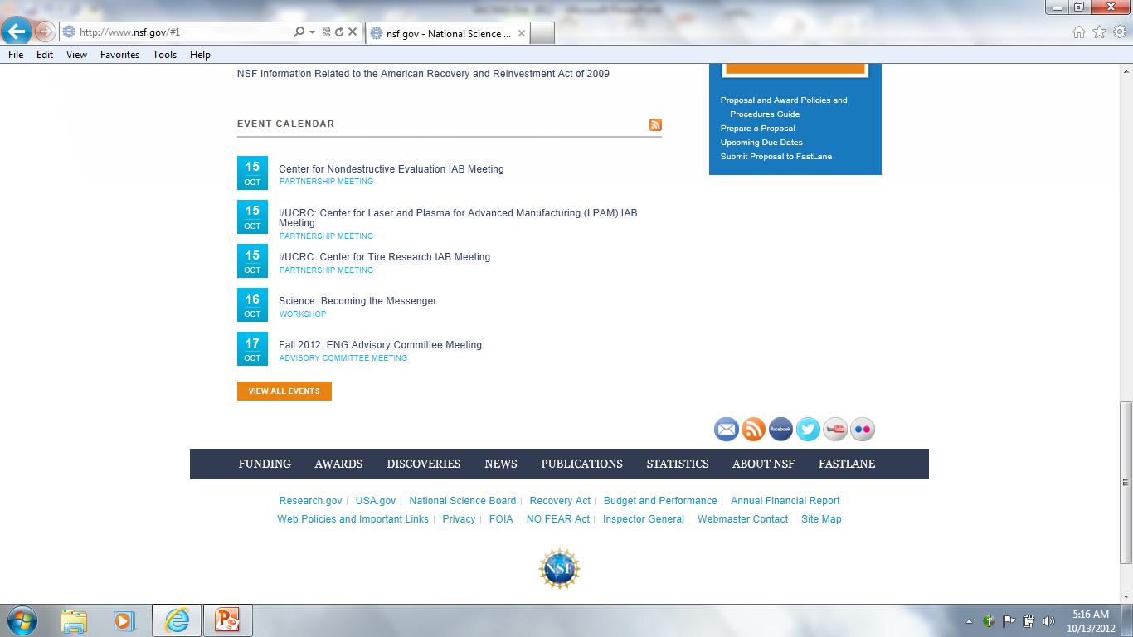

Stay connected

