Slide 1
Volcanic Plumes and Ash Clouds:
Drivers of ash dispersal
Larry G. Mastin

Slide 2
Talk outline
Main features of a volcanic plume:
The Physics of plume rise
Plume models and what they tell us
  1D
  3D
Dispersion models and their operational use
The experience at Eyja and how it changed operational modeling
The challenge of making model forecasts more accurate
Questions and Challenges

Slide 3
General observations of plumes

Slide 4
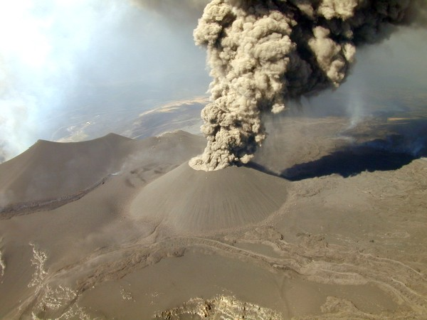
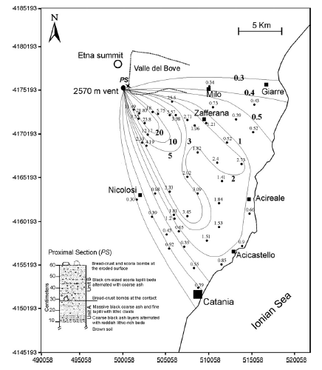
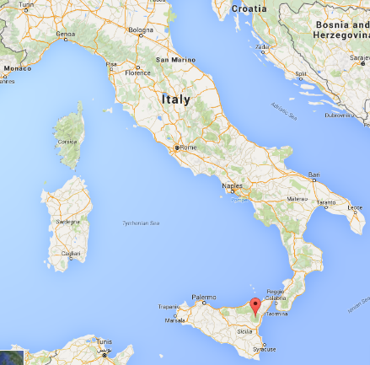
A small (VEI 2) eruption
Etna volcano, Italy, 2001
3 km plume height
Lasted 5 days
Erupted 90,000 m³ (0.00009 km³) magma
Tephra deposit¹
a
A sphere 60 m in diameter
Location of Etna
¹Scollo et al., 2007, JVGR, 160:147-164

Slide 5
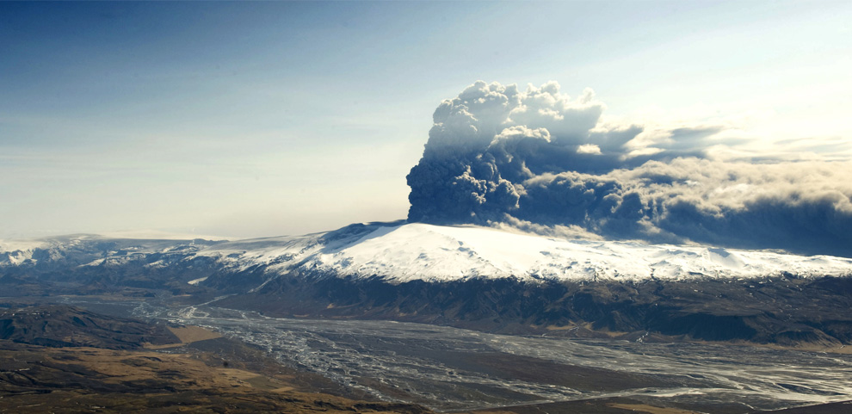
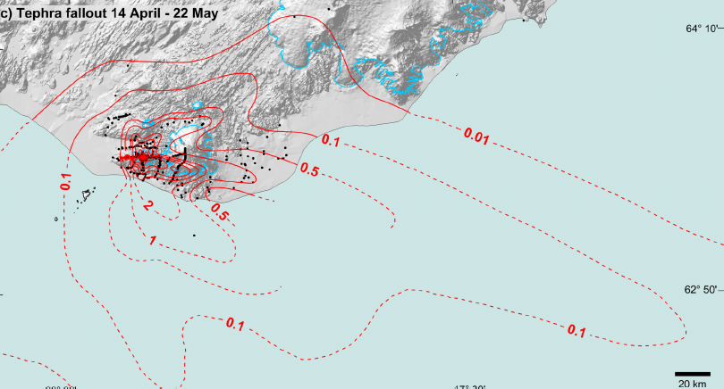

Bigger (VEI 3-4)
Eyjafjallajökull, Iceland, 2010
2-7 km plume height
Persisted for 3 weeks
0.2 km³ magma erupted
Eyjafjallajökull
Etna
0.2 km
3
1 km
Deposit map¹
¹Gudmundsson et al., 2012, Scientific Reports 2(572):DOI: 10.1038/srep00572
The eruption that shut down Europe

Slide 6
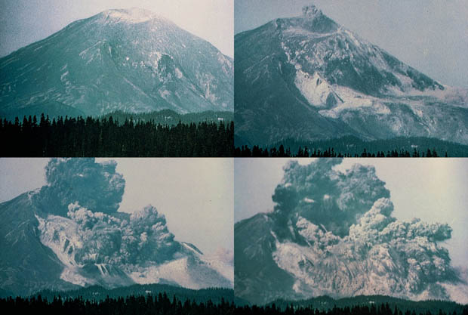
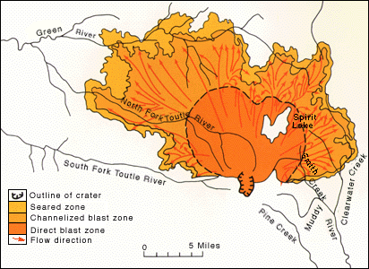
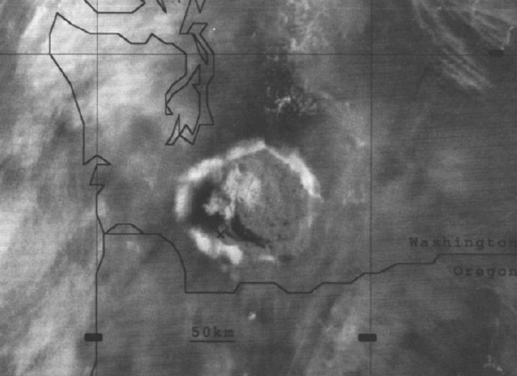
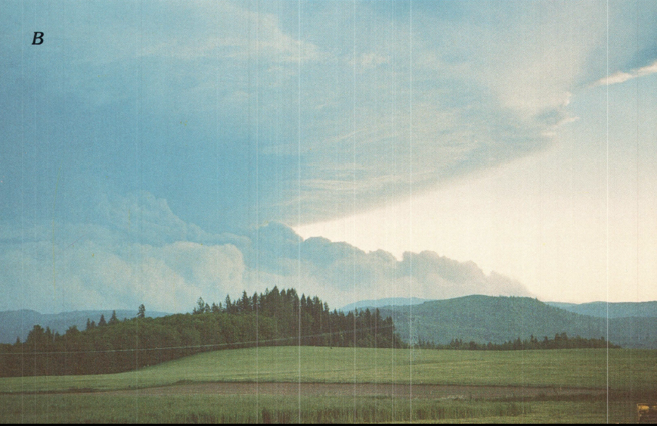
Bigger still (VEI 5)
Mount St. Helens, May 18, 1980
Started as a landslide at 8:32 AM
Expanded N as a lateral blast
Blast rose to form an umbrella cloud +30 km high & ~150 km in diameter
9:20 AM
Umbrella cloud
Umbrella cloud
MSH
100 km
Holasek et al., 1995, JGR 100(B5):8469-8487

Slide 7
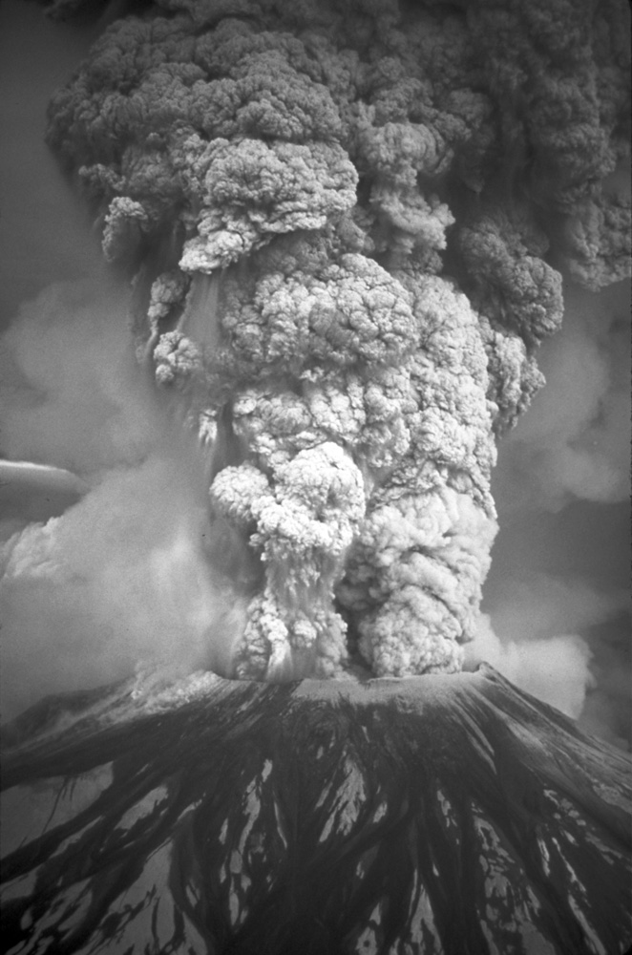
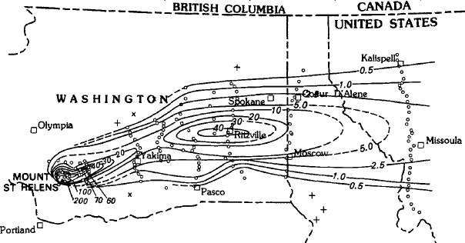

It then developed a normal vertical eruption
(9 AM-6 PM)
Plume height of 13-17 km
9 hour duration
0.2 km³ magma erupted
Deposit map¹
Eyja, MSH
¹Sarna-Wojcicki et al., 1981, USGS Professional Paper 1250, pp. 577-601
Etna
0.2 km
3
1 km

Slide 8
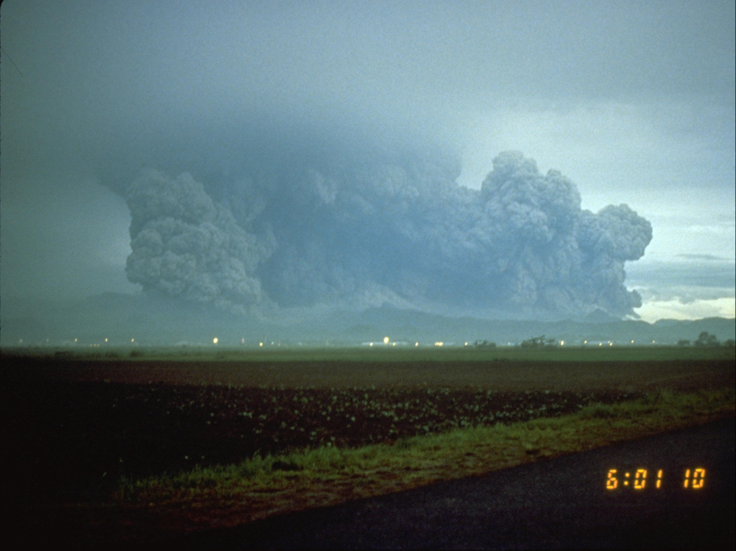
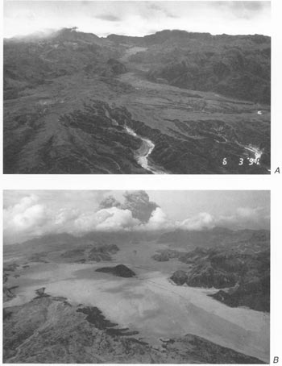
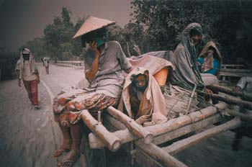
Still bigger! (VEI 6)
Pinatubo, June 15, 1991
Largest eruption in the past 50 years
Plume height to 40 km
Extensive devastation
~300 people killed, thousands evacuated
Erupted 6 km³ magma in ~9 hours
Before
after

Slide 9
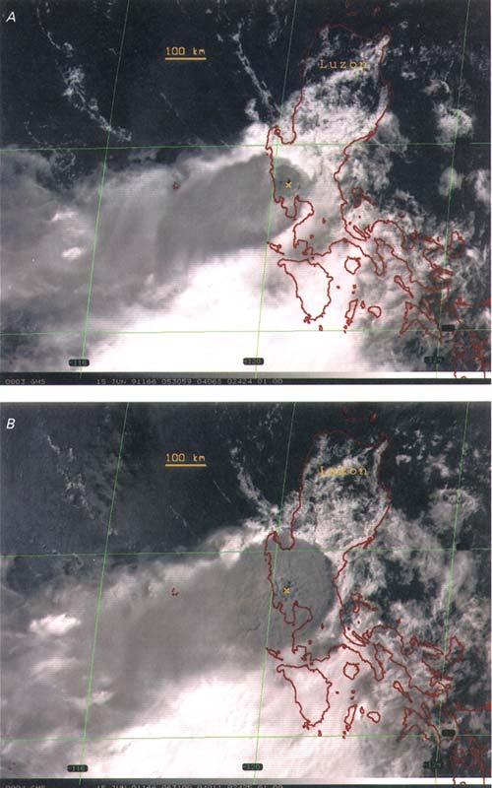
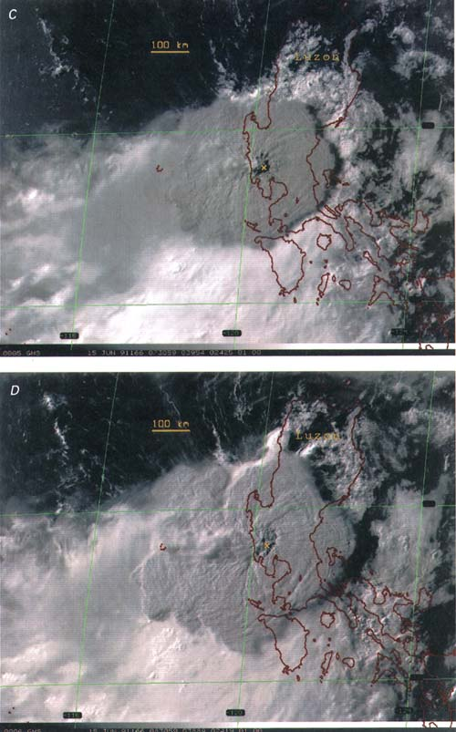
The cloud could only be seen from space
3:40 PM
1:40 PM
Over the first few hours,
The cloud expanded to >600 km diameter
And moved >200km UPWIND
2:40 PM
4:40 PM
200
600km
Pinatubo
Self et al., 1996, in Fire and Mud, Univ. Washington Press, Seattle, pp 1089-1116

Slide 10
Plumes change with eruption size
They’re higher for bigger eruptions
But they also change shape . . .
  From bent, weak plumes, to
  Anvil clouds, and
  Tall umbrella clouds
Plinian
Blast
stratosphere
troposphere
Etna
Eyja
MSH
Pinatubo
Typical jet cruise
altitude
VEI
2
3-4
5
6

Slide 11
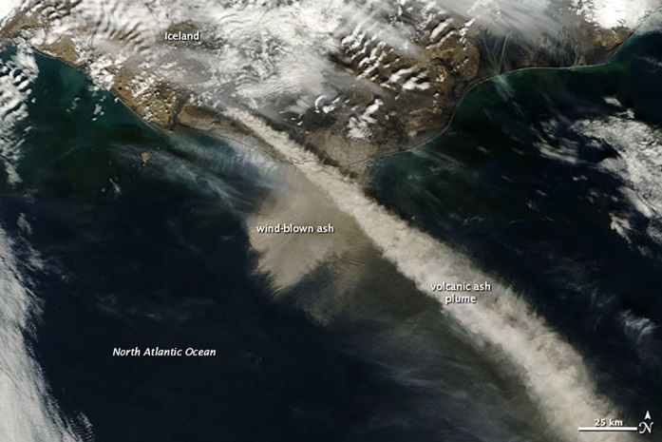
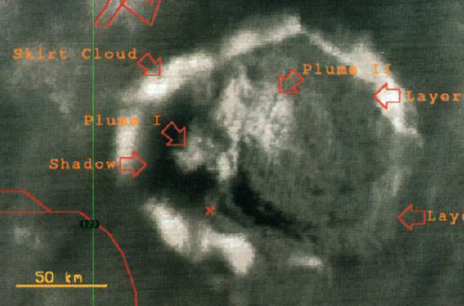
But for big eruptions (VEI>=5)
Plume WIDTH is the key!
Small eruptions inject ash that moves passively downwind
Big eruptions produce umbrella clouds
They can drive ash UPWIND
wind
No umbrella
cloud
St. Helens
vent
60 km
upwind
Plume
center
vent
200 km
upwind
Eyjafjallajokull
Pinatubo
wind
The same plot as before, but corrected for horizontal scale (km)
wind
Etna
Eyja
MSH
Pinatubo

Slide 12
The physics of plume rise

Slide 13
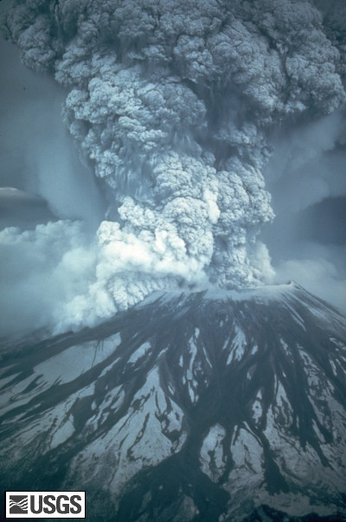
At the vent, the exiting jet must adjust to atmospheric pressure

Slide 14
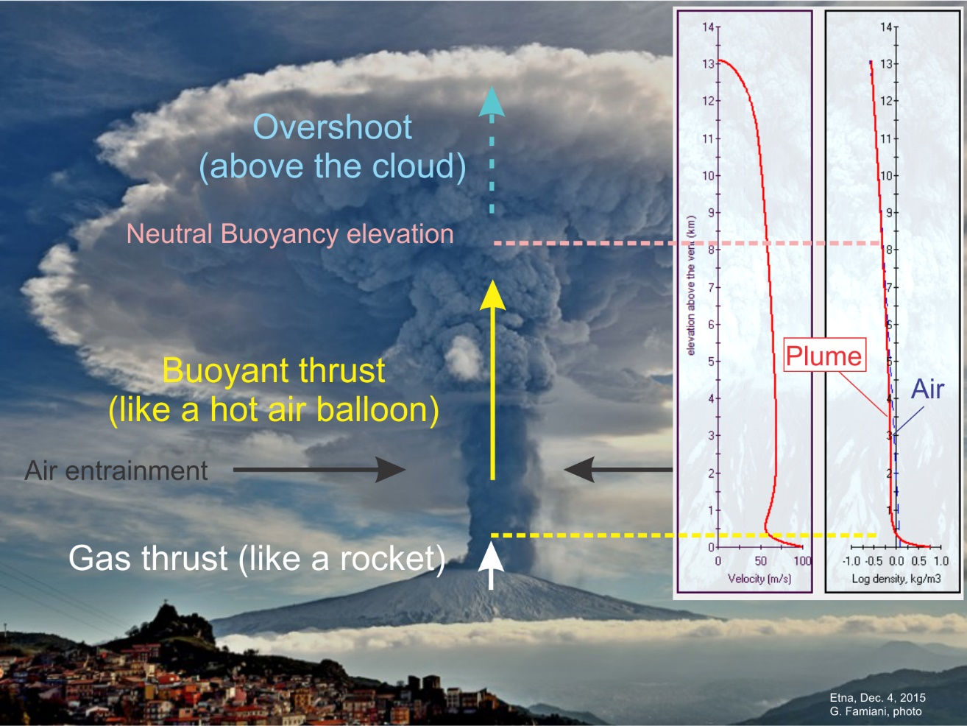
Plumes rise in 3 stages

Slide 15
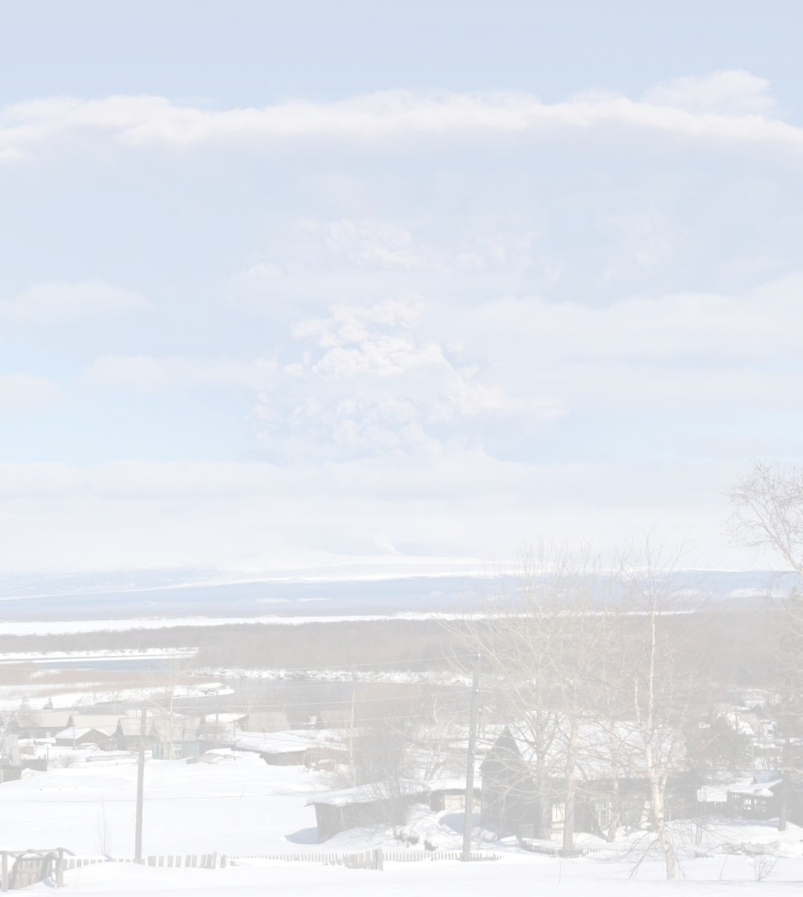
Plume height is primarily controlled by mass discharge rate
Theory¹ predicts that
  H∝Q^{1/4}
This is supported by compilations of eruption data^{2,3,4,5}:
  H=1.67Q^{0.259}
  Q=eruption rate (m³/s)
Pinatubo
Spurr
MSH
¹Morton et al., 1956, Proc. Royal Soc. London, ser. A, 234: 1–23.
²Sparks et al., 1997, Volcanic Plumes
³Wilson et al., 1978, JGR, 83(B4): 1829-1836
⁴Mastin et al., 2009, JVGR 186(1–2): 10-21
⁵Aubry et al., 2017, JVGR 343: 233-251
Fig 5.1, Sparks et al., 1997

Slide 16
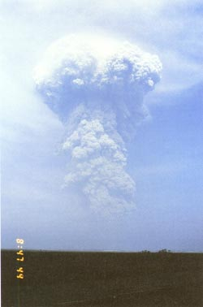
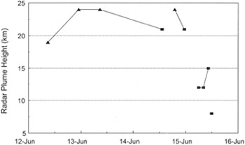
But there are also atmospheric influences; e.g. Humidity
The height of VEI <=3 eruptions at Pinatubo,
June 12-15¹
Pinatubo,
June 13, 1991¹
Plumes at Pinatubo June 12-15 were only VEI 2-3,
Yet they rose to 20-25 km in the hot humid air!
¹Fig. 13, 14 from Hoblitt, et al., 1996. The Pre-climactic eruptions of Mount Pinatubo, June 1991. in Fire and Mud, pp. 457-511.

Slide 17
Modeling illustrates the effect of humidity
MSH
5/18/80
Spurr
plume height, km
tropopause
100%
air temp at vent=0º C
T=10º C
20% humidity
Cerro Negro
Log mass eruption rate, kg/s
Sparks et al, 1997. Volcanic Plumes. Fig. 4.11

Slide 18
Low-latitude plumes also go higher, due to a higher tropopause & warm air
Effect of a tropopause
On plume height
Humidity=0%
100%
Low-latitude**
tropopause
High-latitude*
*air temp. at vent=0º C, tropopause elevation=10 km
**air temp. at vent=25ºC, tropopause elevation=15 km

Slide 19
Wind bends plumes over
At Eyja, plume height dropped
When wind speed increased,
April 14-16, 2010
Effect of wind on plume height¹
No wind
H, km
40 m/s wind
10³
10⁵
10⁷
Mass flux, kg/s
1Model results from Woodhouse et al., 2013. JGR: Solid Earth, 118(1): 92-109.

Slide 20
Plumes are strong when wind is weak
(and/or eruption rate is high)
Pinatubo
strong
MSH
weak
Spurr
r
dx

Slide 21
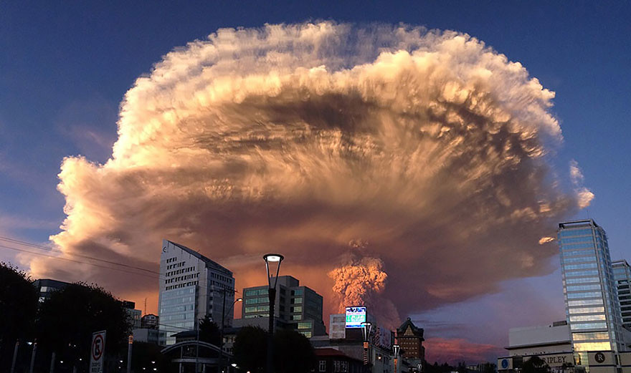
Umbrella clouds
Calbuco, April 24, 2015
Flickr public domain
https://www.flickr.com/photos/estudio_an/17256303935

Slide 22
Umbrella clouds form when mass expulsion exceeds the ability of wind to move ash away

Slide 23
Pinatubo changed our understanding of umbrella clouds
3:40 PM
1:40 PM
Over the first few hours,
The cloud expanded to >600 km diameter
And moved >200km UPWIND
2:40 PM
4:40 PM
200
600km
Pinatubo
Self et al., 1996, in Fire and Mud, Univ. Washington Press, Seattle, pp 1089-1116

Slide 24
As size increases, dispersal evolves from fan-shaped to circular
In small eruptions, ash moves passively downwind
Big eruptions can drive ash UPWIND
wind
No umbrella
cloud
St. Helens
vent
60 km
upwind
Plume
center
vent
200 km
upwind
Eyjafjallajokull
Pinatubo
wind
Plume shape, corrected for horizontal scale (km)
wind
Etna
Eyja
MSH
Pinatubo

Slide 25
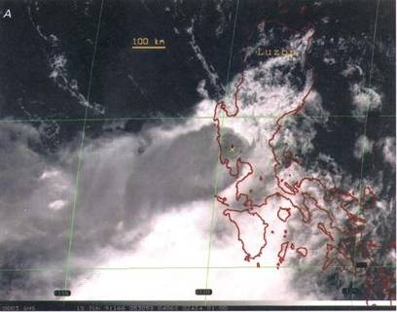
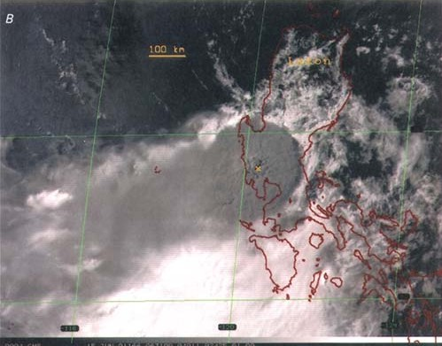
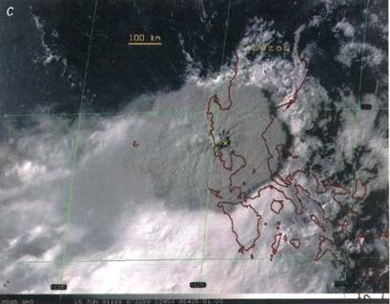
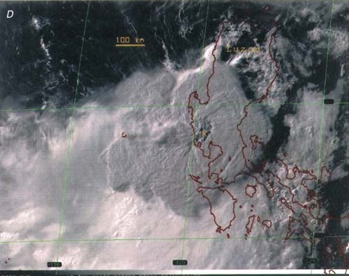
Rate of growth is proportional to mass eruption rate
Volume growth rate (dV/dt) = 2πrΔH(dr/dt)
At Pinatubo, dV/dt was about 50 km³ per second!
Umbrella cloud
r
ΔH
Neutral
buoyancy
Input volume
Rate
t<30 minutes
~1 hr
~3 hrs
~2 hrs
Pinatubo
MSH 1980
Spurr, 1991
Pinatubo, 6/14/91
Umbrella cloud growth can constrain
Eruption rate
Pinatubo, 6/15/91
100 km

Slide 26
Modeling plumes

Slide 27
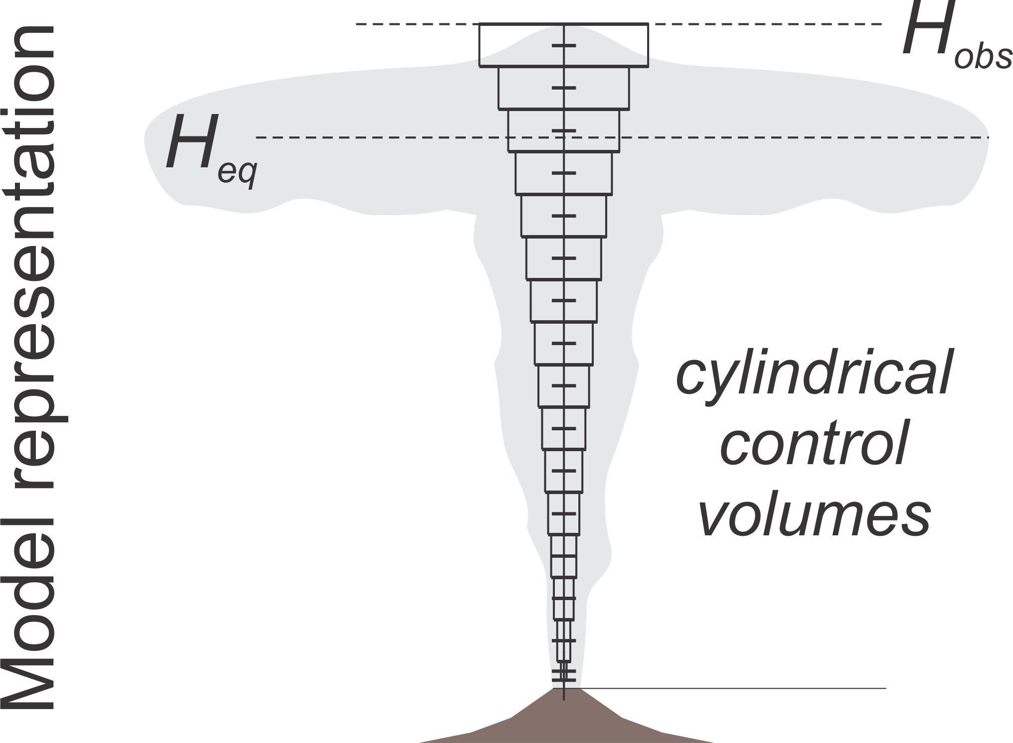
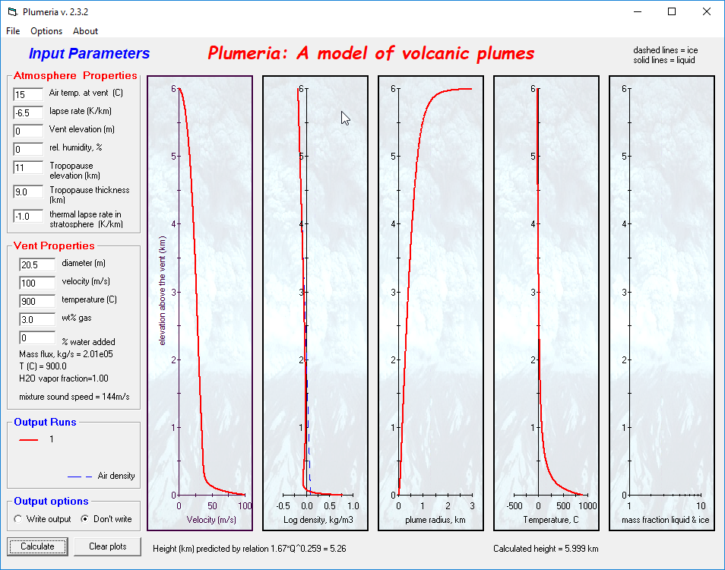



Modeling plumes in 1D
Models track mass, momentum, energy in a series of control volumes from the vent to the plume top.
Assume entrainment rate is proportional to ascent rate¹
Can use properties from a real atmosphere, and consider condensation, freezing etc.
u_{z}
Entrainment
velocity
u_{e}
Mass flux (M) change
Plumeria² output
$$\frac{dM}{dz}=2πru_{e}=2πr{αu}_{z}$$
Momentum flux
$$\frac{d(Momentum)}{dz}=πr^{2}\left(ρ^{amb}−ρ\right)$$
Energy
$$\frac{dE}{dz}=\left(gZ+h^{amb}\right)\frac{dM}{dz}$$
¹Morton et al., 1956. Proc Royal Soc. London, ser. A, 234: 1–23.
²Mastin, 2007. G³, 8(Q03014): doi:10.1029/2006GC001455.

Slide 28
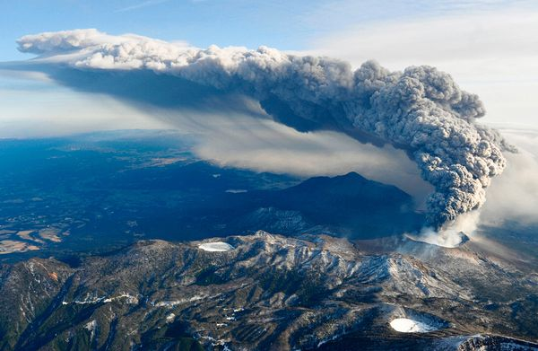
Modeling plumes in crossflow
2011 Shinmoedake eruption,
National Geographic photo

Slide 29
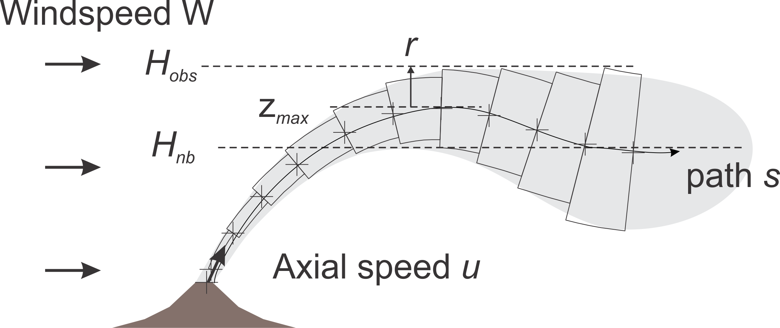
Modeling plumes in crossflow
Control volumes are now bent cylinders that follow a path s
Entrainment rate is a linear sum of that due to to both plume velocity and crossflow speed¹
Entrainment coefficients
Mass flux (M) change
Radial entrainment
crossflow entrainment
¹Hoult, et al., 1969. A theory of plume rise compared with field observations. Journal of the Air Pollution Control Association, 19: 585-590.

Slide 30
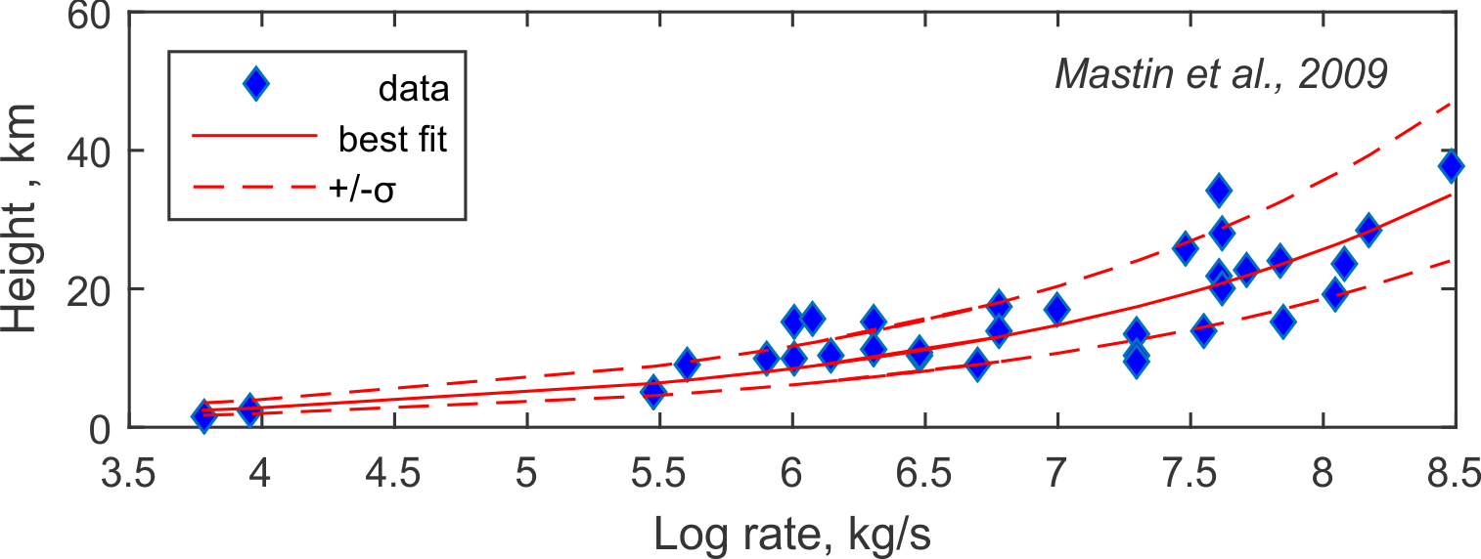
1D models are used during eruptions to estimate eruption rate
Modeled ash concentration
Model forecast
During eruptions, mass eruption rate (MER) is a key input into ash-cloud models
Using observed plume height, 1D models can theoretically estimate MER more accurately than traditional, empirical correlations
H
Empirical relationship ignores wind, humidity

Slide 31
Two issues limit our ability to estimate MER using 1d models
Different models give different estimates of MER for a given H
When compared with observations, a 1D model (Plumeria) shows no better fit—probably because observations aren’t very good
MER estimated different plume models for the same H¹
Comparison of MER estimates²
Empirical curve
Model results were no better
Plumeria
Modeled (plumeria)
¹Costa et al., 2016. JVG, 326: 2-25.
²Mastin, 2014, JGR Atmospheres, 119(5)

Slide 32
3d plume models
Too slow to be used during eruptions
Useful for
  Checking key predictions of 1d models
  Exploring processes including aggregation,

Slide 33
Examples
3D results show that entrainment rate is not constant with height (unlike 1D assumptions), leading to <~10% differences in
  Total height
  Neutral buoyancy level
  Evolution of plume radius
Allow us to check parameterizations used, e.g., to calculated umbrella spreading
Velocity streamlines showing re-entrainment¹
Neutral buoyancy level in 1D versus 3D model²
¹Cerminara et al., 2016. JVGR, 326: 143-171.
²Suzuki & Koyaguchi, 2009. JGR: Solid Earth, 114(B3): B03209.

Slide 34
3d plume models can also examine processes
E.g. the complexity of column collapse¹
Hydrometeor formation^{2,3}
ATHAM simulation plus radar reflectivity suggest rapid ash removal by hail in 2009 Redoubt event 5 eruption
Model-derived region of oscillating columns²
¹Neri, A. and Dobran, F., 1994. JVGR, 99(B6): 11833-11857.
²Van Eaton et al., 2015. Nat Commun, 6: 7860.
³Textor et al., 2006, JVGR 150: 359-377.

Slide 35
Dispersion models
Dispersion models calculate the downwind dispersal of ash after it rises into the atmosphere.
The do not calculate the dynamics of the rising plume, only downwind dispersal

Slide 36
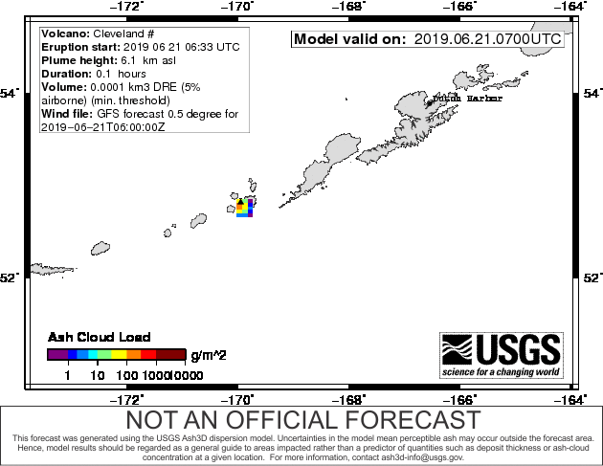
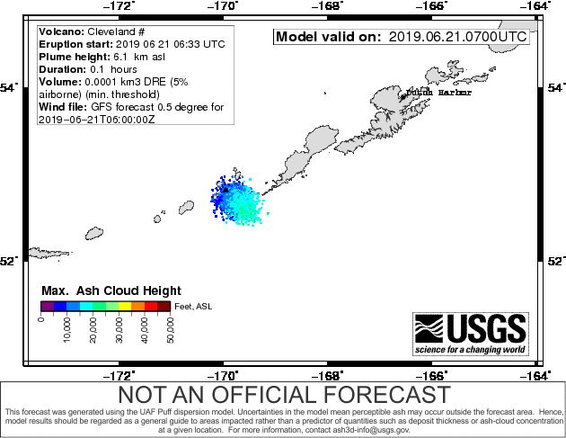
Types of dispersal models
(that use a 3d wind field*)
Eulerian: Set up a 3-D cell grid and track flux through cell walls
Lagrangian: Track individual ash particles
Ash3d: Eulerian
Eulerian examples: Fall3d, Ash3d
Lagrangian examples: Hysplit, NAME, Puff
Puff: Lagrangian
*There are also semi-analytical models such as Tephra2 that use a 1-D wind sounding. These are useful for deposits but not ash clouds

Slide 37
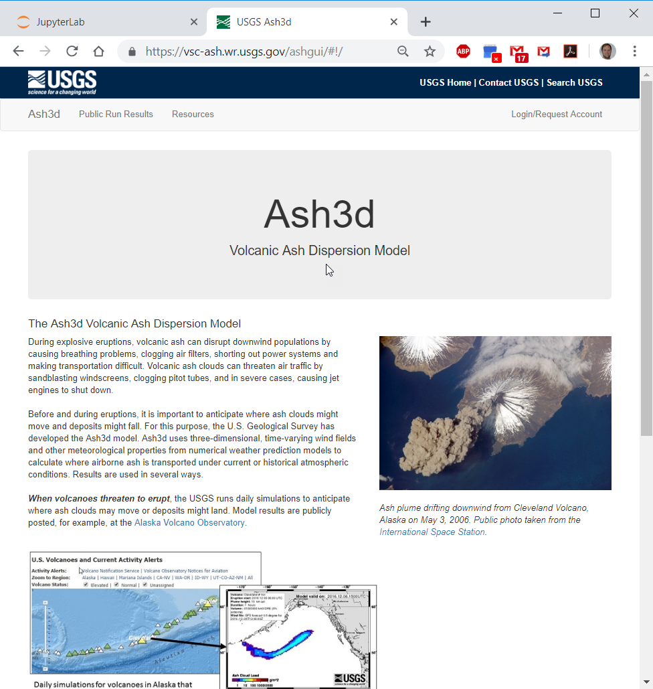
One example: Ash3d

Slide 38
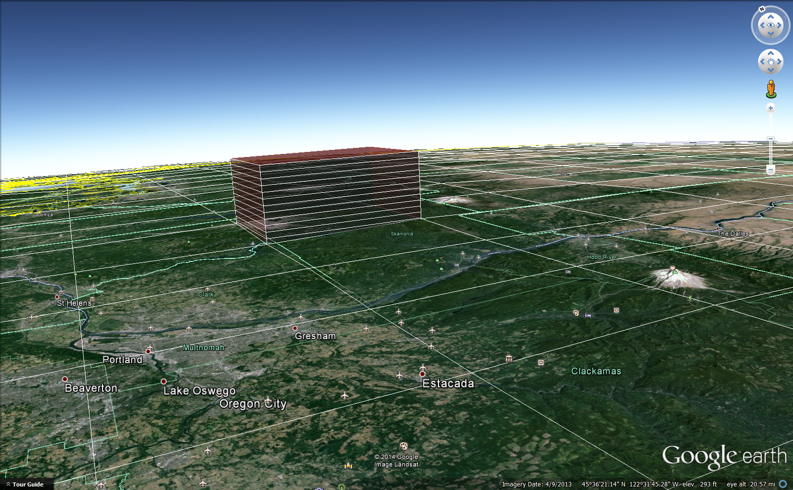

Standard initiation
(for Eulerian models)
Places ash within a column of source nodes,
It distributes the mass with height using the formula shown here, from a paper by Takeo Suzuki¹
Height
Mass
Mass distribution
Q_{m}=mass erupted in a time step
z=elevation
H=plume height
k=adjustable constant (we use k=4)
¹Suzuki, T. (1983), A Theoretical model for dispersion of tephra, in Arc Volcanism: Physics and Tectonics, edited by D. Shimozuru and I. Yokoyama, pp. 95-113, Terra Scientific Publishing Company, Tokyo.

Slide 39
Advection
Fall
wind vectors
Diffusion¹
v
u
u_{s}
u_{s}
At each time step, Ash3d calculates the flux through cell walls as ash
is advected downwind
falls at its settling velocity
And spreads by turbulent diffusion
You can find more information in:
Mastin LG, Randall M, J., Schwaiger H, Denlinger R (2013) User's Guide and Reference to Ash3d: A Three-Dimensional Model for Atmospheric Tephra Transport and Deposition. In: U.S. Geological Survey Open-File Report 2013-1122. p 48
Schwaiger H, Denlinger R, Mastin LG (2012) Ash3d: a finite-volume, conservative numerical model for ash transport and tephra deposition. J. Geophys. Res. 117(B04204):doi:10.1029/2011JB008968
q=concentration, S=mass added to source nodes per unit time,
u, v, w=wind speed components, u_{s}=fall velocity, K_{x}, K_{y}, K_{z}=diffusivity in x, y, z
¹Diffusivities are set to zero in runs on the web interface because diffusion is found to play a secondary role in ash transport

Slide 40
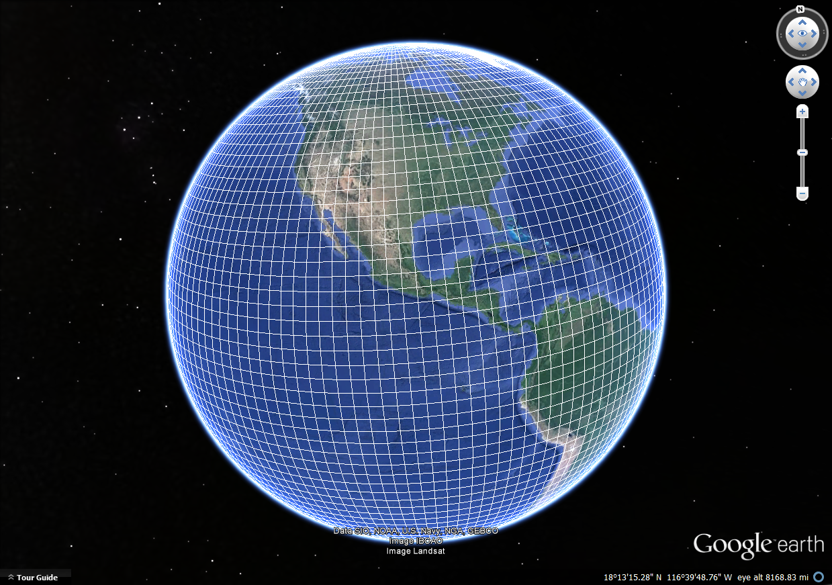
Source of wind fields
2.5° lat/lon grid
Dispersion models use wind fields provided numerical weather prediction models, such as
  NOAAs Global Forecast System (GFS)
  Europe’s ECMWF model
¹ http://www.esrl.noaa.gov/psd/data/gridded/data.nmc.reanalysis.html
²http://thredds.ucar.edu/thredds/catalog/grib/NCEP/GFS/Global_0p5deg/catalog.html

Slide 41
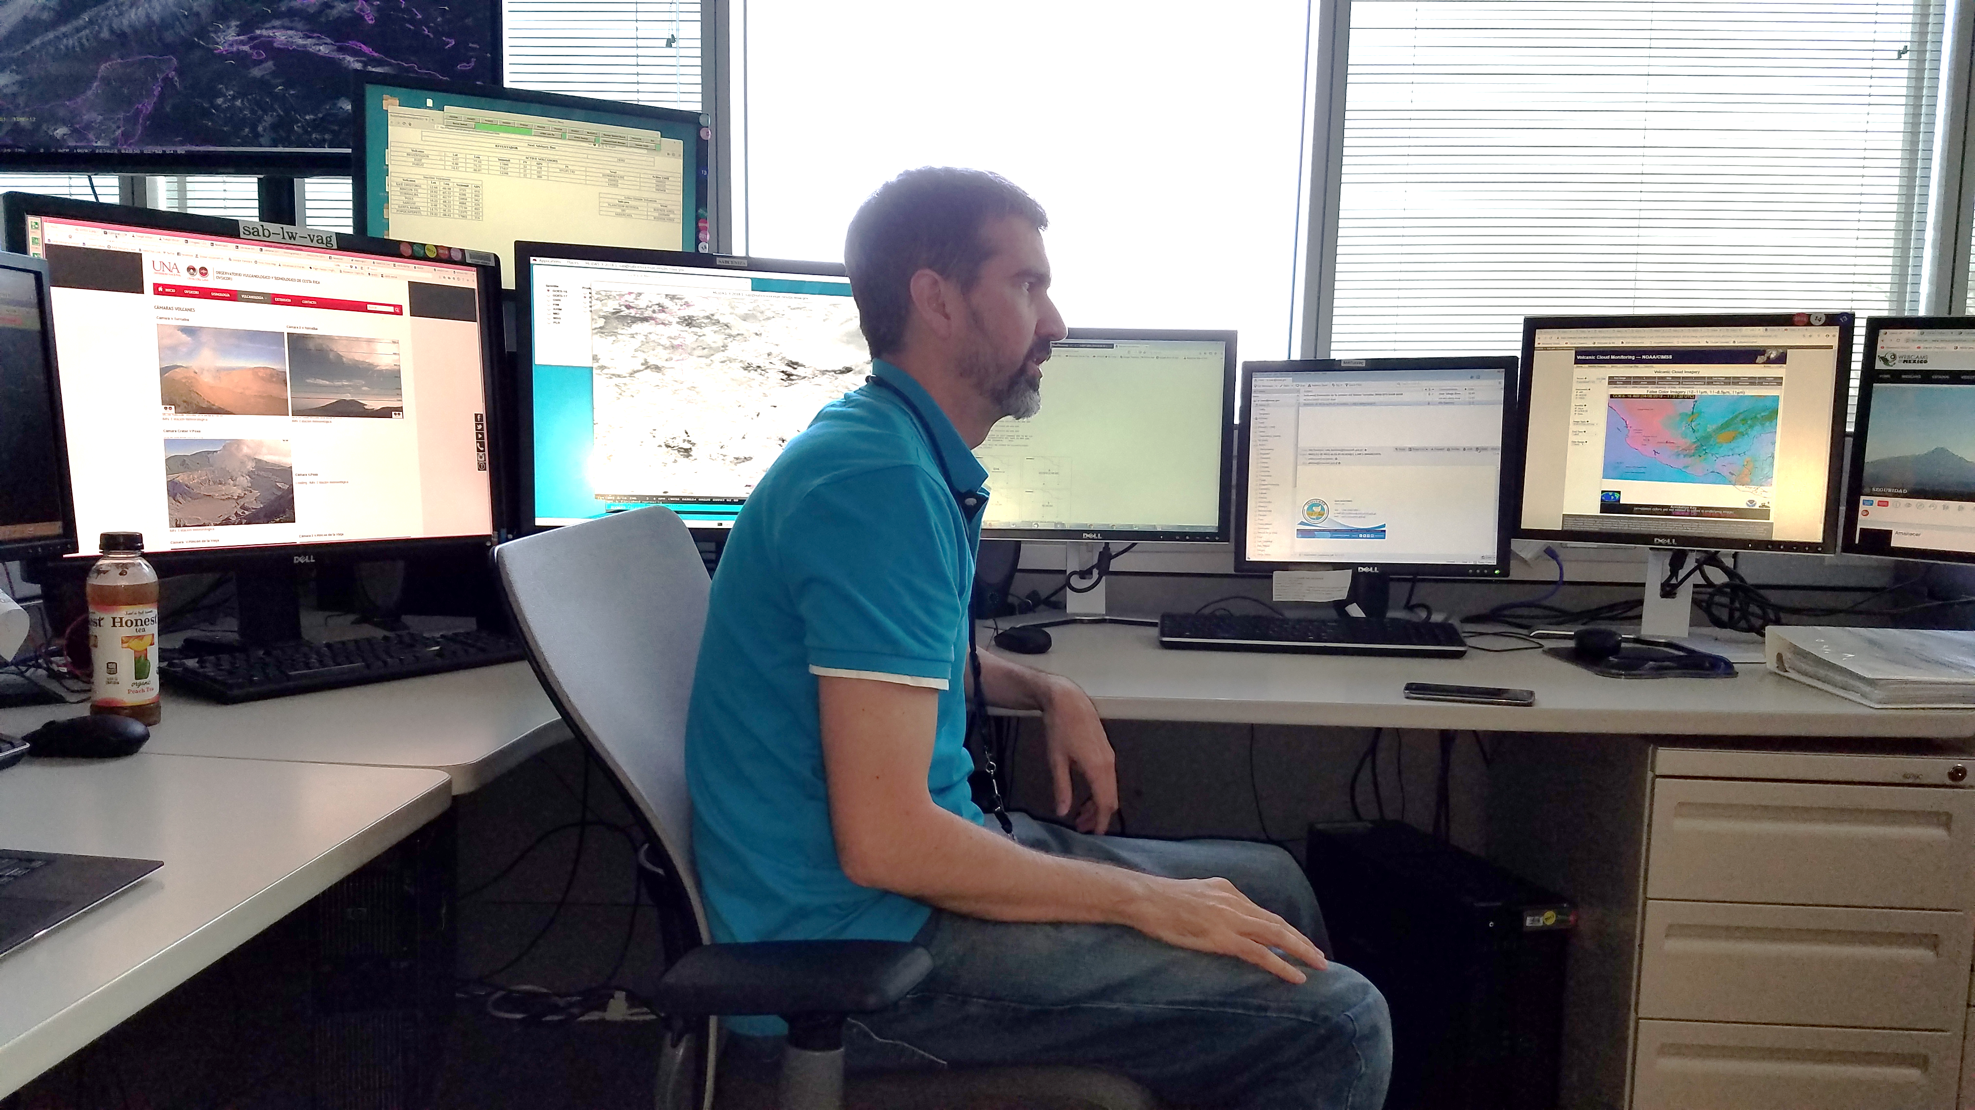
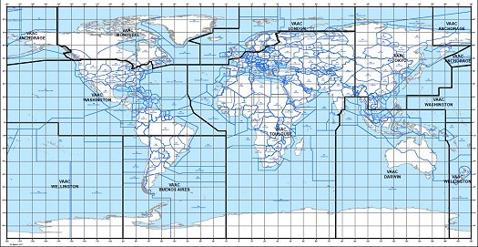
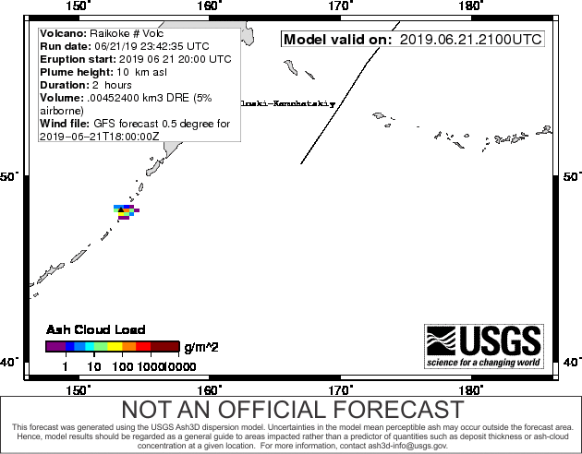
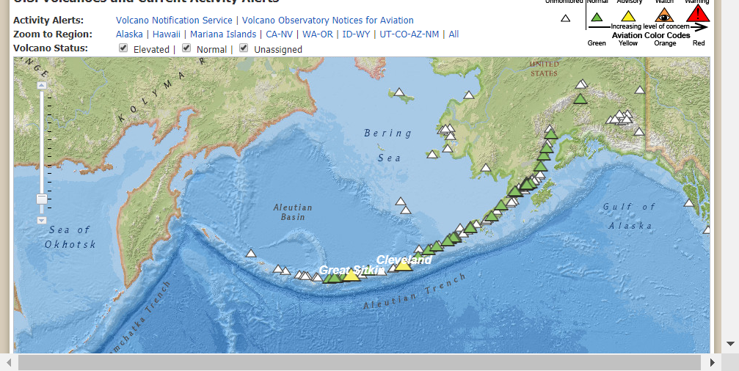
Dispersion models are used to forecast ash and avoid it
Volcanic Ash Advisory Centers (VAACs) and volcano observatories use models during eruptions
The Washington VAAC
The World’s nine VAAC regions
Yesterday’s eruption!
U.S. volcanoes currently at unrest
volcanoes.usgs.gov
Today’s forecast for Cleveland volcano

Slide 42
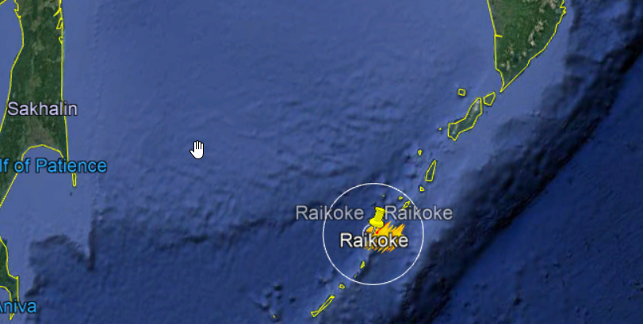
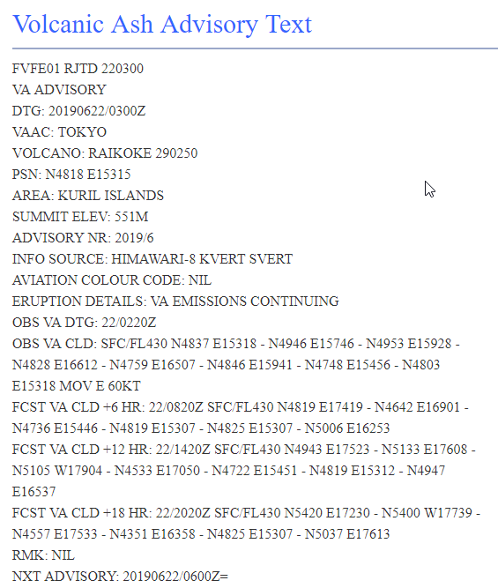
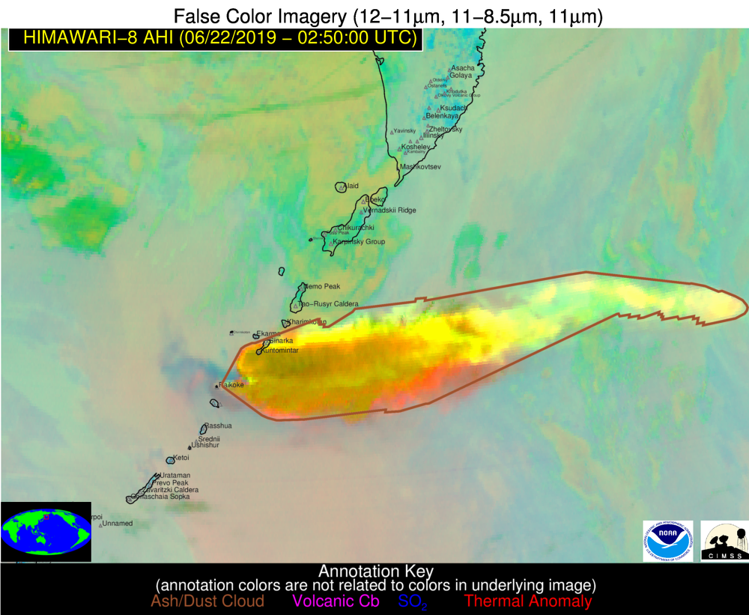
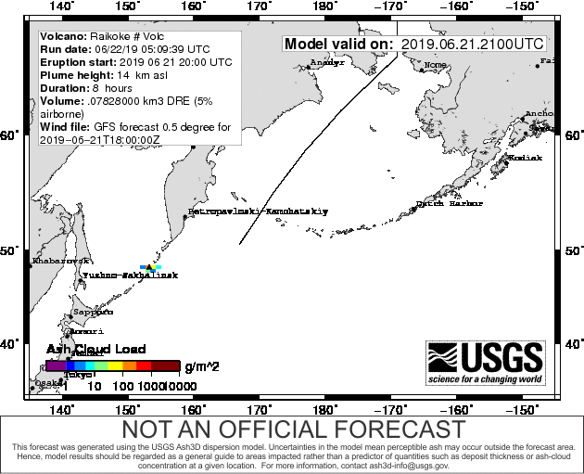
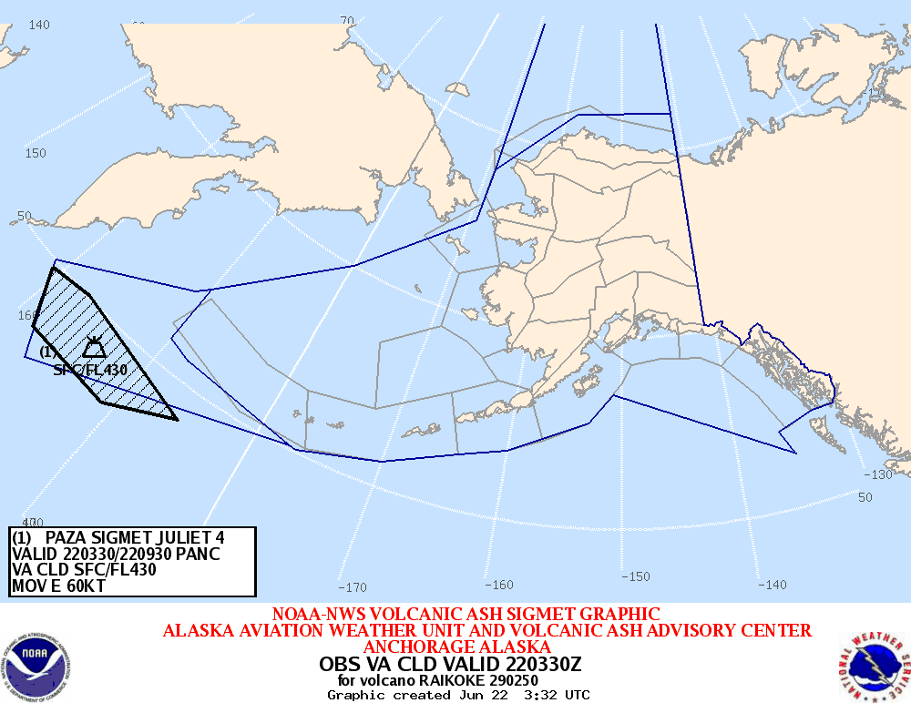
And it’s used during eruptions
Yesterday’s eruption at Raikoke
Lightning alerts
Advisory
Volcat automatic
Pick of cloud
Ash3d model run
SIGMET issued by Anchorage VAAC
Some of the internal chatter
3:03 PM: “FYI, Real eruption. Up to FL340 according to the Tokyo VAAC.”
7:16 PM: I agree that it looks to be ramping up. The last explosion (7th?) looks bigger than the first six.
7:23 PM: “. . . numerous air traffic diversions . . .. This may be the most significant eruption to impact aviation in the North Pacific region Sarychev Peak in 2009.”
7:30 PM: “Ash3D has been very helpful to us today!” --Jeff Osiensky, Anchorage VAAC manager

Slide 43
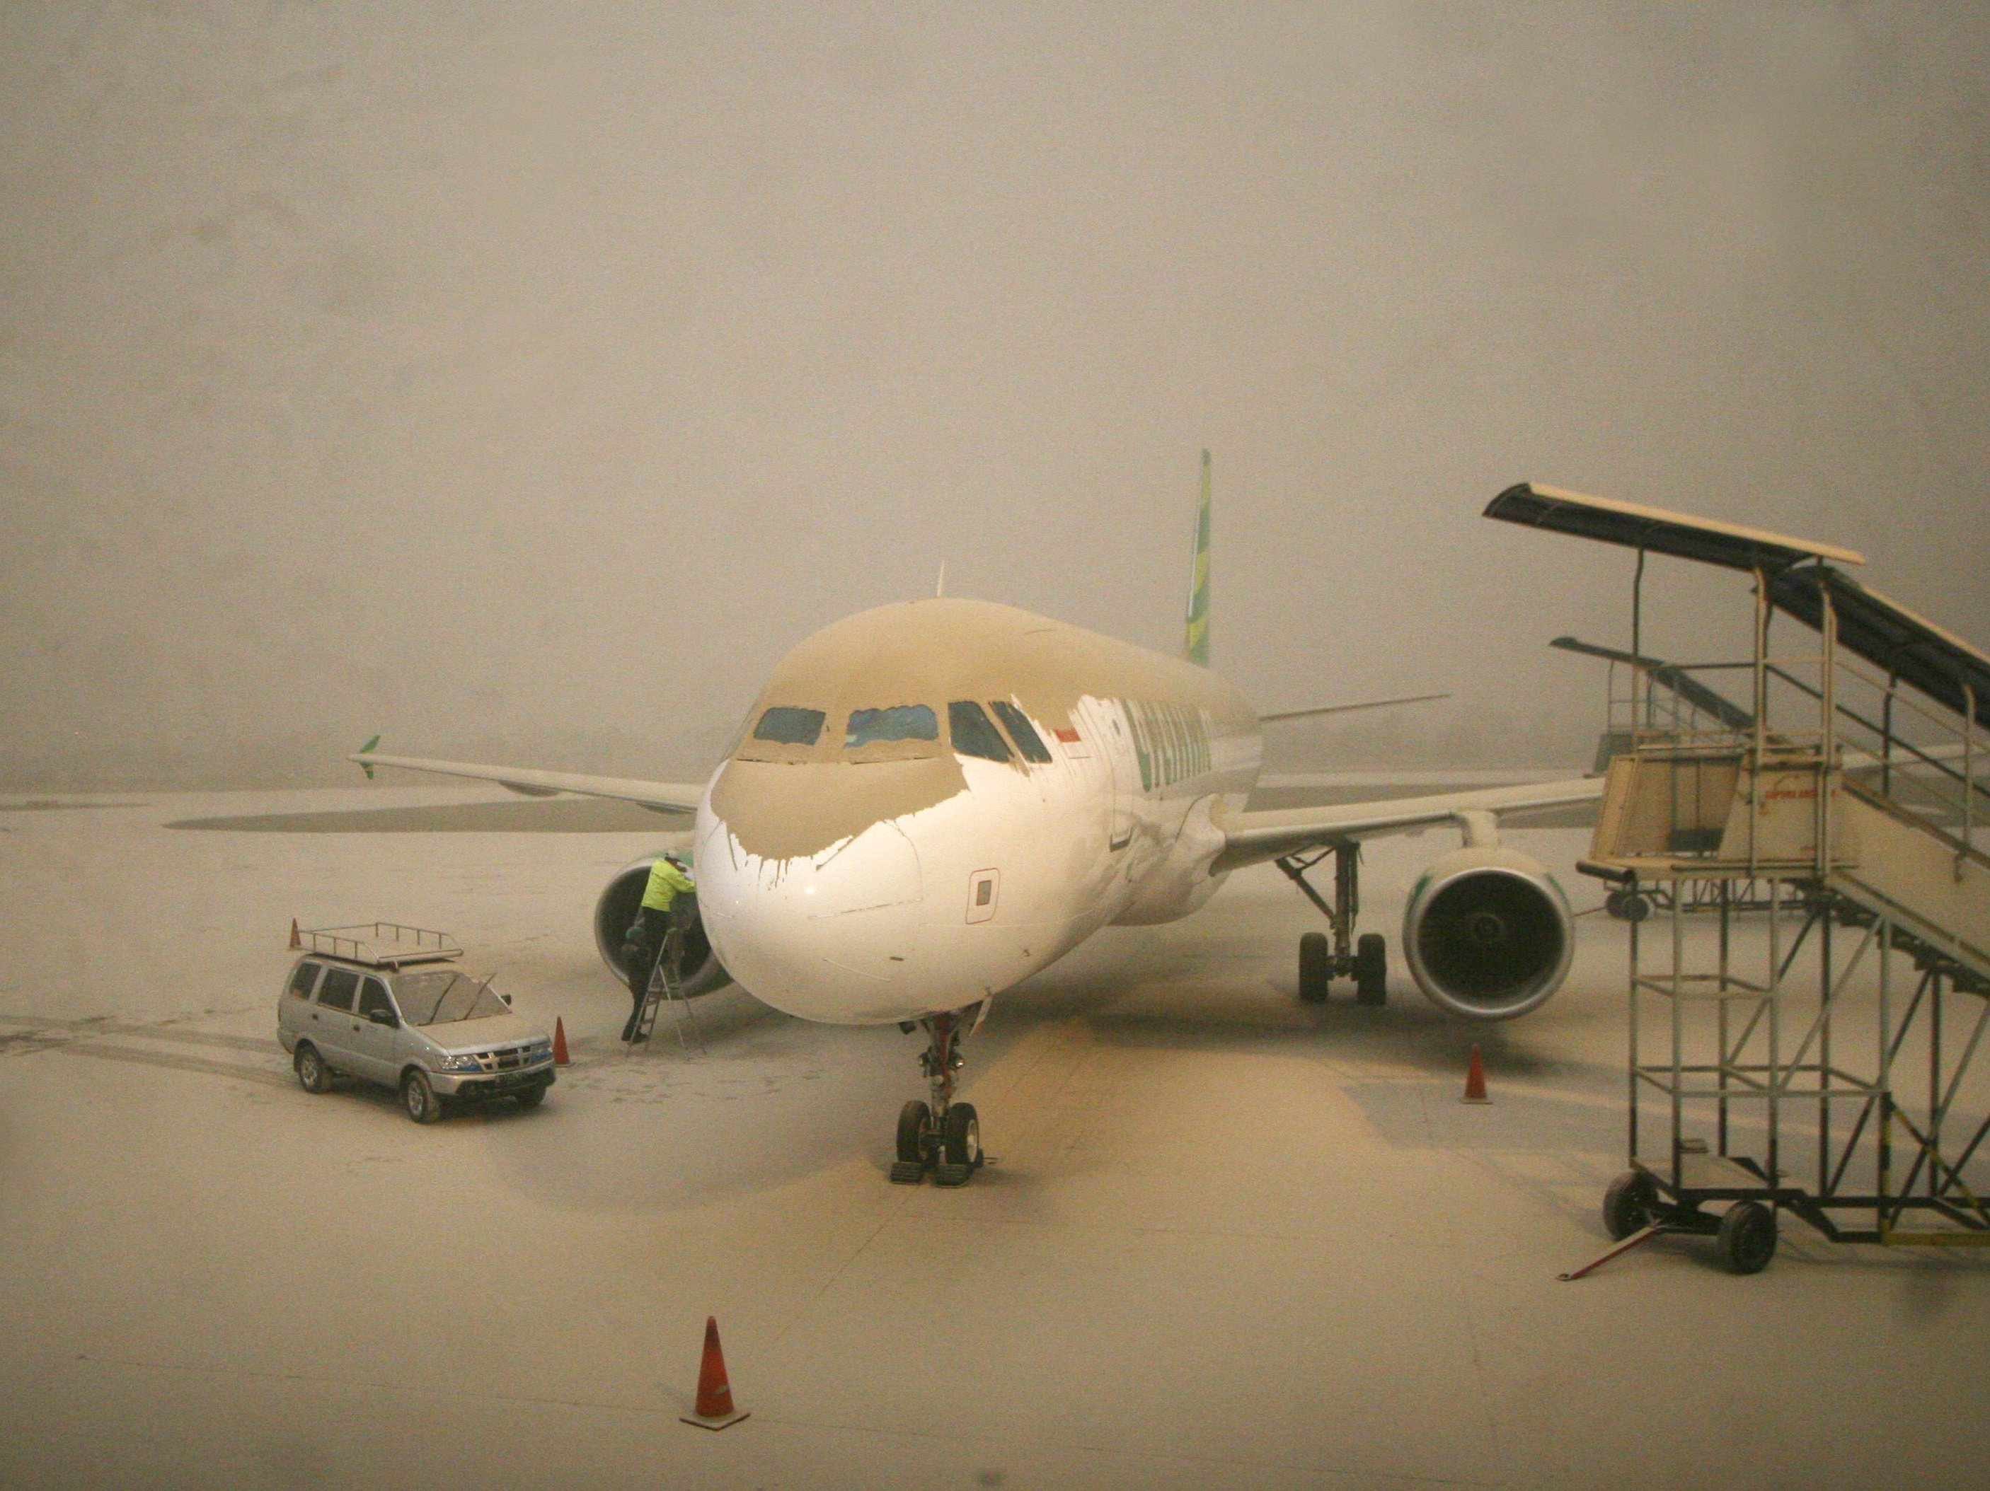
The hazards of airborne ash to aircraft
Airborne ash can affect visibility, breathing, avionics, and shut down engines.
Since 1953, there have been 253 damaging in-air encounters, including 9 with total engine shutdown.
Avoiding encounters is costly—disruption during the Eyjafjallajokull crisis cost ~$5B in economic loss.
Yogyakarta airport following Kelut eruption,
Agence-Presse France photo

Slide 44
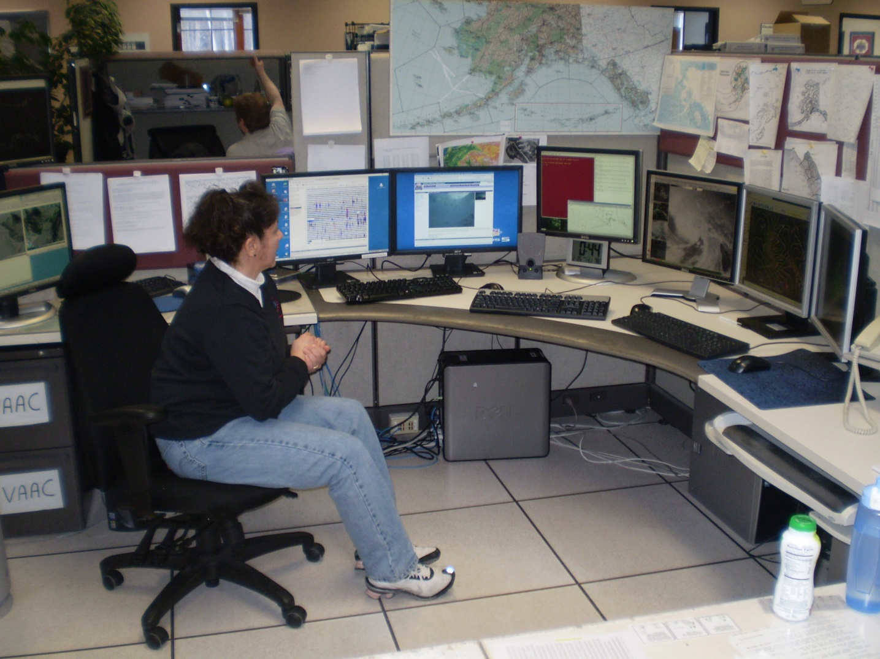
How models are used during eruptions
The Anchorage VAAC, 2009

Slide 45
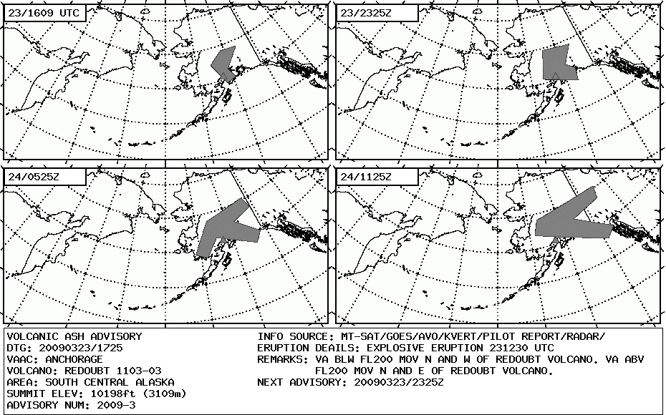


Volcanic ash advisories combine:
  Observations
  model forecasts
  human judgment
The “official” output is a polygon—an ICAO standard
In this operational environment,
Model forecasts provide a qualitative but useful predictor of the location and extend of the cloud
Observed cloud
Modeled cloud
AVHRR IR
The Anchorage VAAC

Slide 46

2010: Eyjafjallajökull turns the modeling world upside down
People stranded in airports for a week seeing “no ash”
Disruption caused $5B economic loss
To get flights moving, regulators allow flight through “dilute ash”. But what is “dilute”
Engine manufacturers (under pressure) propose a standard: 2 mg/m3
Regulators now require the London VAAC to produce maps of direct model output with ash concentration: 0.2, 2, and 4 mg/m3
Modelers freak out!
Old forecasts
New forecasts

Slide 47
Political fallout
An “international volcanic ash task force” was convened for two years to review rules & procedures, set priorities. Questions included:
  Should we use modeled ash concentration worldwide for setting no-fly zones? (no)
  Can we assign confidence or probability to an ash forecast? (not easily)
  Can a pilot see an ash cloud with 2 mg/m3 ash? (barely--it depends)
  What are satellite detection limits for ash? (~0.2 mg/m³)

Slide 48









New efforts to test models
First ever quantitative model validation studies
Intercomparison workshops
Efforts to standardizing “best practices”
Webster et al. (2012, JGR¹) compared modeled & measured concentrations during the Eyja eruption
2012 WMO VAAC model “ins and outs” workshop
¹Webster, H. N., et al. (2012), JGR., doi:10.1029/2011JD016790
²https://www.wmo.int/aemp/archive

Slide 49
Inputs were ranked by our level of constraint¹
Eruption Source Parameter | Current level of suitability (5=best)
Eruptive plume height | 4 (1 in certain locations)
Winds (NWP model) | 4 (tropics worse)
Mass eruption rate (MER) | 2
Onset and duration | 5 (as low as 1 for poorly monitored volcanoes)
Vertical distribution of mass near the source | 2
Particle size distribution | 2
Ash density | 5
Ash sphericity | 3
¹World Meteorological Organization, Final Report, in VAAC 'Inputs and Outputs' (Ins and Outs) Dispersion Modelling Workshop. 2013, World Meteorological Organization, Commission for Aeronautical Meteorology: Washington, D.C. p. 1-25.

Slide 50


Since Eyja:
Efforts to improve detection
Raikoke eruption lightning
6/21/19 1759 UTC
New monitoring to get better plume height
Automatic alerts for SO2, lightning, ash, infrasound etc. constrain eruption start, plume height etc.
IMO Mobile Radar, Iceland

Slide 51
Improving mass eruption rate estimates
A key model input
1D plume models now used to get improved estimates of MER from height¹
Using growth rate of umbrella clouds to estimate MER^{2,3}
Umbrella growth rate of Calbuco fits to MER=7-9e06 kg/s³
Umbrella growth rate & Best-fit MER of several eruptions²
¹Bursik et al., 2012, Bull Volc. 74(10): 2321-2338
²Pouget et al., 2013, JVGR 258(0): 100-112
³Van Eaton et al., 2016, GRL 43(7): 3563-3571

Slide 52
There have also been recent improvements in model capability

Slide 53

Some can automatically Compare with satellite to improve source parameters
Courtesy U.K. Met. Office
Ash cloud
Satellite retrieval
Example of Grimsvotn 2011 simulation using NAME model & Bayesian inversion.
U.K. Met. Office is prepared to make such runs operational.
Similar procedures in development by Austalian Bureau of Met.² USGS³
A priori run
Ash cloud
¹Webster et al., 2017. Forecasting Research Technical Report 618, U.K.Met. Office.
²Zidikheri et al., 2017, JGR Atmospheres 122(15): 8207-8232
³Denlinger et al., 2012, JGR Atmospheres 117(D13): D13208
A posteriori

Slide 54
Adding umbrella clouds to models
Traditional: place ash in a column above the volcano: let the ambient wind field advect downwind
But umbrellas push ash upwind!
Theory and 3d modeling have helped us develop a method to add umbrella spreading
¹Suzuki & Koyaguchi, 2009. JGR: Solid Earth, 114(B3): B03209.
²Costa et al., 2013. GRL, 40(18): 4823-4827.
³Mastin et al., 2014, G-cubed, 15(8): 3459-3475
⁴Webster et al., in review
⁴Bursk et al., 1992, Bull. Volc. 54: 329-344.
Radius vs. time²
Volume flux into cloud⁴
Constants calibrated using 3d models

Slide 55



Model forecasts using umbrella cloud
February 2014
Commercial jet from Perth to Jakarta flew into umbrella cloud, suffered major engine damage
Satellite images every 10 minutes
With umbrella
VIIRS Satellite infrared image
No umbrella
Yogyakarta airport following Kelut eruption,
Agence-Presse France photo

Slide 56


We can now model super-eruptions
Results for a 3-day eruption
Yellowstone¹ and Toba² have recently been modeled
With umbrella cloud
¹Mastin et al., 2014, G-cubed, 15(8): 3459-3475.
²Costa et al., 2014, Frontiers in Earth Science, 2.
No umbrella cloud

Slide 57

Weather models, used by dispersion models, have also improved¹
NH=northern hemisphere
SH=southern
High accuracy
useful
¹Bauer, P., Thorpe, A. and Brunet, G., 2015. The quiet revolution of numerical weather prediction. Nature, 525: 47.

Slide 58
Challenges to more accurate model forecasts

Slide 59
1. Vertical distribution of mass
Lower cloud
Not in sat image. Why?
It could be related to the vertical distribution of mass
Source strength vs. height & time at Eyja
The only observational constraints seem to to come from inverse modeling¹
¹Kristiansent et al., 2012, JGR 117: D00U11

Slide 60
2. Aggregation and removal
Fine ash doesn’t fall as individual particles: it aggregates
We don’t understand the physics well enough to model it.
Thus, we don’t know how much fine ash remains aloft at distance
Models assume ~5% of the mass goes into the cloud. But it seems to vary a lot!¹ We don’t know why.
Ice aggregates at Redoubt, 2009²
¹Gouhier et al., 2019, Scientific Reports, 9(1): 1449
²Wallace et al., 2013, JVGR 259(0): 145-169.

Slide 61
Why it is important to model ash removal

Slide 62
Research questions
A key objective is to issue volcanic ash advisories that are both timely, and accurate (i.e. they include the entire cloud but no more)
How can we more easily validate our models (or VAAs)?
  Validation requires good observations & measurements, which are difficult to obtain
How can more tightly constrain model inputs?
  Mass fraction that goes into the cloud
  Vertical distribution of mass
How can we model ash aggregation & removal?
What factors control the concentration of airborne ash at ground level? Can it be modeled?

