Slide 1
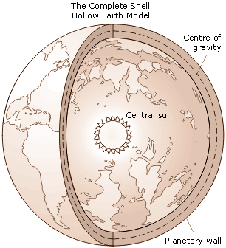
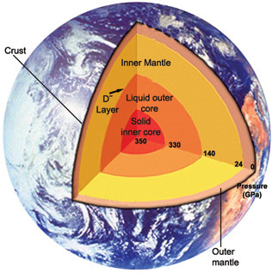
Two theories of the Internal Structure of the Earth
Moronic Design
Conventional Dogma

Slide 2
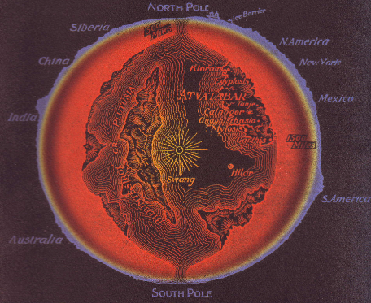

Slide 3
Impact Lecture - Overview
Stray Bodies in the Solar System
The Master Power Law
The Siberian Event of 1908
The Jupiter Event of 1994
The Yucatan Event of 65 Ma
When Impacts Ruled the Earth
When Impacts Were the Earth

Slide 4
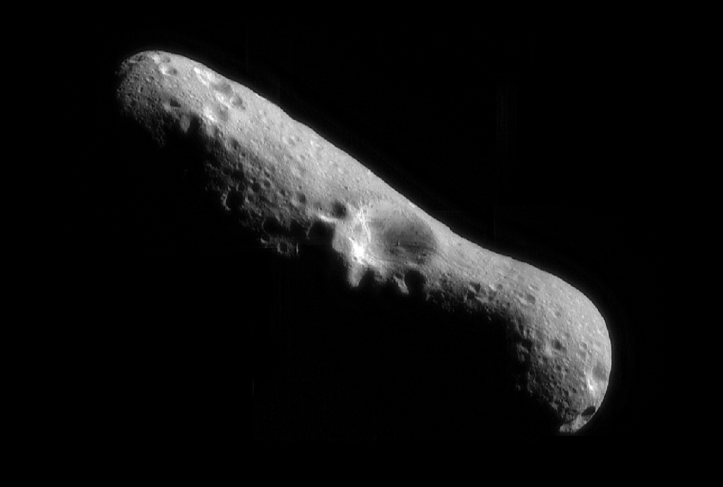
Asteroid Eros

Slide 5
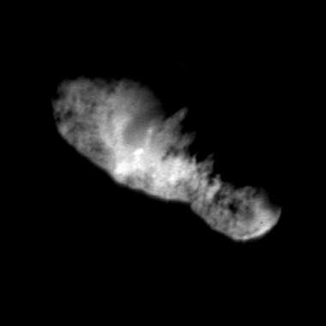
19P/Borrelly

Slide 6
Comet West
1976

Slide 8
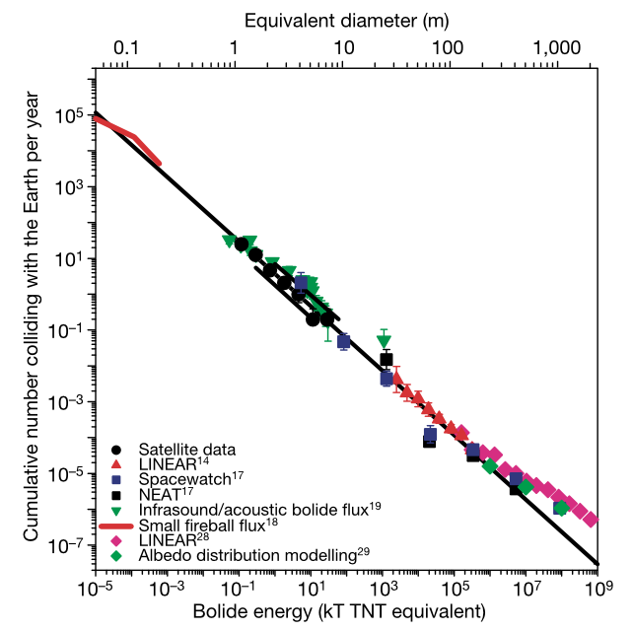

Slide 11
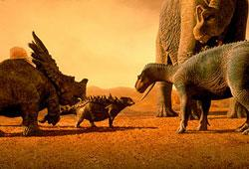
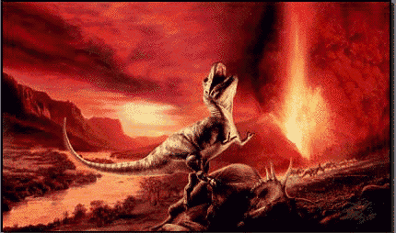
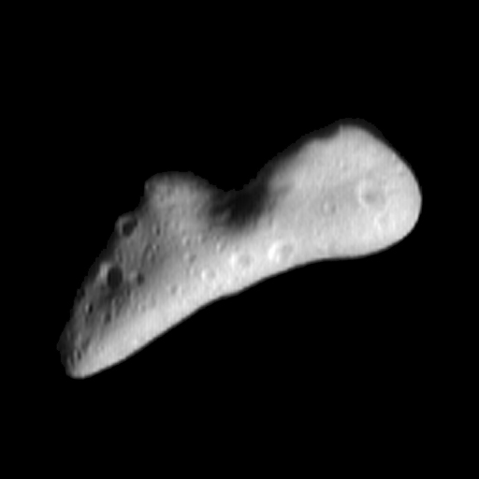
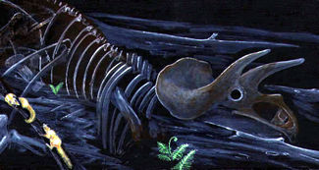
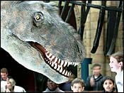
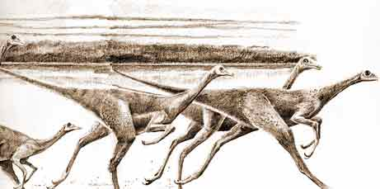

Slide 13
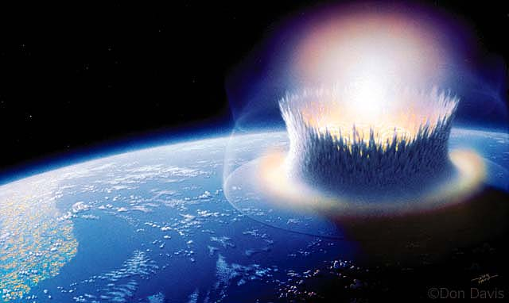

Slide 14
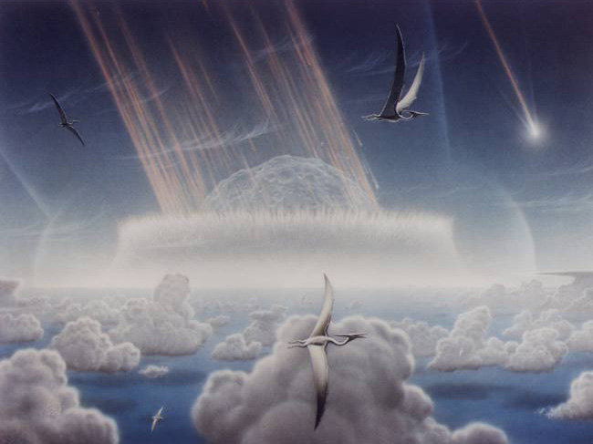

Slide 15
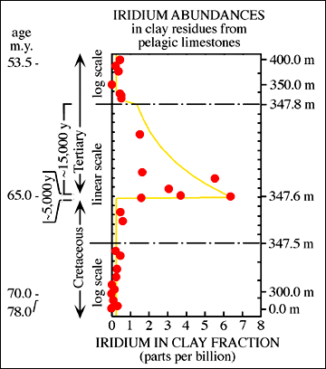
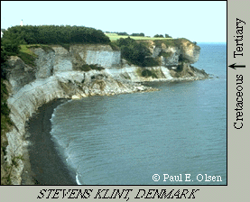

Slide 16
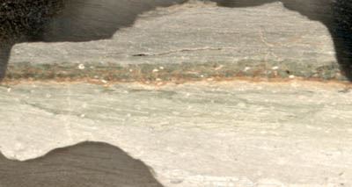

Slide 17
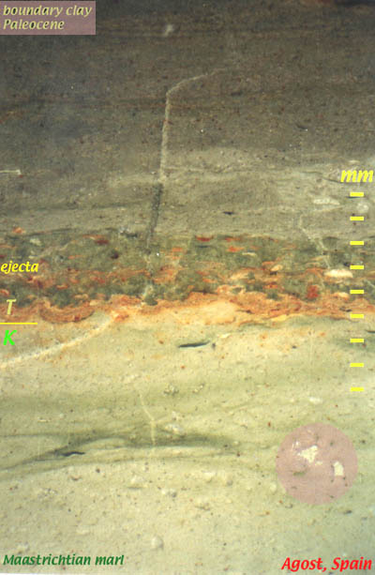
K/T boundary clay (6.5 cm thick)
Ejecta layer, containing here 24.4 ppb Ir, and numerous cross sections of altered microkrystites, and a few droplets of altered tektites
K/T boundary, here placed according to the definition of the IUGS GSSP
Uppermost Maastrichtian hemipelagic marls. The large foraminifers are Globotruncanids

Slide 18
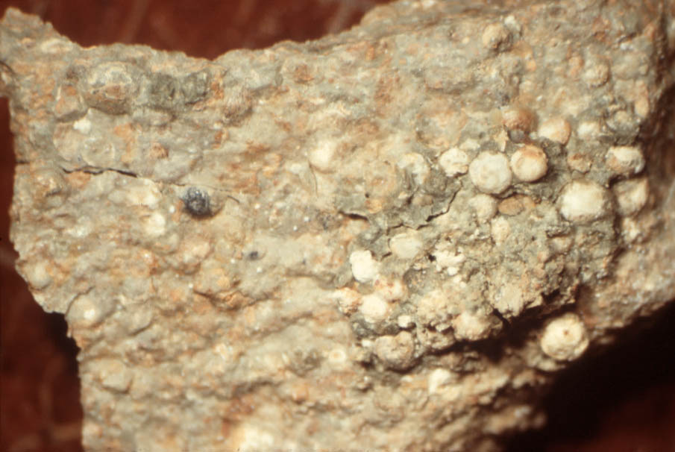
The ejecta layer is ~3 mm thick in this image

Slide 19
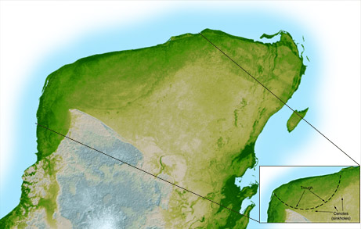
Surface Expression of the Chicxulub Crater

Slide 20
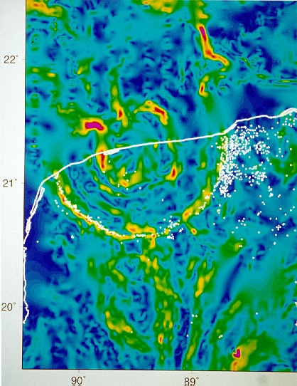
Horizontal gradient map of the Bouguer gravity anomaly over the Chicxulub crater (North is up.). The coastline is shown as a white line.
White dots represent the locations of water-filled sinkholes
Text and images by Alan Hildebrand, Geological Survey of Canada.

Slide 21
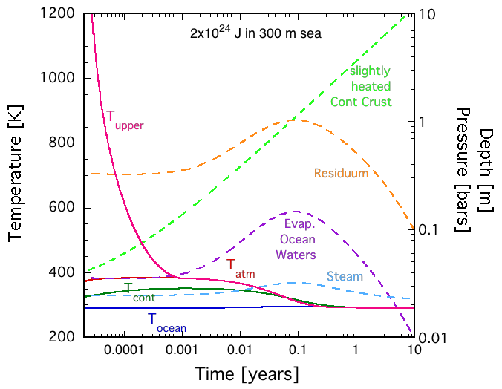

Slide 22
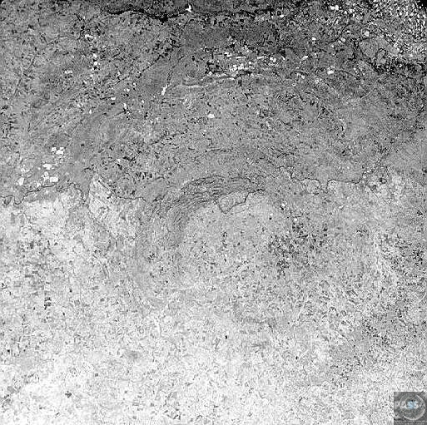
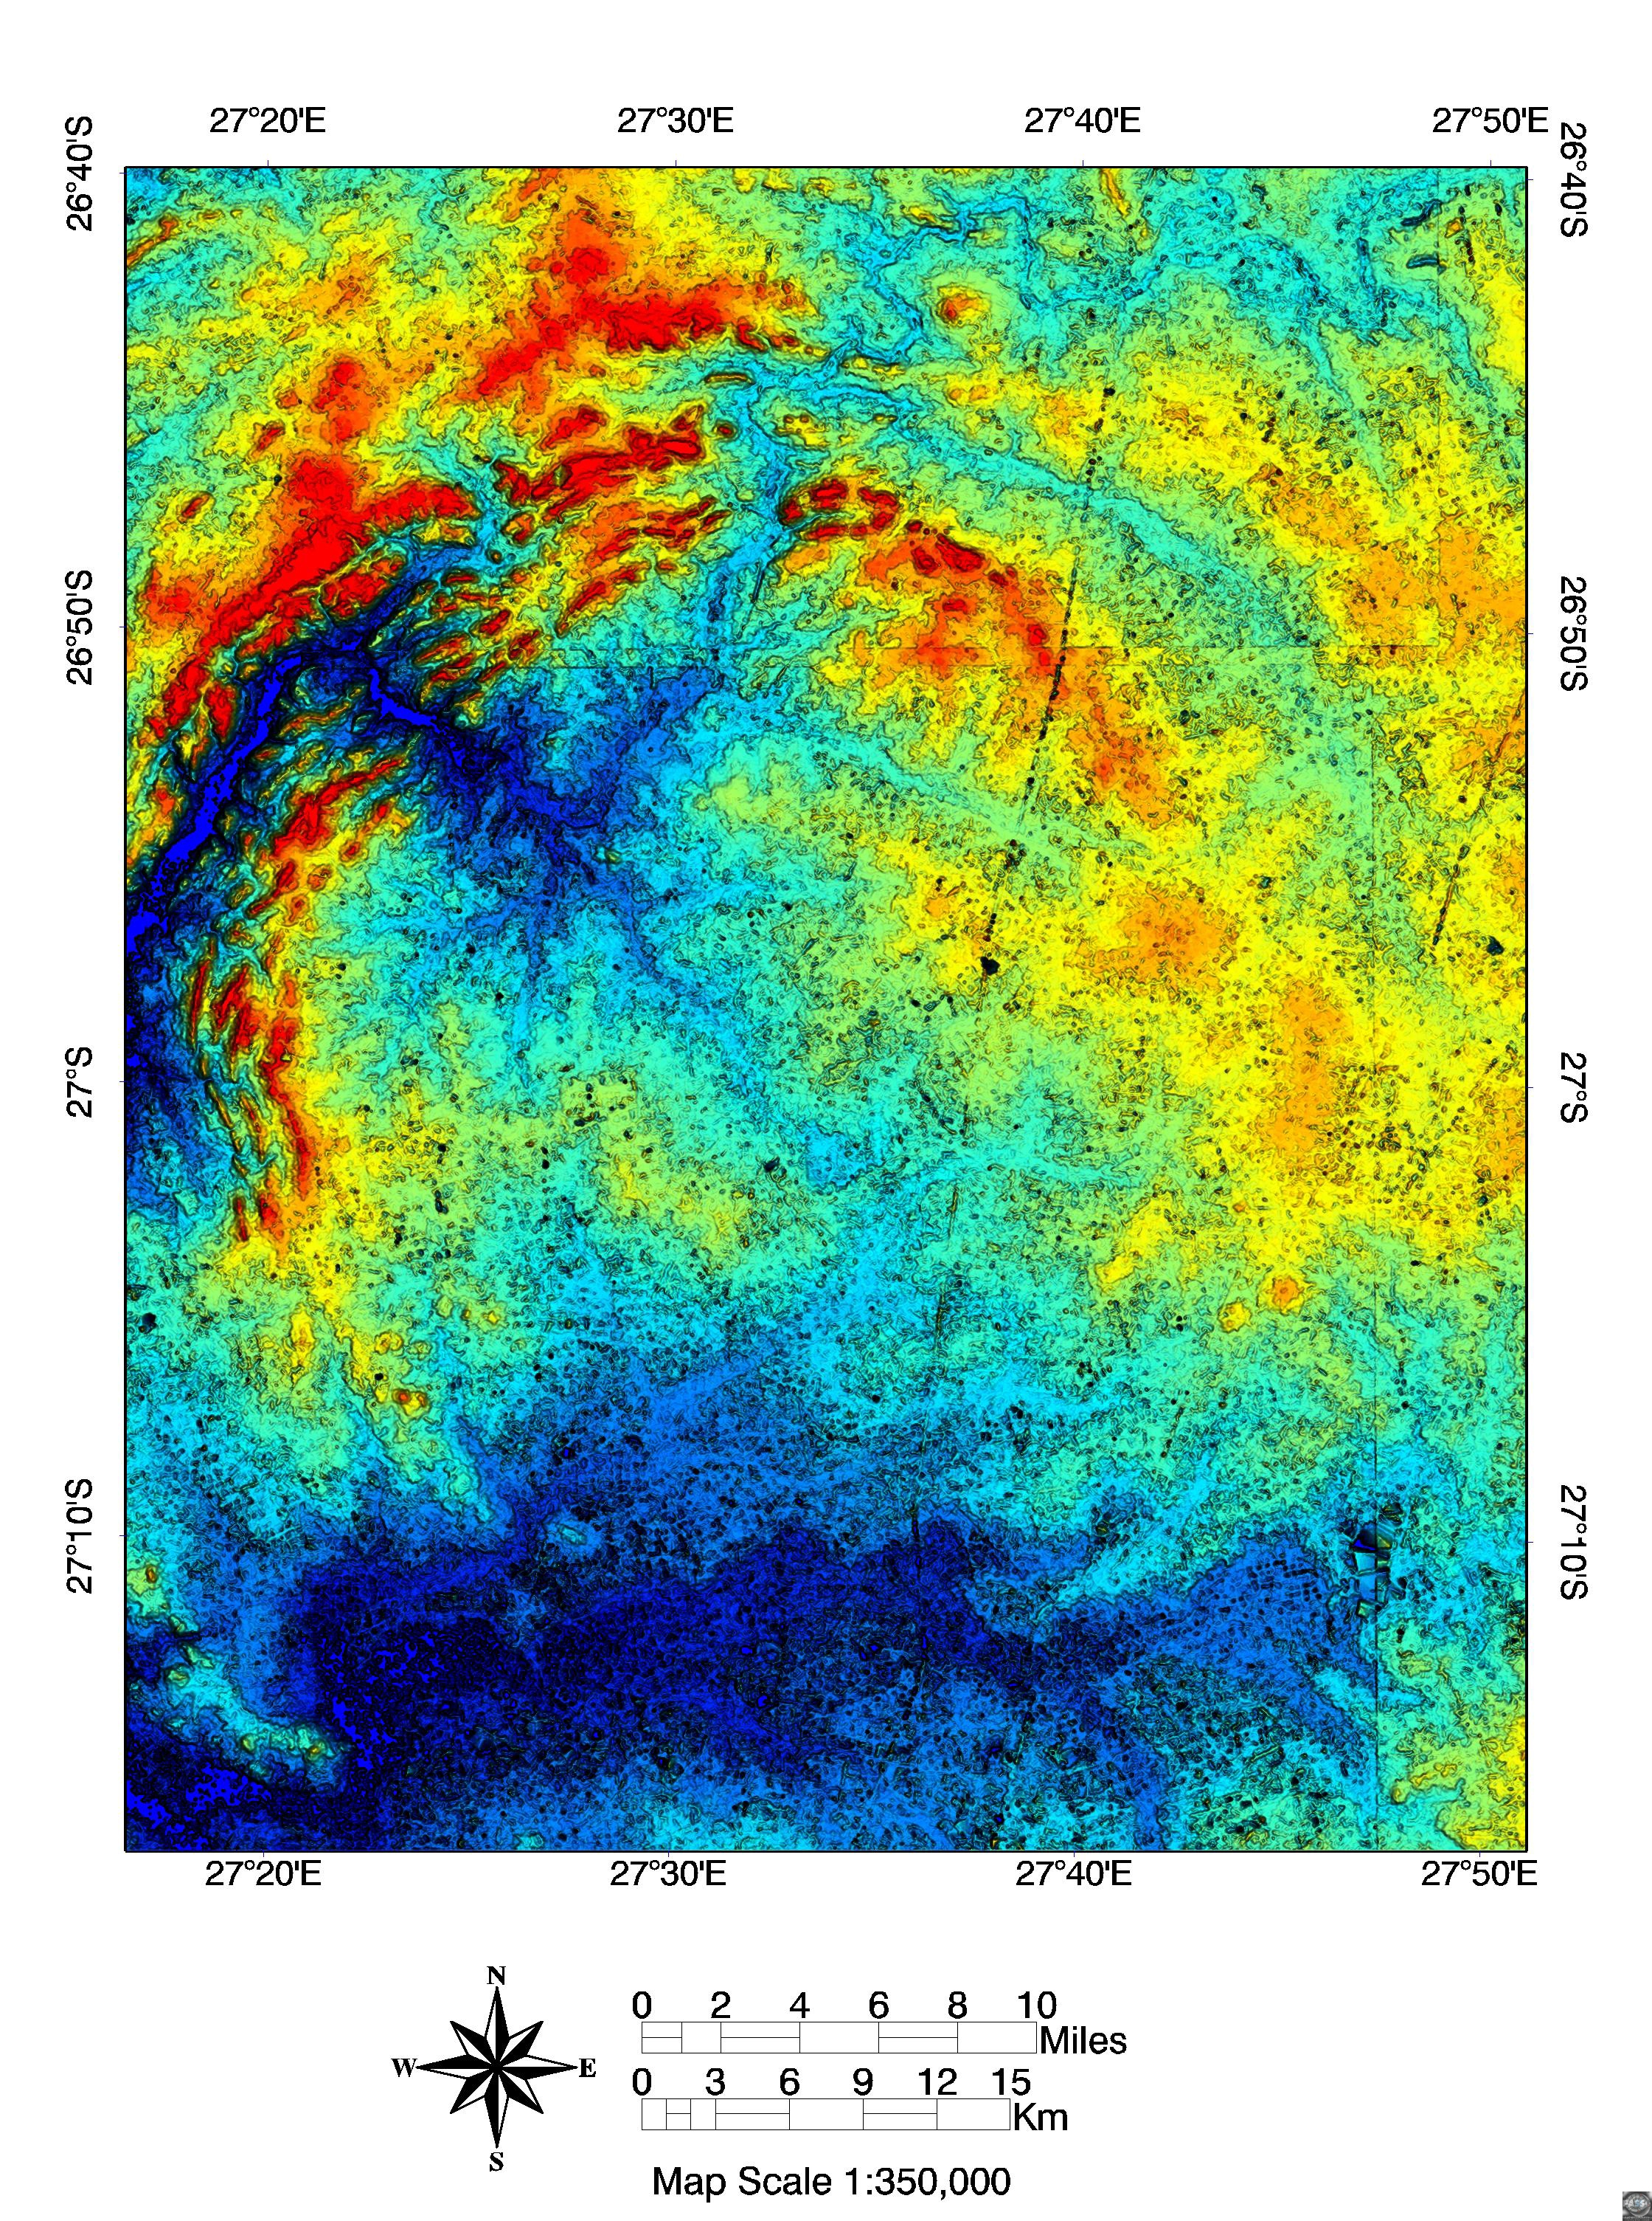
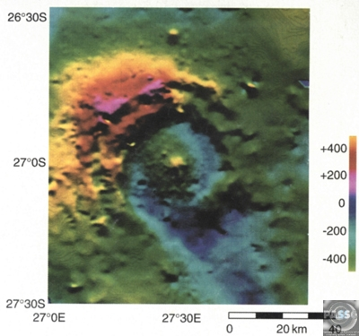
Elevation
Bouger Gravity
Vredefort >160 km crater 2.02 Ga

Slide 23
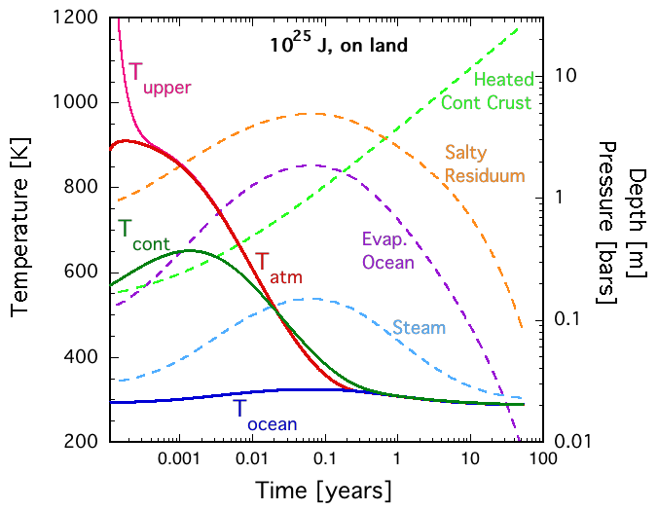

Slide 25
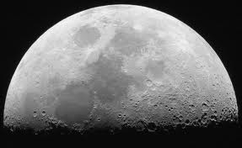

Slide 26
the late inner solar system bombardment

Slide 27
4 views of the Lunar Bombardment

Slide 30
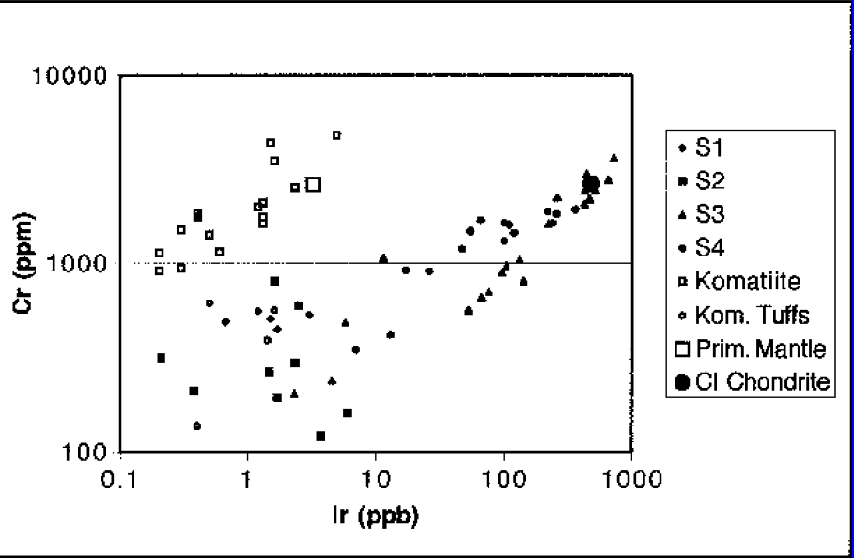

Slide 31
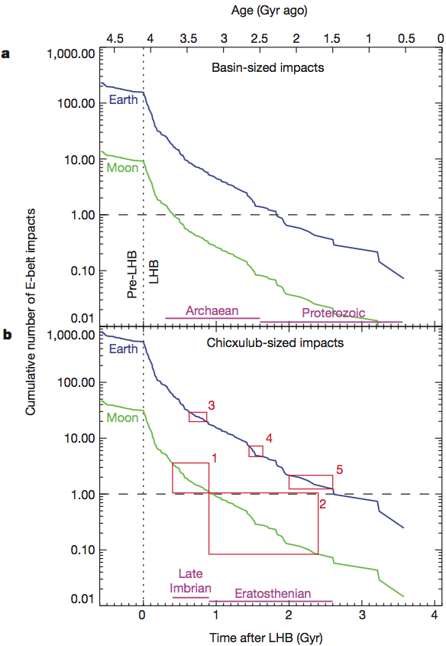
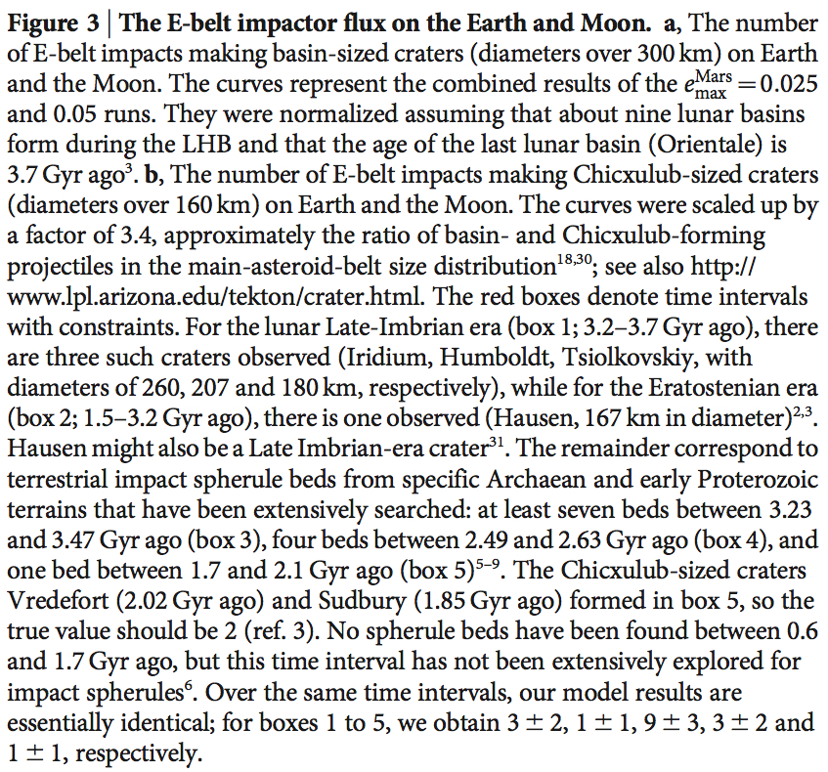

Slide 32
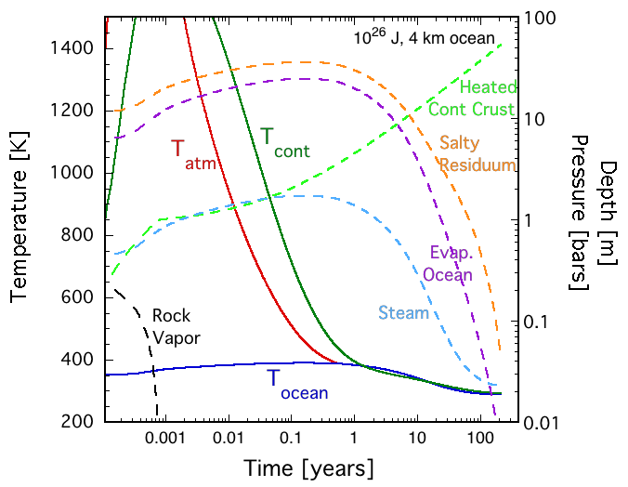

Slide 33
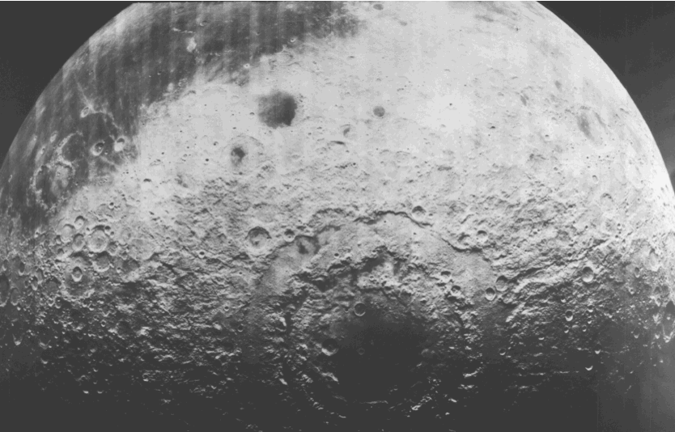
Orientale Impact Basin, The Moon

Slide 34
N(>m)~m^{-b}
b
0.5
0.7
0.9

Slide 36
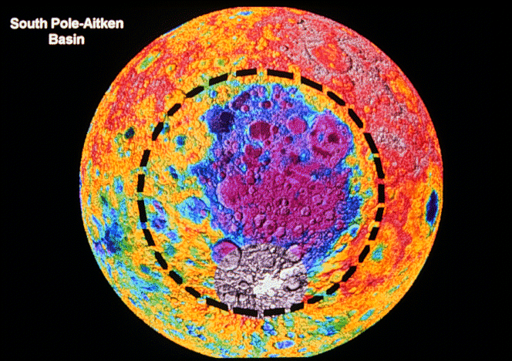
its on the Moon

Slide 37
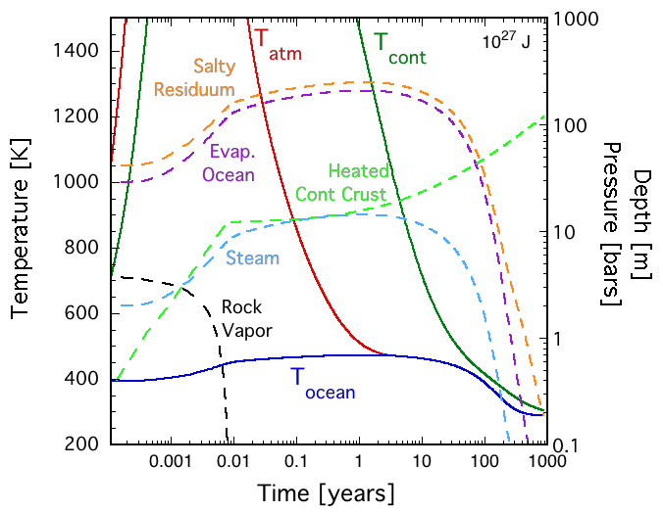

Slide 38
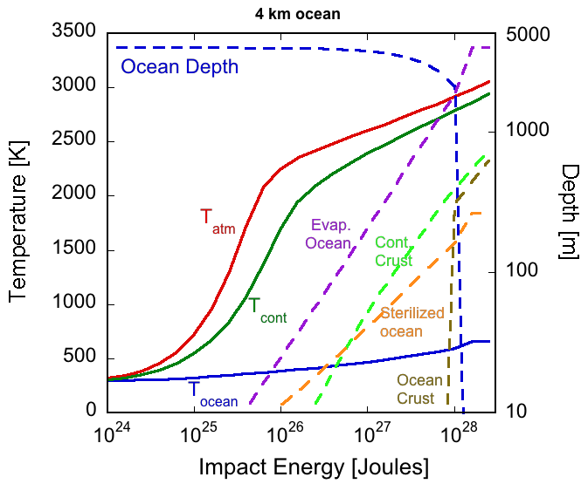

Slide 39
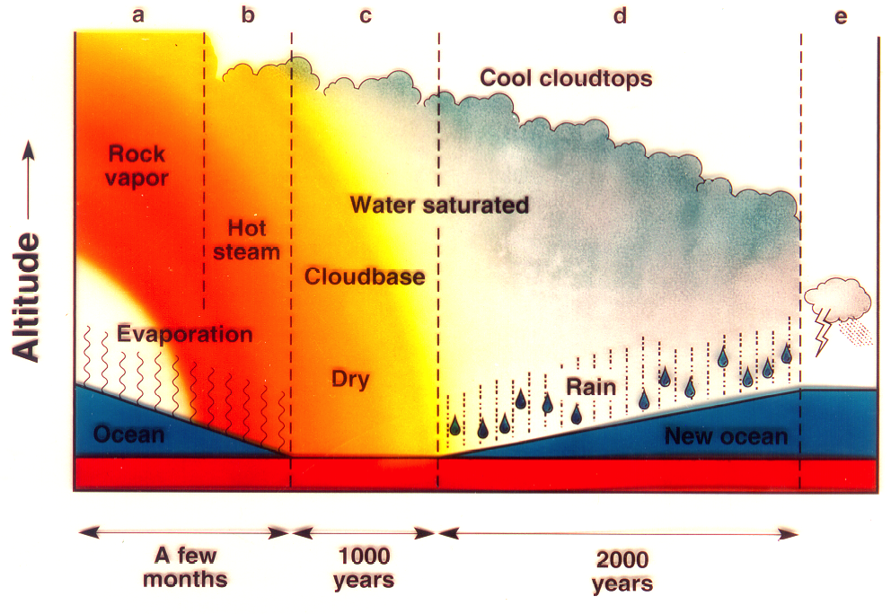
The aftermath of an ocean-vaporizing impact on Earth

Slide 40
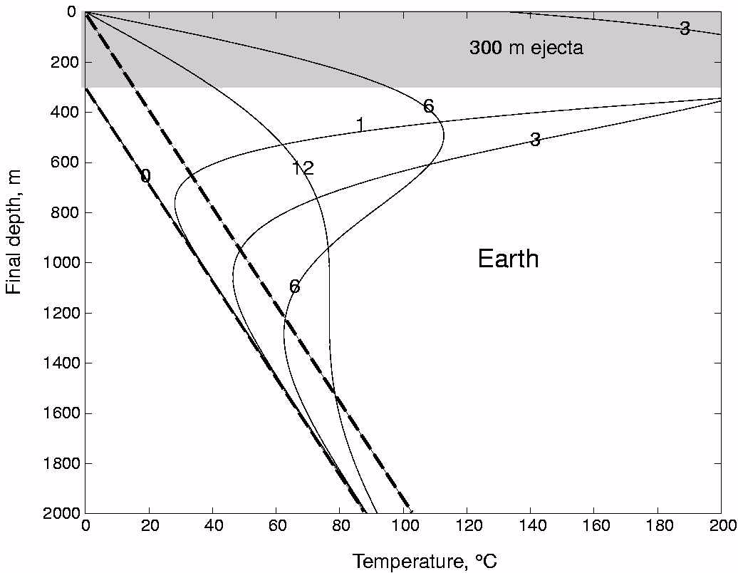
1000 yrs
3000 yrs
6000 yrs
Propagation of the thermal wave into the seafloor
12000 yrs
Background heat flow
before impact
after impact

Slide 41
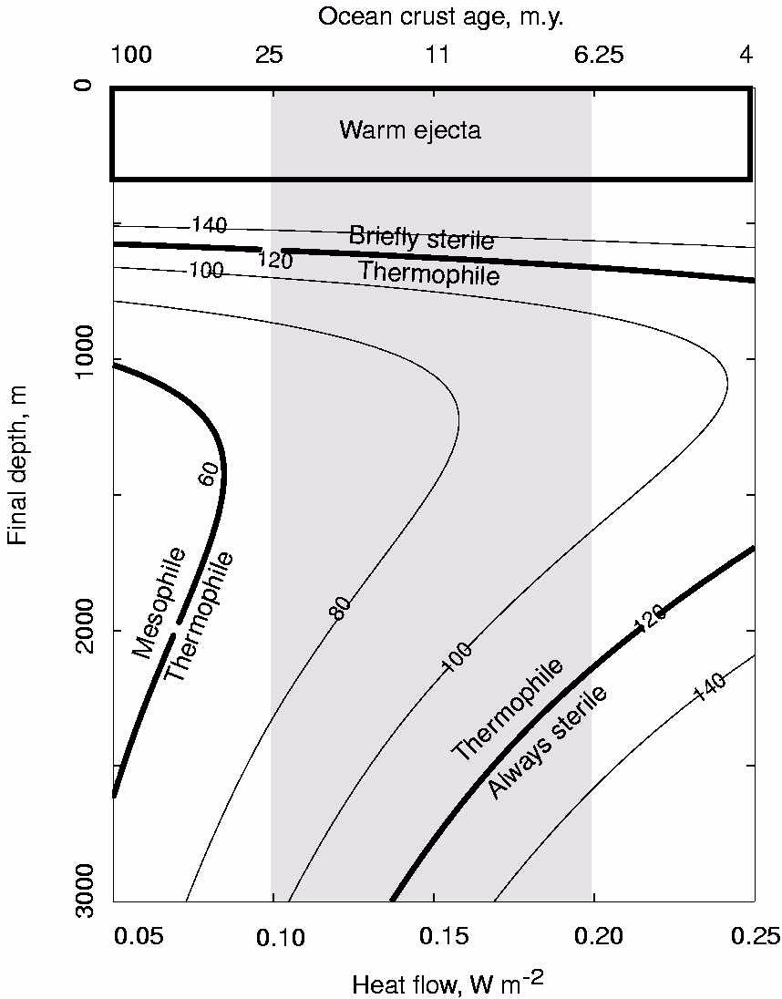
Maximum Temperature
experienced
below the surface
after
an ocean-vaporizing
impact.

Slide 42
Red indicates
thermophiles
Thermophilic ancestry may indicate that life originated in a hot place, or it may indicate that nonthermophiles were pruned.
A popular last common ancestor
You are here

Slide 43
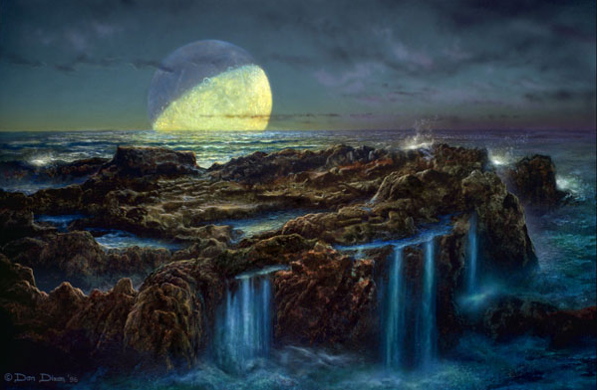
Earth after the
Moon-forming
Impact
Conditions fit only for hyperthermophiles and thermophiles?

Slide 44
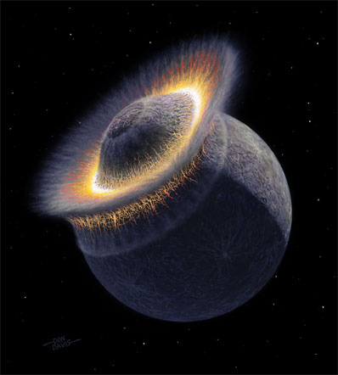

Slide 45
Scientists have speculated about possible
consequences of planets colliding.
Their speculations have been reported in newspapers.

Slide 46
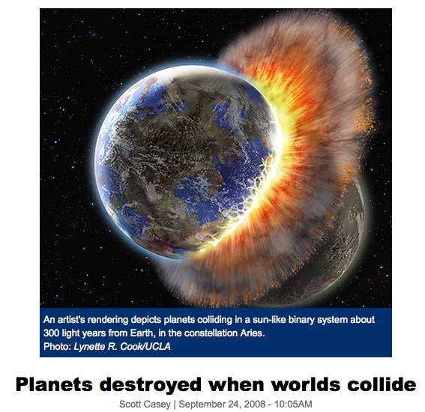

Slide 47
